Slide 1
Your partner for vehicle cybersecurity
Notes:
Prezentare
Ma intrerupeti cand aveti nevoie de clarificatii
Nu sunt intrebari gresite, doar lucruri pe care nu le-am explicat bine.

Slide 2
Cybersecurity
AES – Advanced Encryption Standard

Slide 3
Advanced Encryption Standard (AES) is a highly trusted symmetric encryption algorithm used to secure data by converting it into an unreadable format without the proper key.
AES encryption uses various key lengths (128, 192, or 256 bits) to provide strong protection against unauthorized access.

Slide 4
AES is a Block Cipher.
The key size can be 128/192/256 bits.
Encrypts data in blocks of 128 bits each.
Notes:
Block Cipher Modes of Operation define how to securely encrypt and decrypt large amounts of data using a block cipher. A block cipher is an encryption algorithm that processes data in fixed-size blocks (e.g., 128 bits) rather than one bit at a time.

Slide 5
b0 | b1 | b2 | b3 | b4 | b5 | b6 | b7 | b8 | b9 | b10 | b11 | b12 | b13 | b14 | b15
b0 | b4 | b8 | b12
b1 | b5 | b9 | b13
b2 | b6 | b10 | b14
b3 | b7 | b11 | b15
“State”

Slide 6
Key Expansion
Private key –> “X” Round keys
A series of operations (swap bytes, shifts, additions)
The AES algorithm takes the Cipher Key, K, and performs a Key Expansion routine to generate a key schedule. The Key Expansion generates a total of Nb (Nr + 1) words: the algorithm requires an initial set of Nb words, and each of the Nr rounds requires Nb words of key data. The resulting key schedule consists of a linear array of 4-byte words, denoted [w_{i} ], with i in the range 0 £ i < Nb(Nr + 1).

Slide 7
AddRoundKey
b0 | b4 | b8 | b12
b1 | b5 | b9 | b13
b2 | b6 | b10 | b14
b3 | b7 | b11 | b15
k0 | k4 | k8 | k12
k1 | k5 | k9 | k13
k2 | k6 | k10 | k14
k3 | k7 | k11 | k15
^

Slide 8
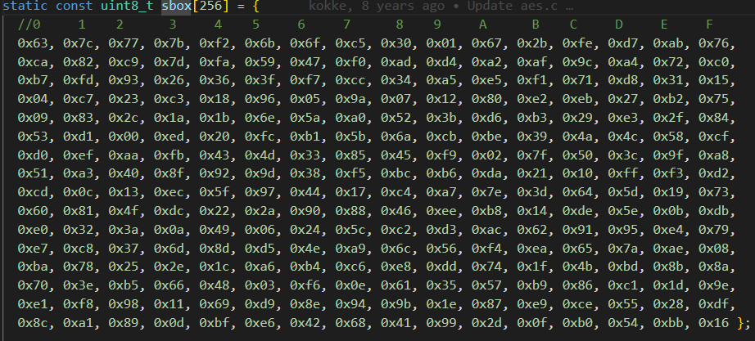
SubBytes
In this step, each byte is substituted by another byte. It is performed using a lookup table also called the S-box.

Slide 9
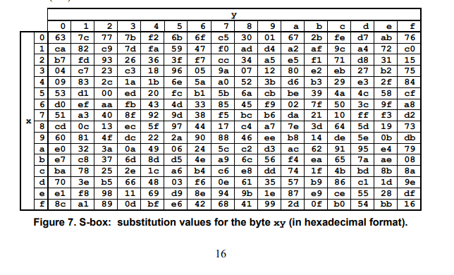
Notes:
https://nvlpubs.nist.gov/nistpubs/fips/nist.fips.197.pdf

Slide 10
ShiftRows
The first row is not shifted
The second row is shifted once to the left.
The third row is shifted twice to the left.
The fourth row is shifted thrice to the left.
b0 | b1 | b2 | b3
b4 | b5 | b6 | b7
b8 | b9 | b10 | b11
b12 | b13 | b14 | b15
b0 | b1 | b2 | b3
b5 | b6 | b7 | b4
b10 | b11 | b8 | b9
k15 | b12 | b13 | b14

Slide 11
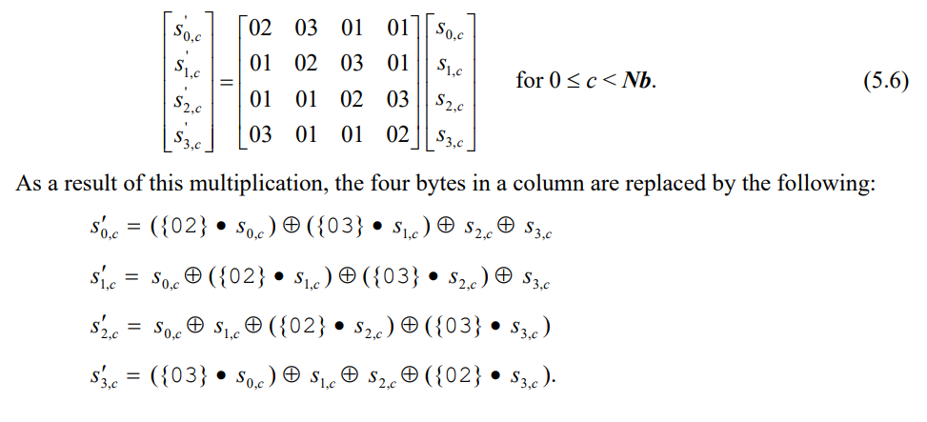
MixColumns
The MixColumns() transformation operates on the State column-by-column, treating each column as a four-term polynomial
a(x) = {03}x³ + {01}x² + {01}x + {02} .
This step is skipped in the last round.

Slide 12
static void Cipher(state_t* state, const uint8_t* RoundKey)
{
uint8_t round = 0;
// Add the First round key to the state before starting the rounds.
AddRoundKey(0, state, RoundKey);
// There will be Nr rounds.
// The first Nr-1 rounds are identical.
// These Nr rounds are executed in the loop below.
// Last one without MixColumns()
for (round = 1; ; ++round)
{
SubBytes(state);
ShiftRows(state);
if (round == Nr) {
break;
}
MixColumns(state);
AddRoundKey(round, state, RoundKey);
}
// Add round key to last round
AddRoundKey(Nr, state, RoundKey);
}
Notes:
Ce este securitatea cibernetica?
Pe scurt: securitatea cibernetică face ca echipamentele inteligente (conectate - IoT) să fie sigure, cu software la zi, nu doar funcționale.

