Slide 1



Your partner for vehicle cybersecurity

Slide 2

Structură curs
Week 1: Foundations of C and memory — from programming to vulnerability thinking
day 1: Intro + Theory day I
day 2: Theory day II
day 3: Theory day III
day 4: When C Goes Wrong — Memory Vulnerabilities
day 5: From Bug to Exploit — Defensive Thinking

Slide 3
A)
History of C language
Applications in automotive
Memory: Stack vs Heap
binary/hex representation
bitwise operations (&), logical operations (&&), masks
XOR encryption
B)
Build tools: pre-processor, compiler, assembler, linker. Q&A

Slide 4
A

Slide 5
C is a procedural general-purpose programming language that was originally created by Dennis Ritchie in 1972 in Bell Laboratories of AT&T Labs. It was originally intended as a system programming language to implement the UNIX system.

Slide 6
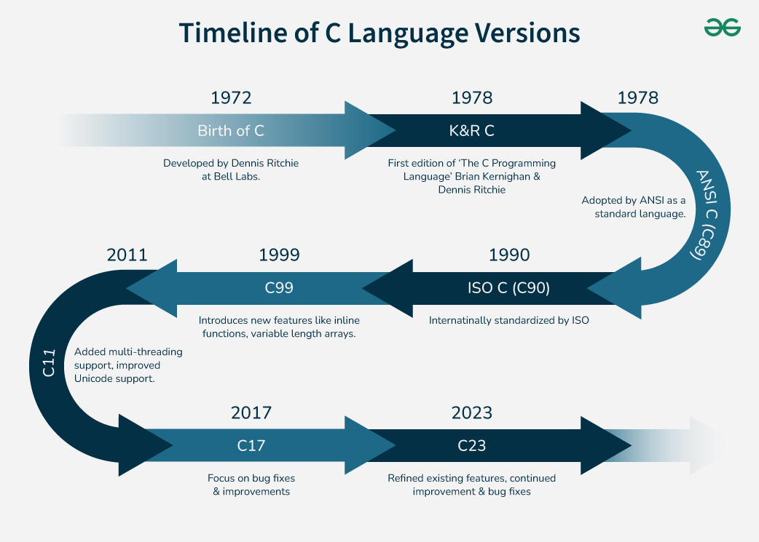
Notes:
Embedded Systems
C is heavily used in embedded systems programming, in large part due to its ability to interact directly with hardware. Microcontrollers in products such as Arduino, automotive control units, and IoT devices are all implemented using C to provide a program the ability to use limited resources, associated with real-time programming.

Slide 7
Real-Time Systems
C is essential for real-time systems, including aerospace control (usually flight controllers), medical devices, and industrial automation. Its deterministic performance provides precise timing within applications, such as flight controllers and robotic systems.
Notes:
Deterministic performance – if we are careful about the way we implement the applications – we are going to take care about some of the main vulnerabilities in this training program.

Slide 8
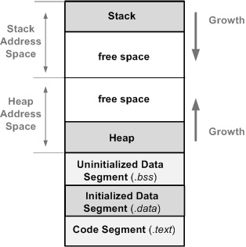
Data segment
Notes:
Code Segment (.text)
This segment stores the executable program code (the machine instructions). Variables defined with the const type qualifier can also be placed in the code segment. It is a read-only segment stored in a non-volatile memory. Depending on the platform it can be copied to a faster RAM memory or the program code can be executed in place (directly from the non-volatile memory).
Initialized Data Segment (.data)
This segment stores all global variables (with storage class specifier static or extern)¹ and local (defined inside a function) static variables that have defined initial values different than zero. The segment’s size is determined by the size of the variables and is know at compile time. This segment can be further classified into initialized read-only area and initialized read-write area (storing data that can be altered at run time). This segment is copied from the non-volatile memory it is initially stored (e.g Flash) to RAM.
Uninitialized Data Segment (.bss)
This segment stores all global and local variables that are initialized to zero or do not have explicit initialization in the source code. The memory locations of variables stored in this segment are initialized to zero before the execution of the program starts. This is usually performed by the boot code. Since the value of these variables are all zeroes, they do not have to be stored in a non-volatile memory.
Heap
The heap is a segment of the system memory (RAM) that provides dynamic memory allocation. Heap is responsible for memory leaks! The C malloc() and free() function can take a long time to execute, which is in conflict with the real-time constraints of an embedded system.
Stack
In general we can describe the stack segment as a temporary storage for data. The access to data in the stack is organized as Last In First Out (LIFO), which means that the last data stored in the stack is the first than can be retrieved and the first data stored in the stack is the last to be retrieved. The operation of adding data to the stack is called PUSH and the operation of retrieving data is called POP(PULL). There are stacks that grow downwards and ones that grow upwards – we only care about the downward growing ones. The stack is fundamental to an embedded system. Setting it properly is crucial to system stability and reliability. Underestimating stack usage can lead to serious issues such as overwritten variables, uninitialized pointers, and corrupted return addresses.

Slide 9
Address
Data
0x08001234
1
0
1
0
0
1
0
1
0XA5

Slide 10
Binary representation
Hexadecimal representation
bitwise operations (&)
logical operations (&&)

Slide 11
Operation | A | B | OUTPUT
NOT ( ~ ) | 1 |  | 0
 | 0 |  | 1
AND ( & ) | 0 | 0 | 0
 | 0 | 1 | 0
 | 1 | 0 | 0
 | 1 | 1 | 1
OR ( | ) | 0 | 0 | 0
 | 0 | 1 | 1
 | 1 | 0 | 1
 | 1 | 1 | 1
XOR ( ^ ) | 0 | 0 | 0
 | 0 | 1 | 1
 | 1 | 0 | 1
 | 1 | 1 | 0
Operation | A | B | OUTPUT
NOT ( ! ) | 0x04 |  | 0
AND ( && ) | 0x04 | 0x08 | 1
OR ( || ) | 0x04 | 0x08 | 1

Slide 12
0x08
1
0
0
0
0x04
0
1
0
0
Operation | Bitwise | Logical
NOT | 0111 | 0
AND | 0000 | 1
OR | 1100 | 1
XOR | 1100 | 1
Notes:
#include <stdio.h>
int main()
{
char a = 0x04;
char b = 0x08;
char bitwiseand = a&b;
char and = a&&b;
char bitwiseor = a|b;
char or = a||b;
char bitwisexor = a^b;
char xor = a!=b;
char bitwisenot = ~a;
char not = !a;
printf("bitwiseand: %d\n", bitwiseand);
printf("and: %d\n", and);
printf("bitwiseor: %d\n", bitwiseor);
printf("or: %d\n", or);
printf("bitwisexor: %d\n", bitwisexor);
printf("xor: %d\n", xor);
printf("bitwisenot: %d\n", bitwisenot);
printf("not: %d\n", not);
return 0;
}
bitwiseand: 0
and: 1
bitwiseor: 12 = C
or: 1
bitwisexor: 12 = X
xor: 1
bitwisenot: -5
not: 0

Slide 13
Bit masks
Used to read/set/clear/toggle one or more bits
The same length as the object (not necessary)
Used in cryptography often
! ALWAYS use shifts when defining a mask
Notes:
unsigned long long c = 0x123456789ABCDEF5ULL;
unsigned int d = 0x12345678;
unsigned long long ulongswapped = __builtin_bswap64(c);
unsigned int uintswapped = __builtin_bswap32(d);
char ulongmasked = c & mask;
char uintmasked = d & mask;
char ulongswappedmasked = ulongswapped & mask;
char uintswappedmasked = uintswapped & mask;
printf("masked long value: %d\n", ulongmasked);
printf("masked int value: %d\n", uintmasked);
printf("masked swapped long value: %d\n", ulongswappedmasked);
printf("masked swapped int value: %d\n", uintswappedmasked);
masked long value: 5
masked int value: 8
masked swapped long value: 2
masked swapped int value: 2
Be careful with the endianness of the masked object!

Slide 14
object
1
0
1
0
0
1
0
1
mask
0
0
0
0
0
1
1
1
result
0
0
0
0
0
1
0
1
Notes:
unsigned long long c = 0x123456789ABCDEF5ULL;
unsigned int d = 0x12345678;
unsigned long long ulongswapped = __builtin_bswap64(c);
unsigned int uintswapped = __builtin_bswap32(d);
char ulongmasked = c & mask;
char uintmasked = d & mask;
char ulongswappedmasked = ulongswapped & mask;
char uintswappedmasked = uintswapped & mask;
printf("masked long value: %d\n", ulongmasked);
printf("masked int value: %d\n", uintmasked);
printf("masked swapped long value: %d\n", ulongswappedmasked);
printf("masked swapped int value: %d\n", uintswappedmasked);
masked long value: 5
masked int value: 8
masked swapped long value: 2
masked swapped int value: 2
Be careful with the endianness of the masked object!

Slide 15
B

Slide 16
Build chain
Preprocessor
Compiler
Assembler
Linker
Notes:
Preprocessor
What it does: Handles directives that start with # before real compilation begins.
Main responsibilities:
Expands #define macros
Inserts header files (#include)
Handles conditional compilation (#ifdef, #ifndef, #if)
Removes comments
Output: Expanded C source code
!!! It does text substitution only — no type checking, no syntax checking. !!!
Compiler
What it does: Translates preprocessed C/C++ code into assembly language.
Responsibilities:
Syntax checking
Type checking
Optimization
Converts high-level code → assembly
Output: Assembly code (.s file)
What it does: Converts assembly code into machine code (binary).
Output: Object file (.o or .obj)
!!! Important: Still not a full executable! May contain unresolved references to functions in other files !!!
Linker
What it does: Combines object files and libraries into a single executable.
Responsibilities:
Resolves external symbols
Connects function calls across files
Links standard libraries
Assigns memory addresses
Output: Executable file (.exe / a.out)
Which stage handles syntax errors?
Answer: Compiler
Which stage resolves undefined references?
Answer: Linker

Slide 17
Thank you!

