Slide 1
Your partner for vehicle cybersecurity

Slide 2
In an embedded system, communication isn't just an "extra feature"—it is the “nervous system” that allows the controller to interact with the physical world and other digital entities.

Slide 3
Most embedded systems need to gather data from the environment. Sensors (temperature, acceleration, light) and actuators (motors, displays) often use specific communication protocols like I²C, SPI, or UART to talk to the main processor.

Slide 4
Protocol | Distance | Speed | Primary Use Case
UART | Short | Low | Debugging, GPS modules
I2C | Short | Medium | Low-power sensors
SPI | Short | High | SD cards, Displays
CAN | Long | Medium | Automotive, Robotics
Ethernet | Long | Very High | Industrial automation, IoT

Slide 5
Synchronous vs Asynchronous communication protocols
The fundamental difference between synchronous and asynchronous communication boils down to timing: how do the sender and receiver agree on when a bit of data starts and ends?

Slide 6
Feature | Synchronous | Asynchronous
Clock Link | Required (Dedicated wire) | Not required
Data Speed | Fast (Megabits to Gigabits) | Slower (Usually Kilobits)
Complexity | More wires, simpler logic | Fewer wires, complex timing logic
Overhead | Low (Raw data transfer) | High (Start, Stop, Parity bits)
Use Case | High-speed chip-to-chip | Long-distance or simple sensors

Slide 7
Protocol | Category | Clock Line? | Description
UART | Asynchronous | No | Uses a pre-configured Baud Rate. Relies on Start and Stop bits to frame data.
I2C | Synchronous | Yes (SCL) | Uses a Serial Clock (SCL) to synchronize the Serial Data (SDA). Supports multiple devices on the same two wires.
SPI | Synchronous | Yes (SCK) | Uses a Serial Clock (SCK) for very high-speed "full-duplex" communication. Requires a chip-select wire for every device.
CAN | Asynchronous | No | Uses "bit-stuffing" and precise internal timing to stay synced. Designed for rugged environments like cars.
Ethernet | Synchronous* | Yes/No | Technically "Self-Clocking." It embeds the clock timing into the data signal itself (e.g., using Manchester encoding), so a separate clock wire isn't needed.

Slide 8
UART
Universal Asynchronous Receiver Transmitter Protocol
UART is a communication protocol that is used for serial communication, using just two wires (Tx and Rx).
Data format and transmission speeds can be configured with pre-defined values specified in the protocol.
The configuration of UART is done before transmission, both connected devices should know the speed and data format of data transmission!

Slide 9
Start Bit | DataBit LSB | DataBit 1 | DataBit 2 | DataBit 3 | DataBit 4 | DataBit 5 | DataBit 6 | DataBit 7 | Parity Bit | End Bit
0 | 1 | 0 | 1 | 0 | 1 | 1 | 0 | 0 | 0 | 1
 | A |  |  |  | C
Notes:
Oversampling (16) – check in the middle – check at 6 8 and 10

Slide 10
huart1.Init.BaudRate = 115200;
huart1.Init.WordLength = UART_WORDLENGTH_8B;
huart1.Init.StopBits = UART_STOPBITS_1;
huart1.Init.Parity = UART_PARITY_NONE;
huart1.Init.Mode = UART_MODE_TX_RX;
huart1.Init.OverSampling = UART_OVERSAMPLING_16;
Notes:
UART relies on a start-stop protocol. Because there is no shared clock, both devices must oscillate at a frequency within a ~2% tolerance of each other to avoid bit-drift.
Frame Structure: A standard frame consists of 1 Start Bit (low), 5–9 Data Bits, an optional Parity Bit (for error checking), and 1–2 Stop Bits (high).
Baud Rate Generation: The MCU uses a Baud Rate Generator (BRG)—essentially a frequency divider that taps off the system clock ($f_{sys}$).
Sampling: The receiver typically oversamples the incoming line at 16x the baud rate. It looks for the high-to-low transition of the Start Bit and then samples at the 8th clock pulse of every bit-period to ensure it hits the center of the data bit where the signal is most stable.

Slide 11
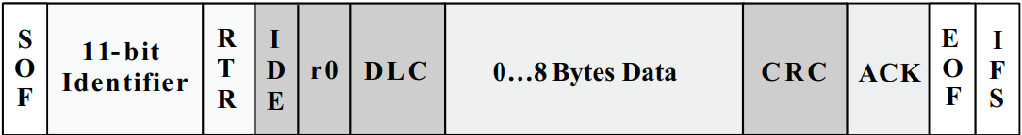
CAN
Controller Area Network
The CAN communication protocol is a multiple-access protocol with collision detection and arbitration on message priority.
Notes:
https://www.ti.com/lit/an/sloa101b/sloa101b.pdf?ts=1775019890412

Slide 12
What is Bit Stuffing?
Bit stuffing is a method used in data communication to avoid confusion between data and special control signals (like start or end markers). When a specific sequence of bits appears in the data an extra bit is added to break the pattern.
“When 5 bits of the same logic level occur in succession during normal operation, a bit of the opposite logic level is stuffed into the data.”
This prevents the receiver from mistaking the data for control information. Once the data is received the extra bit is removed restoring the original message. This technique helps ensure accurate data transmission.
- Enabled in normal operation -

Slide 13
How does Bit Stuffing work?
Bit sequence: 110101111101011111101011111110 (without bit stuffing)
Bit sequence: 11010111110010111110101011111010 (with bit stuffing)
After 5 consecutive 1-bits, a 0-bit is stuffed. Stuffed bits are marked bold
(No 6 consecutive 1's exist after stuffing).

Slide 14
Manchester Encoding (IEEE 802.3)
Manchester encoding is a synchronous clock encoding technique used by the physical layer of the Open System Interconnection to encode the clock and data of a synchronous bit stream.
It is widely used in Ethernet technology and other digital communication systems due to its reliability and simplicity.
!Synchronous = the clock is encoded in the data stream (no clk wire)

Slide 15
SPI
Serial Peripheral Interface
SPI facilitates short-distance communication between peripheral integrated circuits and microcontrollers: synchronous serial communication.
Mainly used for connecting the microcontrollers to peripheral devices like sensors, displays, and memory chips.
four signal lines such as SCK, MOSI, MISO, SS
Full-Duplex Communication

Slide 16
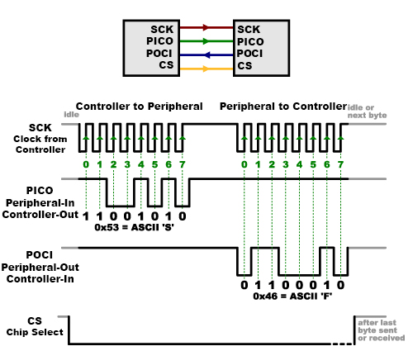
SPI communication

Slide 17
Debugging and Maintenance
During development, engineers need to know what’s happening inside the chip. Communication ports (like JTAG or SWD) allow developers to:
Flash new firmware.
Monitor variable values in real-time.
Receive error logs via a serial terminal.

Slide 18
JTAG refers to the boundary scan architecture standardized as IEEE 1149.1, defining the Test Access Port (TAP) and associated registers for standardized test access to integrated circuits and circuit board assemblies. Developed to enable structural PCB testing without physical probing of every signal, it improves test coverage and fault isolation.
Although widely used for embedded debug and in-system programming (ISP), these applications build upon the underlying boundary scan infrastructure originally intended for manufacturing test.

Slide 19
The main register added to a device specifically for JTAG testing is called the Boundary Scan Register (BSR). As its name suggests, the individual bits, or cells, of this register are at the boundary of the device, between its functional core and the pins or balls by which it is connected to a board, allowing each pin to be independently driven or sampled during test mode – very often JTAG testing is referred to as boundary scan.

