Slide 1



Your partner for vehicle cybersecurity

Slide 2


Pointers
A pointer is a variable that stores the memory address of another variable. Instead of holding a direct value, it holds the address where the value is stored in memory. It is the backbone of low-level memory manipulation in C.
// Normal Variable
int var = 10;
// Pointer Variable ptr that stores address of var
int *ptr = &var;

Slide 3
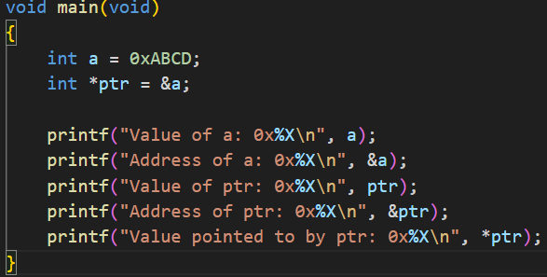

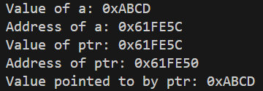







a
0xABCD
0x61FE5C
ptr
0x61FE5C
0x61FE50
Pointer actions:
declaring
initializing
dereferencing

Slide 4
Pointers
The size of a pointer:
The size of a pointer in C depends on the architecture of the machine, not the data type it points to.
On a 32-bit system, all pointers typically occupy 4 bytes.
On a 64-bit system, all pointers typically occupy 8 bytes.

Slide 5
References
C vs C++
There's no explicit reference type in C like in C++. Anywhere anybody says "reference" in context of C language you can assume a pointer.
HOWEVER

Slide 6
Reference
While a pointer exists in the memory, a reference is just the memory location of the variable we want to use in the function.
“Get me the thing from there”

Slide 7

In C++
int& ref = a;
This is a valid implementation in C++/C#/Java
In C

Slide 8
When any argument is passed by reference in the function call as a parameter, it is passed using the address of(&) operator from the main function.
In the function definition, the function takes the value of the parameter by using (*) operator. By using this, it can directly access the value of the parameter directly from its original location. (pass by reference)
There will be no need for extra memory or copying the same data into some other fields.

