Slide 1
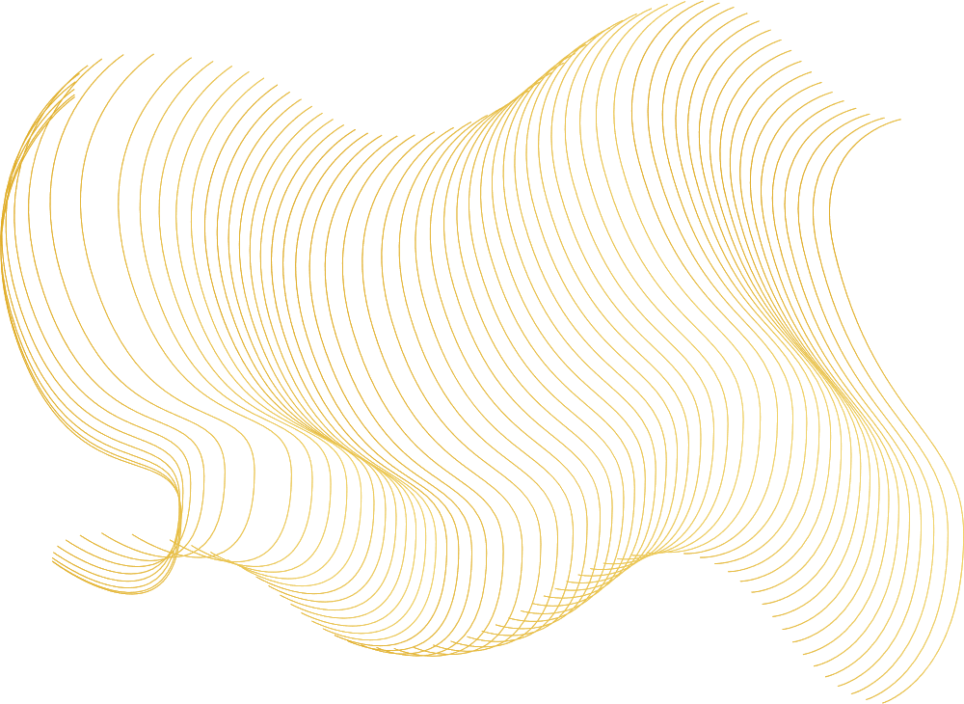

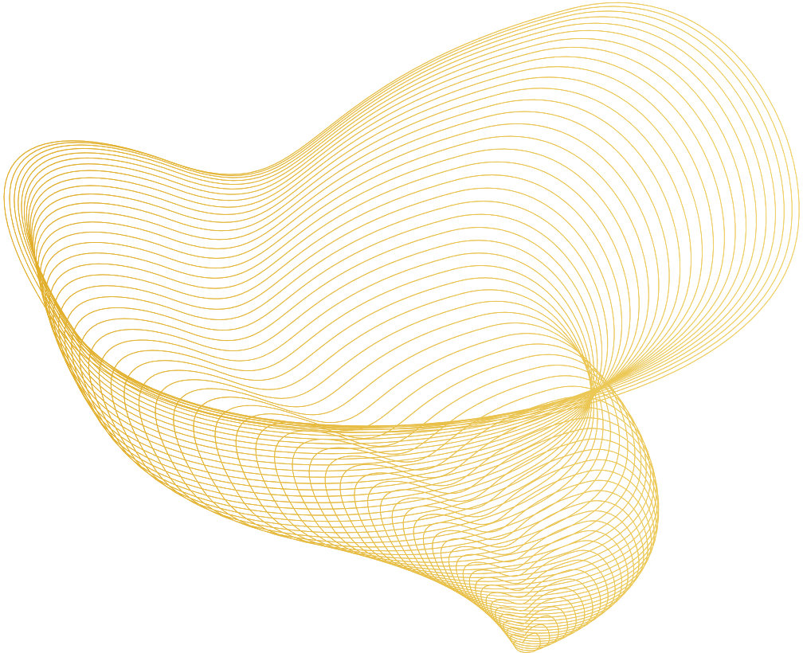
Your partner for vehicle cybersecurity

Slide 2

Multidimensional Arrays in C
A multi-dimensional array in C can be defined as an array that has more than one dimension. Having more than one dimension means that it can grow in multiple directions.
The total number of elements that can be stored in a multidimensional array can be calculated by multiplying the size of both dimensions. Consider the array letters[2][26]: size = 52

Slide 3
Multidimensional Arrays in C
Accessing elements:
arr_name[i][j]
With pointers
*(arr_name + i)

Slide 4
Multidimensional Arrays in C
As for any other array, the memory location used for an array is CONGRUENT (no gaps, alligned)
This means that we have

