Slide 1
🌍 Why You Should Own a Life Story Website? By Eugene Mbayire
Did you know everyone should have their own life story website?
Don’t let others write your story — write your own!
🖋️ Leave behind your real life story — as you lived it.
📸 Organize your memories digitally — better than HARD photo albums.
🔒 Private & secure — only accessible by those you allow.

Slide 2
Tip: Preserve Your Memories the Smart Way
Why risk losing your precious photos to damage, aging, or misplacement in physical albums?
Instead, create your own life story website — a secure, organized, and lasting digital home for your memories.
✨ Take it a step further:
🖨 Print a QR code linked to your website, place it in an elegant frame, and hang it on the wall of your living room. This simple setup allows your friends, guests, and loved ones to easily access your life story with just a quick scan.
Below👇 is an example of a QR code of my life story website(SAMPLE WEBSITE) displayed on a living room wall. — a modern way to keep your story alive and easily accessible 👇 (feel free to scan it 🙂)

Slide 3
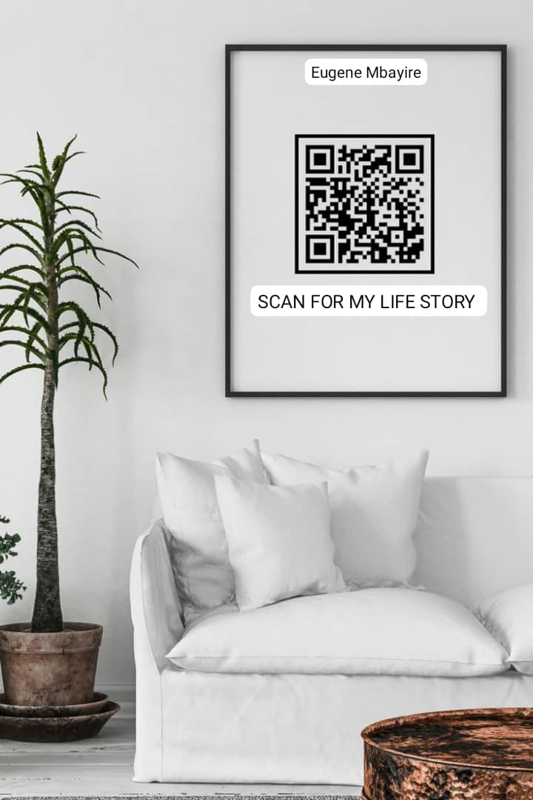
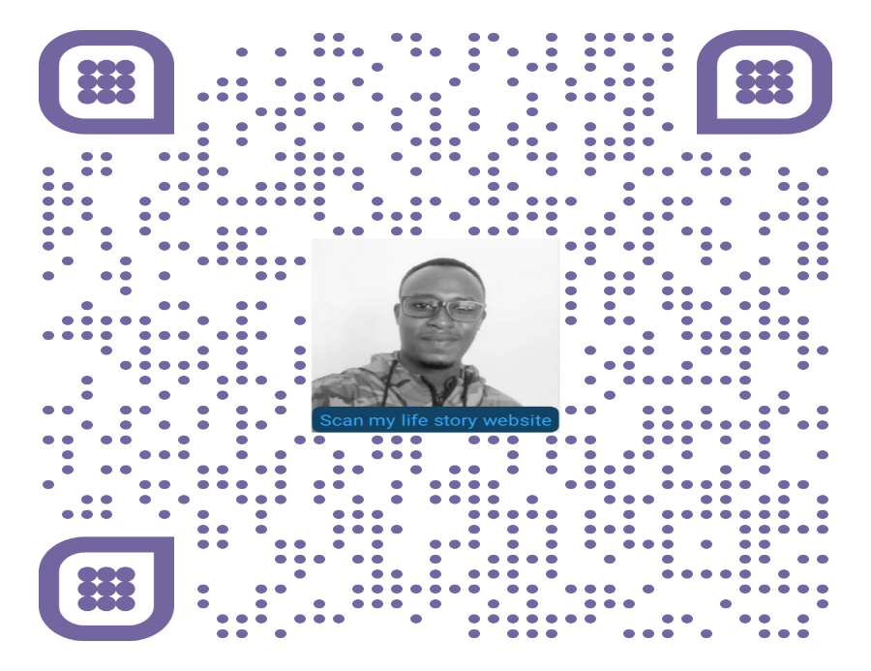

Slide 4
💻 About This Sample Website
This life story website of mine was built just for fun and as a sample. And it doesn’t include sensitive information as it’s just a sample without any protection.
Imagine what I can build for you — together with my software development team 😊

Slide 5
🚀 What We Do:
Web Design & Hosting
Business Systems SOFTWARE Development
Mobile Apps Software Development
Software project management

Slide 6
📩 Interested? Let’s talk!
Email: eugenembayire@gmail.com
Phone (Whatsapp & M 🙂 MO ): +250784643357

Slide 7
MY WEBSITE ACCESS AND FEEDBACK
SCAN THE ABOVE 👆 QR CODE (ON PAGE3) 👆
OR
👇YOUR FEEDBACK MATTERS👇
CLICK HERE TO GIVE YOUR FEEDBACK
CLICK HERE TO VISIT MY LIFE STORY SAMPLE WEBSITE

