Slide 1
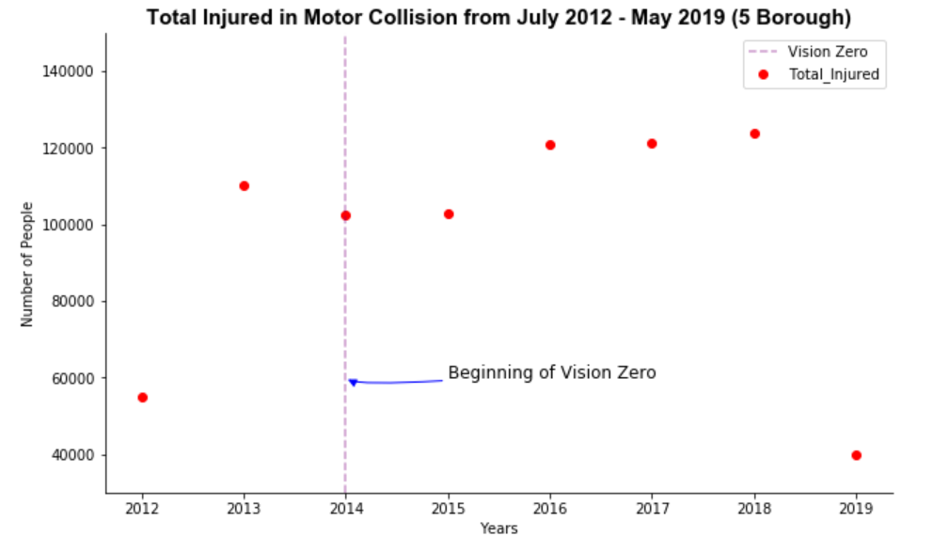
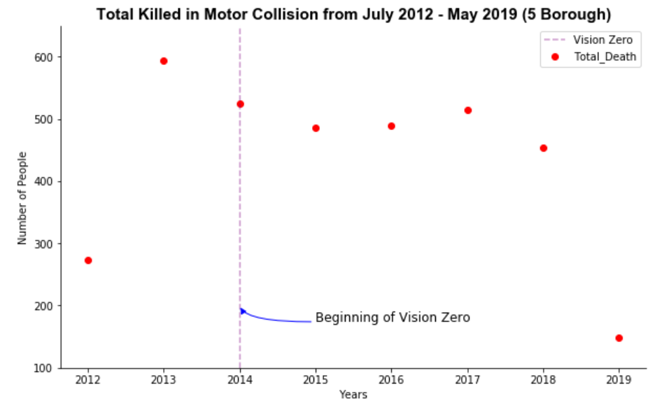
Figure 1: Total Injured in NYC by year
Figure 2: Total Killed in NYC by year
In Figure 1 and Figure 2, they show the total number of injuries and deaths from July 2012 to May 2019 across 5 Borough. By looking at the scatter plot, we can conclude that Vision Zero is effective and it has decreased the amount of people who were killed in accidents since 2014. Vision Zero is a program that was adopted by Mayor Bill de Blasio in 2014 and the goal of Vision Zero is to prevent deaths in NYC by 2024. Although Vision Zero did prevent deaths, it did not prevent injuries. The number of injuries across 5 borough has increased through time and it reached the highest on 2018 with 123817 injuries.

Slide 2
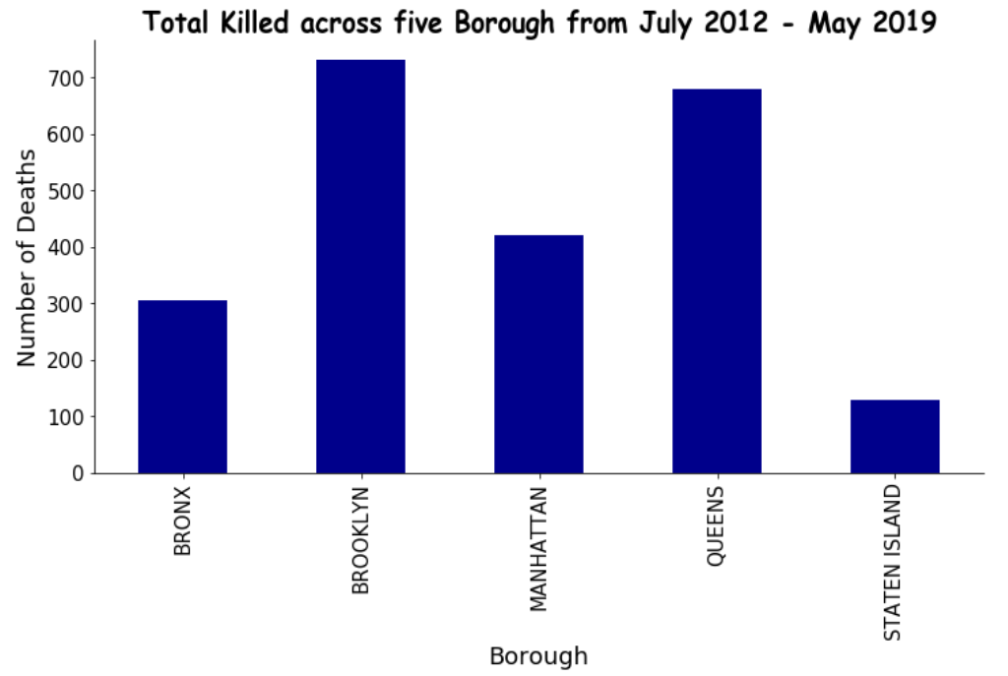
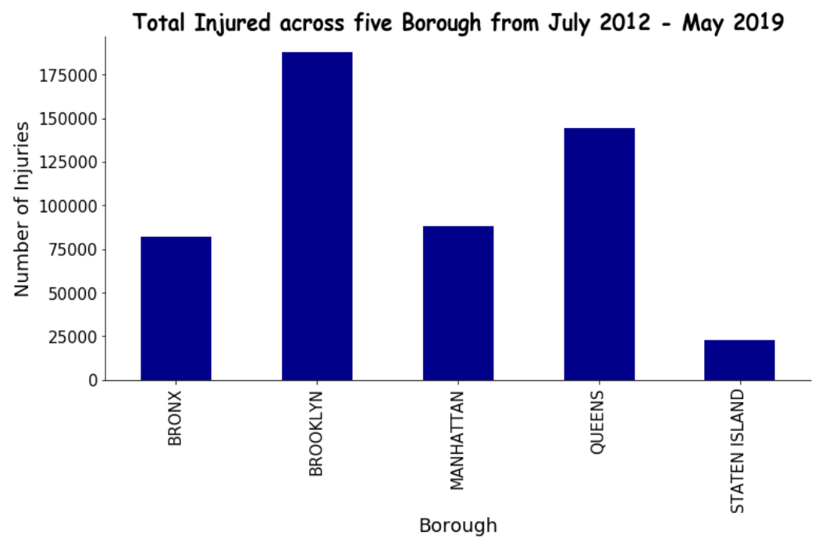
Figure 3: Total Killed across 5 Borough
Figure 4: Total Killed across 5 Borough
After exploring the data sheet on NYC Open Data, I discovered that the most dangerous Borough in NYC is Brooklyn and the safest is Staten Island. In Figure 3 and Figure 4, we can observe that Brooklyn has the highest number of deaths and injuries with 731 and 187635 people, respectively. Furthermore, Staten Island has the lowest number of deaths and injuries with 128 and 22663 people, respectively. One main reason that Brooklyn is dangerous is because Brooklyn is the most populated borough followed by Queens.

Slide 3
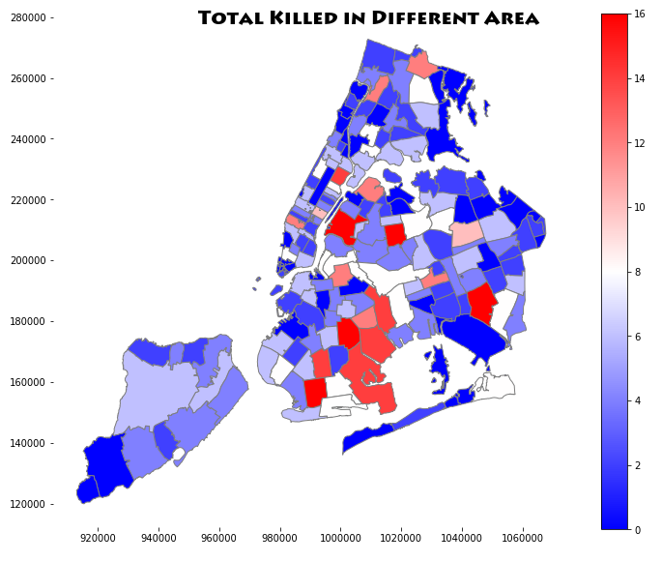
In Figure 5, it illustrates that most deaths occur in SE of Brooklyn which are Canarsie, East New York, East Flatbush, Brownsville etc.
Figure 5: Total Killed in Different Area of NYC (Zip Code)

Slide 4
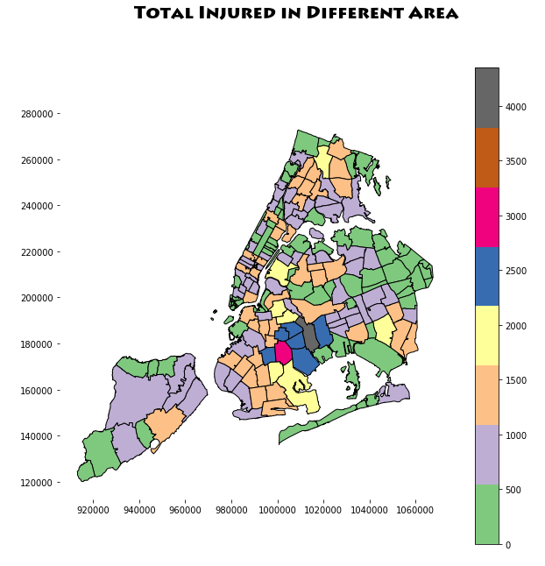
In Figure 6, it illustrates that East New York (Zip code: 11207) has the highest number of injuries followed by East Flatbush (Zip code: 11203)
In addition, we can also conclude that living in Downtown Manhattan is much safer than living in Midtown.
Figure 6: Total Injured in Different Area of NYC (Zip Code)

Slide 5
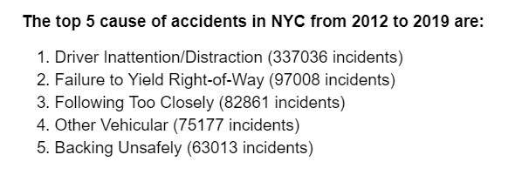
Figure 7: Top 5 cause of accidents

