Slide 1
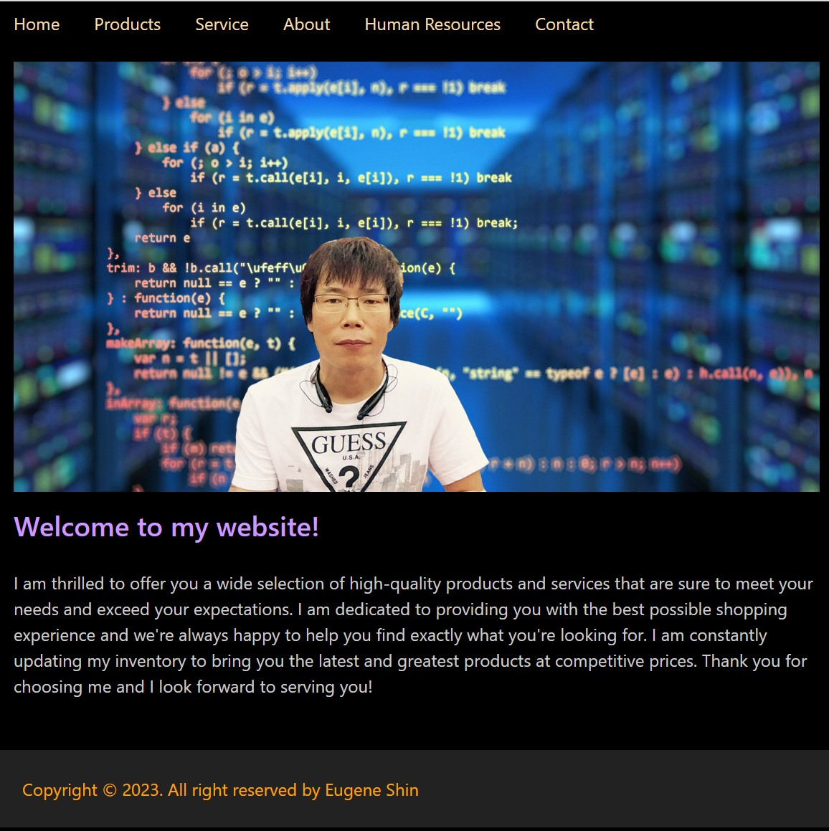
WEBD6201-06 WEB DEVELOP : CLIENT-SIDE SCRIPT LAB 1
Eugene(Hongju) Shin
100844220
Instructor : Sarah Powell

