Slide 2
Introduction: Objectives
Main Objective
Design and fabricate a hydrodynamic submersible vehicle capable of manoeuvring underwater environments and capturing videos and images
Specific Objectives
In order to achieve the above main objective, the following specific objectives must be satisfied:
1. To design and fabricate a water-tight hull of the ROV, keeping in mind hydrodynamics and strength of the mechanical design.
2. To design and fabricate the propulsion and pitch control system of the ROV.
3. To design the power delivery circuit to the electrical components in the ROV.
4. To design and implement the algorithm that coordinates the functioning of the ROV.
5. To test the operation and performance of the ROV system modules, and eventually the entire system operation with the modules working in tandem.

Slide 3
Production Plan
Week | Tasks/ Activities | Materials Required | Special equipment | Simultaneous/ Concurrent activities | Status/ Remarks
5 | Assembly of live stream equipment Testing the live video stream | Raspberry pi camera module Raspberry pi microcontroller Display unit CAT 6 Cable |  |  | Complete
6 | Assembly of the power circuit: Acquisition of power supply unit Acquisition of terminal block and buck converter. Acquisition of CAT 6 cable Assembling the above components | CAT 6 Cable Power supply unit Buck converter |  |  | Power supply + Buck Converter acquired. Acquisition of cables underway.

Slide 4
Production Plan
Week | Tasks/ Activities | Materials Required | Special equipment | Simultaneous/ Concurrent activities | Status/ Remarks
7 | Modification of Bilge pumps: Marking the housing where it needs to be cut. Cutting around the entire impeller housing being careful not to cut to deep into the motor casing, then discarding it. Prying the impeller off to expose the motor shaft. | 3No. Bilge pumps | Hobby Saw |  | Complete
8 | Assembly of the motor control circuit Acquisition of materials required Connection to power circuit Testing the motor control for propulsion and pitch motors | Modified Bilge Pump Motors Dual channel H-bridge DC motor drivers Raspberry pi Microcontroller Jumper cables |  |  | Motor drivers – acquired.

Slide 5
Production Plan
Week | Tasks/ Activities | Materials Required | Special equipment | Simultaneous/ Concurrent activities | Status/ Remarks
9 | 3D Print the mechanical structure of the ROV - Outer hull, propeller shrouds, propellers, motor support brackets. | Polyactic Acid (PLA) | 3D Printer |  | Ongoing
10 | Machining of camera sight glass | Glass (108 × 106 × 3 mm) |  |  | Complete
11 | Assembly of the different components of the mechanical structure | Acetone / Epoxy / Cyanoacrylate Superglue / Solvent cement M5 × 10 set screws (6No.) M5 × 12 set screws (8No.) M5 Lock nuts (9No.) |  | i) Fine tuning motor control
12 | Test of the complete U-ROV assembly and fine tuning its operation

Slide 6
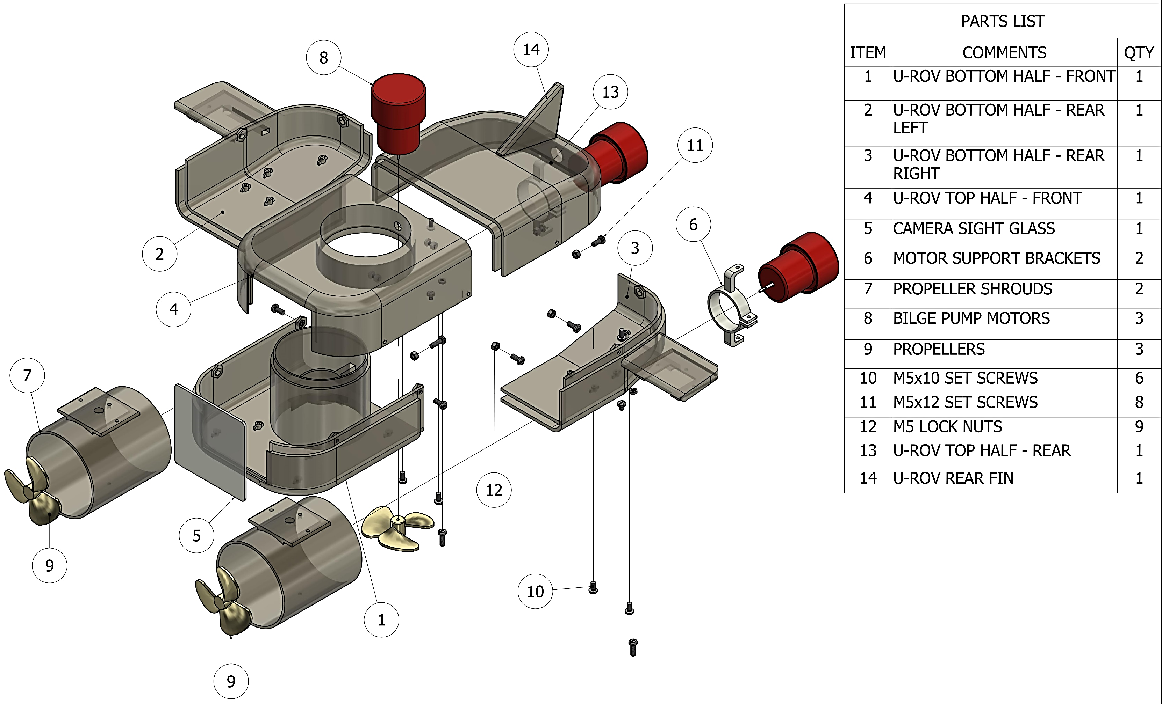
Methodology – Revised Mechanical Design - Exploded View

Slide 7
Methodology – Flowchart
START
PITCH THRUSTER DEACTIVATED
LIVESTREAM AUTOMATICALLY ACTIVATED
FORWARD (F) / BACKWARD (B) MOTION?
c
PITCH THRUSTER TRIGGERED
F
B
NO
THRUSTER CLOCKWISE MOTION TRIGGERED
THRUSTER COUNTERCLOCKWISE MOTION TRIGGERED
DESIRED DEPTH REACHED?
YES
A

Slide 8
Methodology – Flowchart
A
B
TURN LEFT(L) / RIGHT(R)?
RESURFACE?
N
C
L
R
Y
LEFT THRUSTER SPEED DECREASED
RIGHT THRUSTER SPEED DECREASED
PITCH THRUSTER REVERSED
B
END

Slide 9
Control Module
Gamepad connected to laptop to which it sends signals based on user input.
Signal sent from joystick includes:
Direction of motion i.e ‘F’ for Forward, ‘R’ for Right.
Speed value to be passed to motor as PWM value:
Joystick input range (0-1) mapped to PWM values (0-255)
Laptop connected to Raspberry Pi as client with Pi acting as server.
Raspberry Pi receives Gamepad signal from laptop.
Raspberry pi sends signal to Arduino through Serial Connection.
Arduino actuates motors based on received signal.

Slide 10
Budget
S/No | Item | Specifications | Qty | Units | Material | Estimated Unit Cost | Total Cost
1 | Raspberry pi camera module** |  | 1 | Pieces |  | 3,500 | 3,500*
2 | Raspberry pi** |  | 1 | Pieces |  | 6,000 | 6,000*
3 | Electric Bilge Pump | 1100 GPH, 12V, 3A | 3 | Pieces |  | 1,836 | 5,508
4 | DC motor drivers | 3V-36V, 15A Dual Channel H-bridge | 2 | Pieces |  | 1,838 | 3,676
5 | CAT6 cable |  | 6 | Length (m) |  | 70 | 420
6 | CAT6 cable end connectors |  | 2 | Pieces |  | 10 | 20
7 | Buck converter | LM2596HVS – 60V, 3A | 1 | Pieces |  | 400 | 400

Slide 11
Budget
S/No. | Item | Specifications | Qnty | Units | Material | Estimated Unit Cost | Total Cost
8 | LED Ring Lights | 61mm OD, 52mm ID | 1 | Pieces |  | 1,707 | 1,707
9 | Set screws | M5×10 | 6 | Pieces |  | 10 | 60
10 | Set screws | M5×12 | 8 | Pieces |  | 10 | 80
11 | Fuse | 10A | 3 | Pieces |  | 130 | 390
12 | Glass | 106mm × 108mm × 3 mm | 1 | Pieces |  | 200 | 200
13 | Waterproof Cable Glands | PG7 (12.5 mm OD), PG13.5 (20.4mm OD) | 4 | Pieces |  | 150 | 600
14 | 3D Printing |  | 1 | Item | PLA | 20,000 | 20,000
Total Estimated Cost |  |  |  |  |  |  | 33,061
Subtotal Currently Spent |  |  |  |  |  |  | 20,311

