Slide 2
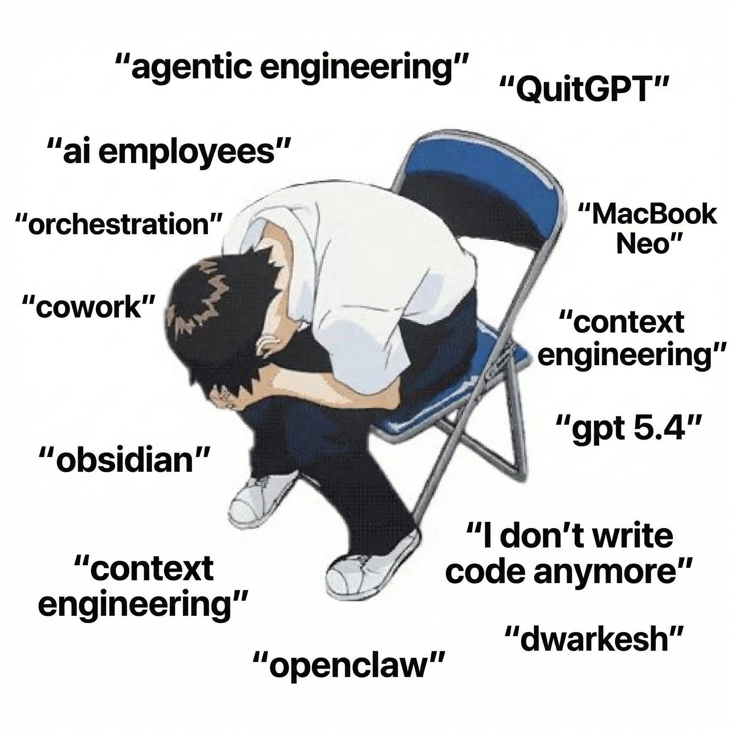

The AI crisis in theoretic research
(AI) read ≠ checked ≠ reusable
scientific publications
scale
Human researcher will be drowned in infinite ”recent progress” papers.
Any open problem be solved increases the confidence of AGI, and also the anxiety of our career.
Later work still needs the exact imported claim and verification.
Claims and semantic content are often exaggerated.
human verification bandwidth
2024
time

Slide 3

What is inside the black box of LLM reasoning
f : String -> String
Zhang Y, Khan S A, Mahmud A, et al. npj Artificial Intelligence, 2025, 1(1): 14.
Notes:
From tobias talk
why did two calls answer differently
输入文本 String
↓ 分词（tokenization）
输入 token 序列
↓ 模型计算
下一个 token 的概率分布
↓ 按解码规则选择
一个新 token
↓ 追加到已有序列，重复上述过程
输出 token 序列
↓ 转回文本（detokenization）
输出文本 String

Slide 4
What is inside the black box of LLM reasoning
f : String -> String
f : String -> token -> prob. distribution -> (next) token -> String
Notes:
From tobias talk
why did two calls answer differently
输入文本 String
↓ 分词（tokenization）
输入 token 序列
↓ 模型计算
下一个 token 的概率分布
↓ 按解码规则选择
一个新 token
↓ 追加到已有序列，重复上述过程
输出 token 序列
↓ 转回文本（detokenization）
输出文本 String

Slide 5
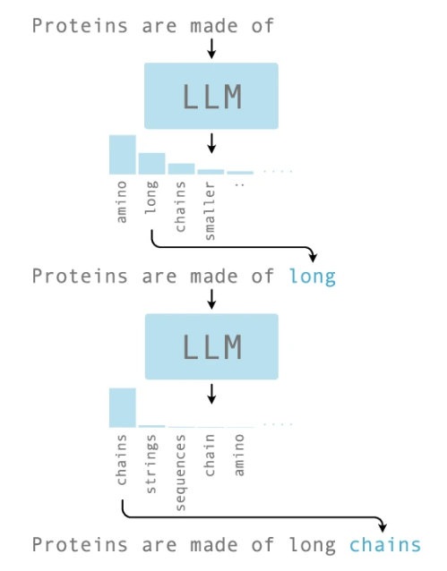
What is inside the black box of LLM reasoning
f : String -> String
f : String -> token -> prob. distribution -> (next) token -> String
LLM outputs a conditioned probabilistic distribution $P(next token|context)$, then samples.
Zhang Y, Khan S A, Mahmud A, et al. npj Artificial Intelligence, 2025, 1(1): 14.
Notes:
From tobias talk
why did two calls answer differently
输入文本 String
↓ 分词（tokenization）
输入 token 序列
↓ 模型计算
下一个 token 的概率分布
↓ 按解码规则选择
一个新 token
↓ 追加到已有序列，重复上述过程
输出 token 序列
↓ 转回文本（detokenization）
输出文本 String

Slide 6
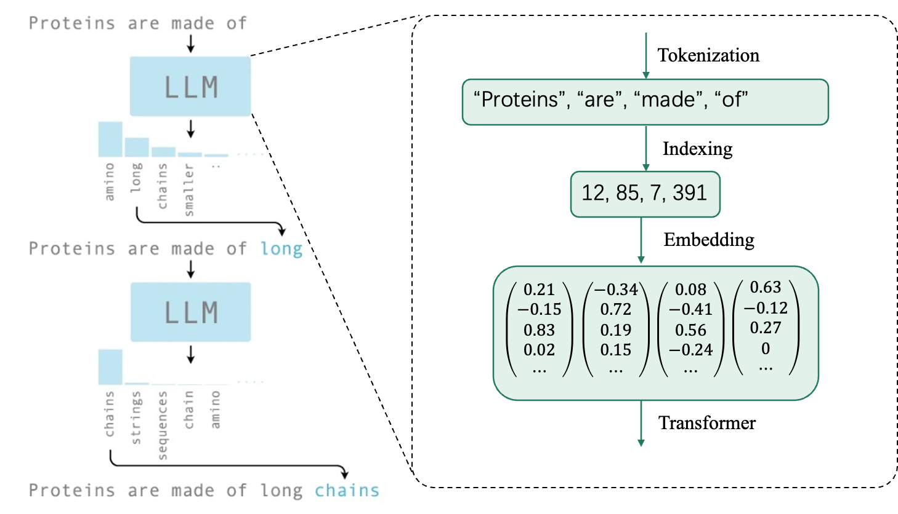
What is inside the black box of LLM reasoning
f : String -> String
f : String -> token -> prob. distribution -> (next) token -> String
LLM outputs a conditioned probabilistic distribution $P(next token|context)$, then samples.
Zhang Y, Khan S A, Mahmud A, et al. npj Artificial Intelligence, 2025, 1(1): 14.
Notes:
From tobias talk
why did two calls answer differently
输入文本 String
↓ 分词（tokenization）
输入 token 序列
↓ 模型计算
下一个 token 的概率分布
↓ 按解码规则选择
一个新 token
↓ 追加到已有序列，重复上述过程
输出 token 序列
↓ 转回文本（detokenization）
输出文本 String

Slide 7
Model Momery
Normally, the conversation with LLM is a forward pass and does not update any model weights
Model Momery: saves previous prompts and answers re-sends the history every time
Turn 1
[User: I am a physicist.]
→ LLM → [Response: Understood.]
Turn 2
[User: I am a physicist.]
[Response: Understood.]
[User: Explain entropy at my level.]
→ LLM → [Response: ...]
Tobias Osborne’s talk 2026 at UCL: https://www.youtube.com/@tobiasjosborne
Notes:
From tobias talk
输入文本 String
↓ 分词（tokenization）
输入 token 序列
↓ 模型计算
下一个 token 的概率分布
↓ 按解码规则选择
一个新 token
↓ 追加到已有序列，重复上述过程
输出 token 序列
↓ 转回文本（detokenization）
输出文本 String

Slide 8
Model Momery
Normally, the conversation with LLM is a forward pass and does not update any model weights
Model Momery: saves previous prompts and answers re-sends the history every time
Turn 1
[User: I am a physicist.]
→ LLM → [Response: Understood.]
Turn 2
[User: I am a physicist.]
[Response: Understood.]
[User: Explain entropy at my level.]
→ LLM → [Response: ...]
system prompt
conversation history
new prompt
context window
(token capacity)
Tobias Osborne’s talk 2026 at UCL: https://www.youtube.com/@tobiasjosborne
Notes:
From tobias talk
输入文本 String
↓ 分词（tokenization）
输入 token 序列
↓ 模型计算
下一个 token 的概率分布
↓ 按解码规则选择
一个新 token
↓ 追加到已有序列，重复上述过程
输出 token 序列
↓ 转回文本（detokenization）
输出文本 String

Slide 9
Model Momery
Normally, the conversation with LLM is a forward pass and does not update any model weights
Model Momery: saves previous prompts and answers re-sends the history every time
Turn 1
[User: I am a physicist.]
→ LLM → [Response: Understood.]
Turn 2
[User: I am a physicist.]
[Response: Understood.]
[User: Explain entropy at my level.]
→ LLM → [Response: ...]
system prompt
conversation history
new prompt
context window
(token capacity)
When the context window is exceeded, the compression/truncation/selection must be applied
Tobias Osborne’s talk 2026 at UCL: https://www.youtube.com/@tobiasjosborne
Notes:
From tobias talk
输入文本 String
↓ 分词（tokenization）
输入 token 序列
↓ 模型计算
下一个 token 的概率分布
↓ 按解码规则选择
一个新 token
↓ 追加到已有序列，重复上述过程
输出 token 序列
↓ 转回文本（detokenization）
输出文本 String

Slide 10



API/Agent/MCP/schema/skills … prompt sorcery from LLM era
Numpy API
LLM API
import numpy as np
result = np.mean([1, 2, 3])
Prompt
Client
API
Response
Agent is a system with a LLM as its core to execute high-level tasks: LLM decides next step
Notes:
How many of you know what is API? Then how many of you know/ have tried to set up an agent in codex/claude …
with the help of python package API, we could easily use this np.mean function, this is because API is written in a way to illustrate how to use it.
SO the actual definition of agent is a bit ambigious, like how much level of

Slide 11
API/Agent/MCP/schema/skills
1 / 9
LLM
text → a distribution over next tokens
Notes:
Text in, a distribution over next tokens out. Stateless: nothing carries between calls, and the weights never change.

Slide 12
API/Agent/MCP/schema/skills
2 / 9
AGENT · the loop
LLM
The agent calls the model repeatedly, decides what to do next, and stops when it judges the work done.
Notes:
The agent calls the model repeatedly, decides what to do next, and stops when it judges the work done. The model is the engine; the loop is the agent.

Slide 13
A skill is a stuctural prompt document
4 / 9
SKILL · a written procedure
loaded into context — advice
AGENT · the loop
TASK
LLM
A protocol loaded into the context when the task matches it — drawn dashed, because it is advice. The model can read it and not follow it, and nothing records that it did.
Notes:
A protocol loaded into the context when the task matches it — drawn dashed, because it is advice. The model can read it and not follow it, and nothing records that it did.

Slide 14
MCP: Model Context Protocol
5 / 9
SKILL · a written procedure
loaded into context — advice
AGENT · the loop
TASK
LLM
tool call
MCP
A published convention for exposing a tool so that any model can call it.
It standardises the plug.
Notes:
A published convention for exposing a tool so that any model can call it. It standardises the plug; it says nothing about what comes through it.

Slide 15
Agent uses tools and the loop
6 / 9
SKILL · a written procedure
loaded into context — advice
AGENT · the loop
TASK
LLM
tool call
result returns
MCP
TOOLS
the socket
a compiler · a database · a filesystem
A compiler, a database, a filesystem. The result returns to the loop, which calls the model again.
Notes:
A compiler, a database, a filesystem. The result returns to the loop, which calls the model again — this return arrow is the whole reason it is called an agent.

Slide 16
Schema: a machine-checked contract
7 / 9
SKILL · a written procedure
loaded into context — advice
AGENT · the loop
TASK
SCHEMA
LLM
output
tool call
a machine-checked contract
result returns
MCP
TOOLS
the socket
a compiler · a database · a filesystem
A machine-checked contract: A valid record must output correct types with respect to contract
Notes:
A machine-checked contract: which fields a valid record must have, which types, and — crucially — that no field nobody agreed to may be added.

Slide 17
Schema: a machine-checked contract
8 / 9
SKILL · a written procedure
loaded into context — advice
AGENT · the loop
conforms → recorded
TASK
SCHEMA
LLM
output
does not → REFUSED
tool call
a machine-checked contract
result returns
MCP
TOOLS
the socket
a compiler · a database · a filesystem
A record that does not conform is not repaired or accepted with a warning, but it is refused.
Notes:
This is the only arrow on the diagram that rejects. A record that does not conform is not repaired or accepted with a warning; it is refused.

Slide 18
Schema: a machine-checked contract
9 / 9
SKILL · a written procedure
loaded into context — advice
AGENT · the loop
conforms → recorded
TASK
SCHEMA
LLM
output
does not → REFUSED
tool call
a machine-checked contract
result returns
MCP
TOOLS
the socket
a compiler · a database · a filesystem
The prompt, the skill and the tool call are all requests — they can be ignored, and the transcript looks the same either way. Only the schema can make an answer impossible to express.
Notes:
The prompt, the skill and the tool call are all requests — they can be ignored, and the transcript looks the same either way. Only the schema can make an answer impossible to express.

Slide 19
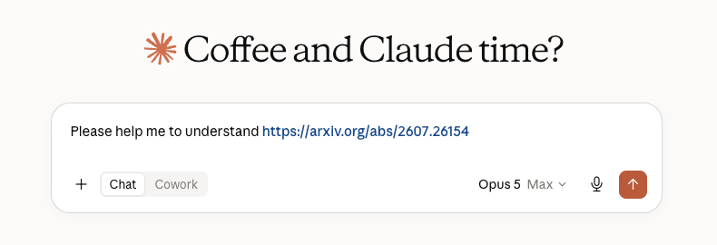
“Please help me …”
Learn backwards
Notes:
I don’t mean to debate the morality and drama behind it, I just want it to point out that as theorist, we usually have two typical working mode while interacting with AI: one is to learn from the paper/book/thesis, another one is to try to discover if there is some niche to generate new theorem/or disprove the conjectures, etc. And the modes can be entangled, sometimes we first learn the field then move forward, or we moved forward first then go back to check some previous research.

Slide 20
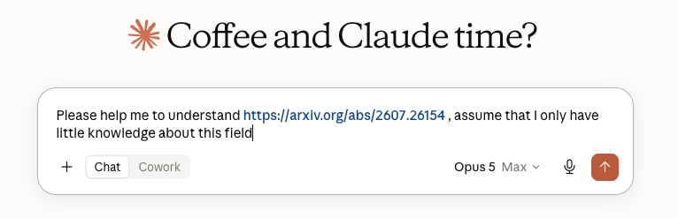
“Please help me …”
Learn backwards
Notes:
I don’t mean to debate the morality and drama behind it, I just want it to point out that as theorist, we usually have two typical working mode while interacting with AI: one is to learn from the paper/book/thesis, another one is to try to discover if there is some niche to generate new theorem/or disprove the conjectures, etc. And the modes can be entangled, sometimes we first learn the field then move forward, or we moved forward first then go back to check some previous research.

Slide 21
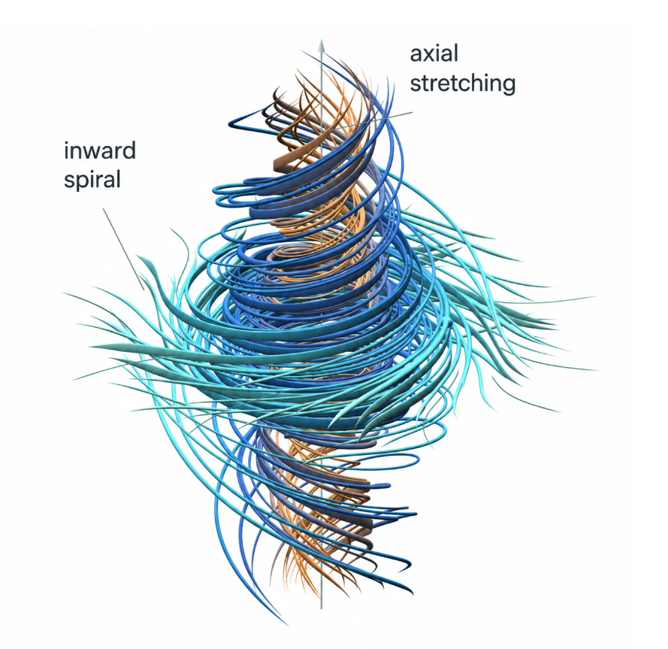
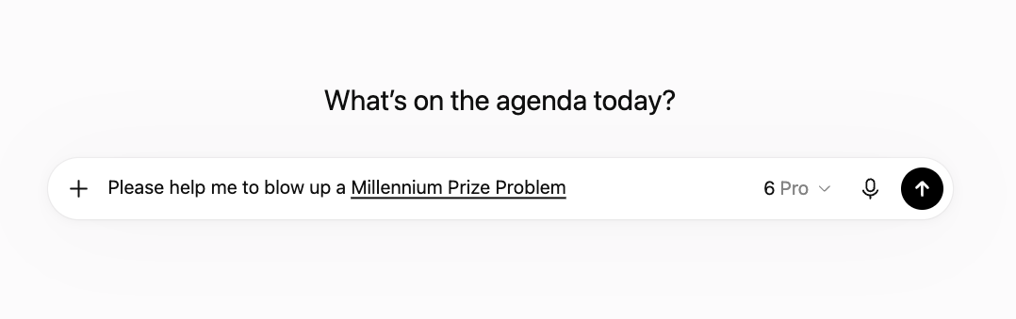
“Please help me …”
Learn backwards
Reasoning forwards
Notes:
I don’t mean to debate the morality and drama behind it, I just want it to point out that as theorist, we usually have two typical working mode while interacting with AI: one is to learn from the paper/book/thesis, another one is to try to discover if there is some niche to generate new theorem/or disprove the conjectures, etc. And the modes can be entangled, sometimes we first learn the field then move forward, or we moved forward first then go back to check some previous research.

Slide 22
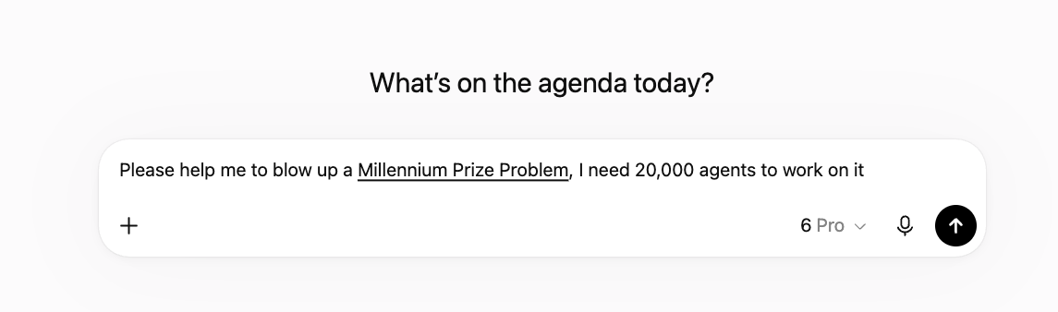
“Please help me …”
Learn backwards
Reasoning forwards
Notes:
I don’t mean to debate the morality and drama behind it, I just want it to point out that as theorist, we usually have two typical working mode while interacting with AI: one is to learn from the paper/book/thesis, another one is to try to discover if there is some niche to generate new theorem/or disprove the conjectures, etc. And the modes can be entangled, sometimes we first learn the field then move forward, or we moved forward first then go back to check some previous research.

Slide 23
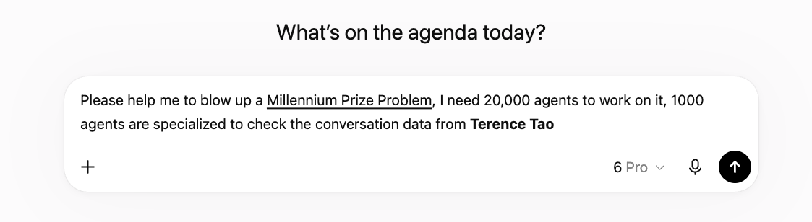
“Please help me …”
Learn backwards
Reasoning forwards
Or, sometimes together …
Notes:
I don’t mean to debate the morality and drama behind it, I just want it to point out that as theorist, we usually have two typical working mode while interacting with AI: one is to learn from the paper/book/thesis, another one is to try to discover if there is some niche to generate new theorem/or disprove the conjectures, etc. And the modes can be entangled, sometimes we first learn the field then move forward, or we moved forward first then go back to check some previous research.

Slide 24
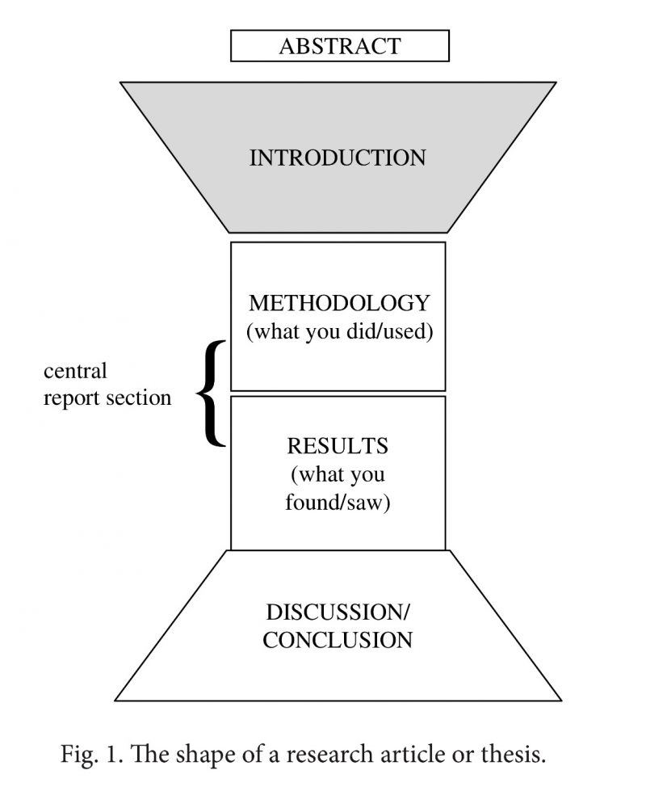
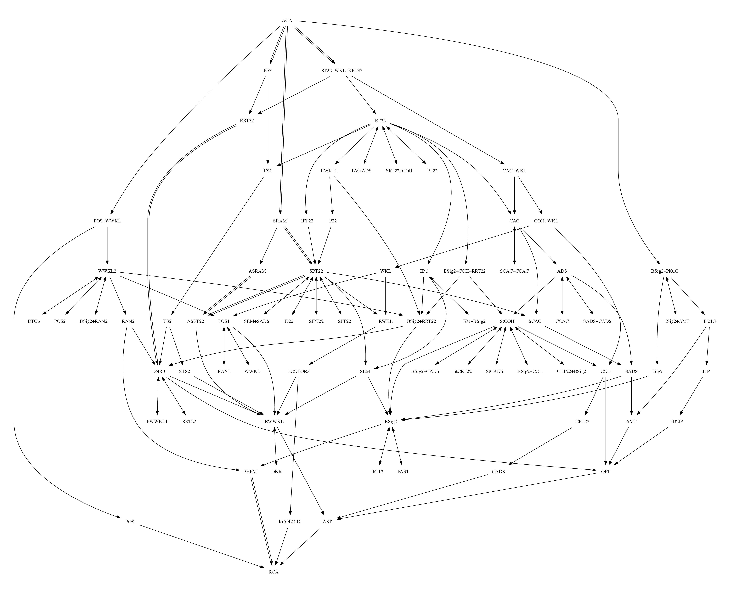
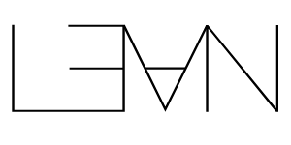

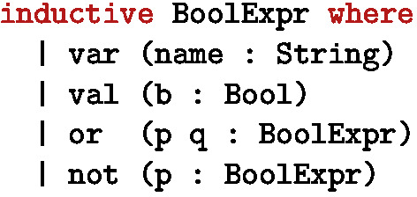


What we actually care, and … what we can trust? (as theorists)
The story
What did the paper actually state?
Mathematical correctness
Does the conclusion follow from encoded assumptions?
Computational reproducibility
Can the numerical result be reproduced?
Physical-semantic alignment
Does the formal object represent the intended physics?
?
The reverse mathematics zoo,
founded by Damir Dzhafarov , 2019
The Lean 4 Theorem Prover and Programming Language
by Moura L, Ullrich S. 2021
Paper formatting, SUNY

Slide 25
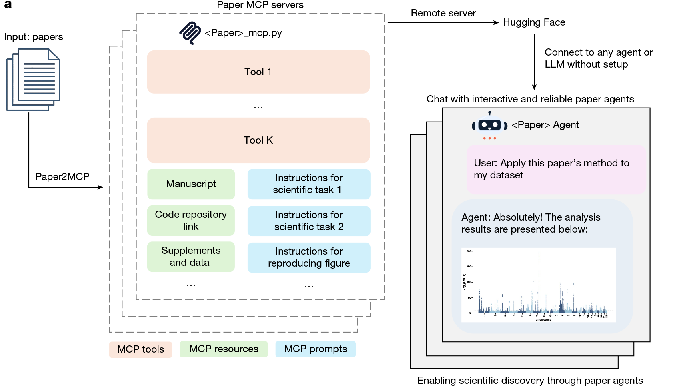
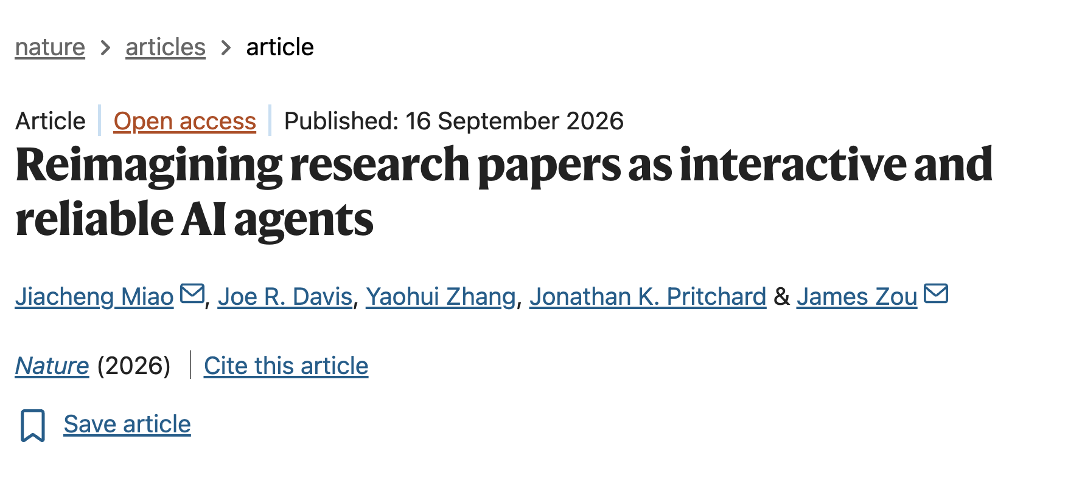
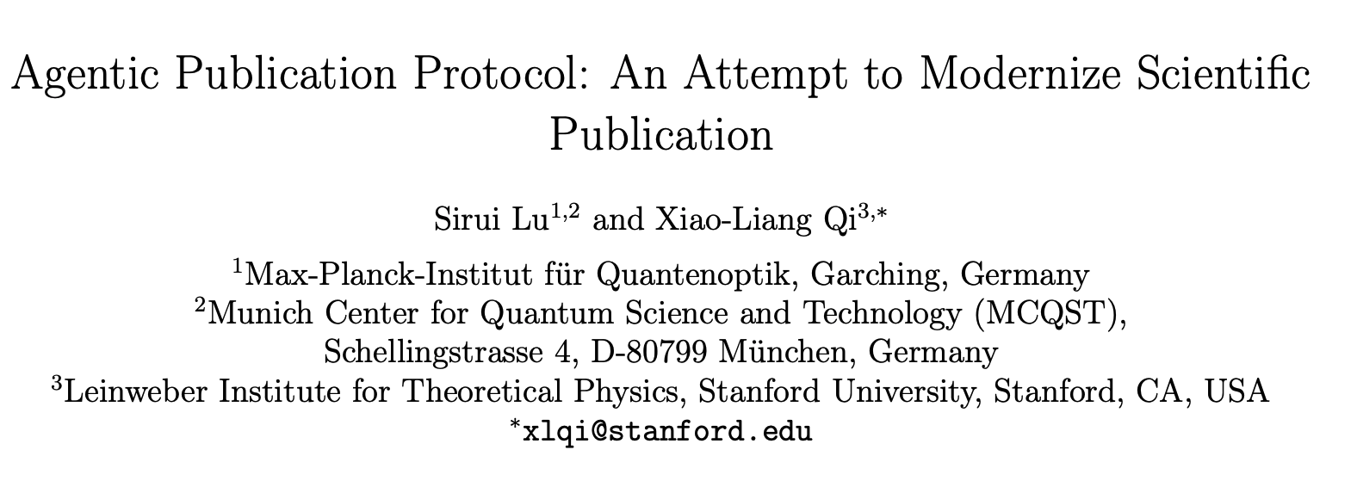
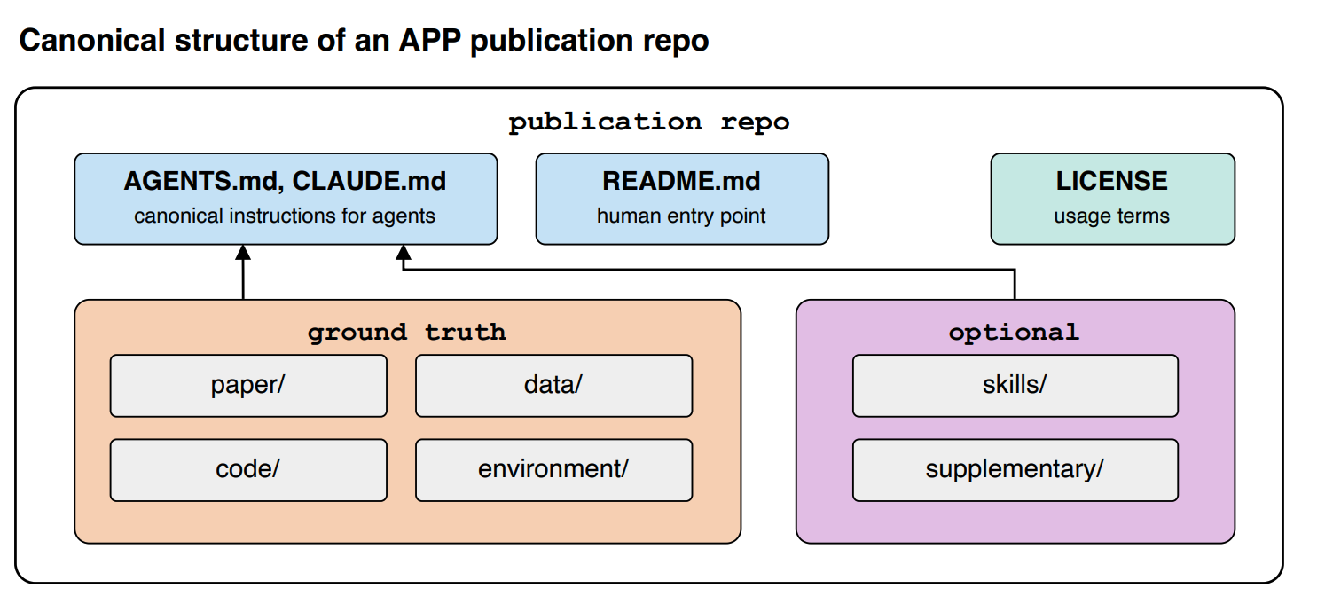
Imaging paper as an agent
A paper no need to be static, but an agent
Notes:
This is why I am here and give this talk, I would like to explain more about this idea, but the details takes a long story…. Here is an example of the work

Slide 26
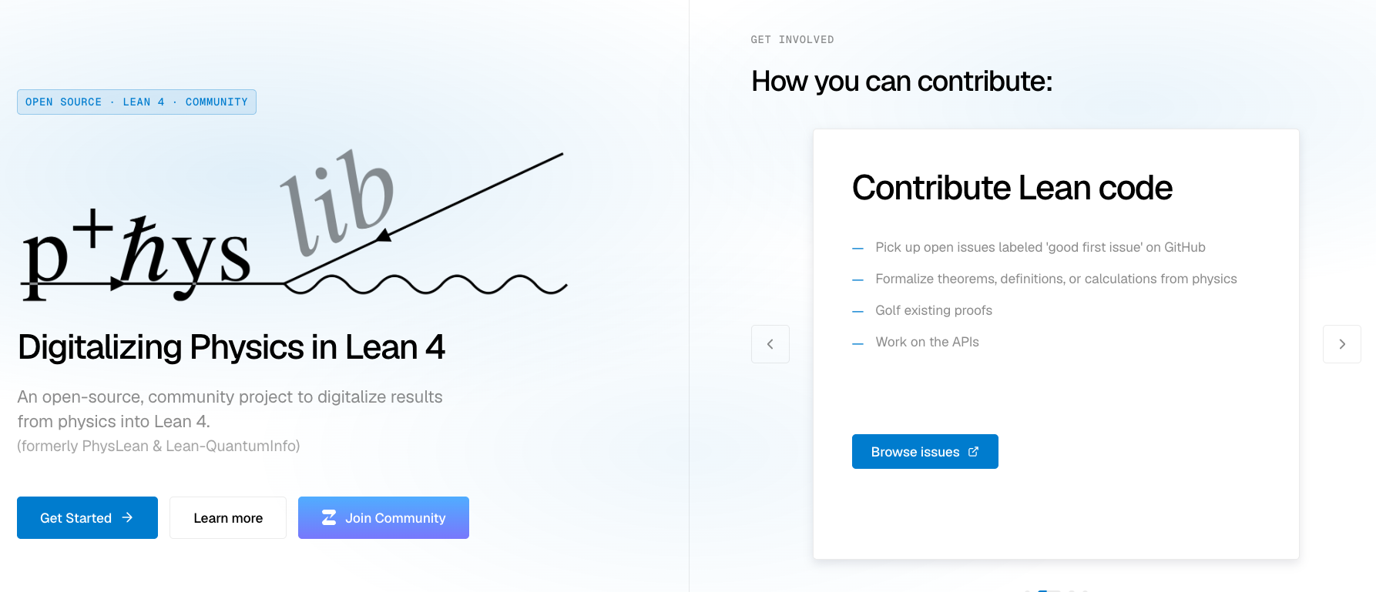
How formalization works

Slide 27
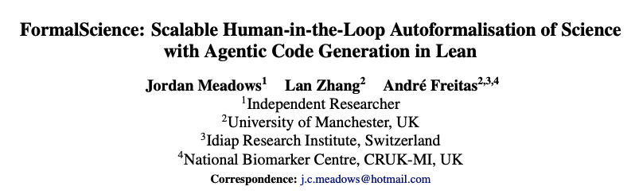
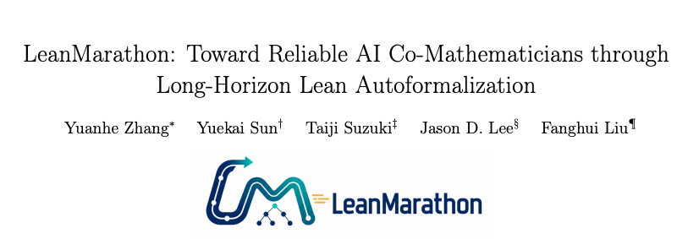
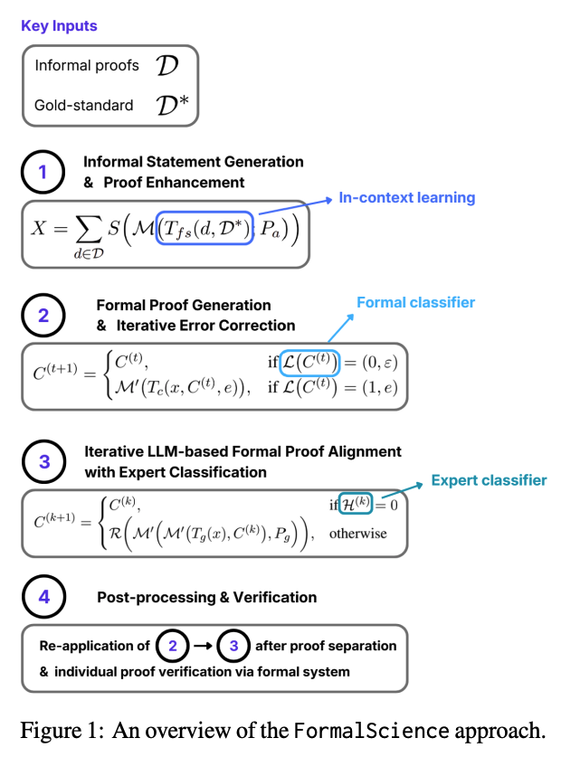
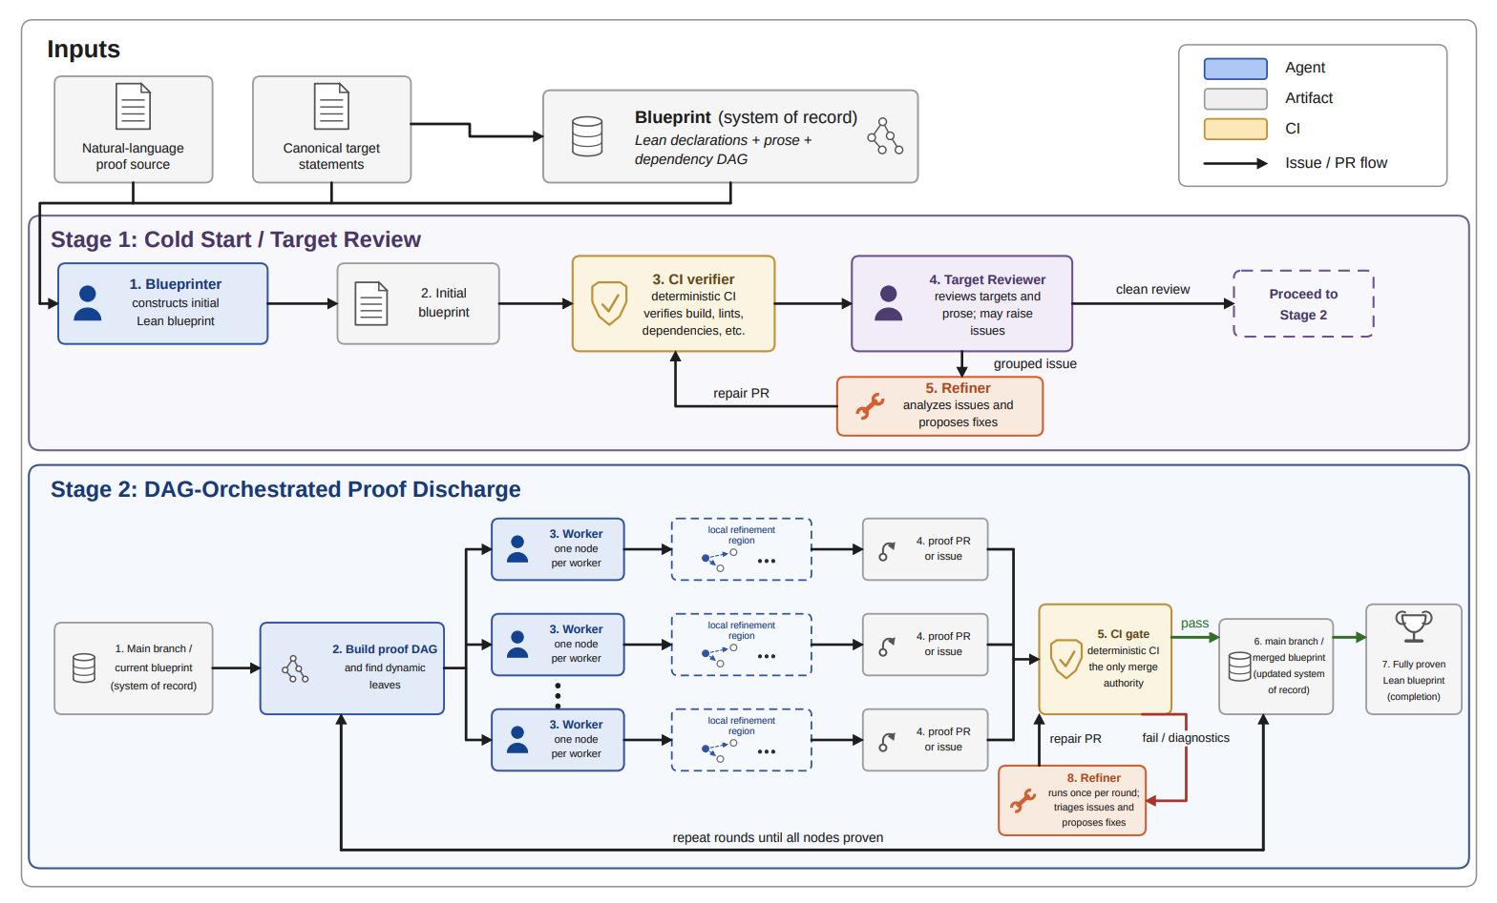
Autoformalization

