Slide 1
The AI crisis in theoretical research
scale
scientific publications
human verification bandwidth
2024
time
read ≠ checked ≠ reusable
TWO CURVES · PUBLISHING AND CHECKING
Notes:
THE OPENING CLAIM, and it is a claim about the field rather than a measurement - the curves have no numbers on them and no numbers are implied.
The top curve is how fast results are produced. The bottom one is how fast a human being can check them. They are not growing at the same rate, and 2024 is roughly where most people in this room felt the gap open.
The line in the box is the whole talk in three words: READ is not CHECKED, and CHECKED is not REUSABLE. A paper you have read is not a paper you have verified; a paper you have verified is not a thing the next paper can build on without doing the verification again.
Four things to say out loud: researchers are drowning in "recent progress"; every open problem solved raises both the confidence in AGI and the anxiety about our own careers; later work still needs the exact imported claim, not the headline; and claims and semantic content are routinely exaggerated.

Slide 2
What is inside the black box of LLM reasoning
f : String → String
A MODEL IS A FUNCTION FROM STRING TO STRING
Notes:
Before anything else, what the thing actually is. A language model is a function from a string to a string. That is the entire type signature, and it is worth writing down because almost every confusion about these systems comes from imagining something richer.
Source for the diagram: Zhang Y, Khan S A, Mahmud A, et al., npj Artificial Intelligence, 2025, 1(1): 14.

Slide 3
What is inside the black box of LLM reasoning
f : String → String
f : String → token → prob. distribution → (next) token → String
… BY WAY OF TOKENS AND A DISTRIBUTION
Notes:
Expand the signature and the mechanism appears. The string becomes tokens; the model maps the tokens to a probability distribution over what comes next; one token is drawn from it; the token is appended; and the whole thing runs again.
Nothing in there is reasoning in the sense a physicist means. It is a very good conditional distribution, sampled repeatedly.

Slide 4
What is inside the black box of LLM reasoning
f : String → String
f : String → token → prob. distribution → (next) token → String
a distribution over the next token, then one is sampled
the
cat
dog
sat
…
IT RETURNS A DISTRIBUTION · THEN SAMPLES ONE
Notes:
And here is the part with consequences. At each step the model does not choose a token, it produces a distribution over all of them and something samples from it.
Run the same prompt twice and you get two different answers, both fluent. That is not a bug being fixed in the next version; it is the operation. Any system built on top has to be designed for an engine whose output is a sample.

Slide 5
What is inside the black box of LLM reasoning
f : String → String
f : String → token → prob. distribution → (next) token → String
a distribution over the next token, then one is sampled
the
cat
dog
sat
…
the model returns a conditioned probability distribution — not an answer
NOT AN ANSWER · A CONDITIONED DISTRIBUTION
Notes:
So: the model does not return an answer. It returns a conditioned probability distribution, and then something takes a sample.
Hold onto that sentence. It is the reason the rest of this talk is about contracts rather than about prompts - you cannot make a sampler reliable by asking it nicely.

Slide 6
Model memory
the conversation is a forward pass. It does not update any weight.
Turn 1
[User: I am a physicist.]
→ LLM → [Response: Understood.]
Turn 2
[User: I am a physicist.]
[Response: Understood.]
[User: Explain entropy at my level.]
→ LLM → [Response: …]
the whole history is re-sent every single time
NO WEIGHTS CHANGE · THE HISTORY IS RE-SENT
Notes:
Second thing worth being concrete about: the model has no memory.
Every turn is a forward pass. No weight is updated. What looks like memory is the client re-sending the entire conversation each time - turn 2 contains all of turn 1, verbatim, as text.
Source: Tobias Osborne's 2026 talk at UCL, which is where I first saw this laid out properly for physicists.

Slide 7
Model memory
the conversation is a forward pass. It does not update any weight.
Turn 1
[User: I am a physicist.]
→ LLM → [Response: Understood.]
system prompt
conversation history
new prompt
Turn 2
[User: I am a physicist.]
[Response: Understood.]
context window — a fixed token capacity
[User: Explain entropy at my level.]
→ LLM → [Response: …]
the whole history is re-sent every single time
THE CONTEXT WINDOW · A FIXED TOKEN CAPACITY
Notes:
Which means there is a budget. The system prompt, the whole conversation so far, and the new prompt all have to fit inside a fixed token capacity: the context window.
The system prompt is drawn filled because it is the one part you do not control from inside the conversation.

Slide 8
Model memory
the conversation is a forward pass. It does not update any weight.
Turn 1
[User: I am a physicist.]
→ LLM → [Response: Understood.]
system prompt
conversation history
new prompt
Turn 2
[User: I am a physicist.]
[Response: Understood.]
context window — a fixed token capacity
[User: Explain entropy at my level.]
→ LLM → [Response: …]
exceed it and something must be
the whole history is re-sent every single time
compressed, truncated or dropped
EXCEED IT AND SOMETHING MUST BE DROPPED
Notes:
And when it does not fit, something has to go. The history gets compressed, truncated, or selected from.
This is worth a moment because it is invisible from the outside: the transcript looks the same whether the model saw the whole history or a summary of it. Any claim of the form "but I told it that earlier" has to survive this, and often does not.

Slide 9
API / Agent / MCP / schema / skills
prompt sorcery from the LLM era
a numpy API
an LLM API
prompt
import numpy as np
client
model
result = np.mean([1, 2, 3])
response
one answer, and the same one every time
a distribution, and a different sample each time
an agent is a system with a model at its core: the model decides the next step
TWO KINDS OF API · ONE ANSWERS, ONE SAMPLES
Notes:
Two kinds of API, and the difference is the whole problem.
Call numpy and you get one answer, and the same answer every time. Call a model and you get a sample from a distribution, and a different one on the next call.
An agent is a system with a model at its core, executing high-level tasks: the model decides the next step. Which means the non-determinism is now inside the control flow, not just in the output.

Slide 10
A language model, by itself
text in, a distribution over next tokens out
LLM
text → a distribution over next tokens
A LANGUAGE MODEL, BY ITSELF
Notes:
Now build the stack, one box at a time. Start with the engine: text in, a distribution over next tokens out. Stateless - nothing carries between calls and the weights never change.

Slide 11
Put it in a loop — that is an agent
the model is the engine; the loop is the agent
AGENT · the loop
LLM
PUT IT IN A LOOP · THAT IS AN AGENT
Notes:
Put it in a loop, and that is an agent. The loop calls the model repeatedly, decides what to do next, and stops when it judges the work done. The model is the engine; the loop is the agent.

Slide 12
Give the loop a task
what to do, on what, and what counts as finished
AGENT · the loop
TASK
LLM
GIVE THE LOOP A TASK
Notes:
Give the loop a task: a bounded work order - what to do, on which inputs, and what counts as finished.

Slide 13
A skill is a written procedure
a protocol loaded into context — drawn dashed, because it is advice
SKILL · a written procedure
loaded into context — advice
AGENT · the loop
TASK
LLM
A SKILL IS ADVICE · DRAWN DASHED
Notes:
A skill is a written procedure - a protocol loaded into the context when the task matches it.
Drawn dashed, because it is advice. The model can read it and not follow it, and nothing records that it did. This is the single most over-sold idea in the current ecosystem and the dashes are the honest way to draw it.

Slide 14
MCP is the socket, not the tool
a published convention for exposing a tool
SKILL · a written procedure
loaded into context — advice
AGENT · the loop
TASK
LLM
tool call
MCP
MCP IS THE SOCKET, NOT THE TOOL
Notes:
MCP is the socket, not the tool. A published convention for exposing a tool so that any model can call it. It standardises the plug; it says nothing whatever about what comes through it.

Slide 15
Tools are what actually act
a compiler, a database, a filesystem
SKILL · a written procedure
loaded into context — advice
AGENT · the loop
TASK
LLM
tool call
result returns
MCP
TOOLS
a compiler · a database · a filesystem
TOOLS ARE WHAT ACTUALLY ACT
Notes:
Tools are what actually act: a compiler, a database, a filesystem. The result returns to the loop, which calls the model again - and that return arrow is the whole reason the thing is called an agent rather than a chatbot.

Slide 16
The output meets a schema
a machine-checked contract
SKILL · a written procedure
loaded into context — advice
AGENT · the loop
LLM
output
SCHEMA
TASK
tool call
result returns
a machine-checked contract
MCP
TOOLS
a compiler · a database · a filesystem
THE OUTPUT MEETS A SCHEMA
Notes:
The output meets a schema: a machine-checked contract. Which fields a valid record must have, which types, and - crucially - that no field nobody agreed to may be added.
The source deck paints this box in a blue accent. Here it is filled ink, like the task box, because in this deck colour already means two specific things and this is not one of them.

Slide 17
And the schema can say no
the only arrow on the diagram that rejects
SKILL · a written procedure
loaded into context — advice
AGENT · the loop
conforms → recorded
LLM
output
SCHEMA
TASK
does not → REFUSED
tool call
result returns
a machine-checked contract
MCP
TOOLS
a compiler · a database · a filesystem
AND THE SCHEMA CAN SAY NO
Notes:
And the schema can say no. This is the only arrow on the diagram that rejects. A record that does not conform is not repaired, and not accepted with a warning - it is refused.
Say the closing line slowly, because the rest of the talk depends on it: the prompt, the skill and the tool call are all REQUESTS. They can be ignored, and the transcript looks exactly the same either way. Only the schema can make an answer impossible to express.

Slide 18
“Please help me …”
learn backwards
here is a result I do not understand.
take me back to what it rests on.
LEARN BACKWARDS
Notes:
How the tool is actually used, in practice, by people in this room.
Backwards: here is a result I do not understand, take me back to what it rests on. That is most of what I do with it, and it is the mode the rest of this talk is about.
The source deck shows real sessions here; those are redrawn rather than pasted.

Slide 19
“Please help me …”
learn backwards
reason forwards
here is a result I do not understand.
here is where I want to get to.
take me back to what it rests on.
work out what has to hold first.
— and, more often than either, both at once
REASON FORWARDS · AND USUALLY BOTH
Notes:
And forwards: here is where I want to get to, work out what has to hold first.
In practice it is almost never one or the other. You go backwards until you hit something you believe, then forwards from there, and the useful question is what got recorded along the way - which is, as far as I can tell, usually nothing.

Slide 20
What we actually care about — and what can we trust?
The story
Mathematical correctness
What did the paper actually state?
Does the conclusion follow from the stated assumptions?
Computational reproducibility
Physical-semantic alignment
Can the numerical result be reproduced?
Does the formal object represent the intended physics?
FOUR THINGS A THEORIST MIGHT WANT TO TRUST
Notes:
So what do we actually want to trust, as theorists? Four different things, and they are genuinely different questions with genuinely different methods.
THE STORY - what did the paper actually state? MATHEMATICAL CORRECTNESS - does the conclusion follow from the stated assumptions? COMPUTATIONAL REPRODUCIBILITY - can the numerical result be reproduced? PHYSICAL-SEMANTIC ALIGNMENT - does the formal object represent the intended physics?
The references on the source slide: the Reverse Mathematics Zoo (Dzhafarov, 2019), and the Lean 4 theorem prover and programming language (de Moura and Ullrich, 2021).

Slide 21
What we actually care about — and what can we trust?
The story
Mathematical correctness
What did the paper actually state?
Does the conclusion follow from the stated assumptions?
Computational reproducibility
Physical-semantic alignment
Can the numerical result be reproduced?
Does the formal object represent the intended physics?
everything after this slide is about the second box
and about one paper, one theorem, and what it actually rests on
OF THE FOUR, THIS TALK IS ABOUT THE SECOND
Notes:
THE BRIDGE, and it is worth being blunt about the scope.
Of those four, everything after this slide is about the second one - does the conclusion follow from the stated assumptions - plus a little of the first, because you cannot check a conclusion until you have pinned down what was actually claimed.
It is NOT about physical-semantic alignment. Whether a Lean definition of the reduced stabilizer polytope means the physics you had in mind is a judgement no kernel makes, and this project does not pretend otherwise - the records carry alignment_notes precisely because that gap cannot be closed mechanically.
It is NOT about computational reproducibility either; there is no numerical claim in the case study.
So the rest of the talk narrows hard: one paper, one theorem, and what it actually rests on. The next few slides are the honest version of the first curve on the opening slide - not the field's publication rate, which I cannot measure, but my own logs, which I can.

Slide 22
where it came from
ONE RESULT · AND THE SPACE UNDERNEATH IT
Notes:
OPEN BY CONCEDING THE RESULT. I am not here to tell you the machine is wrong. Take the diamond as given - it arrived, it is probably right, and arguing with it is not my talk.
Everything I am going to say is about the space underneath it, and about that grey line at the bottom, which is where it came from. When a result arrives with nothing between it and its sources, there is nothing for a reader to do except believe it or not. That is a new situation for us. It is not that the answer is suspect; it is that the answer is the only thing we were handed.
Hold that empty region in mind - the rest of the talk is an attempt to put something in it.

Slide 23
6 lines
7,765 lines
one model call
written by hand, so that
21 seconds
six citations could be used
6 LINES OF ANSWER · 7,765 LINES OF GROUND
Notes:
THE INVERSION, and it is the most surprising thing I found in my own logs.
On the left: the one piece of Lean in this project that a model wrote and a kernel accepted. Six lines. One model call, 21.4 seconds. You will see that proof itself, with its own caveats attached, later in the deck - for now only its size matters.
On the right: 7,765 lines of Lean in formal/AgtXIvRootMath, written so that six citations in one paper could be used at all - definitions, bridges, the statements of things the paper simply cites.
The drawing is NOT to scale; the true ratio is about 1,300 to 1. One qualifier, because somebody will check: "written by hand" means authored rather than model-generated - 25 of the 32 recorded source adaptations later in this deck do touch files in this package, so it is not untouched, it is not autoformalized. Note what that means for concern one. The worry is usually "who will check the ten thousand lines the AI wrote". In this project the AI wrote six. The ten thousand lines are the theory-building that had to happen first - and that is the work nobody gets credit for, because it is not an answer to anything.

Slide 24
213 support groups, proposed in 71 minutes
0
of them reviewed by a person
213 SUPPORT GROUPS · 0 REVIEWED BY A PERSON
Notes:
THE ASYMMETRY, measured - and measured on my own work rather than asserted about the field, because I cannot measure the field and neither can anyone who has tried.
Seventy-one minutes of model time produced this: 613 claim nodes and 213 support groups extracted from one paper. Every one of those 213 groups is a proposal that some set of claims, taken together, discharges another claim.
The number underneath is the point. accepted_support_edges: 0. all_judgements_unreviewed: true. Not one of them has been looked at by a person.
That is the shape of the whole problem in two numbers from one repository. Producing candidate structure is now minutes of machine time. Reviewing it is unchanged - it is a person reading, at the speed a person reads. Nothing in this project makes review faster, and I want to be honest that it does not: what it changes is that the unreviewed thing is now a small, enumerable, addressable list instead of a paragraph of prose.
Source: schema v0.3/runs/research-terra-continuation-20260920/summary.json

Slide 25
54 kernel-checked theorems
46 rest on a premise Lean does not
establish can be satisfied at all
54 KERNEL-CHECKED THEOREMS · 46 OF THEM CONDITIONAL
Notes:
WHAT A KERNEL-CHECKED YES ACTUALLY MEANS. This project has 64 kernel-checked declarations - 54 theorems, 9 definitions, 1 inductive - resting on exactly three axioms (propext, Classical.choice, Quot.sound) and no project-introduced axiom. That part is real, and it is machine-verified.
Now the honest part. The audit's own metric PREMISE_NONVACUITY_UNKNOWN is 46 of 54: forty-six of those theorems carry at least one Prop hypothesis whose inhabitation Lean does not establish. The kernel confirms the implication. It does not confirm that the premise can ever be met - and a vacuously true theorem looks identical to a useful one from the outside.
I want to be careful: this is not a flaw in Lean, and it is not fraud. It is what "verified" means, stated precisely. The eight unstubbed marks are gathered at the right only for legibility; the audit does not order them.
Source: schema v0.3/runs/lean-evidence-20260919/lean-audit.json, coverage[2].

Slide 26
the answer
82 of 82 modules compile
82 OF 82 MODULES COMPILE · THE ANSWER IS STILL EMPTY
Notes:
CONCERN ONE, IN ITS SHARPEST FORM. The largest single verification event in this project is the common-epoch migration: 82 modules, and all 82 compile under leanprover/lean4 v4.33.0. 74 declarations audited, 44 composition witnesses recorded.
And the same file records query_chain_complete = false and query_declaration = null. Eighty-two modules compile and compose into no answer. The empty box at the top is not a rhetorical device; it is a null in a JSON file.
That is what an isolated proof is. Not a wrong proof - a proof with no socket on either end. Getting those modules to compile also took 32 recorded source adaptations, each one a machine edit to somebody's proof, each stamped AGENT_NORMALIZED_UNREVIEWED.
Source: schema v0.3/epoch-migration/runs/20260919-full-case/full-case-audit.json.

Slide 27
7.6M
74
71
tokens
model calls
minutes
dollars
TOKENS, CALLS AND SECONDS ARE RECORDED · DOLLARS ARE NOT
Notes:
CONCERN TWO, AND I HAVE TO BE CAREFUL HERE, because this is the concern my own repository can say the least about.
What it does record: 74 model receipts, 7,591,305 input tokens, 97,677 output tokens, 4,280 seconds - 71 minutes of model time for the entire project, on an ordinary personal account quota. No cluster, no allocation, no scheduler.
What it refuses to record is the fourth box. Every one of 23,583 cost_microusd fields is null; 225 receipts carry cost_basis = CHATGPT_ACCOUNT_QUOTA_NOT_DOLLAR_METERED. I did not leave the price out to be coy - a token count stays true and a price does not, so the deck records the thing that will still be checkable in a year.
Say the caveat out loud: 71 minutes is an argument from smallness, not a measured comparison against anyone's large-compute baseline. I have no such comparison, and neither, as far as I can tell, does anybody else. "Theory will become a capital game" is itself an unmeasured claim.

Slide 28
8.6 GB
137 s
87,659 objects
to check this whole
the library every proof is checked against,
chain, on a laptop
identical for everybody who downloads it
8.6 GB OF LIBRARY · 137 SECONDS OF CHECKING
Notes:
CONCERN TWO AGAIN, and this is the one place where I think there is a real answer rather than a caveat.
The expensive object in this picture is not the model time. It is the checker: the Lean library the proofs are checked against - 87,659 objects, 8.6 gigabytes. That is the fixed capital of the whole enterprise.
And it is a DOWNLOAD. Not an allocation, not a quota, not a queue. Everybody who works this way gets the identical one, and a proof that the kernel accepts against it is accepted for everybody. Checking this project's entire audited chain took 136.68 seconds across four receipts on one laptop.
So: if the worry is that theoretical research becomes a competition in who can afford the compute, then the most useful property of a proof kernel is that it is cheap, shared, and the same for everyone. That is not a refutation of the worry - the generation side may well concentrate. It is the one counterexample in this repository that I can put a number on.
One caveat, because it is in the file: the audit records that the 8.6 GB figure comes from an inventory manifest whose hash it verified, and that it did not independently re-hash those library bytes. Source: schema v0.3/runs/proof-worker-normalization-attempt02-20260919/audit-proof-walk-attempt05.json, scope_notes[0].

Slide 29
with everything it passed through
without
THE SAME STATEMENT, TWICE · ONCE WITH ITS INTERMEDIATES
Notes:
CONCERN THREE, which I think is the one that actually matters.
Two routes to the same statement, drawn at the same height because they end in the same place. The lower one is what an answer looks like when it arrives alone. The upper one is the same result with the things it passed through still attached.
Concretely, from this project: the closure of one theorem is 29 claims, and 11 of them are definitions - more than a third of what the headline result rests on is not a result at all. It is vocabulary. That is the part that transfers to the next problem, and it is exactly the part a good answer throws away.
Then hand over: for the rest of the talk, the question is what would have to come back instead of a single mark.

Slide 30
a paper
frozen.
every byte fixed,
so pointers hold.
ONE PAPER · FROZEN
Notes:
THE WHOLE PIPELINE IN FIVE BOXES. Deliberately no product name, no version number and no field names on the slide - none of that has been introduced yet, and the five boxes are the part that generalises beyond this project.
Box one: a paper, frozen. Every downstream pointer is a byte offset into these exact bytes, so nothing can drift underneath the record while the work is going on. This is the cheapest and least glamorous idea in the system and it is the one that makes everything else auditable.

Slide 31
a paper
extract
the claims
frozen.
what it says
every byte fixed,
where it came from
so pointers hold.
a fingerprint
EVERY STATEMENT BECOMES ONE CLAIM RECORD
Notes:
Box two: every statement in the paper becomes one record, and the record carries three things - what it says, where in the source it came from, and a fingerprint of its content.
"Where it came from" is a byte range, not a page number. "A fingerprint" is a hash, so re-wording the statement produces a different record rather than silently editing the old one. The next slide shows one of these records in full.

Slide 32
a paper
extract
dependency
the claims
graph
frozen.
what it says
every byte fixed,
where it came from
so pointers hold.
a fingerprint
THE CLAIMS POINT AT EACH OTHER · A DEPENDENCY GRAPH
Notes:
Box three: the records point at each other. This premise discharges that conclusion. Do that for every record and you no longer have a list, you have a network - and that network is the object the rest of the talk is about.
The little sketch is a cartoon. Two slides from now you see the real one.

Slide 33
outside
dependency
nobody has fetched it
a paper
extract
dependency
the claims
graph
frozen.
what it says
every byte fixed,
where it came from
so pointers hold.
a fingerprint
AND SOME POINT OUTSIDE THE PAPER
Notes:
Box four, drawn dashed and in the one warm colour this deck uses: some records point OUTSIDE the paper, at work it leans on that nobody has fetched.
Warm means exactly one thing in every frame of this deck - NOT FROM THIS PAPER. Keep it that way; the moment warm also means "bad" or "pending", the audience stops being able to read the colour.
This box is where most of the honest difficulty lives. A paper's citations are promises, and until somebody resolves one it is a promise the machine cannot check.

Slide 34
outside
dependency
nobody has fetched it
a paper
extract
dependency
core claims
the claims
graph
+ dependencies
frozen.
what it says
every byte fixed,
where it came from
so pointers hold.
a fingerprint
THE CORE CLAIMS · ONLY WHAT THE RESULT RESTS ON
Notes:
Box five: choose one result and keep only what it rests on. Everything else in the network goes faint - not deleted, just not part of this question.
This is the single most useful operation in the system, and it is also the answer to "why are there so many claims?" There are that many because nobody asked a question yet. Ask one, and the graph collapses to the part that answers it.

Slide 35
outside
dependency
nobody has fetched it
a paper
extract
dependency
core claims
auto-
the claims
graph
+ dependencies
formalization
frozen.
what it says
a kernel does not
every byte fixed,
where it came from
negotiate, and it
so pointers hold.
a fingerprint
does not tire.
EVERY REMAINING STEP GOES TO AUTO-FORMALIZATION
Notes:
Box six: every step that survives goes to a checker that cannot be argued with - a proof kernel. It does not negotiate, it does not get tired on the fortieth lemma, and it does not care who wrote the step.
That is the entire reason for the machinery in front of it. The pipeline exists to get statements into a shape where a thing that cannot be persuaded can look at them.

Slide 36
outside
dependency
nobody has fetched it
a paper
extract
dependency
core claims
auto-
the claims
graph
+ dependencies
formalization
frozen.
what it says
a kernel does not
every byte fixed,
where it came from
negotiate, and it
so pointers hold.
a fingerprint
does not tire.
it holds
it does not
every step
and it names
was accepted
what is missing
what is missing goes back in
IT HOLDS · OR WHAT IS MISSING GOES BACK IN
Notes:
And the output has two exits, which is the point of the whole design.
It holds - every step was accepted. Or it does NOT hold, and the system names what is missing. The second exit is the valuable one: a "no" that comes with a specific unmet obligation is a research to-do list, where a "no" without one is just a failure.
What it never does is the third thing, which is to return something that looks like a proof because the prose around it was fluent.

Slide 37
math-claim-ir · the theorem this chain ends at
claim.id
closed-form-equality
statement_kind
theorem
source.occurrence_work
arxiv:2607.26154v1
as the paper states it
RoM_M(rho) = max( 1, max_Q sum_{P in Q} |tr(P rho)| )
structured_statement — what that one sentence actually contains
assumptions.explicit
M has no active dependencies
G_M is perfect
assumptions.source_implicit
m >= 1 found in the PROOF, not the statement
quantifiers
4 — 3 SOURCE_IMPLICIT (n, m, M), 1 SOURCE_EXPLICIT (rho)
local_binders
Q over Cliques(G_M)
conventions
The empty clique is allowed and contributes 0.
conclusion
RoM_M(rho) = max{ 1, max_{Q in Cliques(G_M)} sum_{P in Q} |tr(P rho)| }
normalization.relation_to_source
LOGICAL_FORM_EXPANDED
normalization.unresolved_symbols
[ ] nothing left unresolved
claim.content_hash
sha256:9168a6687534c0387f16decb4e334d18b…
semantic_content_hash
sha256:bfd91f0b1a13fec71d05f5e4e5f0e890c…
artifact.artifact_hash
sha256:46b60671563656ba0e1e919f833599a84…
one sentence in the paper. four quantifiers, three assumptions and a convention in the record.
ONE MATH CLAIM · NORMALIZED, HASHED, ANCHORED
Notes:
How the schema turns one sentence of a paper into a MathClaim - and deliberately the SAME theorem this deck spends its last eleven frames building the chain for. The registry holds 25 such records for this paper; this is the headline one.
Read the middle block. The paper states the closed form in a single line. The record has to say what that line actually contains: two assumptions the paper states (no active dependencies, G_M perfect), FOUR quantifiers of which THREE are marked SOURCE_IMPLICIT - n, m and M are never quantified in the sentence - a local binder for Q over the cliques, and a convention that the empty clique counts as zero.
And one line worth stopping on: assumptions.source_implicit, m >= 1, anchored to the PROOF rather than the statement. The paper uses a hypothesis in its proof that its theorem does not state. That is not a criticism of the paper; every paper does it. It is the thing a reader has to reconstruct by hand, and it is exactly what this record exists to make mechanical.
Three separate hashes, differing on purpose: re-wording the statement changes one and not the others.
A caution if asked: this registry id (closed-form-equality) and the chain's id (claim:closed-form-rom) are different identifiers in different files. They are the same mathematics, not the same record.
Source: Stabilizerness/MathClaimIRRegistry/claims/graph-theoretic-nonstabilizerness.jsonl

Slide 38
lamport.json · the structured proof the model returned
1. Fix a finite index type ι and coefficients x : ι → ℝ satisfying ∑ i, x i
= 1.
2. Apply AgtXIv.RoM.normalized_l1 to x and the normalization hypothesis;
project its first conjunct to obtain 1 ≤ AgtXIv.RoM.l1Cost x.
3. Unfold l1Cost to express the bound as 1 ≤ ∑ i, |x i|.
alignment_notes
· Fintype represents the finite index type; x has real coefficients and the
hypothesis preserves their sum being one. No nonnegativity or nonempty-
index assumption is added.
· The explicit sum of absolute values represents the source's coefficient
cost. Only the lower-bound conjunct of normalized_l1 is used.
· This statement concerns the coefficient bound alone; it does not assert
primal feasibility or strong duality.
remaining_obligations
· Host elaboration of the proposed terms remains pending; no Lean execution
was performed.
ledger.json · and what the host did next
result.kernel_checked
true
audit_record.declaration
AgtXIv.Generated.Proof_a29f133fb6f82da97507
audit_record.axioms
propext, Classical.choice, Quot.sound
result.lean_source
488 bytes
the obligation above was outstanding when the model wrote it.
the host then elaborated the terms and the kernel accepted them.
ONE LAMPORT PROOF · WHAT THE MODEL RETURNED, THEN WHAT THE HOST DID
Notes:
A Lamport-style structured proof: hierarchically numbered steps, each one checkable on its own, rather than a paragraph of prose.
This is the real artifact from the one end-to-end run that worked - 1 model call, and the Lean it produced was accepted by the kernel using the audited library theorem AgtXIv.RoM.normalized_l1.
READ THE TWO HALVES IN ORDER, because they look like a contradiction and are not. The model's record ends with remaining_obligations: "no Lean execution was performed" - which was true at the moment it wrote it. The ledger below records what happened next: the host elaborated the proposed terms, Lean accepted the declaration AgtXIv.Generated.Proof_a29f133fb6f82da97507, and the audit shows it resting on the three standard axioms and nothing else.
That sequence is the point. A record is a snapshot carrying its own outstanding obligations; the ledger is the account of which ones were then discharged. Neither alone tells you the state - and a deck that showed only the first half would be claiming the opposite of what it meant.
Note what else travels with it. alignment_notes record what the formal statement does and does NOT assert ("no nonnegativity or nonempty-index assumption is added"; "does not assert primal feasibility or strong duality"). remaining_obligations records what was still pending at that point. The proof does not arrive alone - it arrives with its own caveats attached.
Source: schema v0.3/runs/proof-worker-normalization-attempt02-20260919/attempts/*/lamport.json

Slide 39
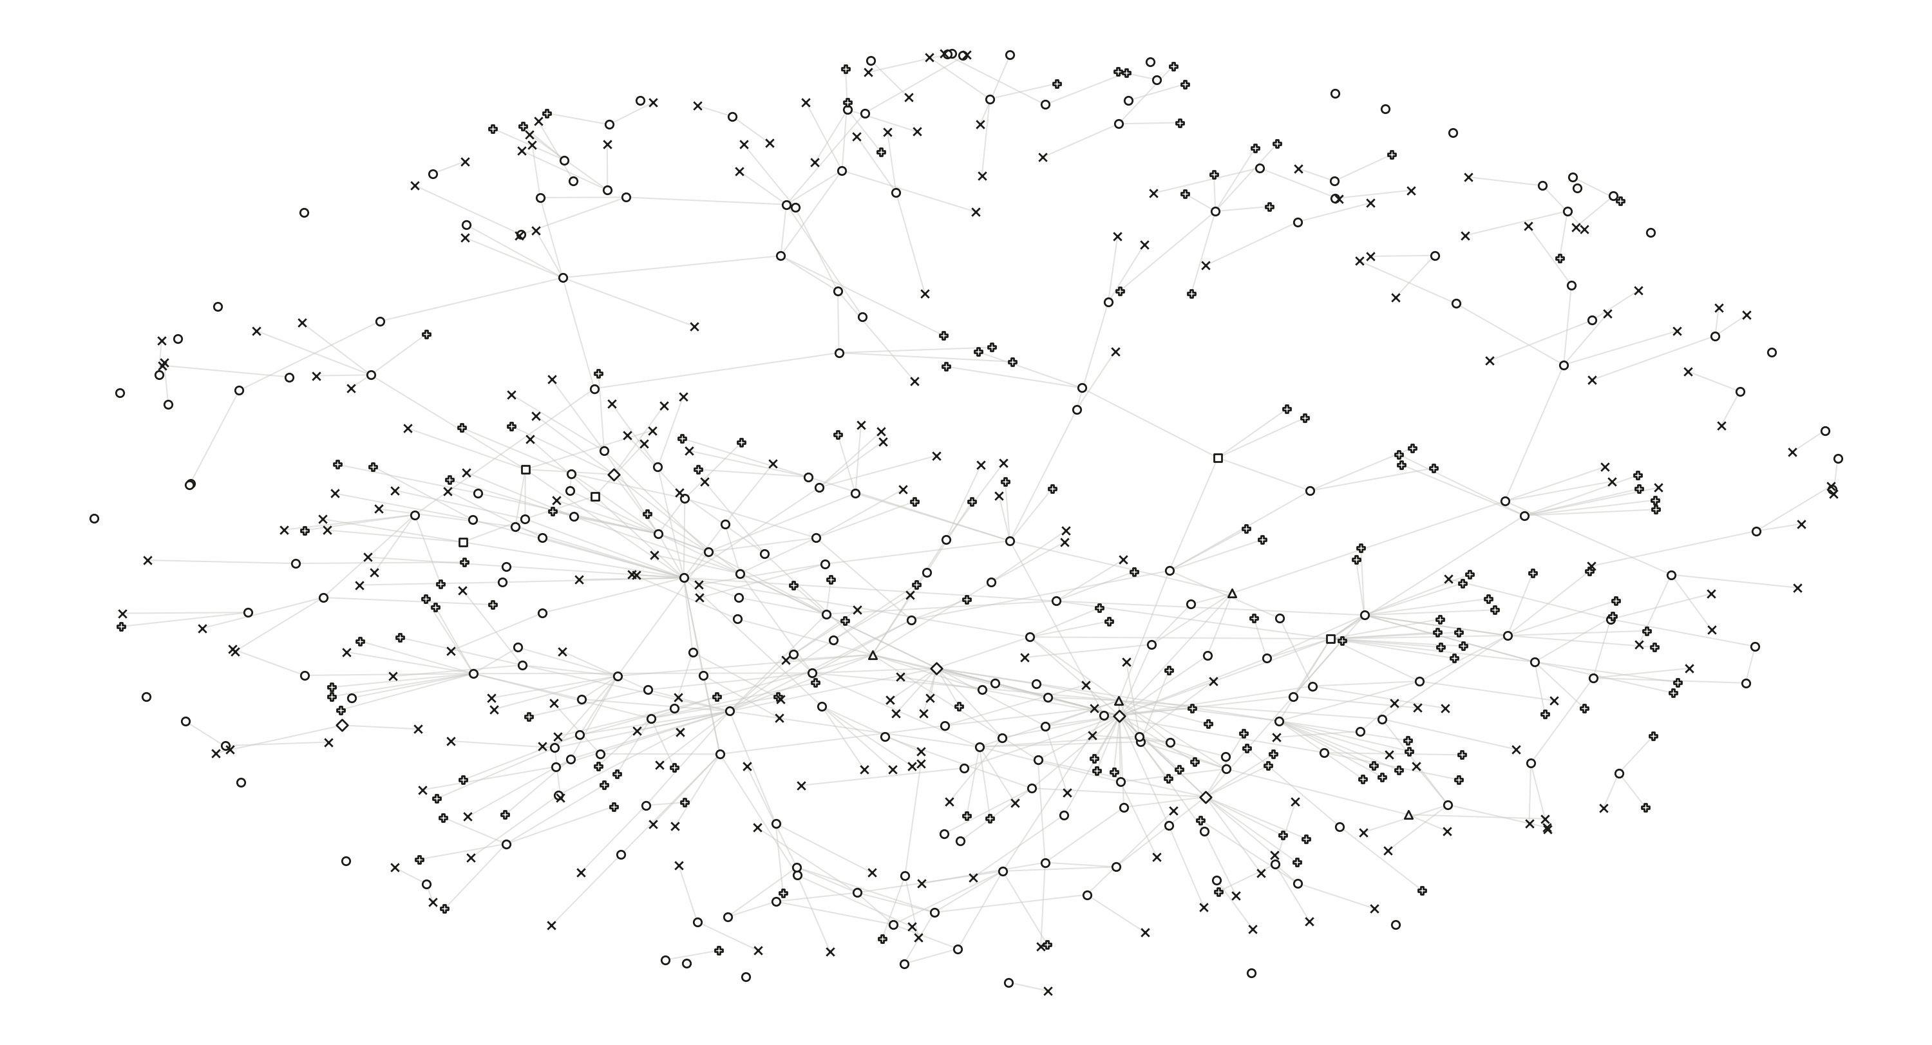
613 NODES · 634 DEPENDENCIES · ONE PASS OVER ONE PAPER
Notes:
What you get when you ask a machine to extract every mathematical claim in one paper and every dependency between them: 613 nodes, 634 edges, assembled from the frozen bytes of arXiv:2607.26154v1 without using any hand-authored graph (legacy_dag_edges_used: false).
Shape = node kind, as in the seminar deck. Everything is hollow because v0.3 has no accepted state to fill a mark with: accepted_support_edges is 0.
This frame and the next two extracted-graph frames are images rather than shapes - several hundred marks each, where a flattened picture is the honest format.
Source: schema v0.3/runs/research-terra-continuation-20260920/graphs/00001-db0e3d21/graph.json

Slide 40
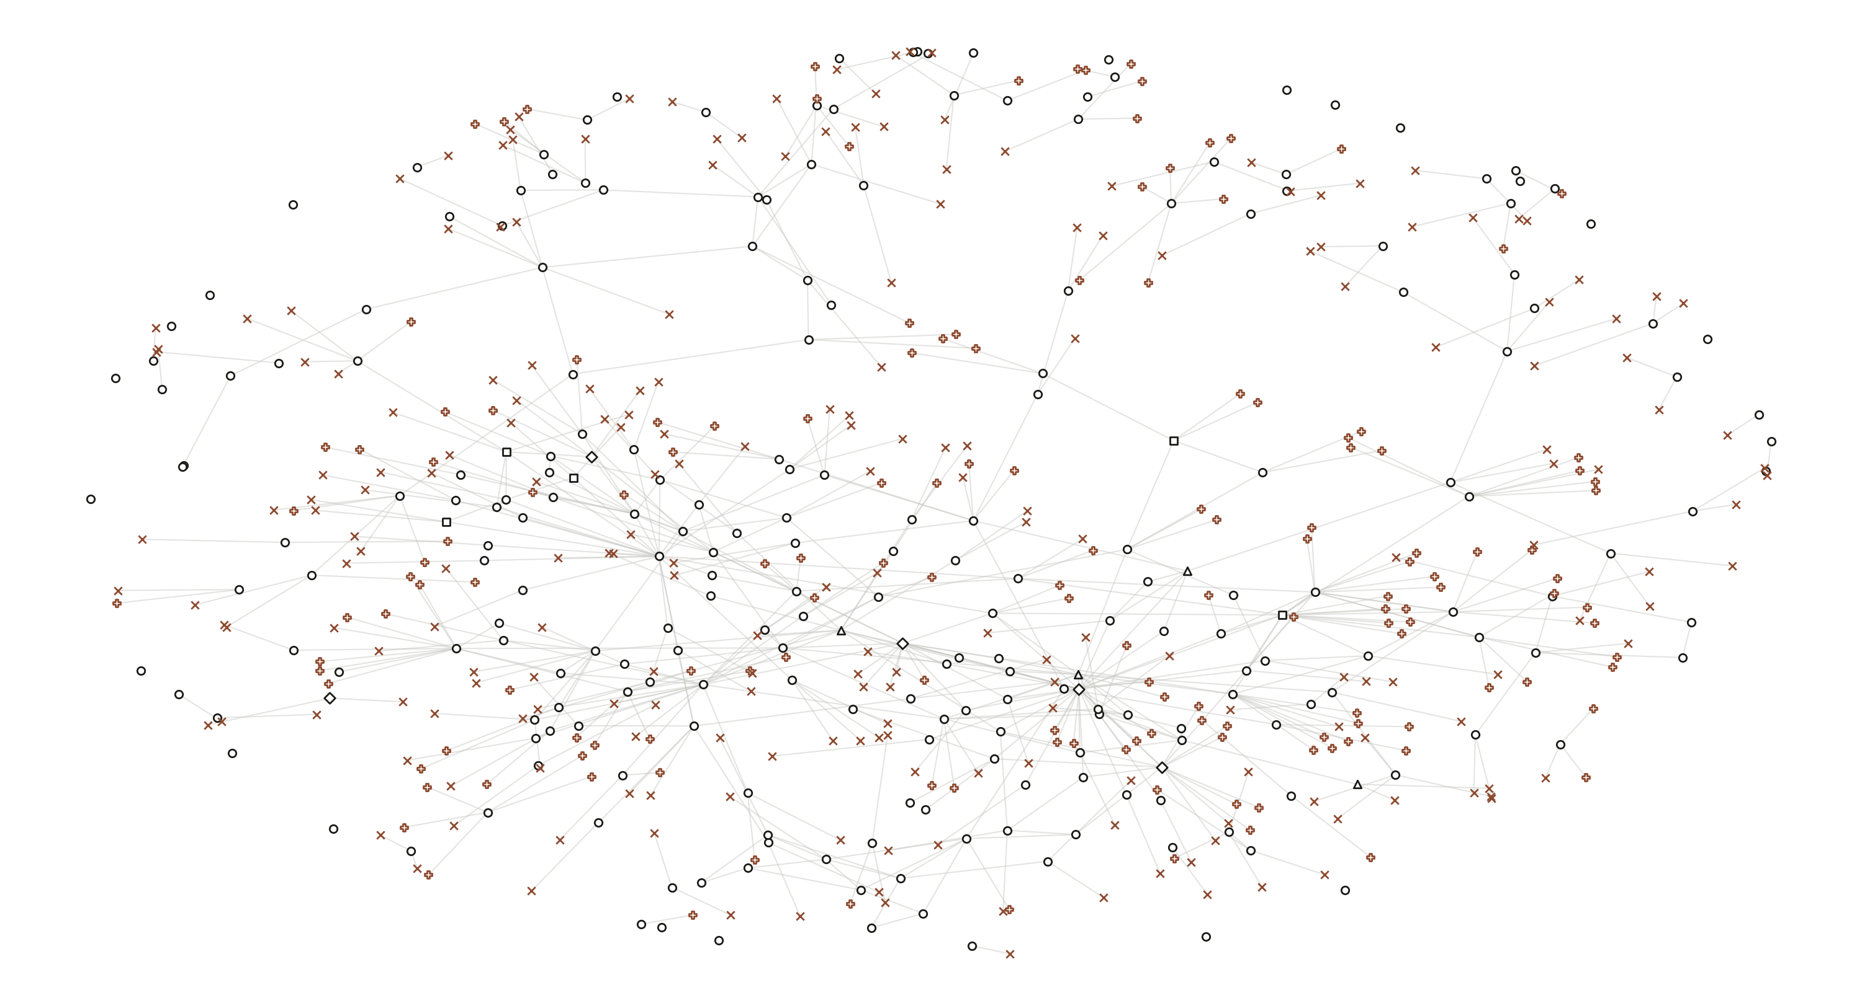
240 FROM THE TARGET PAPER · 373 EVERYTHING ELSE
Notes:
The same graph, two colours.
INK - the 240 candidate statements actually extracted from the target paper's own .tex. These carry a paper_id.
WARM - the other 373: 152 external claim requests (anchored to a .bbl byte range, paper_id null - nobody has fetched the source yet) and 221 unresolved source occurrences (a location in the paper no candidate has yet claimed).
The point of the colour split: most of this graph is not knowledge, it is the system's own record of what it has not done. Computed connectivity: 80 weakly connected components, largest 379 nodes, 24 isolated, and the digraph is NOT acyclic - 7 simple cycles.

Slide 41
14 candidates that land inside a declared result (one mark each, kind not shown)
def:active
thm:mwis
thm:solvable
lem:lovasz-sandwich
prop:extremal
definition
theorem
theorem
lemma
proposition
lem:collapse
prop:relaxation
prop:clifford
lem:perfect-collapse
lemma
proposition
proposition
lemma
the 9 results the paper actually declares
14 OF THE 240 LAND ON A RESULT THE PAPER DECLARES · 9 OF 9 HIT
Notes:
THE REDUCTION, and it is mechanical - no model judgement anywhere in it.
The host reads the frozen .tex and takes the byte range of every \begin{theorem}...\end{theorem} and its siblings. The paper declares NINE formal results: 2 theorems, 3 lemmas, 3 propositions, 1 definition, each with its own \label. Then it asks which of the 240 extraction candidates have a source span falling inside one.
Answer: 14 candidates, hitting 9 of 9 - so nothing the paper formally declares was missed - and 8 of the dependency edges survive among them. The other 226 candidates are assertions in running prose, where "is this a claim?" is a judgement rather than a fact.
WHAT THIS IS NOT. It does not delete the 226 and it asserts nothing about them; many are load-bearing (the curated registry holds 25, not 9). It is a mechanical attribution, fully reversible, and it is the cheapest honest cut available: from 240 unreviewed candidates to the 9 results the paper itself chose to state formally.
Counts computed live from draft.tex and graphs/00001-db0e3d21/graph.json.

Slide 42
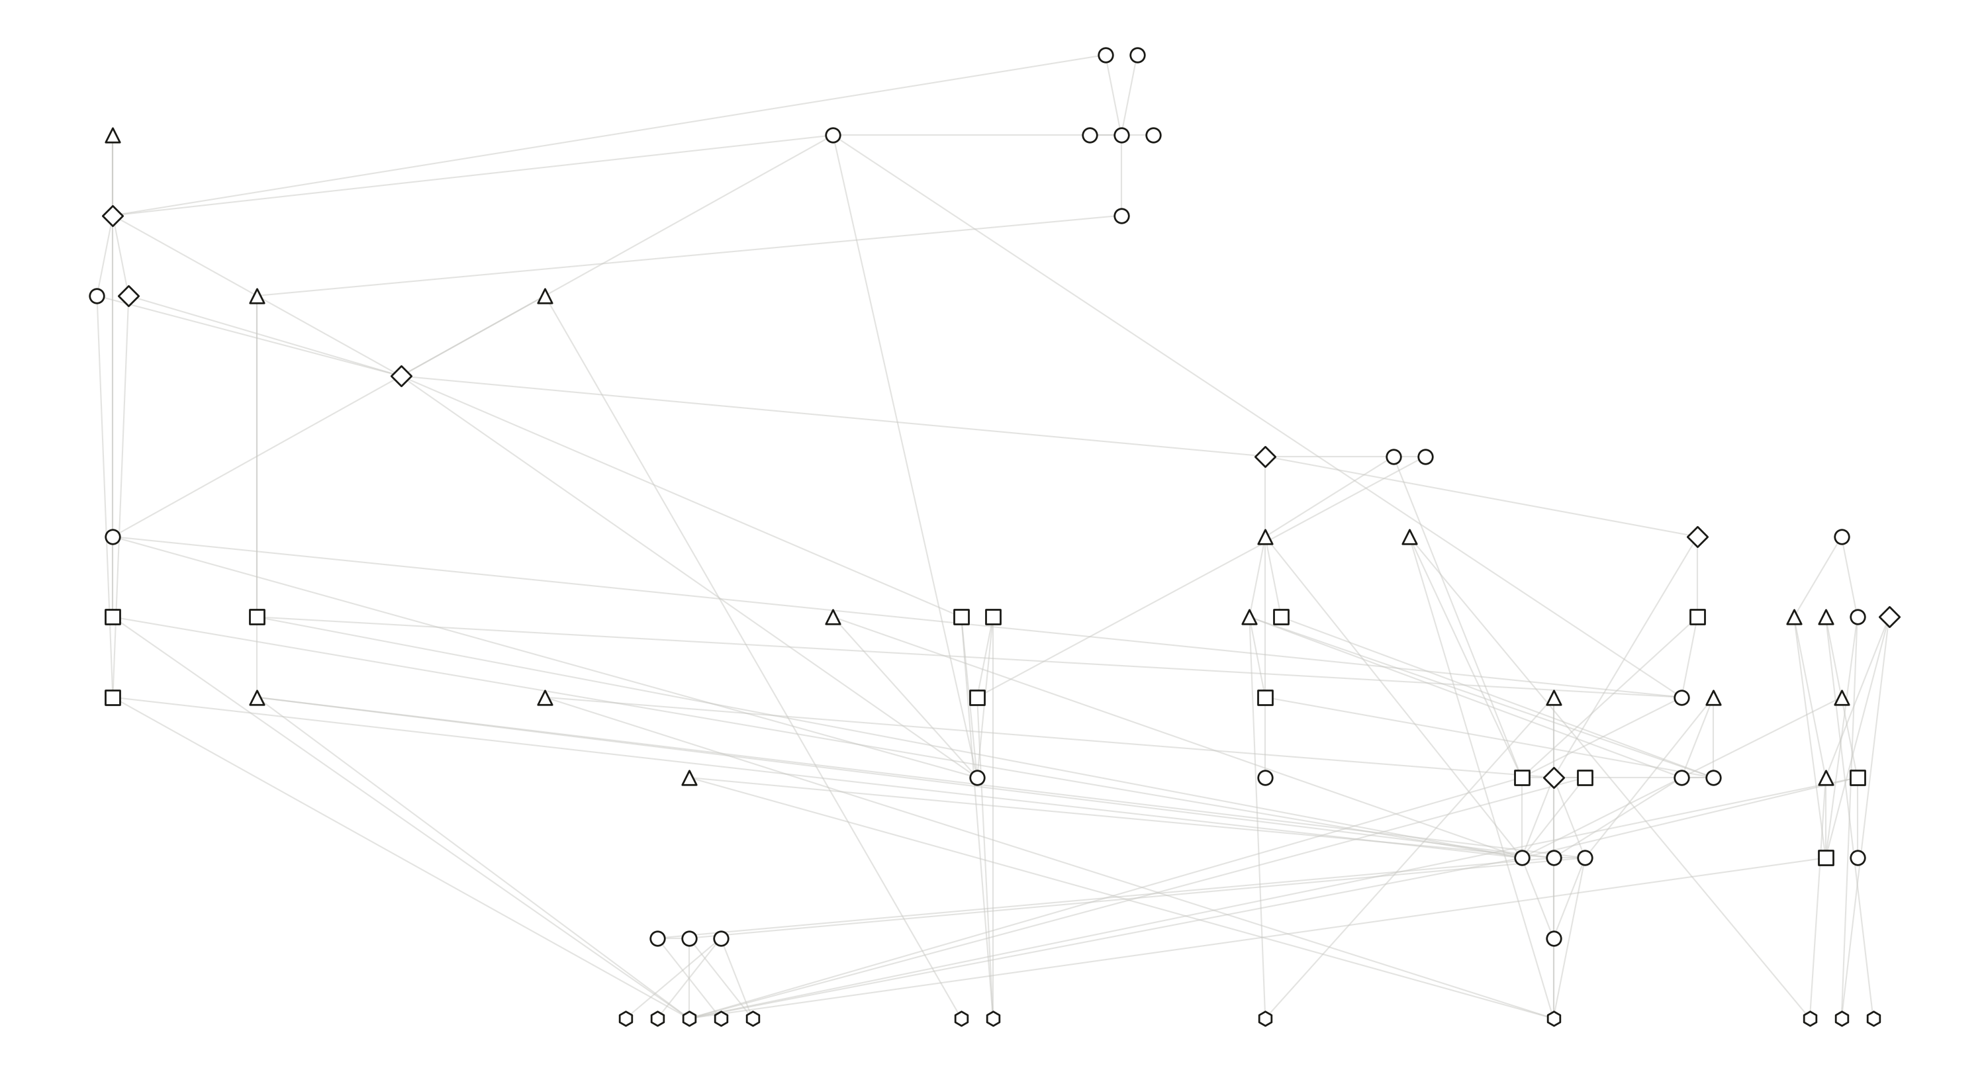
A DIFFERENT OBJECT · 74 CLAIMS, AUTHORED BY HAND
Notes:
IMPORTANT - this is a CHANGE OF OBJECT, not a zoom.
This is the paper's hand-authored dependency DAG: 74 claim nodes, 129 edges, one connected structure, acyclic because a person made it so.
It is NOT a subgraph of the previous slide, and the deck must never imply that it is. The two graphs share ZERO node ids (extracted ids look like claim:candidate:51e98811..., authored ids like claim:closed-form-rom). I also tested correspondence by source location - converting the authored line anchors to byte ranges and intersecting them with the extracted spans - and it is far too coarse to be an extraction: 436 of 458 extracted candidates overlap SOME authored claim, 224 overlap this theorem's chain. So no clean subgraph exists.
Say it plainly if asked: the machine's reading and the human's reading of the same paper are two different objects, and neither is derived from the other.
Source: Stabilizerness/dag/claim-dag.json

Slide 43
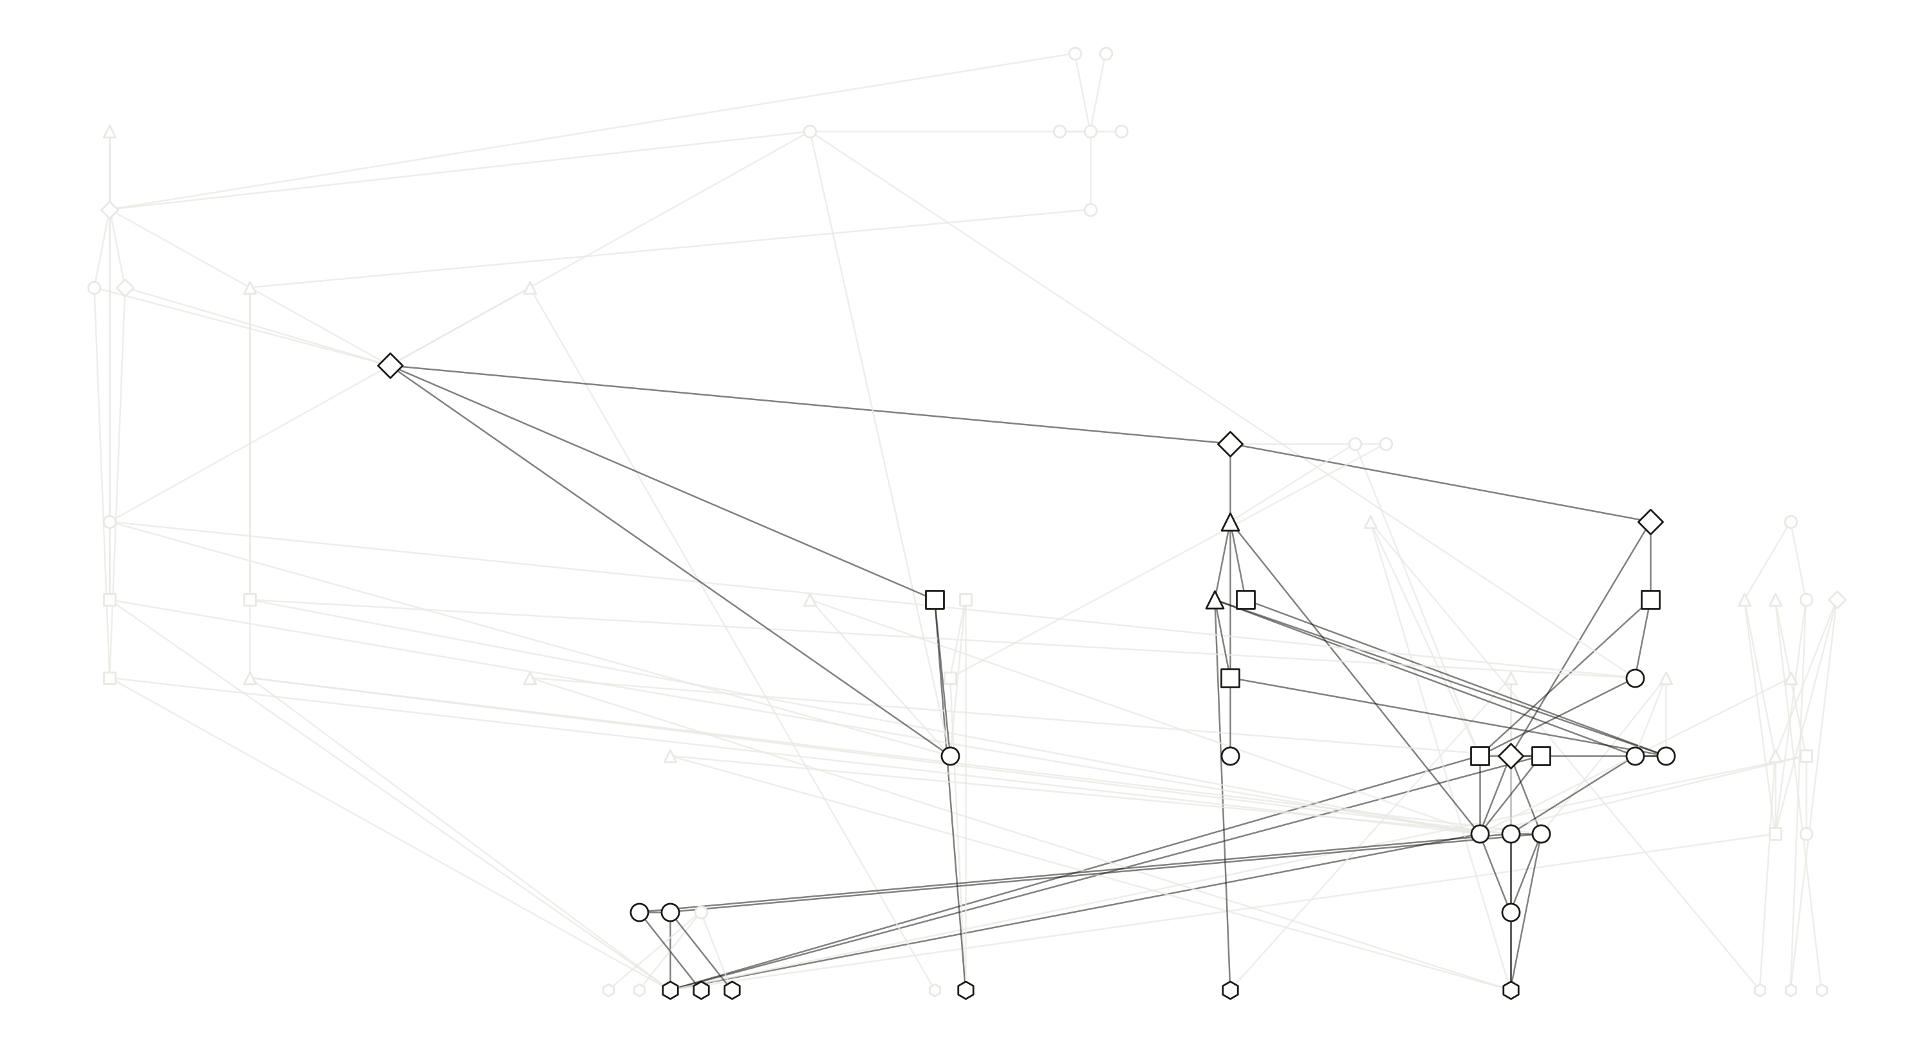
29 OF 74 · THE CLOSURE OF ONE THEOREM
Notes:
THIS extraction is real, and verified: the 29 node ids of the closure are a strict subset of the 74 authored ids (checked in code - the build asserts it).
Ink = the backward closure of the main theorem (the closed form for reduced robustness of magic). Ghosted = the other 45 claims of the paper, which include five further external roots, the whole empirical branch behind Figure 2, three open problems and two stated limitations.
So: the figure everything after this is built on covers 29 of the paper's 74 claims - 39%. A closure answers "what does this theorem rest on", not "what is in this paper".
ONE EDGE OF BOOKKEEPING, in case somebody counts the lines. The ink edges here are the AUTHORED DAG restricted to these 29 claims, and there are 45 of them. From the next frame on, the deck draws the v0.3 pruned branch artefact, which has 46 - it carries no-active-free-signs -> sign-alignment-identity, an edge the hand-authored graph does not. Same 29 nodes, one more edge. Both drawings are faithful to their own source; they are two readings of one closure, a version apart.

Slide 44
COLOUR = SOURCE
this paper
Chvátal 1970s
Gottesman 1997
Veitch 2013
Howard 2016
Handbook 2024
the theorem
Varela 2026
L8
L7
L6
L5
L4
L3
L2
L1
L0
1 CLAIM
Notes:
Start at the theorem: claim:closed-form-rom. Nothing under it yet.
The unit of construction here is the SUPPORT GROUP - an AND-set of premises that together discharge one target - not the individual edge. closed-form-branch.json records 20 such groups over the 29 claims.

Slide 45
COLOUR = SOURCE
this paper
Chvátal 1970s
Gottesman 1997
Veitch 2013
Howard 2016
Handbook 2024
the theorem
Varela 2026
L8
L7
L6
L5
L4
L3
perfect graph
L2
L1
L0
4 CLAIMS · 1 AND-GROUP
Notes:
The theorem’s support group opens: exact-graph-program, perfect-graph-antiblocker and perfect-graph-definition.
Drawn as a bracket rather than three separate edges, because it is an AND: all three must hold. Any one missing and the target is not discharged. That is why the bracket, not the arrows, is the right primitive.

Slide 46
COLOUR = SOURCE
this paper
Chvátal 1970s
Gottesman 1997
Veitch 2013
Howard 2016
Handbook 2024
the theorem
Varela 2026
L8
L7
L6
L5
L4
L3
perfect graph
L2
L1
L0
perfect-graph duality
7 CLAIMS · 3 GROUPS
Notes:
The same question is now asked of each premise: what discharges this? Two more groups open underneath.

Slide 47
COLOUR = SOURCE
this paper
Chvátal 1970s
Gottesman 1997
Veitch 2013
Howard 2016
Handbook 2024
the theorem
Varela 2026
L8
L7
L6
L5
L4
L3
MWIS
perfect graph
L2
L1
L0
perfect-graph duality
13 CLAIMS · 5 GROUPS
Notes:
The relaxation branch and the antiblocker branch descend separately.
From here on, a heavier stroke and a faint ring mark what arrived at THIS step, and the brighter brackets are the groups that just opened. Later steps add only 3, 2 and 1 marks among 26-29, which is otherwise undetectable in a static frame.

Slide 48
COLOUR = SOURCE
this paper
Chvátal 1970s
Gottesman 1997
Veitch 2013
Howard 2016
Handbook 2024
the theorem
Varela 2026
L8
L7
L6
L5
L4
L3
MWIS
perfect graph
L2
L1
Varela
perfect-graph duality
L0
Gottesman
23 CLAIMS · 10 GROUPS
Notes:
The widest step: ten new claims at once, and three more of the roots arrive together.

Slide 49
COLOUR = SOURCE
this paper
Chvátal 1970s
Gottesman 1997
Veitch 2013
Howard 2016
Handbook 2024
the theorem
Varela 2026
L8
L7
L6
L5
L4
L3
MWIS
perfect graph
L2
L1
Varela
perfect-graph duality
L0
Gottesman
26 CLAIMS · 16 GROUPS
Notes:
Three more, completing the reduced-polytope side.

Slide 50
COLOUR = SOURCE
this paper
Chvátal 1970s
Gottesman 1997
Veitch 2013
Howard 2016
Handbook 2024
the theorem
Varela 2026
L8
L7
L6
L5
L4
L3
MWIS
perfect graph
L2
L1
Varela
perfect-graph duality
L0
Gottesman
28 CLAIMS · 19 GROUPS
Notes:
Two: the full robustness of magic, and the resource theory that defines it.

Slide 51
COLOUR = SOURCE
this paper
Chvátal 1970s
Gottesman 1997
Veitch 2013
Howard 2016
Handbook 2024
the theorem
Varela 2026
L8
L7
L6
L5
L4
L3
MWIS
perfect graph
L2
L1
Varela
perfect-graph duality
L0
Gottesman
29 CLAIMS · 20 GROUPS · NOTHING LEFT TO EXPAND
Notes:
Twenty-nine claims, twenty support groups. The recursion terminates because every remaining premise is already in the chain.
Say “terminates”, not “complete”. The pipeline’s own chain-certificate.json records state CHAIN_INCOMPLETE for this very query, and three frames from now this deck prints that. What has finished is the expansion; what has not is the proof.
Worth saying aloud: it terminates because the input was a closed, hand-authored DAG. Run the same question against the paper itself and it does not terminate - the v0.3 controller stops at a budget limit with 400 roots, 373 of them unfetched requests.

Slide 52
COLOUR = SOURCE
this paper
Chvátal 1970s
Gottesman 1997
Veitch 2013
Howard 2016
Handbook 2024
the theorem
Varela 2026
L8
L7
L6
L5
L4
L3
MWIS
perfect graph
L2
L1
Varela
perfect-graph duality
L0
Gottesman
9 ROOTS · NOTHING BELOW THEM
Notes:
Nine claims have NO support group at all - nothing in the chain explains them. They are where the paper stops arguing and starts citing.
Six are imported foundations. Three are the paper’s own definitions that rest on nothing, which is why the DAG has 9 sources rather than 6.

Slide 53
COLOUR = SOURCE
this paper
Chvátal 1970s
Gottesman 1997
Veitch 2013
Howard 2016
Handbook 2024
the theorem
Varela 2026
L8
L7
L6
L5
L4
L3
MWIS
perfect graph
L2
L1
Varela
perfect-graph duality
L0
Gottesman
FORMALIZATION ORDER · 14 OF 29
Notes:
The system orders the chain for Lean and can reach fourteen of the twenty-nine. formalization_order begins at the MWIS definition, the Pauli window, the perfect-graph definition and finite LP strong duality.
Note the shape: every filled mark sits in the lower-left mass. Nothing near the top is reachable.

Slide 54
COLOUR = SOURCE
this paper
Chvátal 1970s
Gottesman 1997
Veitch 2013
Howard 2016
Handbook 2024
the theorem
Varela 2026
L8
L7
L6
L5
L4
L3
MWIS
perfect graph
L2
L1
Varela
perfect-graph duality
L0
Gottesman
15 UNREACHABLE · CHAIN_INCOMPLETE
Notes:
The fifteen the ordering cannot reach - everything downstream of a blocked root, including the theorem itself. Not because the Lean is missing, but because a premise above it has no discharged source.
The two ringed marks are the CAUSE, and they carry their own source colours - Varela in violet, the perfect-graph duality (Chvatal/Fulkerson) in blue, exactly as in the seminar deck. They are the only two imports outside formalization_order. Computed from closed-form-branch.json, the fifteen break down as 11 blocked by Varela alone, 1 by the perfect-graph root alone, 1 (the theorem) by both, plus the 2 blocked roots themselves. So resolving the Varela citation would return 11 of the 15.
The chain is complete and the proof is not: mathematical_status CHAIN_INCOMPLETE, accepted_support_edges 0, proof_backend NOT_CONNECTED.

Slide 55
one theorem’s chain — 29 claims, 46 dependencies
ONE THEOREM’S CHAIN · 29 CLAIMS, 46 DEPENDENCIES
Notes:
The ending is three wishes with one measurement wedged in the middle, and I will keep saying which is which.
Start from the object the deck has been building: the closure of one theorem. Twenty-nine claims, forty-six dependencies, laid out exactly as in the chain frames - same positions, same shapes, same claims.

Slide 56
more papers, and the same claim leaned on twice
WISH ONE · MORE PAPERS, ONE NETWORK
schematic
Notes:
WISH ONE. Do this to the next paper, and the next.
The heavier lines between clusters are the point: the same claim, leaned on by two different papers. That is the moment a pile of decomposed papers becomes one network.
It is also the joint I said I cannot build. Deciding that this lemma and that lemma are the SAME lemma is an identity question, and v0.3 does not answer it. Schematic layout, no counts, nothing asserted.

Slide 57
claims lost if this one is removed
the graph program — 25
1
5
10
15
20
the MWIS dual — 11
the LP dual — 7
no active free signs — 4
CUT ONE CLAIM OUT · COUNT WHAT LEAVES THE CLOSURE
Notes:
NOT A WISH. Cut one claim out of the graph - remove every dependency into it - and recompute the backward closure of the theorem. Count what is no longer in it. Size and ink are that count.
Before trusting any of this: my computation reproduces all 46 of the omission experiments the pipeline recorded in closed-form-branch.json, edge for edge. The assertion is in gen_skeleton.py and the build fails if it ever stops matching. I am not showing you a model of the pipeline, I am showing you the pipeline's own arithmetic.
The graph program carries 25 of the 29. The distribution has a long thin tail and one spike, which is the shape that makes the rest of this worth attempting: you do not need taste to find the load-bearing parts, you need an omission test.

Slide 58
sorted by what removing one costs
46 DEPENDENCIES · WEIGHTED BY WHAT REMOVING ONE COSTS
Notes:
The same question asked of every dependency rather than every claim - and this one the pipeline already answered for itself, in all 46 cases.
Line weight is what removing that one edge costs. Most of the graph is thin.
The small chart is the whole distribution, sorted. It is deliberately small: the number on any one bar does not matter, the SHAPE does, and the shape is a cliff.

Slide 59
each of these 29 dependencies is free on its own
take them away together and 14 of the 29 claims leave the closure
sorted by what removing one costs
29 cost nothing alone
29 FREE ON THEIR OWN · TOGETHER THEY COST 14 CLAIMS
Notes:
AND HERE IS THE TRAP, which I walked into while building this frame and think is the most useful thing on it.
Twenty-nine of the forty-six dependencies cost nothing when you remove them. Each one, on its own, is redundant - every claim is still reachable by some other route.
Take all twenty-nine away together and fourteen of the twenty-nine claims fall out of the closure.
Individual redundancy does not compose. Two edges can each be safe to cut because the other one is there. It is obvious once stated and it is extremely easy to miss - I had this frame drawn the wrong way round, asserting that the 29 could go and 17 would remain, before I checked it jointly.
That is precisely the kind of mistake a person makes reading a dependency structure by eye, and precisely the kind a machine does not.

Slide 60
28 dependencies, and every claim still reachable
THE SKELETON · 28 DEPENDENCIES, NOTHING LOST
Notes:
So the skeleton has to be computed properly: remove one dependency, recheck the whole closure, and only then try the next. Greedily, to exhaustion.
Eighteen can go. TWENTY-EIGHT remain, and all twenty-nine claims are still reachable.
That is what I mean by the skeleton of a theory. Not a summary and not the important bits as judged by anybody - the subgraph you cannot cut any further without losing something, arrived at by an operation with no opinion in it.
Two honest caveats. It is a statement about the graph as recorded: if the extraction missed a route, an edge looks more necessary than it is. And 29 claims is small enough that a careful person could have done this by hand - slowly, and as the previous frame shows, probably wrongly.

Slide 61
a claim nobody has written, in a gap the structure names
proposed
WISH TWO · A CLAIM IN A GAP THE STRUCTURE NAMES
schematic
Notes:
WISH TWO. If you can compute where the load sits, you can also see where the structure is thin: a place where several load-bearing claims converge and nothing has been written.
The diamond is a claim nobody has stated, proposed because the shape of the network says something belongs there.
And the reason the junction is drawn exactly like every other junction in this deck: a proposed claim gets no special status. Same AND-junction, same premises, same arrow, same kernel. Accepted, it is knowledge. Refused, the system names what was missing and that becomes the next thing to read.

Slide 62
a new paper
three new checks, not a hundred
already checked — and it stays checked
WISH THREE · A NEW PAPER INHERITS WHAT IS ALREADY CHECKED
Notes:
WISH THREE, and this is the one I would most like to be true.
Along the bottom: what has already been checked, and stays checked. A proof the kernel accepted does not need re-accepting next year.
Above: a new paper. Most of what it rests on is already down there - the same foundations, the same definitions, the same handful of load-bearing claims every paper in the area leans on. Those edges cost nothing new.
Only three things in it are actually new, and only those three need a junction and a check.
That is what the apparatus is FOR. Not to verify a paper - to make the NEXT paper cheap, by making verification something you inherit instead of something you repeat. Today, reading a paper properly means reconstructing its dependencies from scratch, every reader, every time. This is the version where you do not.
Then stop, and say the status: 29 claims, 14 reachable, accepted_support_edges 0, CHAIN_INCOMPLETE. Three wishes and one measurement.

