Slide 1

Thoughts about LLM for theorist
Yingjian Liu
aqa retreat talk
24/09/2026
1
Notes:
OPEN HERE, on almost nothing. The title is deliberately modest - these are thoughts, not results, and saying so in the first ten seconds buys the room's patience for the honest parts later.
Everything that used to be printed on this frame is now yours to say: where you are, what the date is, and the sentence the talk is actually about - a paper states what it proves, and it does not state what it depends on, or who checked which part.
Say that sentence here, word for word. It is the only one in the talk worth memorising.

Slide 2
The AI crisis in theoretic research
scientific publications
scale
2024
time
2

Slide 3
The AI crisis in theoretic research
scientific publications
scale
human verification bandwidth
2024
time
2

Slide 4
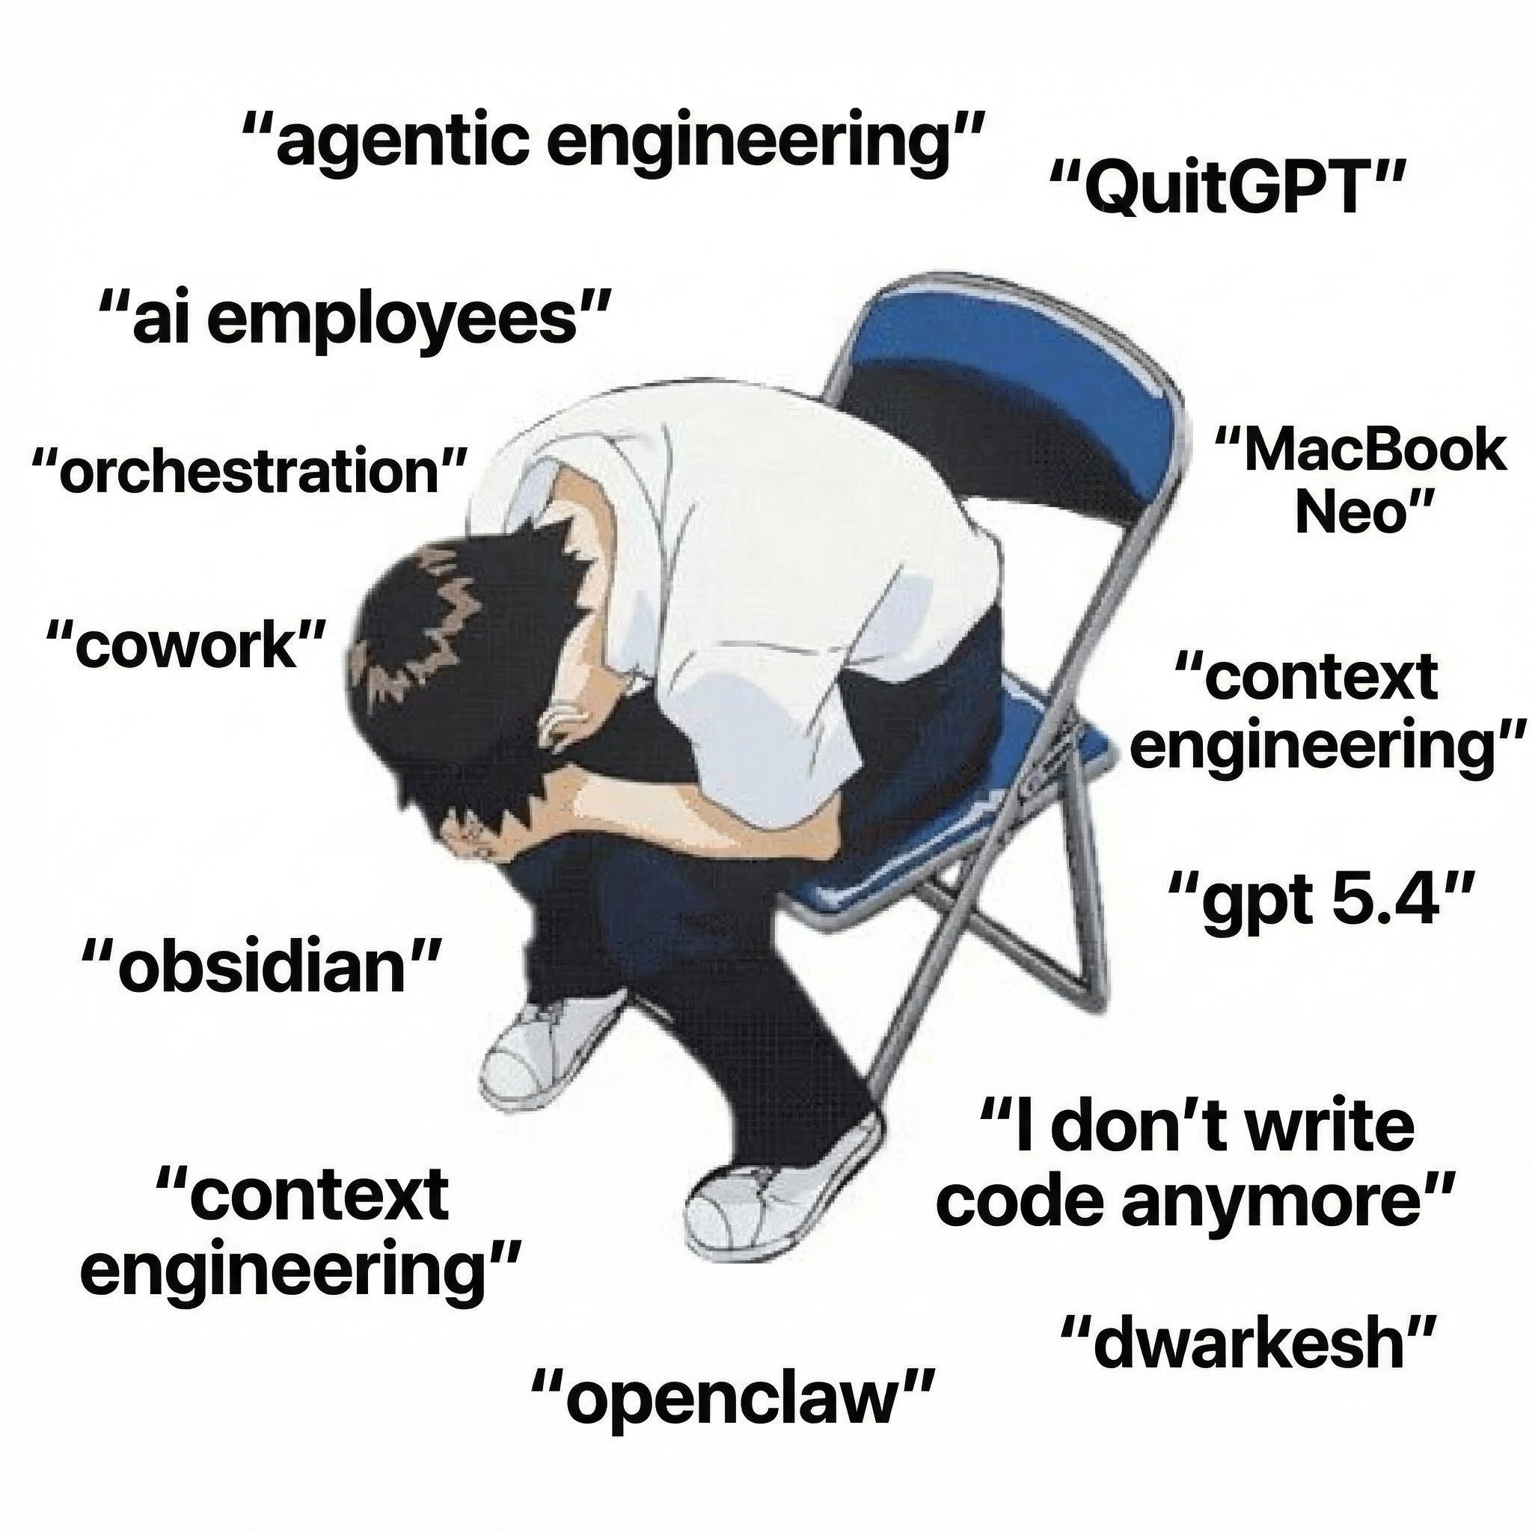

The AI crisis in theoretic research
scientific publications
scale
human verification bandwidth
2024
time
2

Slide 5
The AI crisis in theoretic research
(AI) read ≠ checked ≠ reusable
scientific publications
scale
Human researcher will be drowned in infinite ”recent progress” papers.
Open problem solved, AGI, and anxiety of our career.
Later work still needs the exact imported claim and verification.
human verification bandwidth
2024
time
2

Slide 6
Before asking whether we can trust what it writes,
look at what it is doing when it writes.
3
Notes:
ONE SENTENCE, THEN TURN THE PAGE. Do not elaborate - the next four frames are the elaboration.
The curve you just saw is about volume. This is the turn from volume to mechanism: the reason a generated result is hard to reuse is not that it is sloppy, it is that of what the machine did to produce it, nothing survives except the text.
Say the second line - it is a description, not a criticism - and move on. It buys you the room's patience for four frames of mechanism.

Slide 7
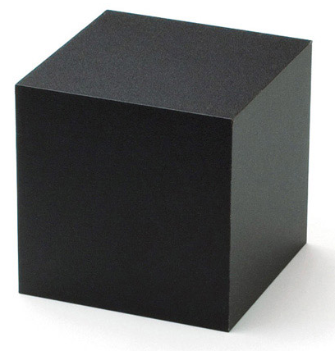
What is inside the black box of LLM reasoning
f : String -> String
4
Zhang Y, Khan S A, Mahmud A, et al. npj Artificial Intelligence, 2025, 1(1): 14.
Notes:
From tobias talk
why did two calls answer differently
输入文本 String
↓ 分词（tokenization）
输入 token 序列
↓ 模型计算
下一个 token 的概率分布
↓ 按解码规则选择
一个新 token
↓ 追加到已有序列，重复上述过程
输出 token 序列
↓ 转回文本（detokenization）
输出文本 String

Slide 8
What is inside the black box of LLM reasoning
f : String -> String
f : String -> token -> prob. distribution -> (next) token -> String
5
Notes:
From tobias talk
why did two calls answer differently
输入文本 String
↓ 分词（tokenization）
输入 token 序列
↓ 模型计算
下一个 token 的概率分布
↓ 按解码规则选择
一个新 token
↓ 追加到已有序列，重复上述过程
输出 token 序列
↓ 转回文本（detokenization）
输出文本 String

Slide 9
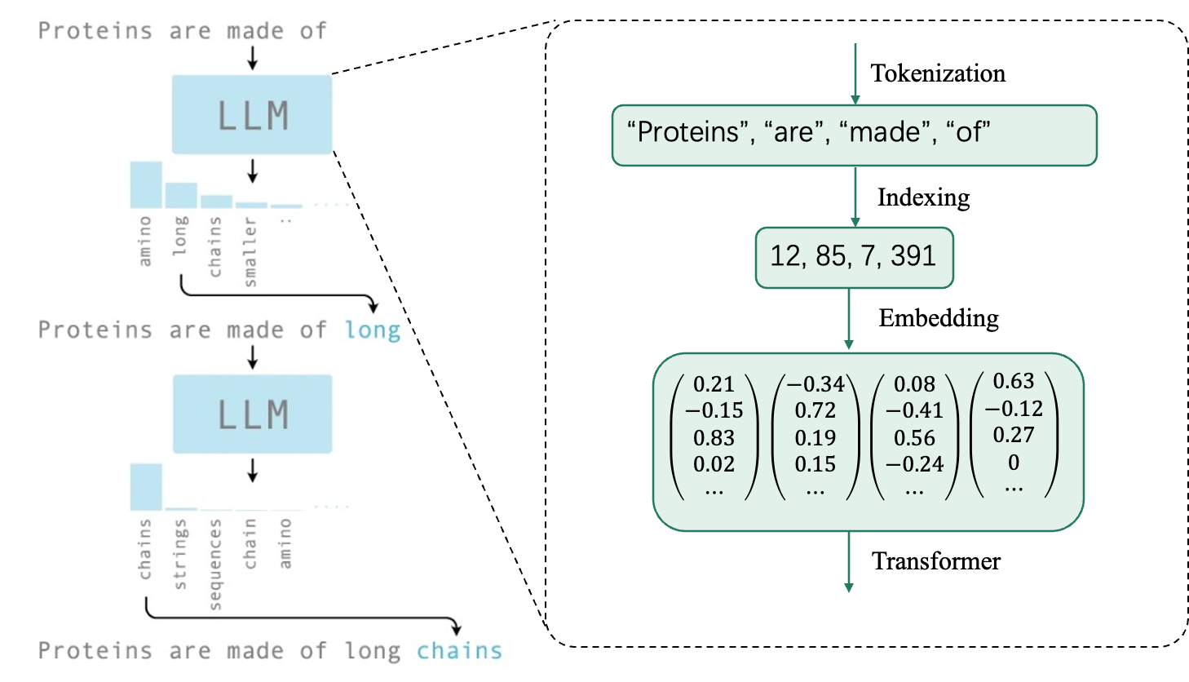
What is inside the black box of LLM reasoning
f : String -> String
f : String -> token -> prob. distribution -> (next) token -> String
LLM outputs a conditioned probabilistic distribution $P(next token|context)$, then samples.
6
Zhang Y, Khan S A, Mahmud A, et al. npj Artificial Intelligence, 2025, 1(1): 14.
Notes:
From tobias talk
why did two calls answer differently
输入文本 String
↓ 分词（tokenization）
输入 token 序列
↓ 模型计算
下一个 token 的概率分布
↓ 按解码规则选择
一个新 token
↓ 追加到已有序列，重复上述过程
输出 token 序列
↓ 转回文本（detokenization）
输出文本 String

Slide 10
Model Memory
Normally, the conversation with LLM is a forward pass and does not update any model weights
Model Momery: saves previous prompts and answers re-sends the history every time
Turn 1
[User: I am a physicist.]
→ LLM → [Response: Understood.]
Turn 2
[User: I am a physicist.]
[Response: Understood.]
[User: Explain entropy at my level.]
→ LLM → [Response: ...]
system prompt
conversation history
new prompt
context window
(token capacity)
7
Tobias Osborne’s talk 2026 at UCL: https://www.youtube.com/@tobiasjosborne
Notes:
From tobias talk
输入文本 String
↓ 分词（tokenization）
输入 token 序列
↓ 模型计算
下一个 token 的概率分布
↓ 按解码规则选择
一个新 token
↓ 追加到已有序列，重复上述过程
输出 token 序列
↓ 转回文本（detokenization）
输出文本 String

Slide 11
Model Memory
Normally, the conversation with LLM is a forward pass and does not update any model weights
Model Momery: saves previous prompts and answers re-sends the history every time
Turn 1
[User: I am a physicist.]
→ LLM → [Response: Understood.]
Turn 2
[User: I am a physicist.]
[Response: Understood.]
[User: Explain entropy at my level.]
→ LLM → [Response: ...]
system prompt
conversation history
new prompt
context window
(token capacity)
When the context window is exceeded, the compression/truncation/selection must be applied
8
Tobias Osborne’s talk 2026 at UCL: https://www.youtube.com/@tobiasjosborne
Notes:
From tobias talk
输入文本 String
↓ 分词（tokenization）
输入 token 序列
↓ 模型计算
下一个 token 的概率分布
↓ 按解码规则选择
一个新 token
↓ 追加到已有序列，重复上述过程
输出 token 序列
↓ 转回文本（detokenization）
输出文本 String

Slide 12
How far have you been using LLM?
Chat window/Codex/Claude code
3
Notes:
ONE SENTENCE, THEN TURN THE PAGE. Do not elaborate - the next four frames are the elaboration.
The curve you just saw is about volume. This is the turn from volume to mechanism: the reason a generated result is hard to reuse is not that it is sloppy, it is that of what the machine did to produce it, nothing survives except the text.
Say the second line - it is a description, not a criticism - and move on. It buys you the room's patience for four frames of mechanism.

Slide 13
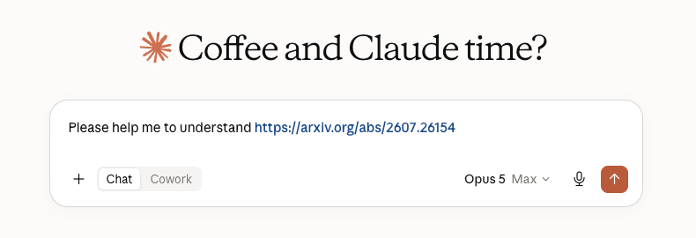
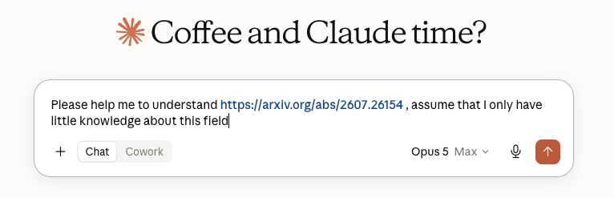
“Please help me …”
Learn backwards
19
Notes:
I don’t mean to debate the morality and drama behind it, I just want it to point out that as theorist, we usually have two typical working mode while interacting with AI: one is to learn from the paper/book/thesis, another one is to try to discover if there is some niche to generate new theorem/or disprove the conjectures, etc. And the modes can be entangled, sometimes we first learn the field then move forward, or we moved forward first then go back to check some previous research.

Slide 14
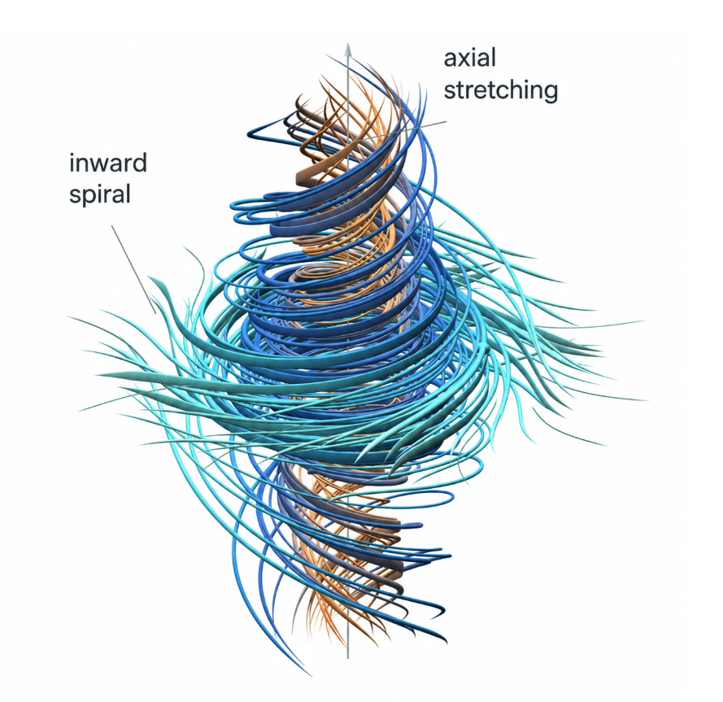
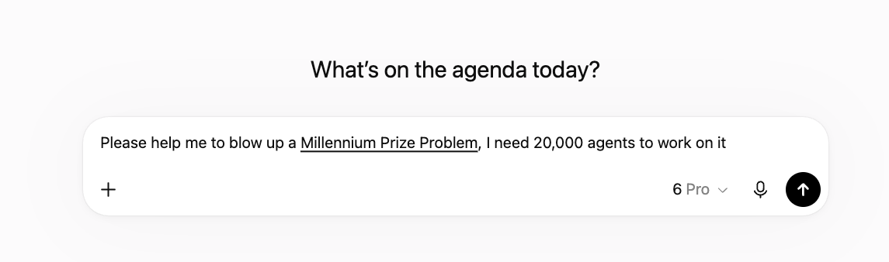
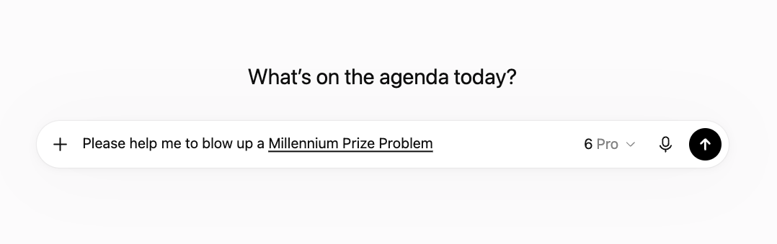
“Please help me …”
Learn backwards
Reasoning forwards
20
Notes:
I don’t mean to debate the morality and drama behind it, I just want it to point out that as theorist, we usually have two typical working mode while interacting with AI: one is to learn from the paper/book/thesis, another one is to try to discover if there is some niche to generate new theorem/or disprove the conjectures, etc. And the modes can be entangled, sometimes we first learn the field then move forward, or we moved forward first then go back to check some previous research.

Slide 15
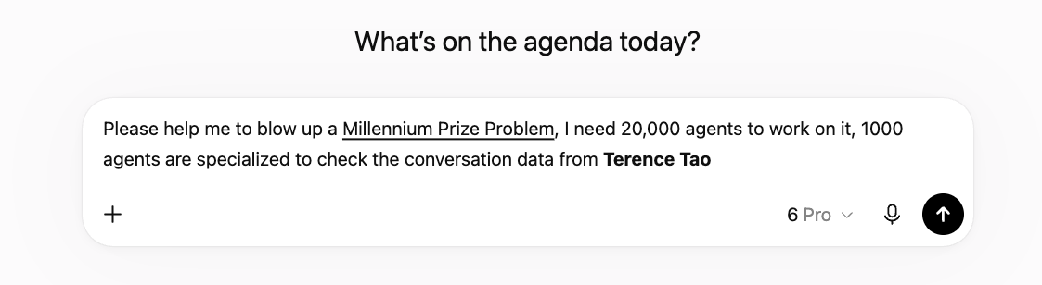
“Please help me …”
Learn backwards
Reasoning forwards
21
Or, sometimes together …
Notes:
I don’t mean to debate the morality and drama behind it, I just want it to point out that as theorist, we usually have two typical working mode while interacting with AI: one is to learn from the paper/book/thesis, another one is to try to discover if there is some niche to generate new theorem/or disprove the conjectures, etc. And the modes can be entangled, sometimes we first learn the field then move forward, or we moved forward first then go back to check some previous research.

Slide 16
How far have you been using LLM?
API/Agent/MCP/schema/skills/harness …
3
Notes:
ONE SENTENCE, THEN TURN THE PAGE. Do not elaborate - the next four frames are the elaboration.
The curve you just saw is about volume. This is the turn from volume to mechanism: the reason a generated result is hard to reuse is not that it is sloppy, it is that of what the machine did to produce it, nothing survives except the text.
Say the second line - it is a description, not a criticism - and move on. It buys you the room's patience for four frames of mechanism.

Slide 17



API/Agent/MCP/schema/skills … prompt sorcery from LLM era
Numpy API
LLM API
import numpy as np
result = np.mean([1, 2, 3])
Prompt
Client
API
Response
9
Notes:
How many of you know what is API? Then how many of you know/ have tried to set up an agent in codex/claude …
with the help of python package API, we could easily use this np.mean function, this is because API is written in a way to illustrate how to use it.
SO the actual definition of agent is a bit ambigious, like how much level of

Slide 18
API/Agent/MCP/schema/skills
1 / 9
LLM
text → a distribution over next tokens
Agent is a system with a LLM as its core to execute high-level tasks: LLM decides next step
10
Notes:
Text in, a distribution over next tokens out. Stateless: nothing carries between calls, and the weights never change.

Slide 19
API/Agent/MCP/schema/skills
2 / 9
AGENT · the loop
LLM
The agent calls the model repeatedly, decides what to do next, and stops when it judges the work done.
11
Notes:
The agent calls the model repeatedly, decides what to do next, and stops when it judges the work done. The model is the engine; the loop is the agent.

Slide 20
A skill is a stuctural prompt document
4 / 9
SKILL · a written procedure
loaded into context — advice
AGENT · the loop
TASK
LLM
A protocol loaded into the context when the task matches it — drawn dashed, because it is advice. The model can read it and not follow it, and nothing records that it did.
12
Notes:
A protocol loaded into the context when the task matches it — drawn dashed, because it is advice. The model can read it and not follow it, and nothing records that it did.

Slide 21
MCP: Model Context Protocol
5 / 9
SKILL · a written procedure
loaded into context — advice
AGENT · the loop
TASK
LLM
tool call
MCP
A published convention for exposing a tool so that any model can call it.
It standardises the plug.
13
Notes:
A published convention for exposing a tool so that any model can call it. It standardises the plug; it says nothing about what comes through it.

Slide 22
Agent uses tools and the loop
6 / 9
SKILL · a written procedure
loaded into context — advice
AGENT · the loop
TASK
LLM
tool call
result returns
MCP
TOOLS
the socket
a compiler · a database · a filesystem
A compiler, a database, a filesystem. The result returns to the loop, which calls the model again.
14
Notes:
A compiler, a database, a filesystem. The result returns to the loop, which calls the model again — this return arrow is the whole reason it is called an agent.

Slide 23
Schema: a machine-checked contract
7 / 9
SKILL · a written procedure
loaded into context — advice
AGENT · the loop
TASK
SCHEMA
LLM
output
tool call
a machine-checked contract
result returns
MCP
TOOLS
the socket
a compiler · a database · a filesystem
A machine-checked contract: A valid record must output correct types with respect to contract
15
Notes:
A machine-checked contract: which fields a valid record must have, which types, and — crucially — that no field nobody agreed to may be added.

Slide 24
Schema: a machine-checked contract
8 / 9
SKILL · a written procedure
loaded into context — advice
AGENT · the loop
conforms → recorded
TASK
SCHEMA
LLM
output
does not → REFUSED
tool call
a machine-checked contract
result returns
MCP
TOOLS
the socket
a compiler · a database · a filesystem
A record that does not conform is not repaired or accepted with a warning, but it is refused.
16
Notes:
This is the only arrow on the diagram that rejects. A record that does not conform is not repaired or accepted with a warning; it is refused.

Slide 25
Schema: a machine-checked contract
9 / 9
SKILL · a written procedure
loaded into context — advice
AGENT · the loop
conforms → recorded
TASK
SCHEMA
LLM
output
does not → REFUSED
tool call
a machine-checked contract
result returns
MCP
TOOLS
the socket
a compiler · a database · a filesystem
The prompt, the skill and the tool call are all requests — they can be ignored, and the transcript looks the same either way. The schema include constraints and boundaries of ouputs of LLM.
17
Notes:
The prompt, the skill and the tool call are all requests — they can be ignored, and the transcript looks the same either way. Only the schema can make an answer impossible to express.

Slide 26
A request can be ignored. A constraint cannot.
REQUESTS
CONSTRAINT
the prompt
the schema
the skill
the tool call
REFUSED
can be ignored — and the transcript
a record that does not conform is not
looks exactly the same either way
repaired, and not accepted with a warning
A paper’s claims are requests too.
The rest of this talk is an attempt to make them refusable:
one paper, broken into claims that each carry what they rest on.
18
Notes:
THE HINGE OF THE TALK. Do not rush this frame.
The previous slide said it in the source deck's own words: the prompt, the skill and the tool call are all requests. The model can read them and not follow them, and the transcript looks identical either way. Only the schema can make an answer impossible to express.
Now spend that sentence. A paper's claims are requests too. 'By Theorem 3 of reference 14' is a request that the reader go and check something, and almost nobody does, and the paper looks the same either way.
So the question for the rest of the talk is: what would it take to make a paper's claims refusable? That is the only thing being attempted here.

Slide 27
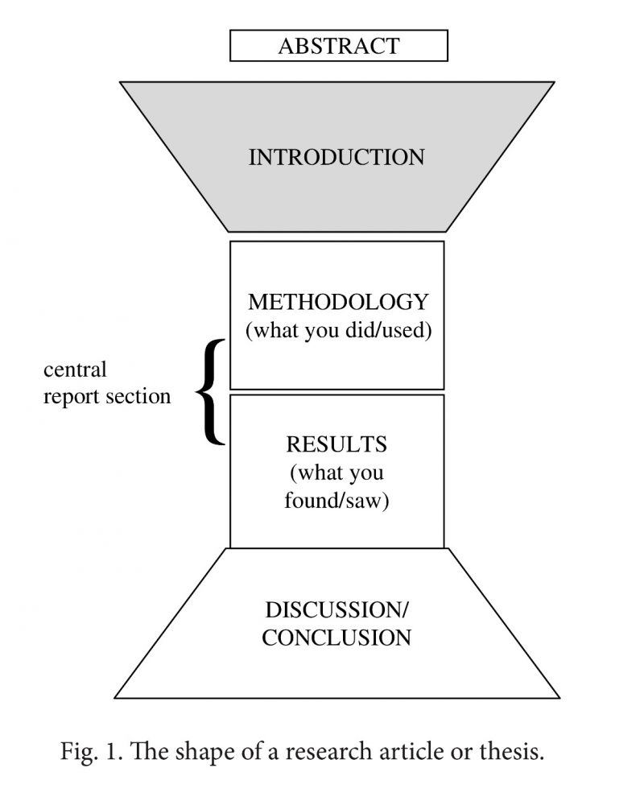
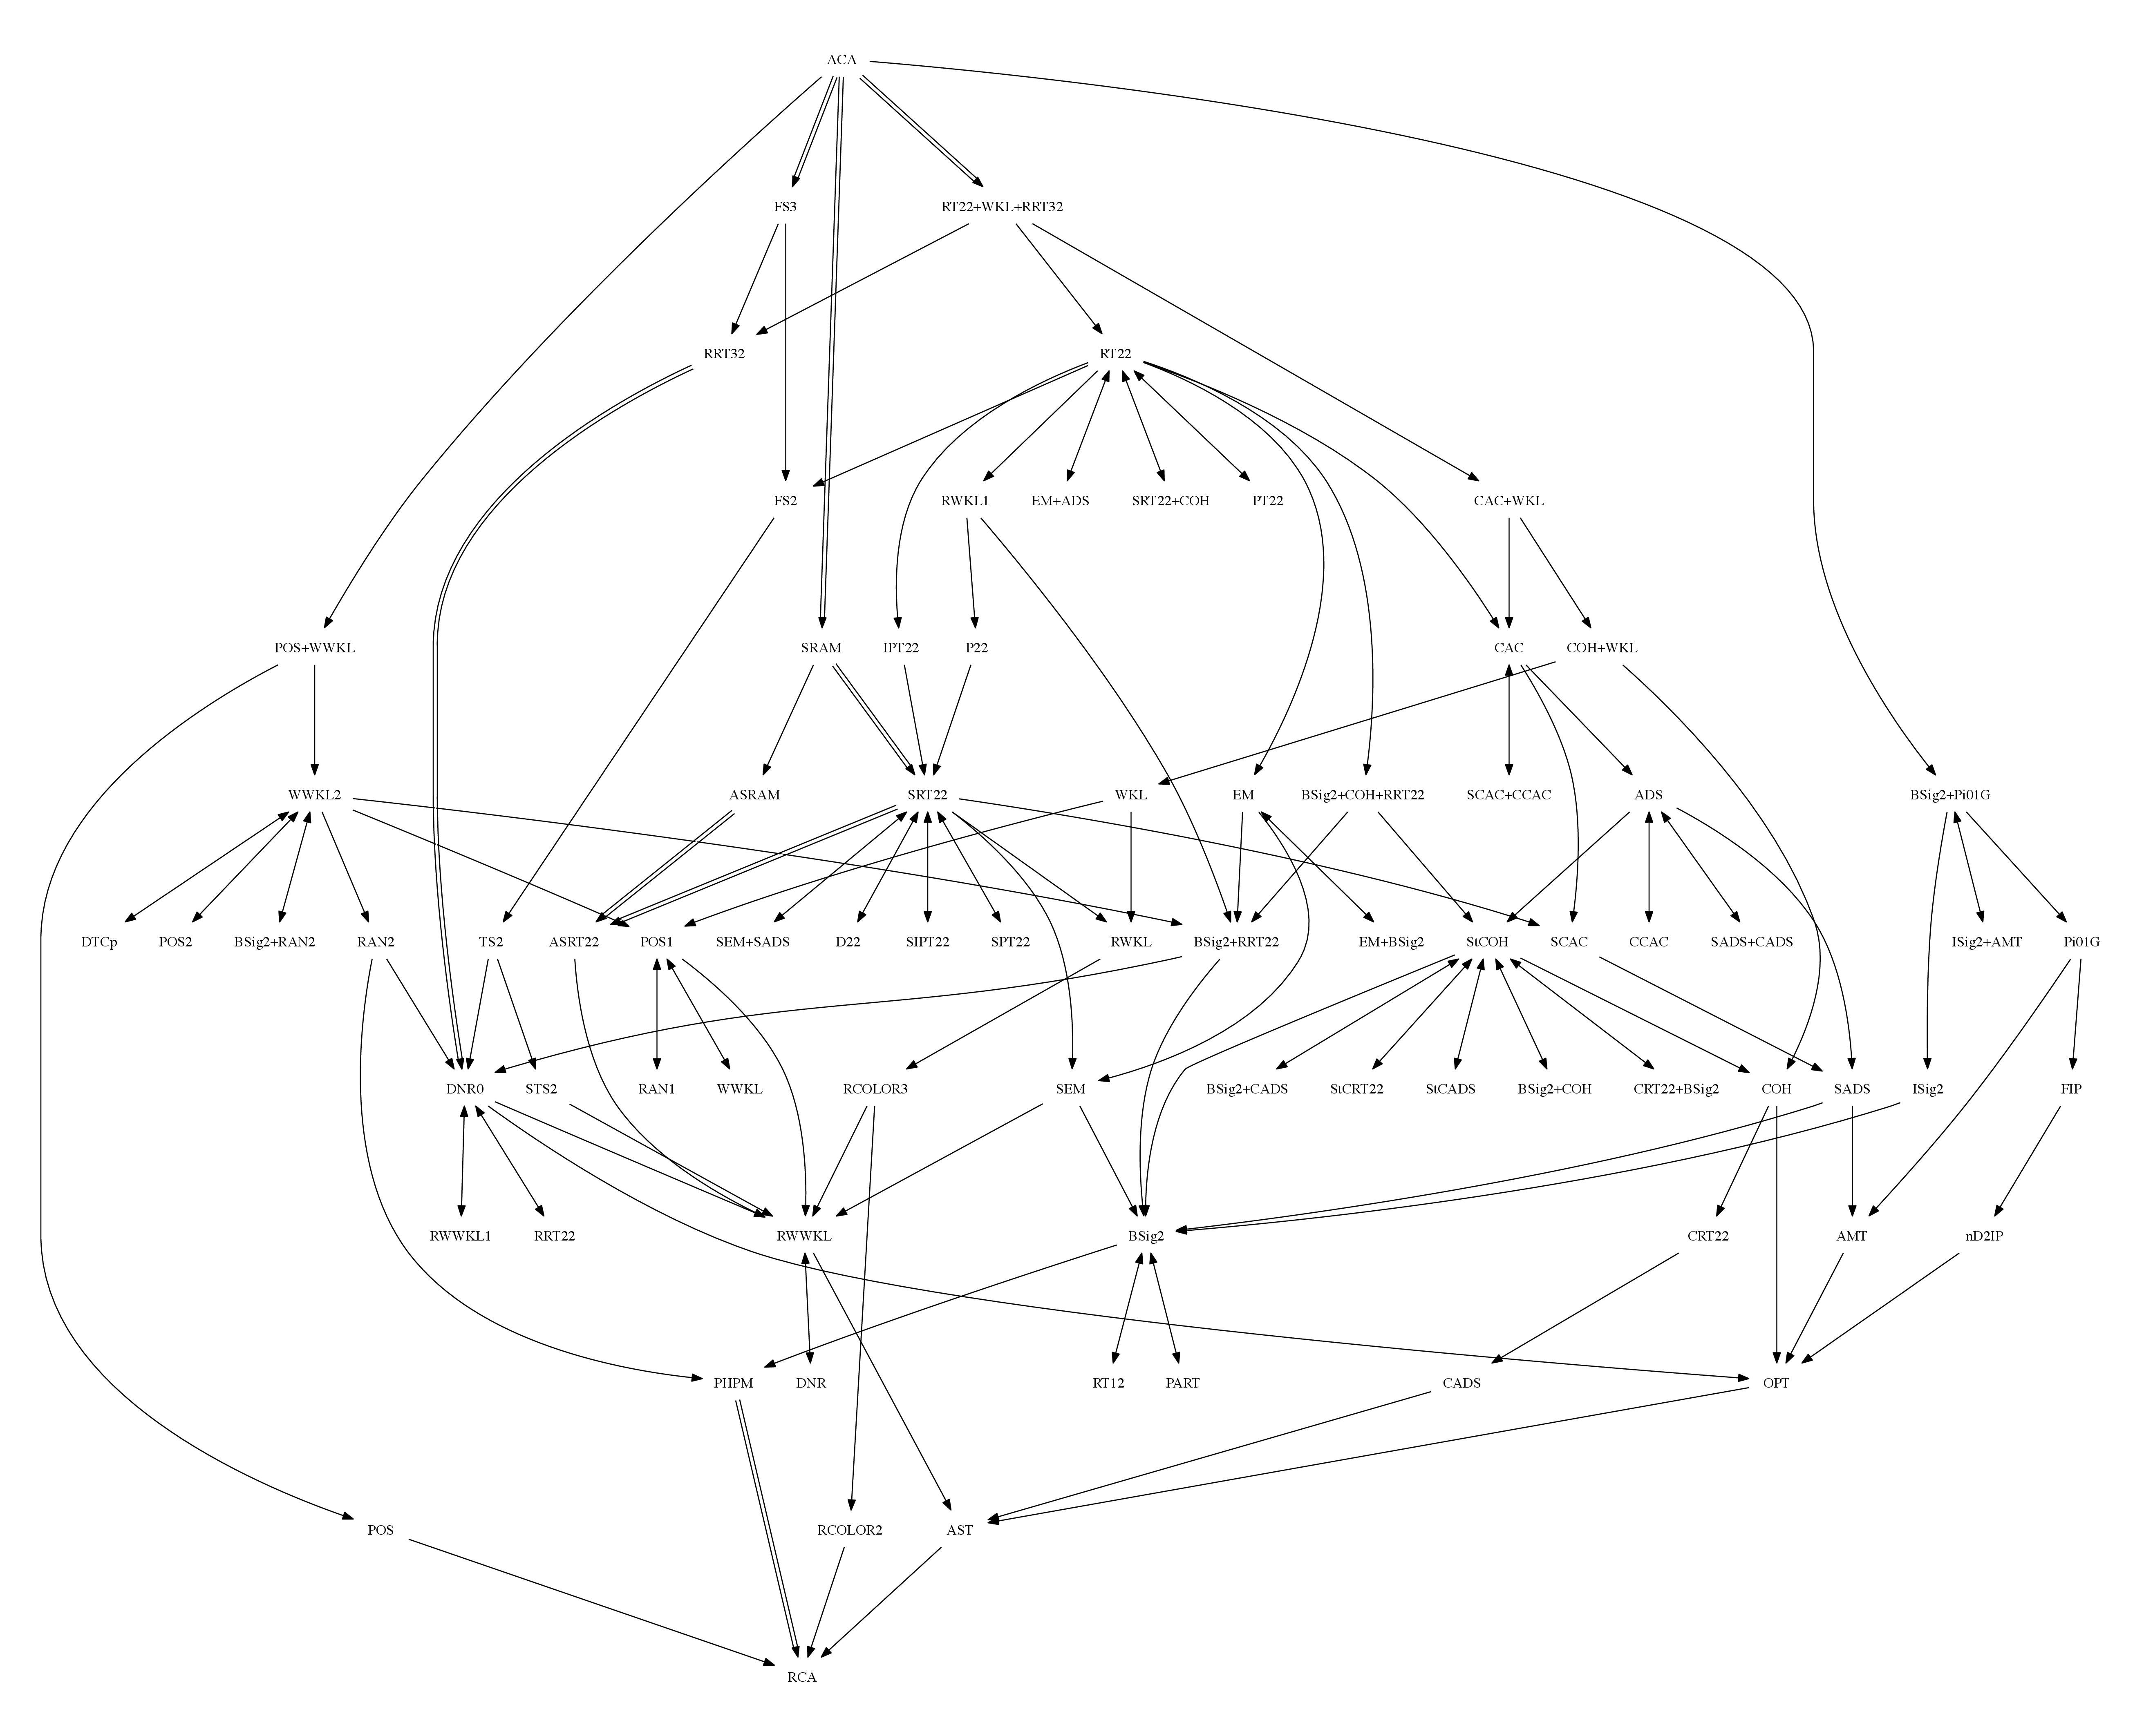


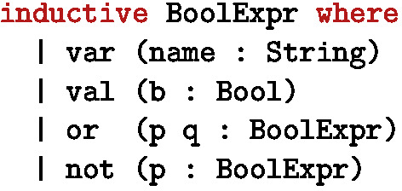


What we actually care, and … what we can trust? (as theorists)
The story
What did the paper actually state?
Mathematical correctness
Does the conclusion follow from encoded assumptions?
Computational reproducibility
Can the numerical result be reproduced?
Physical-semantic alignment
Does the formal object represent the intended physics?
?
The reverse mathematics zoo,
founded by Damir Dzhafarov , 2019
The Lean 4 Theorem Prover and Programming Language
by Moura L, Ullrich S. 2021
Paper formatting, SUNY
22

Slide 28
The story
Mathematical correctness
What did the paper actually state?
Does the conclusion follow from encoded assumptions?
Computational reproducibility
Physical-semantic alignment
Can the numerical result be reproduced?
Does the formal object represent the intended physics?
one paper · one theorem · and what it actually rests on
not whether the formalisation means the physics you had in mind — no kernel judges that
and not reproducibility — there is no numerical claim in the case study
23
Notes:
THE BRIDGE, and it is worth saying the scope out loud before the room starts wondering.
Of the four boxes on the trust slide four frames back, everything after this one is about MATHEMATICAL CORRECTNESS - does the conclusion follow from the stated assumptions - plus a little of THE STORY, because you cannot check a conclusion until you have pinned down what was actually claimed.
It is NOT about physical-semantic alignment. Whether a Lean definition of the reduced stabilizer polytope means the physics you had in mind is a judgement no kernel makes, and this project does not pretend otherwise - the records carry alignment_notes precisely because that gap cannot be closed mechanically.
It is NOT about computational reproducibility either; there is no numerical claim in the case study.
Two practical notes. The slides up to here are the opening deck reproduced as it is, in its own colours; from here the deck is monochrome, and colour means exactly two things - warm for NOT FROM THIS PAPER and teal for A JUNCTION. And the opening curve was a claim about the field that neither I nor anyone else has measured. What comes next is the same argument measured on my own logs, which I can.

Slide 29
For later work to use a conclusion, it has to know three things
what it said
what it relied on
what was checked
the exact statement, not the abstract
every claim underneath it, named
and by what — a kernel, or nobody
one paper, frozen
claims + dependencies
one theorem’s chain
where it stops
the source, byte for byte
what points at what
29 claims, 46 links
and it does stop
One real paper, one real run. Every number after this frame is read out of the logs, not estimated.
Where nobody measured it, the frame says so.
24
Notes:
THE ROADMAP, and the only one in the deck - say it once, clearly, and then do not repeat it.
Three things a later paper needs before it can use your conclusion: what you actually said, what you relied on, and which parts anybody checked. A PDF gives you the first, sometimes. It does not give you the other two in any form a machine - or a hurried human - can follow.
Then the route across the bottom. One paper, frozen. Its claims and the dependencies between them. One theorem's chain pulled out of that graph. And then, honestly, where the whole thing stops - because it does stop, and the last act of this talk is about exactly where.
The promise on the last line matters more than it looks: every number from here on is read out of this repository's own logs. Where nobody has measured something, the frame says nobody measured it.

Slide 30
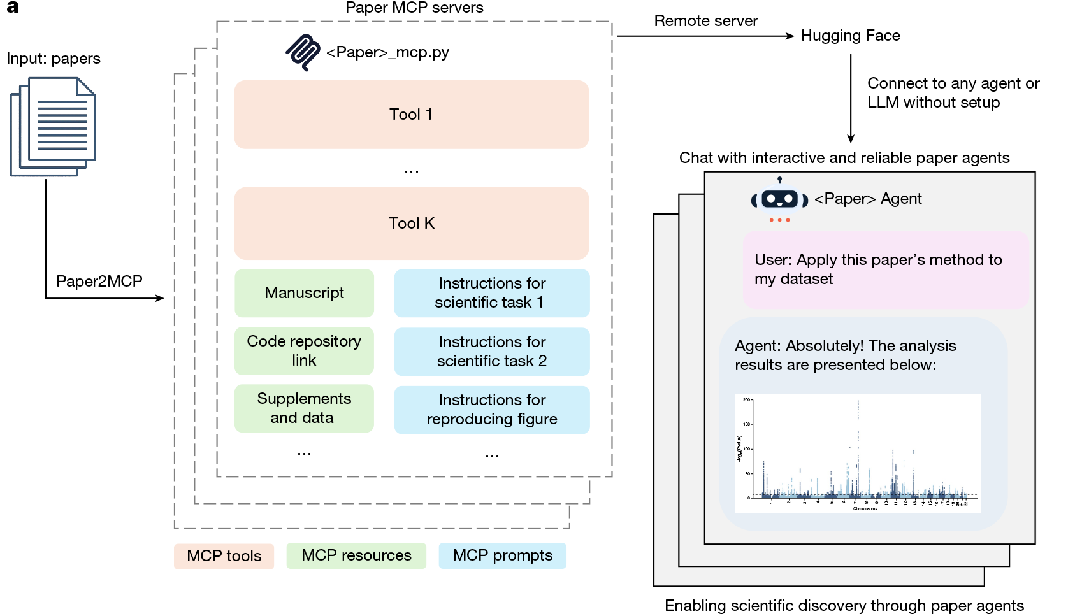
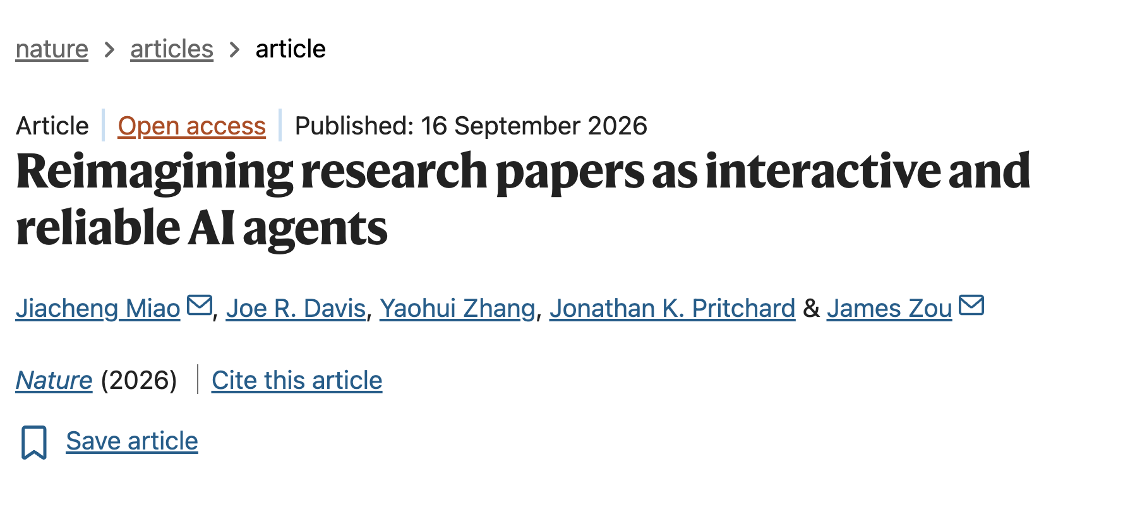
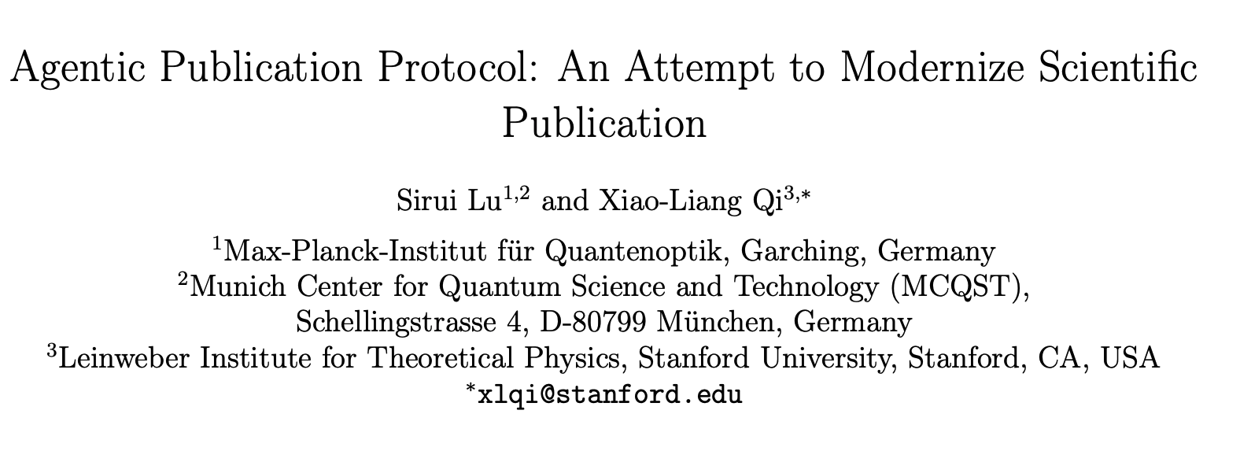
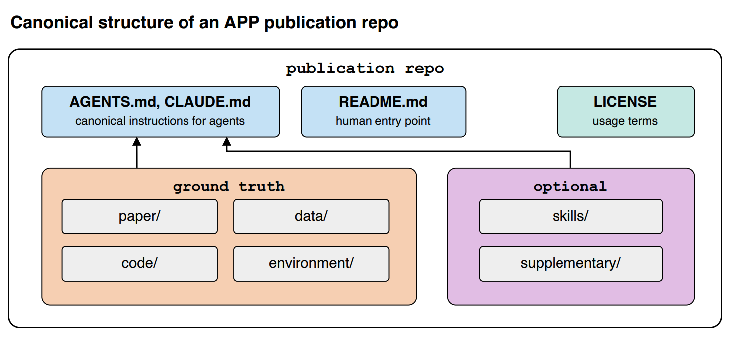
Imaging paper as an agent
25
A paper no need to be static, but an agent
Notes:
This is why I am here and give this talk, I would like to explain more about this idea, but the details takes a long story…. Here is an example of the work

Slide 31

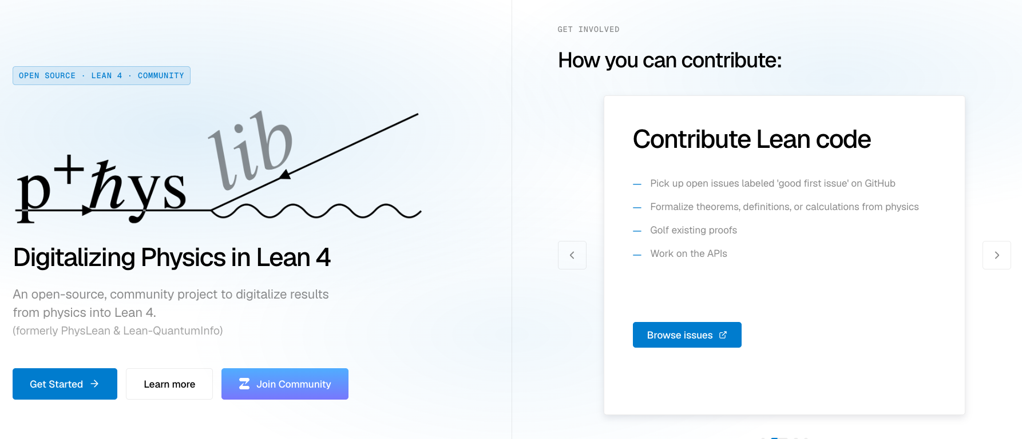
How formalization works
Mathlib — the mathematics
physlib — the physics
groups, measure, linear algebra, polytopes
an open-source community project, still being built
26

Slide 32
Lean 4 — how to read it
Six lines. On the left is what you type; on the right is what each line says.
def double (n : Nat) : Nat :=
DEFINE a thing called double. Give it a whole number n …
2 * n
… and what comes back is 2 times n. Nothing is claimed yet.
theorem double_eq_add (n : Nat) :
CLAIM, and give the claim a name. For every whole number n …
double n = n + n := by
… double n is the same as n + n. "by" means: proof follows.
unfold double
step 1 — replace double by what it stands for: 2 * n = n + n.
omega
step 2 — omega settles arithmetic statements like that one.
Nothing here is prose. That line IS the theorem — not a description of one.
Which is the whole trade: you give up the words, and in exchange the claim becomes something
a machine can check, and refuse.
27
Notes:
THE ONLY CODE IN THE TALK. Give it a full minute and read it out loud, left column then right column, line by line. Most of the room has never seen this.
Line one: def. I am DEFINING a thing. 'double' is its name, '(n : Nat)' means it takes a whole number which I will call n, and the ': Nat' after it means it hands back a whole number too. Line two says what it hands back: two times n. Stop and make one point - a definition cannot be wrong. It is not claiming anything. It is just naming a construction.
Line three is where it gets interesting: theorem. Now I am CLAIMING something, and I give the claim a name so other work can refer to it. Line four is the claim itself: double n equals n + n, for every n. The word 'by' at the end means: what follows is the proof.
Lines five and six are the proof, and they are a program, not an argument. 'unfold double' replaces the name by what it stands for, so the goal becomes 2 * n = n + n. 'omega' is a decision procedure for this kind of arithmetic; it either closes the goal or it does not.
Then the bottom line, which is the point of the frame: that fourth line is not a description of a theorem. It IS the theorem. You gave up the prose and got back something checkable.

Slide 33
It compiles, or it does not. There is no third answer.
accepted
rejected
each step re-checked by a kernel of a few thousand lines
and it names the step it would not take —
that does not know who wrote it, or how tired it is
which is a research to-do list, not a failure
There is exactly one way to cheat, and it is a keyword:
sorry
— accept this claim without a proof. It compiles. It is also recorded, forever, in the file.
Anybody can write it, and it compiles. The difference from prose is that it is written down
— it sits in the file, and anybody who looks can find every one of them.
28
Notes:
THE POINT OF THE WHOLE APPROACH IS ON THIS FRAME.
A referee can be tired, generous, or in a hurry. A kernel is none of those. It re-checks every step, and it does not know whose proof it is.
The right-hand box matters more than it looks. When Lean refuses, it tells you WHICH step it would not take. A 'no' with a specific unmet obligation is a to-do list. A 'no' without one is just a failure. That distinction is why this is worth doing at all.
Then be honest about the escape hatch. 'sorry' means: accept this without proof. It compiles. Anybody can write it. The difference from prose is that it is WRITTEN DOWN - you cannot wave at it, it sits in the file and anybody grepping finds it.
The four numbers are this repository, counted this morning: sixty-six files, and not one sorry, admit, or new axiom. Say 'counted this morning' - it is the kind of claim you should be able to date.

Slide 34
Nobody proves anything from nothing
Every proof stands on definitions somebody else already wrote and checked.
9,146
Mathlib
.lean files
the mathematics. Groups, measure, linear algebra, polytopes. Begun 2017.
927
physlib
.lean files
the physics. An open-source community project to digitalize results from physics into Lean 4. Begun 2024.
Ten times the size, and seven years of a head start.
So the question for any paper is not "can Lean express this" — it is how much of what the paper
stands on already exists, and how much somebody has to build first.
For a physics paper today, the honest answer is: a great deal has to be built first.
29
Notes:
THE FRAME FOR THIS AUDIENCE. Slow down; this is what a physicist should leave the room remembering.
Mathlib is the mathematics - nine thousand files of it, other people's work, and it is the reason formalizing a piece of mathematics is affordable at all. You are not proving anything from nothing; you are standing on a decade of somebody else's checked definitions.
physlib is the physics equivalent, and you saw its front page a few frames ago. Nine hundred files against nine thousand. It exists, it is a real community project, and it is an order of magnitude earlier in its life - the mathematics library lineage starts in 2017, physlib in 2024. Both counts are every .lean file on each project's own main branch, taken this morning; if somebody challenges a number, that is the definition to give them.
Then the honest question, which is the one that decides whether any of this is practical for us. It is not 'can Lean express my physics' - the answer to that is almost always yes, eventually. It is: how much of what my paper stands on is already in a library, and how much does somebody have to build first? For a physics paper today, a great deal has to be built first, and that is where the time goes.
If somebody asks how much: say you have not measured it, because you have not.

Slide 35
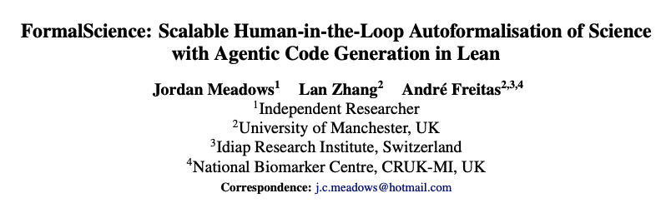
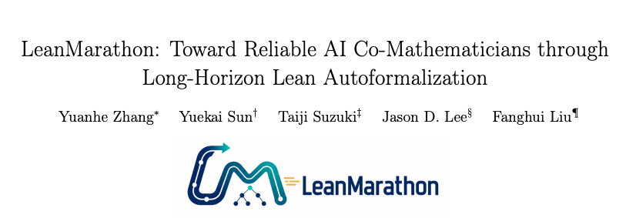
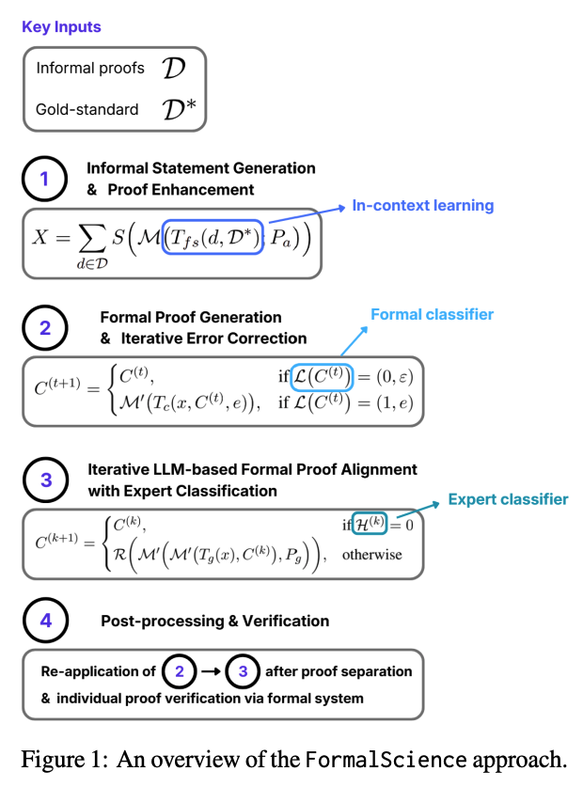
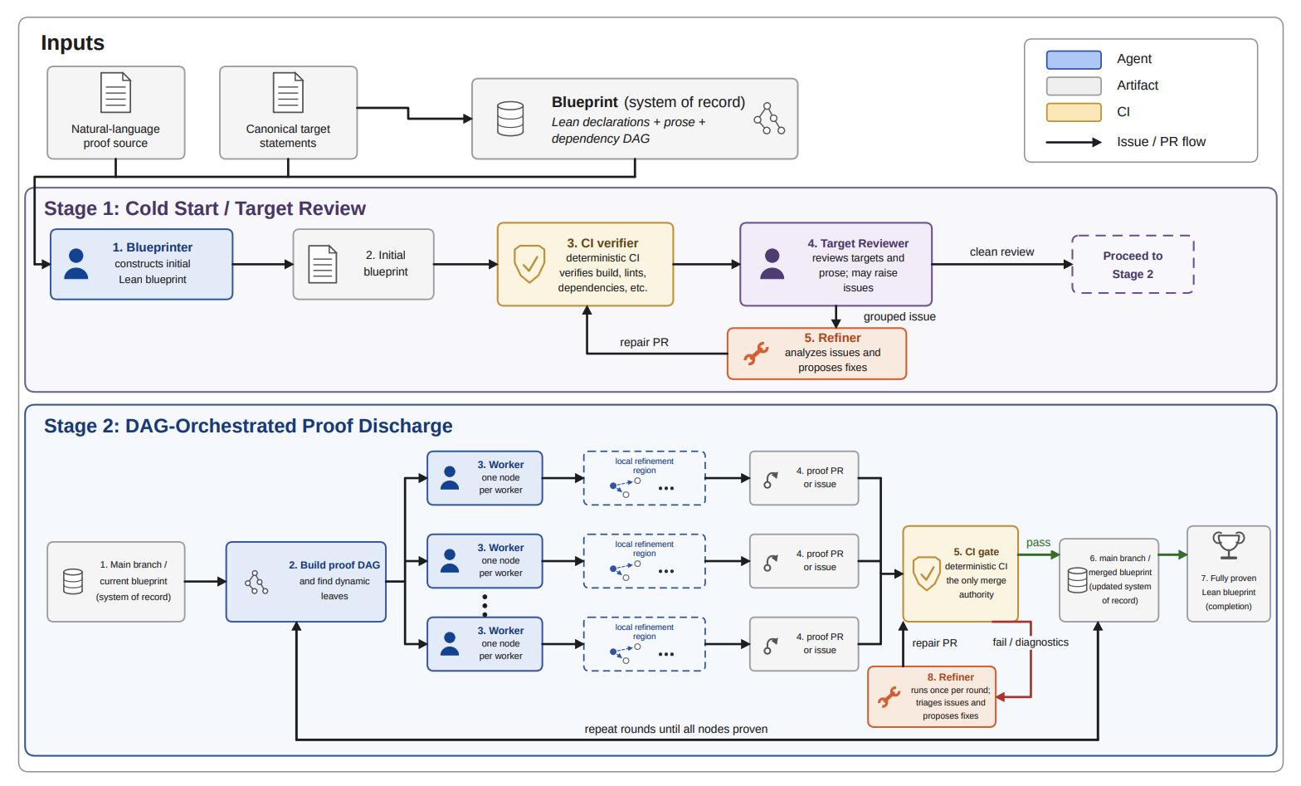
Autoformalization
30

Slide 36
a paper
frozen.
every byte fixed,
so pointers hold.
31
Notes:
THE WHOLE PIPELINE IN FIVE BOXES. Deliberately no product name, no version number and no field names on the slide - none of that has been introduced yet, and the five boxes are the part that generalises beyond this project.
Box one: a paper, frozen. Every downstream pointer is a byte offset into these exact bytes, so nothing can drift underneath the record while the work is going on. This is the cheapest and least glamorous idea in the system and it is the one that makes everything else auditable.

Slide 37
a paper
extract
the claims
frozen.
what it says
every byte fixed,
where it came from
so pointers hold.
a fingerprint
32
Notes:
Box two: every statement in the paper becomes one record, and the record carries three things - what it says, where in the source it came from, and a fingerprint of its content.
"Where it came from" is a byte range, not a page number. "A fingerprint" is a hash, so re-wording the statement produces a different record rather than silently editing the old one. The next slide shows one of these records in full.

Slide 38
a paper
extract
dependency
the claims
graph
frozen.
what it says
every byte fixed,
where it came from
so pointers hold.
a fingerprint
33
Notes:
Box three: the records point at each other. This premise discharges that conclusion. Do that for every record and you no longer have a list, you have a network - and that network is the object the rest of the talk is about.
The little sketch is a cartoon. Two slides from now you see the real one.

Slide 39
outside
dependency
nobody has fetched it
a paper
extract
dependency
the claims
graph
frozen.
what it says
every byte fixed,
where it came from
so pointers hold.
a fingerprint
34
Notes:
Box four, drawn dashed and in the one warm colour this deck uses: some records point OUTSIDE the paper, at work it leans on that nobody has fetched.
Warm means exactly one thing in every frame of this deck - NOT FROM THIS PAPER. Keep it that way; the moment warm also means "bad" or "pending", the audience stops being able to read the colour.
This box is where most of the honest difficulty lives. A paper's citations are promises, and until somebody resolves one it is a promise the machine cannot check.

Slide 40
outside
dependency
nobody has fetched it
a paper
extract
dependency
core claims
the claims
graph
+ dependencies
frozen.
what it says
every byte fixed,
where it came from
so pointers hold.
a fingerprint
35
Notes:
Box five: choose one result and keep only what it rests on. Everything else in the network goes faint - not deleted, just not part of this question.
This is the single most useful operation in the system, and it is also the answer to "why are there so many claims?" There are that many because nobody asked a question yet. Ask one, and the graph collapses to the part that answers it.

Slide 41
outside
dependency
nobody has fetched it
a paper
extract
dependency
core claims
auto-
the claims
graph
+ dependencies
formalization
frozen.
what it says
a kernel does not
every byte fixed,
where it came from
negotiate, and it
so pointers hold.
a fingerprint
does not tire.
36
Notes:
Box six: every step that survives goes to a checker that cannot be argued with - a proof kernel. It does not negotiate, it does not get tired on the fortieth lemma, and it does not care who wrote the step.
That is the entire reason for the machinery in front of it. The pipeline exists to get statements into a shape where a thing that cannot be persuaded can look at them.

Slide 42
outside
dependency
nobody has fetched it
a paper
extract
dependency
core claims
auto-
the claims
graph
+ dependencies
formalization
frozen.
what it says
a kernel does not
every byte fixed,
where it came from
negotiate, and it
so pointers hold.
a fingerprint
does not tire.
it holds
it does not
every step
and it names
was accepted
what is missing
what is missing goes back in
37
Notes:
And the output has two exits, which is the point of the whole design.
It holds - every step was accepted. Or it does NOT hold, and the system names what is missing. The second exit is the valuable one: a "no" that comes with a specific unmet obligation is a research to-do list, where a "no" without one is just a failure.
What it never does is the third thing, which is to return something that looks like a proof because the prose around it was fluent.

Slide 43
math-claim-ir · the theorem this chain ends at
claim.id
closed-form-equality
statement_kind
theorem
source.occurrence_work
arxiv:2607.26154v1
as the paper states it
RoM_M(rho) = max( 1, max_Q sum_{P in Q} |tr(P rho)| )
structured_statement — what that one sentence actually contains
assumptions.explicit
M has no active dependencies
G_M is perfect
assumptions.source_implicit
m >= 1 found in the PROOF, not the statement
quantifiers
4 — 3 SOURCE_IMPLICIT (n, m, M), 1 SOURCE_EXPLICIT (rho)
local_binders
Q over Cliques(G_M)
conventions
The empty clique is allowed and contributes 0.
conclusion
RoM_M(rho) = max{ 1, max_{Q in Cliques(G_M)} sum_{P in Q} |tr(P rho)| }
normalization.relation_to_source
LOGICAL_FORM_EXPANDED
normalization.unresolved_symbols
[ ] nothing left unresolved
claim.content_hash
sha256:9168a6687534c0387f16decb4e334d18b…
semantic_content_hash
sha256:bfd91f0b1a13fec71d05f5e4e5f0e890c…
artifact.artifact_hash
sha256:46b60671563656ba0e1e919f833599a84…
one sentence in the paper. four quantifiers, three assumptions and a convention in the record.
38
Notes:
How the schema turns one sentence of a paper into a MathClaim - and deliberately the SAME theorem this deck spends its last eleven frames building the chain for. The registry holds 25 such records for this paper; this is the headline one.
Read the middle block. The paper states the closed form in a single line. The record has to say what that line actually contains: two assumptions the paper states (no active dependencies, G_M perfect), FOUR quantifiers of which THREE are marked SOURCE_IMPLICIT - n, m and M are never quantified in the sentence - a local binder for Q over the cliques, and a convention that the empty clique counts as zero.
And one line worth stopping on: assumptions.source_implicit, m >= 1, anchored to the PROOF rather than the statement. The paper uses a hypothesis in its proof that its theorem does not state. That is not a criticism of the paper; every paper does it. It is the thing a reader has to reconstruct by hand, and it is exactly what this record exists to make mechanical.
Three separate hashes, differing on purpose: re-wording the statement changes one and not the others.
A caution if asked: this registry id (closed-form-equality) and the chain's id (claim:closed-form-rom) are different identifiers in different files. They are the same mathematics, not the same record.
Source: Stabilizerness/MathClaimIRRegistry/claims/graph-theoretic-nonstabilizerness.jsonl

Slide 44
lamport.json · the structured proof the model returned
1. Fix a finite index type ι and coefficients x : ι → ℝ satisfying ∑ i, x i
= 1.
2. Apply AgtXIv.RoM.normalized_l1 to x and the normalization hypothesis;
project its first conjunct to obtain 1 ≤ AgtXIv.RoM.l1Cost x.
3. Unfold l1Cost to express the bound as 1 ≤ ∑ i, |x i|.
alignment_notes
· Fintype represents the finite index type; x has real coefficients and the
hypothesis preserves their sum being one. No nonnegativity or nonempty-
index assumption is added.
· The explicit sum of absolute values represents the source's coefficient
cost. Only the lower-bound conjunct of normalized_l1 is used.
· This statement concerns the coefficient bound alone; it does not assert
primal feasibility or strong duality.
remaining_obligations
· Host elaboration of the proposed terms remains pending; no Lean execution
was performed.
ledger.json · and what the host did next
result.kernel_checked
true
audit_record.declaration
AgtXIv.Generated.Proof_a29f133fb6f82da97507
audit_record.axioms
propext, Classical.choice, Quot.sound
result.lean_source
488 bytes
the obligation above was outstanding when the model wrote it.
the host then elaborated the terms and the kernel accepted them.
39
Notes:
A Lamport-style structured proof: hierarchically numbered steps, each one checkable on its own, rather than a paragraph of prose.
This is the real artifact from the one end-to-end run that worked - 1 model call, and the Lean it produced was accepted by the kernel using the audited library theorem AgtXIv.RoM.normalized_l1.
READ THE TWO HALVES IN ORDER, because they look like a contradiction and are not. The model's record ends with remaining_obligations: "no Lean execution was performed" - which was true at the moment it wrote it. The ledger below records what happened next: the host elaborated the proposed terms, Lean accepted the declaration AgtXIv.Generated.Proof_a29f133fb6f82da97507, and the audit shows it resting on the three standard axioms and nothing else.
That sequence is the point. A record is a snapshot carrying its own outstanding obligations; the ledger is the account of which ones were then discharged. Neither alone tells you the state - and a deck that showed only the first half would be claiming the opposite of what it meant.
Note what else travels with it. alignment_notes record what the formal statement does and does NOT assert ("no nonnegativity or nonempty-index assumption is added"; "does not assert primal feasibility or strong duality"). remaining_obligations records what was still pending at that point. The proof does not arrive alone - it arrives with its own caveats attached.
Source: schema v0.3/runs/proof-worker-normalization-attempt02-20260919/attempts/*/lamport.json

Slide 45
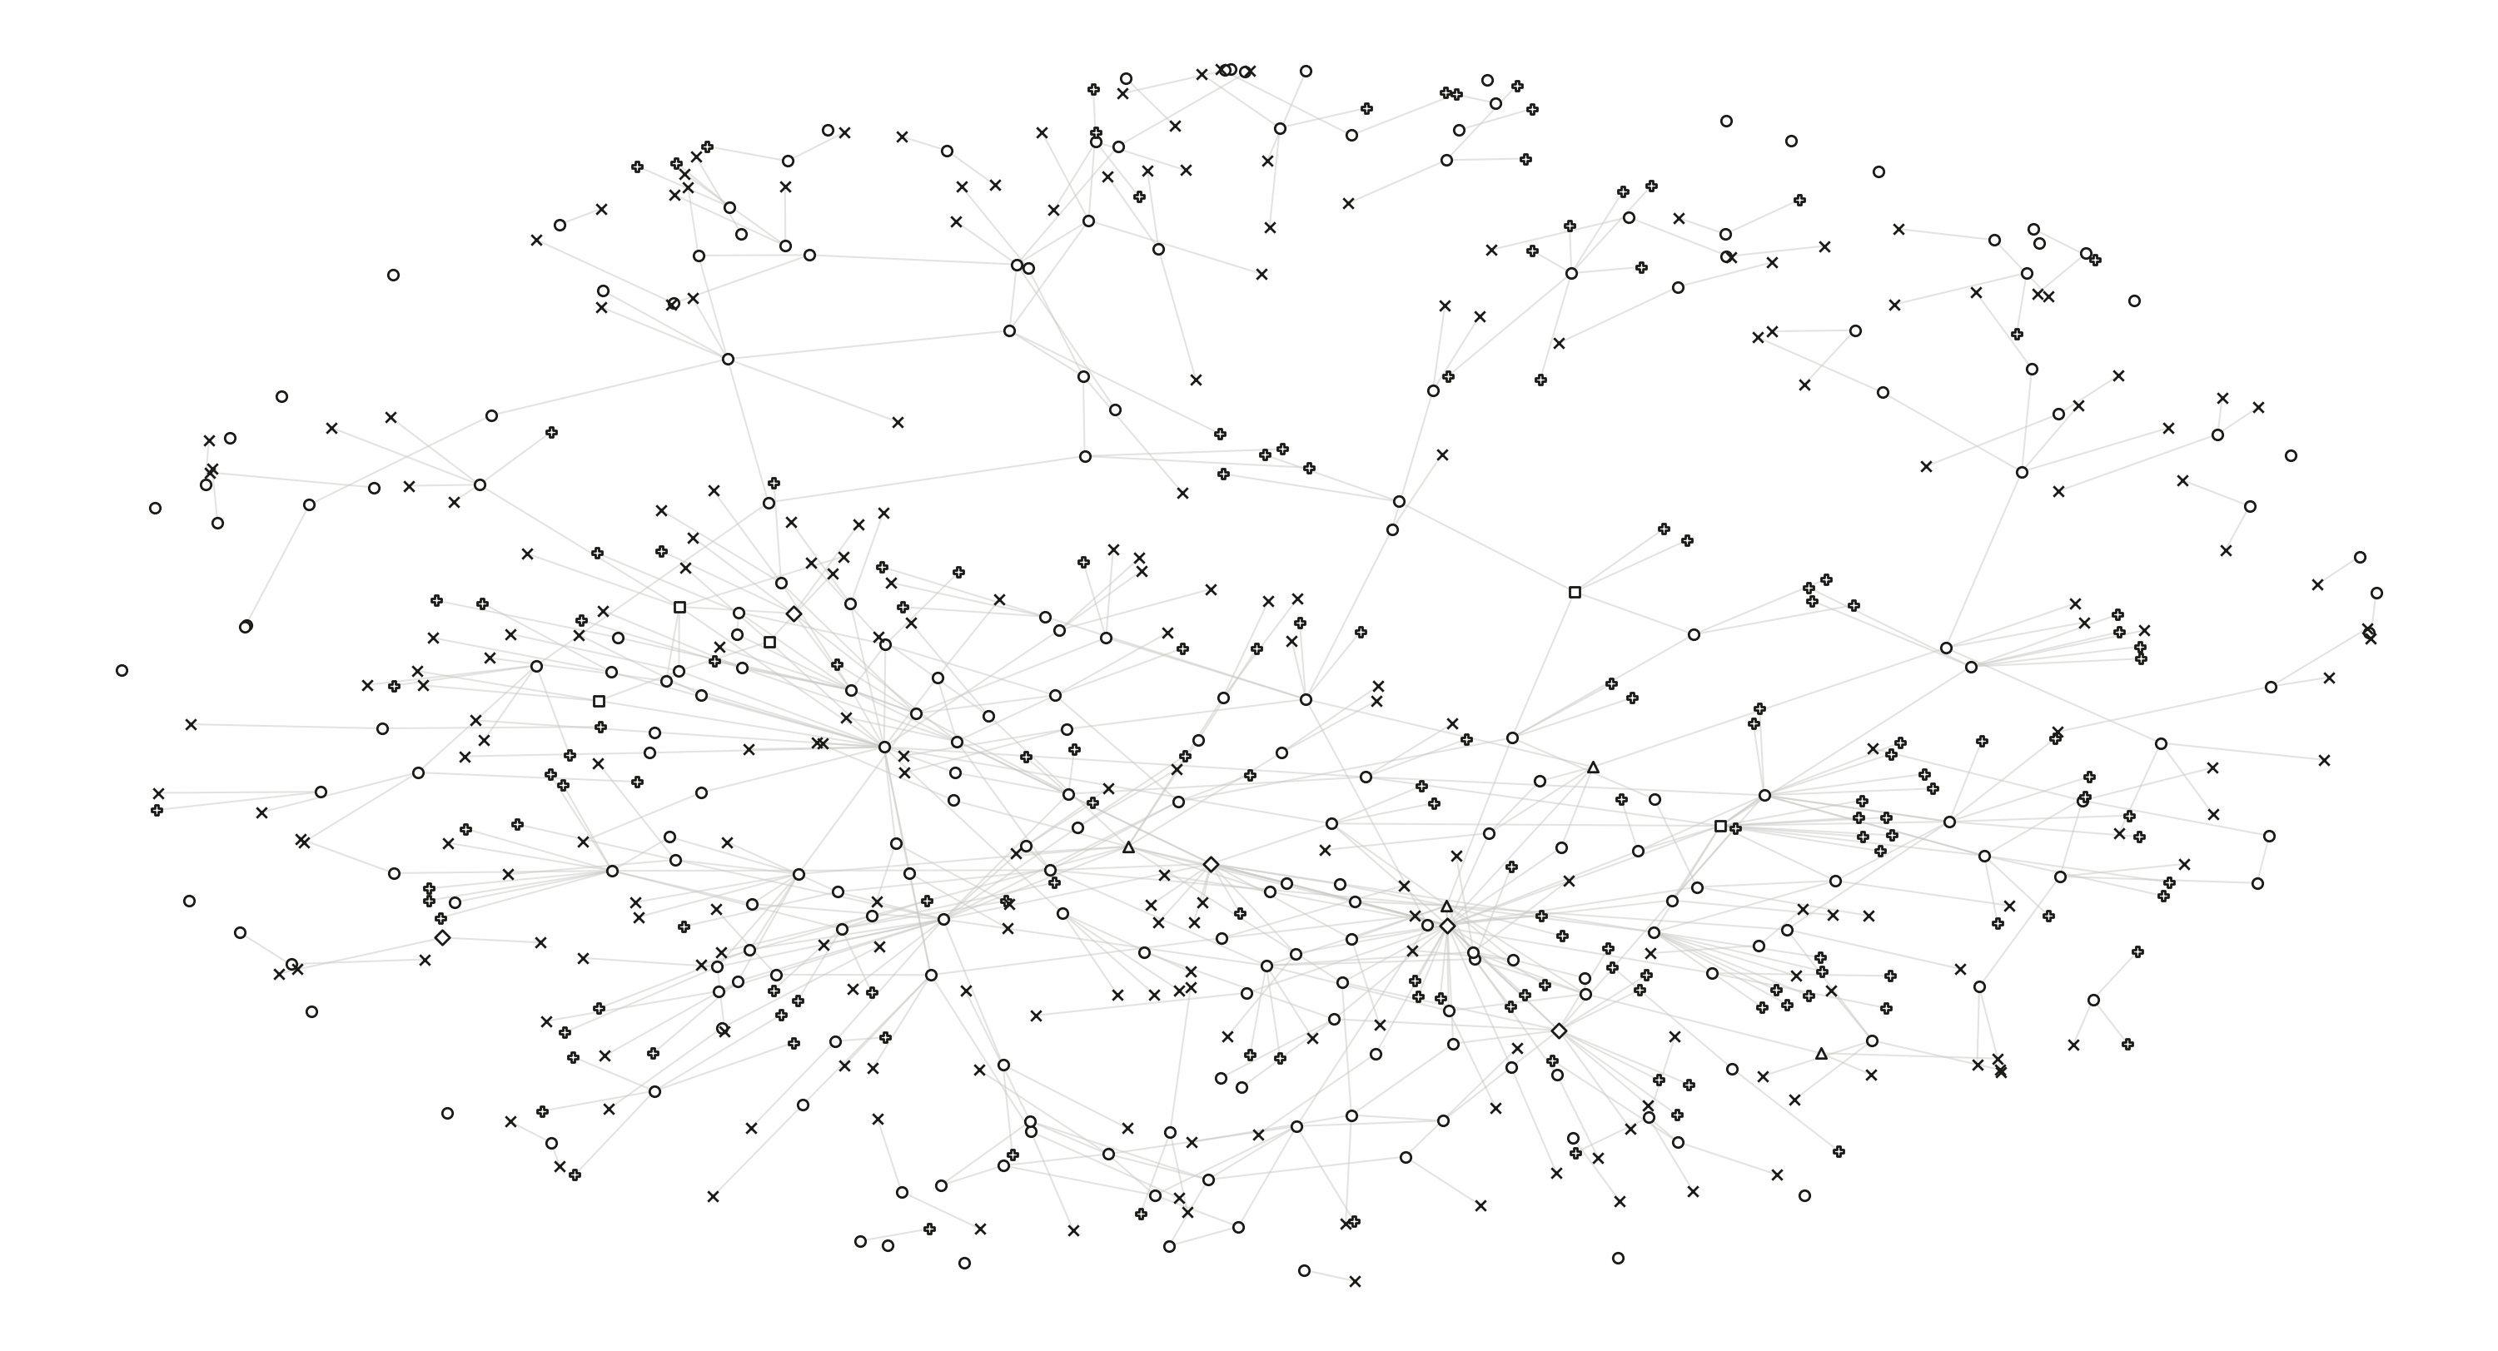
40
Notes:
What you get when you ask a machine to extract every mathematical claim in one paper and every dependency between them: 613 nodes, 634 edges, assembled from the frozen bytes of arXiv:2607.26154v1 without using any hand-authored graph (legacy_dag_edges_used: false).
Shape = node kind, as in the seminar deck. Everything is hollow because v0.3 has no accepted state to fill a mark with: accepted_support_edges is 0.
This frame and the next two extracted-graph frames are images rather than shapes - several hundred marks each, where a flattened picture is the honest format.
Source: schema v0.3/runs/research-terra-continuation-20260920/graphs/00001-db0e3d21/graph.json

Slide 46
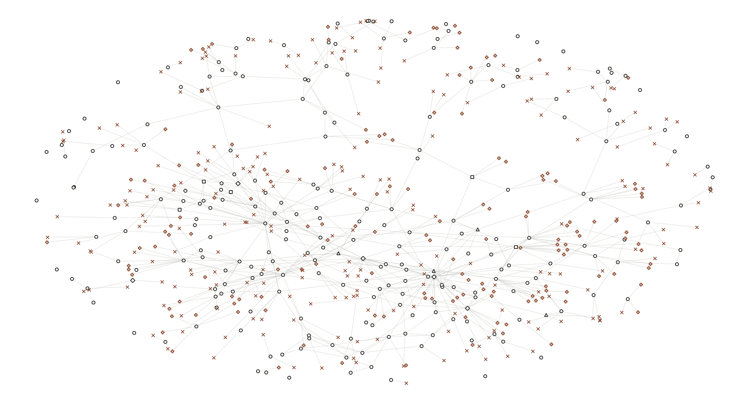
41
Notes:
The same graph, two colours.
INK - the 240 candidate statements actually extracted from the target paper's own .tex. These carry a paper_id.
WARM - the other 373: 152 external claim requests (anchored to a .bbl byte range, paper_id null - nobody has fetched the source yet) and 221 unresolved source occurrences (a location in the paper no candidate has yet claimed).
The point of the colour split: most of this graph is not knowledge, it is the system's own record of what it has not done. Computed connectivity: 80 weakly connected components, largest 379 nodes, 24 isolated, and the digraph is NOT acyclic - 7 simple cycles.

Slide 47
14 candidates that land inside a declared result (one mark each, kind not shown)
def:active
thm:mwis
thm:solvable
lem:lovasz-sandwich
prop:extremal
definition
theorem
theorem
lemma
proposition
lem:collapse
prop:relaxation
prop:clifford
lem:perfect-collapse
lemma
proposition
proposition
lemma
the 9 results the paper actually declares
42
Notes:
THE REDUCTION, and it is mechanical - no model judgement anywhere in it.
The host reads the frozen .tex and takes the byte range of every \begin{theorem}...\end{theorem} and its siblings. The paper declares NINE formal results: 2 theorems, 3 lemmas, 3 propositions, 1 definition, each with its own \label. Then it asks which of the 240 extraction candidates have a source span falling inside one.
Answer: 14 candidates, hitting 9 of 9 - so nothing the paper formally declares was missed - and 8 of the dependency edges survive among them. The other 226 candidates are assertions in running prose, where "is this a claim?" is a judgement rather than a fact.
WHAT THIS IS NOT. It does not delete the 226 and it asserts nothing about them; many are load-bearing (the curated registry holds 25, not 9). It is a mechanical attribution, fully reversible, and it is the cheapest honest cut available: from 240 unreviewed candidates to the 9 results the paper itself chose to state formally.
Counts computed live from draft.tex and graphs/00001-db0e3d21/graph.json.

Slide 48
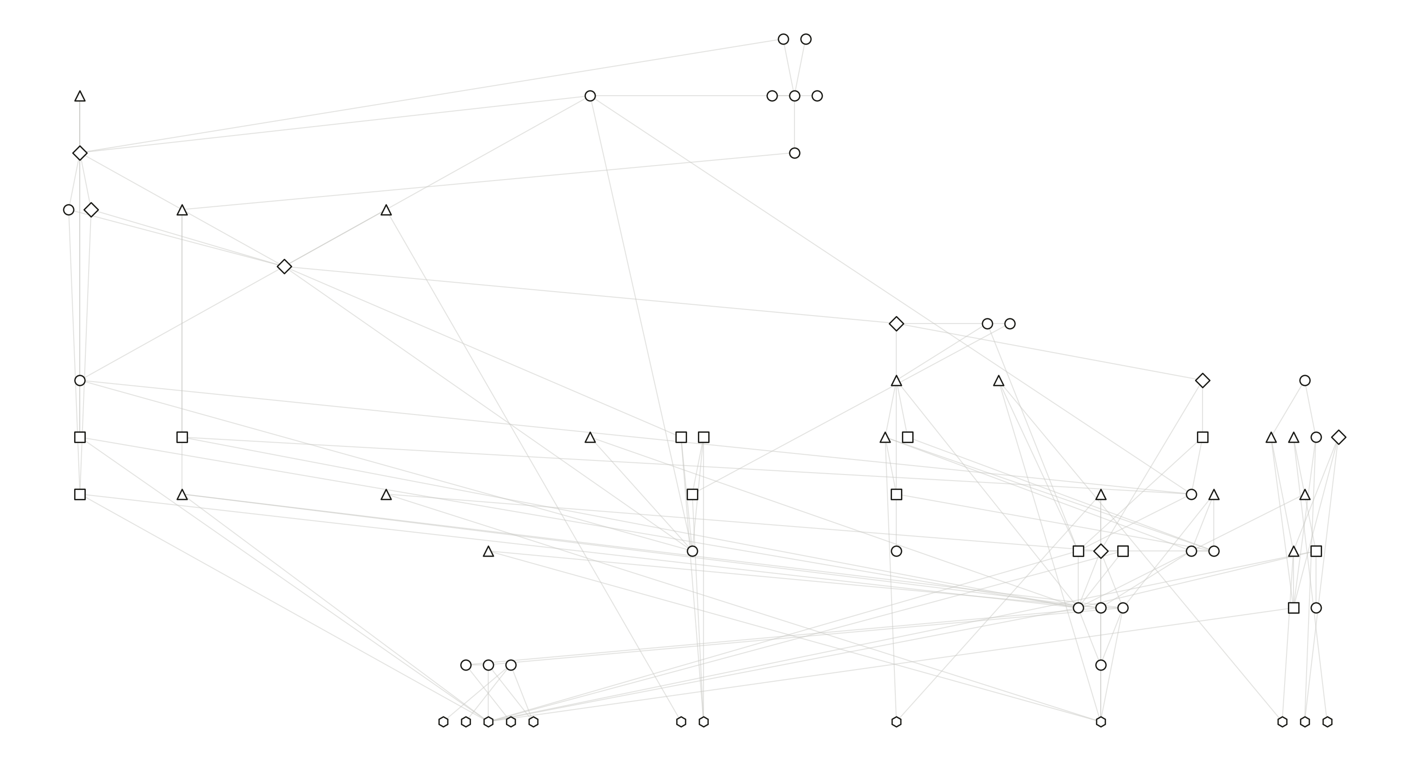
43
Notes:
IMPORTANT - this is a CHANGE OF OBJECT, not a zoom.
This is the paper's hand-authored dependency DAG: 74 claim nodes, 129 edges, one connected structure, acyclic because a person made it so.
It is NOT a subgraph of the previous slide, and the deck must never imply that it is. The two graphs share ZERO node ids (extracted ids look like claim:candidate:51e98811..., authored ids like claim:closed-form-rom). I also tested correspondence by source location - converting the authored line anchors to byte ranges and intersecting them with the extracted spans - and it is far too coarse to be an extraction: 436 of 458 extracted candidates overlap SOME authored claim, 224 overlap this theorem's chain. So no clean subgraph exists.
Say it plainly if asked: the machine's reading and the human's reading of the same paper are two different objects, and neither is derived from the other.
Source: Stabilizerness/dag/claim-dag.json

Slide 49
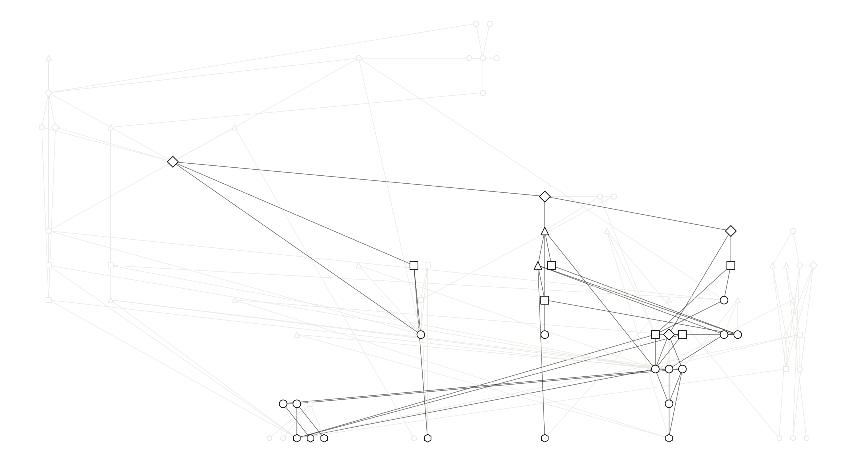
44
Notes:
THIS extraction is real, and verified: the 29 node ids of the closure are a strict subset of the 74 authored ids (checked in code - the build asserts it).
Ink = the backward closure of the main theorem (the closed form for reduced robustness of magic). Ghosted = the other 45 claims of the paper, which include five further external roots, the whole empirical branch behind Figure 2, three open problems and two stated limitations.
So: the figure everything after this is built on covers 29 of the paper's 74 claims - 39%. A closure answers "what does this theorem rest on", not "what is in this paper".
ONE EDGE OF BOOKKEEPING, in case somebody counts the lines. The ink edges here are the AUTHORED DAG restricted to these 29 claims, and there are 45 of them. From the next frame on, the deck draws the v0.3 pruned branch artefact, which has 46 - it carries no-active-free-signs -> sign-alignment-identity, an edge the hand-authored graph does not. Same 29 nodes, one more edge. Both drawings are faithful to their own source; they are two readings of one closure, a version apart.

Slide 50
COLOUR = SOURCE
this paper
Chvátal 1970s
Gottesman 1997
Veitch 2013
Howard 2016
Handbook 2024
the theorem
Varela 2026
L8
L7
L6
L5
L4
L3
L2
L1
L0
45
Notes:
Start at the theorem: claim:closed-form-rom. Nothing under it yet.
The unit of construction here is the SUPPORT GROUP - an AND-set of premises that together discharge one target - not the individual edge. closed-form-branch.json records 20 such groups over the 29 claims.

Slide 51
COLOUR = SOURCE
this paper
Chvátal 1970s
Gottesman 1997
Veitch 2013
Howard 2016
Handbook 2024
the theorem
Varela 2026
L8
L7
L6
L5
L4
L3
perfect graph
L2
L1
L0
46
Notes:
The theorem’s support group opens: exact-graph-program, perfect-graph-antiblocker and perfect-graph-definition.
Drawn as a bracket rather than three separate edges, because it is an AND: all three must hold. Any one missing and the target is not discharged. That is why the bracket, not the arrows, is the right primitive.

Slide 52
COLOUR = SOURCE
this paper
Chvátal 1970s
Gottesman 1997
Veitch 2013
Howard 2016
Handbook 2024
the theorem
Varela 2026
L8
L7
L6
L5
L4
L3
perfect graph
L2
L1
L0
perfect-graph duality
47
Notes:
The same question is now asked of each premise: what discharges this? Two more groups open underneath.

Slide 53
COLOUR = SOURCE
this paper
Chvátal 1970s
Gottesman 1997
Veitch 2013
Howard 2016
Handbook 2024
the theorem
Varela 2026
L8
L7
L6
L5
L4
L3
MWIS
perfect graph
L2
L1
L0
perfect-graph duality
48
Notes:
The relaxation branch and the antiblocker branch descend separately.
From here on, a heavier stroke and a faint ring mark what arrived at THIS step, and the brighter brackets are the groups that just opened. Later steps add only 3, 2 and 1 marks among 26-29, which is otherwise undetectable in a static frame.

Slide 54
COLOUR = SOURCE
this paper
Chvátal 1970s
Gottesman 1997
Veitch 2013
Howard 2016
Handbook 2024
the theorem
Varela 2026
L8
L7
L6
L5
L4
L3
MWIS
perfect graph
L2
L1
Varela
perfect-graph duality
L0
Gottesman
49
Notes:
The widest step: ten new claims at once, and three more of the roots arrive together.

Slide 55
COLOUR = SOURCE
this paper
Chvátal 1970s
Gottesman 1997
Veitch 2013
Howard 2016
Handbook 2024
the theorem
Varela 2026
L8
L7
L6
L5
L4
L3
MWIS
perfect graph
L2
L1
Varela
perfect-graph duality
L0
Gottesman
50
Notes:
Three more, completing the reduced-polytope side.

Slide 56
COLOUR = SOURCE
this paper
Chvátal 1970s
Gottesman 1997
Veitch 2013
Howard 2016
Handbook 2024
the theorem
Varela 2026
L8
L7
L6
L5
L4
L3
MWIS
perfect graph
L2
L1
Varela
perfect-graph duality
L0
Gottesman
51
Notes:
Two: the full robustness of magic, and the resource theory that defines it.

Slide 57
COLOUR = SOURCE
this paper
Chvátal 1970s
Gottesman 1997
Veitch 2013
Howard 2016
Handbook 2024
the theorem
Varela 2026
L8
L7
L6
L5
L4
L3
MWIS
perfect graph
L2
L1
Varela
perfect-graph duality
L0
Gottesman
52
Notes:
Twenty-nine claims, twenty support groups. The recursion terminates because every remaining premise is already in the chain.
Say “terminates”, not “complete”. The pipeline’s own chain-certificate.json records state CHAIN_INCOMPLETE for this very query, and three frames from now this deck prints that. What has finished is the expansion; what has not is the proof.
Worth saying aloud: it terminates because the input was a closed, hand-authored DAG. Run the same question against the paper itself and it does not terminate - the v0.3 controller stops at a budget limit with 400 roots, 373 of them unfetched requests.

Slide 58
COLOUR = SOURCE
this paper
Chvátal 1970s
Gottesman 1997
Veitch 2013
Howard 2016
Handbook 2024
the theorem
Varela 2026
L8
L7
L6
L5
L4
L3
MWIS
perfect graph
L2
L1
Varela
perfect-graph duality
L0
Gottesman
53
Notes:
Nine claims have NO support group at all - nothing in the chain explains them. They are where the paper stops arguing and starts citing.
Six are imported foundations. Three are the paper’s own definitions that rest on nothing, which is why the DAG has 9 sources rather than 6.

Slide 59
COLOUR = SOURCE
this paper
Chvátal 1970s
Gottesman 1997
Veitch 2013
Howard 2016
Handbook 2024
the theorem
Varela 2026
L8
L7
L6
L5
L4
L3
MWIS
perfect graph
L2
L1
Varela
perfect-graph duality
L0
Gottesman
54
Notes:
The system orders the chain for Lean and can reach fourteen of the twenty-nine. formalization_order begins at the MWIS definition, the Pauli window, the perfect-graph definition and finite LP strong duality.
Note the shape: every filled mark sits in the lower-left mass. Nothing near the top is reachable.

Slide 60
COLOUR = SOURCE
this paper
Chvátal 1970s
Gottesman 1997
Veitch 2013
Howard 2016
Handbook 2024
the theorem
Varela 2026
L8
L7
L6
L5
L4
L3
MWIS
perfect graph
L2
L1
Varela
perfect-graph duality
L0
Gottesman
55
Notes:
The fifteen the ordering cannot reach - everything downstream of a blocked root, including the theorem itself. Not because the Lean is missing, but because a premise above it has no discharged source.
The two ringed marks are the CAUSE, and they carry their own source colours - Varela in violet, the perfect-graph duality (Chvatal/Fulkerson) in blue, exactly as in the seminar deck. They are the only two imports outside formalization_order. Computed from closed-form-branch.json, the fifteen break down as 11 blocked by Varela alone, 1 by the perfect-graph root alone, 1 (the theorem) by both, plus the 2 blocked roots themselves. So resolving the Varela citation would return 11 of the 15.
The chain is complete and the proof is not: mathematical_status CHAIN_INCOMPLETE, accepted_support_edges 0, proof_backend NOT_CONNECTED.

Slide 61
One theorem, and everything it rests on
29 claims and 46 dependencies — the object the rest of this act works on
56
Notes:
The ending is three wishes with one measurement wedged in the middle, and I will keep saying which is which.
Start from the object the deck has been building: the closure of one theorem. Twenty-nine claims, forty-six dependencies, laid out exactly as in the chain frames - same positions, same shapes, same claims.

Slide 62
Wish one
another paper
Papers stop being separate piles
because they land on the same claims
this paper
and so on
a claim both papers lean on
one node, not two — check it once and
everything above it inherits the check
a third
57
schematic
Notes:
WISH ONE. Do this to the next paper, and the next.
The heavier lines between clusters are the point: the same claim, leaned on by two different papers. That is the moment a pile of decomposed papers becomes one network.
It is also the joint I said I cannot build. Deciding that this lemma and that lemma are the SAME lemma is an identity question, and v0.3 does not answer it. Schematic layout, no counts, nothing asserted.

Slide 63
Which claims actually carry the load
remove one claim, recompute the closure, count what leaves — size is what is lost
claims lost if this one is removed
the graph program — 25
1
5
10
15
20
the MWIS dual — 11
the LP dual — 7
no active free signs — 4
58
Notes:
NOT A WISH. Cut one claim out of the graph - remove every dependency into it - and recompute the backward closure of the theorem. Count what is no longer in it. Size and ink are that count.
Before trusting any of this: my computation reproduces all 46 of the omission experiments the pipeline recorded in closed-form-branch.json, edge for edge. The assertion is in gen_skeleton.py and the build fails if it ever stops matching. I am not showing you a model of the pipeline, I am showing you the pipeline's own arithmetic.
The graph program carries 25 of the 29. The distribution has a long thin tail and one spike, which is the shape that makes the rest of this worth attempting: you do not need taste to find the load-bearing parts, you need an omission test.

Slide 64
The same question, asked of every dependency
46 links, each weighted by what removing it costs
sorted by what removing one costs
59
Notes:
The same question asked of every dependency rather than every claim - and this one the pipeline already answered for itself, in all 46 cases.
Line weight is what removing that one edge costs. Most of the graph is thin.
The small chart is the whole distribution, sorted. It is deliberately small: the number on any one bar does not matter, the SHAPE does, and the shape is a cliff.

Slide 65
Alone every one of these 29 is free
take them away together and 14 of the 29 claims leave the closure
sorted by what removing one costs
29 cost nothing alone
60
Notes:
AND HERE IS THE TRAP, which I walked into while building this frame and think is the most useful thing on it.
Twenty-nine of the forty-six dependencies cost nothing when you remove them. Each one, on its own, is redundant - every claim is still reachable by some other route.
Take all twenty-nine away together and fourteen of the twenty-nine claims fall out of the closure.
Individual redundancy does not compose. Two edges can each be safe to cut because the other one is there. It is obvious once stated and it is extremely easy to miss - I had this frame drawn the wrong way round, asserting that the 29 could go and 17 would remain, before I checked it jointly.
That is precisely the kind of mistake a person makes reading a dependency structure by eye, and precisely the kind a machine does not.

Slide 66
The skeleton
28 dependencies, and every claim still reachable
61
Notes:
So the skeleton has to be computed properly: remove one dependency, recheck the whole closure, and only then try the next. Greedily, to exhaustion.
Eighteen can go. TWENTY-EIGHT remain, and all twenty-nine claims are still reachable.
That is what I mean by the skeleton of a theory. Not a summary and not the important bits as judged by anybody - the subgraph you cannot cut any further without losing something, arrived at by an operation with no opinion in it.
Two honest caveats. It is a statement about the graph as recorded: if the extraction missed a route, an edge looks more necessary than it is. And 29 claims is small enough that a careful person could have done this by hand - slowly, and as the previous frame shows, probably wrongly.

Slide 67
Wish two
another paper
A claim in a gap the structure names
a claim nobody has written yet
this paper
and so on
proposed
a third
62
schematic
Notes:
WISH TWO. If you can compute where the load sits, you can also see where the structure is thin: a place where several load-bearing claims converge and nothing has been written.
The diamond is a claim nobody has stated, proposed because the shape of the network says something belongs there.
And the reason the junction is drawn exactly like every other junction in this deck: a proposed claim gets no special status. Same AND-junction, same premises, same arrow, same kernel. Accepted, it is knowledge. Refused, the system names what was missing and that becomes the next thing to read.

Slide 68
Wish three
A new paper inherits what is checked
a new paper
and only three of its claims are genuinely new
three new checks, not a hundred
already checked — and it stays checked
63
Notes:
WISH THREE, and this is the one I would most like to be true.
Along the bottom: what has already been checked, and stays checked. A proof the kernel accepted does not need re-accepting next year.
Above: a new paper. Most of what it rests on is already down there - the same foundations, the same definitions, the same handful of load-bearing claims every paper in the area leans on. Those edges cost nothing new.
Only three things in it are actually new, and only those three need a junction and a check.
That is what the apparatus is FOR. Not to verify a paper - to make the NEXT paper cheap, by making verification something you inherit instead of something you repeat. Today, reading a paper properly means reconstructing its dependencies from scratch, every reader, every time. This is the version where you do not.
Then stop, and say the status: 29 claims, 14 reachable, accepted_support_edges 0, CHAIN_INCOMPLETE. Three wishes and one measurement.

Slide 69
Where this actually is
shown
One paper, frozen. 29 claims and 46 dependencies for one theorem, and a chain that runs.
shown
Removing a claim has a measurable cost, so the structure can say which parts carry load.
not yet
The 613-claim extraction is not usable: every node is blocked pending review, and nothing is accepted.
not yet
The chain rests on a DAG written by hand, for this paper. Automatic library lookup is zero lines of code.
not shown
Whether the formal object means the physics you had in mind. No kernel judges that.
The claim is not that this works. It is that it is now small enough to argue about.
Everything on this frame is one paper and one run — a possibility with a receipt, not a result.
64
Notes:
THE CONCLUSION. Do not soften it and do not oversell it - the credibility of the whole talk is spent or kept here.
Two things are shown. A chain for one theorem that actually runs, and a structure whose load-bearing parts can be measured rather than guessed.
Three things are not. The big extraction is not usable - every one of those six hundred nodes is blocked pending a review nobody has done. The chain that does run stands on a dependency graph I wrote by hand for this paper, and automatic library lookup - finding the matching declaration in Mathlib - is zero lines of code today. And none of this touches whether the formal object means the physics you had in mind; no kernel judges that.
Then the last line, which is the honest version of the whole talk: the claim is not that this works. It is that it has become small enough to argue about. A year ago I could not have shown you a specific place where it stops.

Slide 70
Three questions I do not have answers to
A golden age for theoretical research.
But for theoretical researchers?
1
Does more compute and more intelligence excite you — or frustrate you?
2
If a machine can produce the result, which part did you want to do?
3
What would have to be checked before you would build on it?
yingjian@lorentz.leidenuniv.nl
the deck, the records and the logs are all in the repository
65
Notes:
THE LAST FRAME. Ask, then stop talking. Do not answer your own questions.
The framing is the useful part: it is entirely possible that this is a golden age for theoretical RESEARCH and a difficult one for theoretical RESEARCHERS, and those two things pull in opposite directions. Say that out loud - most people in the room have thought it and not said it.
Question one is the honest one and usually gets the room going: excited, or frustrated? Both answers are respectable and people will disagree in public, which is what you want.
Question two is the one that produces the best answers. If the machine can produce the result, which part did you actually want to do? Some people will say the proof; more will say the question, or the picture, or the argument about what it means.
Question three brings it back to this talk: what would have to be checked before you would build on it. That is the only question the last forty minutes was about.
If the room is slow, ask somebody what the ROOT claims of their last paper would be - the things they assumed without proof - and whether they would have been willing to write them down.

