Slide 1
How the pieces fit
Agent · LLM · Skill · MCP · Tools · Schema
One data flow, built one piece at a time. Advance with the arrow key.
Notes:
Nine build steps. Each slide adds exactly one element to the same diagram, so advancing the deck animates the flow.

Slide 2
A language model, by itself
1 / 9
LLM
text → a distribution over next tokens
Text in, a distribution over next tokens out. Stateless: nothing carries between calls, and the weights never change.
Notes:
Text in, a distribution over next tokens out. Stateless: nothing carries between calls, and the weights never change.

Slide 3
Put it in a loop — that is an agent
2 / 9
AGENT · the loop
LLM
The agent calls the model repeatedly, decides what to do next, and stops when it judges the work done. The model is the engine; the loop is the agent.
Notes:
The agent calls the model repeatedly, decides what to do next, and stops when it judges the work done. The model is the engine; the loop is the agent.

Slide 4
Give the loop a task
3 / 9
AGENT · the loop
TASK
LLM
A bounded work order arrives: what to do, on which inputs, and what counts as finished.
Notes:
A bounded work order arrives: what to do, on which inputs, and what counts as finished.

Slide 5
A skill is a written procedure
4 / 9
SKILL · a written procedure
loaded into context — advice
AGENT · the loop
TASK
LLM
A protocol loaded into the context when the task matches it — drawn dashed, because it is advice. The model can read it and not follow it, and nothing records that it did.
Notes:
A protocol loaded into the context when the task matches it — drawn dashed, because it is advice. The model can read it and not follow it, and nothing records that it did.

Slide 6
MCP is the socket, not the tool
5 / 9
SKILL · a written procedure
loaded into context — advice
AGENT · the loop
TASK
LLM
tool call
MCP
the socket
A published convention for exposing a tool so that any model can call it. It standardises the plug; it says nothing about what comes through it.
Notes:
A published convention for exposing a tool so that any model can call it. It standardises the plug; it says nothing about what comes through it.

Slide 7
Tools are what actually act
6 / 9
SKILL · a written procedure
loaded into context — advice
AGENT · the loop
TASK
LLM
tool call
result returns
MCP
TOOLS
the socket
a compiler · a database · a filesystem
A compiler, a database, a filesystem. The result returns to the loop, which calls the model again — this return arrow is the whole reason it is called an agent.
Notes:
A compiler, a database, a filesystem. The result returns to the loop, which calls the model again — this return arrow is the whole reason it is called an agent.

Slide 8
The output meets a schema
7 / 9
SKILL · a written procedure
loaded into context — advice
AGENT · the loop
TASK
SCHEMA
LLM
output
tool call
a machine-checked contract
result returns
MCP
TOOLS
the socket
a compiler · a database · a filesystem
A machine-checked contract: which fields a valid record must have, which types, and — crucially — that no field nobody agreed to may be added.
Notes:
A machine-checked contract: which fields a valid record must have, which types, and — crucially — that no field nobody agreed to may be added.

Slide 9
And the schema can say no
8 / 9
SKILL · a written procedure
loaded into context — advice
AGENT · the loop
conforms → recorded
TASK
SCHEMA
LLM
output
does not → REFUSED
tool call
a machine-checked contract
result returns
MCP
TOOLS
the socket
a compiler · a database · a filesystem
This is the only arrow on the diagram that rejects. A record that does not conform is not repaired or accepted with a warning; it is refused.
Notes:
This is the only arrow on the diagram that rejects. A record that does not conform is not repaired or accepted with a warning; it is refused.

Slide 10
Three ways of asking. One way of refusing.
9 / 9
SKILL · a written procedure
loaded into context — advice
AGENT · the loop
conforms → recorded
TASK
SCHEMA
LLM
output
does not → REFUSED
tool call
a machine-checked contract
result returns
MCP
TOOLS
the socket
a compiler · a database · a filesystem
The prompt, the skill and the tool call are all requests — they can be ignored, and the transcript looks the same either way. Only the schema can make an answer impossible to express.
Notes:
The prompt, the skill and the tool call are all requests — they can be ignored, and the transcript looks the same either way. Only the schema can make an answer impossible to express.

Slide 11
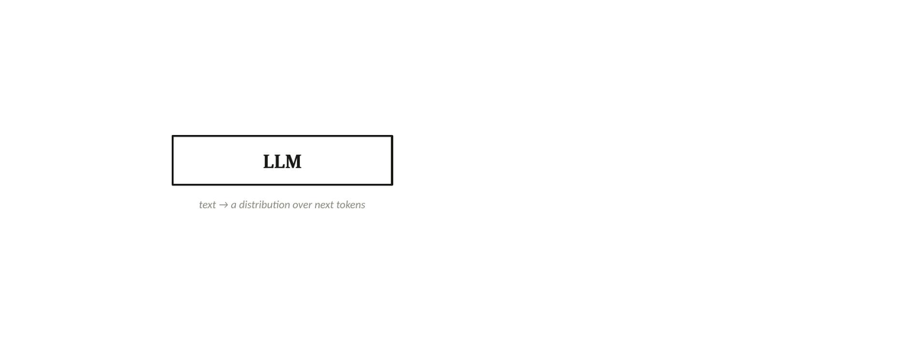
The whole flow, looping
Plays automatically in slideshow mode (press F5 / Play). The nine slides before this one are the same build, under your own clicks — use whichever suits the room.
Notes:
The GIF loops on its own in slideshow mode. It will not animate in the editing view - press F5 to see it move.

