Slide 1
The case, as v0.3 leaves it
One paper, taken from frozen bytes toward a proof — and stopped, precisely, where it stops.
arXiv:2607.26154v1 · schema v0.3 · state of 2026-09-20
Notes:
Every number in this deck is read from a named file under schema v0.3/ and carries the disclaimer that file attaches to it.

Slide 2
THE SETUP
1 / 17
The question the case is meant to answer
THE INPUT
THE QUESTION
One arXiv paper as frozen bytes: draft.tex, 69,678 bytes, content-hashed.
The main theorem: for a measurement set with no active dependencies whose frustration graph is perfect, the reduced robustness of magic has a closed form over cliques.
What does that sentence depend on, and who has checked which part?
Not "is it true". The case is about whether the dependency and the checking can be made mechanical — extracted from the source, traced to origins, and carried into a kernel.
The paper is the author’s own. That removes permission problems; it does not remove the risk of grading one’s own work, which is why every verdict below is a field written by a program rather than a judgement typed by a person.
Notes:
Frame the case as a measurement, not a demonstration.

Slide 3
SO THAT EVERY LATER CLAIM HAS AN ADDRESS
2 / 17
Step one — freeze the source
69,678
2,093
180
bytes of draft.tex, content-hashed
heuristic entries across the target and six selected dependencies
heuristic occurrences in the target paper
every span quoted later resolves to a byte range in this exact file
all with exact byte positions retained
the denominator every later coverage figure is measured against
2,093 entries is not 2,093 independent mathematical results, and does not assert the source was read exhaustively. The 180 is labelled SUPPLIED_HEURISTIC_OCCURRENCE_IDS_NOT_ALL_MATHEMATICS — a heuristic count cannot establish "all maths claims".
Notes:
Freezing is the cheap part, and it is what makes everything after it checkable.

Slide 4
RUNS/RESEARCH-TERRA-CONTINUATION-20260920
3 / 17
Step two — extract the statements
39 / 39
240
149 / 180
output ranges answered, after a two-model continuation
candidate statements from the .tex alone
heuristic occurrences referenced by a candidate
Luna 22 calls, 20 ok, 2 source-location failures; Terra re-ran those 2, both ok
154 generic claim · 38 definition · 34 equation · 5 theorem · 5 lemma · 4 proposition
unfinished_scope_count: 0
source_completeness_asserted: false, in the same summary.json. "Ranges answered" is a dispatch metric, not coverage of the mathematics — and the 240 is a host combination of retained reading batches with no semantic de-duplication, so it is an unreviewed candidate count, not a census of the paper’s claims.
Notes:
39 of 39 is the strongest-sounding number in the deck, which is exactly why its caveat sits under it.

Slide 5
GRAPHS/00001-DB0E3D21/GRAPH.JSON
4 / 17
Step three — assemble the dependency graph
WHAT THE 613 NODES ARE
COUNT
WHAT IT MEANS
candidate statements
240
extracted from the frozen .tex
external claim requests
152
anchored to a .bbl byte range — paper_id null. Nobody has fetched these yet
unresolved claim occurrences
221
a location in the source that no candidate has yet claimed
total nodes / edges
613 / 634
assembled without the legacy DAG: legacy_dag_edges_used false
support groups
213
AND-groups of premises
accepted support edges
0
of 634
all_judgements_unreviewed: true. Three hundred and seventy-three of the 613 nodes are not statements at all — they are open requests and unclaimed locations, i.e. the graph’s own record of what it has not done.
Notes:
The graph is mostly a to-do list, and says so in its own fields.

Slide 6
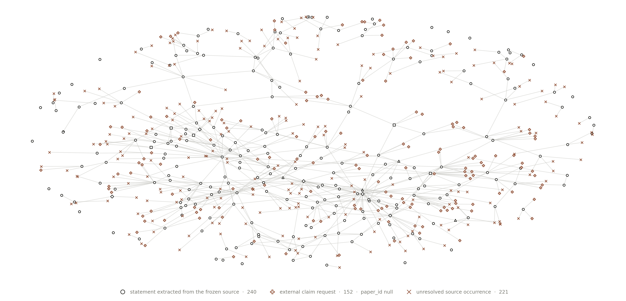
EVERY MARK IS A NODE; EVERY LINE A PROPOSED DEPENDENCY
5 / 17
The same graph, drawn
Hollow throughout, because v0.3 has no accepted state to fill one with. The warm marks are the majority: 373 of 613 are external requests nobody has fetched and source locations no candidate has claimed. This is a picture of a reading list as much as of a proof.
Notes:
Let the room look at it. The point is the proportion of warm to ink.

Slide 7
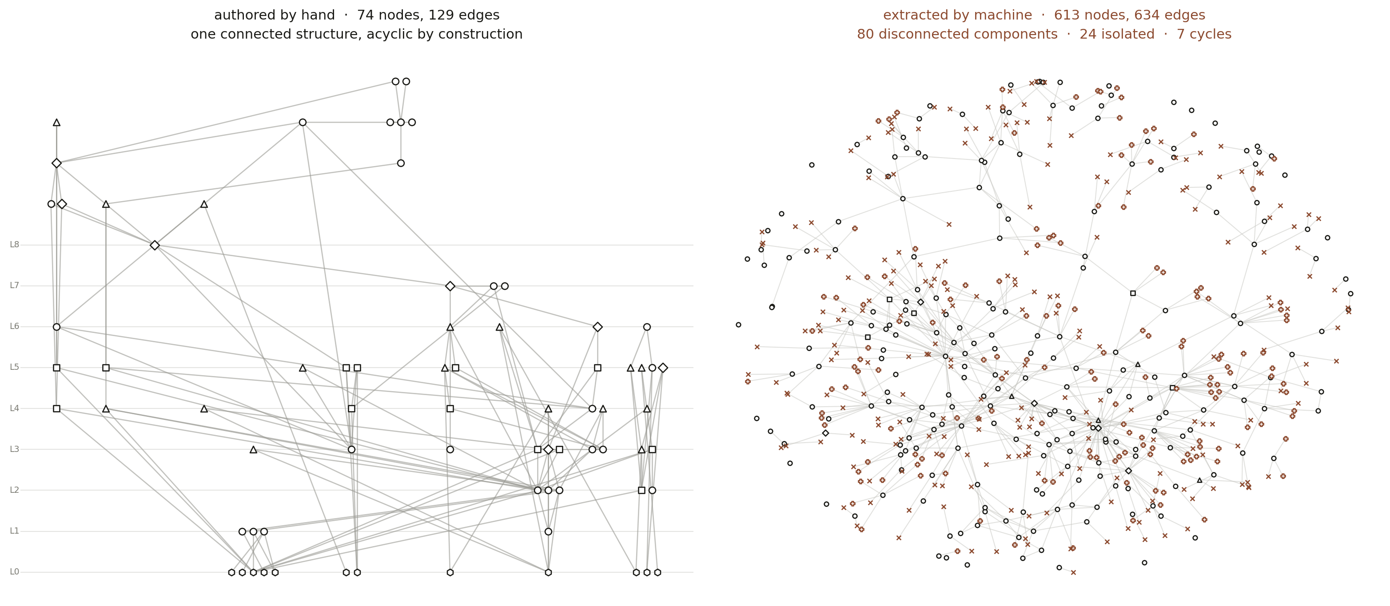
THE MOST IMPORTANT SLIDE IN THE DECK
6 / 17
Two number lines that must not be added
These are two different objects with two different node vocabularies. 613 is not "74 grown"; no completion rate can be computed between them, and v0.3’s own STATUS.md says the scopes cannot be summed. Acyclicity was an editorial achievement of the first, not a finding about the paper.
Notes:
If one slide survives from this deck, it is this one. The temptation to read 74 -> 613 as progress is exactly the over-claim the project exists to prevent.

Slide 8
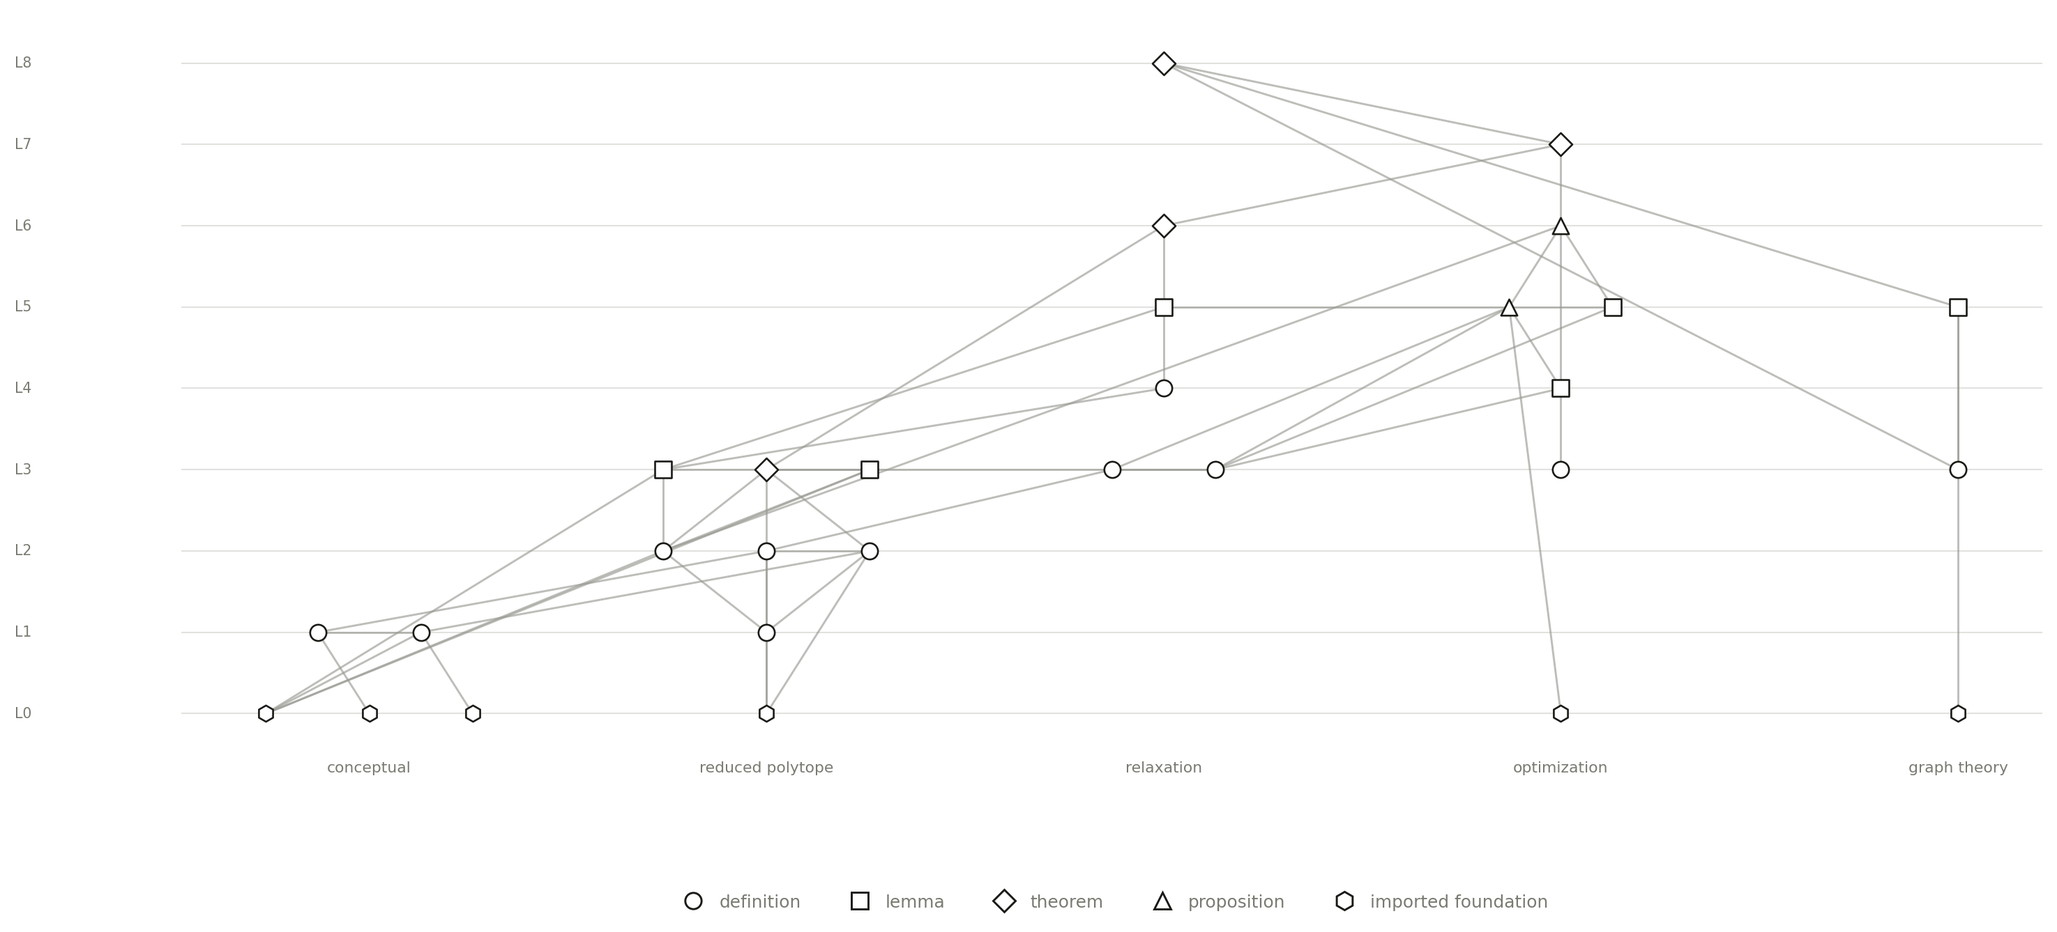
RUNS/2607-FULL-CANDIDATE-20260919/CLOSED-FORM-BRANCH.JSON
7 / 17
The closure, re-derived a month later
Same 29 ids, same 11 / 6 / 4 / 2 / 6 kinds, same cones 19 14 12 7 4 2 — recomputed from frozen bytes a month later. Forty-six edges, not forty-five: v0.3 adds one bridging premise the authored graph never recorded.
And its coverage under v0.3: 0 of 11 definitions with the statement discharged, 0 of 12 theorem-like nodes with the proof discharged.
A v0.3 node has no state field and no declaration field. The graph records disposition, not verification, and will not credit a Lean result to a node until the statement is aligned to its source — none of these 29 is. The three nodes the old deck showed as kernel-checked have had that credit withdrawn, not revoked as wrong.
Notes:
The counts reproducing exactly is the good news: the drawing was not wishful. The coverage rows are the price.

Slide 9
ROOT:PERFECT-GRAPH-WEIGHTED-DUALITY
8 / 17
Step four — trace the hardest root to its origin
WHAT HAPPENED
RESULT
what the paper actually cites here
three separate obligations, not one theorem — weighted duality (Lovász 1972, Chvátal 1975), the antiblocker identity (Fulkerson 1971/72), the polynomial algorithm (Grötschel 1981)
Lovász 1972 characterization
obtained. HTTP 200, 142,102 bytes, 4 of 4 pages read, hash-frozen
Chvátal 1975, Fulkerson 1971/72
publisher metadata only — access failed, subscription preview, HTTP 403
Berge 1961, which Lovász’s own proof rests on
SOURCE_UNREACHABLE_IN_THIS_BOUNDED_SEARCH — not obtained in any form
does the source we read support the claim?
BRIDGE_REQUIRED_NOT_EXACT_WEIGHTED_DUALITY_STATEMENT — it gives a finite unweighted hereditary characterization; the paper needs nonnegative real weighted duality. 4 unproved bridges
"We read the source" and "the source supports the claim" are different sentences. earliest_origin_established is false in every file that records it; the root’s own record still reads role EXPLICIT_UNPROVED_PREMISE, outcome BINDING_CANDIDATE_UNREVIEWED.
Notes:
This is the slide that changed most since August. We went and got the paper. It proves something else.

Slide 10
SECOND LEAN EPOCH
9 / 17
Step five — formalize upward. What the kernel accepted.
82 / 82
302
0
modules recompiled in a common environment
cumulative audited declarations — 230 theorems, 69 definitions, 3 inductive types
forbidden axioms
lean 4.33.0 · mathlib db584cd6 · physlib 7b6e0fee
662 direct term-dependency witnesses
propext, Classical.choice, Quot.sound only
Real mathematics landed here: the complement of a perfect graph is perfect; an optimal integral clique cover equals α(G); a two-sided bound on reduced RoM; and the Varela V-representation — both obligations — machine-proved.
coverage_scope: ACTUALLY_AUDITED_SELECTED_DECLARATIONS_NOT_PAPER_CLAIM_COVERAGE. 43, 64, 74 and 302 are four nested, overlapping target lists including definitions and support declarations — they measure four different things and must never be summed. The Varela proof is of our own restatement, under a hypothesis 30 declarations assume and 0 conclude.
Notes:
Give the Lean its full credit here, because the next slide takes it all back.

Slide 11
THE SAME FILES, THEIR OWN FIELDS
10 / 17
And what none of it is credited for
FIELD
VALUE
query_declaration
null
query_chain_complete
false
source_alignment
AGENT_NORMALIZED_UNREVIEWED
weighted_perfect_duality_proved (all 8 evidence files)
false
declarations assuming / concluding W.NoActiveDependencies
30 / 0
PerfectGraphIntegerCover.lean + PerfectGraphWeightedApproximation.lean
118 + 120 lines · never compiled by any Lean · no receipt anywhere
Nothing here discharges WeightedPerfectGraphFoundation — it remains an explicit unproved Prop hypothesis in the type of weighted_duality_of_foundation, in both epochs. The two uncompiled files are shown as an admission, not a result: they are source text no kernel has read.
Notes:
The kernel holds 302 declarations. The graph will not let one of them touch a node.

Slide 12
THE WHOLE DESIGN IN A SINGLE RUN
11 / 17
One step, model to kernel
theorem AgtXIv.Generated.Proof_a29f133fb6
{ι : Type u} [Fintype ι] (x : ι → ℝ) :
(∑ i, x i) = 1 → 1 ≤ ∑ i, |x i|
axioms propext, Classical.choice,
Quot.sound
uses the audited library theorem
AgtXIv.RoM.normalized_l1
source draft.tex line 608, exact byte span
model calls 1
Lean compile exit 0, network denied
kernel_attestation_state
KERNEL_CHECKED_VACUITY_UNKNOWN
nonvacuity_witness NONE
promotion_allowed false
source_alignment_accepted false
coverage proof_discharged 0 of 1
The index type may be empty, in which case the hypothesis is uninhabited and the statement vacuous — no witness is claimed. In the host’s own weakest-first ordering, KERNEL_CHECKED_VACUITY_UNKNOWN ranks below UNREVIEWED. This is one elementary step from one line of the paper.
Notes:
The kernel accepted it and the system refused to count it. That is the design working.

Slide 13
2026-08-16 AGAINST 2026-09-20
12 / 17
What changed since v0.2
V0.2 · AUGUST
V0.3 · SEPTEMBER
the extraction
74 claim nodes, drawn by hand
240 candidates from the .tex alone; 39 of 39 ranges answered
nodes credited with a Lean result
3 of 29
0 — the graph no longer has that field
the perfect-graph root
"Chvátal 1975 or Fulkerson 1971/72 — candidates only"
three obligations; Lovász 1972 obtained and read — it states a different theorem
Lean environment
4.30.0-rc2, mathlib c1e30e1, "no physlib"
+ common epoch 4.33.0, mathlib db584cd6, physlib 7b6e0fee, 82 of 82 modules
the Varela V-representation
assumed
proved — under a hypothesis 30 declarations assume and 0 prove
the refusal
phase gate: no COMMITTED run
exit 2 · CHAIN_INCOMPLETE · accepted_support_edges 0
support edges anyone accepted
0 of 45
0 of 634
The word COMMITTED does not appear anywhere in v0.3’s host or schemas, and paper.extract has run many times since — so the old gate slide shows a failure the system no longer has, which is the same over-claim in reverse. The August Lean build was never re-run this round.
Notes:
The refusal moved. It did not go away - it got more specific, and it now arrives with receipts.

Slide 14
THE MACHINE’S OWN OBLIGATION LIST
13 / 17
What is still not done
QUERY_DECLARATION_NOT_CONSTRUCTED SEMANTIC_EXTRACTION_NOT_COMPLETE
AUTOMATIC_DEPENDENCY_GATES_NOT_CALIBRATED EARLIEST_ORIGIN_SEARCH_NOT_EXHAUSTED
RECURSIVE_NEW_SUPPORT_ADMISSION_NOT_IMPLEMENTED
ROOT_LIBRARY_COVERAGE_NOT_SOURCE_ALIGNED UNSUPPORTED_ROOT_PREMISES_NOT_RENDERED
RESOLVED_ANCHOR_RECALL_AUDIT_FAILED SUPPORT_BLOCKERS_REMAIN
Not on that list, and also not done
The two 2026-09-20 runs carry no integrity-report.json at all. · No independent artifact audit, test suite or negative test was executed this round.
Provider circuit-breaker, batch-reuse recovery and crash recovery are implemented and have never been exercised. · Every integrity report: semantic_completeness_checked false.
That certificate is a snapshot taken at 00:37 on 2026-09-19 — before the common-epoch audits later the same day. Two of its obligations were discharged afterwards and it was never regenerated. Read it as dated, not current; I would rather say that than let the system look worse than it is.
Notes:
Showing a stale failure list is as dishonest as hiding one. Hence the timestamp.

Slide 15
SCHEMAS/RESEARCH.SCHEMA.JSON · $DEFS.CHAINCERTIFICATE
14 / 17
The schema cannot say otherwise
"human_accepted": {
"const": false
},
"source_completeness_asserted": {
"const": false
},
"premise_extraction_status": {
"const": "QUERY_DECLARATION_ABSENT"
}
These are const, not default.
A chain certificate that claimed human acceptance, or asserted the source was read completely, would not be a false record — it would fail validation. The document cannot be written.
This is the project’s whole thesis, reduced to nine lines of JSON Schema: the dishonest answer is not discouraged, it is unrepresentable.
Exit 2 is a refusal to certify, not a diagnosis. It does not say which obligation is nearest to closing — and route_search is UNPRICED with explored_states 0, so it cannot say what closing one would cost either. Nothing in this deck may be called cheap to fix.
Notes:
If the audience remembers one mechanism, it should be const: false.

Slide 16
IN THE MACHINE’S OWN WORDS
15 / 17
The ending
“CHAIN_INCOMPLETE: no composed query declaration; a conditional implication has not yet been kernel checked.”
runs/2607-full-candidate-20260919/chain-certificate.json
mathematical_status CHAIN_INCOMPLETE · accepted_support_edges 0 · proof_backend NOT_CONNECTED
controller_status FRONTIER_POLICY_OR_BUDGET_LIMIT · exit code 2, raised by construction
This is where the case stops today. It is not a failure report: it is the system declining to certify something it has not earned, in a vocabulary that has no word for the thing it has not earned.
Notes:
Do not dress this up. The ending is the point.

Slide 17
THE MEASUREMENT, NOT THE PROOF
16 / 17
What the case shows
69,678 frozen bytes went in. 240 candidate statements, 613 graph nodes and 634 edges came out.
Zero were accepted — accepted_support_edges 0, at 45 edges in August and at 634 now.
Real mathematics was proved: 302 audited declarations across 82 of 82 modules in a second toolchain, zero forbidden axioms.
None of it was allowed to touch a graph node, because no statement has been checked against its source.
We fetched the 1972 paper the bottleneck is cited to. It states a different theorem, and rests on a 1961 abstract we could not obtain.
What would make the next version of this deck different
one accepted support edge · one source-aligned statement · a composed Lean declaration for the query
None of the five lines above is a claim about the paper’s mathematics. They are claims about what this system did, each read from a file under schema v0.3/.
Notes:
The deliverable is not a proof. It is that we can now say exactly how far this is from done.

