Slide 1






agtXiv
From scientific literature to verified and reusable knowledge

Slide 2
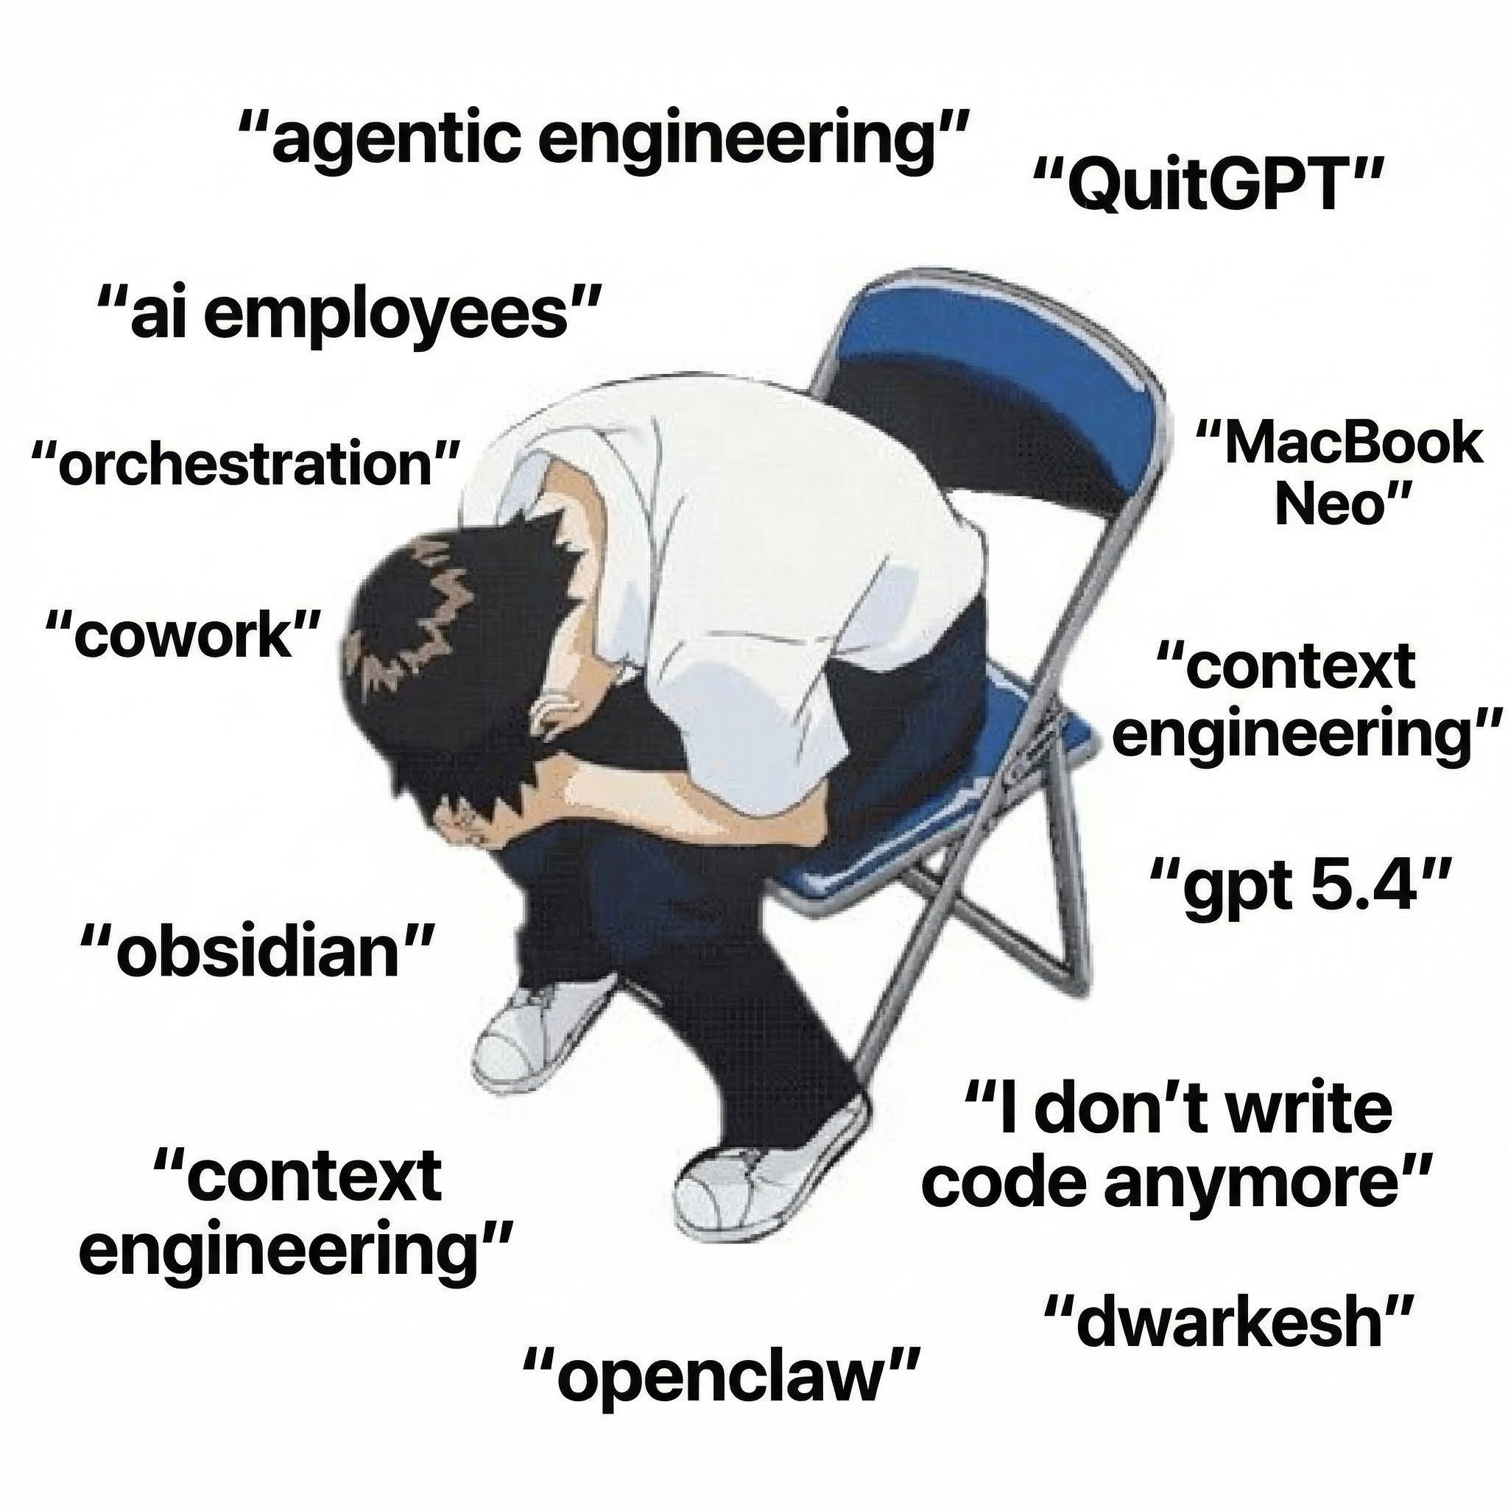

The AI crisis in theoretic research
(AI) read ≠ checked ≠ reusable
scientific publications
scale
Human researcher will be drown in infinite ”recent progress” papers.
Any open problem be solved increases the confidence of AGI, and also the anxiety of our career.
Later work still needs the exact imported claim and verification.
Claims and semantic content are often exaggerated.
expert verification bandwidth
2024
time

Slide 3
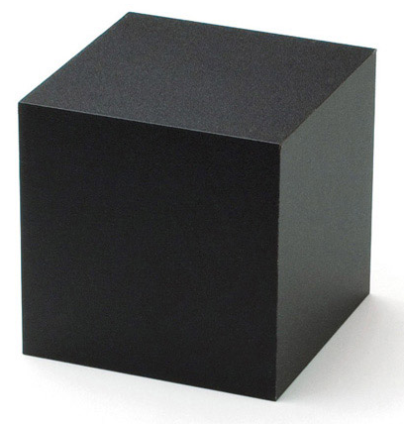
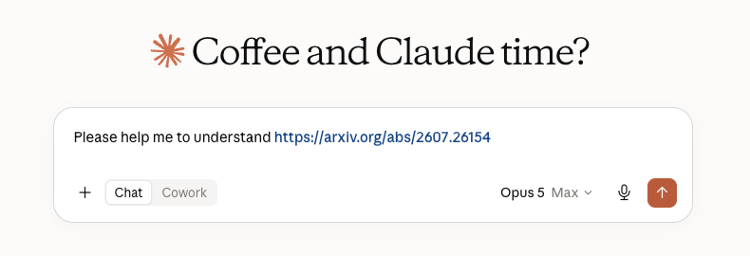
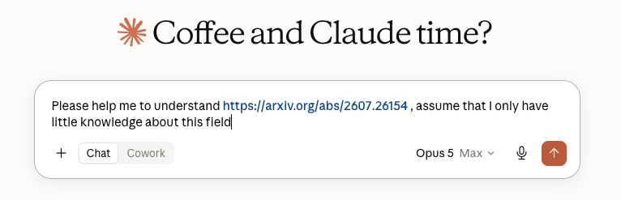
What happen when we query a paper

Slide 4
What is inside the black box?
Typed claim DAG
Citation graph
definition
lemma
B
A
D
assumption
theorem
C
Notes:
From tobias talk

Slide 5
What is inside the black box?
Notes:
From tobias talk

Slide 6
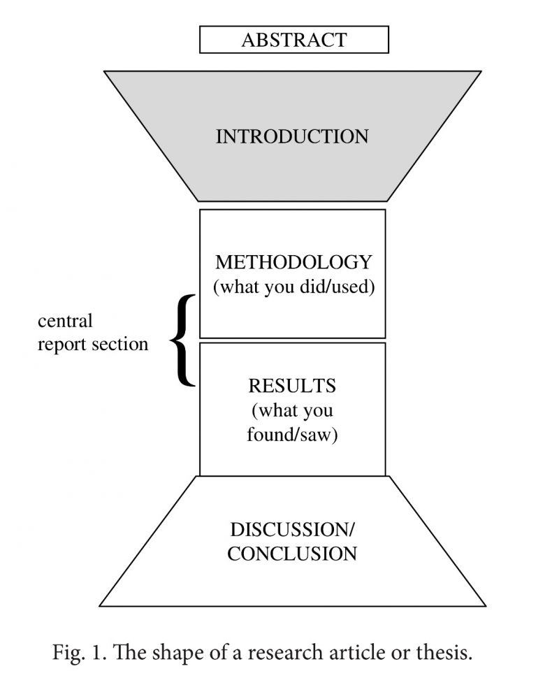
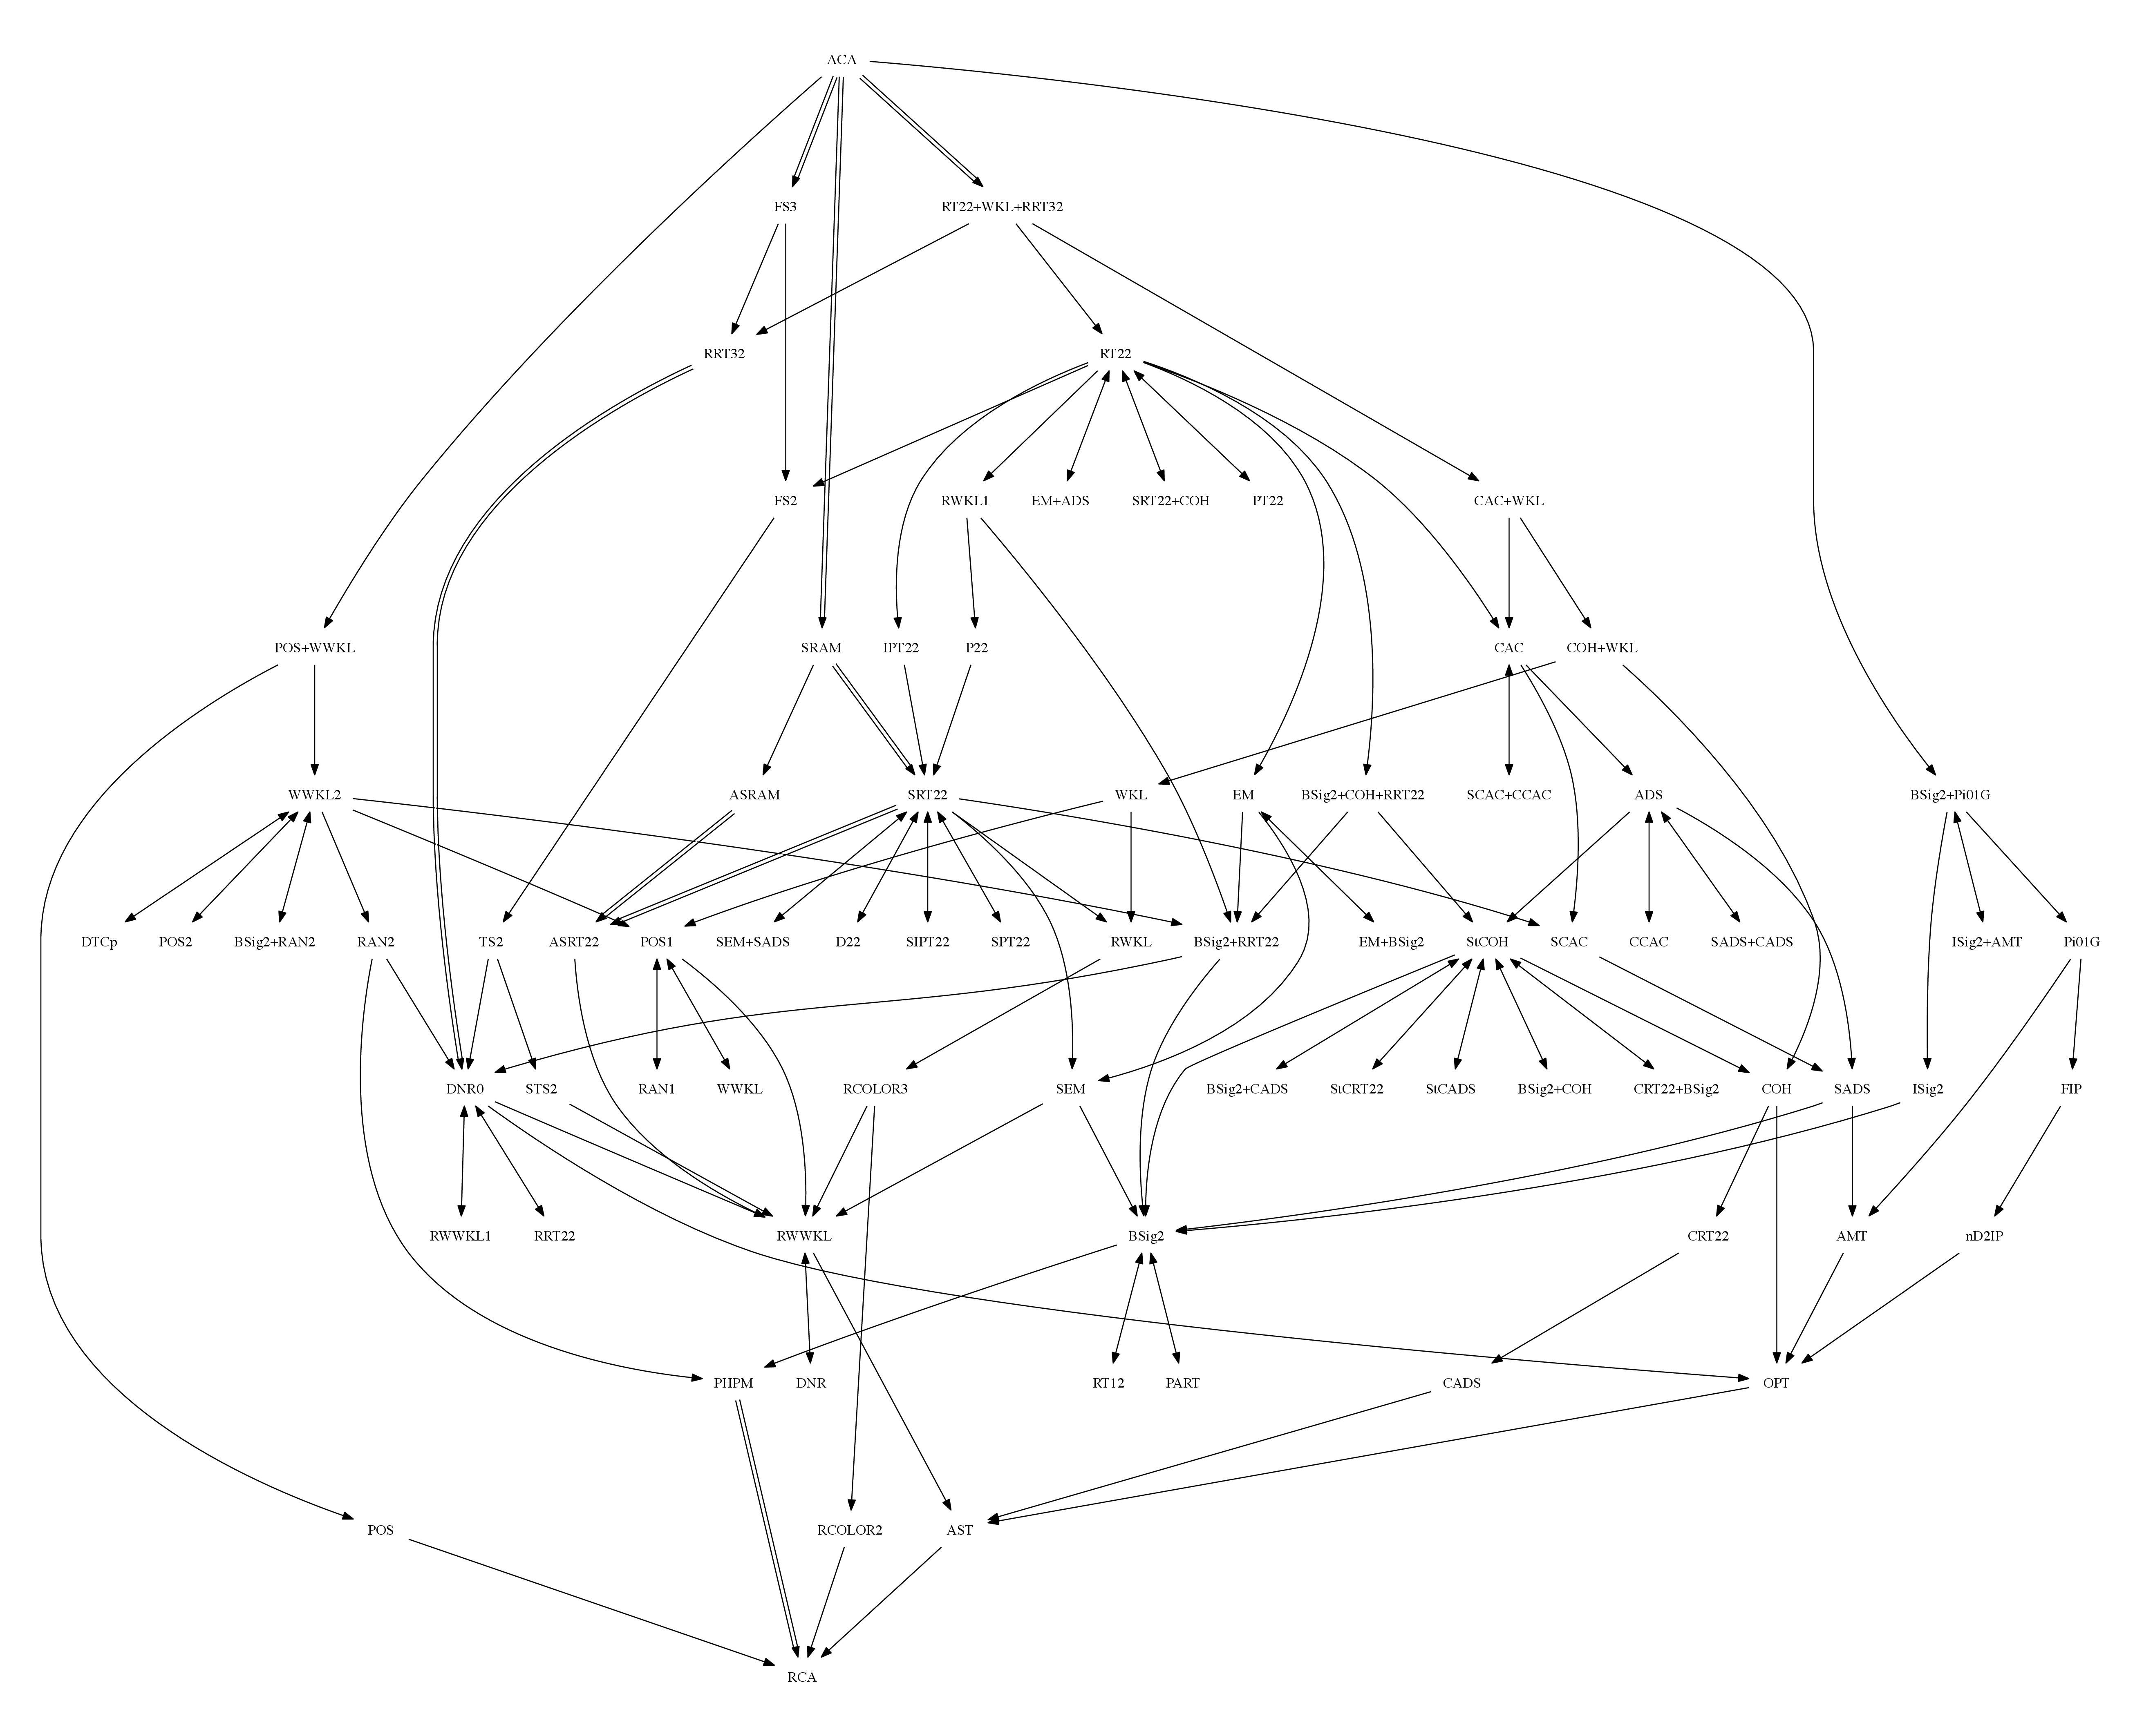
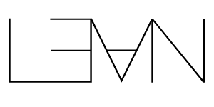


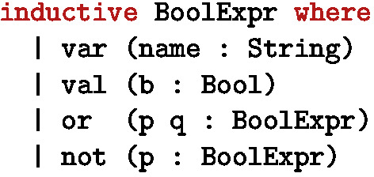
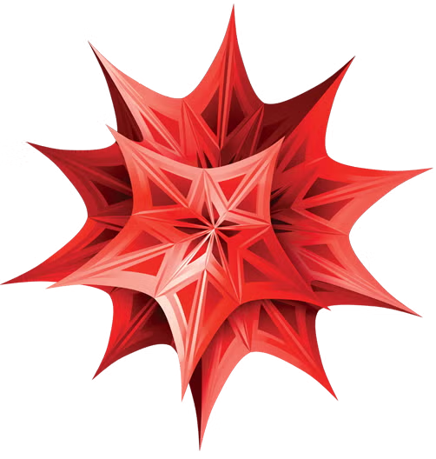
What we actually care, and … what we can trust?
Source fidelity
What did the paper actually state?
Mathematical correctness
Does the conclusion follow from encoded assumptions?
Computational reproducibility
Can the numerical result be regenerated?
Physical-semantic alignment
Does the formal object represent the intended physics?
?
The reverse mathematics zoo,
founded by Damir Dzhafarov , 2019
The Lean 4 Theorem Prover and Programming Language
by Moura L, Ullrich S. 2021
Paper formatting, SUNY

Slide 7
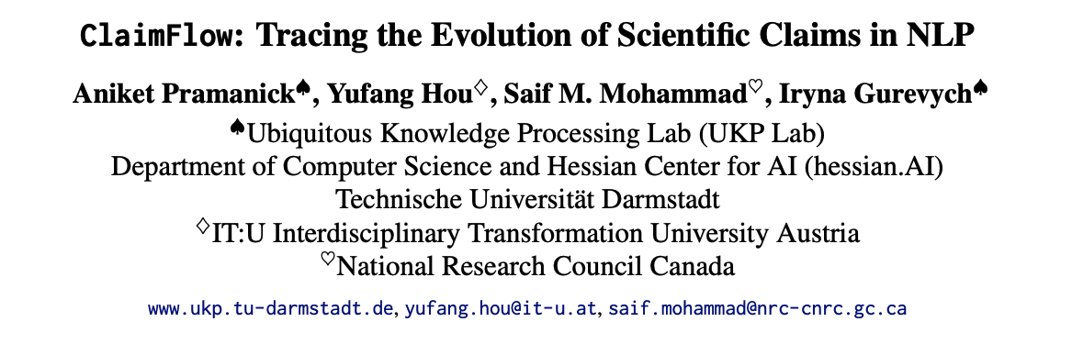
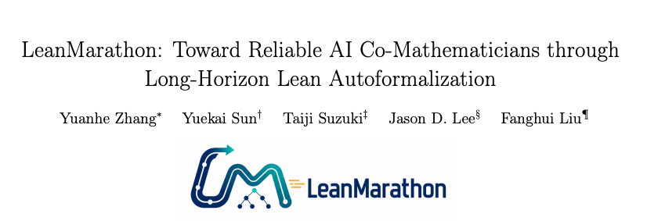
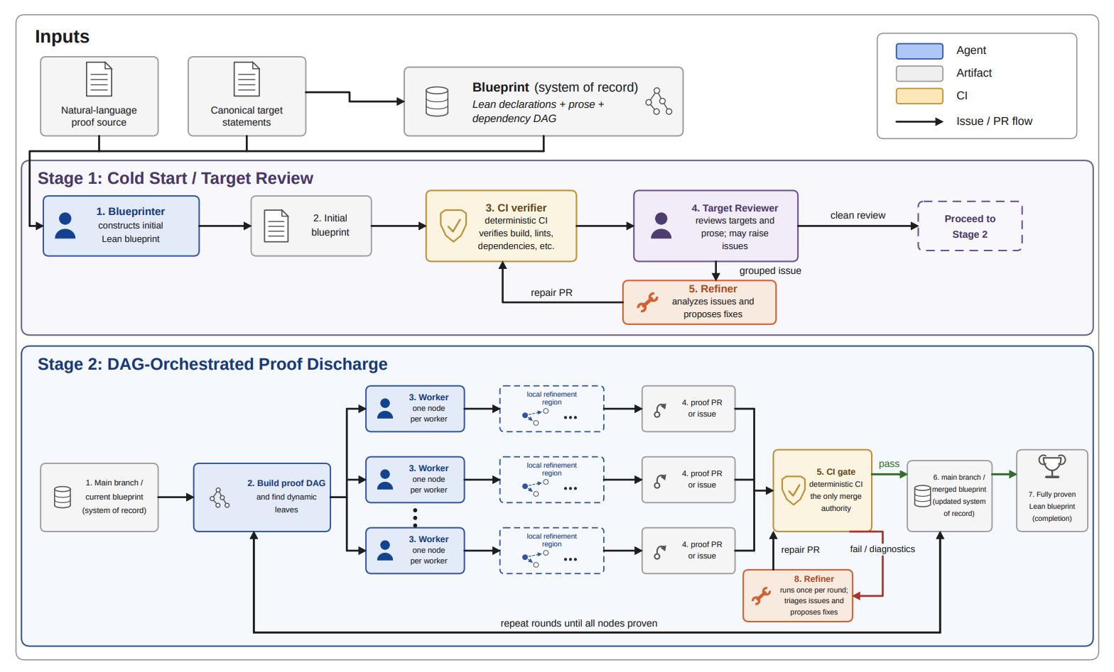
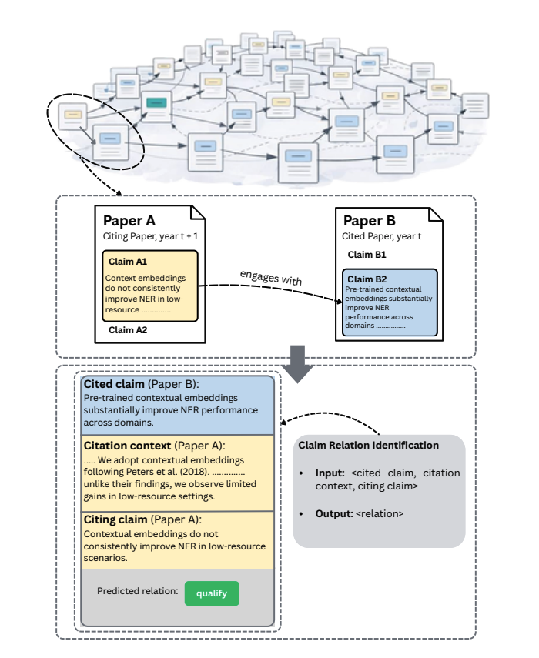
Notes:
跨论文的 claim-level 有向互动图：如何定义和标注 scientific claim；如何判断 citing claim 对 cited claim 的认识论关系；claim 如何传播、受到挑战并随时间演化；claim graph 是否形成主题社群或随时间改变结构。

Slide 8
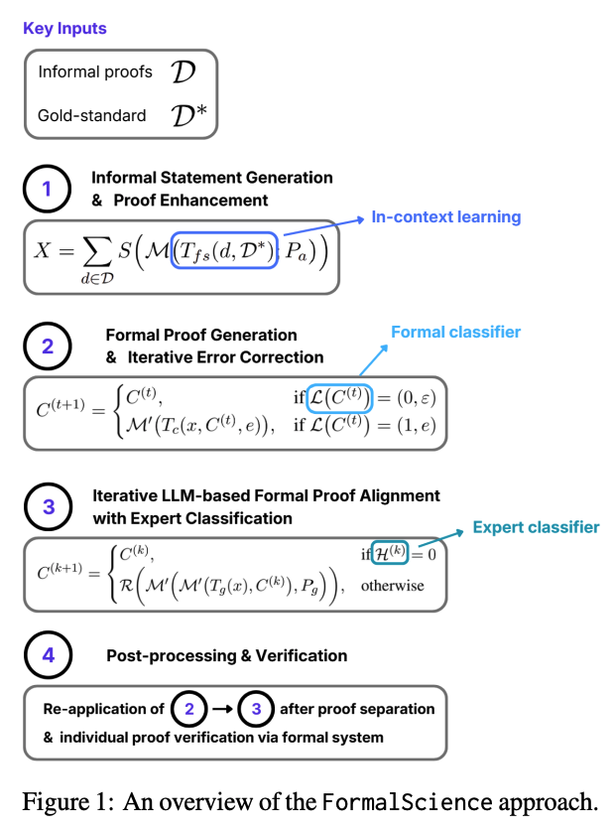
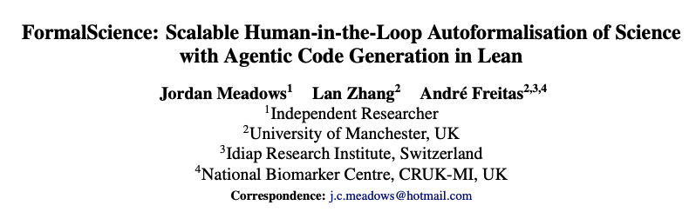
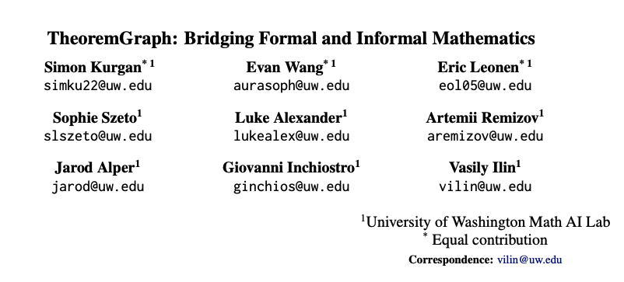
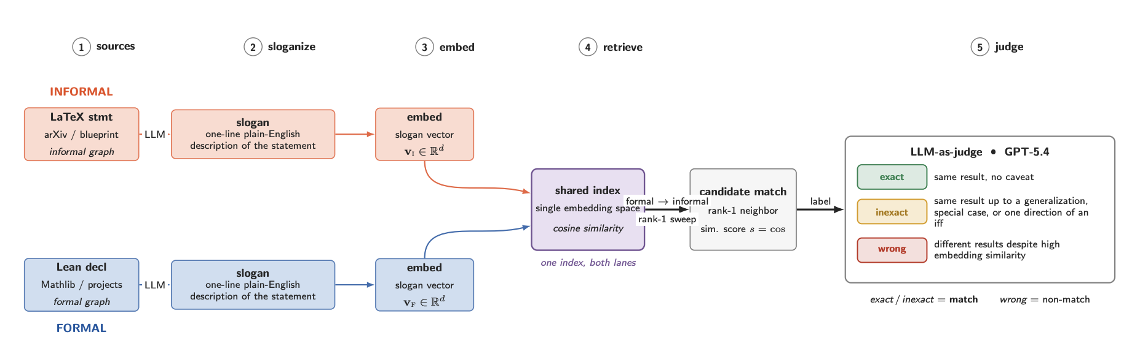

Slide 9
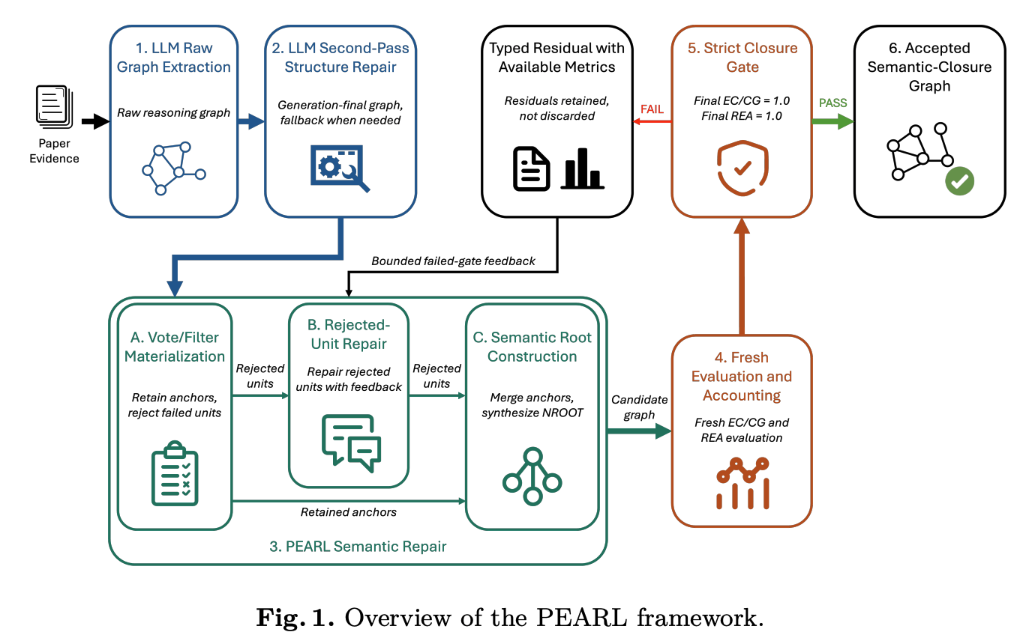
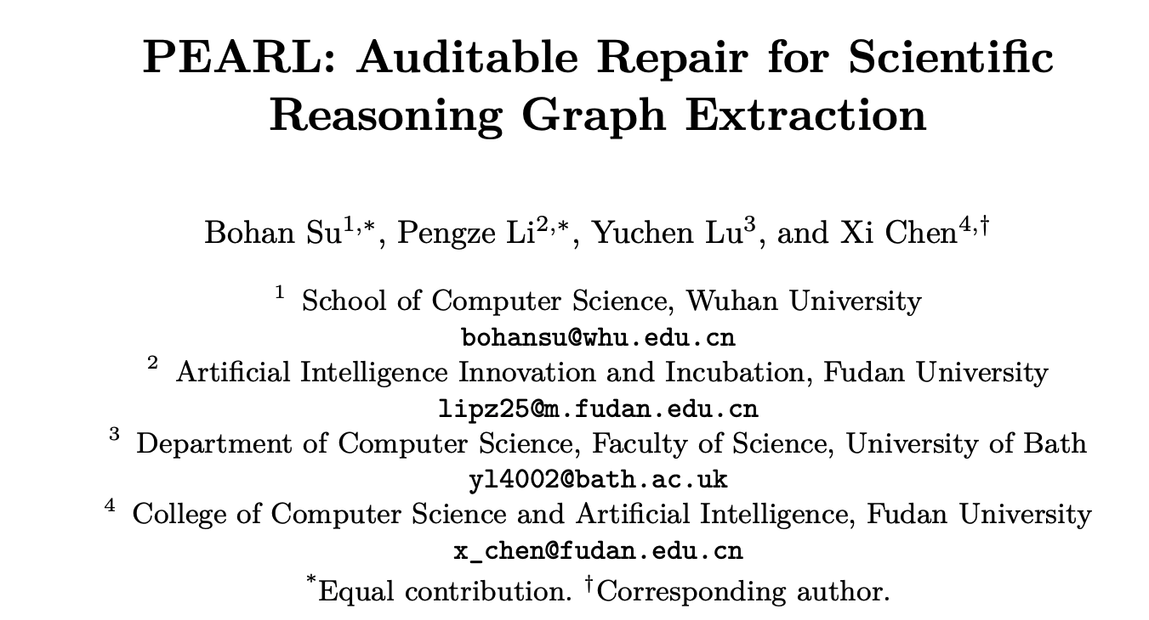
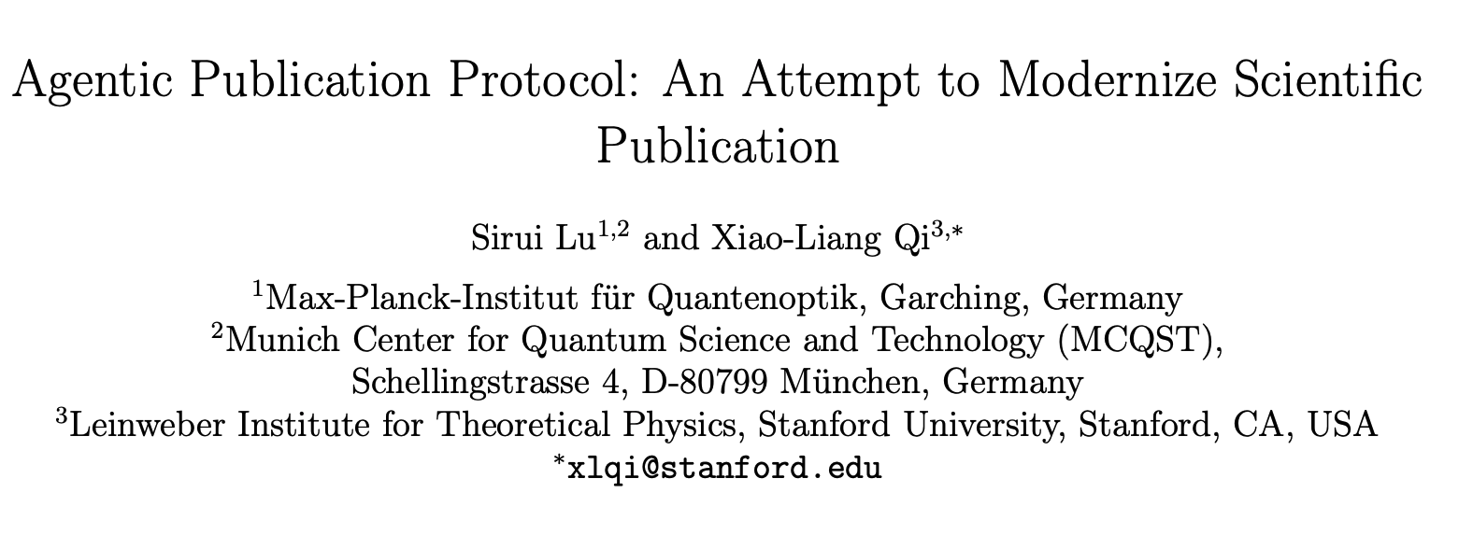
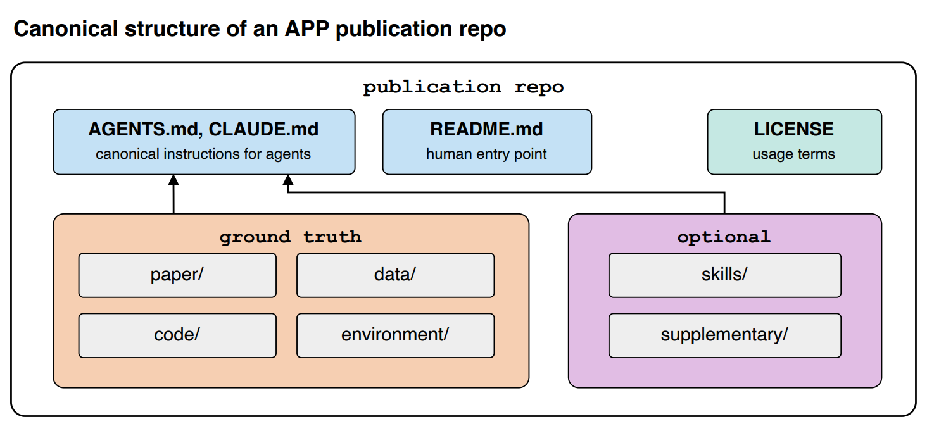
A paper no need to be restricted as a pdf, but could be extended as an agent stayed on git repository

Slide 10
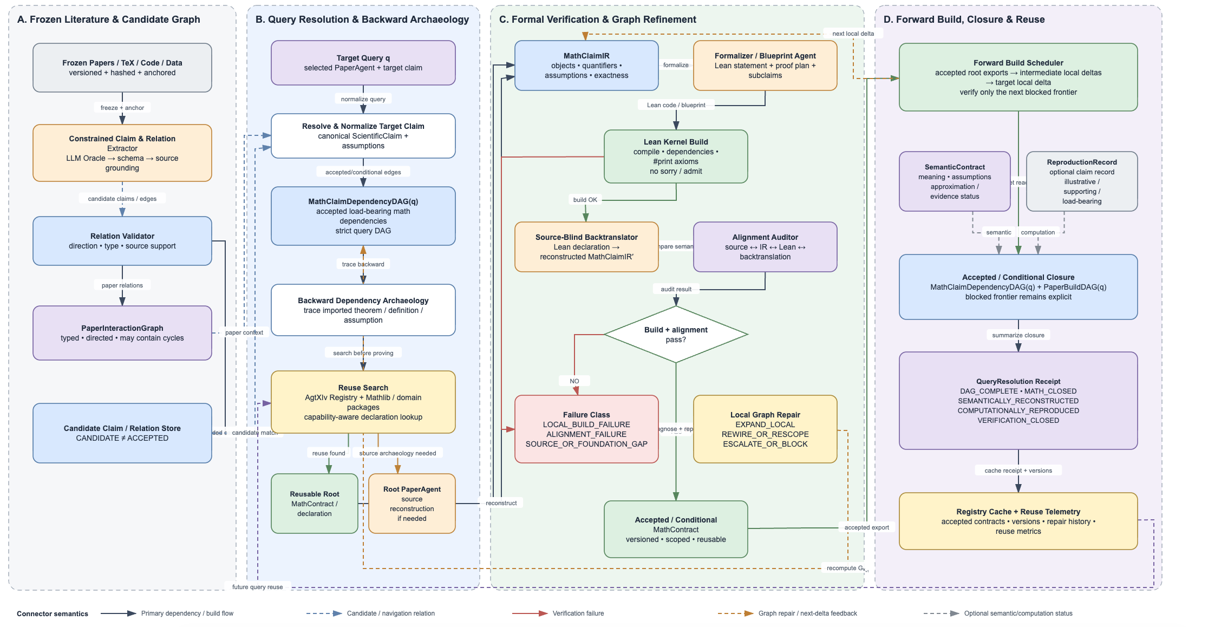
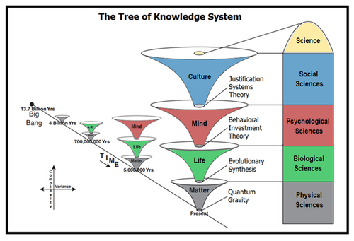
Not just a pipeline, but we need the ”knowledge

Slide 11
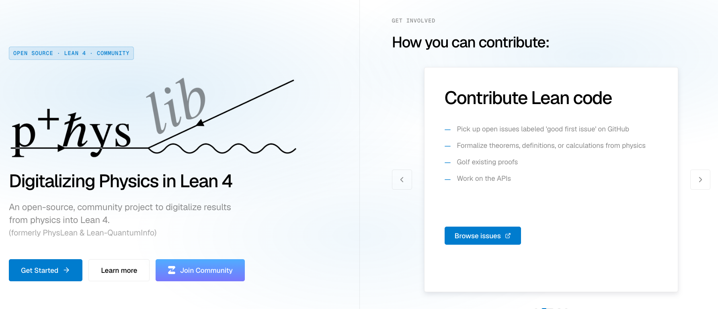

Slide 12
How the auto-formalization works
Notes:
This is from Tobias talk

Slide 13
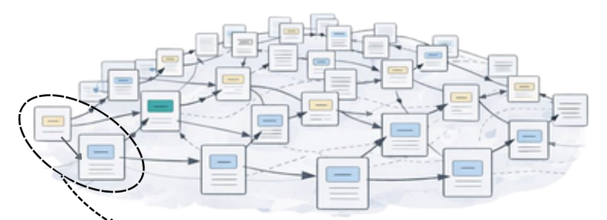



Static arXiv paper → source-faithful Paper Agent → attributable claims → dependency and evidence reconstruction → verification and bounded assessment → contribution delta → reusable knowledge entries → verified knowledge frontier

