Slide 1
Web development assignment 2
An coder nua website

Slide 2
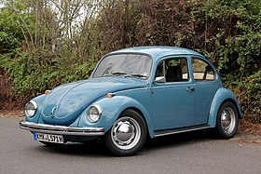

What links these two things?

Slide 3
Purpose of site
Simple means of communicating with starter / intermediate Java programmers
Do so in a quasi professional / personal manner
Combining some other aspects - Personal
Hobbies
Use of external sites
YouTube
Content
Means of providing in an accessible manner
Format
From research from other sites … Keep it simple!
Users don’t want multi-media …They want examples and activities

Slide 4
Original wireframe
Very Basic
6 Pages
Home, Bio, General, Java Tips, Do’s & Don’ts, Contact
Font
Mixture
https://www.dafont.com/c-o-d-e-r.font?text=0+An+COder+Nua+0 - Too brash
Header / Footer
Contains some elements

Slide 5

New structure
8 Pages
1 New
Chop Shop – Tool Kit and The Panucci Chop Shop Challenge
2 Combined
Java Tips + Do’s & Don’t’s – Very similar
Header & Footer
Standardized
3 specific divs with contact info
Does it still meet purpose?
Yes – Means of getting information to intended audience with interactive content
Format
Simplified rather than extended

Slide 6
Required elements
Search bar
Embedded into <head>
Contact us Form (Form validation required)
Separate page with file upload capability
Navigation
Embedded into <head>
Homepage
Sitemap
Not required but will be implemented
Tabular data in a well designed and styled table
Java Topis & Website links
One embedded font using @font-face
Cookie & Forum
Problems with non-alphabetic characters in IE and FireFox (non-Google)
Minimum of 5 pages
8, with plans for 1-2 more or combining
Appropriate use of at least the following HTML elements: ∗ H1, H2, H3, P, EM, STRONG, UL| OL, LI, DIV, SPAN, IMG, A

Slide 7
Lessons Learned & possible remedies
Micro – HTML / CSS
Compatibility
Browser level
Validation
Use of other software
Positive – Excel … List Generating
Negative – An IDE & VERSIONING is needed
Macro
Objectivity & Scope Creep
Nature of site
Time
Balancing of priorities
Equipment (non-software)
Reliability … New PC!!!!

Slide 8
Lesson Learned – An example
Sub lists (a list within a list)
Validation rules with nesting of lists
Example - General_Algorithm_Tips.html
Line 76 – 80 – Old Method
Seems logical (li finishes, then the ol sub list starts)
Format is consistent BUT validation produces an error
Line 69 – 75 - Implementation of recommended suggestion
Incorporate ol into associated li
Validation passes BUT format is messed up
Solutions … on this page
Integrate - ”Help each other”, with nod to “Pass it on” … notion of respect
Separate – “No matter what the topic …”
Eliminate – “Pass it on”

Slide 9
Future
Deployment
Peer Reviews & Feedback
Contact Form / Search functionality
Although not assessed, want to include
Skype / Google hangout
Material
More standard
Some bespoke
More interaction with existing bloggers / websites
Kept simple

Slide 10
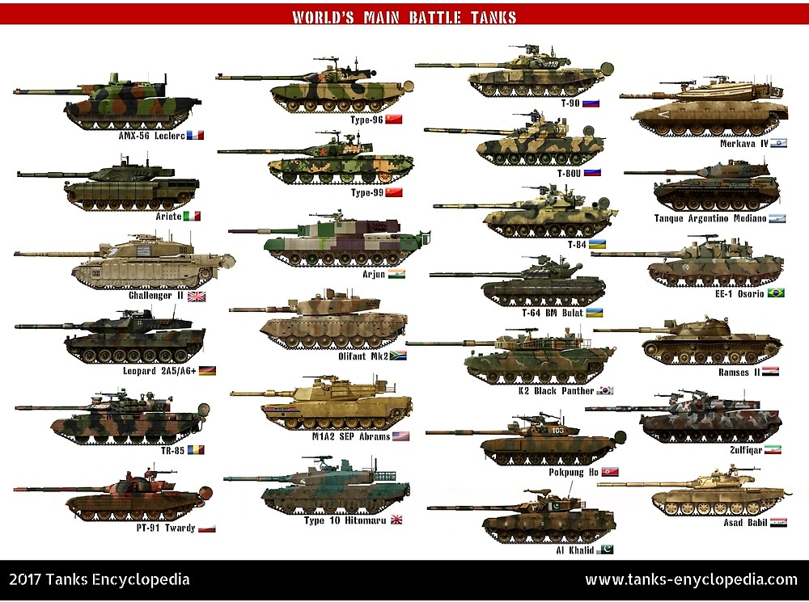
In conclusion …

