Slide 1


Programming with Threads
An Introduction

Slide 2

Why, How and What
Why we use threads?
Make use of Concurrent nature of OS’s
An OS will “context switch” … so must utilise this!
How threads are set up?
Extend Thread class or Implement Runnable interface
Implement own run() and start() methods
What are the main issues when dealing with threads?
Synchronizing … or trying to!!

Slide 3
Processes
Processes
Process is a kernel object that characterizes a 4 gbyte address space within which threads execute
A process is inert.
To work it must have a primary thread
Primary thread enters the program code through one of two functions
main() in the case of console applications
winmain() in the case of Win32 GUI based applications
A subprocess of sorts

Slide 4
Threads
A thread is defined as a path of code execution
Lightweight process
Each thread includes
Set of instructions
Related CPU register values
Stack
CONCURRENCY
Seen as one of the primary means of achieving concurrency
Execution of related tasks in a (more) coordinated fashion
Priority setting

Slide 5
Threads
Two means:
Implement the Runnable interface
Extend the Thread class
Need to look at both
Both use the method:
public void run(){..}

Slide 6

Extending Thread Class
class <TName> extends Thread{
// local variables declared here
public <TName>(param list){
//initialization code here
}
public void run(){
//code for crux of the thread here
}
}

Slide 7
Extending Thread Class II
class MessagePrinter extends Thread{
private String message;
private int n;
MessagePrinter(String m, int count){ // Constructor
message = m; n = count;
}
public void run() { // Thread that prints a message ten times
for(int k = 0; k < n; k++)
System.out.println(message);
}
}

Slide 8
Extending Thread Class III – Running the thread
public static void main(String[] args) {
Thread p = new MessagePrinter(“Hello", 10);
p.start();// start() does reach run(), hence thread will run
}
}

Slide 9

Implementing Runnable Interface
class MessagePrinter implements Runnable {
private String message;
int n;
MessagePrinter(String m, int count){
message = m; n = count;
}
public void run() { // Run method implementation
int k = 0;
while (k < n) {
System.out.println(message);
k++
}
}
}

Slide 10

Implementing Runnable Interface II – Running the thread
class MessagePrinterTest{
public static void main(String[] args) {
Runnable p = new MessagePrinter(“Hi!”, 10);
Thread t = new Thread(p);
t.start();
}
}

Slide 11

Most Important Thread Methods
Most are static methods from the Thread class i.e. Thread.currentThread.
sleep() …Putting a thread to sleep
wait() …Waiting for threads to finish
setName() …Naming threads
getID() …Thread identity
Current thread … currentThread

Slide 12

sleep()
try{
Thread.sleep(<period>);
}catch(InterruptedException e){..}
Time period usually measured in milliseconds
1000 milliseconds = 1sec
Notice Exception Handling needed …

Slide 13

Threads
A thread can delay itself until another thread t has terminated, by executing join()
try {
t.join();
}catch(InterruptedException e) {}

Slide 14

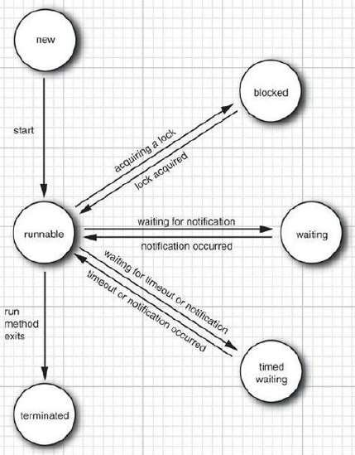



THREAD STATES
6 thread states
New
Runnable
Blocked
Waiting
Time waiting
Terminated
Use getState method
Thread.State
No resources associated
Runnable ≠ Running
13

Slide 15

THREAD STATES
New threads
Just created with the new operator. Not yet running
Runnable threads
Once the start method is invoked.
Resource creation, scheduling
run method is invoked
It may or not actually be running
DO NOT CALL RUN METHOD DIRECTLY!
public static void main(String[] args) {
// Not concurrent, but sequential
new MyThread().run();
for (int i = 0; i < 200; i++) System.out.println("Cycle - " + i);
}

Slide 16
Thread Priority
Higher priority threads - precedence
Threads are created they are given the same priority as the thread that constructed them
However, the underlying operating system can influence the order in which threads are executed
10 different priority values. The range is 1..10
There are three priority constants. These are Thread.MAX_PRIORITY Thread.NORM_PRIORITY Thread.MIN_PRIORITY

Slide 17

Thread Priority
Methods:
setPriority(int p) p>=1 && p <=10
getPriority()

Slide 18
Asynchronous Procedures
Threads that compute results and return them are often referred to as Asynchronous Procedures
Return immediately after invocation
Caller and called run in parallel
Example
Calculate sum of elements in array and return result
Implementation
Extend the Thread class and add a public method, say getResult(), that returns the result of the computation

Slide 19
Example … Using Runnable
public class MyRunnable implements Runnable { private Thread threadToBeCreated; private String nameOfThread; public static void main(String args[]) { //Creating 10 threads so that context switching can be seen fully ... for (int i = 0; i < 10; i++) { MyRunnable R1 = new MyRunnable("Thread: " + i ); R1.start(); // Kicks off start() which eventually reached run() } // MyRunnable R2 = new MyRunnable( "Second Thread-2"); // R2.start(); } // Constructor so that name of thread can be assigned to each one MyRunnable(String name) { nameOfThread = name;
System.out.println("Creating " + nameOfThread + " :ID : " + Thread.currentThread().getId()); }

Slide 20
Example … run() method
// run() overriding method from Runnable interface public void run() { System.out.println("Running " + nameOfThread); try { for (int i = 0; i < 10; i++) { System.out.println("Thread currently in Context: " + nameOfThread + " : ID : " + Thread.currentThread().getId()); // Set the thread sleep to see a context switch. Thread.sleep(500); //.5 of a second sleep interval } } catch (InterruptedException e) { System.out.println("Thread " + nameOfThread + ": ID :" + Thread.currentThread().getId() + " interrupted."); } System.out.println("Thread " + nameOfThread + ": ID :" + Thread.currentThread().getId() + " finishing ..."); }

Slide 21
Example … start() method
// start() which corresponds to Thread class start() public void start() { System.out.println("Starting " + nameOfThread + ": ID :" + Thread.currentThread().getId()); // If the thread isn't already created, create it!! if (threadToBeCreated == null) { threadToBeCreated = new Thread(this, nameOfThread); threadToBeCreated.start(); } } }// End of class

Slide 22
Threads – A Summary
Why
To break a program down into more distinct executable parts to use Context Switching at processor level
How
Extend Thread class
Implement Runnable interface
run() method will represent basis of the thread, but may need to use start() as well
What
Use other methods, states in thread class to “control” threads
Sleep, Join
Priorities
CONCURRENCY!
OR

Slide 23
Exercises
Give everyday applications where you think the use of threads may be benficial
Create two threads (one printing odd numbers, the other printing even). Using sleep(), try to manipulate the processor to see context switching

Slide 24
Links
https://docs.oracle.com/javase/7/docs/api/java/lang/Thread.html
https://www.tutorialspoint.com/java/java_multithreading.htm
https://www.callicoder.com/java-multithreading-thread-and-runnable-tutorial/

