Slide 1
Mixed Effect Models in R
Hannah Tavalire, PhD

Slide 2
What is a mixed effect model?
Assumptions (LME)
The explanatory variables are related linearly to the response…
Errors have constant variance.
Errors are independent.
Errors are normally distributed.
How would you check this…?
ML versus REML? Depends on the questions…
ML estimator attempts to find the parameter values that maximize the likelihood function, given your observations.
ML: principle of ML applied to the full model
REML: ML applied to the least-squared residuals- subtract out the fixed effects then the distribution of the residuals depends on the variance components
REML better for random effects, ML better for fixed effects

Slide 3

Linear Mixed Effect Models
Distribution assumed multivariate normal with mean zero
n x q model matrix for the q-dim random effect variable beta
Vector of random effects
Vector of response values
Diagonal matrix of known prior weights
Vector of known prior offset terms
n x p model matrix
Implies conditional distribution given that we have fixed the values of B to b
P-dim coefficient vector
(Bates et al., 2015)

Slide 4
What is a mixed effect model?
Involves both fixed and random effects
Multiple definitions out there, but for the sake of today…
Fixed effect= Constant across individuals… we are interested in comparing levels
Random effect= Predictor variables where you are interested in making inferences about the distribution of values not necessarily the differences between particular levels
Allowed to vary across individuals
Can be uneven or within group replication can be small

Slide 5

Notes:
Lets say we want to compare DBH in three forests of differing successional stages, and we have time to measure 50 trees in each of 4 forests (2 early and 2 late succession). So in this example our fixed effect would be successional stage, since this is the factor we are interested in. We are randomly selecting trees, and don’t necessarily care about which individuals are measured. We may also want to control for tree species, but we don’t necessarily care about the DBH variation for each species, so we would assign this as a random effect. Then we can describe the proportion of variance attributed to the species after controlling for forest stage.

Slide 6
Main uses of Mixed Effect Models?
Experiments (blocks/plots)
Variance component models
Longitudinal data

Slide 7
Notes:
Back to our tree example, let’s say we go out every 4 months and measure our trees, now we can assign tree ID as a random effect in the model to partition the variance within a tree over time.

Slide 8
Popular packages
lme4
nlme
Some I have found useful…
MCMCglmm
coxme
VarComp

Slide 9
Lme4 versus nlme
PRO LME4:
(1) more efficient linear algebra tools, giving improved performance on large problems;
(2) simpler syntax and more efficient implementation for fitting models with crossed random effects;
(3) the implementation of profile likelihood confidence intervals on random-effects parameters; and
(4) the ability to fit generalized linear mixed models
PRO NLME: The main advantage of nlme relative to lme4 is a user interface for fitting models with structure in the residuals (various forms of heteroscedasticity and autocorrelation) and in the random-effects covariance matrices (e.g., compound symmetric models). With some extra effort, the computational machinery of lme4 can be used to fit structured models that the basic lmer function cannot handle. Actually gives significance values…
(Bates et al., 2015)

Slide 10
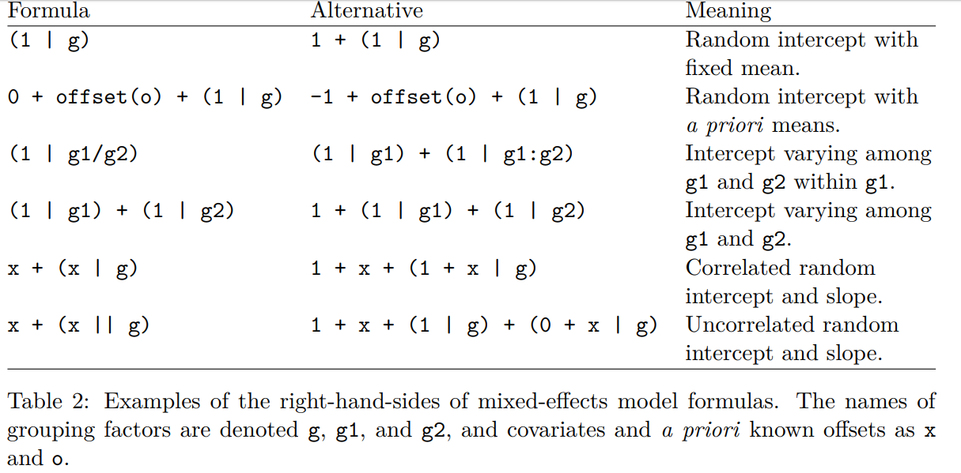
lme4
Coding is similar in nlme… as you will see in the tutorial
(Bates et al., 2015)

Slide 11
Offset versus Weight
Offset= A ‘structural’ predictor, not estimated by the model but assumed to have a value of 1. Differing levels of exposure to an event; common when dealing with count data (age of each forest plot could differ)
Weight= Scales the variance of the response. Known values varying from observation to observation (area of each forest plot or number of trees measured per plot could differ)

Slide 12
lme4 & nlme Tutorial
lme4
lmer (linear)
glmer (generalized- specify error distribution and link function)
binomial(link = "logit")
gaussian(link = "identity")
Gamma(link = "inverse")
inverse.gaussian(link = "1/mu^2")
poisson(link = "log")
quasi(link = "identity", variance = "constant")
quasibinomial(link = "logit")
quasipoisson(link = "log")
Also nlmer, glmer.nb, etc
nlme
lme
gnls
nlme

Slide 13
References
Bates, D., Machler, M., Bolker, B. M., & Walker, S. C. (2015). Fitting Linear Mixed-Effects Models Using lme4. Journal of Statistical Software, 67(1), 1-48.
Bolker, B. M., Brooks, M. E., Clark, C. J., Geange, S. W., Poulsen, J. R., Stevens, M. H. H., et al. (2009). Generalized linear mixed models: a practical guide for ecology and evolution. Trends in Ecology & Evolution, 24(3), 127-135.
Kenward, M. G., & Roger, J. H. (1997). Small sample inference for fixed effects from restricted maximum likelihood. Biometrics, 53(3), 983-997.
Laird, N. M., & Ware, J. H. (1982). RANDOM-EFFECTS MODELS FOR LONGITUDINAL DATA. Biometrics, 38(4), 963-974.
Lindstrom, M. J., & Bates, D. M. (1990). NONLINEAR MIXED EFFECTS MODELS FOR REPEATED MEASURES DATA. Biometrics, 46(3), 673-687.

