Slide 1
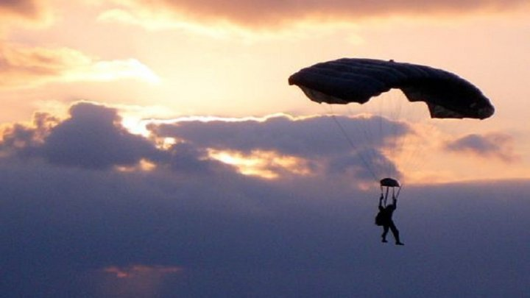
Skydiving
Rogojinar Felicia

Slide 2
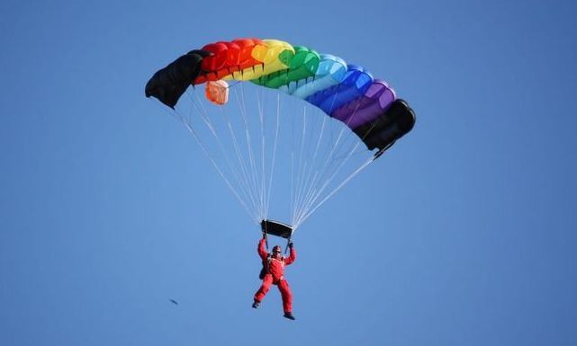
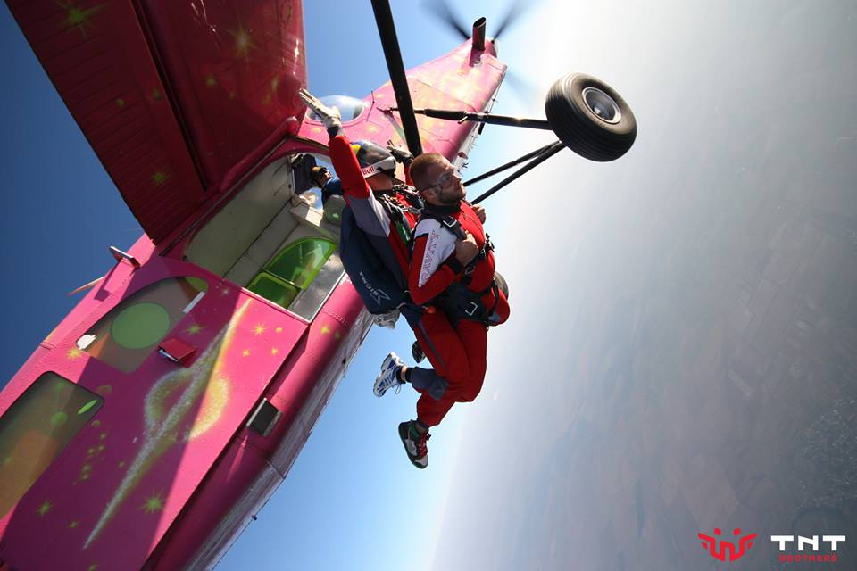
Skydiving is parachuting from an airplane for fun. Skydiving can be done individually and with groups of people. Training is required. Unlike most paratroopers, skydivers often wait until they are low, before opening the parachute. The jump can also be made from a helicopter or a balloon that is high enough in the sky. Skydiving can be an exciting sport.

Slide 3
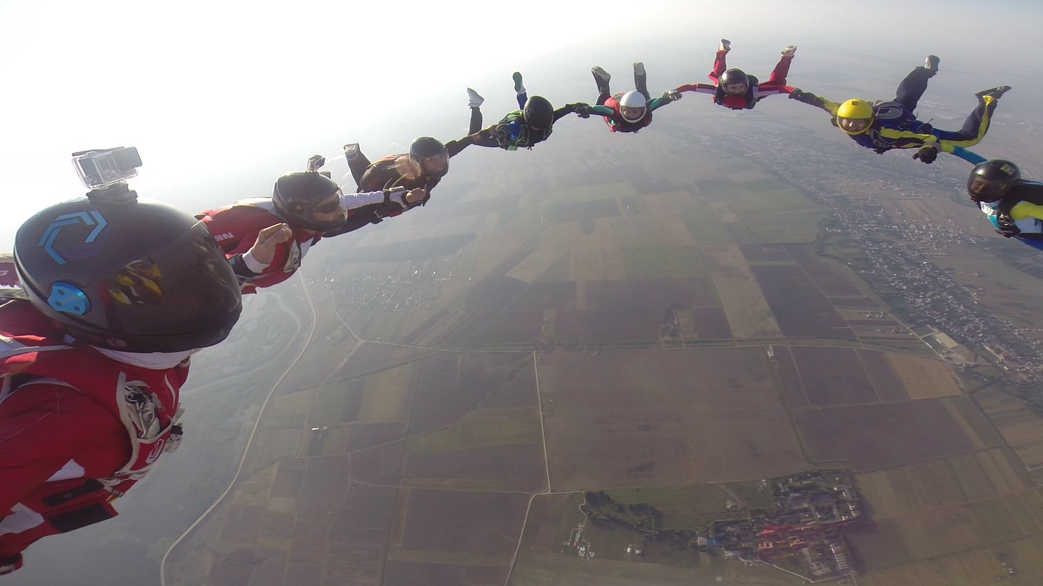
During a skydive, total freedom and control of the air can be enjoyed as well as many complex and spectacular manoeuvres including flat turns, somersaults and formation skydiving. Skydiving can be enjoyed either as an individual - doing solo(alone) jumps - or as part of a team carrying out formation skydiving. Generally, the term ‘skydive’ refers to the time spent in freefall from exiting an aircraft to deploying a parachute but skydiving does include some disciplines such as accuracy landings and canopy formation flying which concentrate on the time spent once a canopy has been deployed.

Slide 4
Jumping from the plane in tandem with an instructor is the most accessible and safe way to experience the unique sensations offered by skydiving. No special training is needed, just a dose of courage and the desire to do something special. Before the jump, the instructor does a theoretical 15-minute training in which he explains exactly how the jump will go. You just have to want to parachute, call us, and we'll take care of the rest.Once you reach the launch height after positioning yourself in the door of the plane, the instructor gives the exit signal and starts the best part of the jump: the free fall. From the moment you get off the plane until the parachute is fully opened, it is a perfectly controlled fall by the instructor that offers an unforgettable feeling. The sensation of floating is further accentuated by the presence of the cameraman, who will be in front of the tandem to film the jump

Slide 5
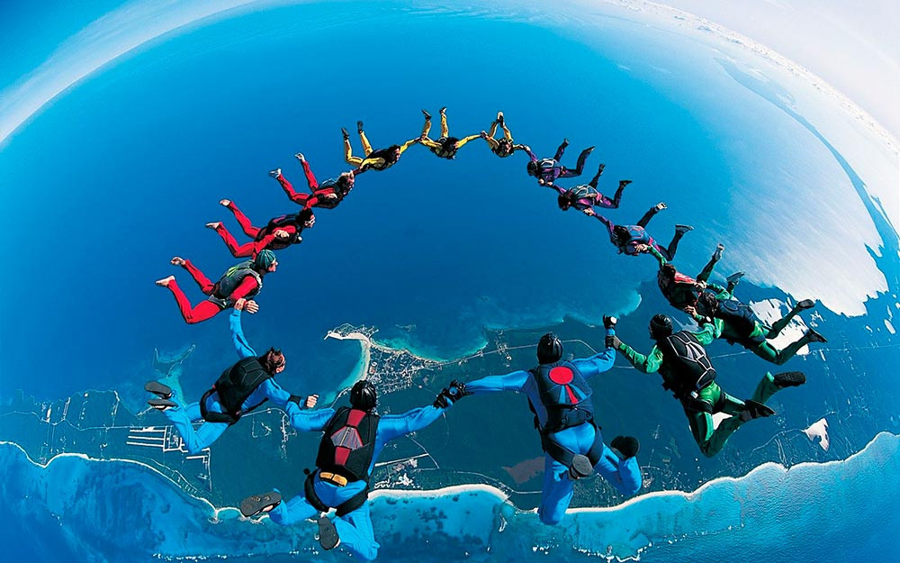
When you fly with a parachute you feel very free and confident. It seems that everything around is changing and you see the world completely from elsewhere. See how beautiful nature is and how many amazing places there are in the world. The parachute helps you feel freer and get rid of the fear of both heights and forget all the problems. Nothing can be more pleasant than being outdoors.

Slide 6
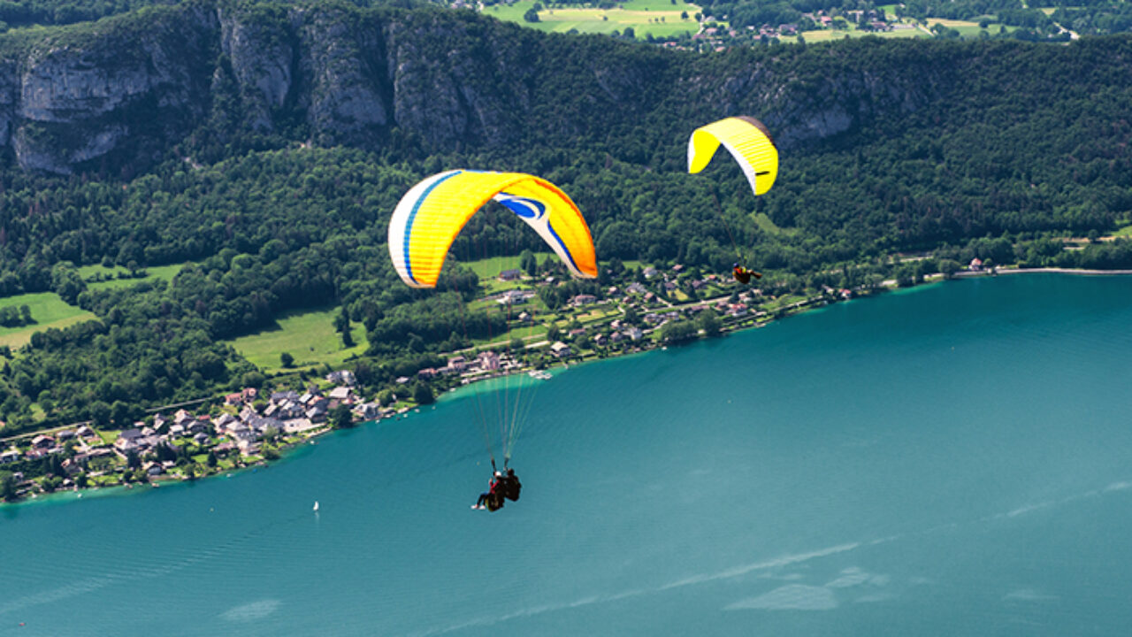
I urge every person who does not feel confident and free to experiment and jump at least once with the parachute. Skydiving will change your view of the world and help you understand that the world is much more beautiful and full of amazing places.

