Slide 1

Evaluation of the vertex coordinate of D* gives as a result a destribution not centred in $\left(x, y ,z\right)=\left(0, 0, 0\right).$
No difference between UP and DOWN configuration

Slide 2
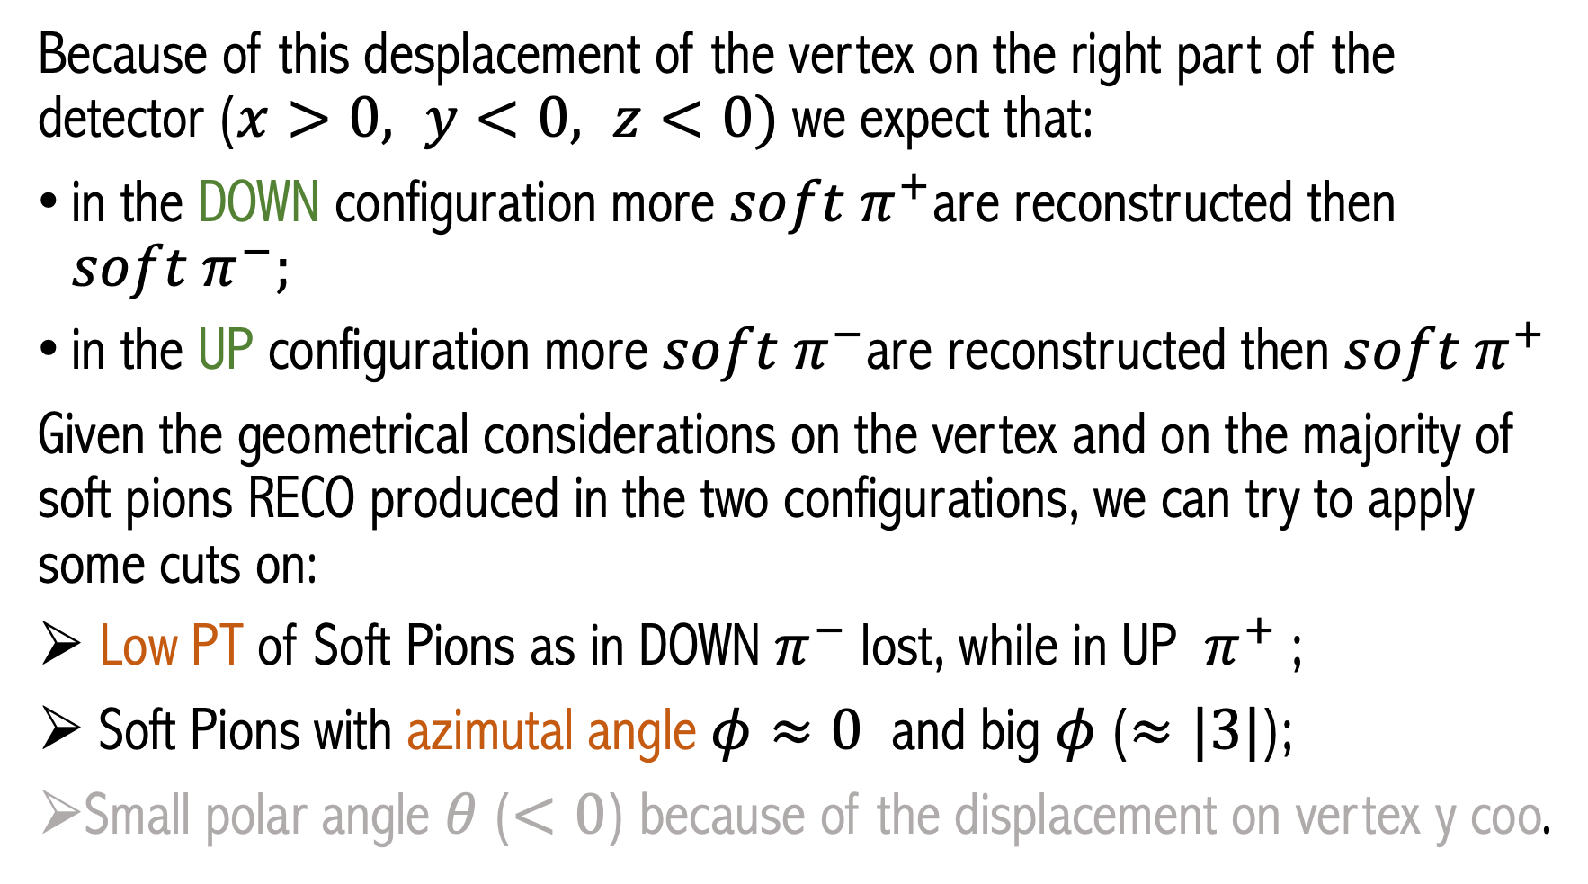
Because of this desplacement of the vertex on the right part of the detector ($x>0, y<0, z<0)$ we expect that:
in the DOWN configuration more ${soft π}^{+}$are reconstructed then ${soft π}^{−};$
in the UP configuration more ${soft π}^{−}$are reconstructed then ${soft π}^{+}$
Given the geometrical considerations on the vertex and on the majority of soft pions RECO produced in the two configurations, we can try to apply some cuts on:
Low PT of Soft Pions as in DOWN${ π}^{−}$lost, while in UP ${ π}^{+}$;
Soft Pions with azimutal angle $φ≈0$ and big $φ$ ($≈|3|$);
Small polar angle $θ$ ($<0$) because of the displacement on vertex y coo.

Slide 3
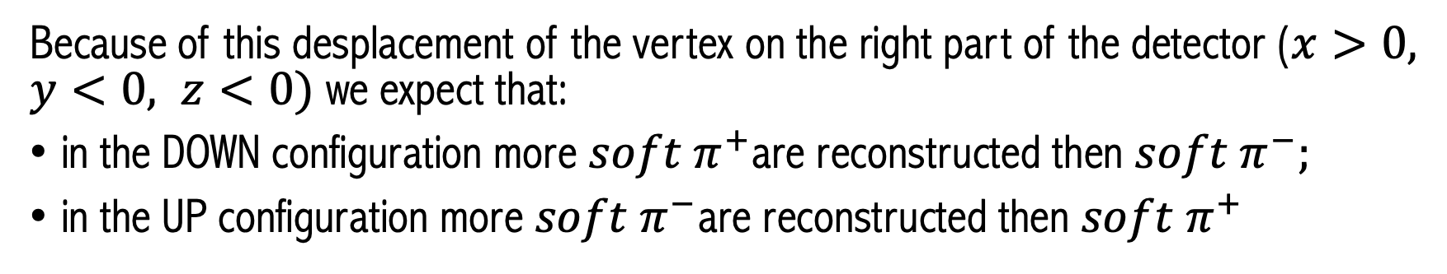
Because of this desplacement of the vertex on the right part of the detector ($x>0, y<0, z<0)$ we expect that:
in the DOWN configuration more ${soft π}^{+}$are reconstructed then ${soft π}^{−};$
in the UP configuration more ${soft π}^{−}$are reconstructed then ${soft π}^{+}$
N_{TOT} = 3 X 10⁶
DOWN | P1 | P2 | SOFT PION | D0 | D*
N_{reco} pos No cut | 2674000 | 2626350 | 2374360 | 2253370 | 1737460
N_{reco} neg No cut | 2675660 | 2598950 | 2356980 | 2276140 | 1740180
N_{reco} pos Cut | 2674000 | 2626350 | 463382 | 2253370 | 342762
N_{reco} neg Cut | 2675660 | 2598950 | 461964 | 2276140 | 344307
UP | P1 | P2 | SOFT PION | D0 | D*
 | 2669990 | 2620280 | 2352910 | 2249370 | 1720940
 | 2670540 | 2595820 | 2371060 | 2270520 | 1749450
 | 2669990 | 2620280 | 461785 | 2249370 | 341617
 | 2670540 | 2595820 | 462610 | 2270520 | 344705

Slide 4
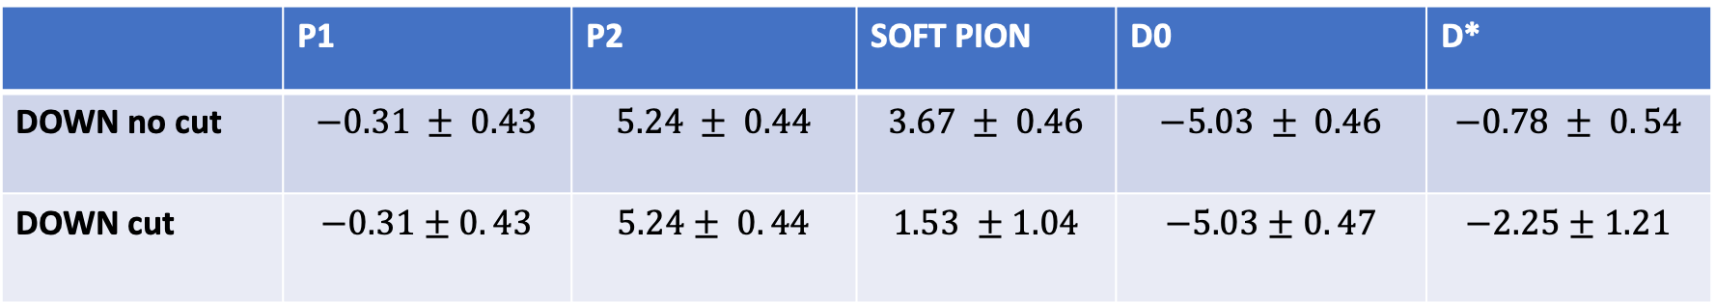
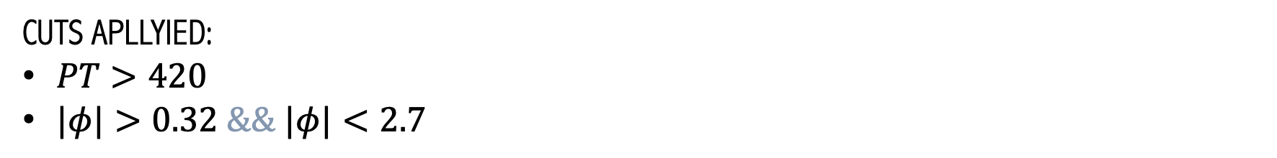
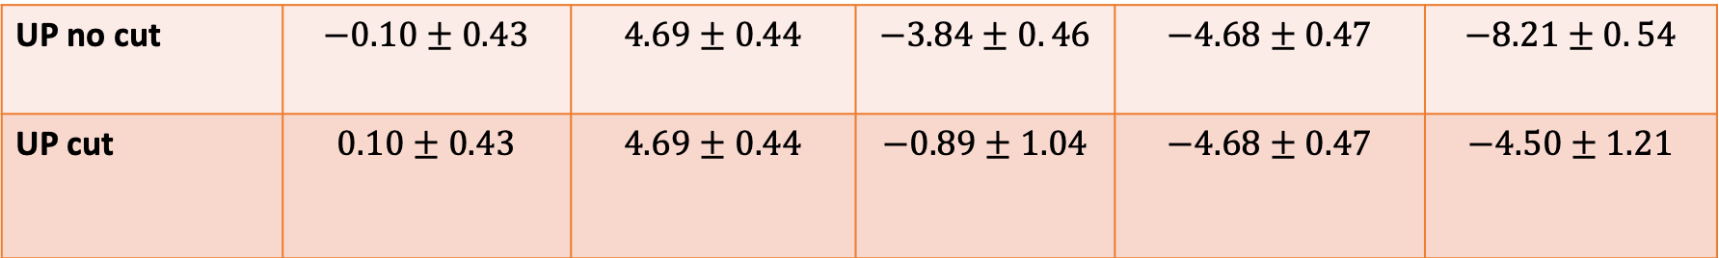
Asymmetries $\frac{N_{+}−N_{−}}{N_{+}+N_{−}}×{10}^{−3}$ for all the particles are
 | P1 | P2 | SOFT PION | D0 | D*
DOWN no cut | $$−0.31 ± 0.43$$ | $$5.24 ± 0.44$$ | $$3.67 ± 0.46$$ | $$−5.03 ± 0.46$$ | $$−0.78 ± 0. 54$$
DOWN cut | $$−0.31±0. 43$$ | $$5.24± 0. 44$$ | $$1.53 ±1.04$$ | $$−5.03±0. 47$$ | $$−2.25±1.21$$
UP no cut | $$−0.10±0.43$$ | $$4.69±0.44$$ | $$−3.84±0. 46$$ | $$−4.68±0.47$$ | $$−8.21±0. 54$$
UP cut | $$0.10±0.43$$ | $$4.69±0.44$$ | $$−0.89±1.04$$ | $$−4.68±0.47$$ | $$−4.50±1.21$$
CUTS APLLYIED:
$PT>420$
$|φ|>0.32 \&\&$ $|φ|<2.7$

Slide 5
NO CUTS vs CUTS (effects on sPi) DOWN configuration:

Slide 6
NO CUTS vs CUTS (effects on sPi) UP configuration:

Slide 7
NO CUTS vs CUTS (effects on sPi asimmetries) DOWN configuration:

Slide 8
NO CUTS vs CUTS (effects on sPi asimmetries) UP configuration:

