Slide 1
Scandalul Parmalat
Frauda corporatista
Cojocaru Eugeniu

Slide 2

Agenda
Introducere
Scurt istoric
Scandal
Concluzii
Bibliografie

Slide 3

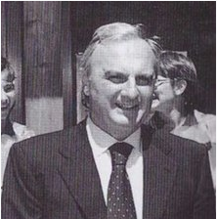
Introducere
Companie fondata in 1961 in Parma, Italia
Fondator: Castilo Tanzi
Listata la bursa din Milano: 1990
Domeniu de activitate: industria alimentara

Slide 4
Scurt istoric
1961 – fondat afacerea
1980 – afacerea urca pe pragul multinational
1990 – listat la bursa din Milano
1997 – piete financiare
2002 – record valoare a stocurilor => 3.7 miliarde €, +30 tari, +30 000 angajati
2003 – insolventa => 14.3 miliarde € (453.44 ani)

Slide 5
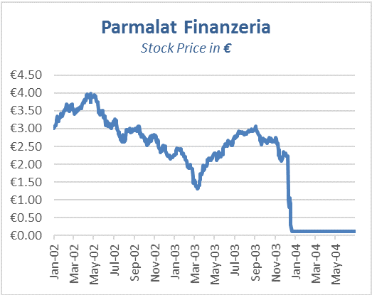
Scandal
1997 – extindere pe bursa, achizitii internationale
2001 – profit redus, vanzare de derivate
2003
150 M €
3.95 mld € - Insulele Cayman
CFO Fausto Tonna (300M), CFO Alberto Ferraris, CFO Luciano Del Soldato
8 mld € decembrie => 14.3 mld €

Slide 6
Concluzii
Declinul investitiilor in companii asemanatoare Parmalat
Statele Unite – Sarbanes-Oxley Act
Uniunea Europeana - Eighth Company Law Directive

Slide 7
Bibliografie
https://www.econcrises.org/2016/11/29/parmalat/
https://en.wikipedia.org/wiki/Parmalat
https://en.wikipedia.org/wiki/Parmalat_bankruptcy_timeline
https://en.wikipedia.org/wiki/Calisto_Tanzi
https://www.theguardian.com/business/2004/oct/06/corporatefraud.businessqandas
https://shippingandcommodityacademy.com/blog/parmalat-scandal-2003-the-complete-story/

Slide 8
Multumesc pentru atentie!
Q & A

