Slide 1
CS 634 Data Mining Term Paper
Professor: Jason Wang
Student Name: YuQing Ding
(UCID: yxd1372 @njit.edu)
Original Review Paper Title
Distribution Network Outage Data Analysis and Repair Time Prediction
Using Deep Learning
Authors: Anmar Arif, Zhaoyu Wang
Published Year: 2018
Conference: 2018 IEEE International Conference on Probabilistic Methods Applied to Power Systems (PMAPS)
References: https://ieeexplore-ieee-org.libdb.njit.edu:8443/document/8440354 (Links to an external site.)
Go to Non-trivial example

Slide 2
Distribution Network Outage Data Analysis and Repair Time Prediction Using Deep Learning
Power outages in the distribution network
6.69 million customers experienced power outages due to Hurricane Irene
8.66 million customers experienced power outages due to Hurricane Sandy
Critical for utilities to estimate the repair time for the damaged components
Critical for logistics planning and dispatch the crews to restore service
Critical for public outreach to inform the public predicted restoration time

Slide 3
Distribution Network Outage Data Analysis and Repair Time Prediction Using Deep Learning
Data Set: 6-year power outrage data of a US utility including major storms
statistical analysis of outages in different weather events
Deep Neural Network (DNN) is used to predict the repair and restoration times
DNN training with 1-5 year outrage data and DNN prediction with 6th year outrage data
Benefit of DNN in prediction as compared to other prediction models.

Slide 4

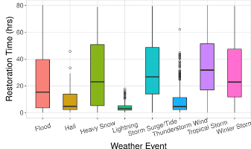
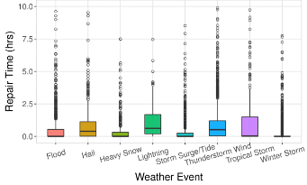
Distribution Network Outage Data Analysis and Repair Time Prediction Using Deep Learning
Data analysis to identify inputs w/ high impact
Statistical analysis of outages showed the restoration time is highly variable.
Large STD in times of extreme events (e.g. ﬂooding, heavy snow, hurricanes)
Dependencies on number of users, circuits failures and weather events.
Click me!
Click me!
Click me!

Slide 5

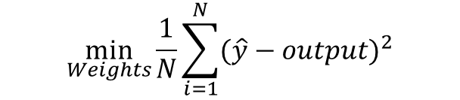
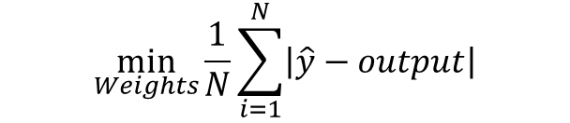
Distribution Network Outage Data Analysis and Repair Time Prediction Using Deep Learning
DNN Model Topology:
feed-forward Neural Network with multiple layers
multiple hidden layers of nodes (neurons) between the input/output layers
353 inputs and 4 hidden layers
Activation function is Rectiﬁed Linear Unit (Relu): f(x)=max (0,x)
Cost Function is error (mean square and abs. error)
$$\min_{Weights}{\frac{1}{N}}\sum_{i=1}^{N}{{(\hat{y}−output)}^{2}}$$
$$\min_{Weights}{\frac{1}{N}}\sum_{i=1}^{N}{\left|\hat{y}−output\right|}$$

Slide 6
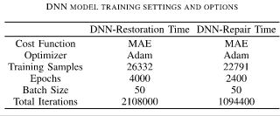
Distribution Network Outage Data Analysis and Repair Time Prediction Using Deep Learning
DNN Training Data Set (1-5th year)
algorithm for the ﬁrst-order gradient-based optimization of stochastic objective functions.
The performance of the network stopped improving signiﬁcantly after 4000 and 2400 epochs for the repair time and restoration time, respectively.

Slide 7
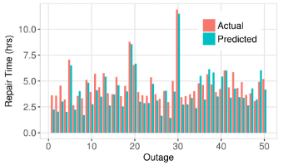
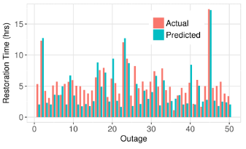
Distribution Network Outage Data Analysis and Repair Time Prediction Using Deep Learning
DNN Prediction Data Set (6th year)
MAE is 0.32 hours and 2.2 hours for the repair time and restoration times.
DNN to predict repair time outperforms the restoration time due to less STD.
Click me!
Click me!

Slide 8
DNN Prediction Non-Trivial Examples
DNN Prediction
Non-Trivial Example

Slide 9
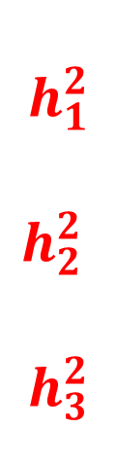
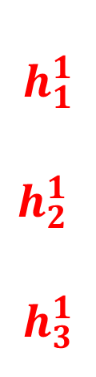
DNN Prediction Non-Trivial Examples
Deep neural network has multiple hidden layers. ‘Deep’ means multiple layers deep.
$$h_{1}^{1}$$
$$h_{2}^{1}$$
$$h_{3}^{1}$$
$$h_{1}^{2}$$
$$h_{2}^{2}$$
$$h_{3}^{2}$$
X1
X2
X3
Y1
Y2
Input layer X: 0 hidden layer: 1 hidden layer: j=2,…n Output Layer Y: n+1
with neutrons $h_{i}^{1}$ with neutrons $h_{i}^{j}$

Slide 10

DNN Prediction Non-Trivial Examples
DNN has multiple neutrons in each layer. Each hidden layer has activation functions to capture (1) non-linear effects (2) interaction effects.
Input layer: 0 hidden layer: 1 hidden layer: 2,…, n Output Layer
X1
X2
X3
Y1
Y2
Y ₁ =0
Y ₂ =1
Rectified Linear Units (ReLU) function: f(x)=max(0,x)
Sigmoid function:
f(x)=sigmoid(x)=

Slide 11
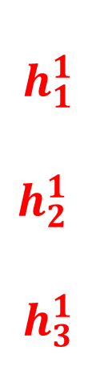
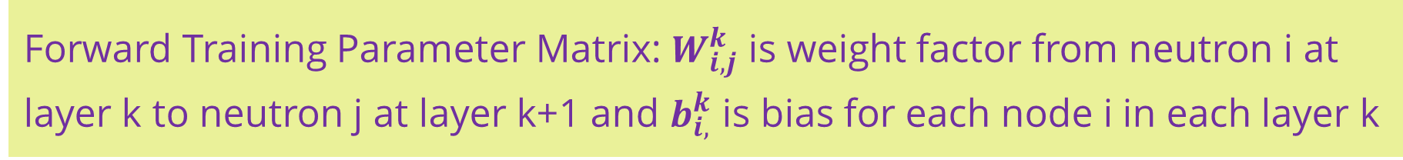
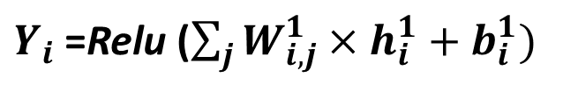
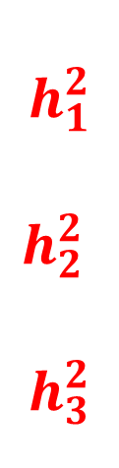
DNN Prediction Non-Trivial Examples
Forward Training Parameter Matrix: $W_{i,j}^{k}$ is weight factor from neutron i at layer k to neutron j at layer k+1 and $b_{i,}^{k}$ is bias for each node i in each layer k
$h_{i}^{1}$=Relu ($\sum_{j}{W_{i, j}^{0}×X_{i}+b_{i}^{0})}$ ${ h}_{i}^{k}\text{=}\text{sigmoid} \text{(}\sum_{j}{W_{i, j }^{k−1}×h_{i}^{k−1}+b_{i}^{k−1})}$
$Y_{i}$=Relu ($\sum_{j}{W_{i,j}^{1}×h_{i}^{1}+b_{i}^{1})}$
W⁰ W¹ W²
$$h_{1}^{1}$$
$$h_{2}^{1}$$
$$h_{3}^{1}$$
$$h_{1}^{2}$$
$$h_{2}^{2}$$
$$h_{3}^{2}$$
X1
X2
X3
Y1
Y2
Y ₁ =0
Y ₂ =1
Input layer: 0 hidden layer: 1 hidden layer: 2, … , n Output Layer n+1

Slide 12
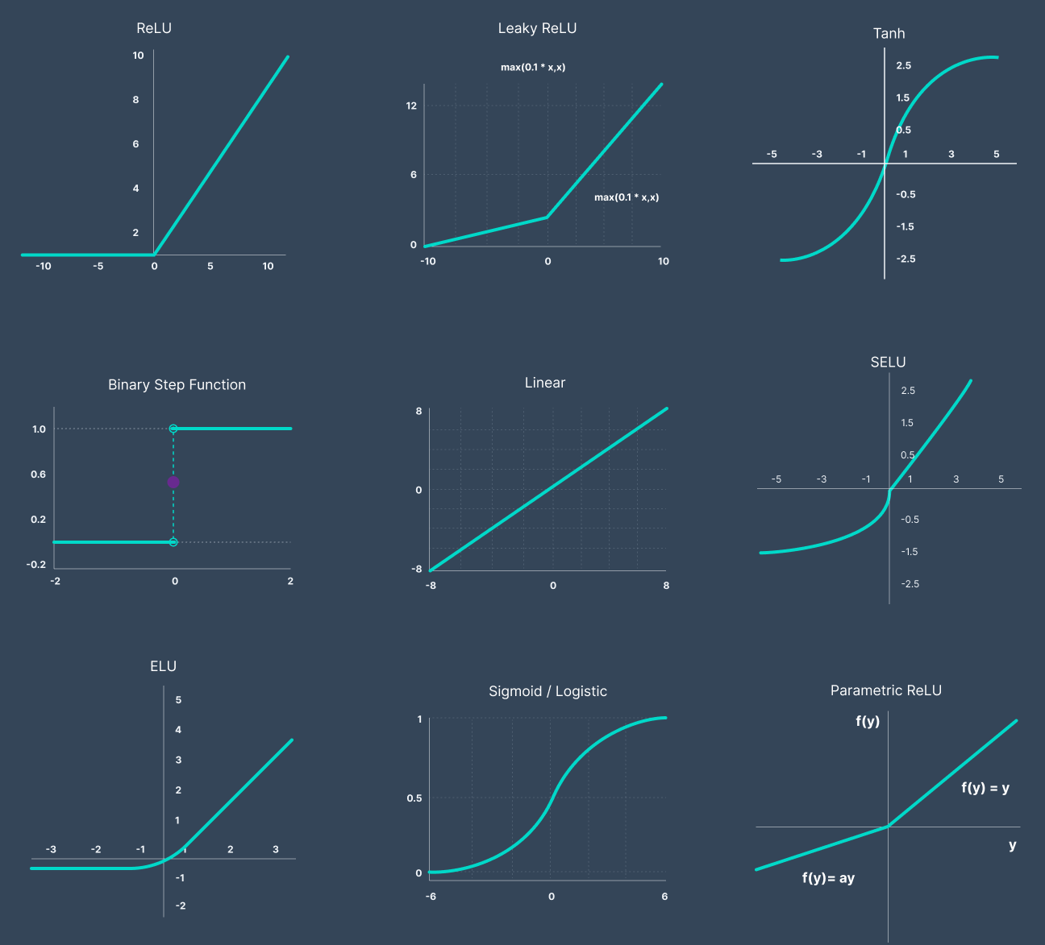
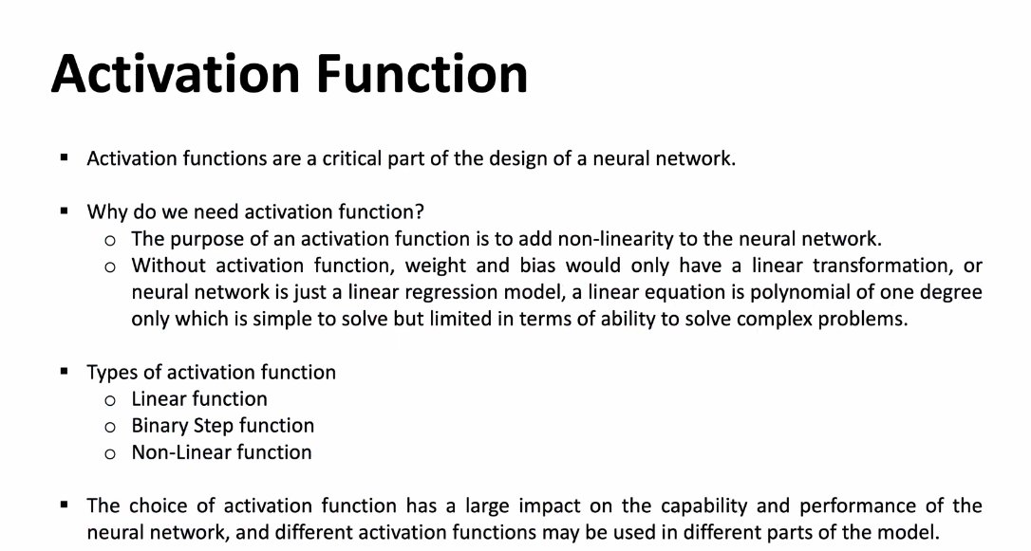
DNN Prediction Non-Trivial Examples
How to choose activation function:
1. Use leaky ReLu function in hidden layers to avoid dead neurons.
2. In binary classification use the Sigmoid function in the output layer
3. In multi-class classification problem use Softmax function in the output layer
4. Due to the vanishing gradient at both ends, ‘Sigmoid’ and ‘Tanh’ activation functions are avoided sometimes in deep neural network architectures.
https://www.v7labs.com/blog/neural-networks-activation-functions

Slide 13


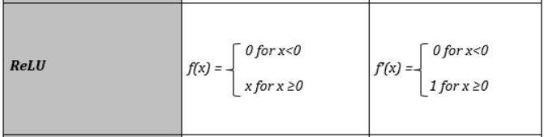

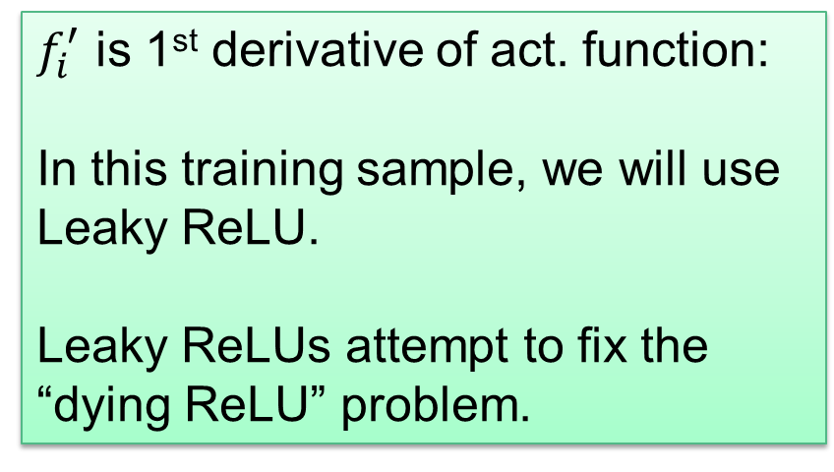
DNN Prediction Non-Trivial Examples
DNN training: the ﬁrst-order gradient-based: activation function f
$f_{i}^{′}$ is 1st derivative of act. function:
In this training sample, we will use Leaky ReLU.
Leaky ReLUs attempt to fix the “dying ReLU” problem.
Change to 0.05
Instead of being 0 when x<0,
a leaky ReLU allows a small positive value.
Leaky ReLU a= 0.05 when x<0 in this example.

Slide 14

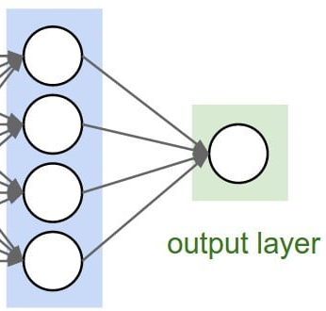

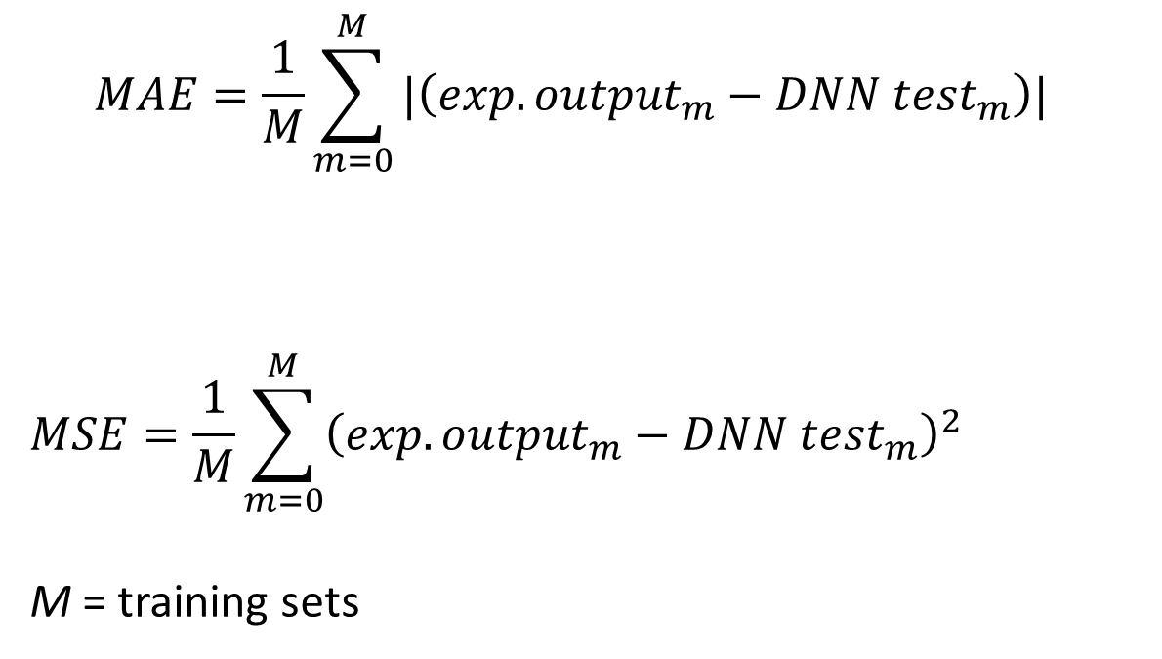
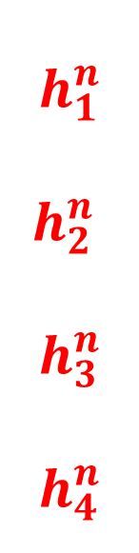
DNN Prediction Non-Trivial Examples
DNN performance/error function is used to evaluate the training process, which measures the error between the expected and true output.
error function E= mean absolute error (MAE)
Output from DNN test set
$$MAE=\frac{1}{M}\sum_{m=0}^{M}{{|\left({exp. output}_{m}−{DNN test}_{m}\right)|}^{}}$$
$$MSE=\frac{1}{M}\sum_{m=0}^{M}{{\left({exp. output}_{m}−{DNN test}_{m}\right)}^{2}}$$
M = training sets
$$h_{1}^{n}$$
$$h_{2}^{n}$$
$$h_{3}^{n}$$
$$h_{4}^{n}$$
Expected output
error function E= mean square error (MSE)
Y1

Slide 15
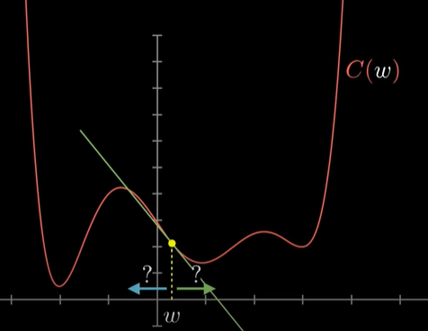
DNN Prediction Non-Trivial Examples
Use the ﬁrst-order gradient-based optimization to update the parameter matrix (weights and bias for each layer) in order to minimize the performance/error function Error
Find the direction of steepest descend to a local minimum.
Due to complexity in DNN and derivatives of many weights and bias parameters involved in the cost error function, even with intensive training, global min. is not guaranteed.
Training process details are shown in next slides
Error Function
Global
Minima
weight matrix
Local min. #1
Local min. #2

Slide 16
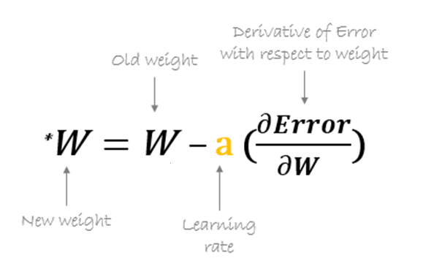
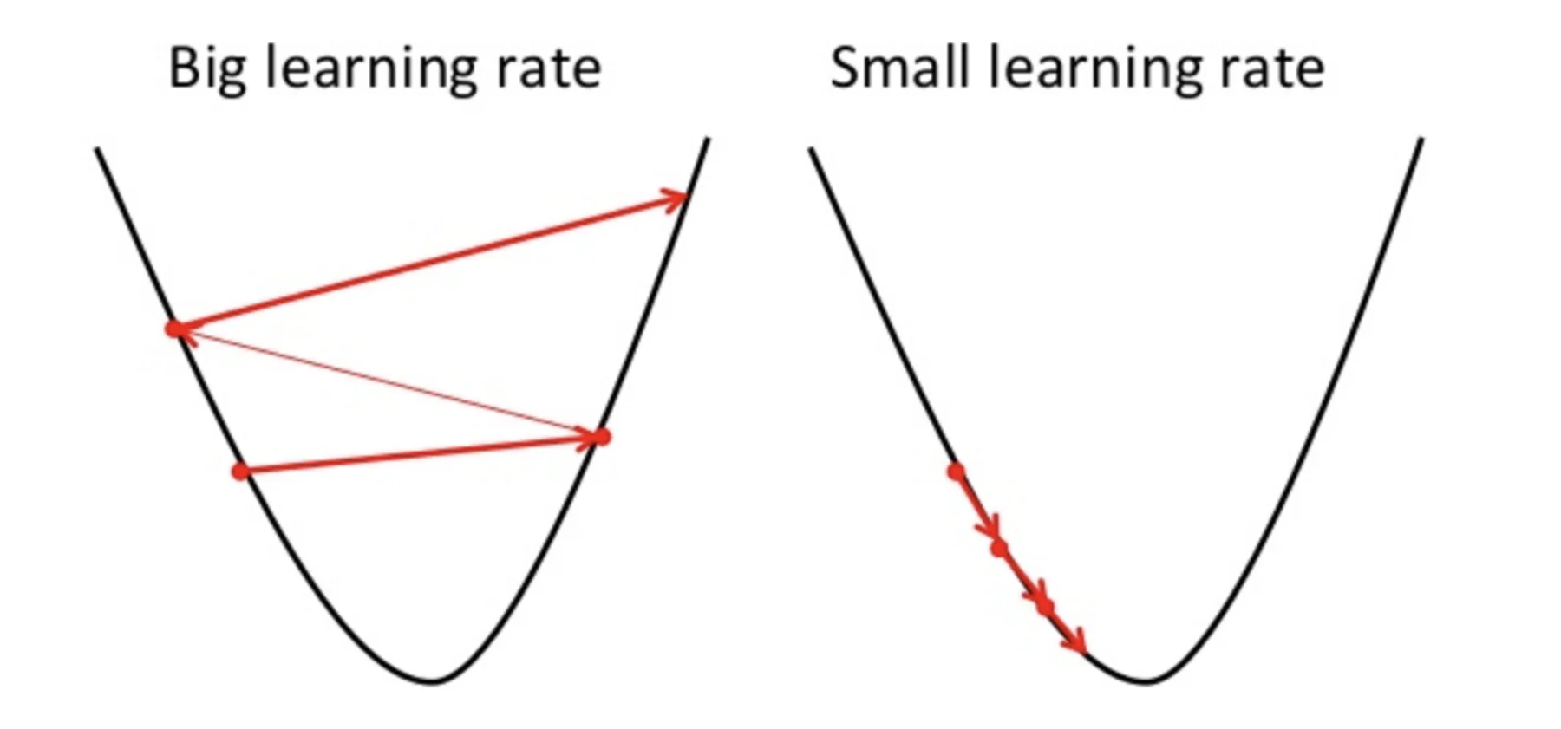
DNN Prediction Non-Trivial Examples
DNN training: the ﬁrst-order gradient-based: weight updates ΔW
a = 0.25
very large rate will miss minima
very small rate will cause slow converge
New weights are calculated by minimizing the error function, where a = [ 0, 1 ] is the learning rate.
Learning rate gives additional control on how fast to move on the curve to reach a minima. This training sample, learning rate a=0.25.

Slide 17
DNN Prediction Non-Trivial Examples
3 steps in each iteration of deep neural architectures: Forward Propagation, Backward Propagation, and Optimization.
1. Forward Propagation: In this step input data is fed in the forward direction through each layer of the neural network. In this step and the activation function is applied.
2. Back Propagation: In this step all the derivatives on weights/biases are calculated for Optimization or updating the parameters.
3. Iteration & Optimization: This step is the convergence of the loss function by continuously updating the parameters in each iteration. Optimization algorithms are as follows: Gradient Descent, Momentum, Adam, AdaGrad, RMSProp, etc.

Slide 18

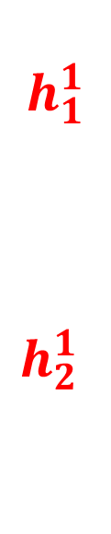



DNN Prediction Non-Trivial Examples
DNN training sample Topology: Leaky Relu & two outputs target as 0 – 1.
$h_{i}^{1}$ = Relu ($\sum_{j}{W_{i, j}^{0}×X_{i}+b_{i}^{0})}{ Y}_{i}$ = Relu ($\sum_{j}{W_{i,j}^{1}×h_{i}^{1}+b_{i}^{1})}$
$$h_{1}^{1}$$
$$h_{2}^{1}$$
$$b_{1}^{1}$$
$$b_{1}^{0}$$
X1
X2
target
W⁰ W¹
Y1
Y2
Y ₁ =0
Y ₂ =1
$$b_{2}^{0}$$
$$b_{2}^{1}$$
(Sample DNN topology has 1 hidden layer with leaky Relu for simplicity).

Slide 19

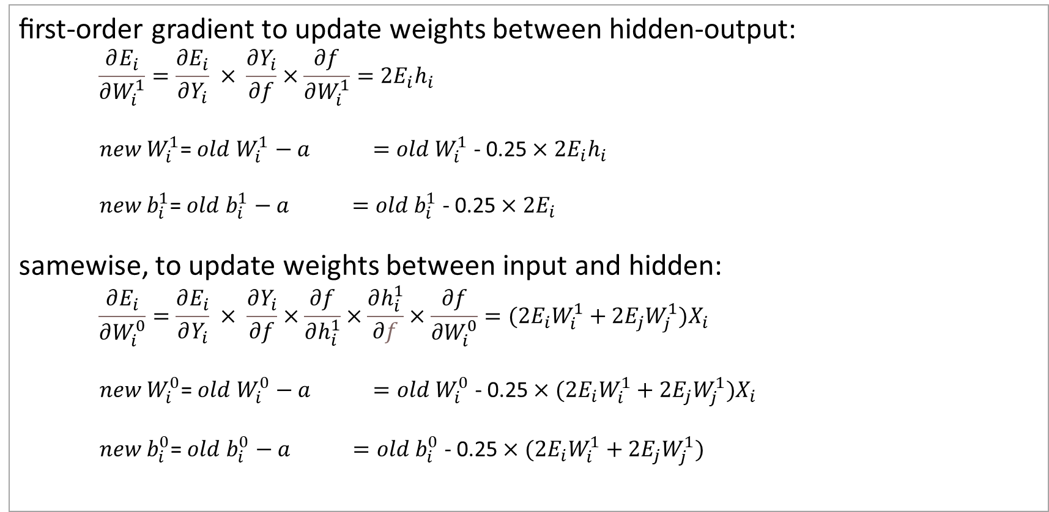



DNN Prediction Non-Trivial Examples
Gradient Descent to update weights and biases backward:
$h_{i}^{1}$=Relu ($\sum_{j}{W_{i, j}^{0}×X_{i}+b_{i}^{0})}{ Y}_{i}$=Relu ($\sum_{j}{W_{i,j}^{1}×h_{i}^{1}+b_{i}^{1})}$
ﬁrst-order gradient to update weights between hidden-output:
$$\frac{∂E_{i}}{∂W_{i}^{1}}=\frac{∂E_{i}}{∂Y_{i}} × \frac{∂Y_{i}}{∂f}×\frac{∂f}{∂W_{i}^{1}}=2E_{i}h_{i}$$
$new W_{i}^{1}$= $old$ $W_{i}^{1}$ $−$ $a =old W_{i}^{1}$ - 0.25 $×$ $2E_{i}h_{i}$
$new b_{i}^{1}$= $old$ $b_{i}^{1}$ $−$ $a =old b_{i}^{1}$ - 0.25 $×$ $2E_{i}$
samewise, to update weights between input and hidden:
$$\frac{∂E_{i}}{∂W_{i}^{0}}=\frac{∂E_{i}}{∂Y_{i}} × \frac{∂Y_{i}}{∂f}×\frac{∂f}{∂h_{i}^{1}}×\frac{∂h_{i}^{1}}{∂f}×\frac{∂f}{∂W_{i}^{0}}=(2E_{i}W_{i}^{1}+2E_{j}W_{j}^{1})X_{i}$$
$new W_{i}^{0}$= $old$ $W_{i}^{0}$ $−$ $a =old W_{i}^{0}$ - 0.25 $×$ $(2E_{i}W_{i}^{1}+2E_{j}W_{j}^{1}{)X}_{i}$
$new b_{i}^{0}$= $old$ $b_{i}^{0}$ $−$ $a =old b_{i}^{0}$ - 0.25 $×(2E_{i}W_{i}^{1}+2E_{j}W_{j}^{1})_{}$
(if :Yi>0, or else 0.05)
$$\frac{∂E_{i}}{∂W_{i}^{1}}$$
(if :Yi>0, or else 0.05)
$$\frac{∂E_{i}}{∂b_{i}^{1}}$$
(if :Yi>0, or else 0.05)
(if :hi>0, or else 0.05)
$$\frac{∂E_{i}}{∂W_{i}^{0}}$$
(if :hi>0, or else 0.05)
$$\frac{∂E_{i}}{∂b_{i}^{0}}$$
(if :hi>0, or else 0.05)

Slide 20





DNN Prediction Non-Trivial Examples
DNN training sample initial condition: Y1=1, Y2=0.18
$$h_{1}^{1}$$
$$h_{2}^{1}$$
$$b_{1}^{1}$$
0.65
0.35
0.15
Initial
Target
$$b_{1}^{0}$$
X1
X2
0.5
Y1
Y2
1.04
0
1
0.2
0.5
0.05
$$b_{2}^{0}$$
0.25
0.1
0.18
$$b_{2}^{1}$$
0.1
0.3
0.35
0.1
0.1
DNN training has output of Y1=1 and Y2=0 to disagree with targets.

Slide 21
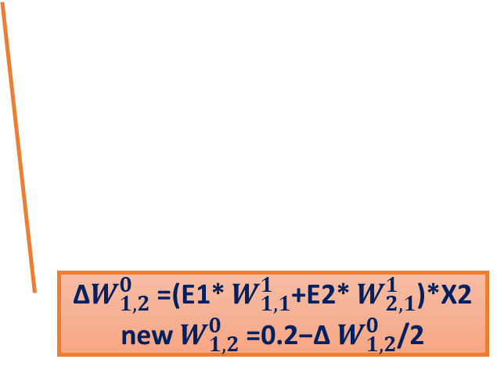
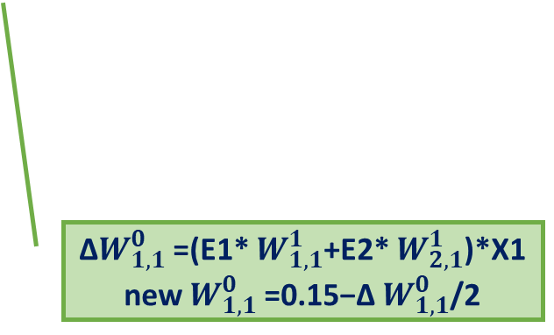
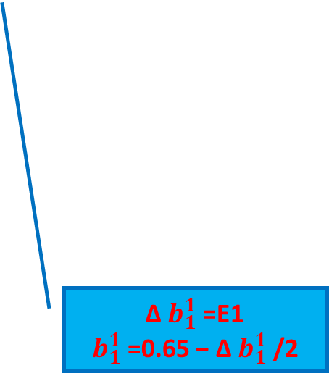
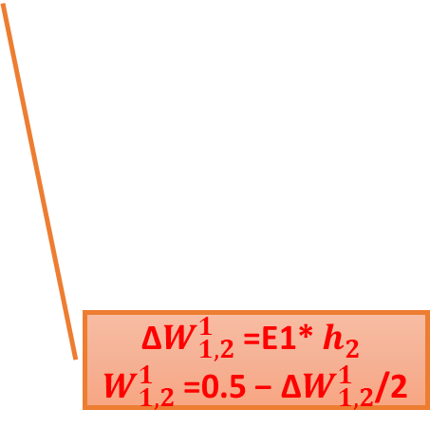
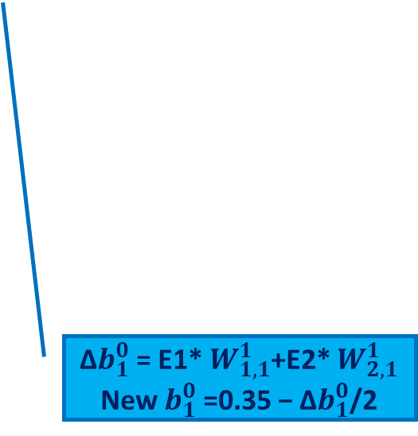
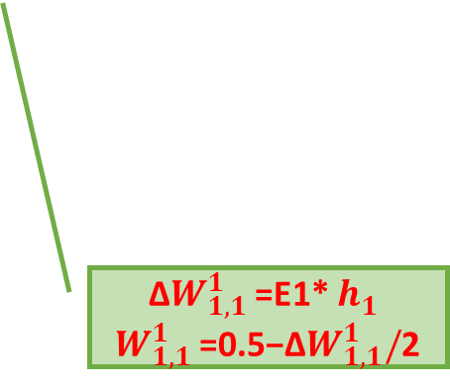
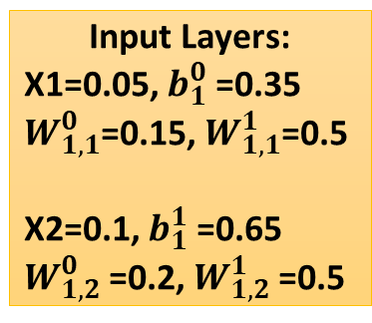
DNN ﬁrst-order gradient to calc. Δ of $W_{1,i}^{0}$, $W_{1,i}^{1}$ , $b_{1}^{0} , b_{1}^{1}$ and update all 6
Input Layers:
X1=0.05, $b_{1}^{0}$=0.35
$W_{1,1}^{0}$=0.15, $W_{1,1}^{1}$=0.5
X2=0.1, $b_{1}^{1}$=0.65
$W_{1,2}^{0}$=0.2, $W_{1,2}^{1}$=0.5
Δ$W_{1,1}^{0}$=(E1* $W_{1,1}^{1}$+E2* $W_{2,1}^{1}$)*X1
new $W_{1,1}^{0}$=0.15−Δ $W_{1,1}^{0}$/2
Δ$W_{1,1}^{1}$=E1* $h_{1}^{}$
$W_{1,1}^{1}$=0.5−Δ$W_{1,1}^{1}/$2
Output Layers: h1=0.378, E1=1.035
h2=0.393, E2=-0.823
Δ$W_{1,2}^{0}$=(E1* $W_{1,1}^{1}$+E2* $W_{2,1}^{1}$)*X2
new $W_{1,2}^{0}$=0.2−Δ $W_{1,2}^{0}$/2
Δ$W_{1,2}^{1}$=E1* $h_{2}^{}$
$W_{1,2}^{1}$=0.5 − Δ$W_{1,2}^{1}$/2
Δ$b_{1}^{0}$= E1* $W_{1,1}^{1}$+E2* $W_{2,1}^{1}$
New $b_{1}^{0}$=0.35 − Δ$b_{1}^{0}$/2
Δ $b_{1}^{1}$=E1
$b_{1}^{1}$=0.65 − Δ $b_{1}^{1}$/2
To next
Iteration
To next
Iteration
(if :hi>0, or else 0.05)
(if :hi>0, or else 0.05)
(if :Yi>0, or else 0.05)

Slide 22
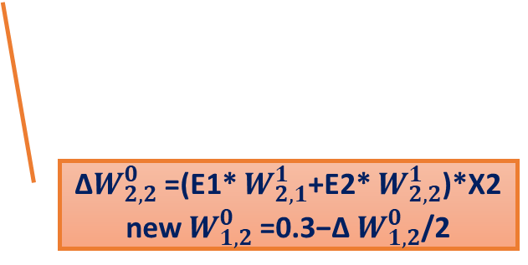
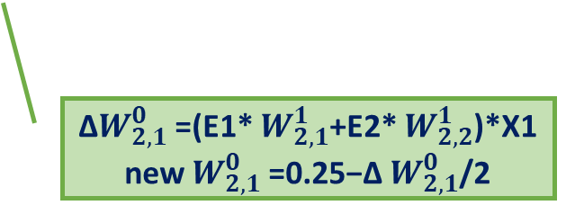
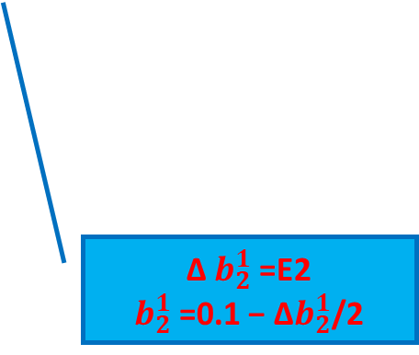
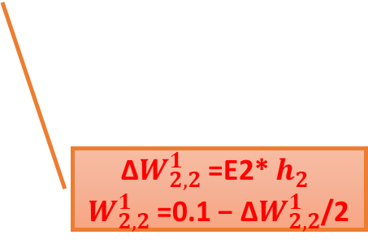
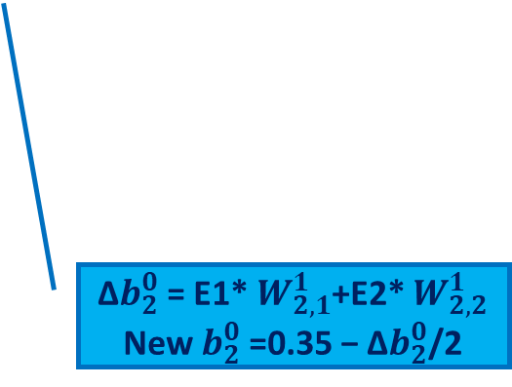
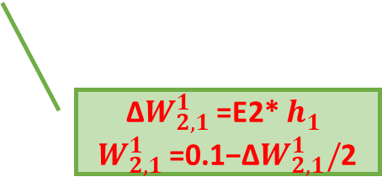

DNN ﬁrst-order gradient to Δ of $W_{2,i}^{0}$, $W_{2,i}^{1}$ , $b_{2}^{0} , b_{2}^{1}$ and update all 6
Input Layers:
X1=0.05, $b_{2}^{0}$=0.35
$W_{2,1}^{0}$=0.25, $W_{2,1}^{1}$=0.1
X2=0.1, $b_{2}^{1}$=0.1
$W_{2,2}^{0}$=0.3, $W_{2,2}^{1}$=0.1
Δ$W_{2,1}^{0}$=(E1* $W_{2,1}^{1}$+E2* $W_{2,2}^{1}$)*X1
new $W_{2,1}^{0}$=0.25−Δ $W_{2,1}^{0}$/2
Δ$W_{2,1}^{1}$=E2* $h_{1}^{}$
$W_{2,1}^{1}$=0.1−Δ$W_{2,1}^{1}/$2
Output Layers: h1=0.378, E1=1.035
h2=0.393, E2=-0.823
Δ$W_{2,2}^{0}$=(E1* $W_{2,1}^{1}$+E2* $W_{2,2}^{1}$)*X2
new $W_{1,2}^{0}$=0.3−Δ $W_{1,2}^{0}$/2
Δ$W_{2,2}^{1}$=E2* $h_{2}^{}$
$W_{2,2}^{1}$=0.1 − Δ$W_{2,2}^{1}$/2
Δ$b_{2}^{0}$= E1* $W_{2,1}^{1}$+E2* $W_{2,2}^{1}$
New $b_{2}^{0}$=0.35 − Δ$b_{2}^{0}$/2
Δ $b_{2}^{1}$=E2
$b_{2}^{1}$=0.1 − Δ$b_{2}^{1}$/2
To next
Iteration
(if :hi>0, or else 0.05)
(if :Yi>0, or else 0.05)

Slide 23
DNN ﬁrst-order gradient training (update all 12 parameters to next iteration).
Y1=1, Y2=0.177
1st Iteration, Y1=0.232, Y2=0.597

Slide 24
DNN ﬁrst-order gradient training (update all 12 parameters to next iteration).
2nd Iteration, Y1=0.119, Y2=0.820

Slide 25
DNN ﬁrst-order gradient training (update all 12 parameters to next iteration).
4th Iteration, Y1=0.08, Y2=0.966

Slide 26
DNN Prediction Non-Trivial Examples
DNN ﬁrst-order gradient training (update all 12 parameters to next iteration).
6th Iteration, Y1=0.007, Y2=0.993
after
DNN
training
Y1=0.003, Y2=0.997

Slide 27





DNN Prediction Non-Trivial Examples
after DNN training : Y1=0.003, Y2=0.997
$$h_{1}^{1}$$
$$h_{2}^{1}$$
$$b_{1}^{1}$$
-0.1
0.162
0.141
Final
Target
$$b_{1}^{0}$$
X1
X2
0.266
Y1
Y2
0.003
0
1
0.181
0.254
0.05
0.241
0.315
$$b_{2}^{0}$$
0.997
$$b_{2}^{1}$$
0.327
0.282
0.167
0.1
0.87
DNN training has output of Y1=0 and Y2=1 to match targets.

Slide 28
DNN Prediction Non-Trivial Examples
DNN training sample convergence process with MSE – summary table

Slide 29

Other DNN training algorithms to fix the local minima problems
See link below for more details. https://www.sciencedirect.com/science/article/pii/S1474034617305359
https://ruder.io/content/images/2016/09/saddle_point_evaluation_optimizers.gif
Click me!

Slide 30
DNN Prediction Non-Trivial Examples
Comparison of DNN with
Other traditional algorithms

Slide 31
DNN Prediction Non-Trivial Examples
Comparison, Pros and Cons
DNN (more complicated with multi layers) | Random Forest, Bayesian, kNN (straightforward and fast)
Training is time-intensive: convergence unknown | Real time Training and Prediction: Converge fast
Scalable with large datasets but need adjust network topology or parameters | Scalable with large datasets
Only a probing solution, not optimum due to complexity nature | Requires no tuning of parameters, theoretical guarantees results
Multi class prediction with multi-layers is effective | Multi class prediction is effective

Slide 32
DNN Prediction Non-Trivial Examples
Comparison, Pros and Cons (continue)
DNN (high accuracy training with large data) | Random Forest, Bayesian, kNN (low accuracy for real data)
No requirements on independence of two features. Neutrons are smart enough to learn to filter out irrelevant features from training. | The assumption of Naive Bayes/Forest is that each feature makes an independent and equal contribution to the outcome, very hard to meet in most dataset.
Good performance on non-linear data with activate functions in neurons (filter out bad) | Poor performance with irrelevant and highly correlated features
Robust to noise in the training data | Poor performance on non-linear data, missing data, erroneous data.

Slide 33
DNN Prediction Non-Trivial Examples
Comparison, Pros and Cons (continue)
DNN is more accurate, achieved the state of the art in more domains
DNN is highly depends on topology, number of weights in the network, and the settings of learning algorithm parameters.
Effective topology/ parameters can only be achieved through experience and trial and error.
DNN is time-intensive in training, and training with small datasets or wrong topology commonly produces worse performance!
DNN can tolerate noise in the training data. The training sets can be irrelevant, errors, outliers, which do not affect the final output.

