Slide 1
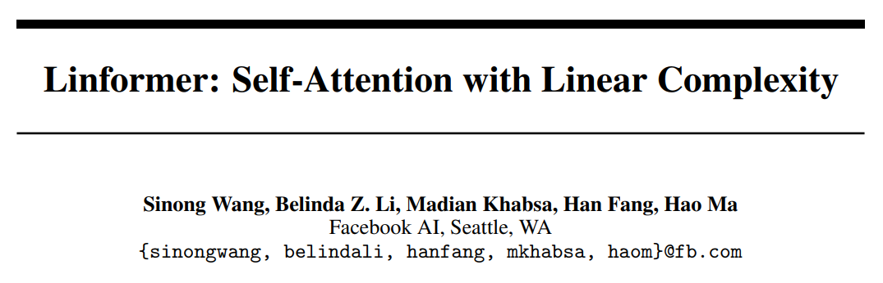

Slide 2

Linformer
Self-Attention Mechanism
: $O(n^{2})$
Linformer Self-Attention Mechanism
: $O(n)$

Slide 3


Introduction
$$n$$
$$n$$
In this paper, we seek to answer the question
can Transformer models be optimized to avoid this quadratic operation, or is this operation required to maintain strong performance?

Slide 4
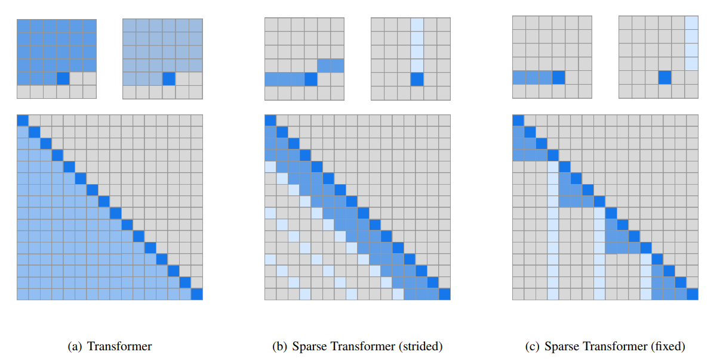
Sparse Transformers
$O\left(n\sqrt{n}\right)$, 2% accuracy drop with 20% speed up.

Slide 5

Reformer - LSH Attention
$$O(nlog\left(n\right))$$
LSH(locally-sensitive hashing)
-> Multi-round(increases the number of sequential operations)
efficiency gains only appear on sequences with length > 2048

Slide 6
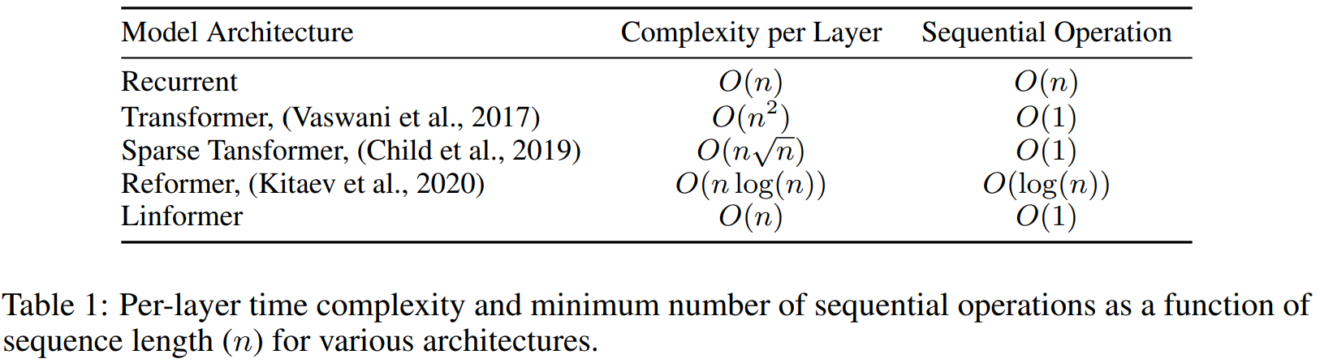
Comparison of Complexity

Slide 7
Related Work
Mixed Precision
Knowledge Distillation
Sparse Attention
LSH Attention
Improving Optimizer Efficiency

Slide 8
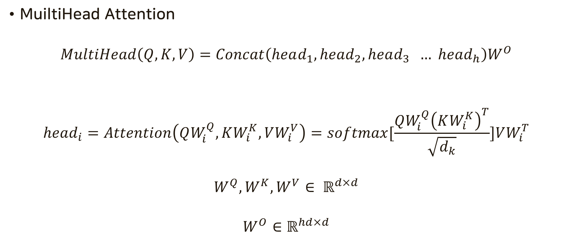

Background
MuiltiHead Attention
$$MultiHead\left(Q, K,V\right)=Concat\left(head_{1}, head_{2}, head_{3} … head_{h}\right)W^{O}$$
$$head_{i}=Attention\left(QW_{i}^{Q}, KW_{i}^{K},VW_{i}^{V}\right)=softmax[\frac{QW_{i}^{Q}{\left(KW_{i}^{K}\right)}^{T}}{\sqrt{d_{k}}}]VW_{i}^{T}$$
$$W^{Q}, W^{K}, W^{V}∈ ℝ^{d×d}$$
$$W^{O}∈ℝ^{hd×d}$$
$$P∈ℝ^{n×n}$$

Slide 9
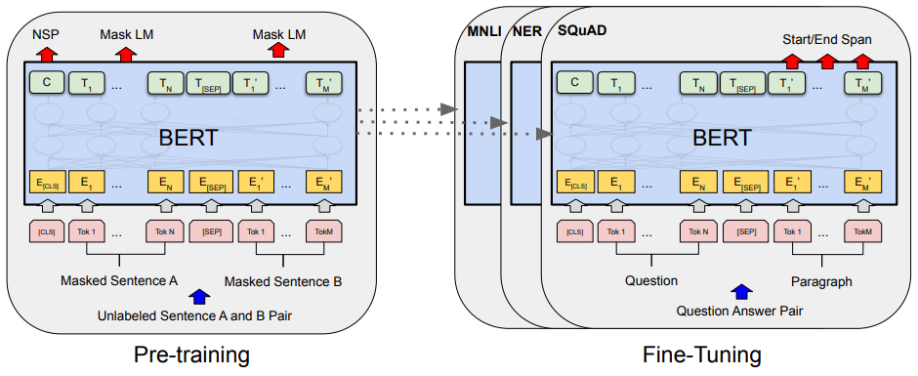
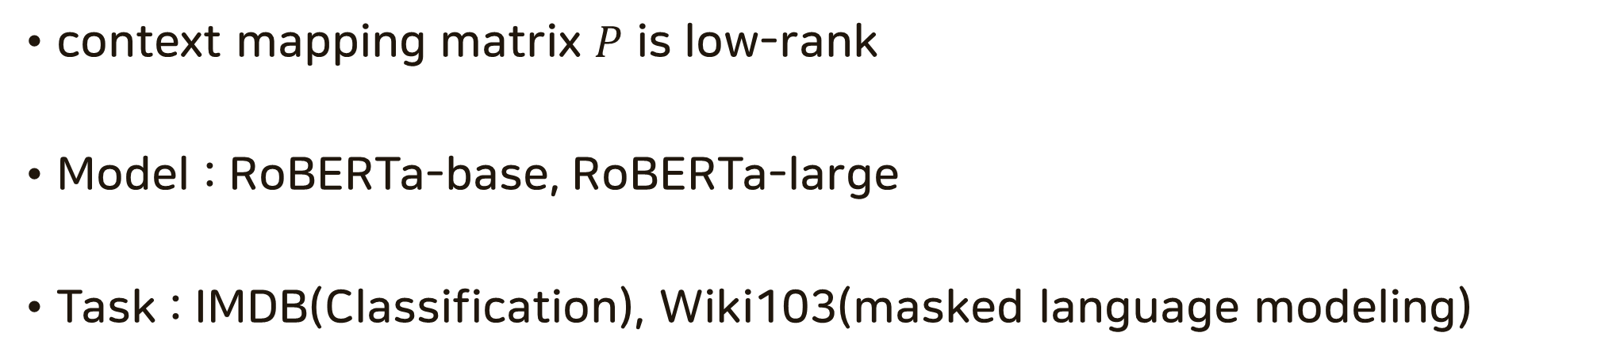
Self Attention is Low Rank
context mapping matrix $P$ is low-rank
Model : RoBERTa-base, RoBERTa-large
Task : IMDB(Classification), Wiki103(masked language modeling)

Slide 10
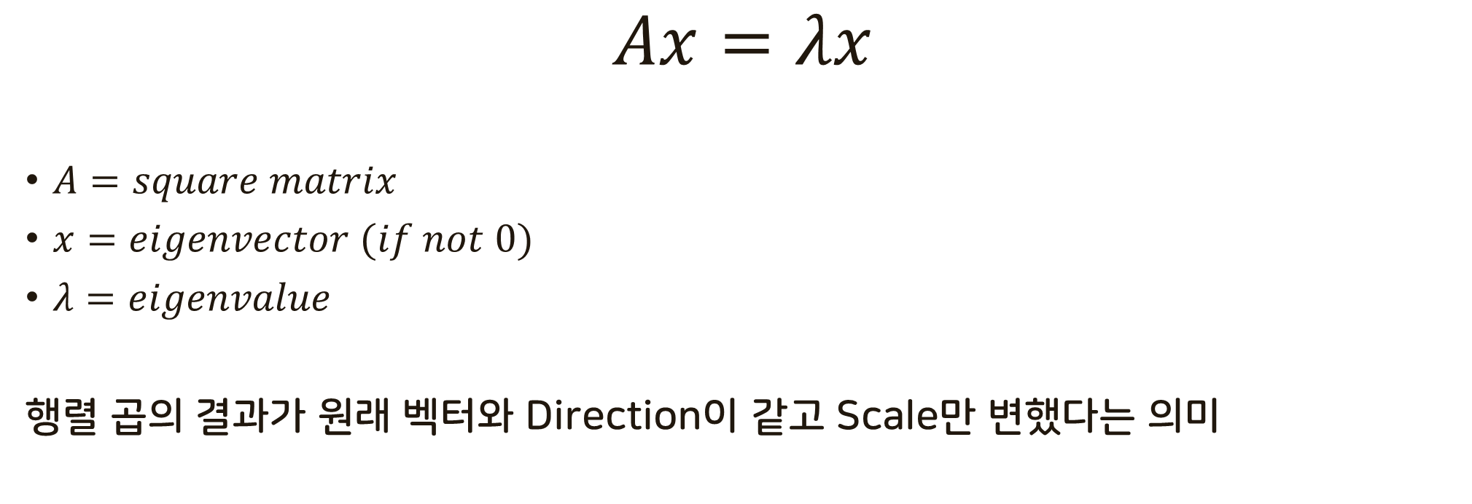
Eigenvalue and Eigenvector
$$Ax=λx$$
$A=square matrix$
$x=eigenvector (if not 0)$
$λ=eigenvalue$
행렬 곱의 결과가 원래 벡터와 Direction이 같고 Scale만 변했다는 의미
https://rfriend.tistory.com/181

Slide 11
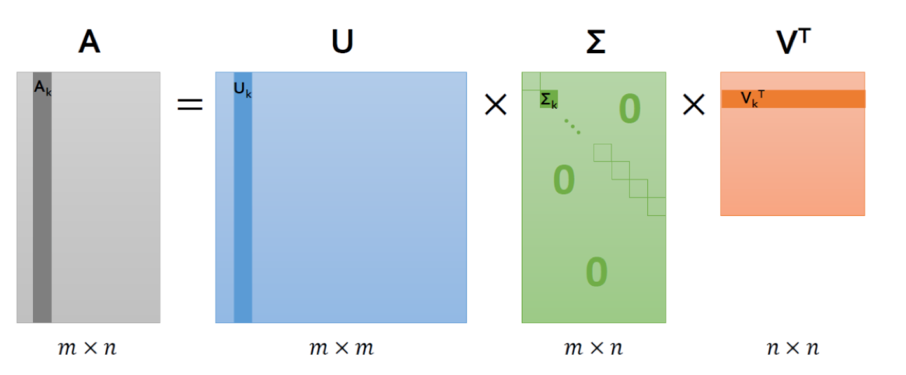
SVD(Singular Value Decomposition)
singular value
Rotation
Scale
Rotation
Sigular Value : 모든 행렬 가능, 음이 아닌 scalar
Eigen Value : 정사각행렬만 가능, 모든 scalar

Slide 12
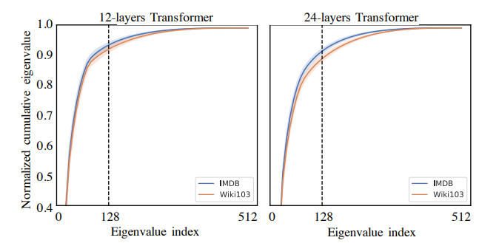
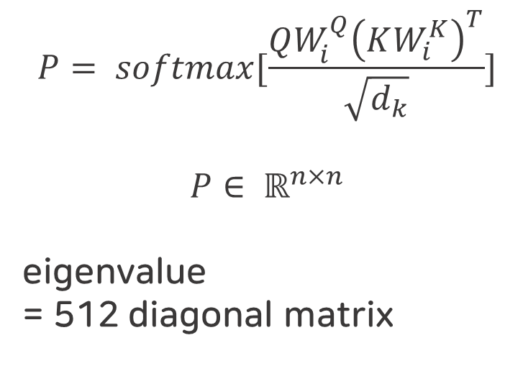
$$P= softmax[\frac{QW_{i}^{Q}{\left(KW_{i}^{K}\right)}^{T}}{\sqrt{d_{k}}}]$$
$$P∈ ℝ^{n×n}$$
eigenvalue
= 512 diagonal matrix
eigenvalue : 512 diagonal matrix 이겠고
eigenvalue를 구해보니 128 ~ 부터 dominan한 값이 saturation 되더라
그래서 low rank가 가능하더라

Slide 13
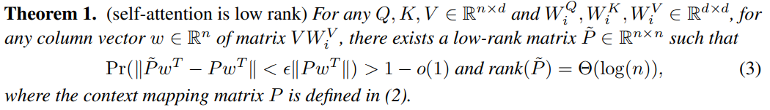
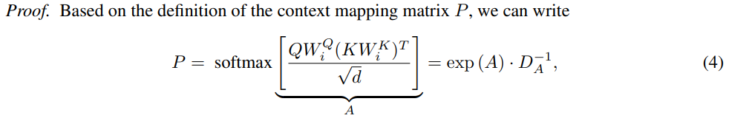


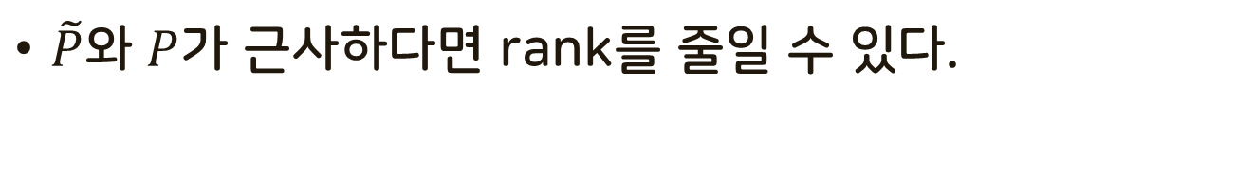
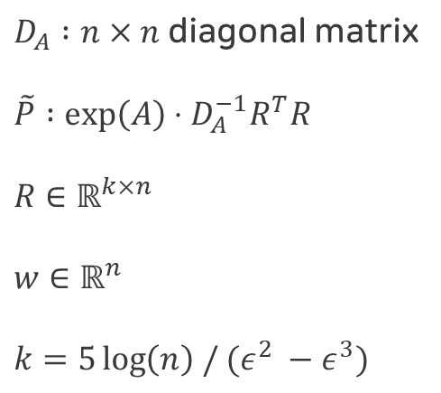
Theorem 1
$D_{A} :n×n$ diagonal matrix
$\tilde{P} :\exp\left(A\right)⋅D_{A}^{−1}R^{T}R$
$R∈ℝ^{k×n}$
$w∈ℝ^{n}$
$k=5\log\left(n\right) / (ε^{2} −ε^{3})$
$\tilde{P}$와 $P$가 근사하다면 rank를 줄일 수 있다.

Slide 14
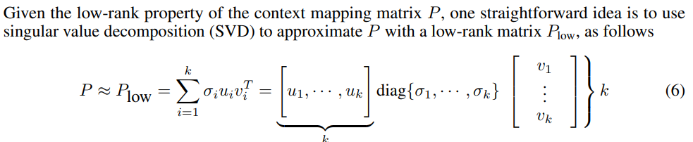
SVD
Theorem 1을 결과를 기반으로 k개를 뽑아서 low rank로 만든다는 것은 이렇게 표현할 수 있지만 SVD를 위한 추가적 연산이 필요하다.
학습 된 파라미터는 줄일 수 있다.
-> 그래서 다른 접근법을 사용한다.

Slide 15
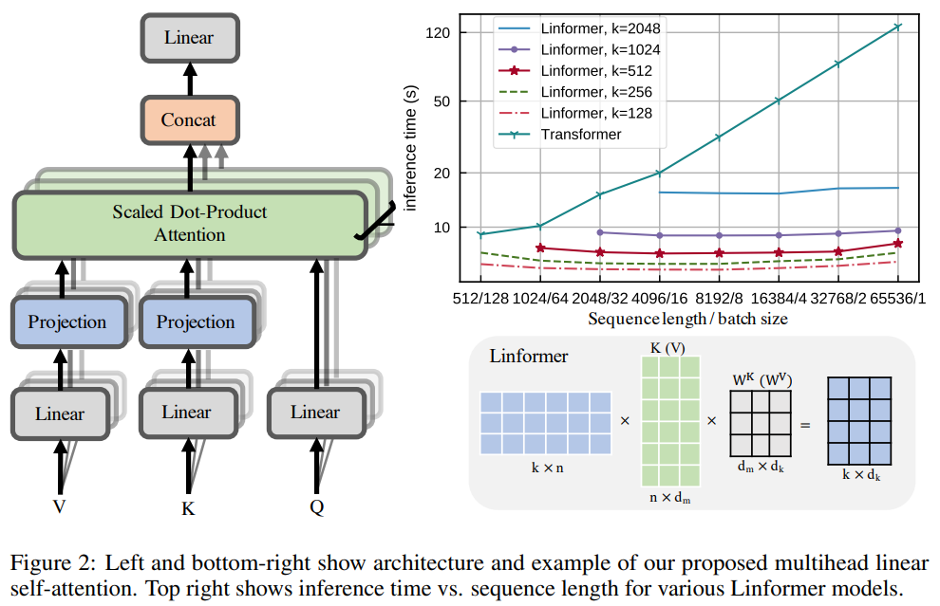
Linformer

Slide 16
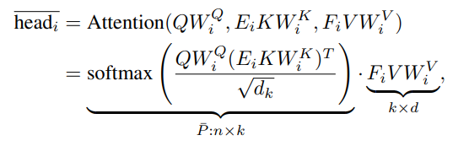
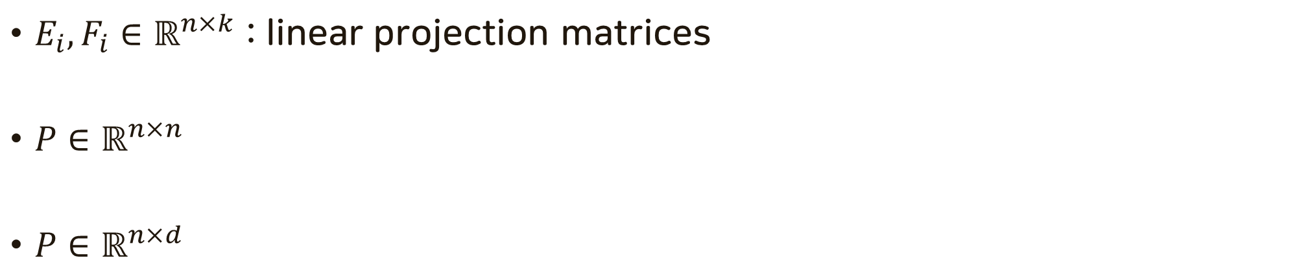
Transformer vs Linformer
$E_{i}, F_{i}∈ℝ^{n×k}$ : linear projection matrices
$P∈ℝ^{n×n}$
$P∈ℝ^{n×d}$

Slide 17
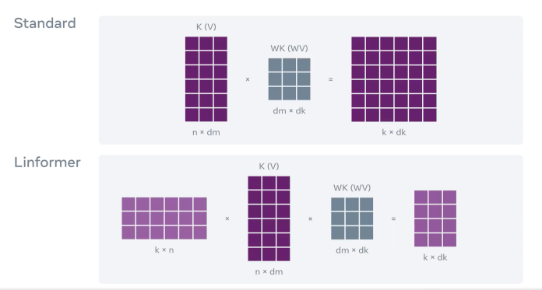

Transformer vs Linformer
$$n$$

Slide 18
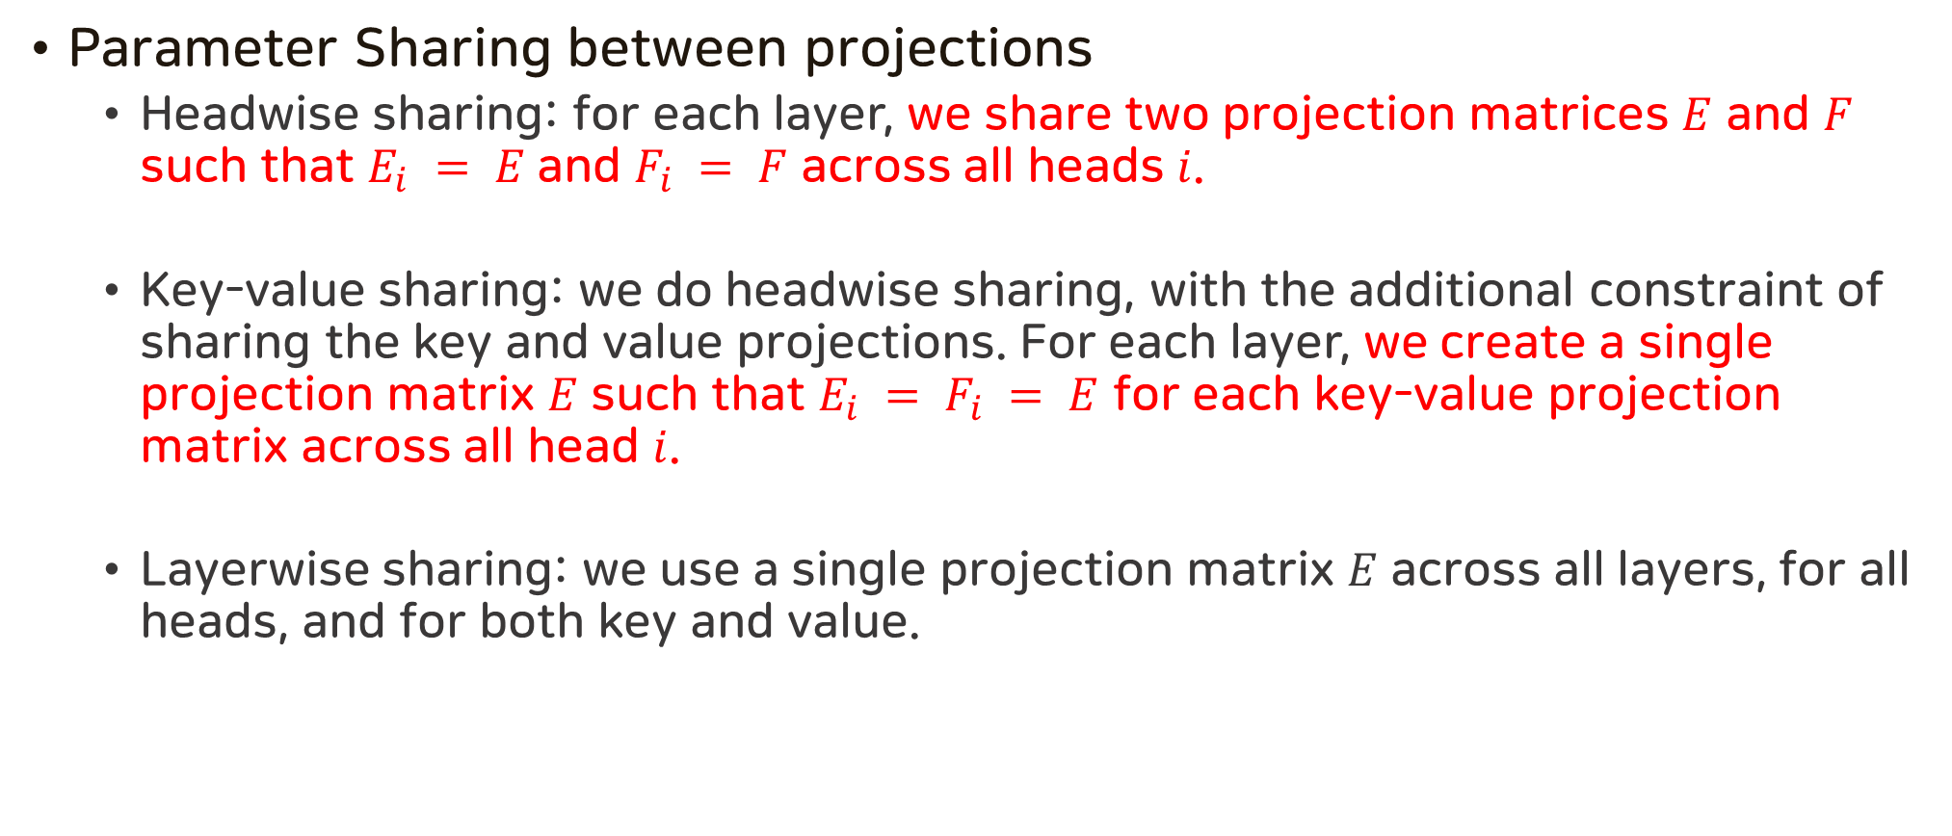
Efficiency Techniques
Parameter Sharing between projections
Headwise sharing: for each layer, we share two projection matrices $E$ and $F$ such that $E_{i} = E$and $F_{i} = F$ across all heads $i$.
Key-value sharing: we do headwise sharing, with the additional constraint of sharing the key and value projections. For each layer, we create a single projection matrix $E$ such that $E_{i} = F_{i} = E$ for each key-value projection matrix across all head $i$.
Layerwise sharing: we use a single projection matrix $E$ across all layers, for all heads, and for both key and value.

Slide 19
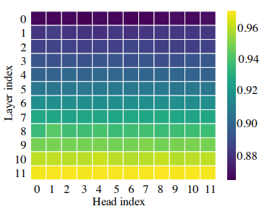
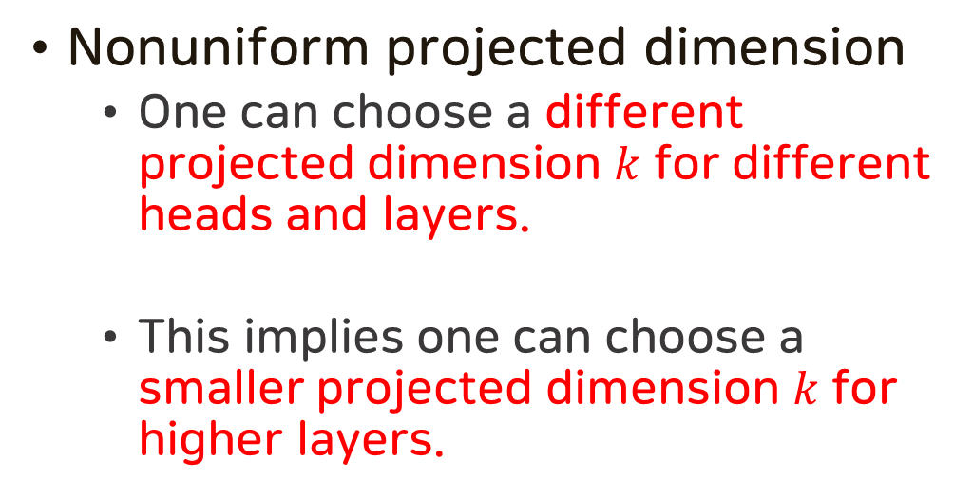
Efficiency Techniques
Nonuniform projected dimension
One can choose a different projected dimension $k$ for different heads and layers.
This implies one can choose a smaller projected dimension $k$ for higher layers.
The right figure plots the heatmap of normalized cumulative eigenvalue at the 128-th largest eigenvalue across different layers and heads in Wiki103 data.

Slide 20
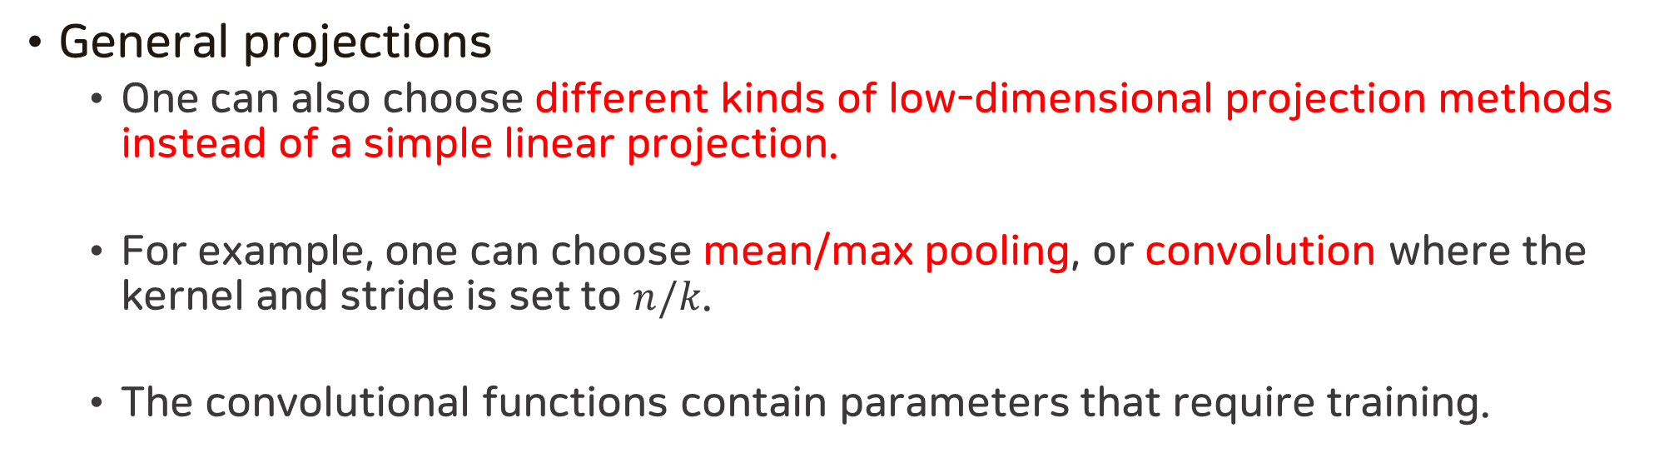
Efficiency Techniques
General projections
One can also choose different kinds of low-dimensional projection methods instead of a simple linear projection.
For example, one can choose mean/max pooling, or convolution where the kernel and stride is set to $n/k$.
The convolutional functions contain parameters that require training.

Slide 21
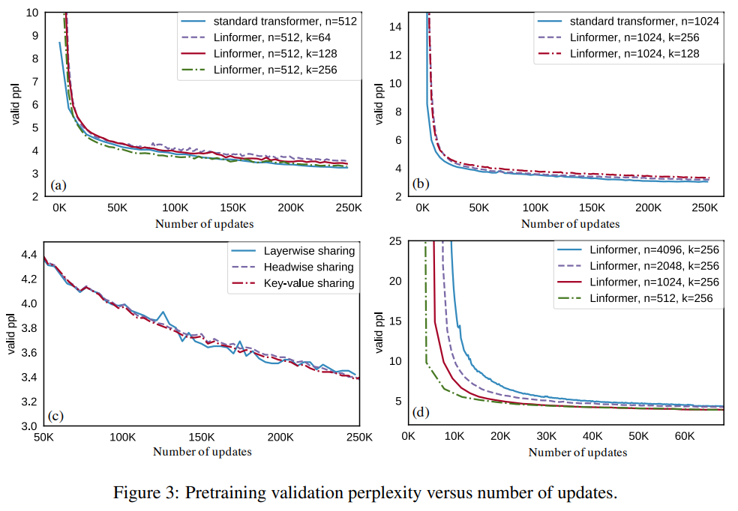
Experiments - Training Curve

Slide 22
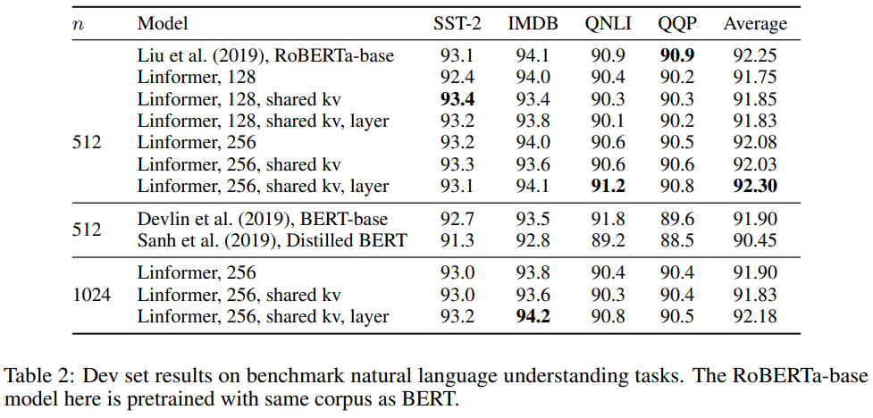
Experiments - Results of Accuracy

Slide 23
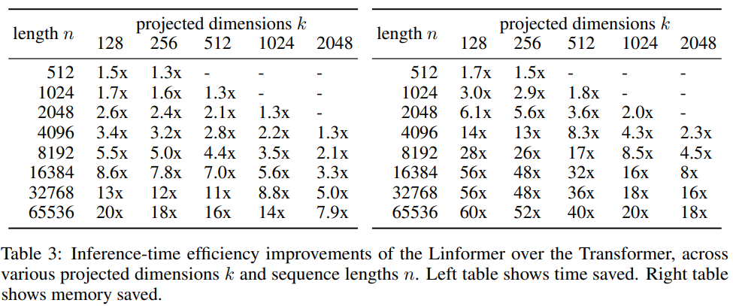
Experiments - Results of Inference time efficiency

