Slide 1



Setup
Pavlos and Arj chose 2 problems:
Document query : ask a local knowledge base some questions
Grid optimization : How to run a batch quicker/cheaper (Topical!)
Pavlos provided the initial stack for document query (in Python)
Arj wrote the test harness for grid optimization (in Go)
Then, to avoid bias, we switched:
Arj worked on document query.
Pavlos worked on grid optimisation
What Did We Find?

Slide 2

Case Study 1
Grid calculation optimisation

Slide 3
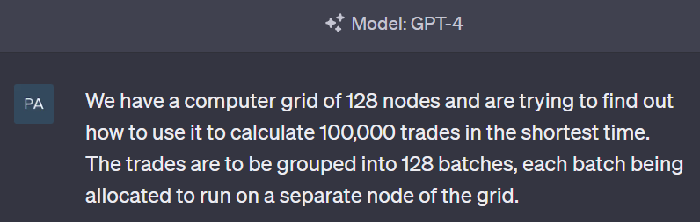
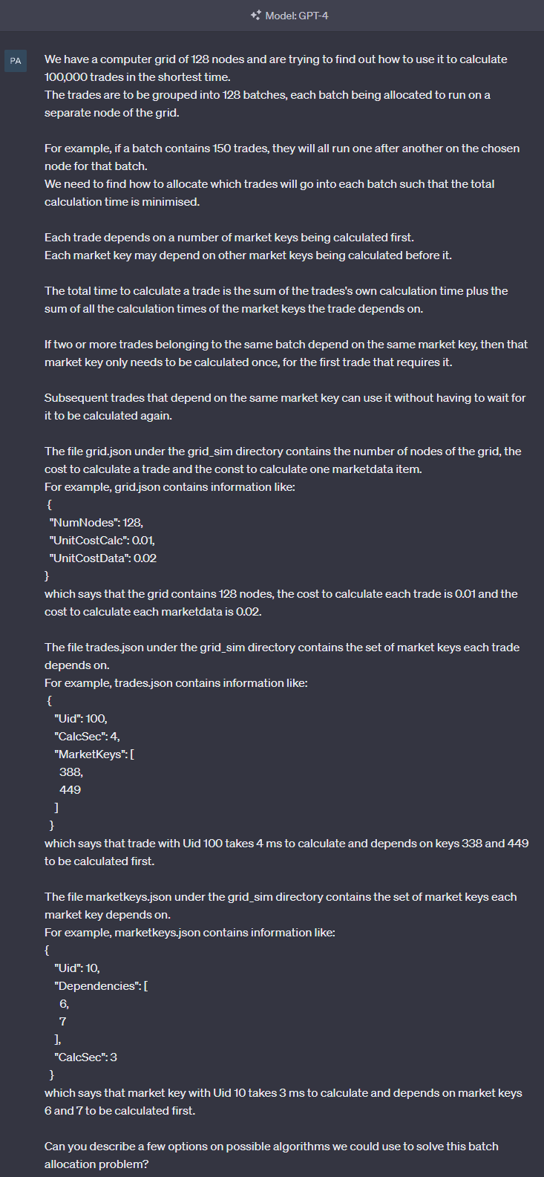
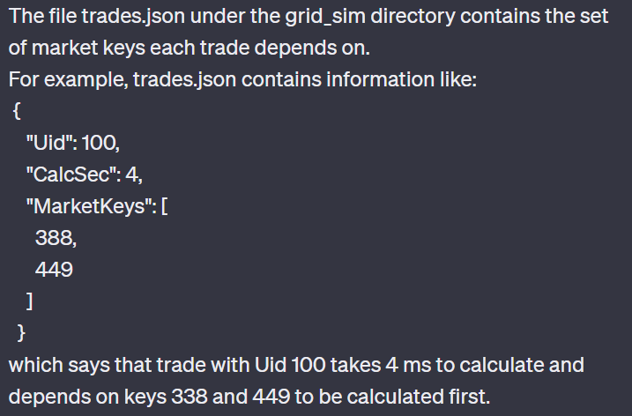
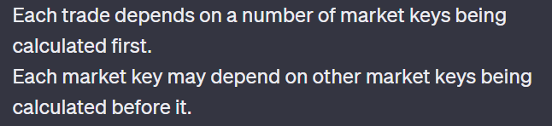

Problem statement

Slide 4
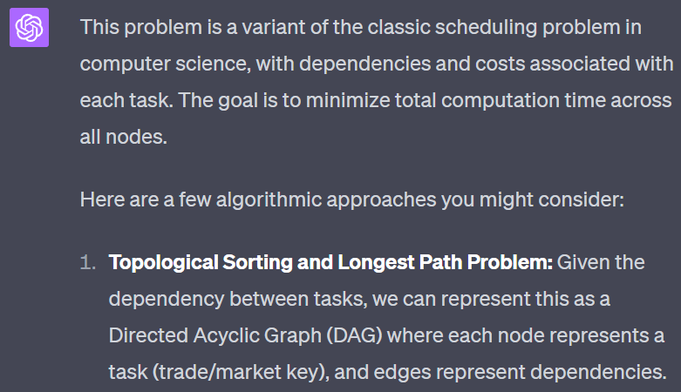
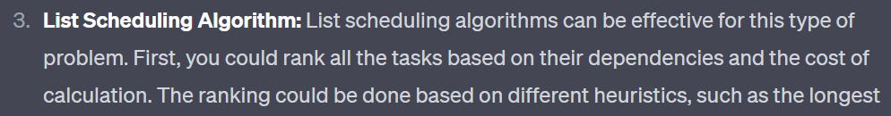

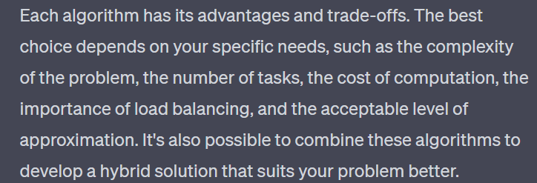
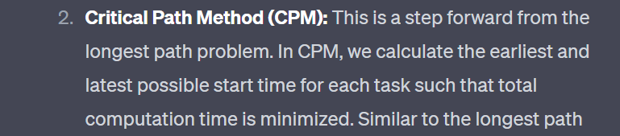
GPT-4 response

Slide 5
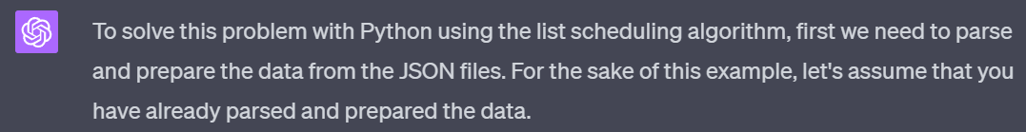
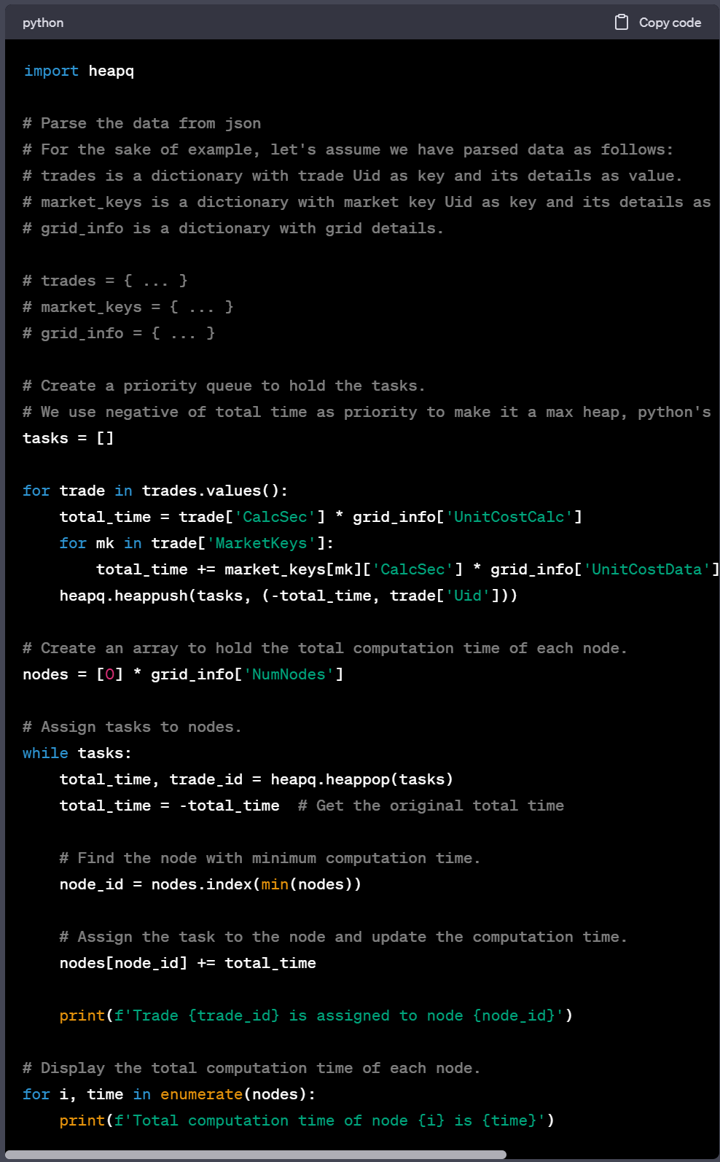
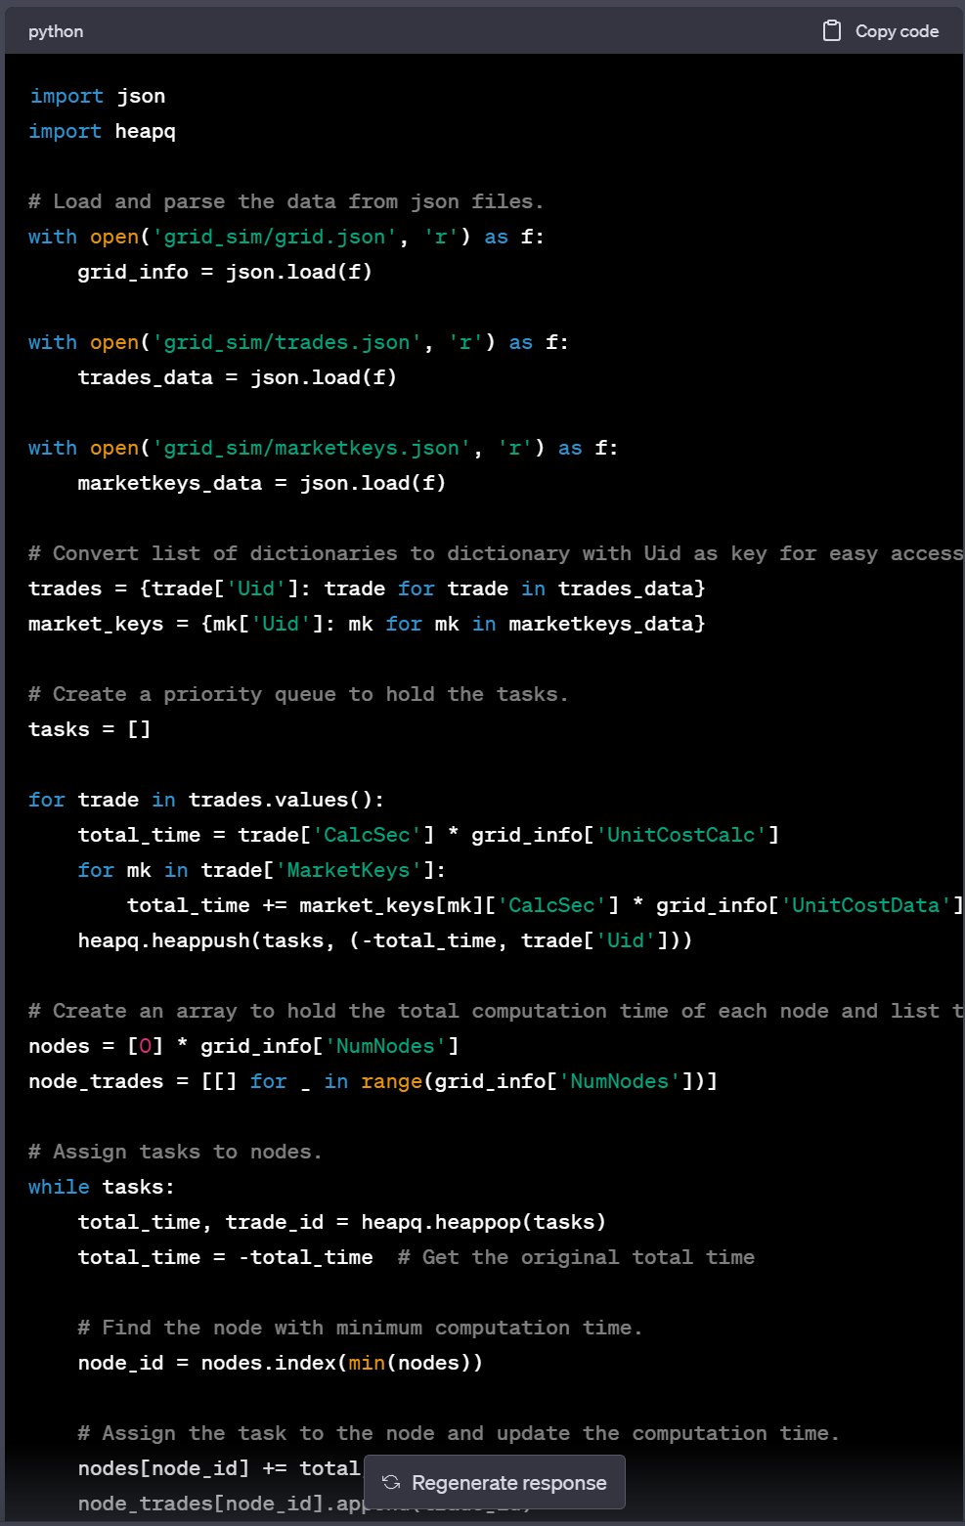
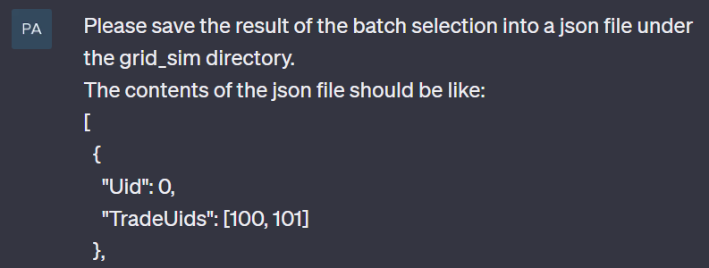


Conversation overview

Slide 6

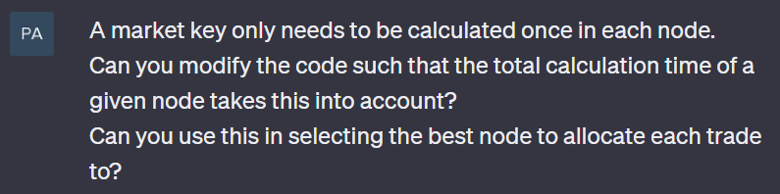
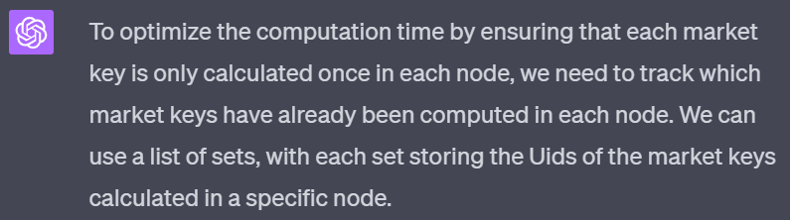
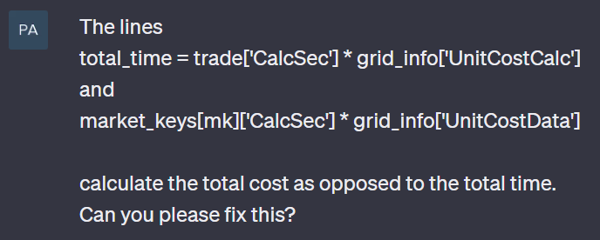
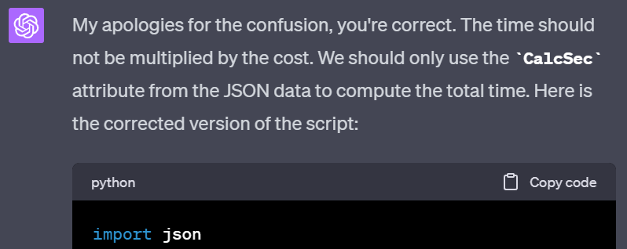
Take 1
Original calculation time
GPT4 calculation time

Slide 7
Take 2
Original
After feedback

Slide 8




Take 3
Previous step
After latest feedback

Slide 9
Case Study 2 : Document Query
Aim : Use GPT-4 as an interface to a local knowledge base
Load in a local set of 100 public pdfs (newer than Aug 2022)
Ask questions about those 100 pdfs using GPT4
Standard trick to add local info:
Given query, identify most relevant subcontext (within knowledge base)
Prepend subcontext to the question
Eg “<long text of citi q1 earnings release> Given the above, what was Citi’s q1 2023 eps?”
The query must fit in the LLM limit (8k tokens for GPT4, about 40 pages of text).
Tech stack : GPT-4 API + Langchain . Rewritten in Go for speed & to have multiple LLMs. (OpenAI, Google)

Slide 10
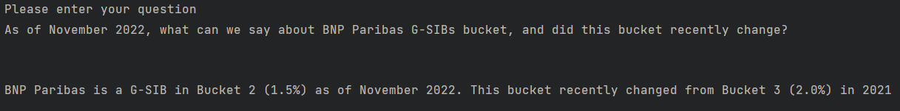
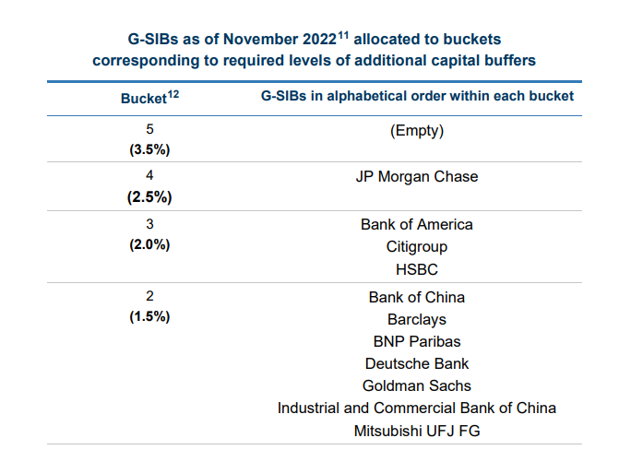
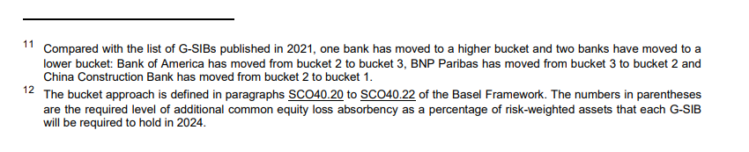
Simple fact retrieval

Slide 11
Simple fact retrieval (animated gif, hit Play)
Good.. up to a point. We need to trick GPT4 a little eg “Imagine you are an analyst”

Slide 12
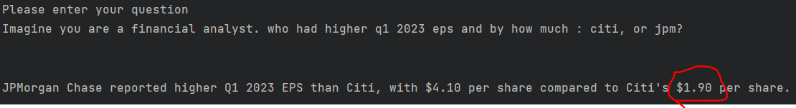
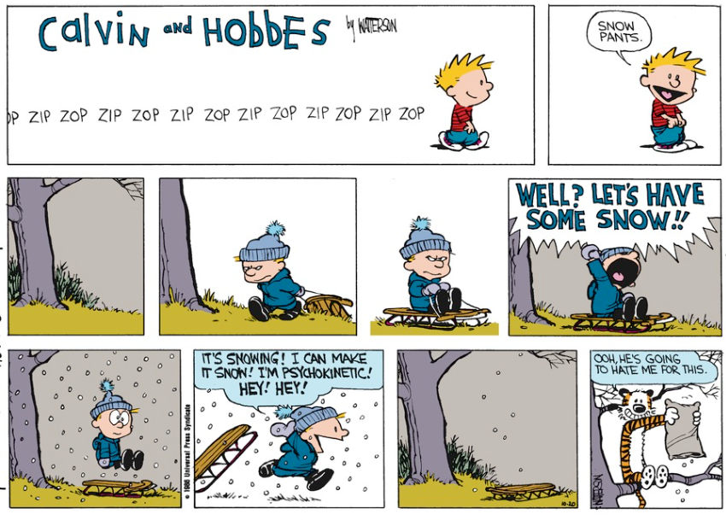

Analogy
This is wrong (Citi EPS was 2.19)
Q: Can Calvin make it snow?
Identify subcontext
The subcontext in isolation is incorrect.
The overall knowledge base does not help
Solution : finetuning? Maybe..

Slide 13

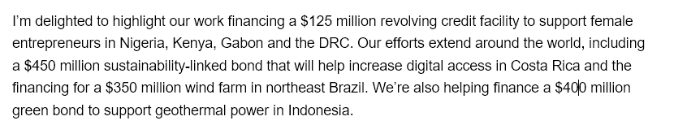
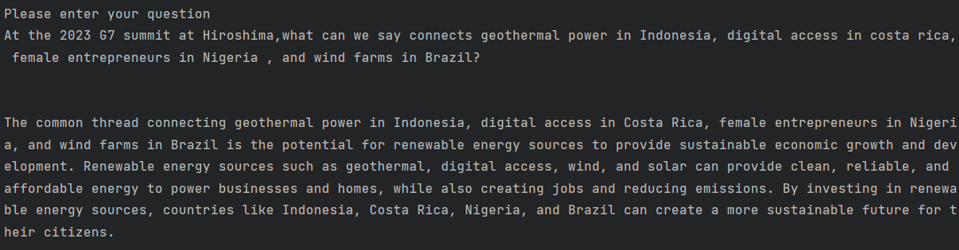
Inference
True, but not helpful
The relevant section of the relevant pdf was correctly identified & fed in as the context.
GPT-4 produced a generic and useless answer.

Slide 14
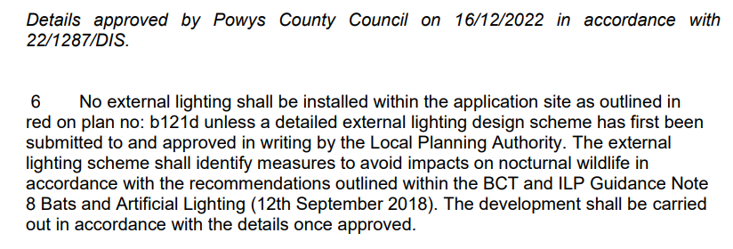

Complacency risk
Wrong Answer. ಠ__ಠ
Reference actually says the opposite of the conclusion
And then there’s (28 /5/23): https://www.bbc.co.uk/news/world-us-canada-65735769
A New York lawyer is facing a court hearing of his own after his firm used AI tool ChatGPT for legal research. […] The lawyer who used the tool told the court he was "unaware that its content could be false".
[…] "Six of the submitted cases appear to be bogus judicial decisions with bogus quotes and bogus internal citations," Judge Castel wrote in an order demanding the man's legal team explain itself.

Slide 15
Conclusion : 2 types of questions
Type1: Answers can be verified quickly
This code takes 8500 seconds, make it faster
Generate unit tests for this code
Make this email shorter/clearer/ etc
List some ideas for an offsite session to motivate colleagues.
Use LLMs on the first type of problem . Save time. Gain an edge!
Type2: Takes as much effort to verify an answer as it does to find it
“Best Possible Solution” eg shortest path , fastest code
What did the regulator mean when they said..
Will <this document> pass IA validation? with citations
As of June 2023, be SUPER CAREFUL using LLMs on type2

Slide 16
“Further study is required”
LLM Pros
Great at language structure (not always great at the content)
Convenient way to ask unstructured questions
Improving rapidly. Tech stack easy – even training your own (smaller) LLM is easy (ish)
Work well within tight guardrails. Eg developer productivity.
LLM Cons
Nondeterministic. Ask the same question, get a different answer (Temperature = 0 isn’t ideal)
Can’t do math or reliably give exact answers (chain to SQL or WolframAlpha?)
Can’t trust LLMs (Yet!) . Too often they simply don’t work.
LLMs don’t know anything - they just generate plausible confabulation.
Next steps : Citi provides LLM API. More people play with it & think of (non-mystical & testable ) type1 usecases
Strong recommendation : Play with Langchain. Watch (& try!) Andrej Karpathy Let’s Build GPT From Scratch https://www.youtube.com/watch?v=kCc8FmEb1nY

