Slide 1

Promoting your event
By The Noble Henric Vanden Casteele
Version 1.0 AS.58 (being 2023 of the Gregorian Calendar)

Slide 2
General Notes
It goes without saying that event promotion is the key to an event’s success: you can plan the most perfect event ever, but if the event is not promoted successfully, it will not get the attention (and sign-ups) it deserves.
Much of what follows may be obvious, but hopefully it will also add a few additional tools to your promotional toolkit. There is no one true way, but with these tips, and common sense, we hope this will enhance your publicity.
Event promotion can be a lot of work, so consider adding a Social Media Officer to your event team for larger events. They should work collaboratively with whoever is running your event website, to ensure the event’s messaging is consistent in style and tone.
All promotional content should point to the event website, which holds all relevant information for attendees.

Slide 3
Stage 1: Identify your “Unique Selling Point” (USP)
What distinguishes your event from other events?
Does it have unique or unusual activities, or traditions?
Such as: Yule Ball’s “Holly Monarch” competitions and gift-giving;
Eisteddfod’s bardic competition for the silver chair;
Ormþing’s Forester’s competition and is also a rare opportunity for equestrian activities.
Is there something special about where it is being held?
Such as: Strawberry Raid’s Sigginstown Castle;
Bourn’s tithe barn;
Yule Ball’s Buckden Towers.

Slide 4
Stage 1: Identify your “Unique Selling Point” (USP)
Does it have a theme?
For example: previous Yule Ball themes have been The Silk Road, The Four Humours, and Mythical Beasts;
Flaming Arrow highlights archery;
Eplaheimr are holding an event in Aug ‘23 focused on fifteenth century Italian court culture.
Even small-scale “Shire day” type events will have something special about them: a chance to focus on the community and hang out, without the hectic schedule of larger events!

Slide 5
Stage 2: Identify your audience
Your target audience helps you prioritise where to focus your attention when promoting your event. It may be helpful to consider a “primary” target audience and a ”secondary” target audience.
Size: What is your attendance minimum to break even? Do you have an attendance cap? This informs how widespread your event promotion needs to be. As a starting point, is it intended primarily as a shire, barony, principality, or kingdom level event?
Activities and interest groups: Does your event have a theme? What events are scheduled to take place? SCA groups form around interests, time periods, and persona regions as well as real-world locality. As a starting point, click here to see a masterlist of SCA Facebook groups centred around specific activities, and click here for a masterlist for groups centred around personae.

Slide 6
Stage 2: Identify your audience
Membership: obviously we welcome newcomers at any SCA event, but if you are planning a event specifically aimed at newcomers such as a “taster day”, you will need to consider how to reach people outside of the existing SCA bubble. (NB: A later slide will focus entirely on this)
In-person/ hybrid/ virtual: if an event has a virtual component, you can consider all SCAdians as a tertiary audience. Use worldwide SCA networks to advertise, such as The Known World Discord server, and hashtags like #MySCA
Once you have identified your target audience, compile a list of places they can be reached. It can be helpful to do this using a “mind-map” or “spider diagram”, starting general and then getting increasingly specific.

Slide 7
Stage 2: Worked example
Let’s use Mynydd Gwyn’s Eisteddfod as a worked example:
Size:
Primary audience = shire members. Most, if not all, shires will at least have a Facebook group, a mailing list, and a website. Some may also have other social media, such as an Instagram, Twitter or TikTok, and/or a Discord server.
Secondary audience = members of the Principality. Members of the Principality can be found in the Principality-level equivalents of these platforms.
It is an in-person event, so no need to waste energy reaching wider groups.

Slide 8
Stage 2: Worked example
Activities and interest groups: Eisteddfod primary audience is people interested in bardic activities. Consider targeting bardic groups, in addition to general arts & sciences groups. Find hashtags used by SCAdians and others interested in early music/ dance/ poetry etc. posting about bardic activities online, e.g. #EarlyMusic, #MedievalMusic, #Troubador, #EarlyDance, #MedievalDance.
Membership: Naturally, your primary audience will almost always be existing members. The level of effort you want to invest in reaching local members of the public at an event not specifically aimed at newcomers is up to you.

Slide 9
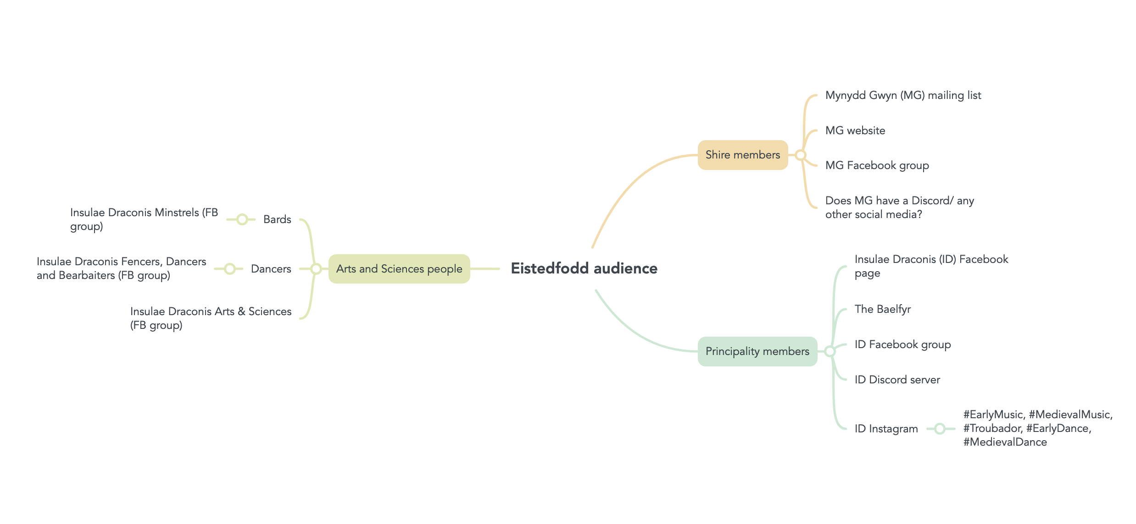
Stage 2: Worked example

Slide 10
Reaching local members of the public
The vast majority of SCA event promotion takes place, for obvious reasons, in existing SCA circles. But what about when you want to reach people who might be interested in joining the SCA, who aren’t already in SCA spaces online?
The lowest-effort way is to include encouragement in your posts in SCA circles to bring along a friend or family member: one of the most successful recruiting tactics in the SCA is word of mouth.

Slide 11
Reaching local members of the public
For other tactics, let’s use an event at Manor Farm in Bourn, Cambridgeshire as a worked example:
Existing networks for the event site, e.g. Manor Farm’s Facebook page
Local residence groups and associations, e.g. Bourn Neighbourhood watch & Bourn village information. Ask local contacts what people tend to use, e.g. WhatsApp groups, apps like NextDoor, etc.
Local newspapers and bulletins, e.g. Bourn’s Parish Council Newsletter
Local and regional interest groups focused on history, re-enactment, LARP etc, e.g. Reenactment UK – Member’s Group; UK Medieval Reenactment Groups; Reenactment UK. Recruitment & Upcoming Events; the LARP events directory, groups like the Cambridgeshire Guild of Weavers, Spinners and Dyers. N.B.: make sure that event advertisement is permitted in the group first!
Regional event listing groups and sites, e.g. What’s On – Cambridgeshire and Cambridgeshire Events

Slide 12
Stage 3: Plan a promotional schedule
Keep a list in the Comms Grid of all the spaces you found and intend to promote your event in as part of Stage 2, so that you consistently post in the same places and don’t forget anywhere.
General principles:
Regularity is key to maintain awareness of your event.
Ideally, start early to allow people to book time off work and travel.

Slide 13
Stage 3: Plan a promotional schedule
Ramp up the frequency of posts as the event gets closer.
Generate excitement over event milestones, e.g. registration opening, the schedule being released, feast menus being announced, being one month away from the event, one week away, etc.
Identify when the online spaces you’re planning on promoting your event in are active, and prioritise posts for these times for maximum engagement. For example, engagement metrics on the Insulae Draconis Facebook group reveal that the group is most active on Sundays in the early evening.

Slide 14
Stage 4a: Write copy
Draft text for your social media posts in advance in your Comms Grid – this doesn’t have to be done all in one go, but it can be helpful to see it all in one place.
Engage your audience with a question: this promotes engagement, which boosts the visibility of your posts. For example, ask people what activity/ class/ other part of the event they are most looking forward to, which feast dish they’re most excited about, or what the theme means to them.
Remind them of your event’s USP(/s)

Slide 15
Stage 4a: Write copy
Include a Call to Action: i.e. what are you hoping people who see your post will go on to do? Make this explicit, noticeable, and as easy as possible. For example, hyperlinked text with relevant phrases such as ‘follow the event page/ join the event group’, ‘check out the event website’, ‘take a look at the schedule/ feast menu’, ‘register your interest/ attendance’.
Wherever possible, include some new information or a new focus. Feel free to re-use text you’ve posted before, but make sure the text is not wholly identical to posts you have made in the past. This is more likely to make people who see the posts “switch off” when they see them, because they’ve seen it before

Slide 16
Stage 4b: Visual content
NB: there is considerable overlap here with general event conception, as well as the design process and content for an event’s website, so some of these decisions may have already been made in the event planning process.
Even on platforms that are primarily text-focused (like Facebook) rather than image or video focused (like Instagram or TikTok), posts that contain media content perform better than posts that are just text.
First, look back at your notes from Stage 1, where you thought about the USP(/s) of your event, and use these same questions to think about a visual identity for your event. It may also be helpful to think about the event atmosphere you are hoping to create.

Slide 17
Stage 4b: Visual content
Try and identify a handful of images that capture these vibes. For example:
elements of group heraldry (e.g. swans for Pont Alarch, apples for Eplaheimr, Insulae Draconis’ demi-sun);
iconic aspects of the event (e.g. Eisteddfod’s silver chair, holly and/or other Yule imagery for Yule Ball, archery equipment for Flaming Arrow)
abstract aesthetic inspiration (e.g. celtic knotwork, sixteenth-century blackwork embroidery, manuscript border illustrations)
These may also inspire a colour palette to stick to, if there isn’t one already.
Choose a couple of fonts that fit with the event vibes and theme: at least one for headings and one for body text. Make sure they are relatively easy to read - it is best to go with a modern font for body text. Click here for some examples of medieval-esque free font files.

Slide 18
Stage 4b: Visual content
Creating visual content can seem intimidating, but remember: you don’t have to reinvent the wheel.
Canva is a free design tool with lots of free templates, graphics and fonts that you can play around with to create Instagram posts and other promotional content for your event, drawing on everything you have pulled together so far for its promotion.
NB: Some graphics are also limited to Premium users only, but the free version still has a wide range of graphics you can use. You can always upload your own images as well. Canva only has a few historical fonts, but you can upload custom fonts with Canva Premium.
Graphic design tools like Photopea (a free Photoshop clone in your browser), Adobe Illustrator or Inkscape can be a lot more difficult to wrap your head around, but also offer a lot more creative freedom.

Slide 19
Stage 4b: Visual content
Click here for a list of photo albums where permissions for SCA use have already been granted. The Drachenwald Unified Media Project is also working on collating photos and videos into a central database for promotional content.
Kabouter Games clean up art from a range of period manuscripts (and nineteenth century illustrations) and make initials and illustrations into image assets with transparent backgrounds that are cheaply available and perfect for SCA promotional purposes.

Slide 20
Stage 4b: Visual content
General rules:
Keep it text light, with only a couple of phrases at most. Instead, put text in the accompanying post/ caption.
Keep it accessible. Use alt text/ write image descriptions.
Keep it visually clear and coherent, making sure it’s easy to see what’s going on and not too visually cluttered.
If you are getting image assets from elsewhere on the web, make sure they are under a creative commons license.

Slide 21
Stage 5: Amplify your social media posts
Social media algorithms vary widely from site to site, and are typically obtuse. They can also change with time, so take what is said here with a grain of salt and be sure to Google how best to work with the algorithm, looking for recent articles.
General rules:
Posts with media content (i.e. photos and videos) get better engagement than posts that are just text.
There are multiple ways for people to engage with posts, and each are weighted differently. Typically, higher-effort ways of engagement are weighted more highly than simple ways to engage, e.g. comments are “worth more” than likes. A post that is promoting discussion is more likely to appear on people’s feeds than one that is not.
Encourage members of the event team and friends to like and comment on posts so that others are more likely to see them.

