Slide 1


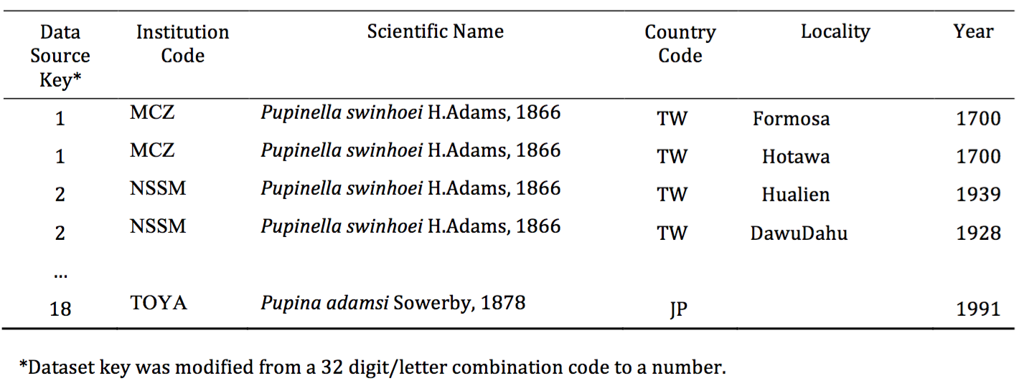
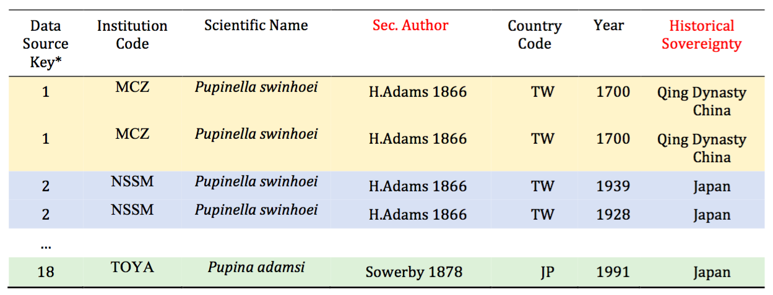
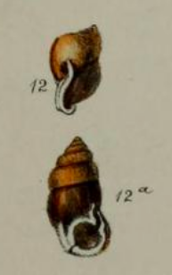

Snailed it! Merging Taxonomically Organized Biodiversity Datasets with Shifting Geopolitical Realities
Yi-Yun Cheng¹, Steven Dilliplane², Bertram Ludäscher¹ ¹School of Information Sciences, University of Illinois at Urbana-Champaign; ² The Academy of Natural Sciences of Drexel University
Taxonomy; Biodiversity Informatics; Geopolitical Realities
PROBLEMS
Difficulties in maintaining a seamless and explicit navigation among biodiversity, taxonomically organized datasets & Natural History Museum Literature (NHM) (Page, 2013, 2019)
Concerns about the quality of aggregated biodiversity data from data integration services such as GBIF (Franz & Sterner, 2017)
Dataset distributors usually provide a more Westernized view of documentation that has overlooked some of the geopolitical realities in other regions of the world (Boakes et al., 2010; Harris & Froufe, 2005; Karl & Bowen, 1999)
RESULTS
DATA SOURCES
NATURAL HISTORY MUSEUM LITERATURE
From the Biodiversity Heritage Library (BHL)
Proceedings of the Academy of Natural Sciences of Philadelphia
A 1905 article on “Catalogue of the land and fresh-water Mollusca of Taiwan (Formosa), with descriptions of new species”
SPECIES OCCURRENCES DATASETS
From Global Biodiversity Information Facility (GBIF)
On Pupinella swinhoei : 50 occurrences from 18 datasets of different sources, ranging from the year 1700 to now
INPUTS
POSSIBLE WORLDS
YEAR
1500
OUR GOALS
Provides a more precise approach to merge taxonomically organized datasets that contain region sovereignty changes over time
Serves as a first step towards bridging NHM literature and biodiversity datasets
1600
USE CASE
GEOGRAPHIC POINT OF INTEREST: TAIWAN
Taiwan has been historically complex in terms of sovereignty, or geopolitical realities
SPECIES: Pupinella swinhoei sec. H. Adams 1866
A land snails species endemic to Taiwan and Japan
WHAT QUESTIONS TO ANSWER?
What is the historical distributions of species such as the land snails?
Are they endemic to Taiwan, Japan, or other locations?
What is different from the 1905 historical text on such species and now?
Can we leverage the 1905 historical texts to enrich species descriptions?
1660
Example of our target modified datasets
After the taxonomy alignment approach on the ‘countries’ with geopolitical realities, we can provide another value-added column showing the true historical sovereignties
1680
1895
PRACTICAL IMPLICATIONS
The alignments of species name and historical sovereignties may aid the creation of a data-driven knowledge graph for a particular species
Species phenotypes, traits, habitat information can then be added to enrich the data that were not included in a Darwin-Core formatted occurrence dataset
METHOD: TAXONOMY ALIGNMENT
Taxonomy Alignment Problems (TAP) : Taxonomies T₁, T₂ are inter-linked via a set of input articulations A to yield a “merged” taxonomy T₃
Articulations: a constraint or rule that defines a relationship (a set constraint) between two concepts from different taxonomies
Region Connection Calculus (RCC-5)
Possible Worlds – When encoding and solving TAPs via ASP, the different answer sets represent alternative taxonomy merge solutions or possible worlds (PWs)
1945
ACKNOLWEDGEMENT
This project is the outcome of the 2019 LEADS-4-NDP fellowship program. The authors wish to thank the program organizers, specifically Dr. Jane Greenberg, and Sam Grabus for their continuous support.
1949
CONTACTS
yiyunyc2@illinois.edu
https://github.com/EulerProject/IDCC20

