Slide 1
Netflix Content Analysis Data Analyst Mini Project Ömer Çiftci | April 10, 2025

Slide 2
Project Objective
In this project, Netflix's movie and TV show data was analyzed using Python.
Goals: - Content type distribution - Yearly content trends - Country-wise content production - Most common content genres

Slide 3
Data Source
🔹 Source: Kaggle - Netflix Titles Dataset 🔹 Rows: 8,807 🔹 Columns: 12 🔹 Period: 2008 – 2021

Slide 4

Data Cleaning Steps
Data Cleaning Steps: - Missing values in 'director', 'cast', and 'country' were replaced with 'Unknown' - 'date_added' column was converted to datetime format - Invalid or missing dates were removed

Slide 5
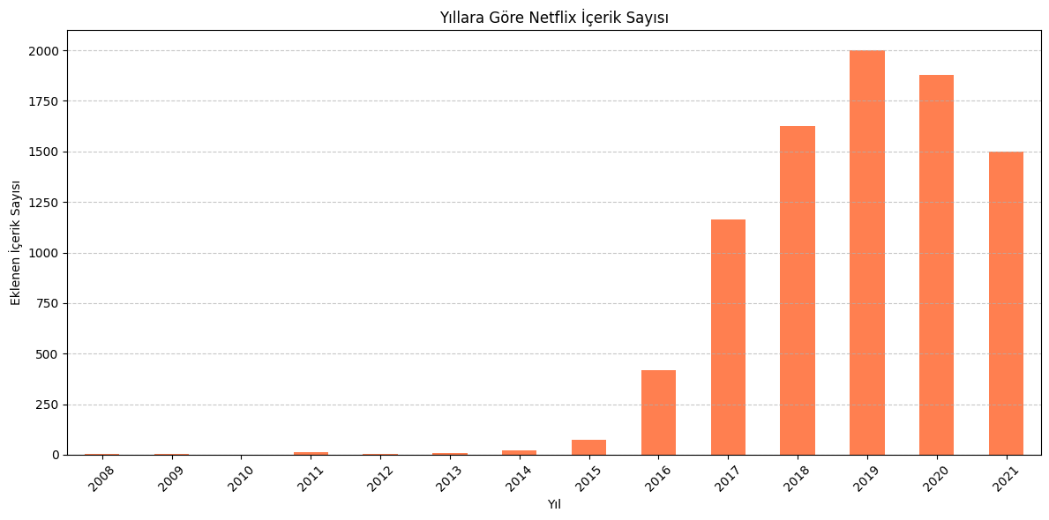
Content by Year
Netflix significantly increased its content additions after 2016. The highest number of titles were added in 2019.

Slide 6
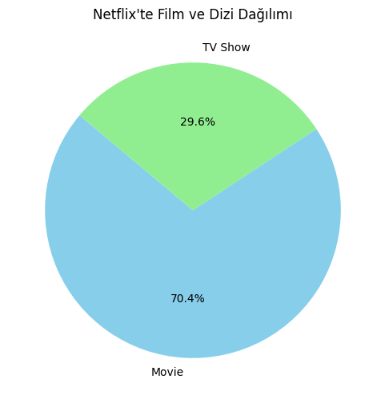
The majority of Netflix content consists of movies (~70%), while TV shows make up a smaller portion.
Movie vs TV Show Ratio

Slide 7
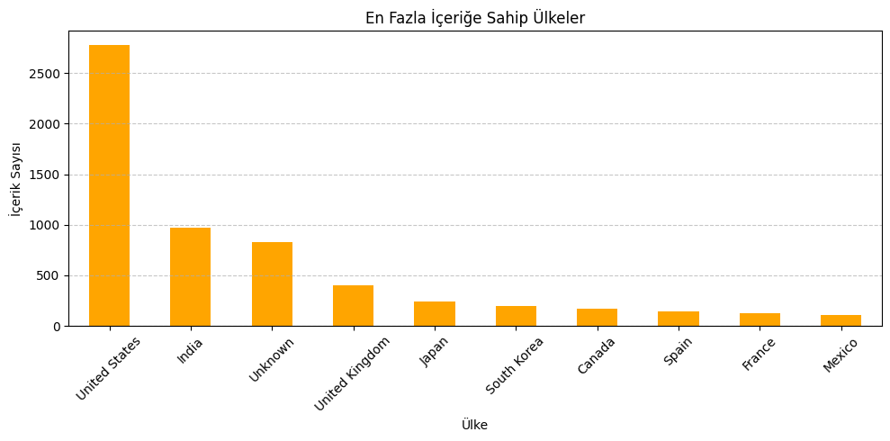
Top Content-Producing Countries
The United States, India, and the UK lead in the number of titles produced. They are key production hubs for Netflix.

Slide 8
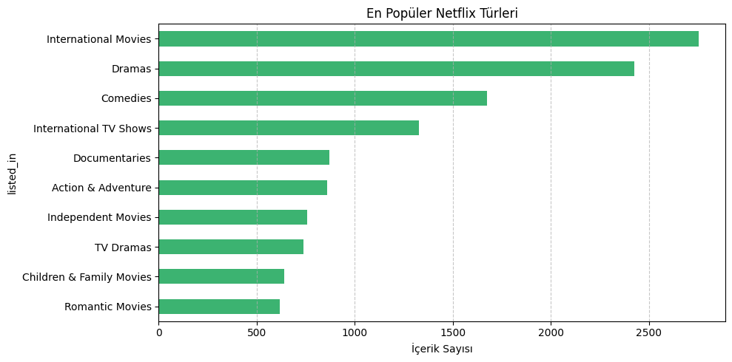
Most Common Genres
Dramas, International Movies, and Comedies are the most prevalent genres on Netflix.

Slide 9
Summary
Netflix has increased its content volume over time Movies dominate, but TV shows are growing Content is global, but the U.S. has a strong presence Wide genre variety is offered to users

Slide 10
Thank you! Q&A Contact: eumerchieftchi@gmail.com linkedin.com/in/eumer-chieftchi/

