Slide 1

CANONNAM
WATER
POWERPOINT
TEMPLATE

Slide 2
1
SAVE WATER
1
SAVE WATER
We should try to save water
We should try to save water
2
SAVE WATER
2
SAVE WATER
We should try to save water
We should try to save water
3
SAVE
WATER
3
SAVE
WATER
4
4
SAVE WATER
SAVE WATER

Slide 3
WATER
Water covers 71%
of the Earth's surface.
It is vital for all known forms of life.
On Earth, 96.5% of the planet's crust water is
found in seas and oceans, 1.7% in groundwater, 1.7%
in glaciers and the ice caps of Antarctica and Greenland,
a small fraction in other large water bodies, and 0.001% in the air as vapor,
clouds (formed of ice and liquid water suspended in air),
and precipitation.

Slide 4
SAVE
WATER
W ter
We should try to save water

Slide 5
WATER
80%
WATER
60%
SAVE
WATER
70%
is a transparent fluid which forms the world's streams, lakes, oceans and rain, and is the major constituent of the fluids of organisms.
is a transparent fluid which forms the world's streams, lakes, oceans and rain, and is the major constituent of the fluids of organisms.

Slide 6
is a transparent fluid which forms the world's streams, lakes, oceans and rain, and is the major constituent of the fluids of organisms.
is a transparent fluid which forms the world's streams, lakes, oceans and rain, and is the major constituent of the fluids of organisms.
procedure
1
2
3
4
WATER
WATER
WATER
WATER
is a transparent fluid which forms the world's streams, lakes, oceans and rain, and is the major constituent of the fluids of organisms.
is a transparent fluid which forms the world's streams, lakes, oceans and rain, and is the major constituent of the fluids of organisms.

Slide 7
WATER
Learned about the importance of water.
WATER
Learned about the importance of water. Increasing water quality is very important because water affects every aspect ofour lives. Water is an important natural resource
WATER
Increasing water quality is very important because water affects every aspect ofour lives.

Slide 8
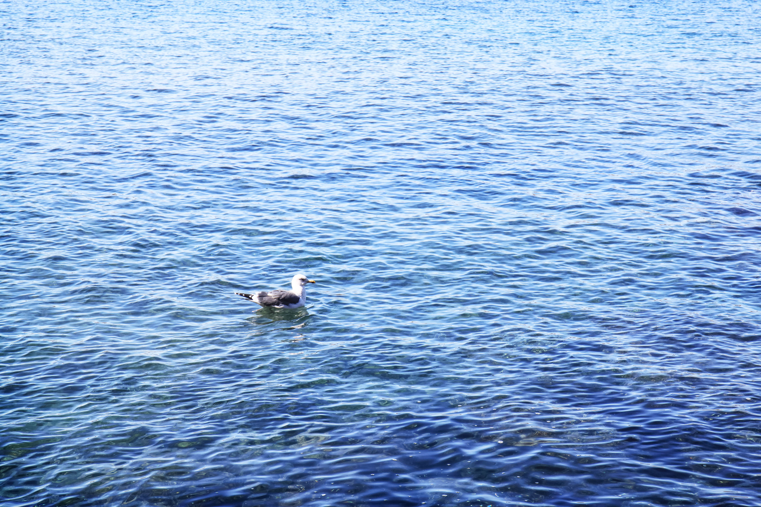
W ter
WATER
WATER
is a transparent fluid which forms the world's streams, lakes, oceans and rain, and is the major constituent of the fluids of organisms.
is a transparent fluid which forms the world's streams, lakes, oceans and rain, and is the major constituent of the fluids of organisms.
WATER
is a transparent fluid which forms the world's streams, lakes, oceans and rain, and is the major constituent of the fluids of organisms.

Slide 9

WATER
is a transparent fluid which forms the world's streams, lakes, oceans and rain, and is the major constituent of the fluids of organisms.
IS LIFE
is a transparent fluid which forms the world's streams, lakes, oceans and rain, and is the major constituent of the fluids of organisms.
PHOTO CANONNAM

Slide 10
55%
WATER
75%
SAVE
65%
TRY
WATER
SAVE
TRY
is a transparent fluid which forms the world's streams, lakes, oceans and rain, and is the major constituent of the fluids of organisms.
is a transparent fluid which forms the world's streams, lakes, oceans and rain, and is the major constituent of the fluids of organisms.
is a transparent fluid which forms the world's streams, lakes, oceans and rain, and is the major constituent of the fluids of organisms.
PHOTO CANONNAM

Slide 11
WATER
IS LIFE
is a transparent fluid which forms the world's streams, lakes, oceans and rain, and is the major constituent of the fluids of organisms.

Slide 12
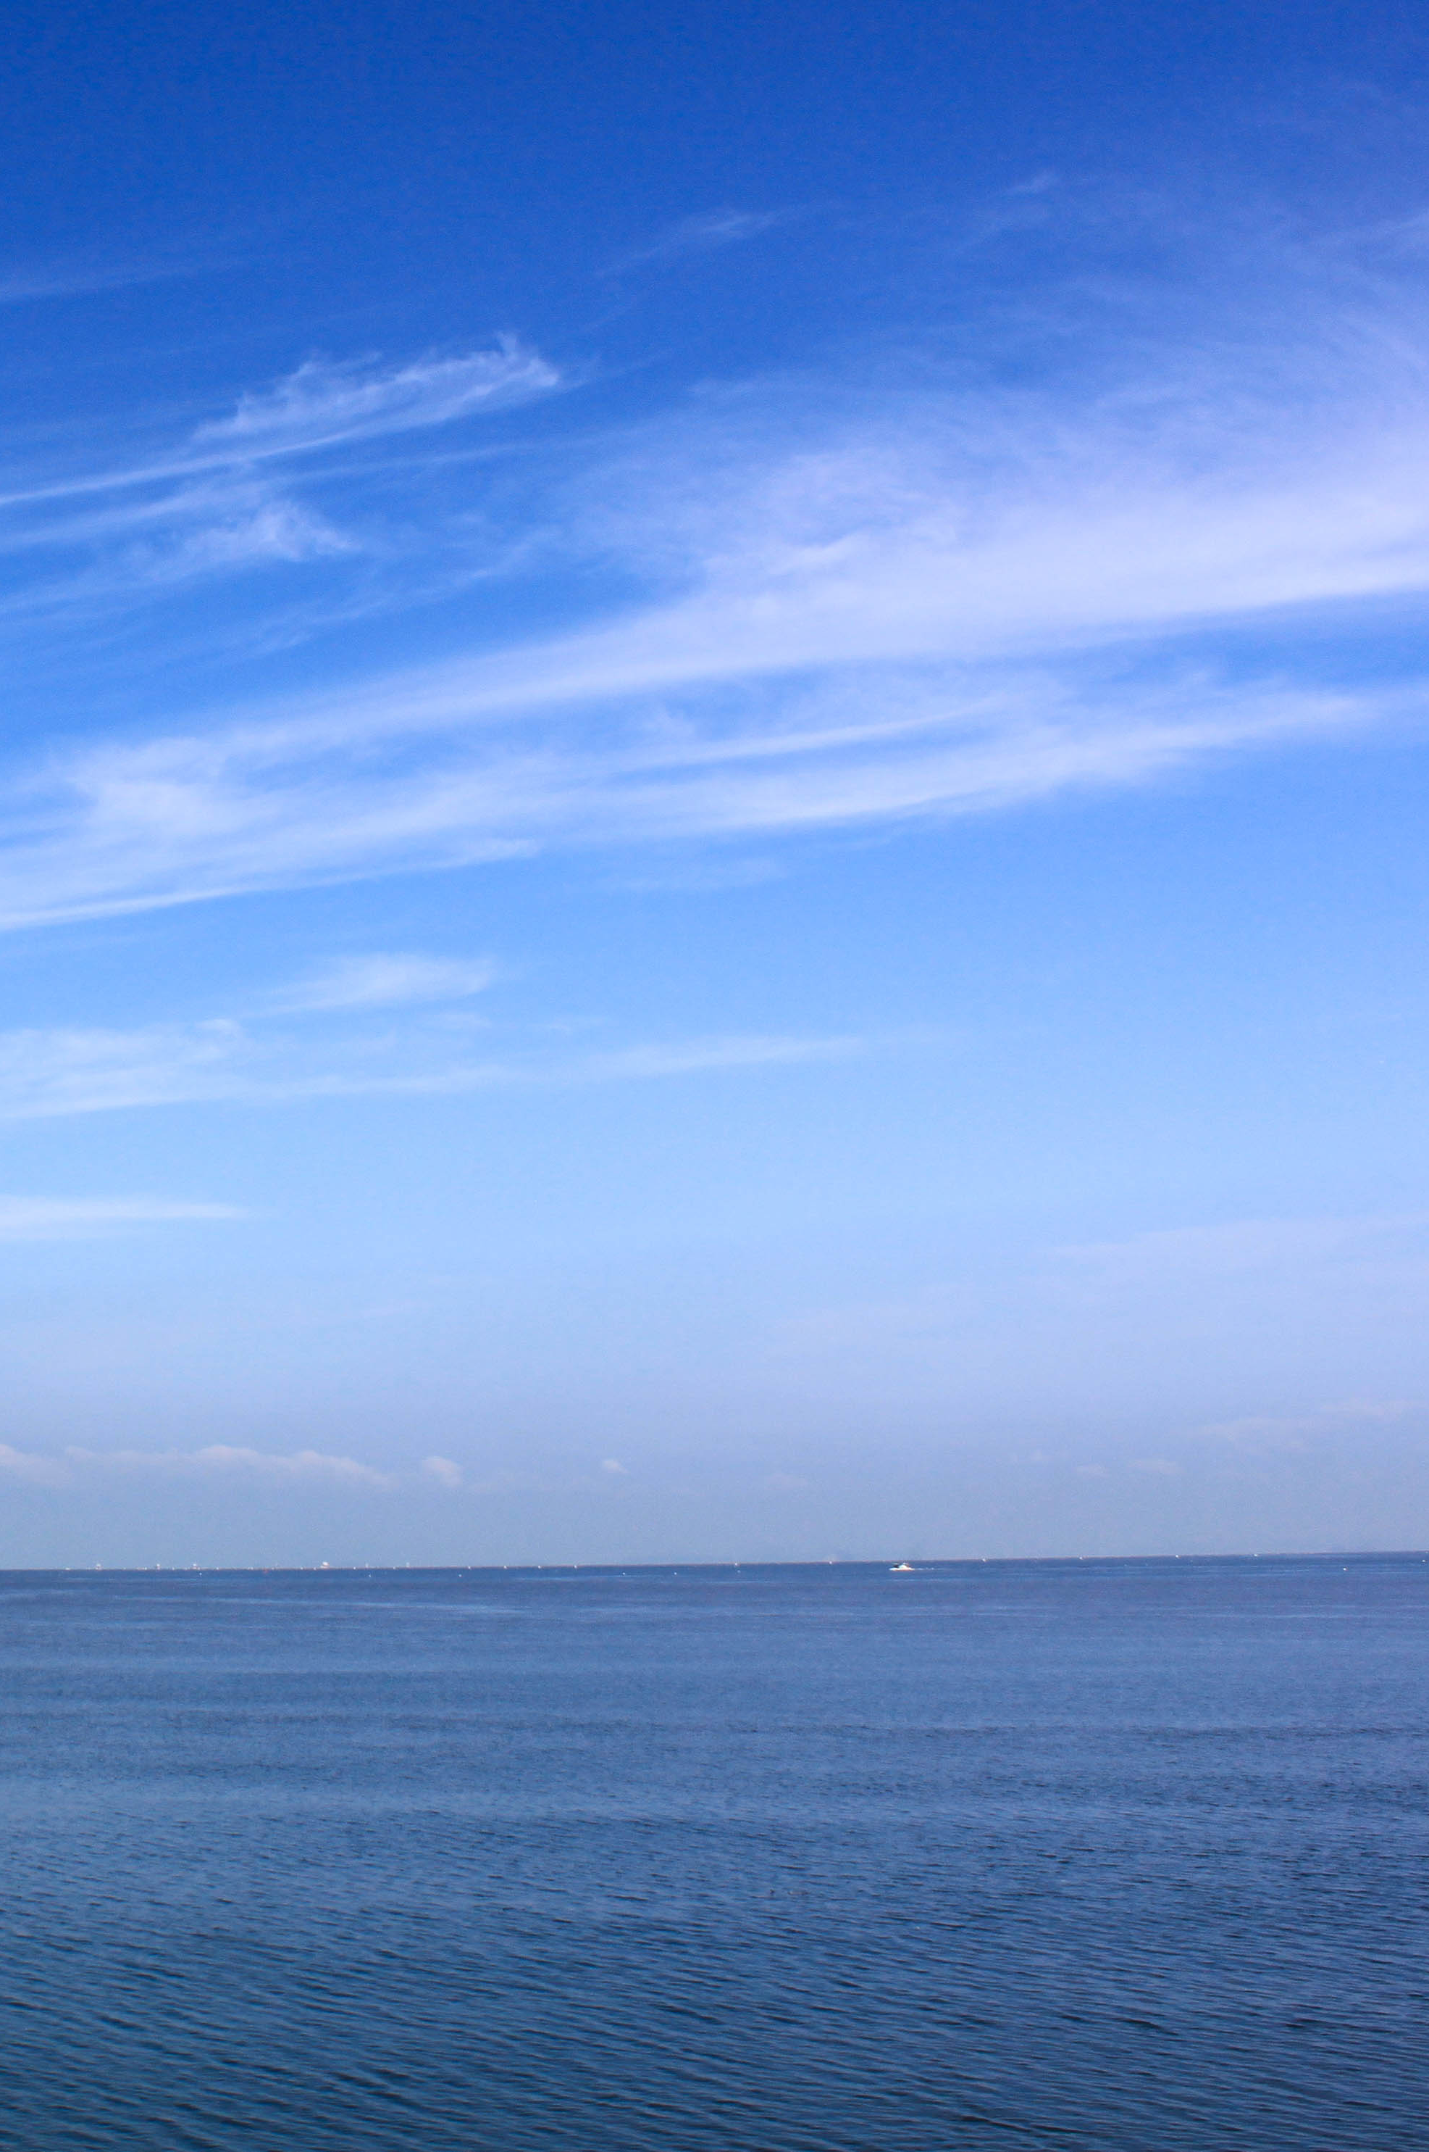
8
WATER
SAVE
%
TRY

Slide 13
WATER
is a transparent fluid which forms the world's streams, lakes, oceans and rain, and is the major constituent of the fluids of organisms.
TRY
TRY
WATER
is a transparent fluid which forms the world's streams, lakes, oceans and rain, and is the major constituent of the fluids of organisms.

Slide 14
WATER
WATER
WATER
is a transparent fluid which forms the world's streams, lakes, oceans and rain, and is the major constituent of the fluids of organisms.
is a transparent fluid which forms the world's streams, lakes, oceans and rain, and is the major constituent of the fluids of organisms.
is a transparent fluid which forms the world's streams, lakes, oceans and rain, and is the major constituent of the fluids of organisms.
is a transparent fluid
is a transparent fluid
is a transparent fluid
WATER
WATER
WATER
is a transparent fluid which forms the world's streams, lakes, oceans and rain, and is the major constituent of the fluids of organisms.
is a transparent fluid which forms the world's streams, lakes, oceans and rain, and is the major constituent of the fluids of organisms.
is a transparent fluid which forms the world's streams, lakes, oceans and rain, and is the major constituent of the fluids of organisms.
WATER

Slide 15
50
43
is a transparent fluid which forms the world's streams, lakes, oceans and rain, and is the major constituent of the fluids of organisms.

Slide 16
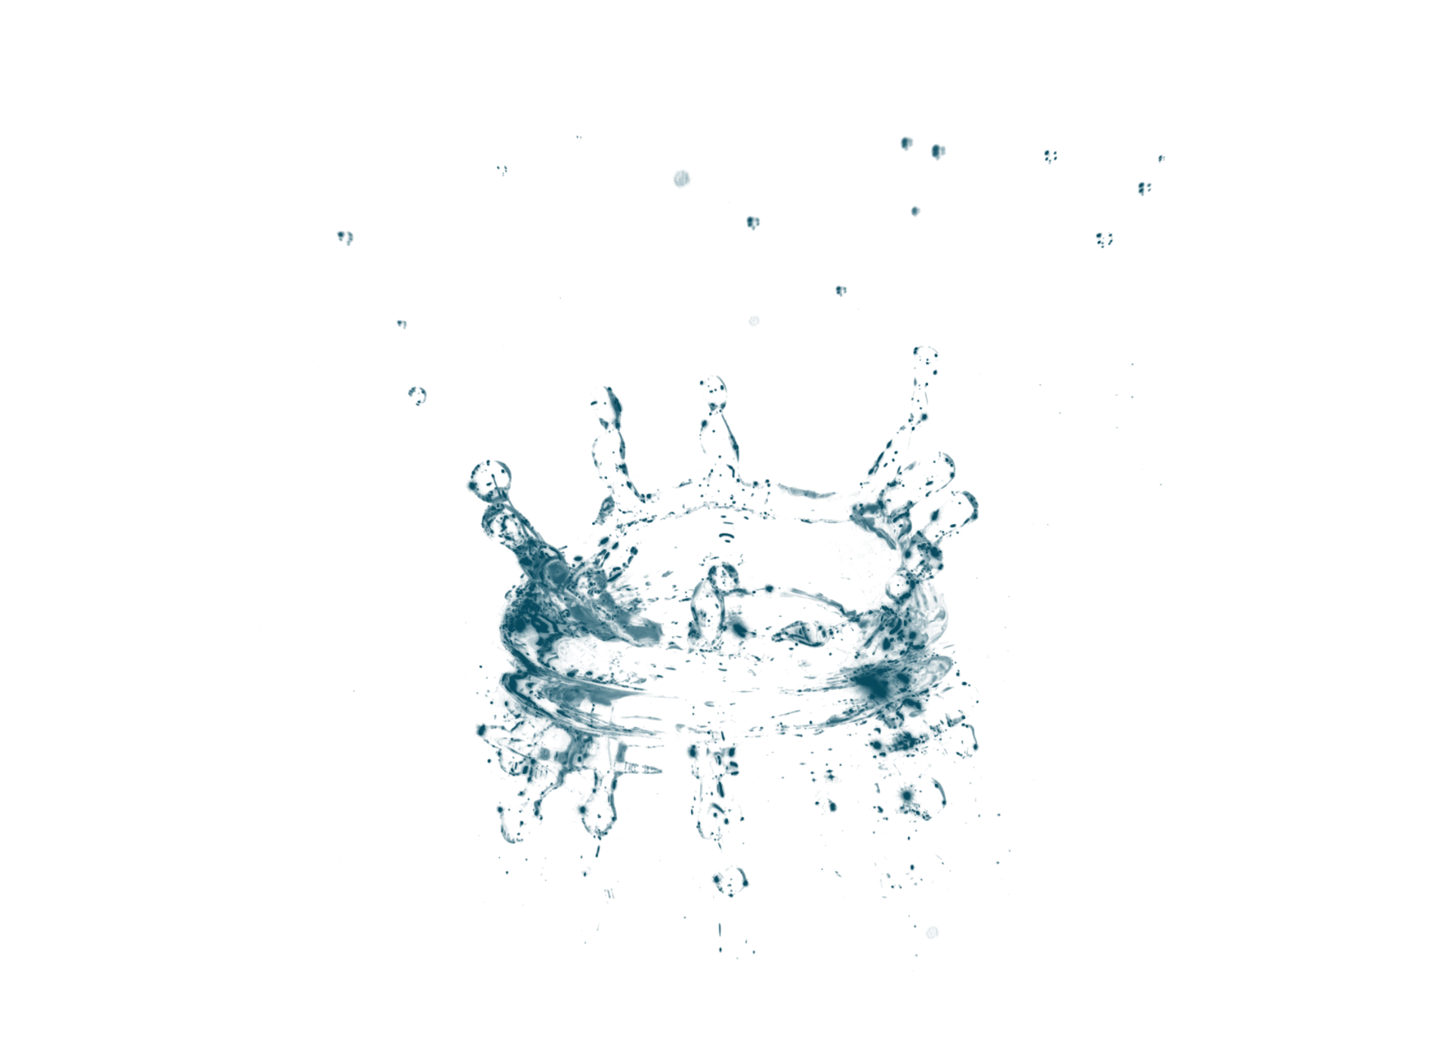
THANKS

