Slide 1
Basic Python Programming
[Session 4] Lab session
ITinerary X University of Ghana
Notes:
ok, then let’s start lab session.

Slide 2
Contents
Poop game
Notes:
We will make a game: poop game

Slide 3
Poop Game

Slide 4
Poop game [1]
Avoid the falling poops as possible you can
We will show the example solution
Notes:
We will make a game: poop game
in this game, you should avoid the falling poops, let me show the example of the sample solution

Slide 5
Poop game [2]
We need some randomization
Initial location of poop
Frequency / period of generation of poop
Speed of poop falling
etc..
random library will help you
random.randint(start, end) returns a random integer between these
Notes:
so, What should we do, for making this game?
First, it contains some randomization. such as initial location of poop, period of poop generatation
, speed of flling, and something else
to make a random number, you can import random library, and use random dot randint function

Slide 6
Character Moving
Use event handler (KEYDOWN / KEYUP)
Moves only with x-direction
Idea and implementation are in the pre-class material and exercise
Notes:
And then, your character should be able to move, by pressing left key and right key, right?
the detail implementation is in the preclass and exercise. so please refer to this, although I will explain this again in the lab session

Slide 7
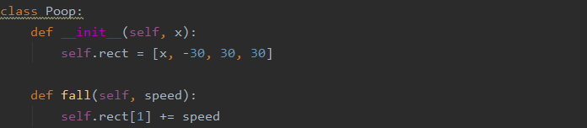
Poop
It should..
be generated with random period
start in the random x-location
fall continuously
collide with character (and then game over)
…
Notes:
In the skeleton code, the poop is defined as a class
the poop should be generated with some random period
and fall continuously, until it drops to the ground
and then, if the poop and character collide with each other, then the game will be over. right?

Slide 8
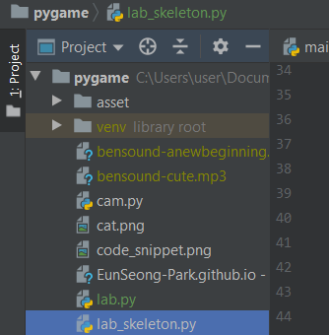

Guide
We uploaded skeleton code and some images to the page
https://eunseong-park.github.io/itinerary/posts/pygame
Don’t forget to save the file in your project directory!
Notes:
You can download the skeleton code, and some images. from the page
and don’t forget to save the file in your project directory

Slide 9
Let’s start!
Notes:
ok. let’s make it together.

