Slide 1
Basic Python Programming
[Session 1] Lab session
ITinerary X University of Ghana

Slide 2
Contents
Class: Dot
Class: Car

Slide 3
Class: Dot

Slide 4
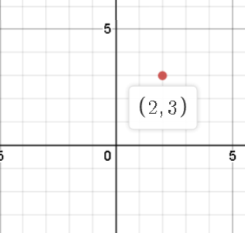
Dot [1]
We will implement “Dot”
dot?

Slide 5
Dot [2]
Basically, Dot contains two data
x and y
Okay, that’s all for member variables
And then?
Define methods!

Slide 6

Review: Methods [1]
Note that, every method should be like…

Slide 7
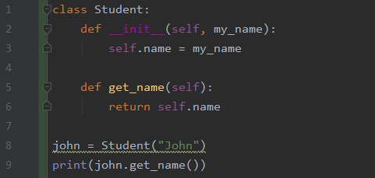
Review: Methods [2]
You can access the member variable inside method, by using self!

Slide 8
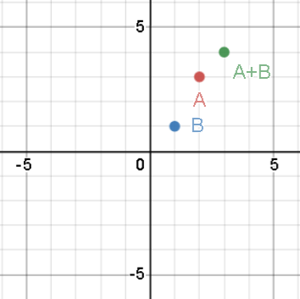
Dot: Methods [1]
dot_add, dot_sub method adds / subtracts each coordinate
Example: (2, 3) + (1, 1) = (3, 4)

Slide 9
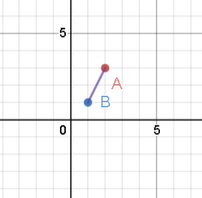
Dot: Methods [2]
dot_dist returns the distance between two points
in this case, root(5).

Slide 10
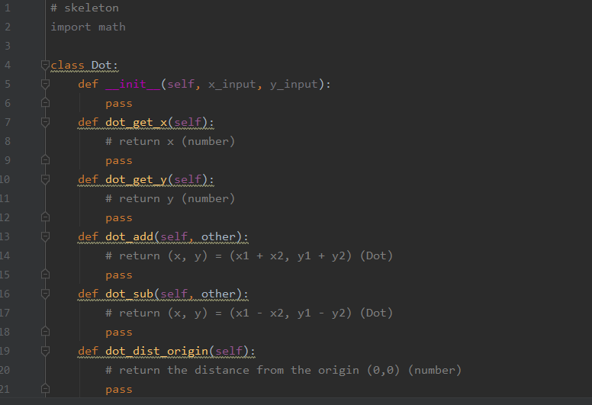
Dot: Methods [3]
Other methods are defined in the skeleton code.
You have to modify this

Slide 11
Let’s start!
Use the skeleton, dot.py

Slide 12
Class: Car

Slide 13
Car
A car can do
drive (as long as the fuel remains)
show the its status:
fuel (L)
total distance (km)
etc.
Cars have their own features:
car name
mileage (km/L)
max fuel (L)

Slide 14
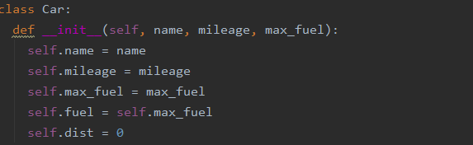
Car: Member Variables

Slide 15
Car: Methods [1]
Brrr(self, km): drive X km
The car should consume the fuel, as you drive
If the fuel is not enough, it cannot go
After that, show the current state
gas_station(self): Full the fuel
It’s free!
After that, show the current state

Slide 16
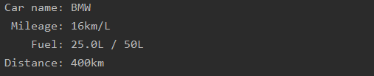
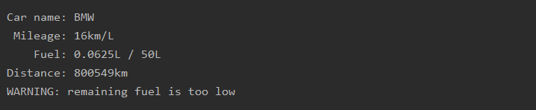
Car: Methods [2]
status(self): show the current status
warn if the fuel is too low

Slide 17
Let’s start!
Use the skeleton, car.py

Slide 18
Thank you

