Slide 1
Basic Python Programming
[Session 3] Lab session
ITinerary X University of Ghana
Notes:
ok, then let’s start lab session.

Slide 2
Contents
Facial recognition: Pixelation
Notes:
today, we will implement pixilation with facial recognition

Slide 3
Facial Recognition

Slide 4
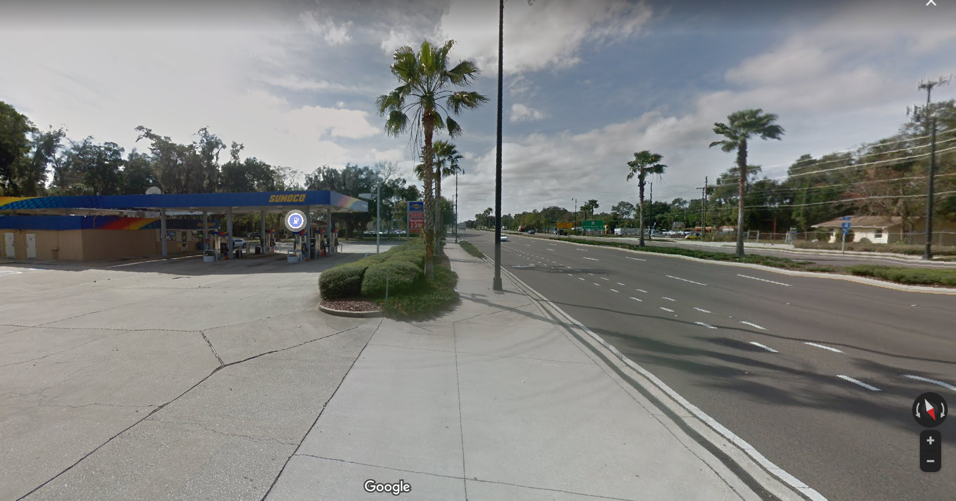
Piexlation [1]
Google map provides “Street view” service
Notes:
First, have you ever seen street view in google map?
It provides very high-quality roadview

Slide 5
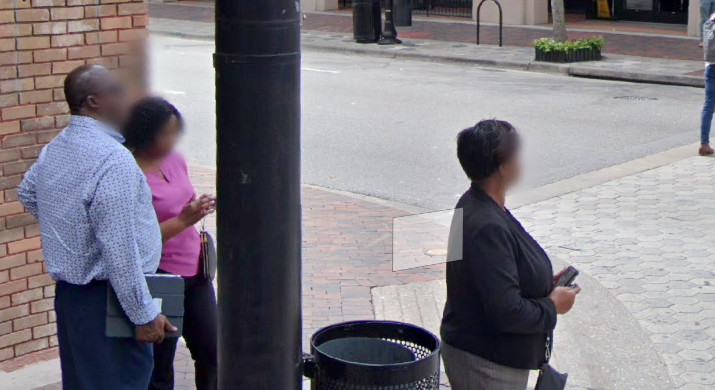
Piexlation [2]
You can see that the face is blured (for privacy)
Notes:
If you see somewhere with many people, you may see that people’s face is blured out
Okay let me show that

Slide 6
We need…
We need two things for that:
Detect face from the given image
and blur out
Notes:
So, we will make such a method for pixilation, or blurring out
We need to do somethings for that
capture video from your camera, and detect face, and then, blur out

Slide 7
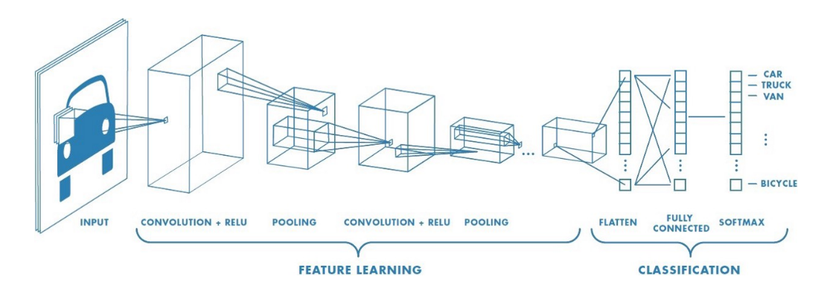
OpenCV Facial Recognition [1]
Haar Cascade is a ML-based algorithm for object detection
This works like CNN(Convolutional Neural Network)
Notes:
Let’s briefely view about background.
OpenCV provides a powerful ML-based object detection and classification model, called haar cascade.

Slide 8
OpenCV Facial Recognition [2]
The steps for Haar cascade is…
1. Prepare lots of data to learn
2. Extract Haar-feature
3. Compute the feature
4. Apply the haar classifier to the given image / frame
…But you don’t need to learn about this
because it contains too annoying math
Notes:
To implement haar cascade
we should prepare some dataset, and extract and compute the feature from this.
And then apply the generated model to the given image or frame
but you don’t need to do these. because..

Slide 9
OpenCV Facial Recognition [3]
We will not conduct learning directly
OpenCV provides pre-learning data
https://github.com/opencv/opencv/tree/master/data/haarcascades
You can load this and use without anything more
We uploaded this to the page
with the skeleton code
Notes:
there are some pre-learning data, it is provided by opencv.
You can use some data, from this link, and just load this data file
We uploaded this to the page, so you can download it.

Slide 10
Pixelation
The method is simple:
(intensely) Zoom in, and zoom out
The function for this is provided in the skeleton
Notes:
After the detection of face, we have to pixelate the face area in the image.
It can be done very easily, just zoom in and zoom out. Then we can break the image intentionally
Also, the function for this is provided in the skeleton. and if you want, you can modify and improve the function,
.

Slide 11
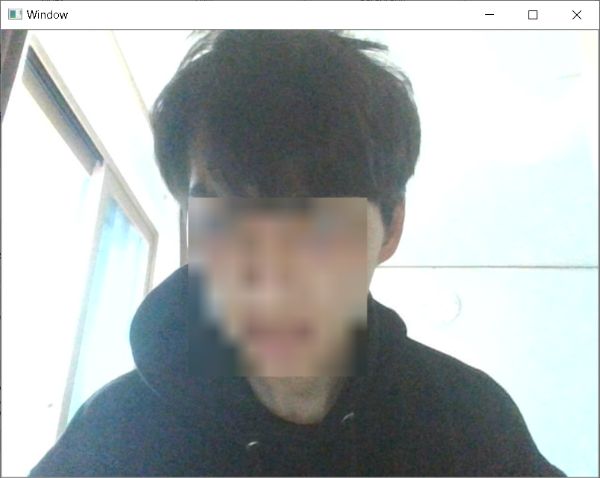
Objectives
Use your webcam in OpenCV
Detect your face
After that, pixelate the face area
Show the video in real-time
Notes:
So, your program should…
capture the video by your webcam
detect your face from this
pixelate the face area, and show the video in realtime

Slide 12
Notes
Be careful about the “light”
If the image contains backlight, detection sometimes doesn’t work
Notes:
Also, you should be careful about the light
because too-intense light can disturb the detection of face
If your facial recognition does not work, please relocate the webcam.

Slide 13
Code Explanation
Notes:
THen, I breifely explain about the skeleton code

Slide 14
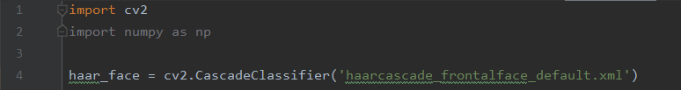
Haar Classifier
It is a dataset for facial recognition
Make sure that the .xml file should be in the same directory with your .py file!!
Notes:
we can load the pre-learned dataset,
and note that, the xml file should be in the same directory with the python file

Slide 15
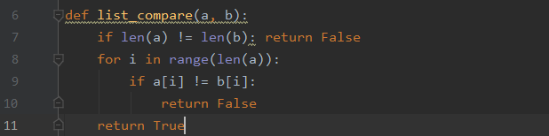
List Comparison
Compares the contents of two lists and return…
True if all of them are same
False if at least one of them are different
Example:
list_compare([1, 2, 3], (1, 2, 3)] => True
list_compare([1, “b”, 3], [1, “b”, 3] => True
list_compare([1, 2, 3], (1, 2)] => False
list_compare([3, 2, 1], [1, 2, 3]) => False
Notes:
We prepared some functions for you
first one is for list comparison you can compare and return True or False.

Slide 16
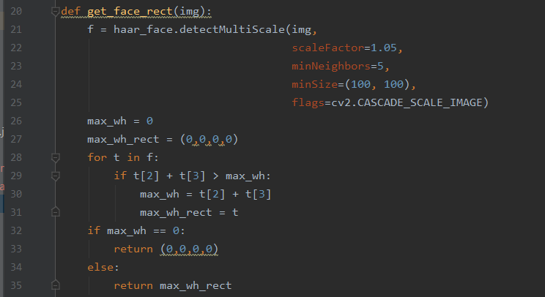
Face Detection
Parameter, img: the image you want to detect
Return value: the area of face (x, y, w, h)
Notes:
get_face_rect function detects face from the image, and return its region, with 4-tuple: x, y, w, h,
And note that, this function will return (0,0,0,0) if there seems no face
because the video contains lots of image, it often fail, but that’s ok

Slide 17
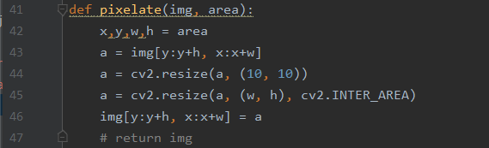
Pixelation
Parameter, img: the image you want to pixelate
Parameter, area: the area you want to pixelate
There’s no return value, you just call, then your image gets modified
Notes:
the pixelate function, blurs out the area in the given image
it doesn’t return anything but it directly modify the image

Slide 18
Notes
The pre-class video shows how to use your webcam and show the video capture
It will be helpful for this lab session
Notes:
I already explained how to use webcam and videocapture in the last of pre-class video.
So it will be helpful for understanding this.
And…

Slide 19
Let’s start!
Notes:
ok. let’s make it together.

