Slide 1
Basic Python Programming
[Session 3] Lab session
ITinerary X University of Ghana
Notes:
ok, then let’s start lab session.

Slide 2
Contents
Facial recognition: Pixelation

Slide 3
Facial Recognition

Slide 4
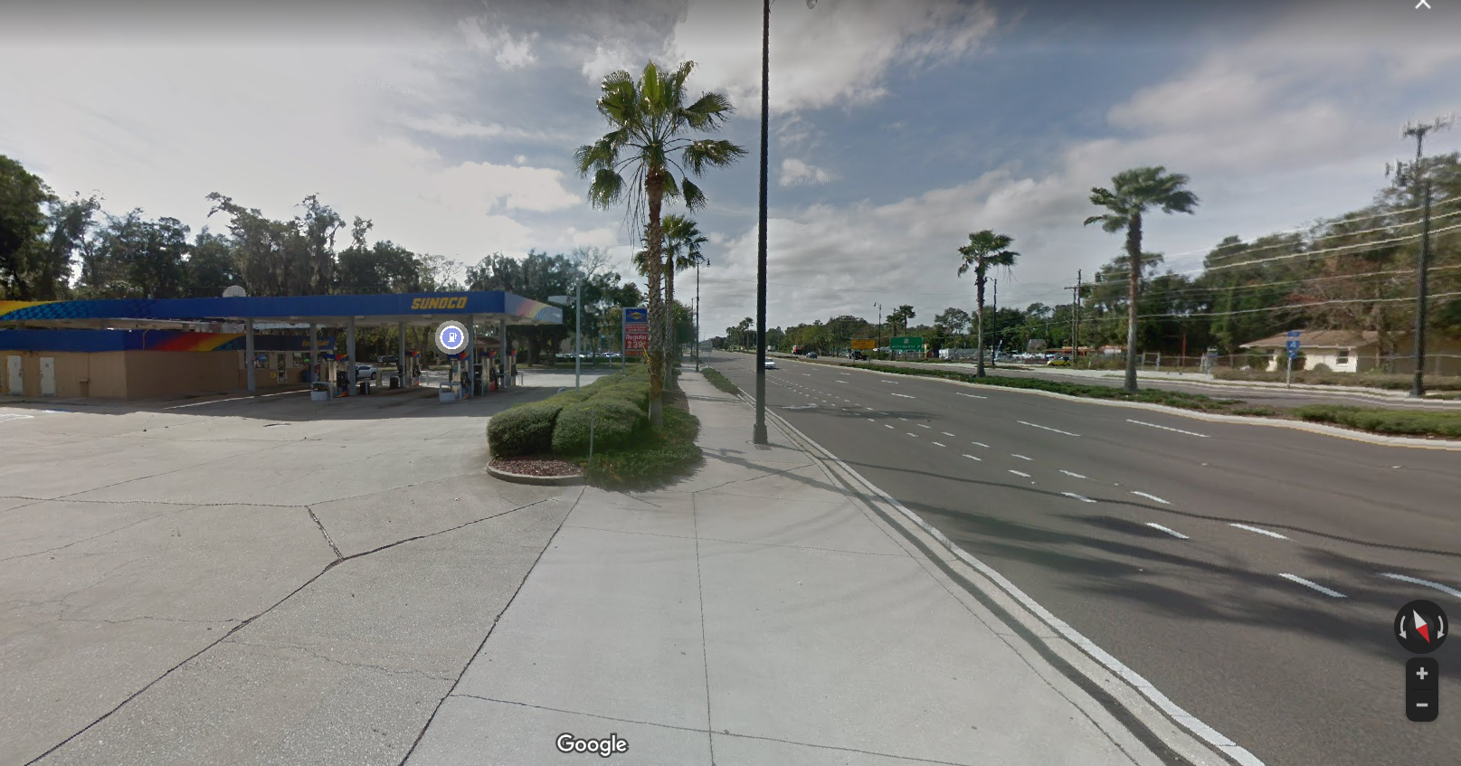
Piexlation [1]
Google map provides “Street view” service

Slide 5
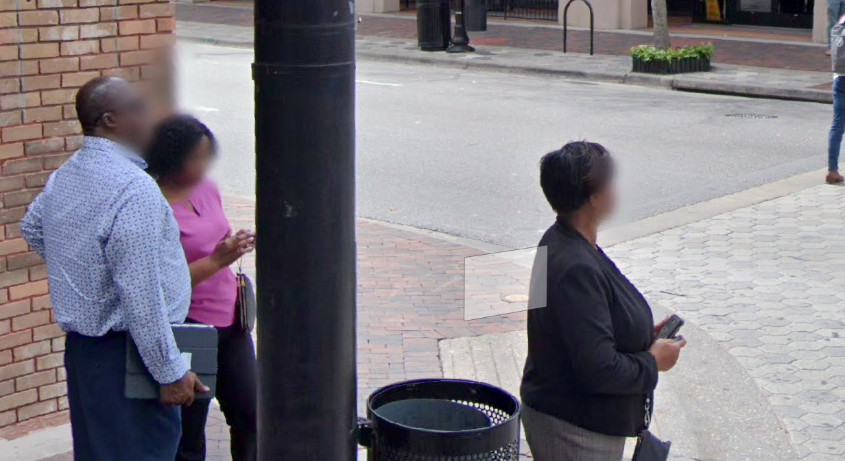
Piexlation [2]
You can see that the face is blured (for privacy)

Slide 6
We need…
We need two things for that:
Detect face from the given image
and blur out

Slide 7
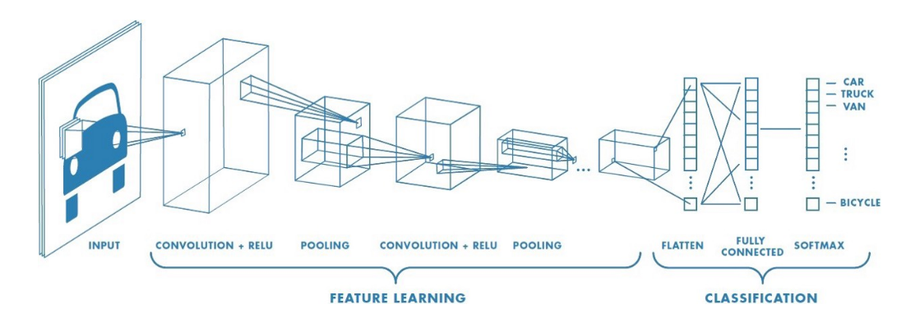
OpenCV Facial Recognition [1]
Haar Cascade is a ML-based algorithm for object detection
This works like CNN(Convolutional Neural Network)

Slide 8
OpenCV Facial Recognition [2]
The steps for Haar cascade is…
1. Prepare lots of data to learn
2. Extract Haar-feature
3. Compute the feature
4. Apply the haar classifier to the given image / frame
…But you don’t need to learn about this
because it contains too annoying math

Slide 9
OpenCV Facial Recognition [3]
We will not conduct learning directly
OpenCV provides pre-learning data
https://github.com/opencv/opencv/tree/master/data/haarcascades
You can load this and use without anything more
We uploaded this to the page
with the skeleton code

Slide 10
Pixelation
The method is simple:
(intensely) Zoom in, and zoom out
The function for this is provided in the skeleton

Slide 11
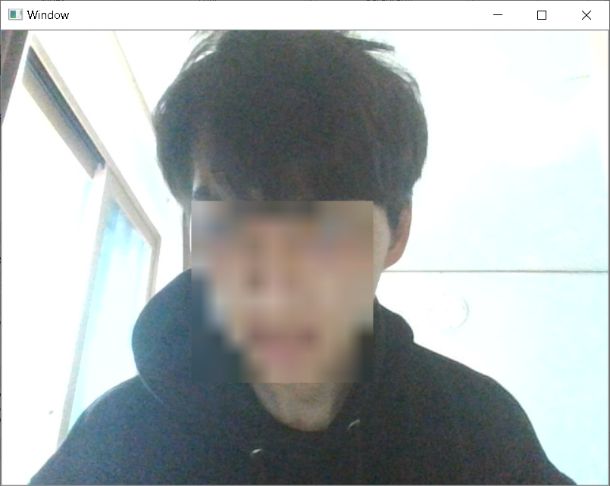
Objectives
Use your webcam in OpenCV
Detect your face
After that, pixelate the face area
Show the video in real-time

Slide 12
Notes
Be careful about the “light”
If the image contains backlight, detection sometimes doesn’t work

Slide 13
Code Explanation

Slide 14
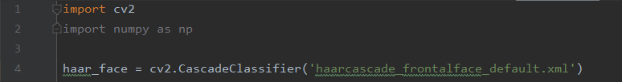
Haar Classifier
It is a dataset for facial recognition
Make sure that the .xml file should be in the same directory with your .py file!!

Slide 15
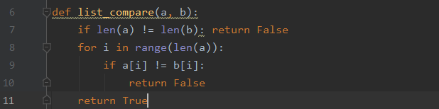
List Comparison
Compares the contents of two lists and return…
True if all of them are same
False if at least one of them are different
Example:
list_compare([1, 2, 3], (1, 2, 3)] => True
list_compare([1, “b”, 3], [1, “b”, 3] => True
list_compare([1, 2, 3], (1, 2)] => False
list_compare([3, 2, 1], [1, 2, 3]) => False

Slide 16
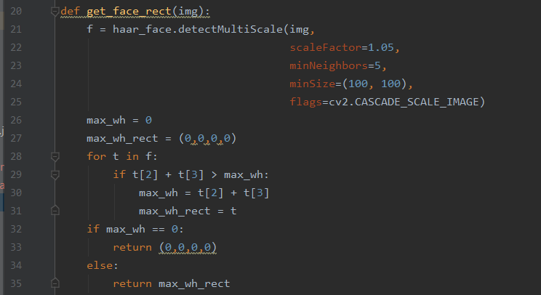
Face Detection
Parameter, img: the image you want to detect
Return value: the area of face (x, y, w, h)

Slide 17
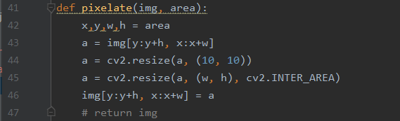
Pixelation
Parameter, img: the image you want to pixelate
Parameter, area: the area you want to pixelate
There’s no return value, you just call, then your image gets modified

Slide 18
Notes
The pre-class video shows how to use your webcam and show the video capture
It will be helpful for this lab session

Slide 19
Let’s start!

