Slide 1
ITinerary X University of Ghana
Introduction

Slide 2






Who are we?
We are team ITinerary: An Itinerary for IT

Slide 3
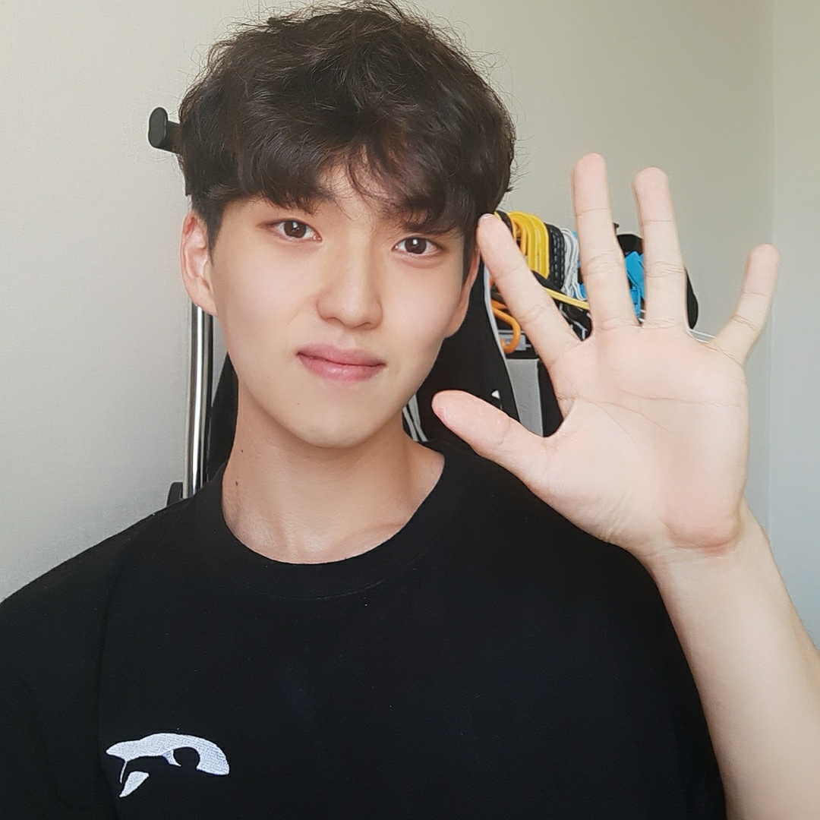
Eunseong Park
- Team Leader
- Computer Science & System Software
Data Science
Big3 370kg
ex-leader of swimming club
Have been to Ghana

Slide 4
Dohun Kim
- Write anything

Slide 5
Jongmin Choi
- Write anything

Slide 6
In this course…
You will learn about the basic skills for Python!

Slide 7
Course Schedule

Slide 8
Course Plan

Slide 9
Notes

Slide 10
Thank you

