Slide 1
Basic Python Programming
[Session 1] Getting Started with Python
ITinerary X University of Ghana

Slide 2
Contents
Programming
Intro. to Python
Installation
“Hello, world!”
Basic Concepts
Exercises

Slide 3
Programming
It matters to all of us today

Slide 4
Programming [1]
What is programming?

Slide 5


Programming [2]
Computer does many task for us
Fast calculation
Repetitive task
Automation
So on…
Here.
<ideal>
Do something!
Result

Slide 6
Programming [3]
Unfortunately, computer cannot understand what we say
What?
<actual>
Do something!

Slide 7

Programming [4]
Programming is a translation our purpose into the instruction(code).
Our purpose
Do something!
Code

Slide 8
Programming [5]
Programming is the way to get computer to work according to our purpose
Oh
I got it
Do something!
Code
Result
Here.

Slide 9
Programming [6]
Then, why should we learn programming?

Slide 10
Programming [7]
Programming can be a “tool”
We can use it in many ways
It eases our life

Slide 11
Programming [8]
Programming is involved in many fields already.
AI
Data science
Bioinformatics
Chemical / Physical simulation
Robotics
Mathematics
Economics
…

Slide 12
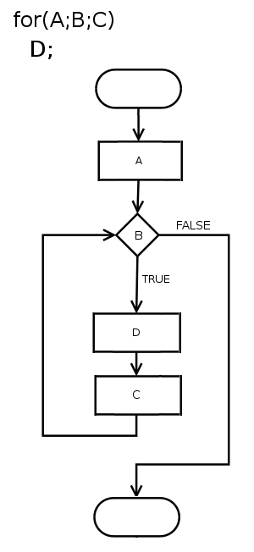
Programming [9]
Programming is helpful for logical thinking
Algorithm
Logical flow
Prediction
…

Slide 13
Programming [10]
Then, let’s start!

Slide 14
Intro. to Python

Slide 15

Python?
Python is a programming language used in many fields.
It is “very” popular programming language, why?
Easy to learn
Easy to program
Many developers made useful libraries
There are lots of documents, guides, and forums
Notes:
무지 쉽고 강력해!!

Slide 16
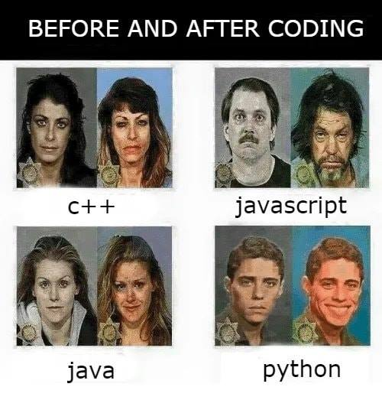
Is Python Easy?
Well… at least easier than other languages

Slide 17
Why Python in This Course? [1]
Python has a lot of libraries, so we can make various program with Python
Notes:
인기있는 언어 -> 개발자도 많음 -> 많은 다양한 기능을 라이브러리로 구현해놓음
- 영상 처리, 딥/머신러닝, 통계, 수학, …. 게임까지!

Slide 18
Why Python in This Course? [2]
By using easy-to-learn language, we can focus on the BIG PICTURE of programming
How to solve the given problem
Algorithmic / computational thinking
Logical flow of programs
So on…
Notes:
지엽적인 문법 지식을 최대한 배제하는걸루
high-level에서의 띵킹~

Slide 19
Installation

Slide 20
We need…
Python 3.7.8
Interpreter for Python language
Be careful of the version!
PyCharm
Editor(IDE) for Python
Recommend to use Windows 10
Ubuntu, MacOS, etc. are also OK.
But the procedure is slightly different

Slide 21
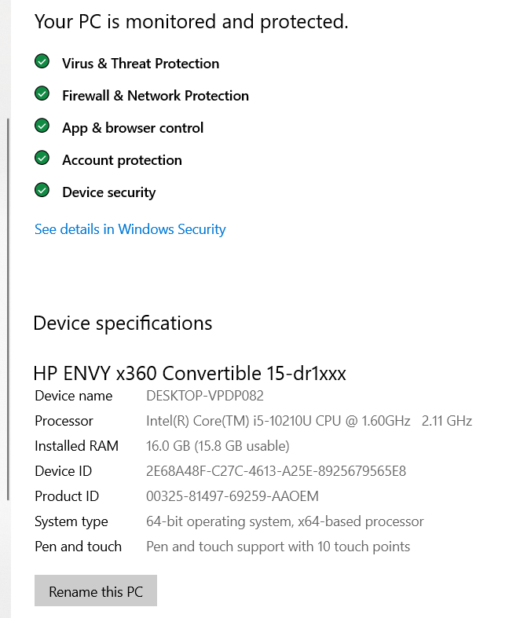
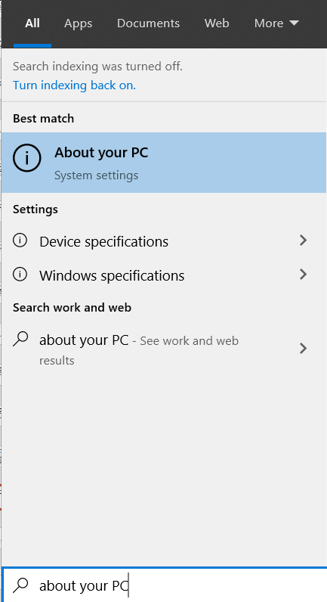
Installing Python [1]
Check your PC

Slide 22
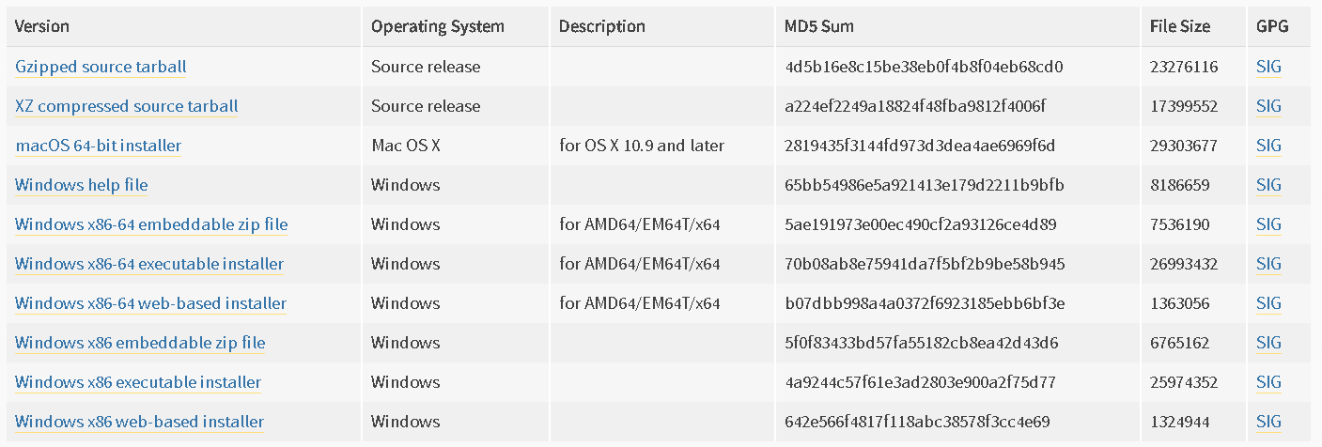
Installing Python [2]
https://www.python.org/downloads/release/python-378/
For Linux
For Mac OS
For Windows (64bit)
For Windows (32bit)

Slide 23
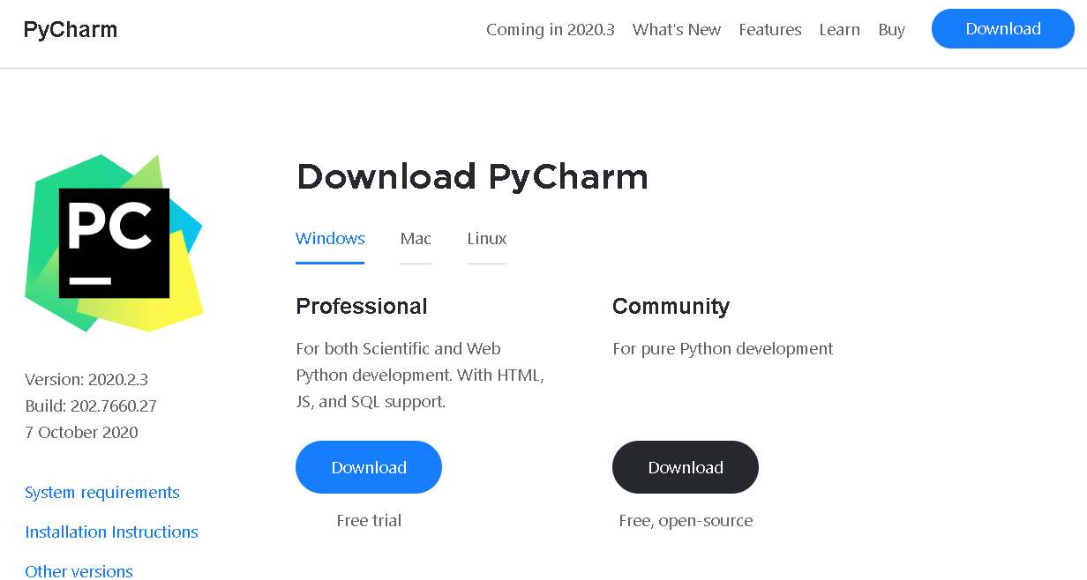
Installing PyCharm
https://www.jetbrains.com/pycharm/download/

Slide 24
Hello, World!
The beginning of everything

Slide 25
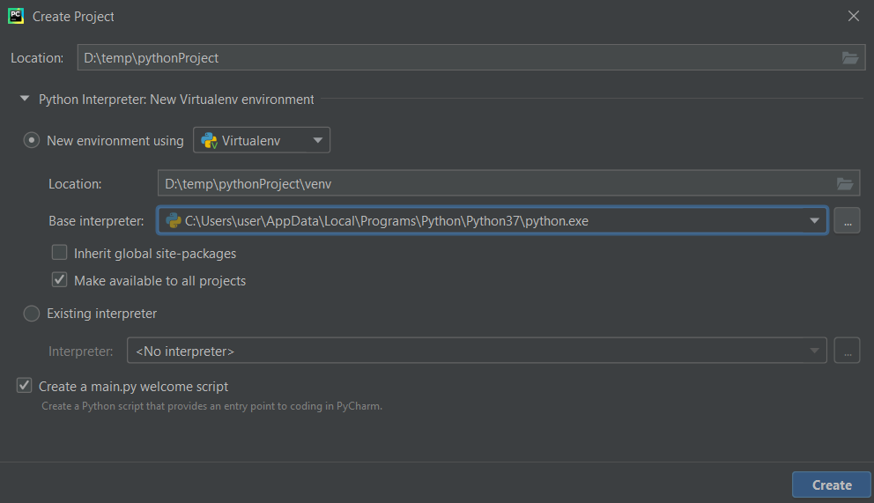
Looking around PyCharm [1]
Create a new project

Slide 26
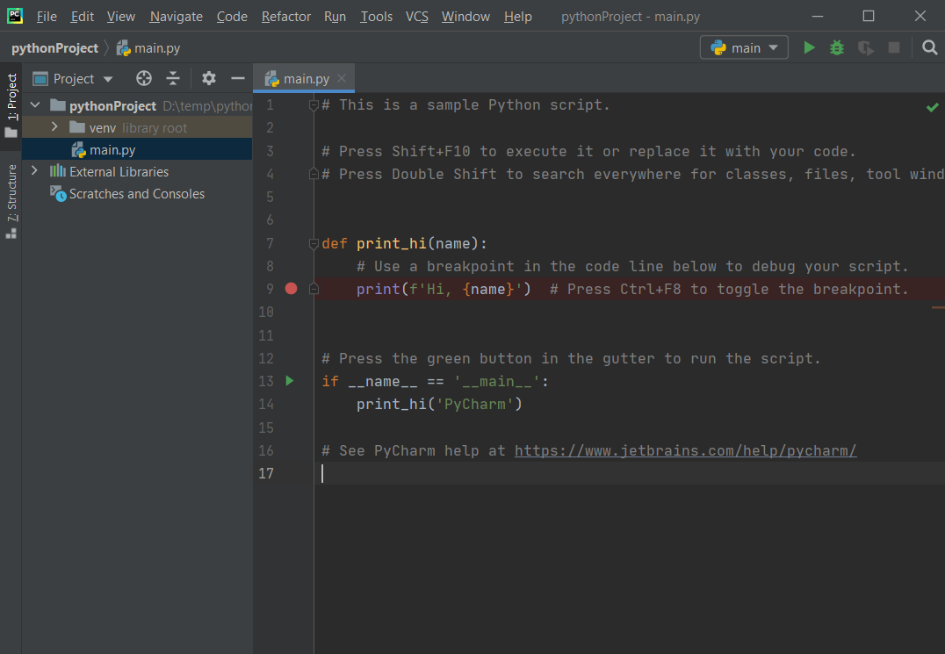
Looking around PyCharm [2]
Running / Debugging
Project directory
Code

Slide 27
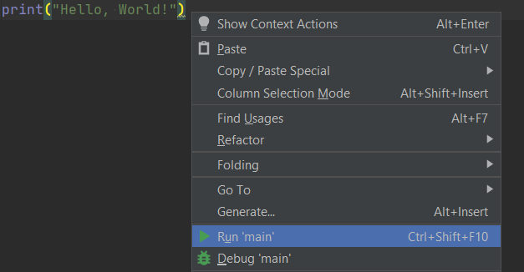
Printing “Hello, World!” [1]
Erase all and write this:
Right-click and Run ‘main’
print("Hello, World!")

Slide 28
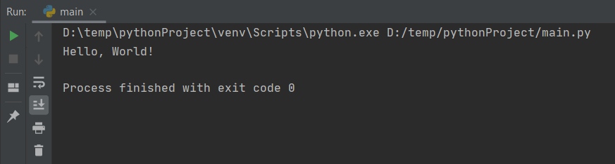
Printing “Hello, World!” [2]
Was it successful?

Slide 29
Basic Concepts [1]

Slide 30
print() Function [1]
Almost everything can be printed out by print() function
We should be able to use this function to see our code’s result.
print(contents)

Slide 31
print() Function [2]
Note that:
Contents can be variable, value, or expression
We can print multiple things, with “,”
print(10, 20, 30)
Practice yourself!

Slide 32

Variables [1]
Variable is a name containing some value.
For example, is a variable named “x”, containing a value, 150.
It can contain various type of value
x = 150

Slide 33
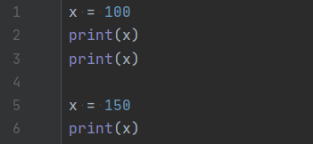
Variables [2]
How can we use variable?
From this, we can know:
Variable can be reused
The value in a variable can be changed
We must declare the variable before use!!!

Slide 34
Data Types
Many kinds of data types are supported in Python
Integer (int)
Float (float)
Boolean (bool)
String (str)
List / Tuple / Set (list, tuple, set)
Dictionary (dict)
Bytes (bytes)
Complex (complex)
…

Slide 35
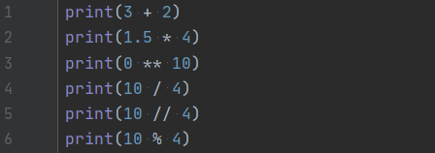
Numeric Types
Integer, float and complex are numeric type data
Basic arithmetic operations are supported (if valid)

Slide 36

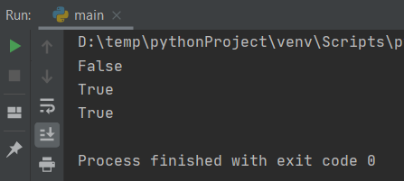
Boolean
Basically, boolean type can have two types of value
True: Equivalent to non-zero number
False: Equivalent to zero
The result of comparison expression is Boolean

Slide 37
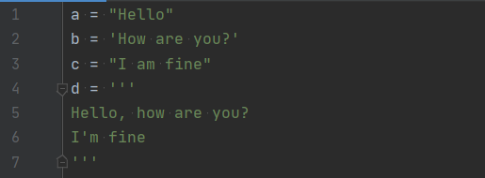
String [1]
We can use ‘ ’, “ ”, or ‘’’ ‘’’ to represent string
‘’’ ‘’’ is for multiple-line string

Slide 38

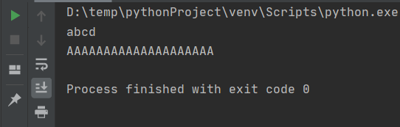
String [2]
String can be added and repeated with + and *

Slide 39

List / Tuple [1]
List / tuple can contain multiple items
Ex) (1, 2, 3, 4, 5), (“a”, “bc”, “def”)
The only difference between these is:
List uses [(item1), (item2), …] and mutable
Tuple uses ((item1), (item2), …) and immutable

Slide 40
List / Tuple [2]
They can have any type of item
Even if the item is list/tuple! (nested)
A list/tuple can have different kinds of items:

Slide 41

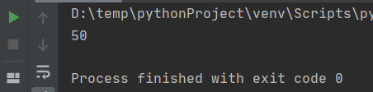
List / Tuple [3]
We can get i-th item from list / tuple (indexing)
Note that the index starts at 0, not 1.

Slide 42


List / Tuple [4]
We can modify the item of list (not tuple)

Slide 43

List / Tuple [5]
We can index multiple items (slicing)
Note that my_list[7] was not included

Slide 44
Notes
Detailed explanation is in supporting material
It is important to try and practice yourself!

Slide 45
Some Important Functions
Before we learn about function, we should know some of important functions
print(): already covered
input(): get the input from user (in console)
int(), str(), list(), …: change the type
len(): get the length of list, tuple, string, etc.
…

Slide 46

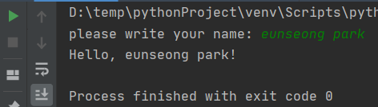
input()
We can get the input from user
Basic use: input((message))
Message can be omitted
Write and then enter!

Slide 47

int(), str(), list(), …
If possible, we can change the type of value / variable
For example, we may want to take “121” as an integer, but it is string…
This may cause an error
int() function can be remedy in this situation

Slide 48
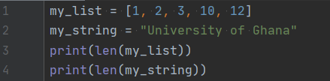


len()
We may want to know the “length” of list or string
How about this?

Slide 49
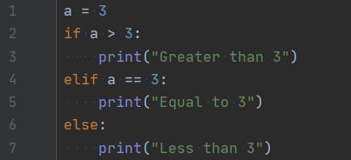
Conditionals: if
We can execute different code according to the condition
if (condition1):
(code_1)
elif (codition2):
(code_2)
elif (condition3):
(code_3)
…
else:
(code_else)
Notes:
elif / else는 optional

Slide 50
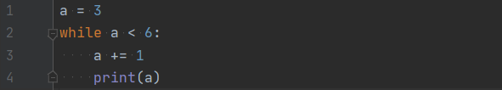
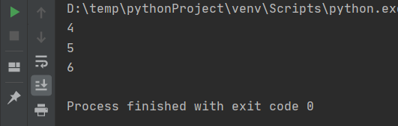
Loops: while
We can repeat some work, by while and for statement
while (condition):
(code)

Slide 51
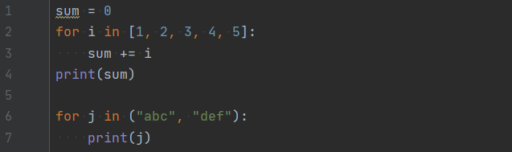
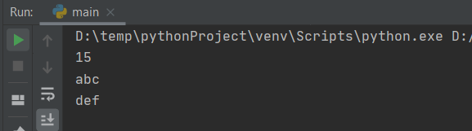
Loops: for [1]
In for statement, an “iterator” traverses given list-like object
Iterator is a (usually) temporary variable
The list-like object is called “iterable” object
for (iterator) in (iterable):
(code)

Slide 52
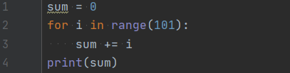
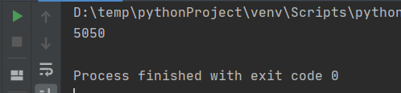
Loops: for [2]
range() function provides a sequence of number
It is useful for using for statement
It gives “range” type, it is also iterable (list-like)
range(start:end:step)
Starting number
(can be omitted)
Ending number
The number, end is not included in the result
step
(can be omitted)

Slide 53
Exercises
Some exercises for you are in “exercises”

Slide 54
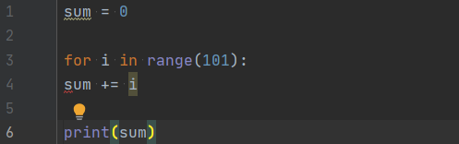
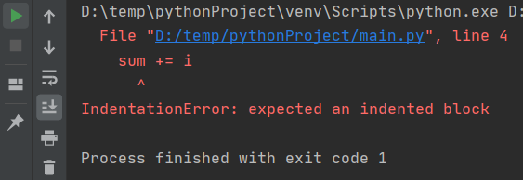
Indentation
It matters in Python, unlike other programming languages
Usually, indent after some statement with “:”
If (condition): / while (condition): / for i in (iterable):
Inappropriate indentation can cause an error

Slide 55
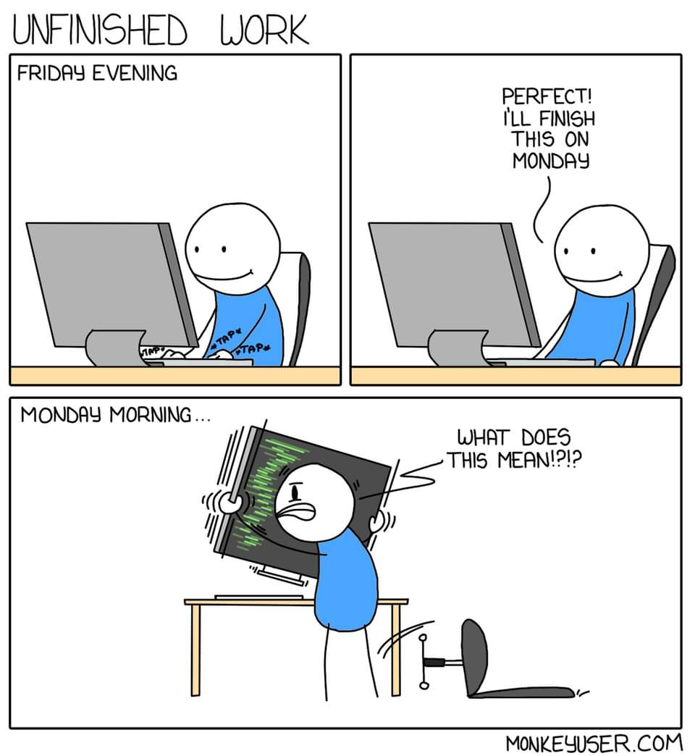
Comment [1]
You can add some comment(memo) in your code
In program, it does nothing
Why we use comment?
To explain to co-worker my code
Also, to explain to myself in tomorrow
Sometimes we use it to disable some code
temporarily
from https://monkeyuser.com
Notes:
You can share and post these comics anywhere you like without telling us, as long as you link back to the site. If you want to use them in a for-profit publication you can reach us at ismonkeyuser@gmail.com and we can talk about it.
공유 되는 거 확인함
코드가 그 기능을 잃기 때문에 잠깐 비활성화

Slide 56
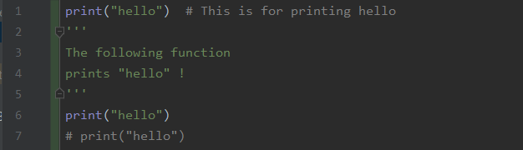
Comment [2]
Two ways:
using # for a line
using ‘’’ ‘’’ for multiple lines

Slide 57
Functions, Classes

Slide 58
Functions in Programming
Functions in programming is slightly different with that in math
Function in math just give some value
For example, in f(x) = 2x, f(10) gives 20.
Just calculation, no side-effects
Function in programming is a code sequence that does some work
We can give some value like the function in math
The value is called “return value”
We can make some side-effects, other than just calculation
Print out some message
Change some variable
Cause an error
Notes:
함수의 기능:
뭔갈 계산해서 내놓음(리턴)
어떤 다른 작업(프로그램의 상태(state)에 영향을 주는)을 함(side-effect)

Slide 59
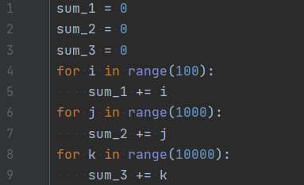
Why Do We Use Function?
We can avoid repetitive task and code
It makes maintenance easier
Reusability
So on…

Slide 60
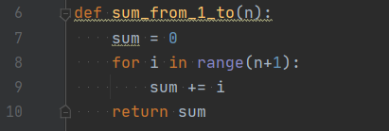

Defining Function [1]
We use def keyword
def function_name(parameter):
(body)

Slide 61

Defining Function [2]
Some function may not have parameter
Some function may have two or more parameters

Slide 62


Defining Function [3]
We can set a default argument
we omit the argument, then default value is used
Note that non-default one must precede default one!
This causes an error

Slide 63
Defining Function [4]
return keyword determines a return value of the function
When we return, the function is terminated, immediately
Some function may not have a return value

Slide 64
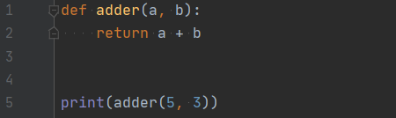
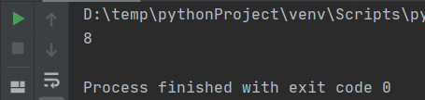
Using Function [1]
We can call some function with (FunctionName)(parameters)

Slide 65
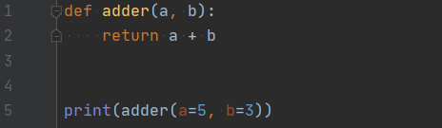
Using Function [2]
We can indicate the parameter explicitly (if needed)

Slide 66
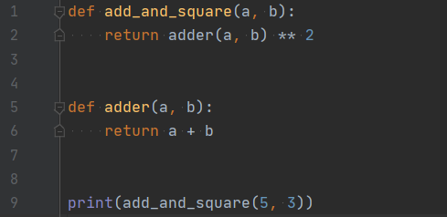
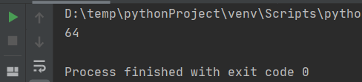
More about Function [1]
A function can call another function

Slide 67
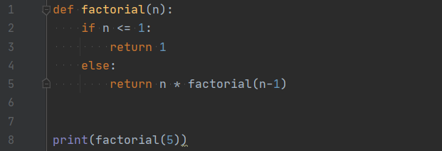
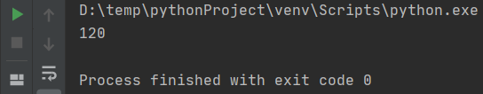
More about Function [2]
Even it can call itself! (called “recursion”)

Slide 68
Exercises
Some exercises for you are in “exercises”

Slide 69
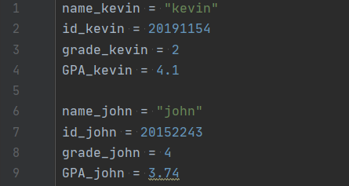
Class: Motivation
How can we store / deal with each student’s information?
It includes name, ID, grade, GPA, etc.
…like this? What if there are 3~4000 students?
Is there any wiser way?

Slide 70
Class [1]
Class is a frame that contains:
Several variables (member variable)
Several functions to deal with the data (method)
For example of student…
Member variable: name, ID, grade, GPA, …
Methods: changing GPA, getting information, increasing grade, …

Slide 71
Class [2]
Each instance of class is called “object”
Adele
Student.name = Adele
Student.ID = 12345
Student.grade = 1
Student.GPA = 4.2
Change her grade to 2
Johnson
Student.name = Johnson
Student.ID = 23456
Student.grade = 4
Student.GPA = 2.6
John Wick
Student.name = John
Student.ID = 25255
Student.grade = 2
Student.GPA = 3.7
Johnson.get_GPA()
Return 2.6
Adele.update_grade(2)

Slide 72
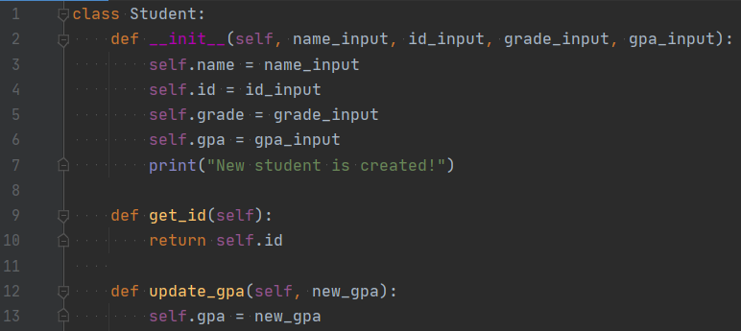
Defining Class [1]
We can define a class with class keyword
methods

Slide 73
Defining Class [2]
We can define a class with class keyword
First parameter of method is (usually) self

Slide 74
Defining Class [3]
We can define a class with class keyword
It is a special method (initializer)

Slide 75
Defining Class [4]
We can define a class with class keyword
Declaring member variable

Slide 76
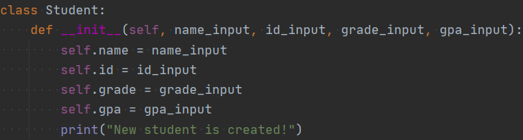
Using Object [1]
We can make an object with (ClassName)(some arguments)
Use the parameter of __init()__

Slide 77
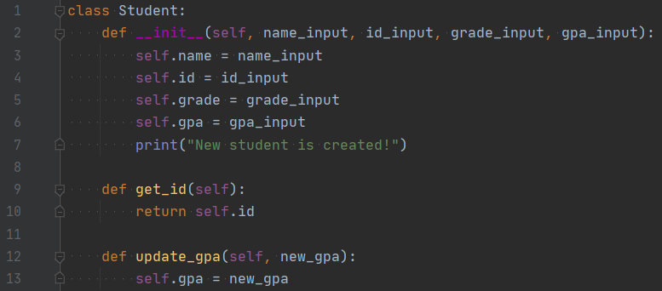
Using Object [2]
Call method with (ObjectName).(MethodName)(param)
Note that (including __init()__) we omit the argument for self

Slide 78
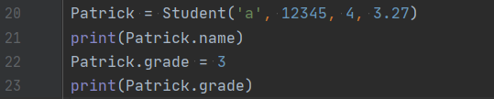
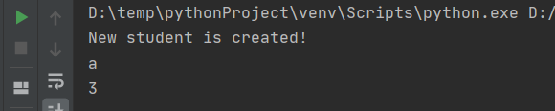
Using Object [3]
We can directly access to member variables
With (ObjectName).(VarName)
Of course, if this is public…
Notes:
접근 제어자는 supplement에서 봐라

Slide 79
Exercises
Some exercises for you are in “exercises”

Slide 80
Libraries
To put it simply, library is a collection of data, function, and classes.
There are many of libraries for many purposes
For math
For statistics
For image processing
For AI, ML
For game
...There’s almost everything we want

Slide 81
Libraries: Motivation [1]
Why we need libraries?

Slide 82
Libraries: Motivation [2]
Why we need libraries?
Because our time is precious!!
We don’t need to implement everything
Just use functions made by professional developers!

Slide 83
Using Library: math [1]
Use import keyword to bring it
If we did not use the library, the font becomes gray
Else…

Slide 84

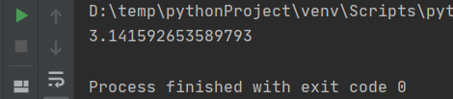

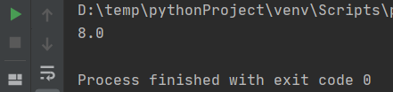
Using Library: math [2]
Then use with (LibName).(Name)
Let’s use π(pi)
How about function?

Slide 85

Using Library: Alias
We can use “alias” of the library
Using math.(name) every time is annoying
There are libraries with long name(e.g. multiprocessing, matplotlib.pyplot)
How about using “m” instead of “math”?
Use as keyword!

Slide 86

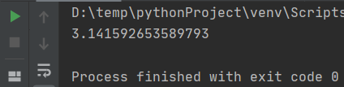

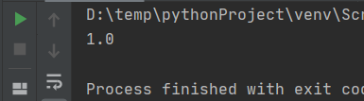
Using Library: from
Using from, we can use several items in the library
Of course, we can use all items by using “ * ”
Note that we do not use “math.” !!
Notes:
와일드카드는 추천 X
다른 애들이랑 이름 겹치는 게 있을 수도

Slide 87
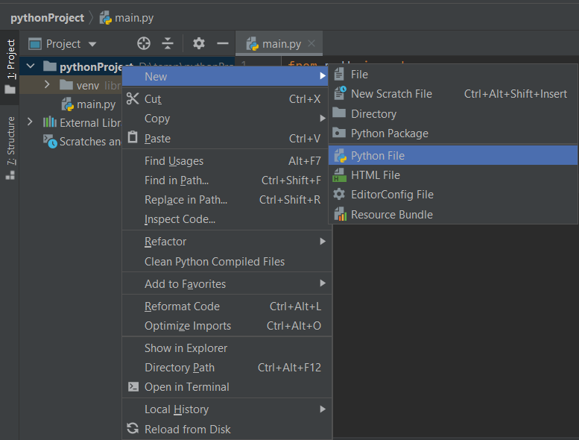
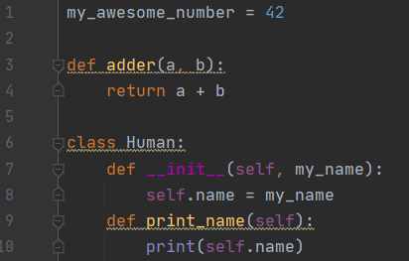
Making Library [1]
We can make our own library
Just define some functions / classes / variables in a file!

Slide 88


Making Library [2]
Then, how can we use it?
Just import! (If it is in same directory)

Slide 89
Exercises
Some exercises for you are in “exercises”

Slide 90
In the Real-time Class…
We will have a lab session (mini project)
We will upload the material as soon as possible
Before that, please review what we covered
Supplement and exercises were uploaded
Feel free to ask us! Via…
Comment in the page (recommended!)
WhatsApp
E-mail

Slide 91
Thank you

