Slide 1
Basic Python Programming
[Session 2] Lab session
ITinerary X University of Ghana
Notes:
ok, then let’s start lab session.

Slide 2
Contents
RAID
Notes:
We will do only one thing, a mini project, RAID!

Slide 3
RAID
Notes:
Ok

Slide 4
RAID [1]
There is a monster: SOCKETMON
very bad socket-monster!!
You should defeat this monster, together!
how?
Notes:
there is very bad monster, SOCKETMON
In this mini-project, you should raid this monster and coordinate with each other.
how do we do that?

Slide 5

RAID [2]
We can attack to SOCKETMON with socket programming
Sending message, we can attack!
Notes:
you can attact to socketmon, by sending some message

Slide 6
RAID [3]
We can use two types of attack
Normal: A normal attack (30 damage)
Lucky: Stronger attack, but sometimes fail…
Chance | Damage
1 % | 1000 Damage
9 % | 100 Damage
40 % | 50 Damage
36 % | 0 Damage
4 % | DIED
Notes:
but… only two message will be effective, for attacking socketmon
The message, normal is just a normal attack
you can give a 30 damage to the socketmon
and the message, lucky, is a random attack
the damage is like the table, but sometimes you may do SUPER UNLUCKY ATTACK, then you may be died

Slide 7
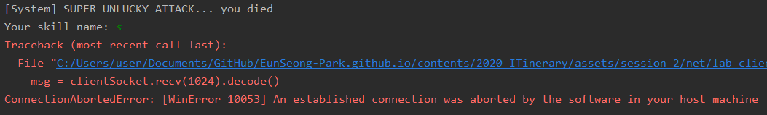
RAID [4]
If you died…
The connection is closed
…and meet some error
But it’s okay, you can just re-run your program
Notes:
If you die, the connection is dead.
But it’s okay. just re-run your program.

Slide 8
RAID [5]
Our goal is…
Defeating SOCKETMON
Its HP is 1,000,000 !!
…Can we defeat?
Notes:
so, our goal is to defeat the socketmon
but its hp, health point is 1 million. oh… it is possible to win?

Slide 9
RAID [6]
Party bonus: sqrt(connected people)
e.g. If 9 people successed to implement (so connected to the server), all of member get x 3 damage bonus
Thus, help your friend implement this program!
Notes:
But, there is a bounus damage.
The more you guys complete the program and connected the socketmon server
the stronger your damage is
If there’s 9 students connected. than your damage become to 3 time
So, please help your friend, to defeat SOCKETMON as fast as possible.

Slide 10
RAID [7]
You implement…
A client program
Message sending (“Lucky” / “Normal”)
Message receiving (we will show the current HP of SOCKETMON)
Also, you can find a better (stronger / faster) way
Hint: just infinite loop may not work :/ (we blocked)
But, except this, you can do anything.
Notes:
I already implement the server for socketmon
so you only need to make clienet
your client should send some message lucky or Normal. And note that, be caustios of capitalization
the first letter is uppercase
anyway, after sending message, you should receive some message from the server.
THen you can get some message, about the ccurent HP
That’s for all.
We will make the client together, but it will be very simple and naïve way. because it is just a sample solution!
so you should make your own optimal solution to raid socketmon quickly

Slide 11
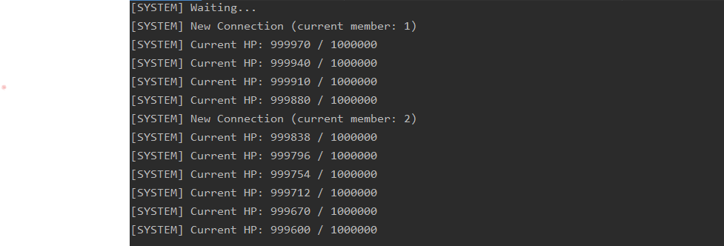
RAID [8]
We will show real-time status of SOCKETMON
Notes:
In this lab session, I will show the current status, in realtime

Slide 12
Let’s start!
There is no skeleton code
But the supplement will be useful
Notes:
There is no skeleton code
It is almost same with what we covered just now
also, you can review this, by supplement, and exercise

Slide 13
Server Info
IP: 192.168.30.33
Port: 56789
Notes:
ok then let’s go
When you connect to the server, you can use this IP and port.

