Slide 1
Basic Python Programming
[Session 4] Lab session
ITinerary X University of Ghana
Notes:
ok, then let’s start lab session.

Slide 2
Contents
Poop game
Notes:
We will make a game: poop game

Slide 3
Poop Game

Slide 4
Poop game [1]
Avoid the falling poops as possible you can
We will show the example solution
Notes:
We will make a game: poop game

Slide 5
Poop game [2]
We need some randomization
Initial location of poop
Frequency / period of generation of poop
Speed of poop falling
etc..
random library will help you
random.randint(start, end) returns a random integer between these
Notes:
We will make a game: poop game

Slide 6
Character Moving
Use event handler (KEYDOWN / KEYUP)
Moves only with x-direction
Idea and implementation are in the pre-class material and exercise

Slide 7
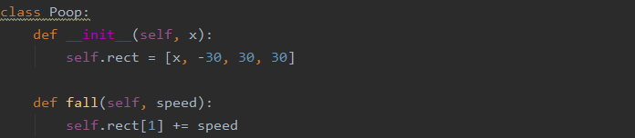
Poop
It should..
be generated with random period
start in the random x-location
fall continuously
collide with character (and then game over)
…

Slide 8
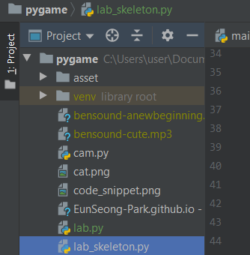

Guide
We uploaded skeletonn code and some images to the page
https://eunseong-park.github.io/itinerary/posts/pygame
Don’t forget to save the file in your project directory!

Slide 9
Let’s start!
Notes:
ok. let’s make it together.

