Slide 1
Basic Python Programming
[Session 2] Network Programming
ITinerary X University of Ghana
Notes:
안뇽

Slide 2
Contents
Internet & Backgrounds
Client-Server Model
Socket Programming
Notes:
이번엔 이런거 다룰거임

Slide 3
Intro
Notes:
고고

Slide 4
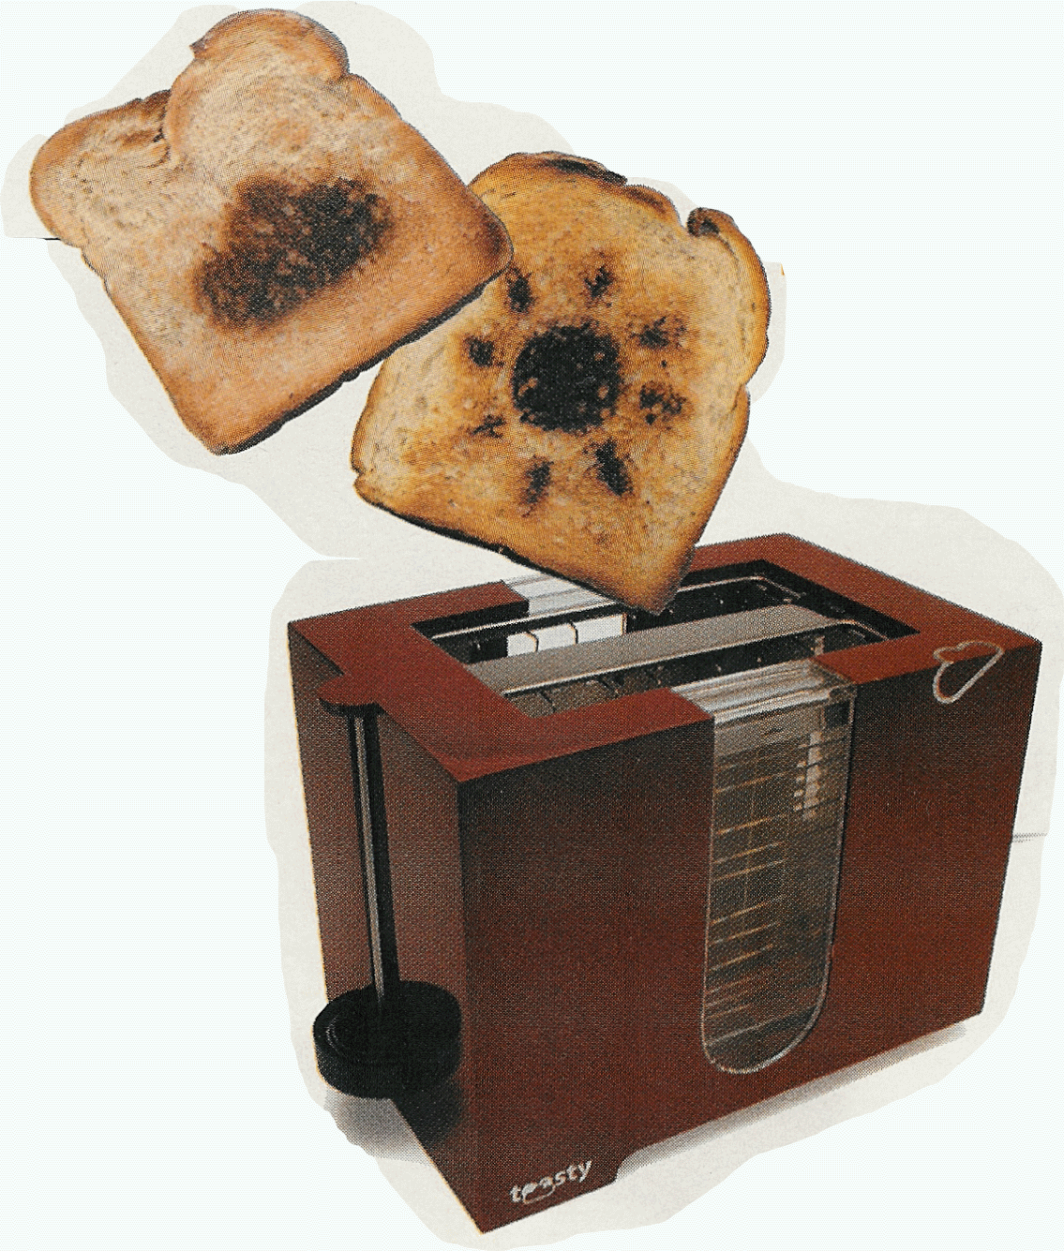
Motivation
Countless connected devices
Smartphones
Desktops
Laptops
…and what?
IoT(Internet of Things)
“Ubiquitous” had already been achieved
Then, we apply network and Internet to everything
Weather forecasting toaster, awesome!
Notes:
오늘날 많은 것들이 연결되어있는 connected world에 살구있음
IoT라고 들어봄? 간단하게 IoT 설명 고고

Slide 5
In This Course…
There are many concepts where the Internet is based on
Network layer, protocol, packet, routing, so on…
We will cover the high-level concepts for networking
…And apply them to our mini-project!
Notes:
이번 쉅에는 인터넷과 네트워크에 대한 기초적인 이론적 배경을 알아보면서,
우리가 어떻게 연결되어있고, 어떻게 상호작용하는지 알아볼거임
또 이를 바탕으로 우리만의 애플리케이션을 랩세션에서 만들거

Slide 6
Internet & Backgrounds
In the connected world

Slide 7
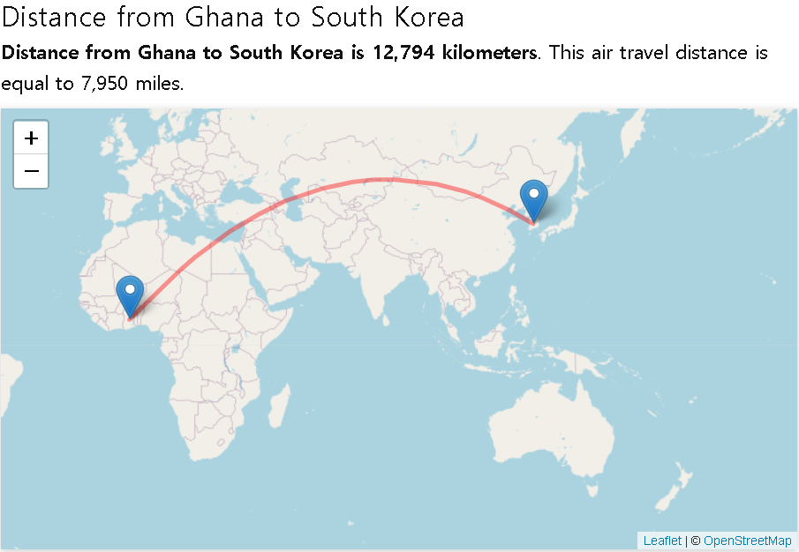
Network [1]
How far is Korea from Ghana?
Let’s ask Google
Notes:
가나랑 한국 개멀음ㄹㅇ로

Slide 8
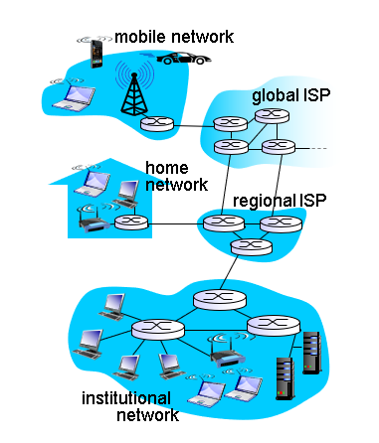
Network [2]
How can we communicate with each other, despite such a long distance?
Whatever you send, you may lose it on the way…
But we are in the connected world!
We send/receive via communication links
Some wire?
And data is forwarded by packet switches
Router?
Notes:
이 먼 거리를 넘어 통신하는게 신기하지 않음?
대체 어케하지? 전파를 쏴도 땅으로 꺼지고 막 난리일텐뎅
먼저 답을 알려주자면, 우리는 데이터를 전달하고 전달해서 보내는거임
우리는 connected 월드에 살고 있으니까 그렇게하면 가나까지도 가능임ㅋㅋㅋ

Slide 9
Internet
Internet is a global network system with Internet protocol suite
Notes:
그래서, 인터넷이 뭐냐 하면
인터넷 프로토콜 스위트를 사용하는 글로벌 네트워크 시스템임

Slide 10

Protocols: Motivation [1]
What if there’s no rule(protocol) in networking?
How can the receiver understand the given data?
Here you are.
Data 2
Wait…what is that???
“hello”
“how”
“are”
“you”
Data 1
335721
23
3
4.02
False
Notes:
근데 프로토콜이 머냐, 프로토콜은 결국 “룰”임
이후 적당히 ppt 따라 설명

Slide 11

Protocols: Motivation [2]
What if there’s no rule(protocol) in networking?
If there’s some problem, then how can handle it?
Yeah, I will send it
?
Data

Slide 12
Protocols
Protocols define rules
Which format of data?
How to establish the connection?
How to check its validity?
What the given data/field means?
So on…
Example
TCP, UDP
IP(IPv4, IPv6)
HTTP, HTTPS, Telnet, DNS, …
You’ve probably heard of some of these!
Notes:
프로토콜은 통신에 대한 거의 모든 걸 정의함

Slide 13
Protocol Example: TCP vs UDP [1]
TCP and UDP defines a rule for sending/receiving data
TCP: Transmission Control Protocol
UDP: User Datagram Protocol
How they differ?
Notes:
대표적인 두 프로토콜이 있음

Slide 14
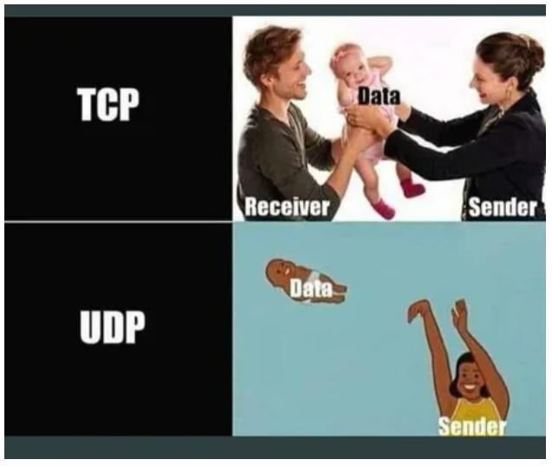
Protocol Example: TCP vs UDP [2]
TCP is reliable because it ensures:
Data must be delivered to receiver (in order)
There’s no data loss
…but slow
UDP is faster than TCP but..
Sometimes, data is lost
Unreliable Damn Protocol..?

Slide 15
Protocol Example: TCP vs UDP [3]
We can choose one according to our purpose / preference
Let’s take some examples!

Slide 16
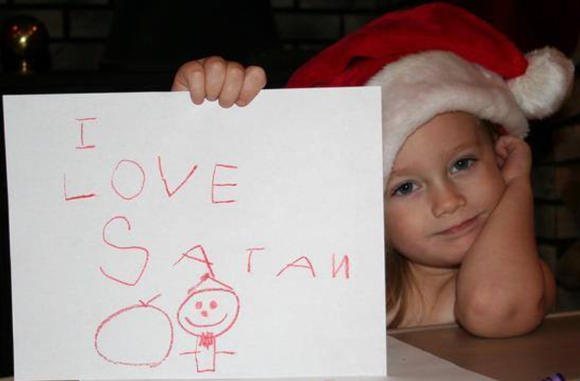
Protocol Example: TCP vs UDP [4]
Example 1: Chat App
Sometimes, a character / the order does matter

Slide 17


Protocol Example: TCP vs UDP [5]
Example 2: Streaming
It must be fast!
Can you notice that 2~3 pixels are missing from a frame of video?

Slide 18
Note
Anyway, we only need to remember just one thing
Communication requires a rule(protocol)!
Notes:
아무튼, 프로토콜은 통신에서 필수적이란거~

Slide 19
IP Address
I want to text to my friend… but how can we find him/her?
We need some addresses!
And this is IP address
Two types of ID address:
IPv4 (32bit): 192.168.10.253
IPv6 (128bit): 2626:28000:0220:0001:0248:1898:25C8:1946
Then... Everything’s OK now?
Notes:
IP는 상대방을 찾을 주소임

Slide 20
Port [1]
Our computer runs a lot of applications concurrently.
Web browser
Messenger
Game
…
And each communicates with a different one
With Google server
With Discord server
With my friend
With PUBG server
…
Notes:
포트 적당히 설명하고

Slide 21
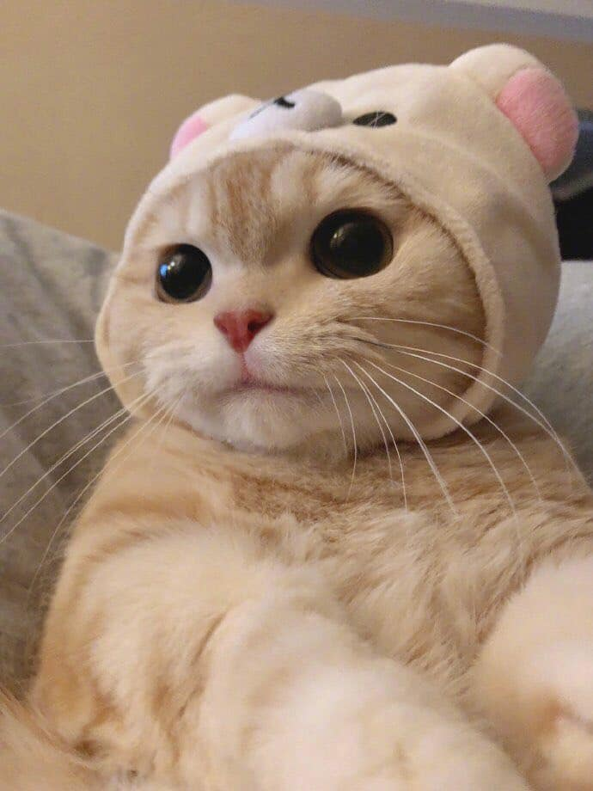


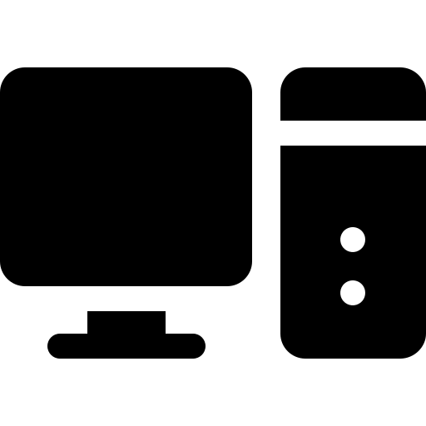
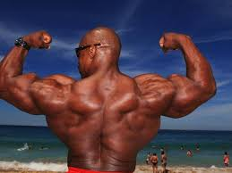

Port [2]
Sure.
At the same time…
New mail arrived
I NEED some cut cat pics
So I will search them in Google!
Hey Google, please give me some cute cat pics
Mail
Hey bro see my AWESOME muscles!
Me
My computer
My muscular friend

Slide 22
Port [3]
Computer may think…
Which one is the cute cat picture from Google??
My computer

Slide 23
Port [4]
We use several “ports” and communicate separately
Port
80
Then use the contents from port 80!
Port 465
Mail
Port 15552
Me
My computer
My muscular friend

Slide 24
So…
We can determine how do we communicate
Who? By IP address
By which application? By port number
With which rule? By protocol

Slide 25
Client-Server Model
Notes:
클라이언트 서버 모델 ㄱㄱ

Slide 26
Intro
What is server and client?
Client: requests / gets the service
Server: provides the service
The meaning is also same in networking!

Slide 27
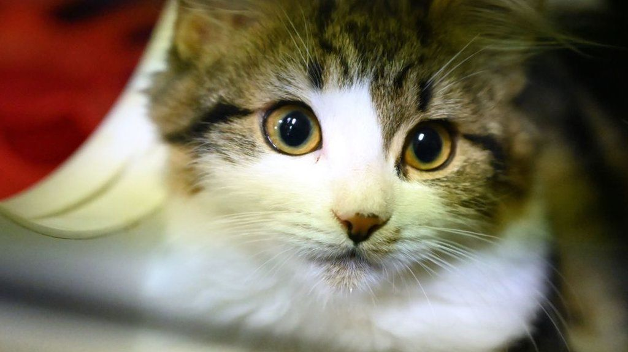
Client / Server [1]
We usually (but not always) communicate as clients
Send cute cat pictures!!!
MEOW
Here.
service
Notes:
예시 보면 설명하기 쉬울것…

Slide 28
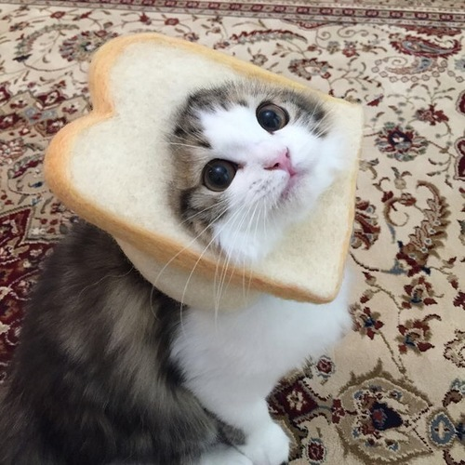

Client / Server [2]
Client doesn’t mean just receiver
I want to upload
my cute cat pics!
MEOW
Oh so cute, OK
Instagram

Slide 29
Client / Server [3]
The important point is that:
The task and role are divided into two parts: client / server

Slide 30
Client / Server: TCP [1]
We will cover only TCP(reliable) client-server
But UDP case works similarly
We explained it in the supplement

Slide 31
Client / Server: TCP [2]
Step 1: Listen
I am waiting for someone who wants to communicate with me
TCP Client
TCP Server

Slide 32
Client / Server: TCP [2]
Step 2: Connect
I want to communicate with you!!
TCP Client
TCP Server

Slide 33
Client / Server: TCP [3]
Step 3: Accept
OK welcome
TCP Client
TCP Server

Slide 34
Client / Server: TCP [4]
Step 4: Request to send / receive data (maybe repetitively)
I want to send this to you
OK
TCP Client
TCP Server

Slide 35
Client / Server: TCP [5]
Step 4: Request to send / receive data (maybe repetitively)
Please give me some data
OK, here you are
TCP Client
TCP Server

Slide 36
Client / Server: TCP [6]
Step 5: Close the connection
Both can close the connection
Goodbye
See you
TCP Client
TCP Server

Slide 37
Implementation
Well… So good so far.
But how can we implement this?
Notes:
이제 이걸 직접 구현해야함

Slide 38
Socket Programming
We use Python, finally!
Notes:
바로 소켓프로그래밍으로!

Slide 39
What Is Socket?
Socket is an interface to communicate across the network
It contains some information
IP address
Port number
Protocol
Socket
Socket
Notes:
소켓 설명

Slide 40
Socket Programming in Python [1]
Several functions for socket programming are provided
The procedure is almost same with that of client-server
Each step is done by calling some function

Slide 41
Socket Programming in Python [2]
Step 1: Both create a socket
Client
send() /
recv()
socket()
connect()
close()
Server
send() /
recv()
socket()
bind()
listen()
accept()
close()
Notes:
구글치면 비슷한거 많이 나옴

Slide 42
Socket Programming in Python [3]
Step 2: Server binds socket (indicate hotename and port #)
Client
send() /
recv()
socket()
connect()
close()
Server
send() /
recv()
socket()
bind()
listen()
accept()
close()

Slide 43
Socket Programming in Python [4]
Step 3: Server listens (waits for client)
Client
send() /
recv()
socket()
connect()
close()
Server
send() /
recv()
socket()
bind()
listen()
accept()
close()

Slide 44
Socket Programming in Python [5]
Step 4: Client connects to server
Client
send() /
recv()
socket()
connect()
close()
Server
send() /
recv()
socket()
bind()
listen()
accept()
close()

Slide 45
Socket Programming in Python [6]
Step 5: Server accepts
Client
send() /
recv()
socket()
connect()
close()
Server
send() /
recv()
socket()
bind()
listen()
accept()
close()

Slide 46
Socket Programming in Python [7]
Step 6: Then they communicate
Client
send() /
recv()
socket()
connect()
close()
Server
send() /
recv()
socket()
bind()
listen()
accept()
close()

Slide 47
Socket Programming in Python [8]
Step 7: Someone terminates the connection
Client
send() /
recv()
socket()
connect()
close()
Server
send() /
recv()
socket()
bind()
listen()
accept()
close()

Slide 48
Notes
As we can see, the task are different between client and server
So we need two applications client / server
We will make both client apps and server apps
You may be able to fully understand the concepts by making apps
In lab session

Slide 49
References
Computer Networking: A Top-Down Approach 6th Ed. Jim Kurose, Keith Ross, Addison-Wesly, March 2012

Slide 50
Thank you

