Slide 1
Basic Python Programming
[Session 4] Pygame
ITinerary X University of Ghana

Slide 2
Contents
Intro. to Pygame & Preparation

Slide 3
Intro & Preparation

Slide 4

Pygame
A free Python library for video games
Fully-optimized
Good portability and cross-platform

Slide 5
About Today’s Class…
We will make several games for exercise
Instead of many backgrounds
What you need to do in this class is learning about:
How to use “a tool”
Overall mechanisms and procedures
So, just enjoy!

Slide 6
Setting Environment
If you didn’t have any problems in the session 3, that’s ok.
Pygame recommends to use Python 3.7.7 or greater
We use 3.7.8
Supports various operating systems:
Windows, Mac, Debian, Ubuntu, Mint, Raspberry Pi, etc.

Slide 7
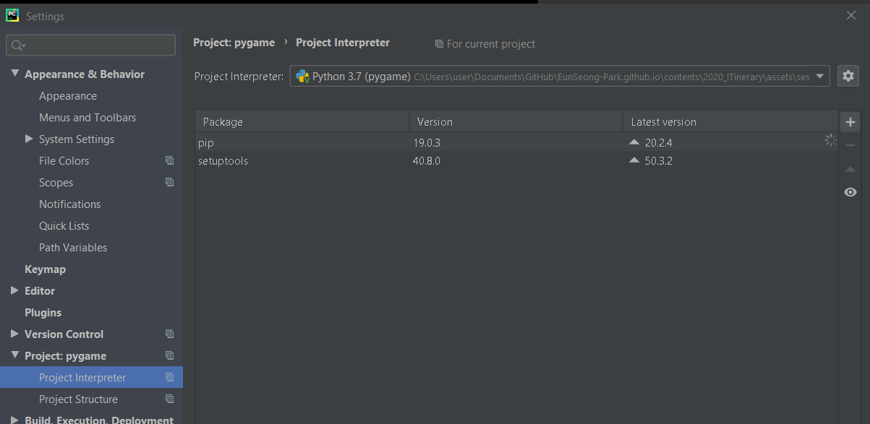
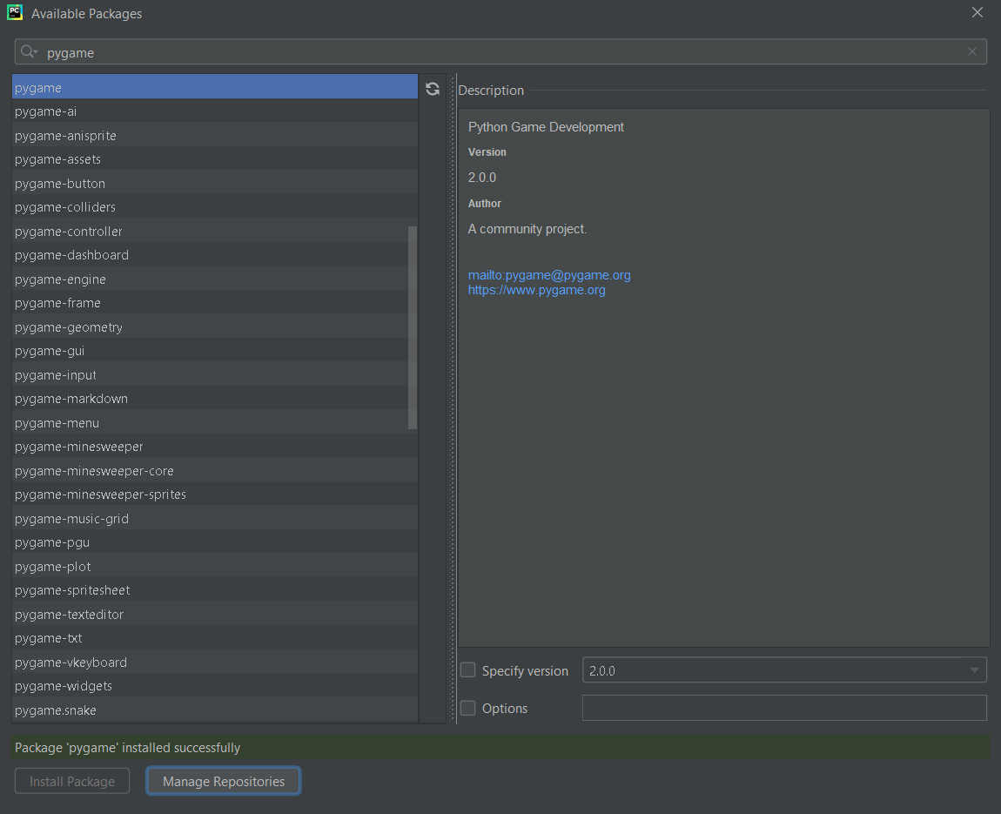
Installing Pygame
Like installing OpenCV, just find “pygame” and install

Slide 8
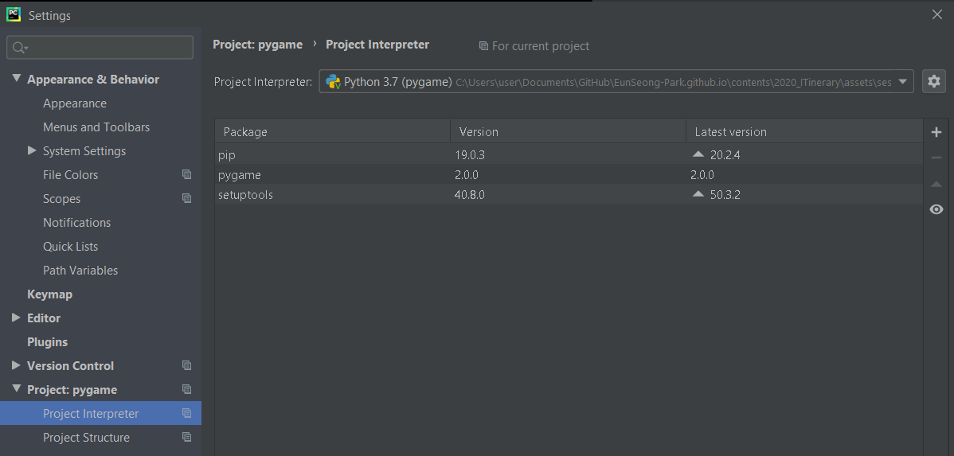

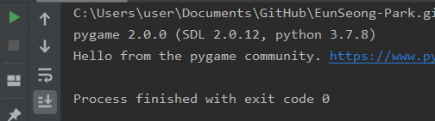
Check
Then you are ready for this class!

Slide 9
Basic Flow of Pygame

Slide 10
Basic Flow
End
We will learn according to this procedure
if the event was “quit”
Some event
Initialization
& Setting
Infinite Loop
Event
Listening
Do Something
Update
Display
Notes:
예시 들어 설명하기

Slide 11
Example: Chrome Dinosaur Game [1]
If you are using Google Chrome, try this after disconnecting your internet
or… Use chrome extension without disconnecting
https://chrome.google.com/webstore/detail/running-dinosaur-game/nihmppmidbbbkfademfpjmhhogegjbjd/related

Slide 12
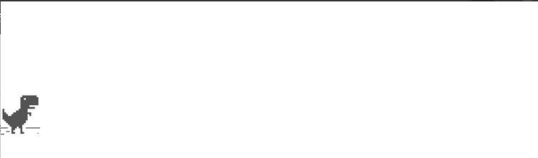
Example: Chrome Dinosaur Game [2]
Initialization
Screen (window) setting
Setting dinosaur object
…

Slide 13
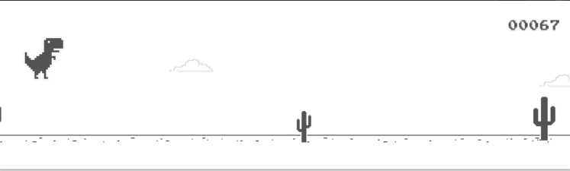
Example: Chrome Dinosaur Game [3]
Event listening / handling
Spacebar is pressed? -> jump
Time is elapsed? -> increase score
collided with cactus? -> game over
…and regularly update screen

Slide 14
Example: Chrome Dinosaur Game [4]
Quit
…If the connection is recovered…
Anyway, in many games, you can find these procedure

Slide 15
Initialization: Module
Every module can be used after pygame.init()
…and terminated by pygame.quit()
…is it over?
no

Slide 16
Initialization: Surface(screen)
“Surface” is one of most important object
It can be used to represent “image” (such as background)
You can imagine a “canvas”
pygame.display.set_mode((w, h)) initializes a window(screen)
And returns the corresponding Surface object
We implicitly set the screen size here
(Optional) You can set the caption of window (title)
pygame.display.set_caption(“title”)

Slide 17
Initialization: Clock
Why we need a clock?
to measure time elapsed
to implement periodical event
to update screen periodically
so on…
Creation is very simple:
We will learn how to use it a little later

Slide 18
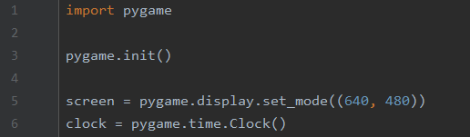
So far… [1]

Slide 19
So far… [2]
End
if the event was “quit”
Some event
CLEAR!
Initialization
& Setting
Infinite Loop
Event
Listening
Do Something
Update
Display
Notes:
예시 들어 설명하기

Slide 20
Loop [1]
First, implement showing empty screen with a fixed FPS
(Surface).fill(“color”) fills surface with the color
“color” is given by 3-tuple(R,G,B)
pygame.display.flip() updates and shows the screen to us
(clock).tick(“msec”) waits for “msec”
Why do we need to wait?

Slide 21
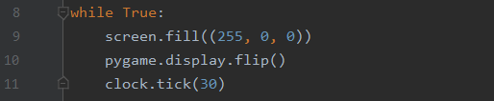
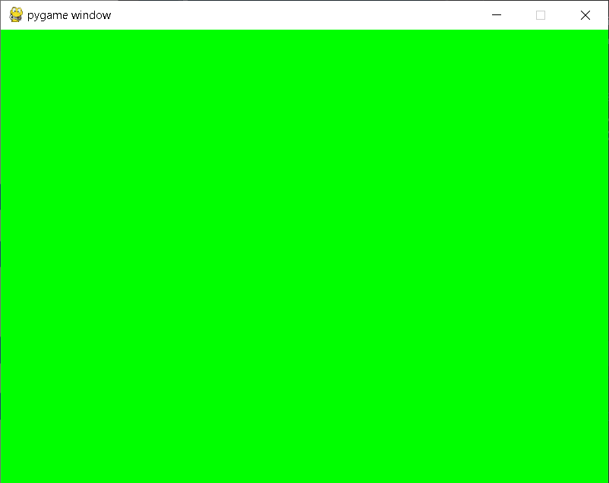
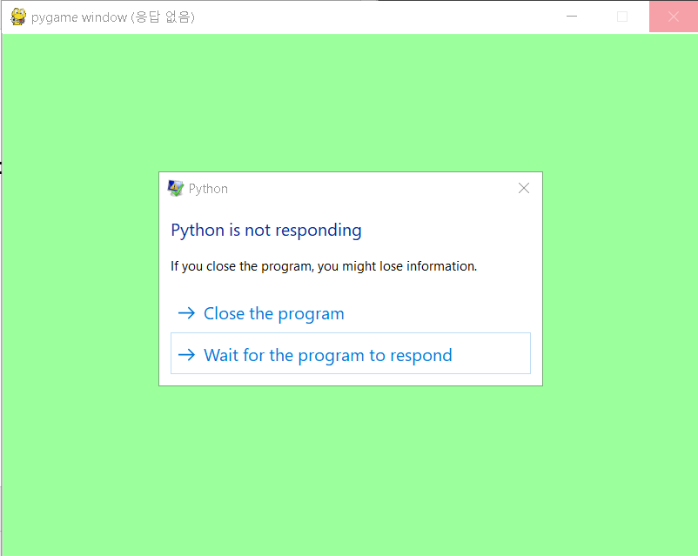
Loop [2]
Let’s run… but somewhat goes wrong
Can we close the program in a normal way?
does it work?

Slide 22
Event Handling [1]
Pygame “listens” events such as:
Mouse move, click, …
Keyboard input
Window activation
“Close window” button
so on…
We can access to the occurred events by pygame.event.get()
We use for statement… why?

Slide 23
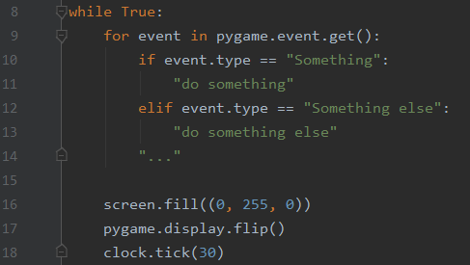
Event Handling [2]
Basic use

Slide 24


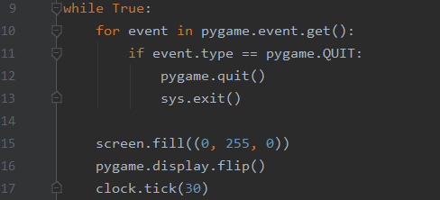
Event Handling: QUIT
First, we should handle the event: quit
“Close button”
Ctrl+C in Linux
To exit the program, import sys module:
sys.exit() terminates the program
The event type is pygame.QUIT
So…

Slide 25
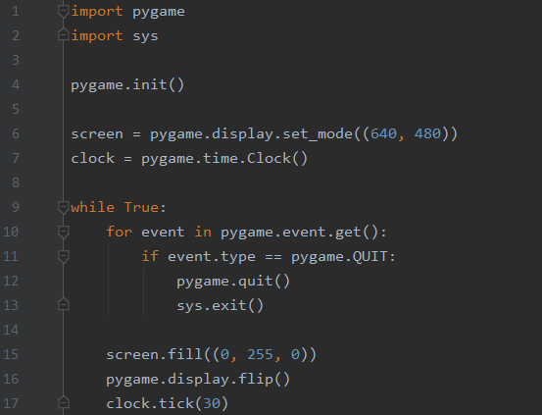
So far… [1]

Slide 26
So far… [2]
CLEAR!
End
CLEAR!
if the event was “quit”
Some event
Initialization
& Setting
Infinite Loop
Event
Listening
Do Something
Update
Display
Notes:
예시 들어 설명하기

Slide 27
Notes
What kinds of event, and how handle these?
It entirely depends on our purpose
We will look at several commonly used methods, by examples
So, of course, you may find a better way!

Slide 28
Implementation Examples

Slide 29
Keyboard Input [1]
Many game uses keyboard input
WASD / ←→↑↓ to move character
Esc for menu / to exit game
QWER to use skill (LoL)
so on…
Key input (key-up and key-down) is defined as an event
we can access to the event by pygame.event.get() (like QUIT)
These are defined as pygame.KEYUP / pygame.KEYDOWN

Slide 30
Keyboard Input [2]
Each key corresponding with event is defined as pygame.K_(key)
and can be accessed by event.key
For example, a -> pygame.K_a
So, the procedure is like…
Listen event, is it keyboard input(up/down)?
Then, the corresponding key is what I want to use?
Then, do something!

Slide 31
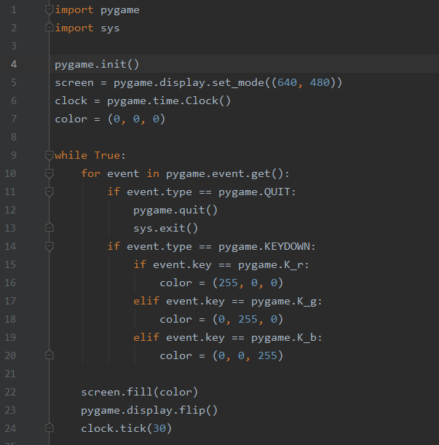
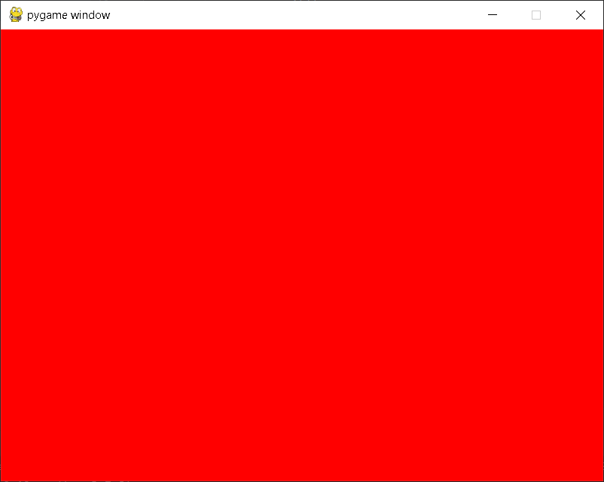
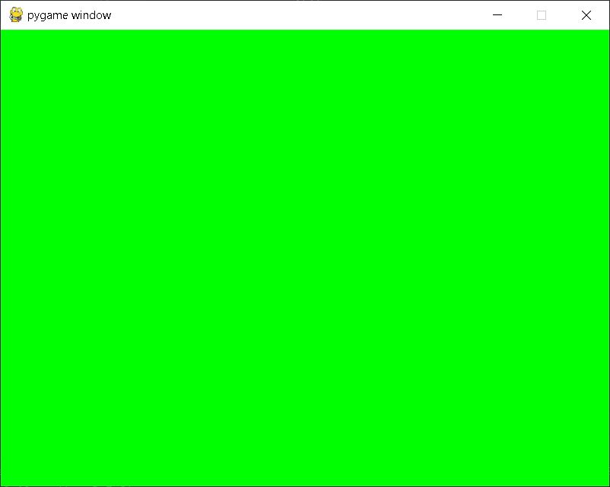
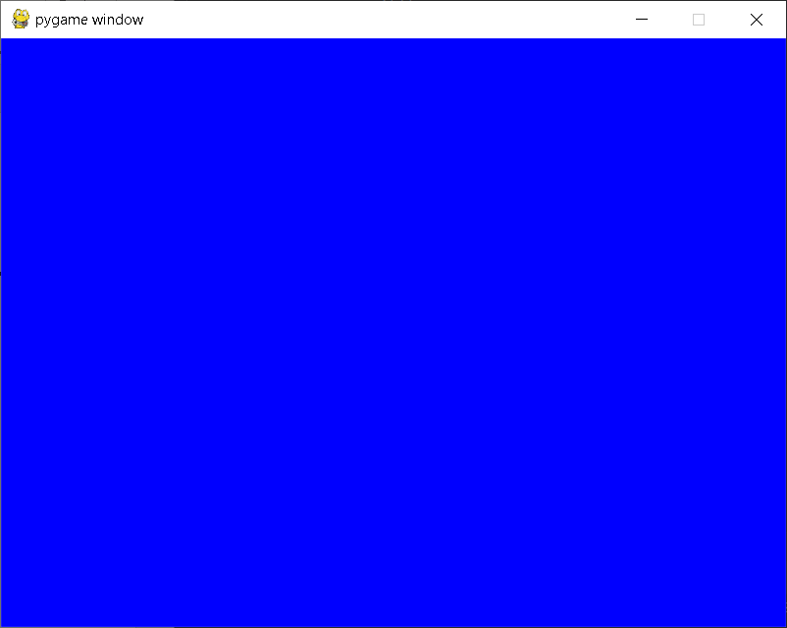
Keyboard Input [3]
Example: press R to screen to red, G to green, B to blue

Slide 32
Drawing Shapes [1]
We need to draw something in the screen:
Character?
User interface?
Message?
…
Pygame provides various shapes to draw
and these are similar with those in OpenCV

Slide 33
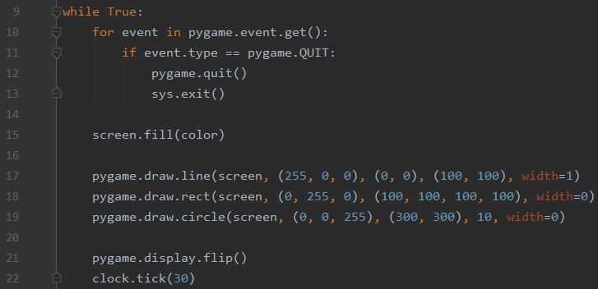
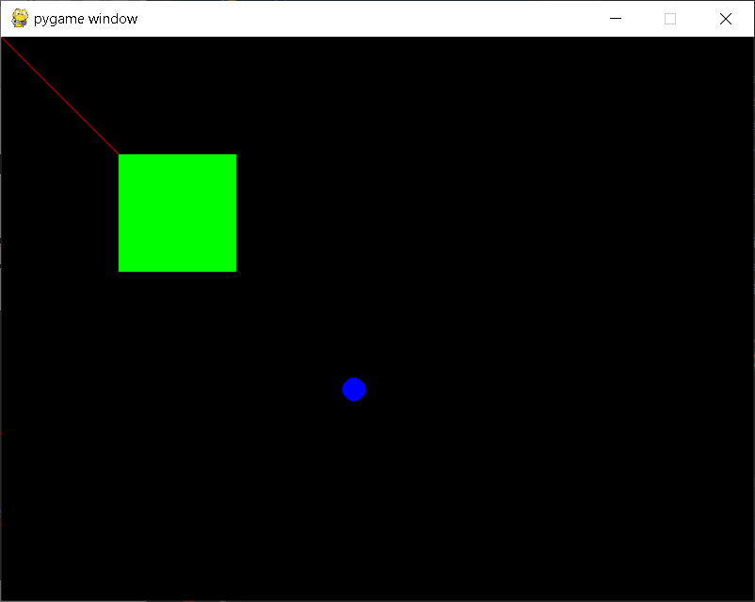
Drawing Shapes [2]
We use pygame.draw.(shape)() function
Let’s see the examples (these are very intuitive!)
Many other shapes are explained in the supplement
shapes must be drawn after background is drawn
surface color start end
surface color (x, y, w, h)
surface color center radius
Notes:
width=0은 내부를 채움을 의미함

Slide 34
blit(): Showing image [1]
A surface’s method, blit() copies given visual object into a certain location
blit(“something”, “location”)
“Location” can be 2-tuple(x, y), 4-tuple(x, y, w, h), or Rect (we will cover soon)
“Something” can be image, rendered text, or something else

Slide 35
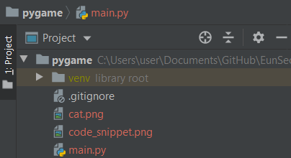
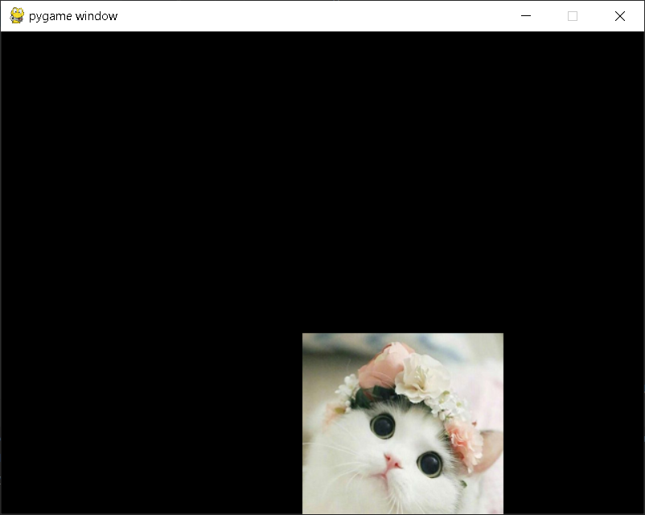
blit(): Showing image [2]
First, load image by using pygame.image.load(“filename”)
And then, use (Surface).blit(“image”, “Rect”)
Notes:
이미지가 rect 를 뚫더라도 rect의 크기가 변하진 않음

Slide 36
blit(): Rendered Text [1]
We may want to show some text or number:
Score / Point
Name
Description
…
Then, how?

Slide 37

blit(): Rendered Text [2]
First, specify the “font”:
pygame.font.Font(“filename”, “size”)
If None, the pygame default font is loaded
pygame.font.SysFont(“name”, “size”)
Bring from system font
These function returns font object
Note that the font size cannot be changed

Slide 38
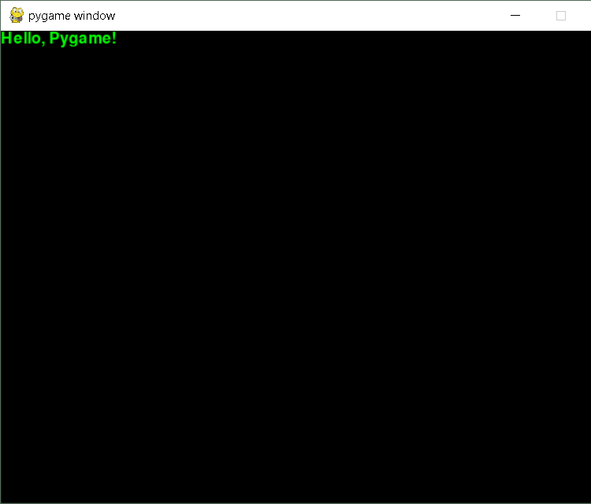
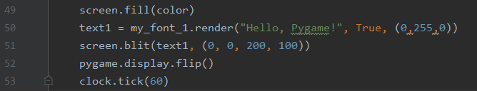
blit(): Rendered Text [3]
We use render() method to draw text
(Font).render(text, antialias, color)
How can we use it?
“blit” this result at a certain region

Slide 39
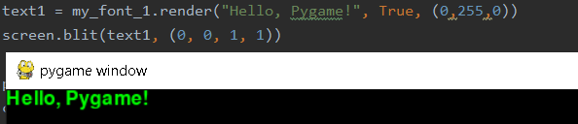
Note
In default, the object is not fitted to the region automatically.
Neither extended nor compressed
Obviously, it is not 1x1 pixel

Slide 40
Mouse Event Handling
There are several events about mouse motion
button-down (pygame.MOUSEBUTTONDOWN)
button-up (pygame.MOUSEBUTTONUP)
motion (pygame.MOUSEMOTION)
You can get the current mouse position with pygame.mouse.get_pos()
It returns 2-tuple (x, y)

Slide 41
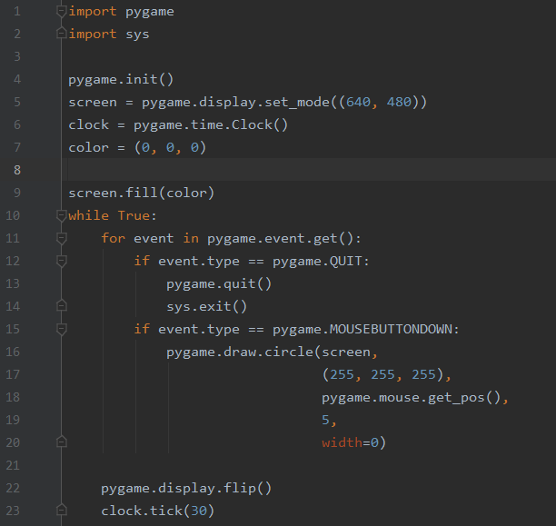
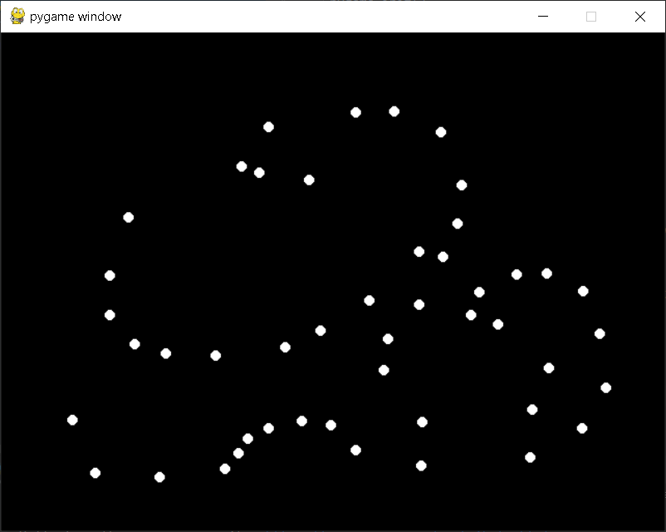
Mouse Event Handling: Example [1]
Easiest, but naïve way

Slide 42
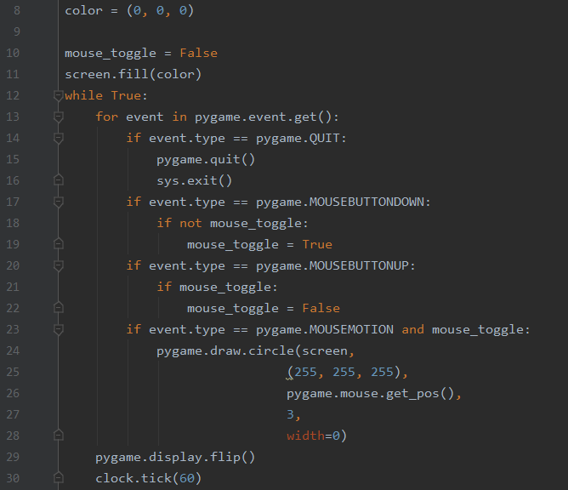
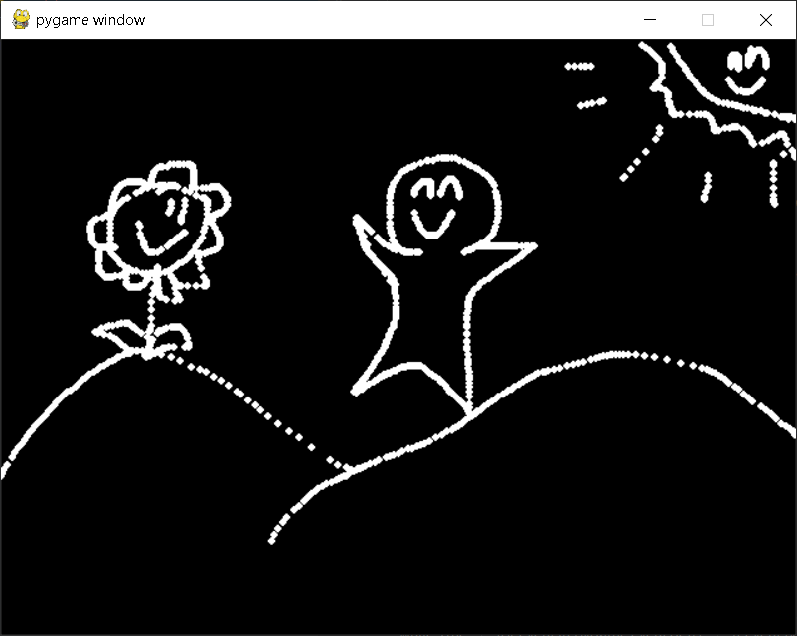
Mouse Event Handling: Example [2]
Better way

Slide 43
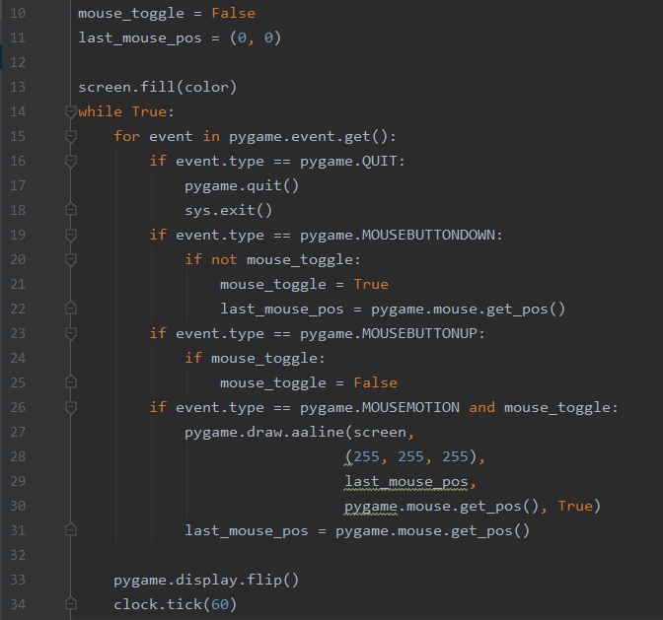
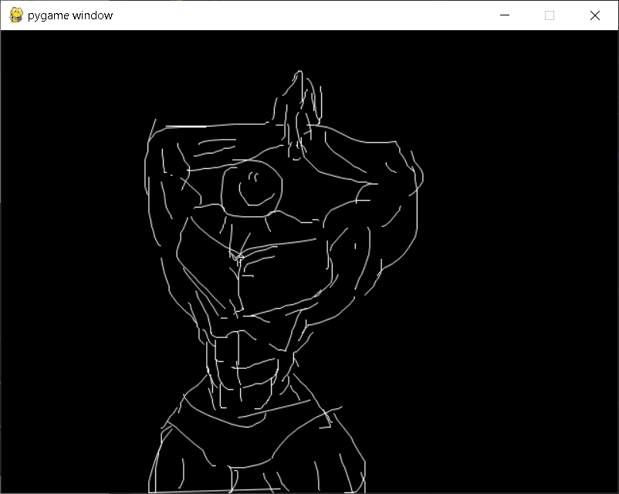
Mouse Event Handling: Example [2]
Much better way… but I am not good at drawing :(

Slide 44
In the Lab Session…
We will make two applications:
Paint tool
Falling poop game
The previous example and the supplement may be helpful

Slide 45
Rect Object
One of most important object in Pygame, as well as Surface
It does..
Indicate a certain region
in many cases, 4-tuple parameter can be replaced with Rect
Interact with another Rect
Represent an image
…
It can be regarded as a “sprite”

Slide 46
Creating Rect
Use pygame.Rect(x, y, w, h)
…but it doesn’t do anything
If you do not use it
So how can we use?

Slide 47
Moving Rect [1]
Two ways:
Directly change each x, y of Rect
(SomeRect).x = 10,
(SomeRect).y += 10
…
Use move(x, y) method
(SomeRect).move(Δx, Δy)
Notes:
이미지가 rect 를 뚫더라도 rect의 크기가 변하진 않음

Slide 48
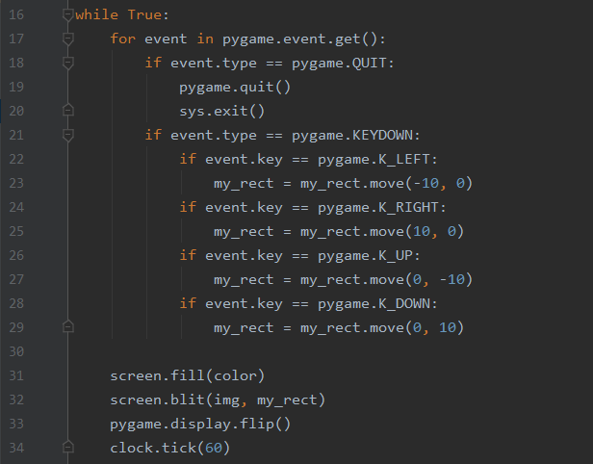
Moving Rect [2]
Simple way:
Cannot move continuously
Notes:
이미지가 rect 를 뚫더라도 rect의 크기가 변하진 않음

Slide 49
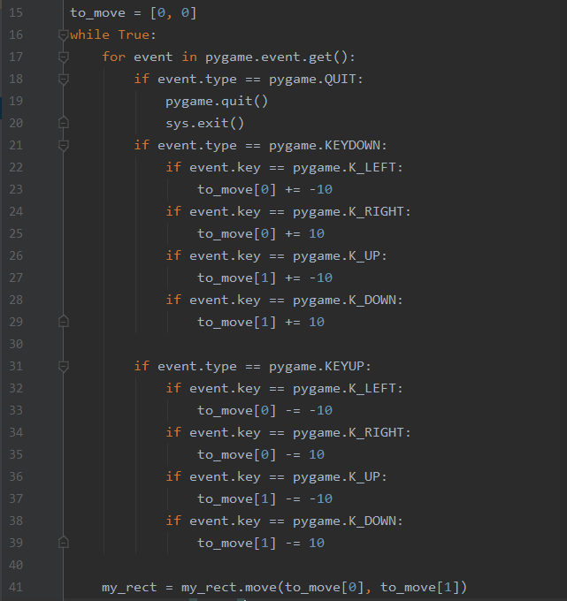
Moving Rect [3]
Better way:
Can move continuously
Diagonal move (using 2 keys)
Notes:
이미지가 rect 를 뚫더라도 rect의 크기가 변하진 않음

Slide 50
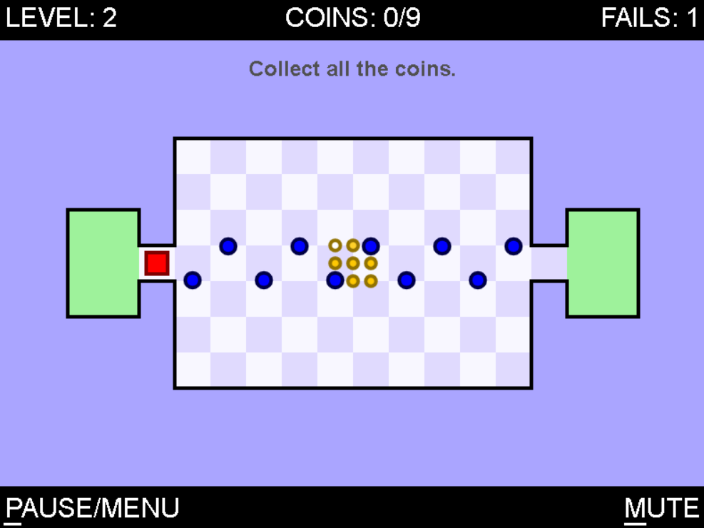
Collision [1]
In many games, two objects collide with each other
Enemy’s attack hits my body
My character is blocked by wall (so cannot move)
Some ball bounces to the ground
…
You know?

Slide 51
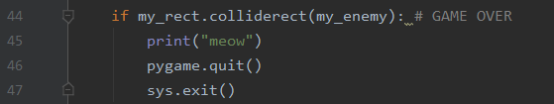
Collision [2]
In pygame, use (Rect).collide_X(“Something”) method
(Rect).collidepoint(x,y): check collision between the rect and point
(Rect).colliderect(rect): check collision between the rects
(Rect).collidelist(list): check collision between the rect and each elements in the list
We can use these in many ways

Slide 52
RE: In the Lab Session…
We will make two applications:
Paint tool
Falling poop game
The previous example and the supplement may be helpful

Slide 53
So far…
End
CLEAR!
if the event was “quit”
Some event
CLEAR!
CLEAR!
Initialization
& Setting
Infinite Loop
Event
Listening
Do Something
Update
Display
Notes:
예시 들어 설명하기

Slide 54
About Pygame
Several useful functions and concepts are explained in the supplement material
You can find an official documentation in here:
https://www.pygame.org/docs/

Slide 55
Thank you

