Slide 1
Basic Python Programming
[Session 1] Lab session
ITinerary X University of Ghana
Notes:
ok, then let’s start lab session.

Slide 2
Contents
About Real-time Class
Class: Dot
Class: Car
Notes:
first, we will announce something about realtime class.
ANd then, we will implement two class in the exercise. Dot, and car.
This lab session will be quite easier than other session. Because it is first programming session.

Slide 3
About Real-time Class
Notes:
Ok

Slide 4
Real-time Class Plan
We will have 4 real-time class
12/08 (Tue) – 12/11 (Fri)
Every 10:00AM – 1:00PM
We meet on Zoom
You can find the link in our page
https://us02web.zoom.us/j/9965189658?pwd=dGxPY1o4clZENnlvWC9MTW5aY09XUT09
Duration can vary
About 2 ~ 3 hourse
Notes:
Realtime class will be held at every 10AM to 1Pm every day, until Friday.
And we meet on Zoom, as we do now.
And, this link will be used across the course.
Lastly, the duration of realtime class can be vary.
ok

Slide 5
Using Zoom: Breakout Rooms [1]
We created 2 breakout rooms:
#1 help session: If you want, you can share your screen and get help here.
#2 submission: You can submit your solution here
Notes:
Then, let’s briefly view how can use Zoom.
First, we created two breakout rooms.
one room is for help session. If you want to one-to-one help. Then, you can come to help session. and get some help from us.
and another room is for code submission. If you complete your work. Then you can come to this breakout room. and submit your code, and go back to here.

Slide 6

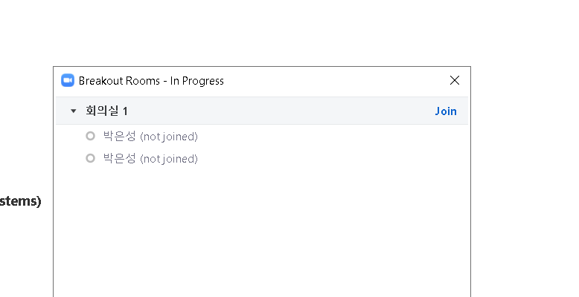
Using Zoom: Breakout Rooms [2]
Notes:
Then how can we enter and leave the breakout room?
You can click breakout button. and select the breakout what you want.
and then click join.

Slide 7

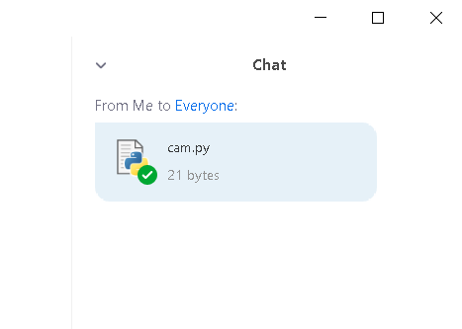
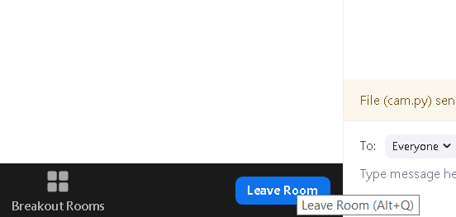
Using Zoom: Code Submission
Notes:
If you want to submit your code. just drog and drop your file, to the chatbox.
And then you can leave and go back to main classroom, by clicking leave room.

Slide 8
Class: Dot
Notes:
Ok, then everything is clear. right?
Before we start, please download the skeleton code from the session 1 page.
and decompress the file, and store these in your project directory.
And I strongly recommend to see this slide with the skeleton code
It will be helpful for understanding what we have to make

Slide 9
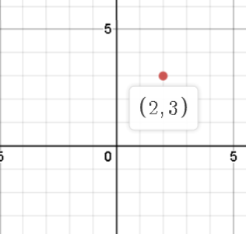
Dot [1]
We will implement “Dot”
dot?
Notes:
We will implement Dot, by using class

Slide 10
Dot [2]
Basically, Dot contains two data
x and y
Okay, that’s all for member variables
And then?
Define methods!
Notes:
Basicllay a dot in 2-dimensional plane contains only two data, x and y.
Does it make sense?
And, we should define several functions for dot.

Slide 11

Review: Methods [1]
Note that, every method should be like…
Notes:
Before that, note that, the first parameter should be self.
This indicates itself.

Slide 12
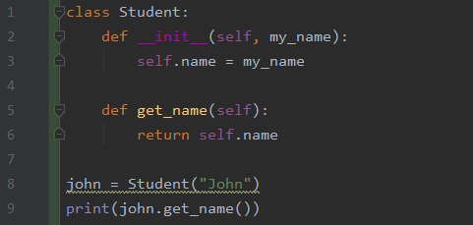
Review: Methods [2]
You can access the member variable inside method, by using self!
Notes:
You can access some member variable by using self.
from when we call john dot get_name. the self dot name stands for John’s name.

Slide 13
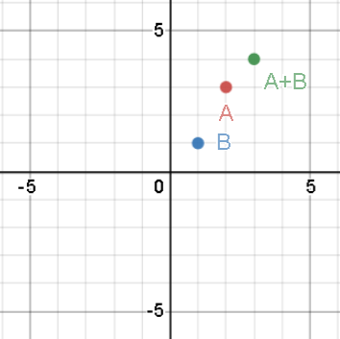
Dot: Methods [1]
dot_add, dot_sub method adds / subtracts each coordinate
Example: (2, 3) + (1, 1) = (3, 4)
Notes:
Ok, then let’s make several method.
first, dot_add method, add each x and y coordinate
for example, 2,3 add 1, 1 can be 3 , 4. right?

Slide 14
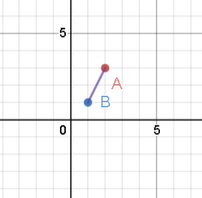
Dot: Methods [2]
dot_dist returns the distance between two points
in this case, root(5).
math.sqrt() function will help you
Notes:
And then, we can define dot_distance function. It returns the distance between two points
so, in this case, it should be square root 5, about 2.23

Slide 15
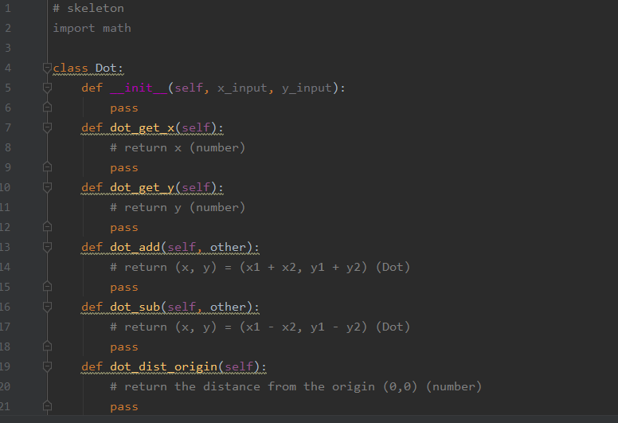
Dot: Methods [3]
Other methods are defined in the skeleton code.
You have to modify this
Notes:
Other methods are defined in the skeleton, so please refer to this.

Slide 16
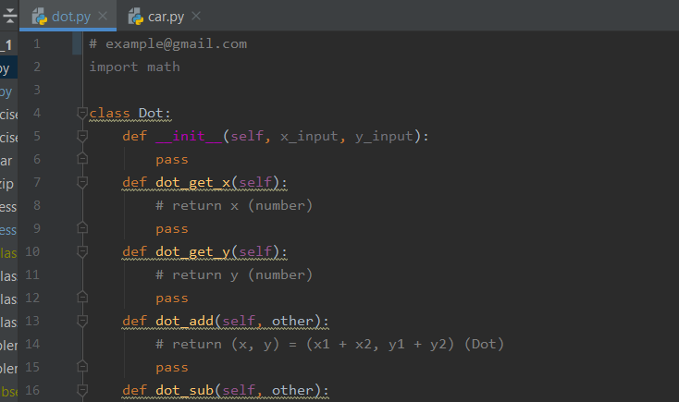
Let’s start!
Use the skeleton, dot.py
Please submit your solution with your email in the first line in the code
Notes:
Ok, then let’s start. We will make it together, but if you can, try to make your own answer.

Slide 17
Class: Car
Notes:
Then, let’s make a car.

Slide 18
Car
A car can do
drive (as long as the fuel remains)
show the its status:
fuel (L)
total distance (km)
etc.
Cars have their own features:
car name
mileage (km/L)
max fuel (L)
Notes:
Car, can do drive. It is essential for the car, do you agree?
Also, you can check the status of car such as fuel , total distance, etc.
Also, each car has its own features
car name can be BMW, 포르쉐, benz
also, each one has difference mileage, an efficiency of fuel usage
and max fuel. a capacity

Slide 19
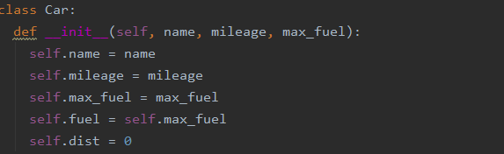
Car: Member Variables
Notes:
SO. car should have these member variables. right?

Slide 20
Car: Methods [1]
Brrr(self, km): drive X km
The car should consume the fuel, as you drive
If the fuel is not enough, it cannot go
After that, show the current state
gas_station(self): Full the fuel
It’s free!
After that, show the current state
Notes:
And then, let’s implement three methods for car
brrr is driving car. You can drive several km, and consumes several amount of fuel.
If you don’t have enough fuel. You cannot go
And gas_station, is visiting gas station, so you can fill the fuel.
It is free gas station! so just fill, without charge.

Slide 21
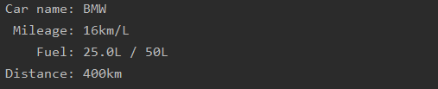
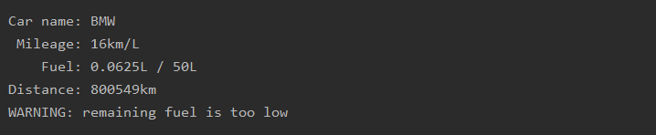
Car: Methods [2]
status(self): show the current status
warn if the fuel is too low
Notes:
Andthen, last method is status. show the current status.
You can follow the fomat like this. It is explained in the skeleton code.

Slide 22
Let’s start!
Use the skeleton, car.py
Notes:
Then, please refer to the skeleton code.

Slide 23
Thank you

