Slide 1
Basic Python Programming
[Session 2] Lab session
ITinerary X University of Ghana
Notes:
ok, then let’s start lab session.

Slide 2
Contents
RAID

Slide 3
RAID
Notes:
Ok

Slide 4
RAID [1]
There is a monster: SOCKETMON
very bad socket-monster!!
You should defeat this monster, together!
how?

Slide 5

RAID [2]
We can attack to SOCKETMON with socket programming
Sending message, we can attack!

Slide 6
RAID [3]
We can use two types of attack
Normal: A normal attack (30 damage)
Lucky: Stronger attack, but sometimes fail…
Chance | Damage
1 % | 1000 Damage
9 % | 100 Damage
40 % | 50 Damage
36 % | 0 Damage
4 % | DIED

Slide 7
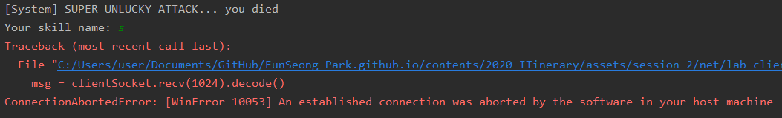
RAID [4]
If you died…
The connection is closed
…and meet some error
But it’s okay, you can just re-run your program

Slide 8
RAID [5]
Our goal is…
Defeating SOCKETMON
Its HP is 1,000,000 !!
…Can we defeat?

Slide 9
RAID [6]
Party bonus: sqrt(connected people)
e.g. If 9 people successed to implement (so connected to the server), all of member get x 3 damage bonus
Thus, help your friend implement this program!

Slide 10
RAID [7]
You implement…
A client program
Message sending (“Lucky” / “Normal”)
Message receiving (we will show the current HP of SOCKETMON)
Also, you can find a better (stronger / faster) way
Hint: just infinite loop may not work :/ (we blocked)
But, except this, you can do anything.

Slide 11
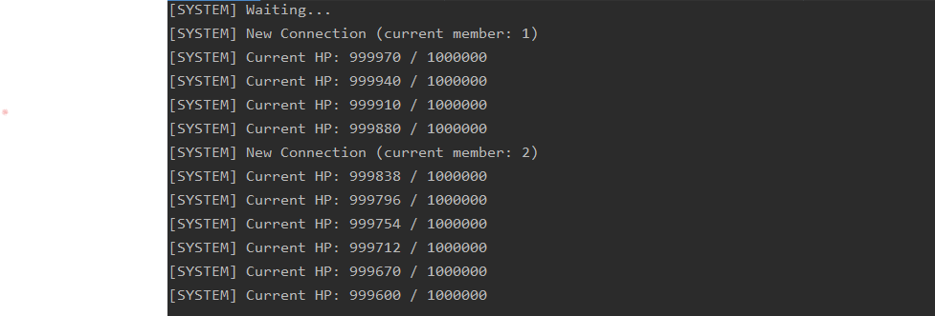
RAID [8]
We will show real-time status of SOCKETMON

Slide 12
Let’s start!
There is no skeleton code
But the supplement will be useful

Slide 13
Server Info
IP:
Port:

