Slide 1
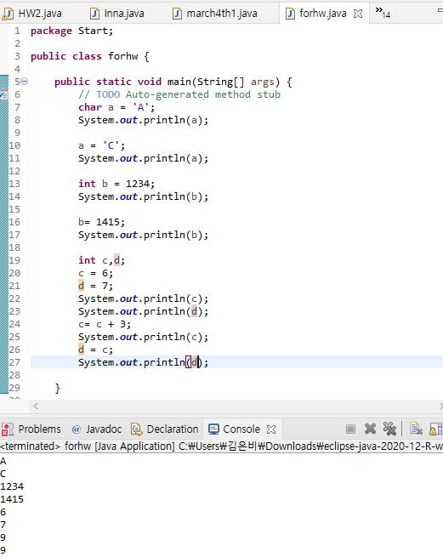
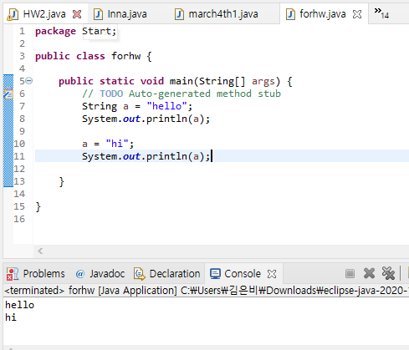
P10
Practice this process with all the other data types

Slide 2
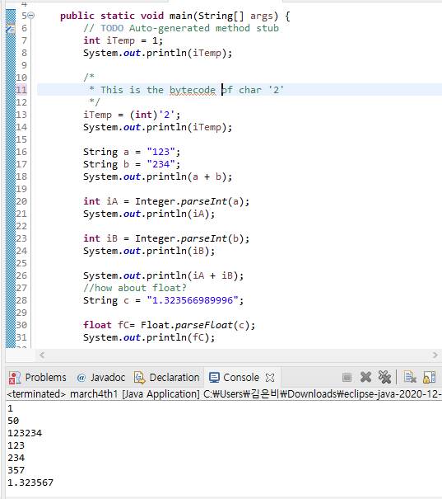
P11
Practice this process with all the other data types
알아서 float 타입에 맞게 값이 변환 됨

Slide 3
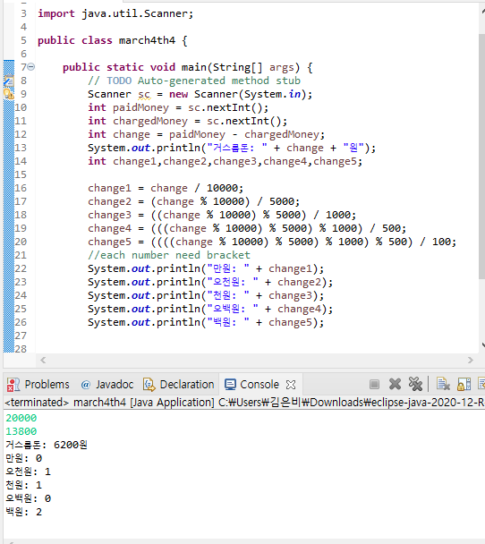
P12
Calculating Change

Slide 4
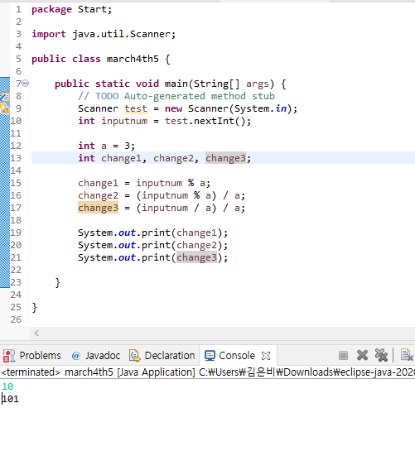
P13
Base 10 to Base 3 Converter

Slide 5
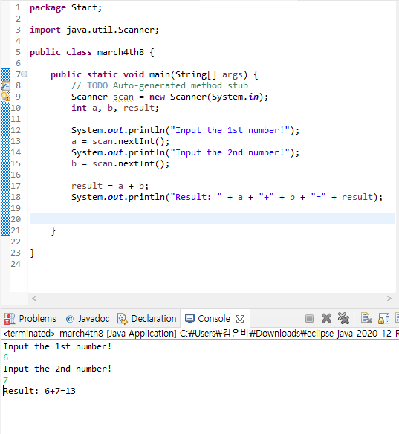
P14
Compose a program with the conditions below

Slide 6
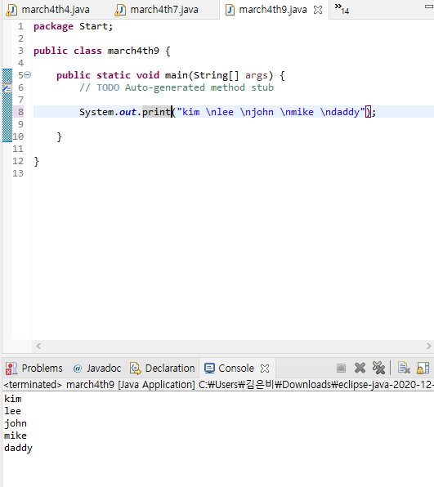
P15
Compose a program with the conditions below
▸ Use the function, “System.out.print()” only once

Slide 7
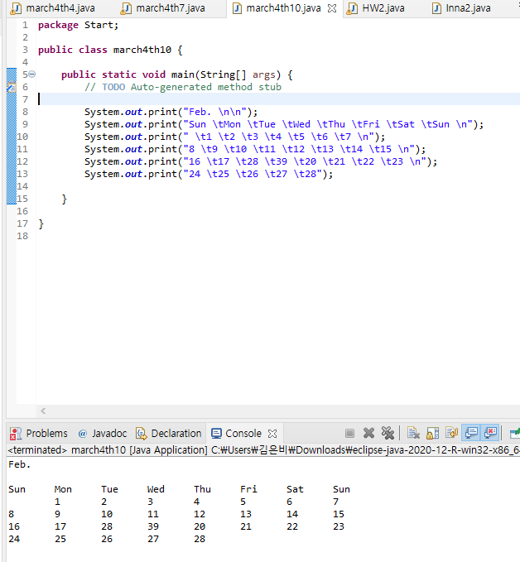
P16
Compose a program with the conditions below
▸ Use the function, “System.out.print()” within 7 times

Slide 8
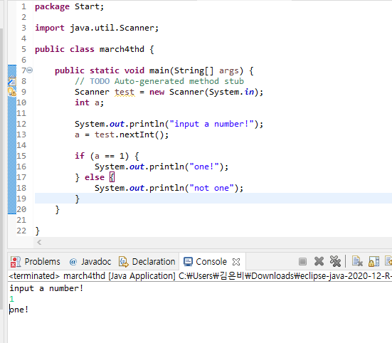
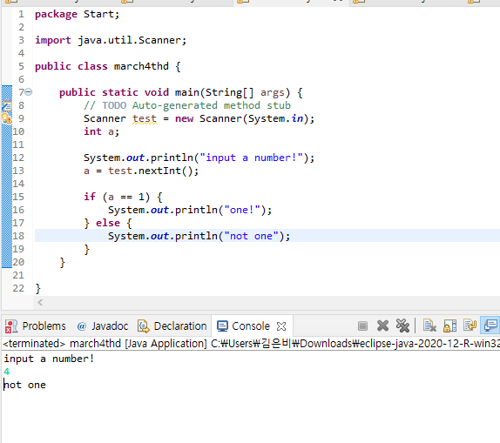
P1
Compose a program that distinguishes the input number

Slide 9
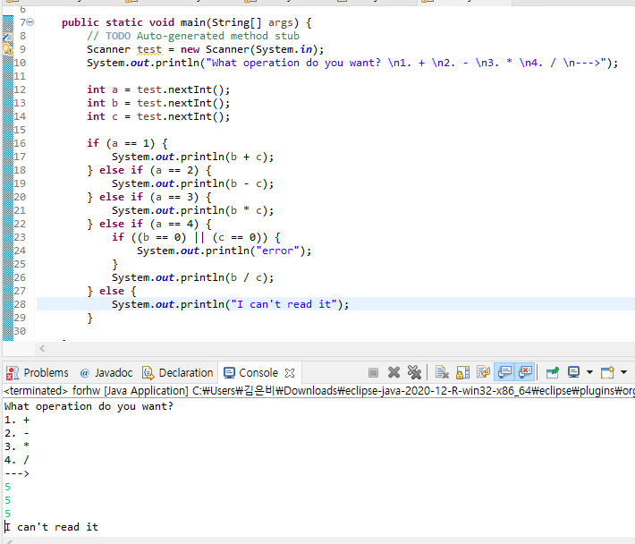
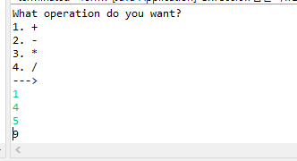
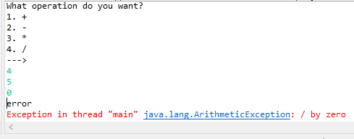
P2
Calculator

Slide 10
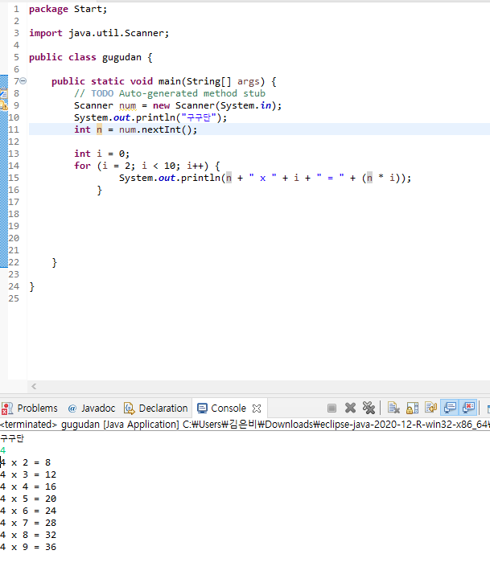
P3
Multiplication Table

Slide 11
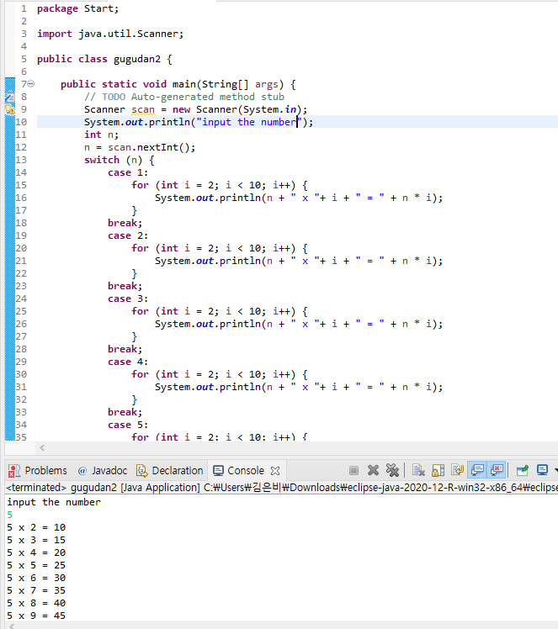
P4
Multiplication Table
▸ In order to compose a condition statement, use the “switch” statement

Slide 12
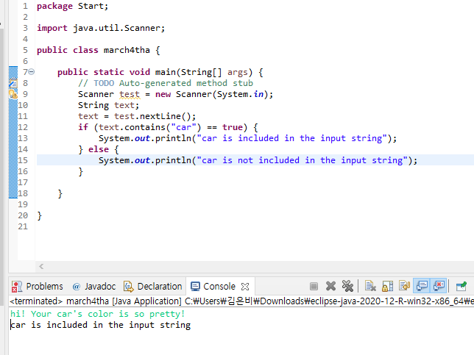
P5
Word Containing Program

Slide 13
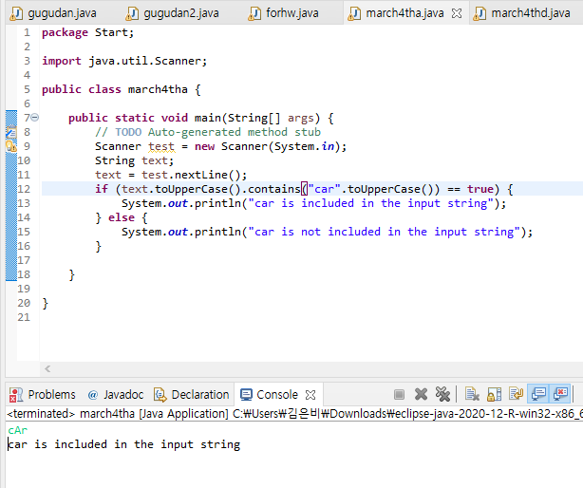
P6
Word Containing Program 2

Slide 14
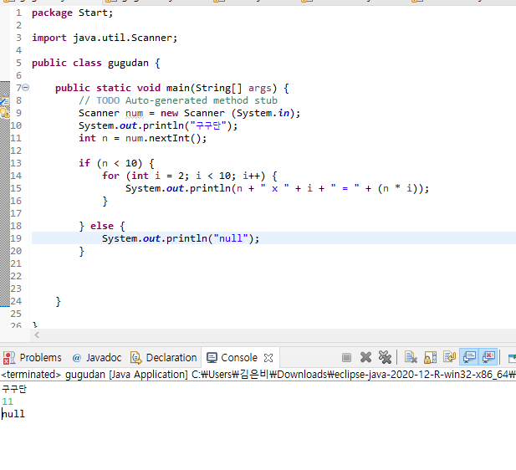
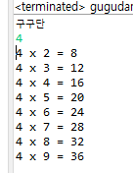
P7
Multiplication Table II

Slide 15
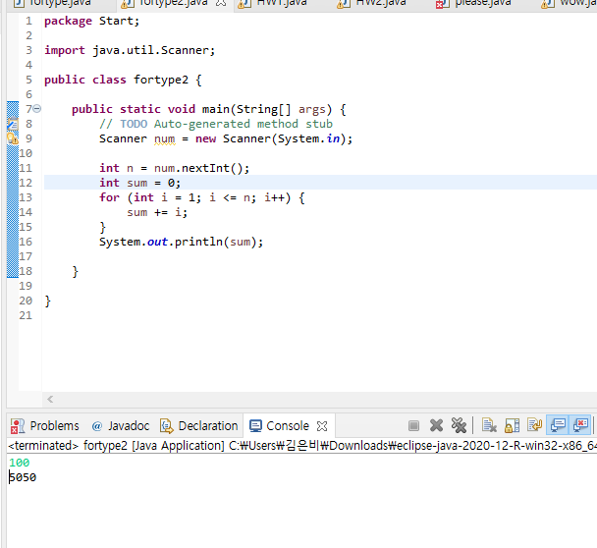
P8
Arithmetic Progression

Slide 16
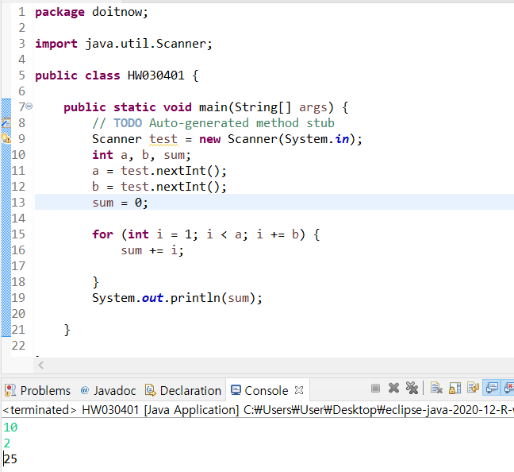
P9
--

Slide 17
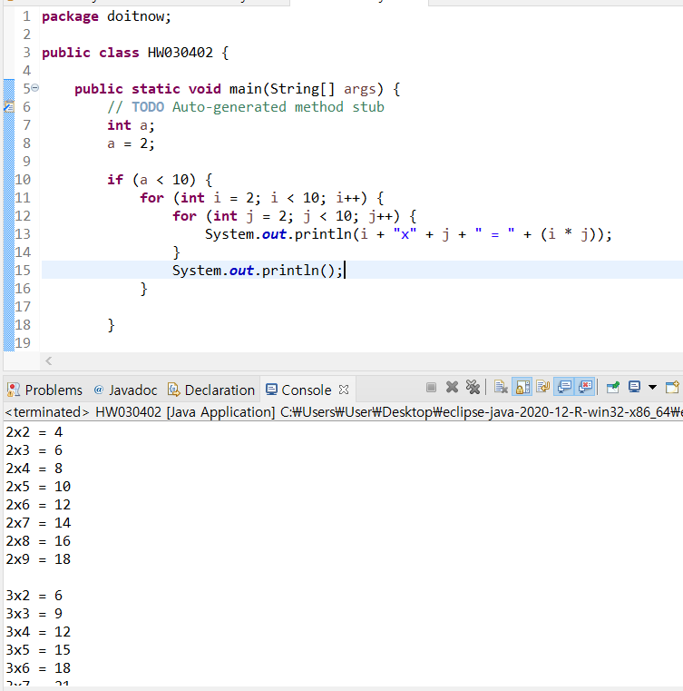
P10
--

Slide 18
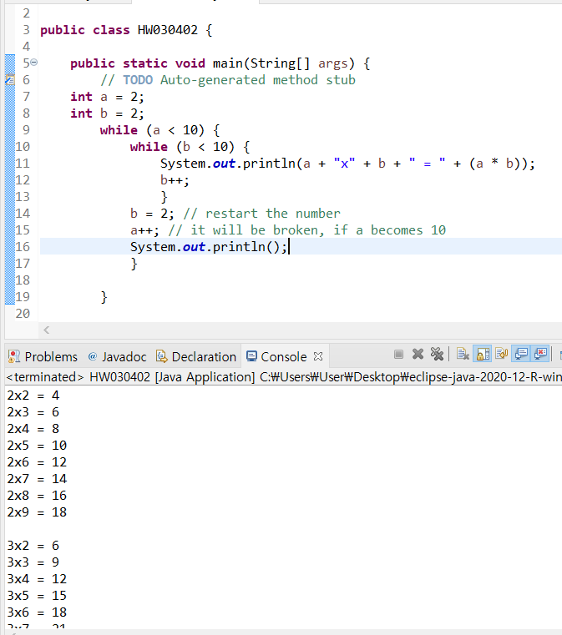
P11
--

Slide 19
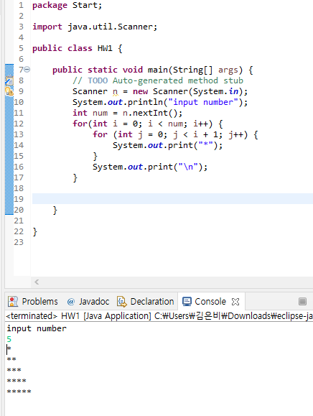
P12
--

Slide 20
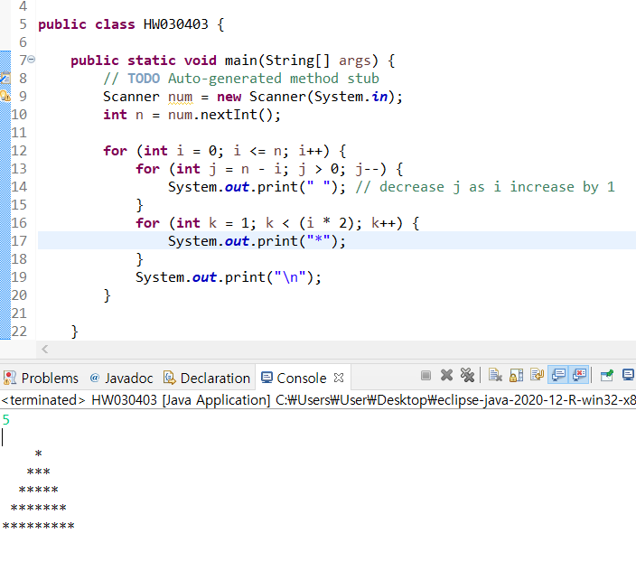
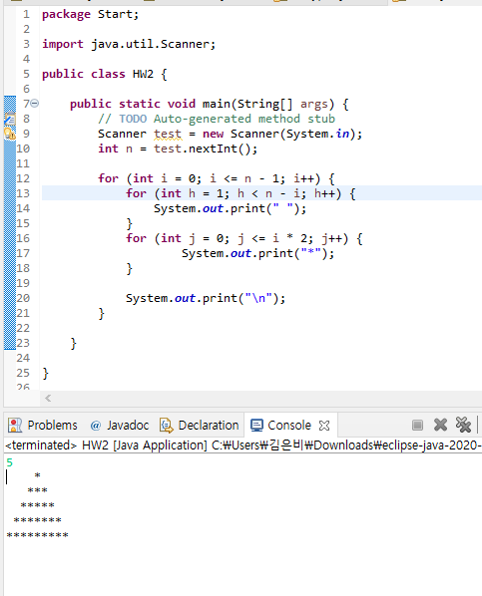
P13
--

Slide 21
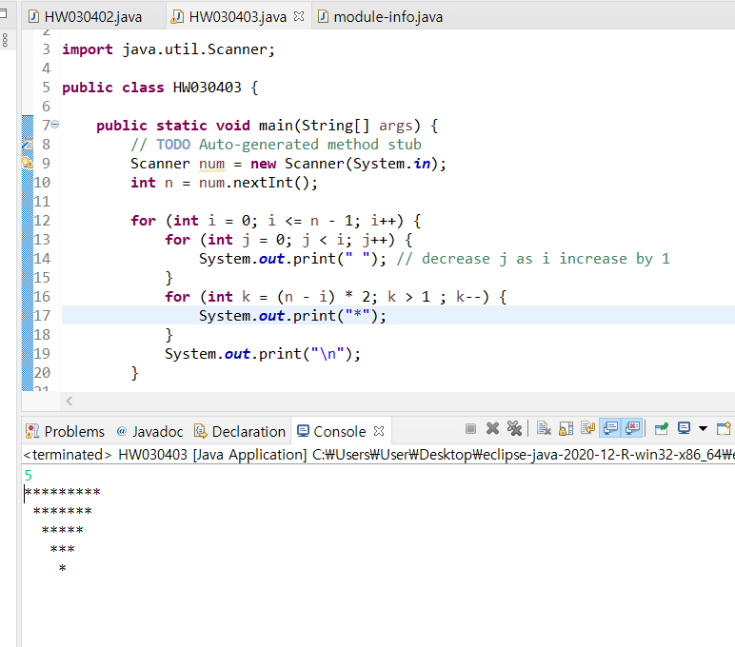
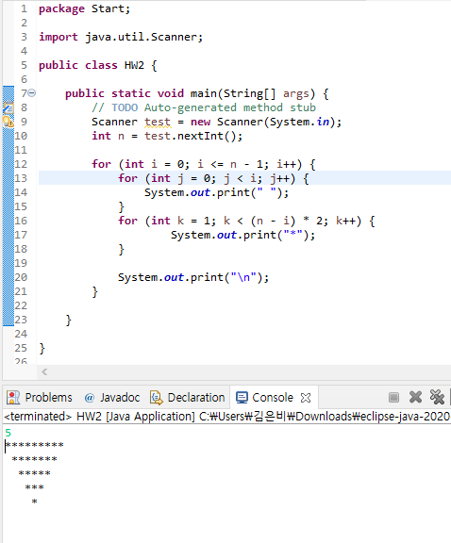
P14
--

