Slide 1
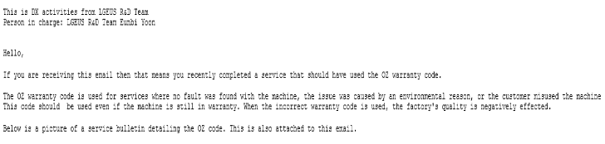
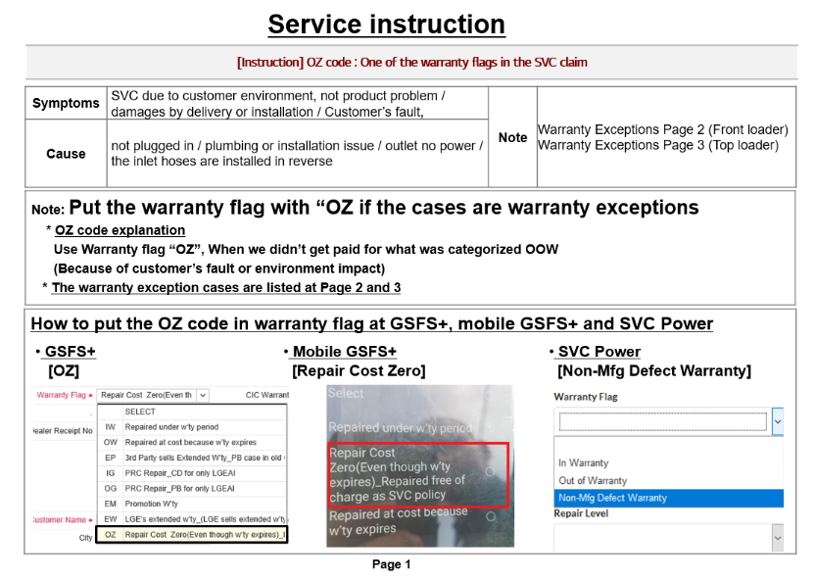
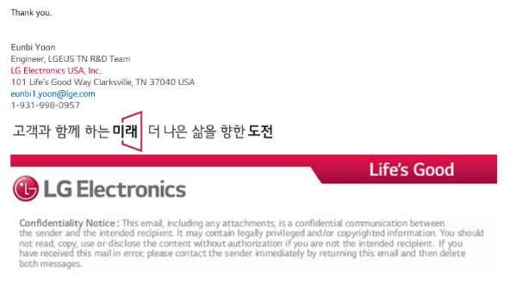
Customer Service Field Technician Management System
Concept : Analyzes field service as a whole and notifies service technicians corresponding to the service bulletin, defective parts and OZ code guide case at once
Improvement : 1) Save time and effort sorting out services that need to notify service technicians
2) Save time and effort sending email to technician one by one
Activities: 1) OZ Code Guide
2) Defective Parts Request
3) Service Bulleting Notice
Result
As - Is
To - Be
GQIS data download
GQIS Data download
Create Pivot Table
Sort Valid data
Make technician list
Send Technician Guide
Send Technician Guide

