Slide 1
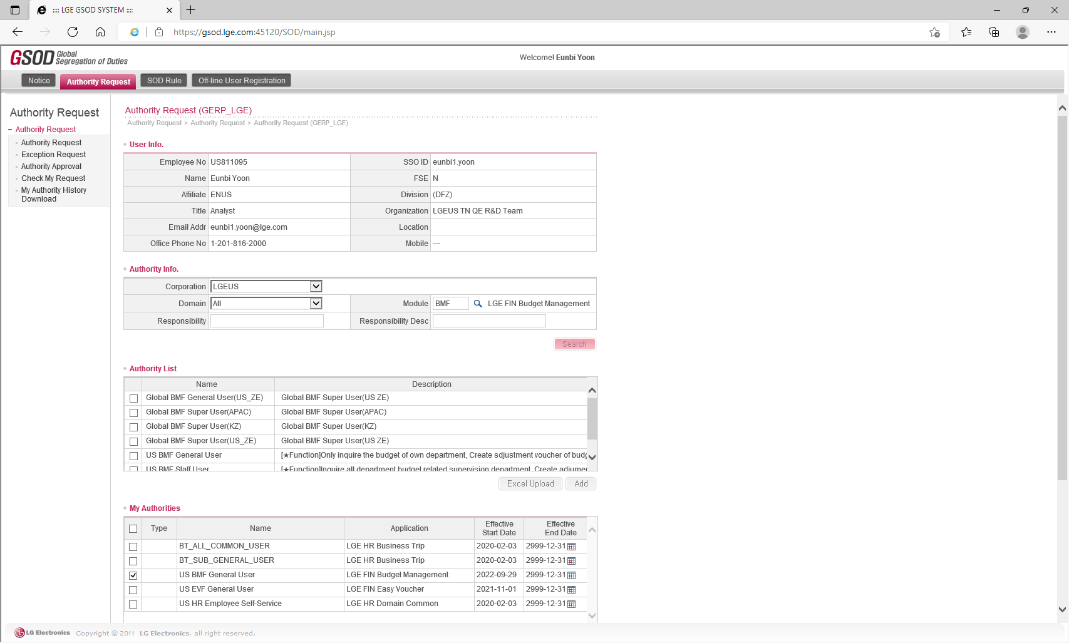
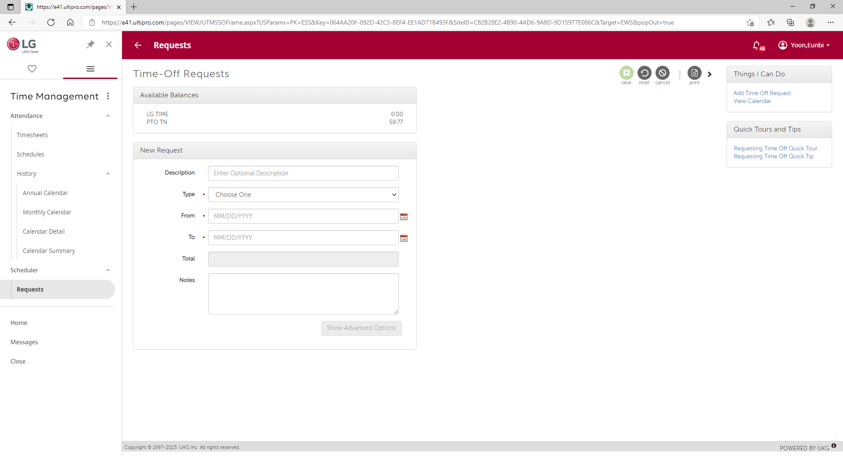
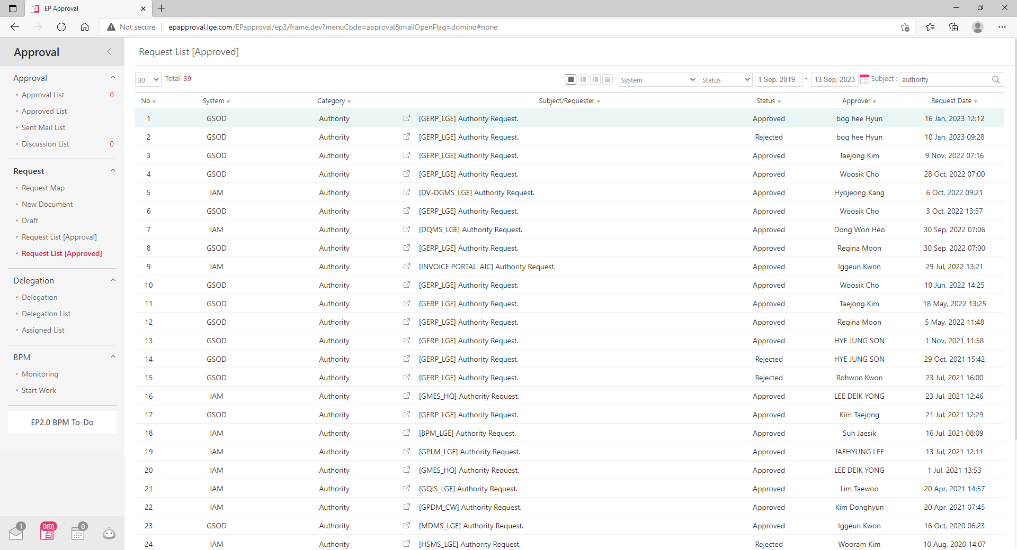
0. Data Center Main
You should log in to access this website and if you are logout it when you click some buttons to move page you will connect to login page automatically
Website has two types of accounts authority, Admin and User. Usually, admin authority is for developer and user is for report’s viewer.
Most of systems development idea comes from LG system for a friendly UI/UX
Map
Function
Authority
Admin
Developer
BOM Comparison
Figure out substitute and price change in BOM.
Account
Reinvent Center
Cost Review
Monitor trends about all model and major item cost
User
LGETN All Member
Flexible Workhours
Calculate Quality Indicator to analyze customer’s service
System Design Idea Comes From LG System
This site has been developed as a reference for the various operating methods of the LG system to provide a friendly LG’s user experience.
Account Authority
Request Function
Approval Function
LG NewEP Authority
Provides System
: IAM, GSOD
LG4ME PTO
Request System
: Time Management
LG NewEP
Approval System
: EP Approval

Slide 2
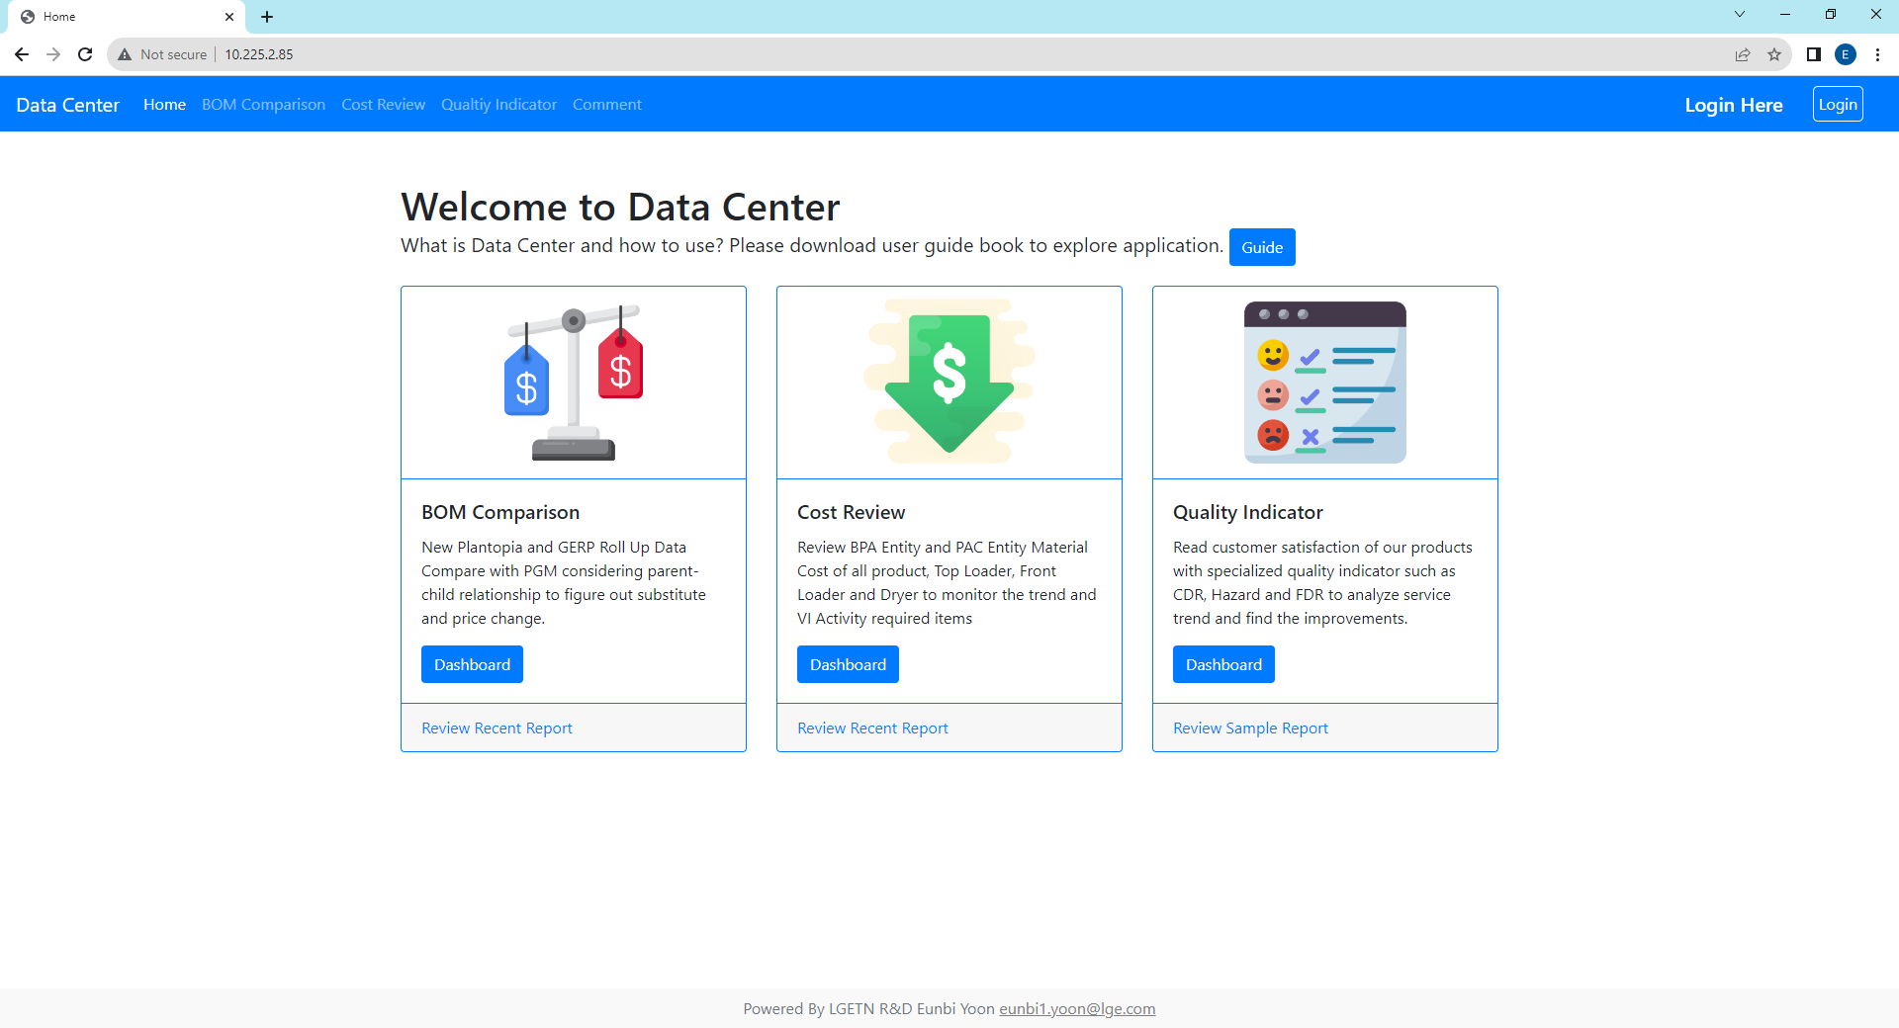

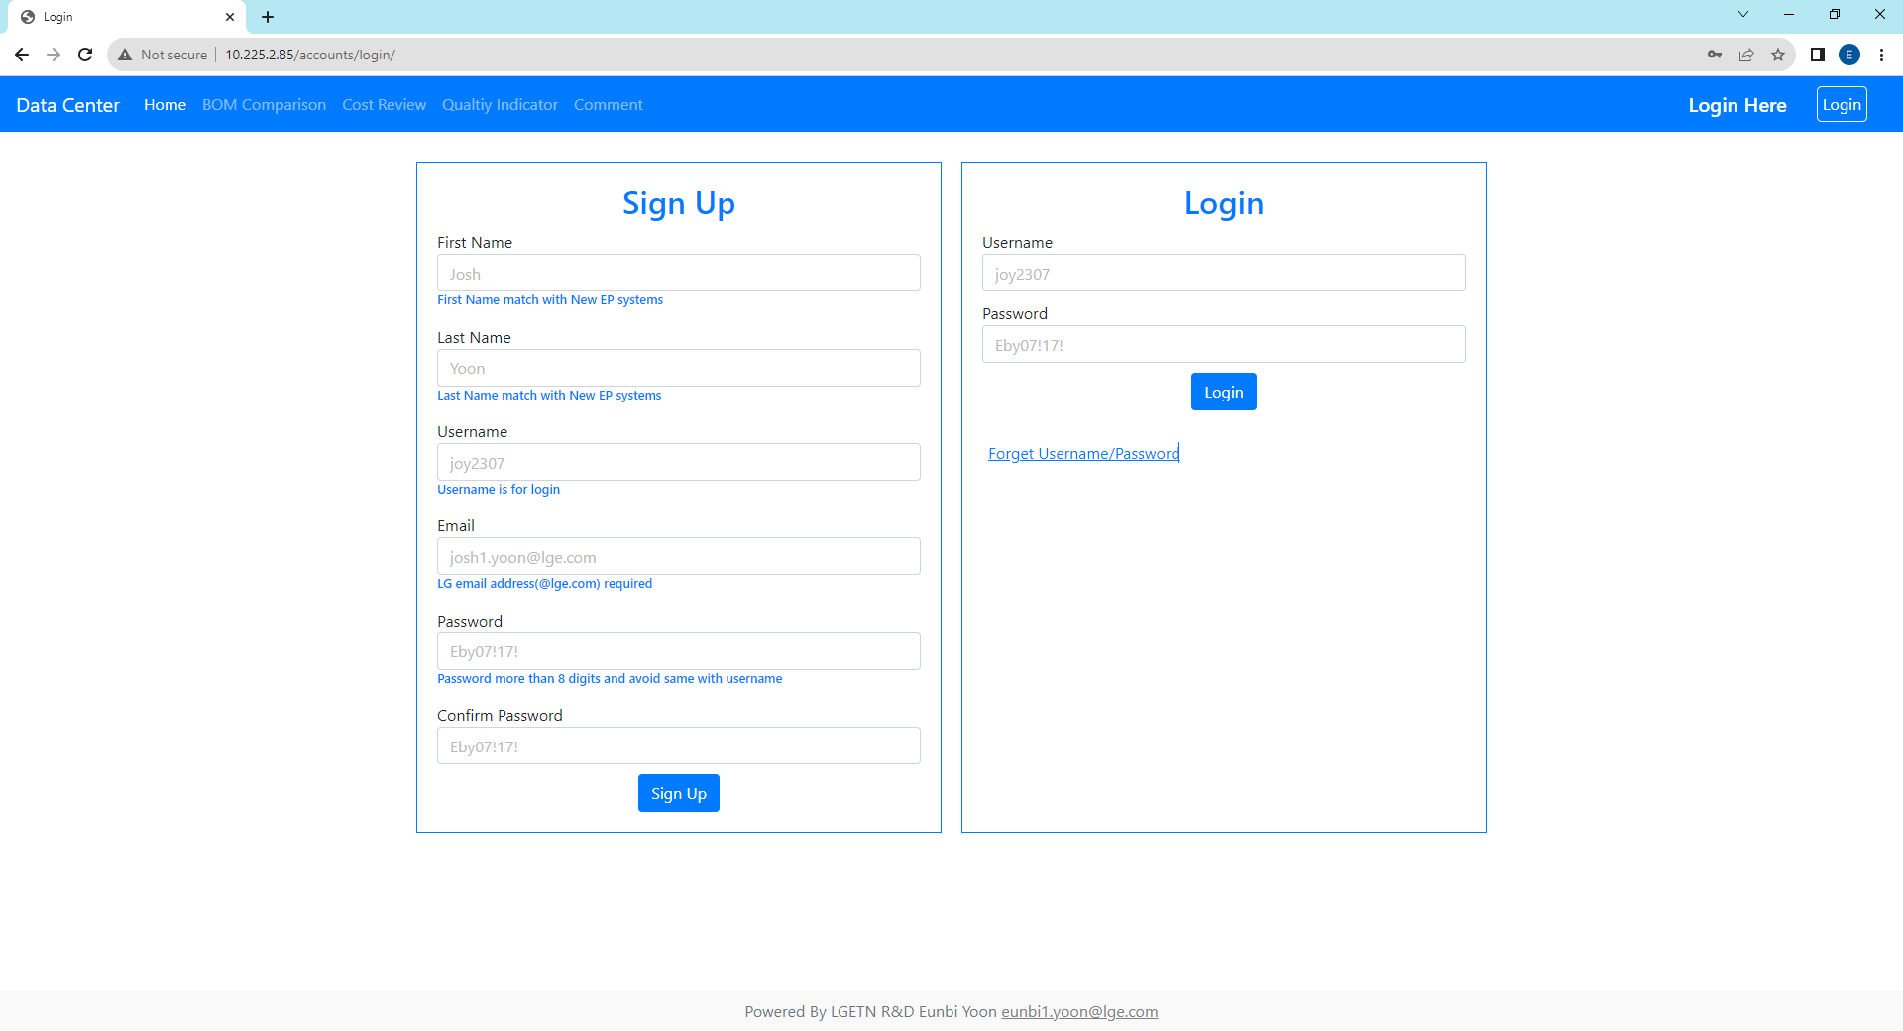
1. Sign Up & Login Page
You should log in to access this website and if you are logout it when you click some buttons to move page you will connect to login page automatically
When you sign up here, you will get user authority, if you need Admin Authority then send your all sign up information referring sign-up form (eunbi1.yoon@lge.com)
For sign up, all blanks are required and check detailed requirements below blanks and password different with username. e.g. username : user, password : user1357(X).
Email address should be @lge.com for security purpose.
Main Page
Log-In
Username
If you are already login, it will link you to this page
Log-Out

Slide 3
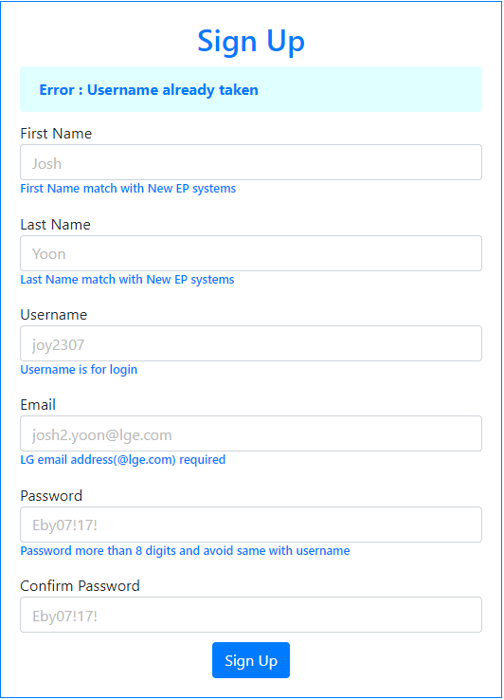
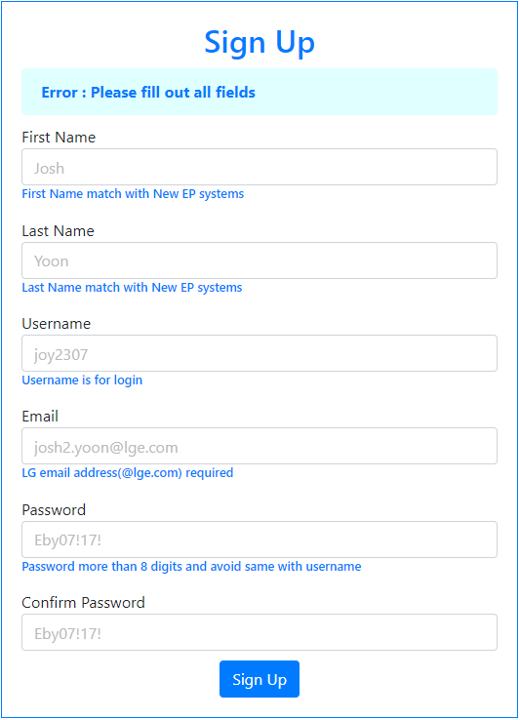
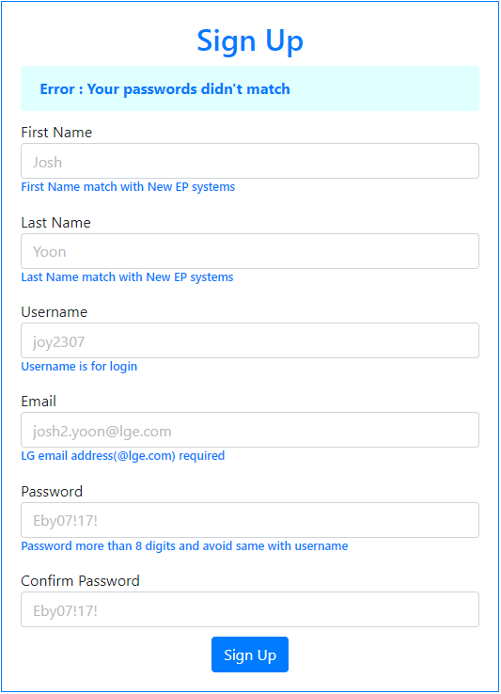

1. Sign Up Page - Error Logic
Parallelized & Serialized Structure : If user avoid duplicate username and email, user can make several different accounts
Error 3
N : No Error Exist
Error 1
Error 2
Error 1. Did not fill out all blanks
→ Fill out all blanks
N
Error 2. Passwords are not same
→ Match both password
N
Error 3. Username already taken
→ Try different username
Error 4
Error 4. Email already taken
→ Try “Forget Username
/Password” in Login Section
N
True
Create “User” Authority Accounts

Slide 4

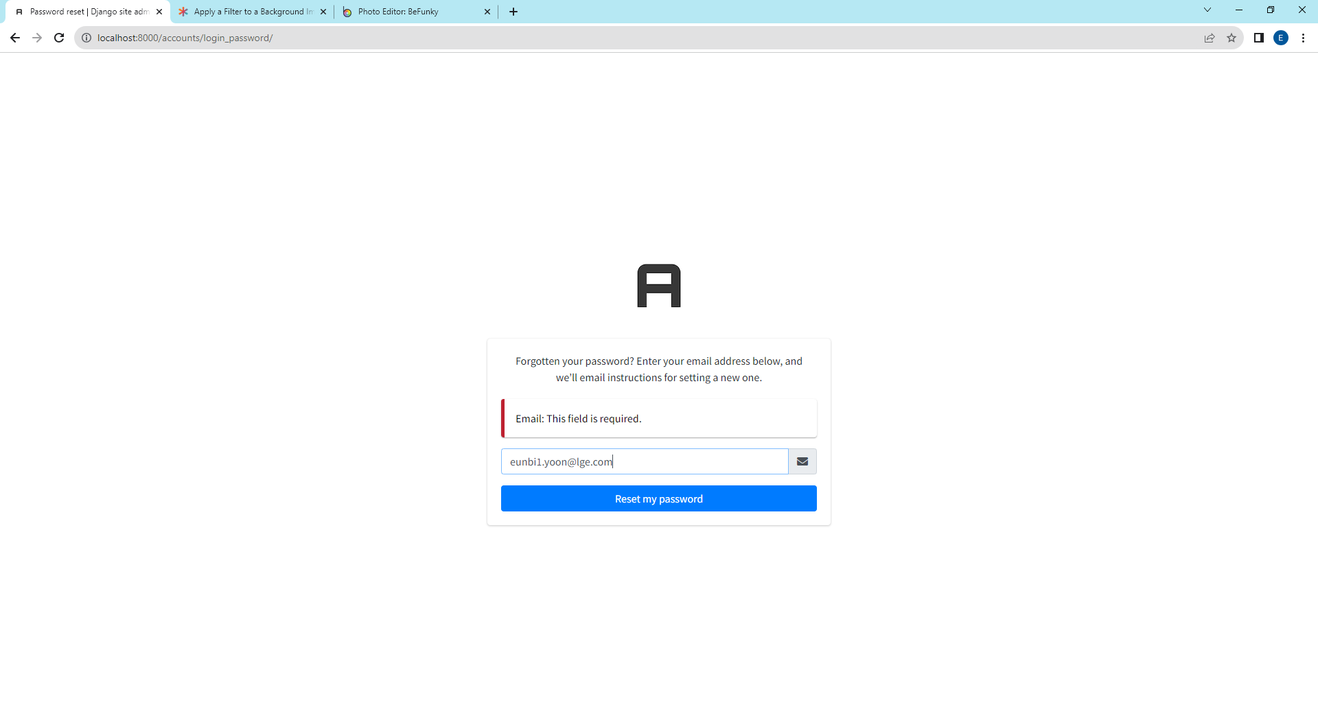
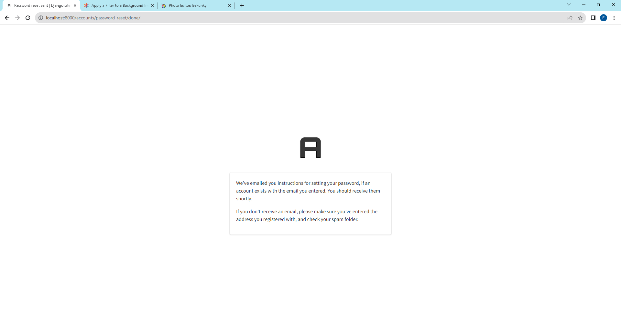
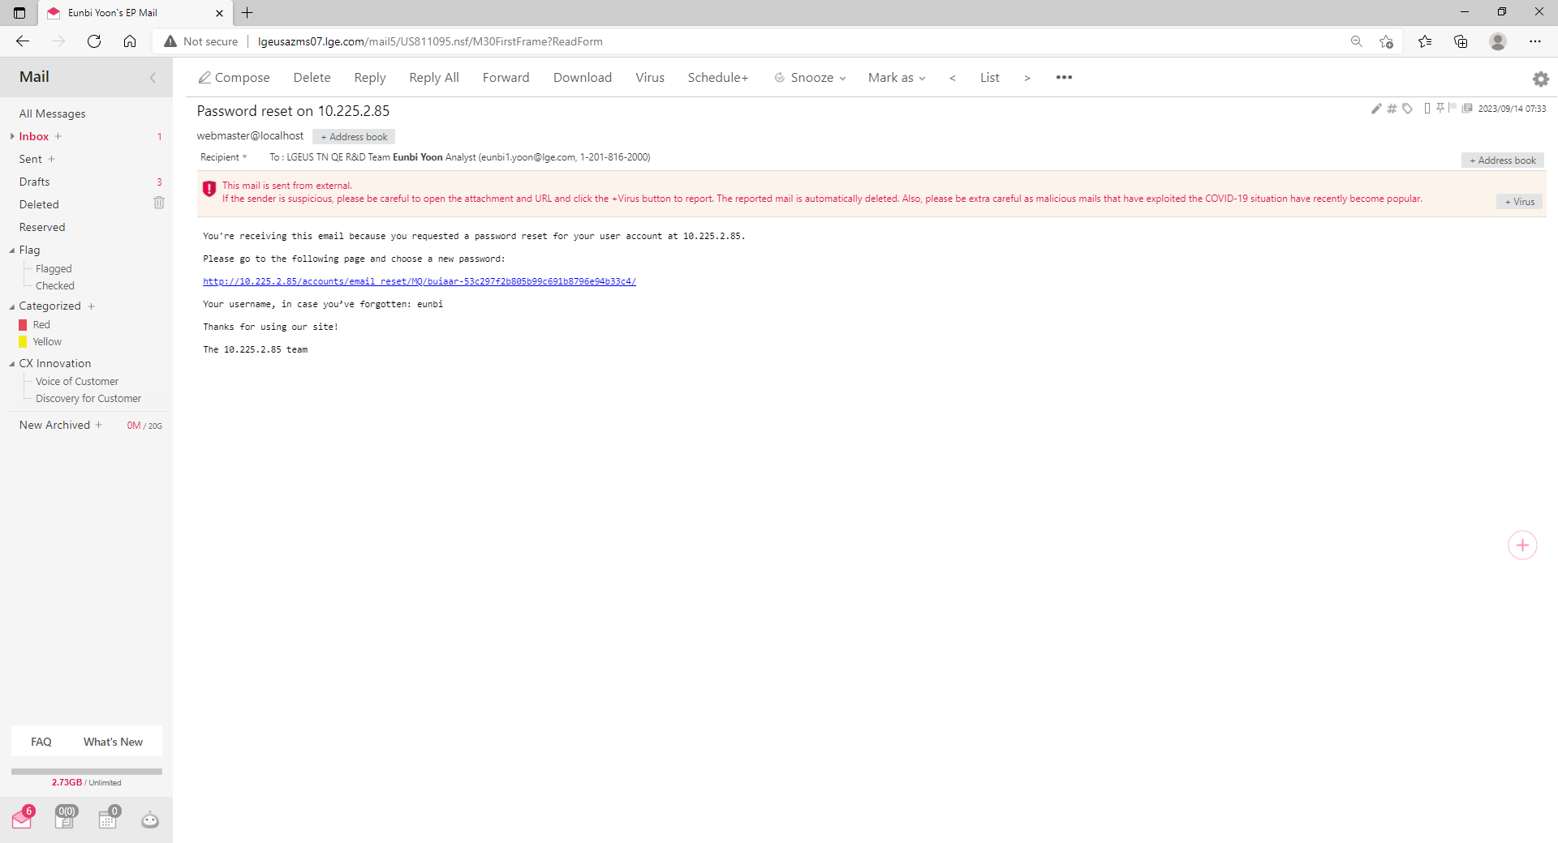
1. Sign Up, Log In Page - Forget Username/Password
If you forget password or username, please click “Forget Username/Password”. You will receive email showing username and password reset link.
When you enter email address to reset your password, it should be LG Email(@lge.com) and match with email address that you sign up.
1
2
Click to send password reset link and username information to your email
It should be matched with email that you fill when sign up.
After this, click reset my password
3
4
Subject Line: Password reset on 10.225.2.85
Password can be reset if you click this link
You can check your username
This link is valid for 10 minutes
Check email sending confirmation message

Slide 5
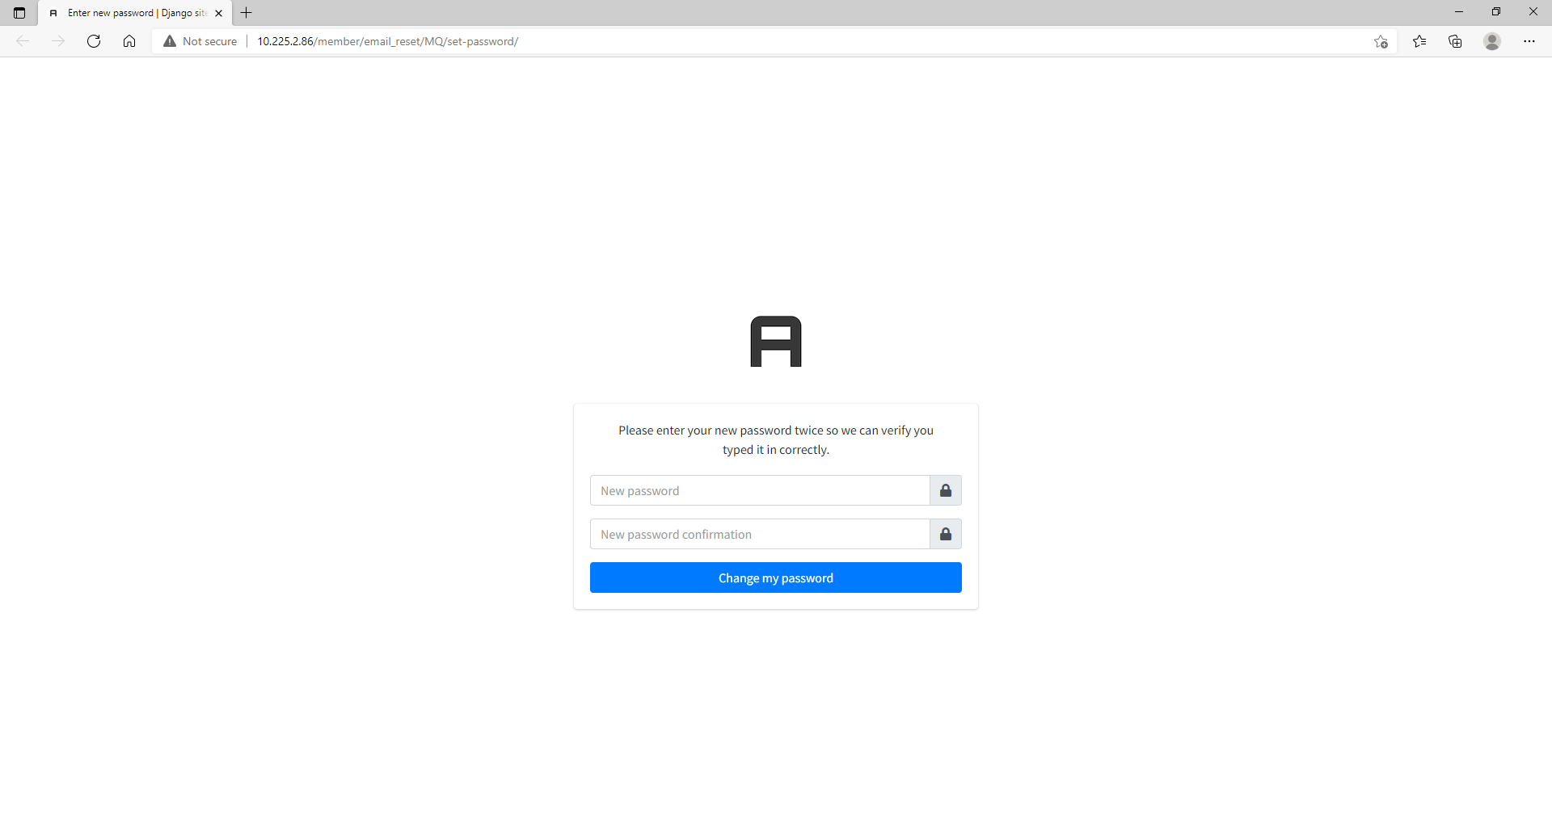
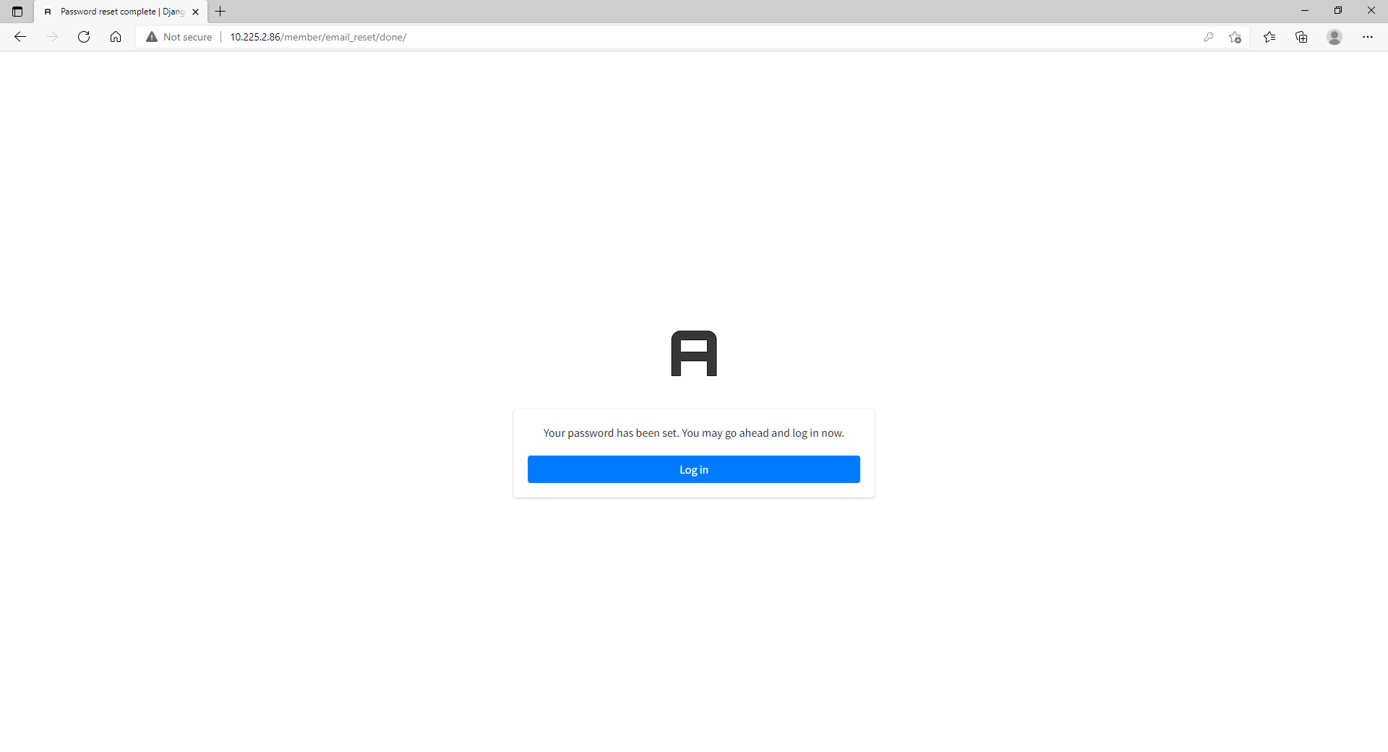

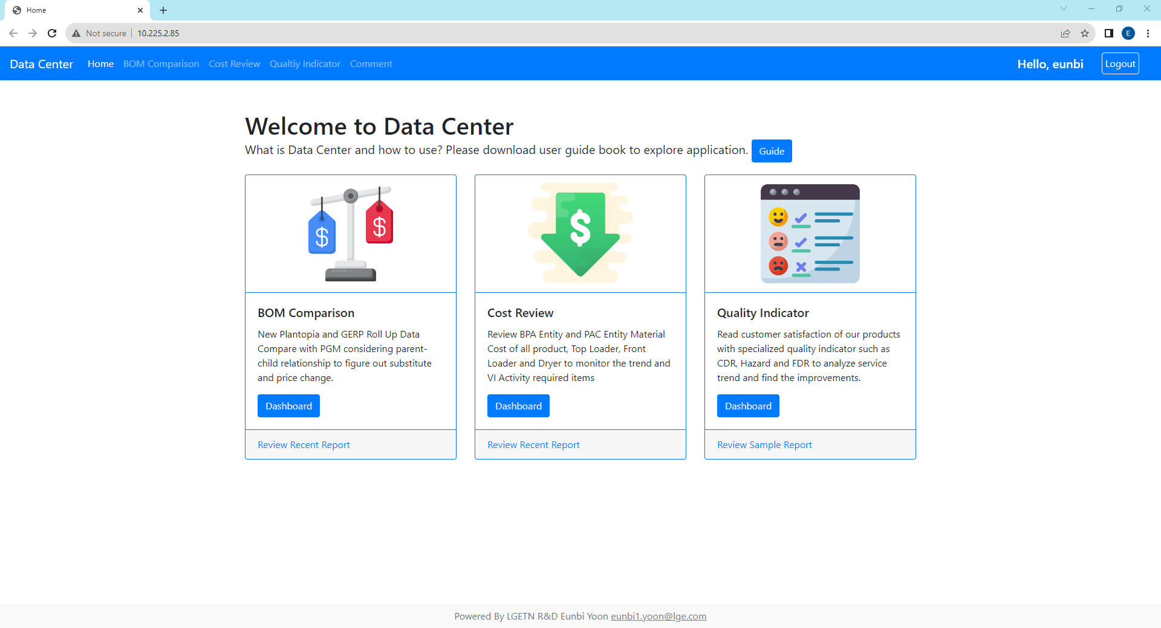
1. Sign Up, Log In Page - Forget Username/Password
Same as sign up, password should be different with username. e.g. username : user, password : user1357(X).
If this method is not working to login, you can try “Forget Username/Password” function one again and contact to eunbi1.yoon@lge.com
5
6
Enter New Password
Click the link to go to login page
7
8
Successfully login to your account
Login with new password

Slide 6

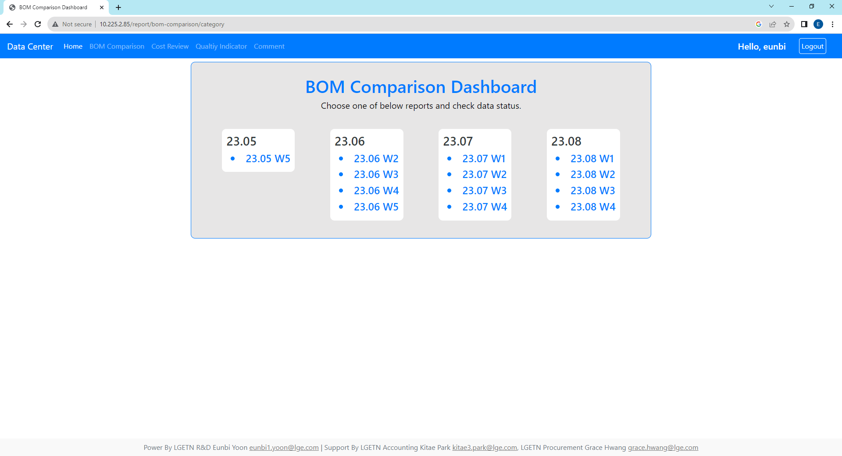
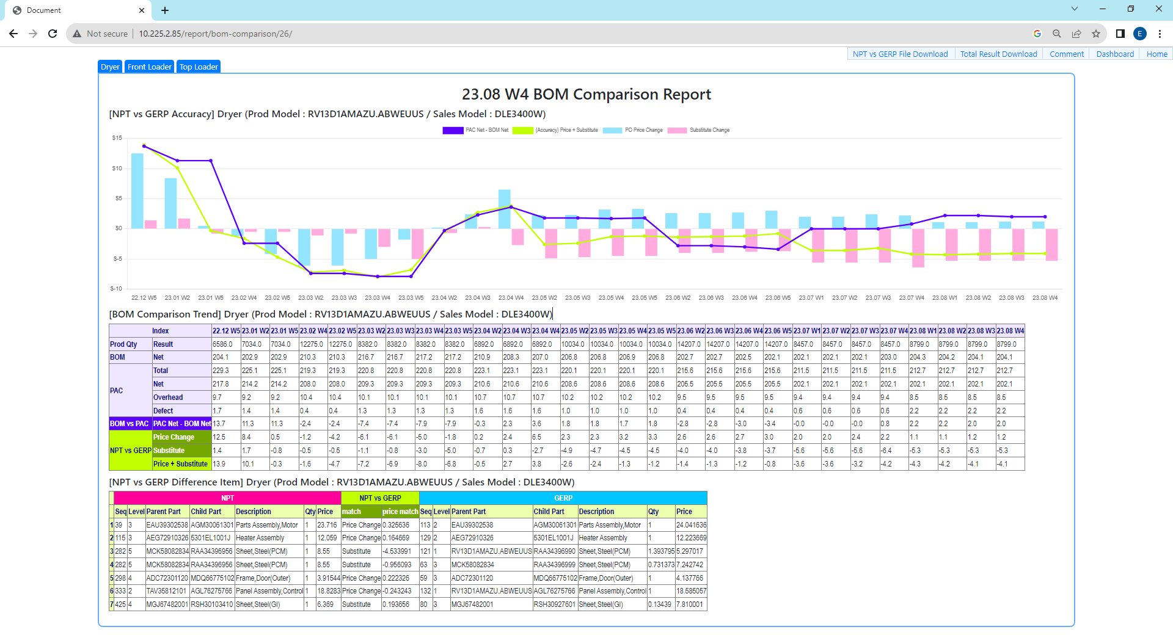
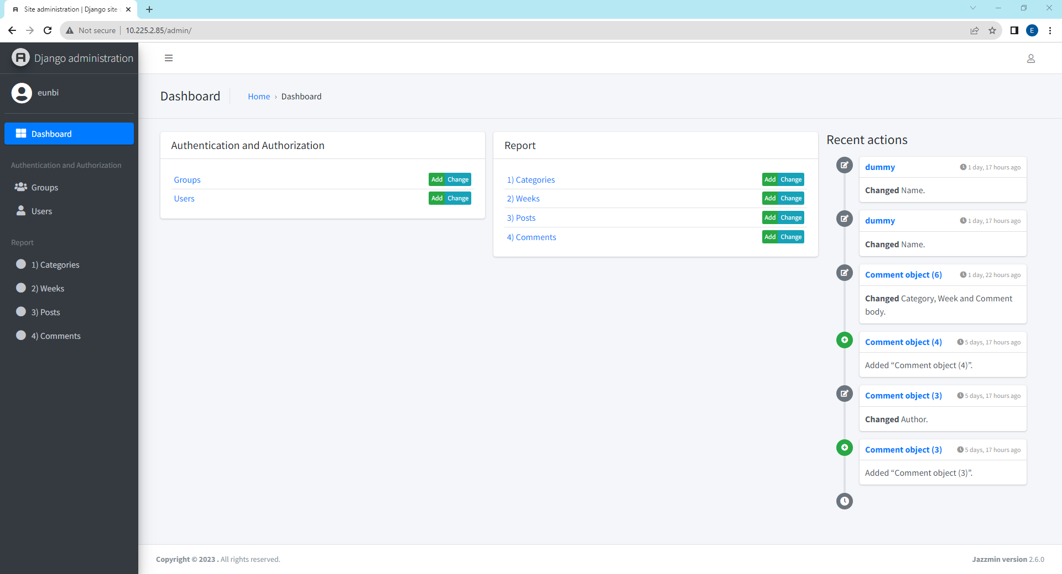
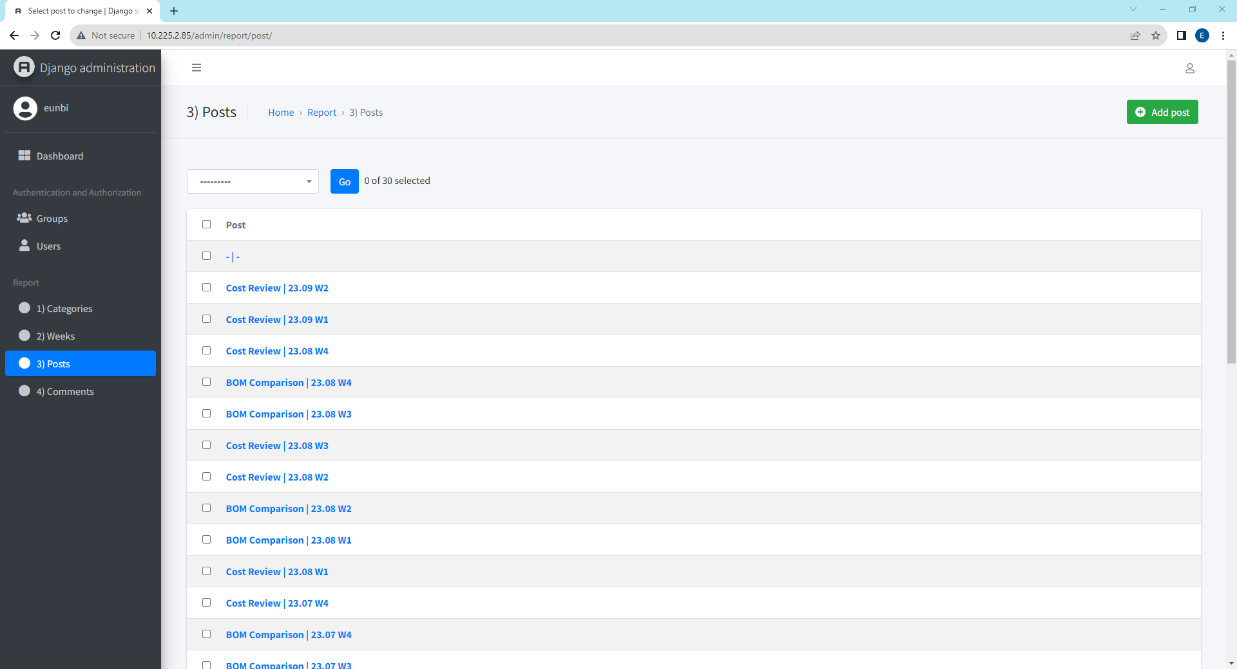
2. BOM Comparison - Report Access Methods
You can use dashboard & report below 3 methods(1. Quick Menu, 2. Dashboard, 3. Recent Report) and dashboard is updating every Friday based on weekly data
If admin want to see report history or status, add at the end of URL as “/admin” and click the BOM Comparison Data Model
Home
Dashboard
Quick Menu
Method1. Use Quick Menu
Method2. Review all report history
Method3. Recent report directly, click this
Report
Report
If the report is too big, reduce display scale(ctrl key + scroll)
Access to
http://10.225.2.85/admin
Choose “Posts” Model Database

Slide 7



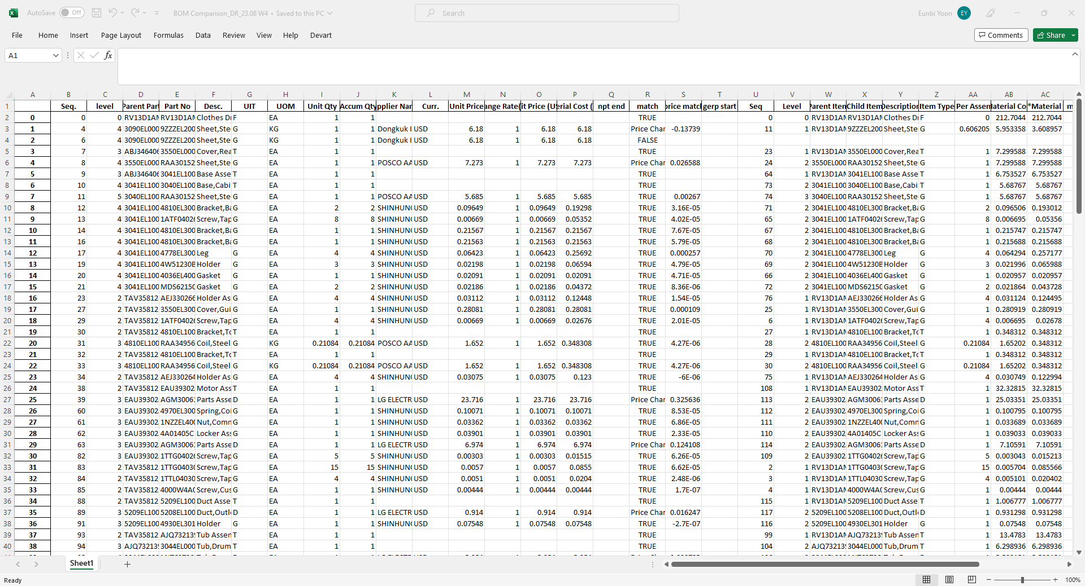
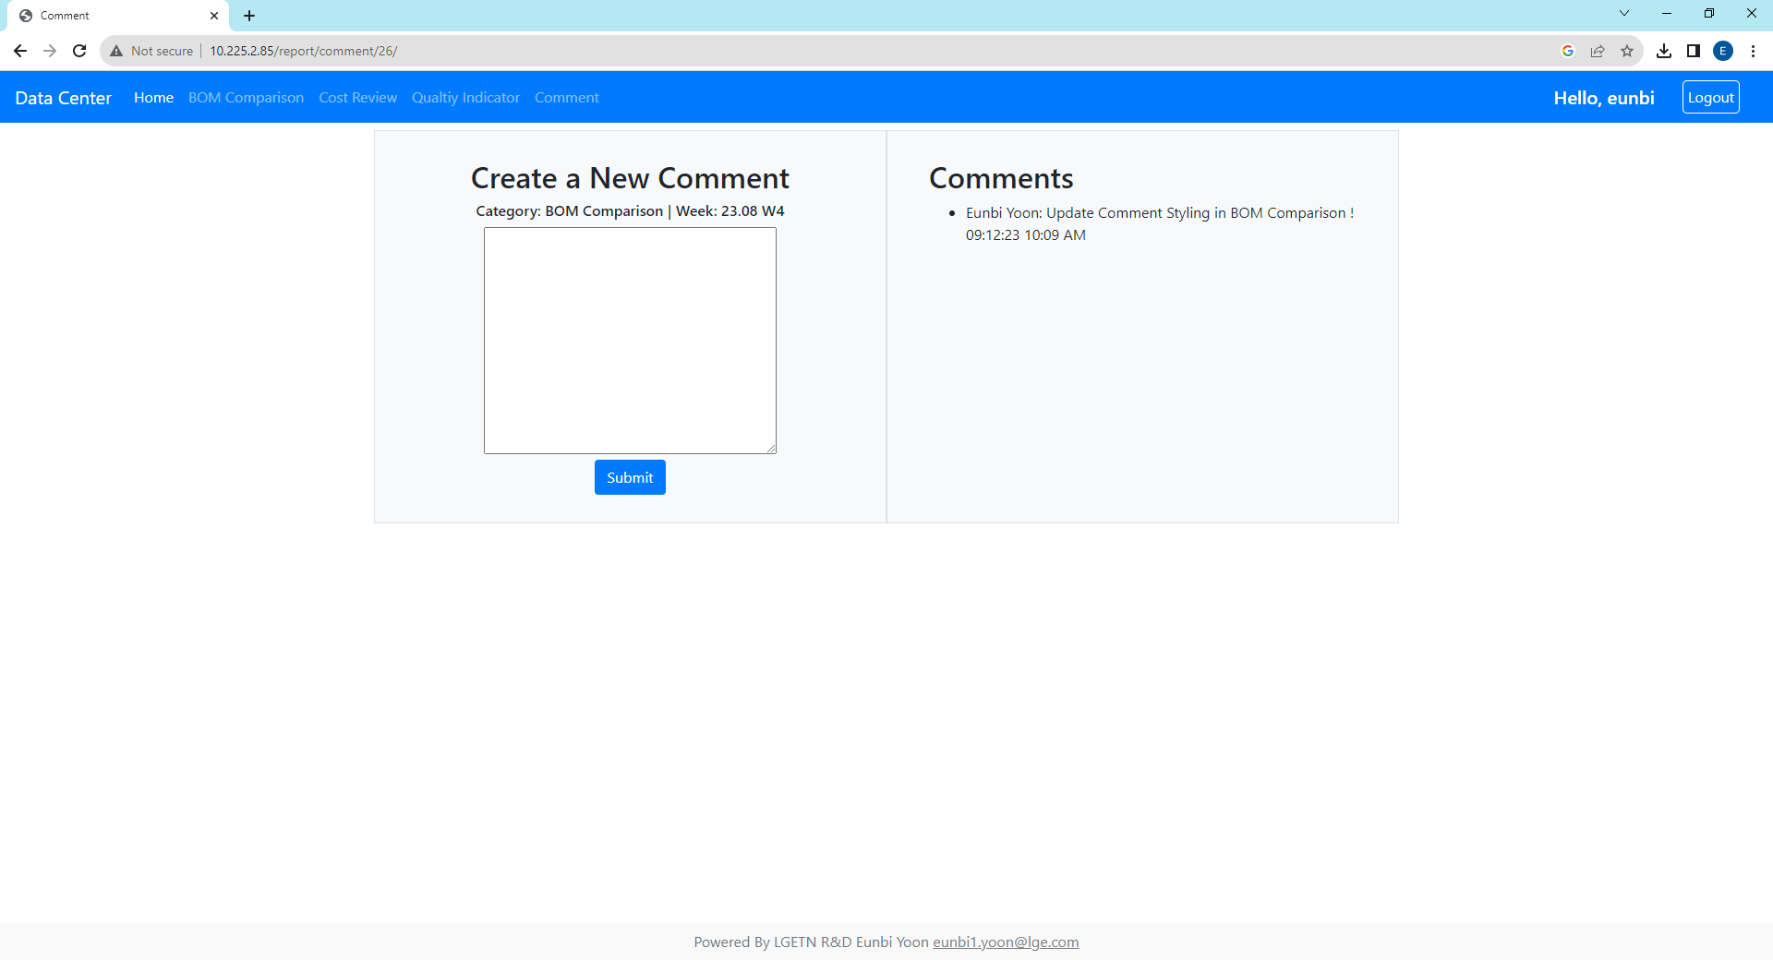
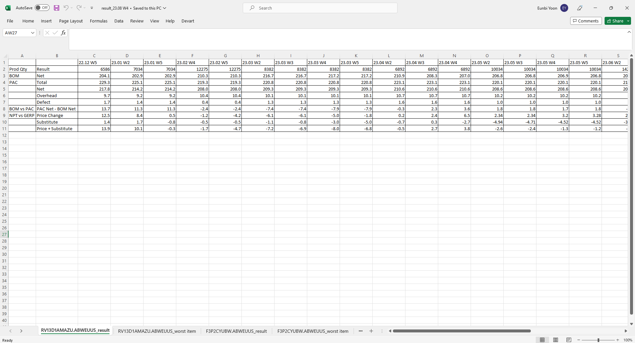
2. BOM Comparison - Side Bar
You can move to another page, export to excel or make comments. Each report’s comment page is linked with Quick Menu Comment.
When you make a comment in each report, don’t have to type category and week info since it recognized report page location.
Report
Side Bar
Back
Go Back To Dashboard
Go Back To Home
Export Data to Excel
Comment
GERP vs NPT Each Parts
Comparison Detailed
Make comments
of this report
View this report’s comments
When you click submit, comment info goes to each report comment page and quick menu comment page(you can see total comments in Data Center)
Model’s Trend and Graph

Slide 8
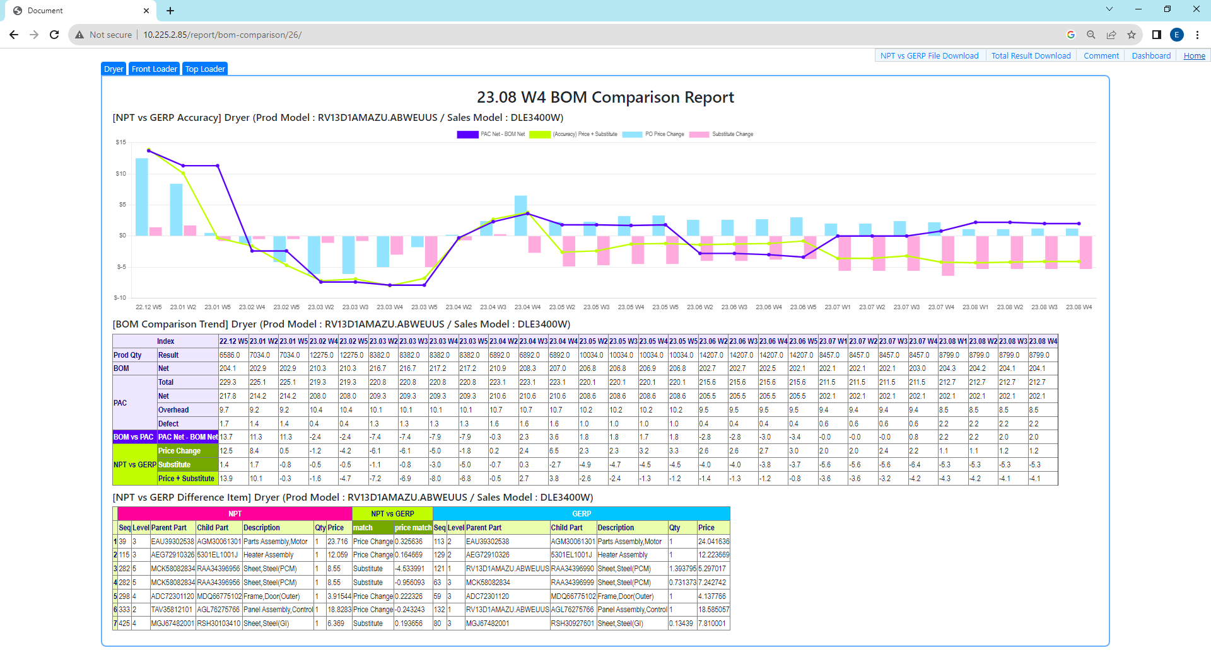
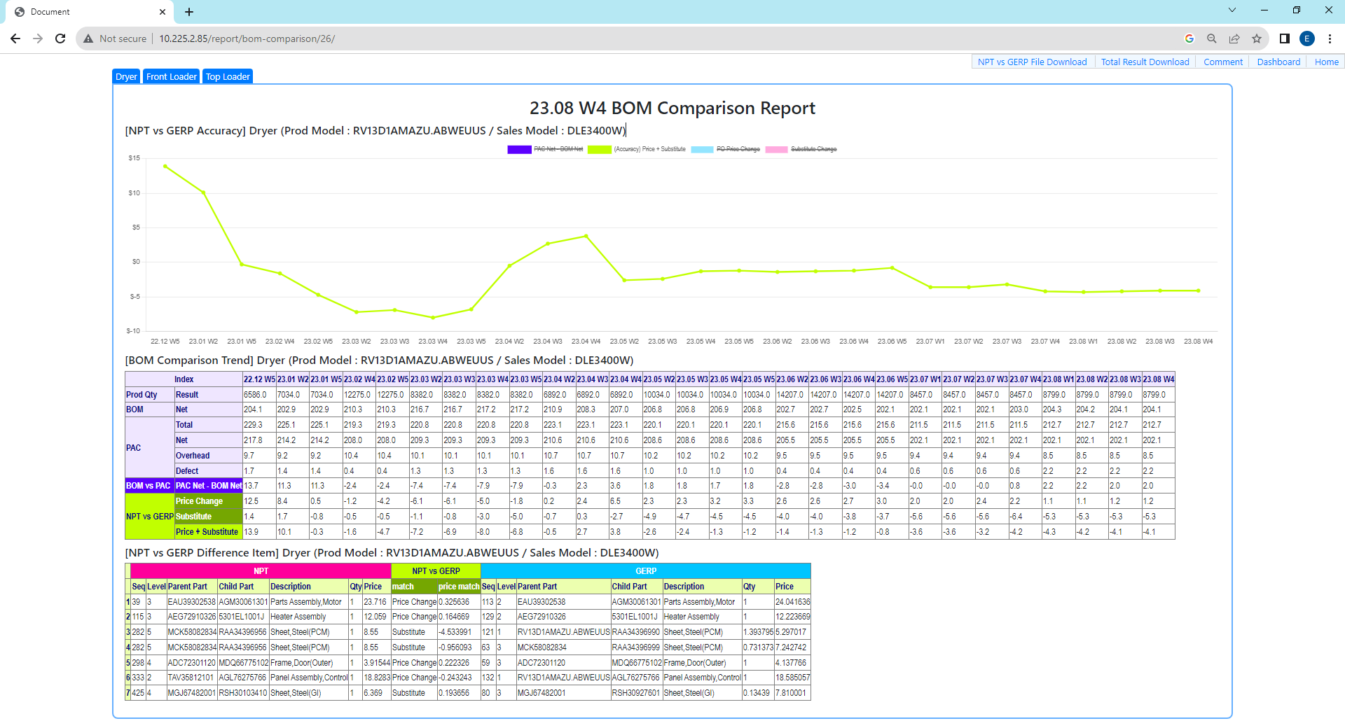
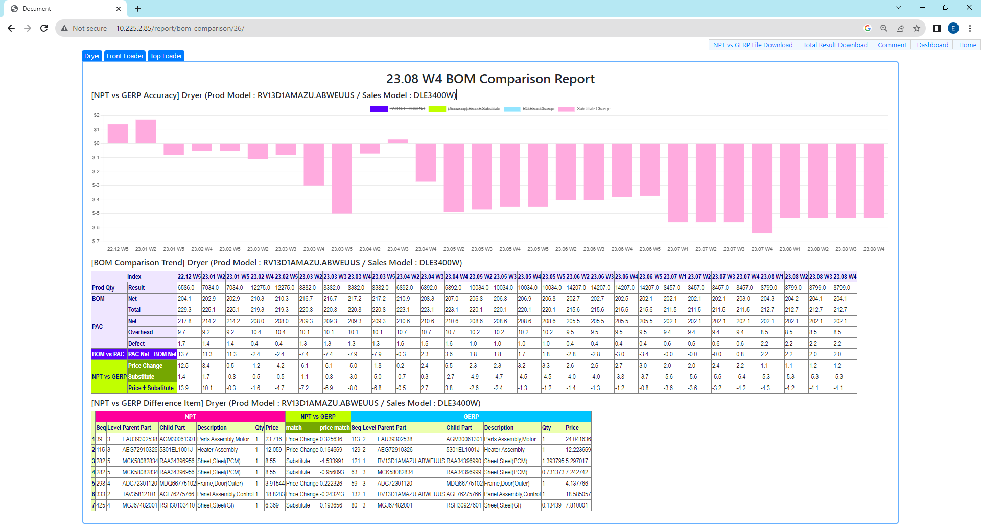
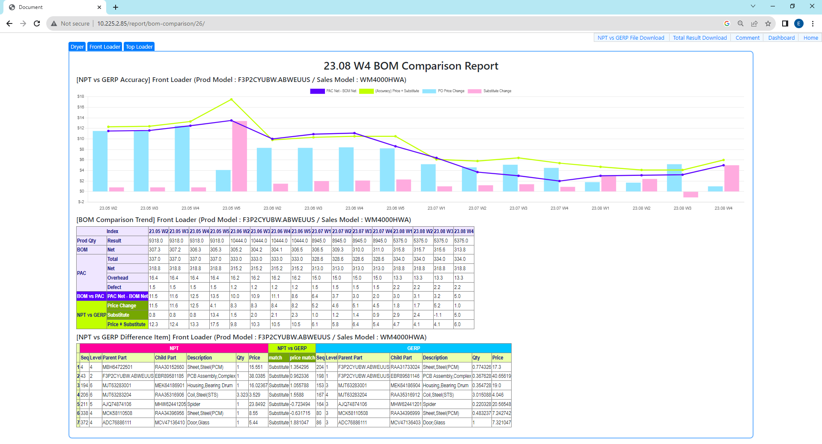
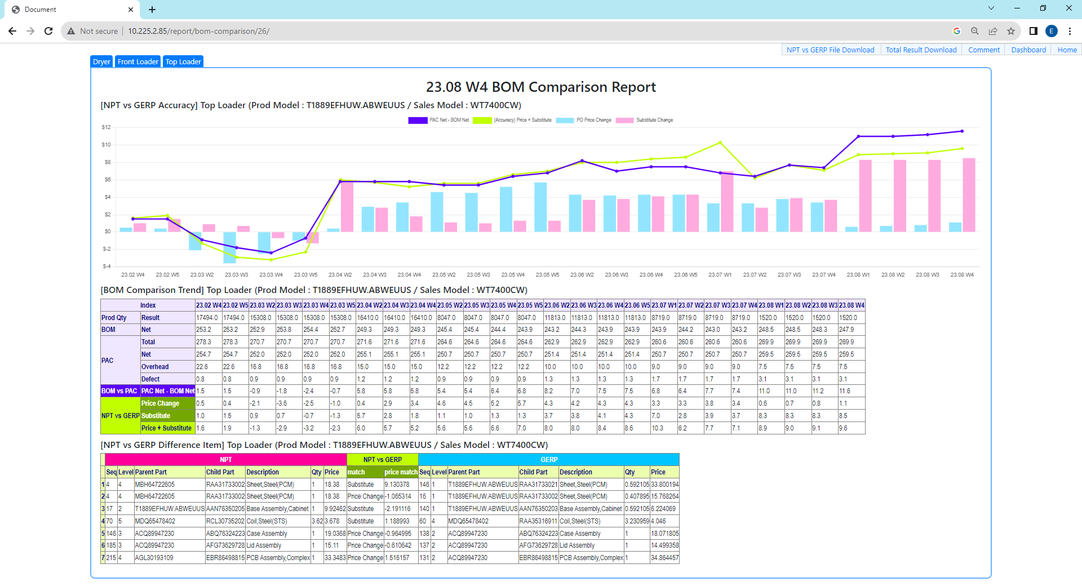
2. BOM Comparison – Data Sorting
In Model Bar, you can click model name “Front Loader”, “Top Loader”, “Dryer” and it shows representative product.
Click graph factor makes “not display” status. And if you click again, changes to “display” status. With this, compare graphs or detail graph view possible.
Graph
Model Bar
(Accuracy)
Price+ Substitute
Graph
All graph shows as “Default”. If you click graph factor, you can delete graph on the board. Axis automatically change depends on what graph is displayed.
This is good when you tried to compare some of graph or review only one trend.
Graph Factor
Substitue Change
Graph
Model
Front Loader Model
Dryer Model is setting as “Default” Model. Depends on you choose model in model bar, it will sort each model data and show
Top Loader Model

Slide 9
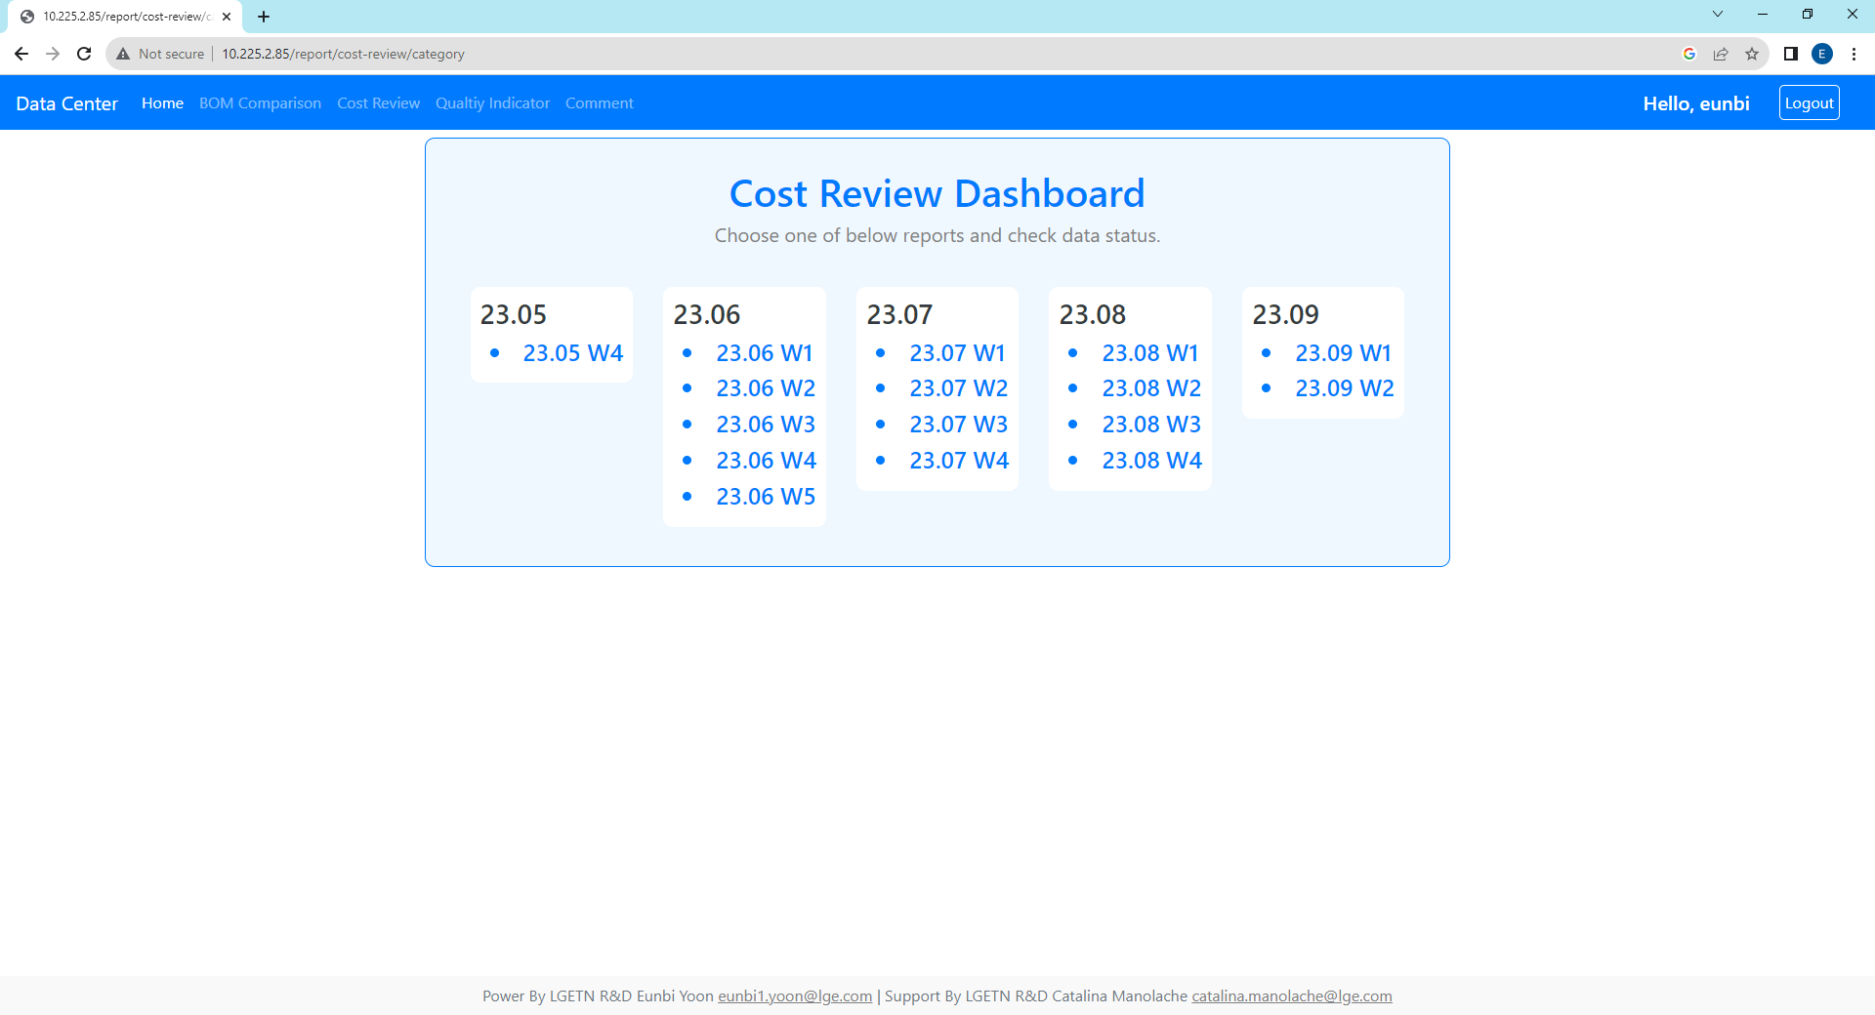
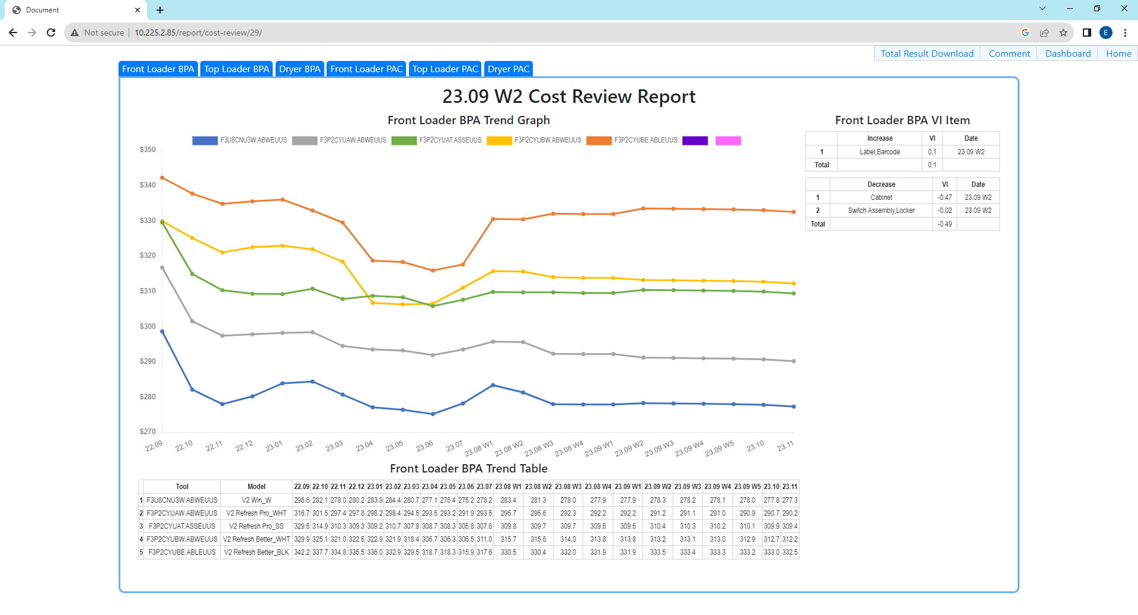
3. Cost Review - Report Access 2 Methods
You can use dashboard & report below 3 methods(1. Quick Menu, 2. Dashboard, 3. Recent Report) and dashboard is updating every Friday based on weekly data
If admin want to see report history or status, add at the end of URL as “/admin” and click the BOM Comparison Data Model
Home
Dashboard
Quick Menu
Quick Menu
Method1. Use Quick Menu
Click
Method1. Review all report history
Method2. Recent report directly, click this
Report
Report
Access to
http://10.225.2.85/admin
Choose “Posts” Model Database
If the report is too big, reduce display scale(ctrl key + scroll)

Slide 10
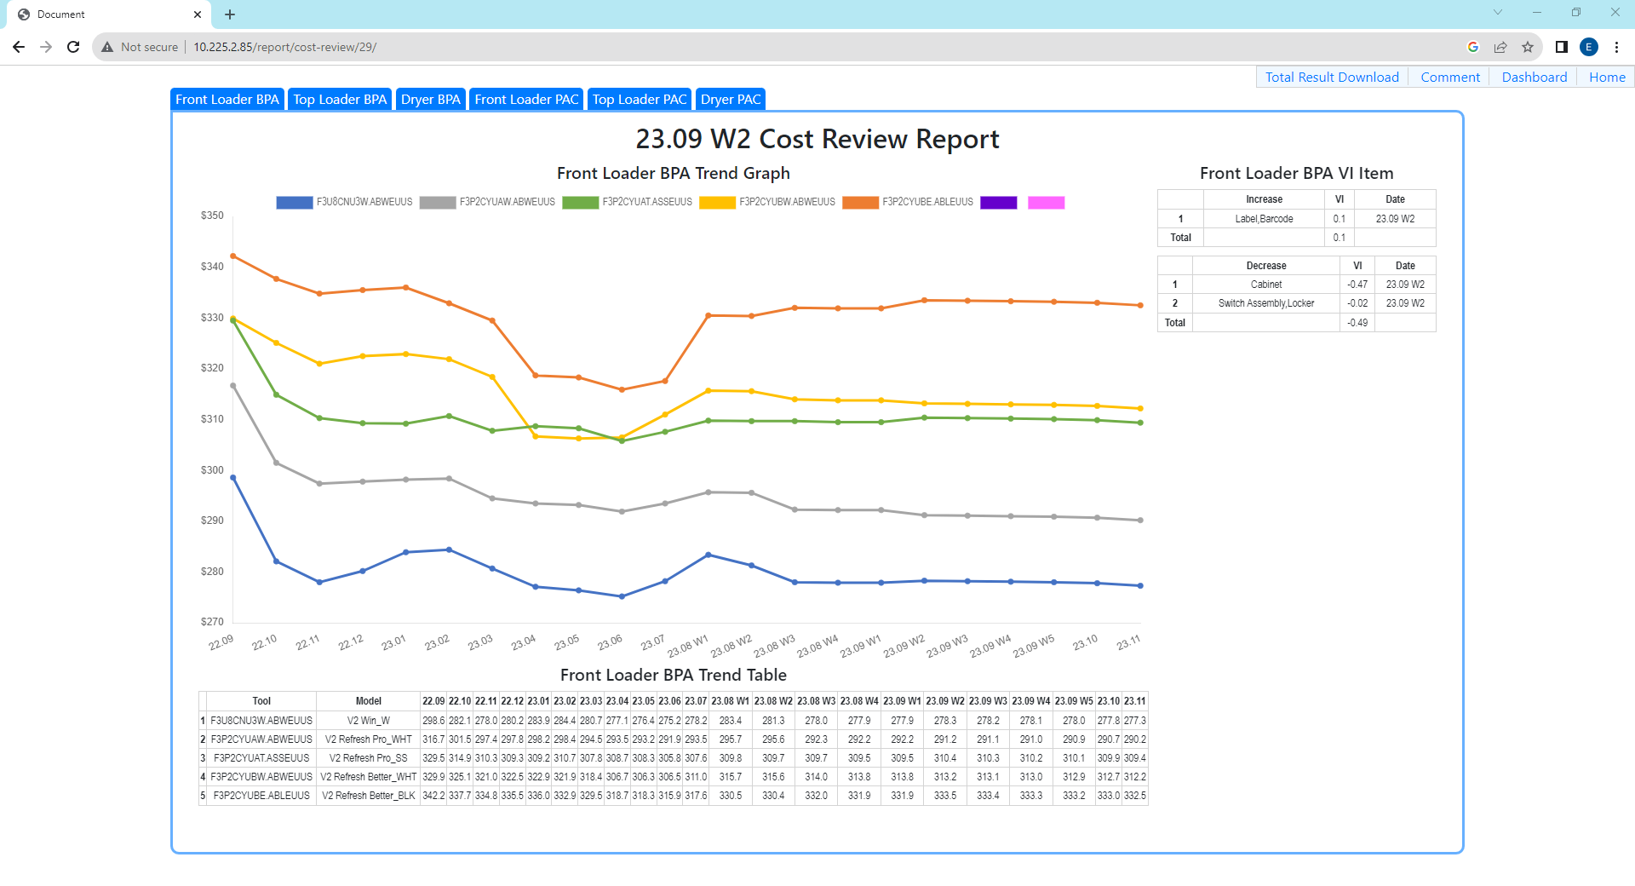

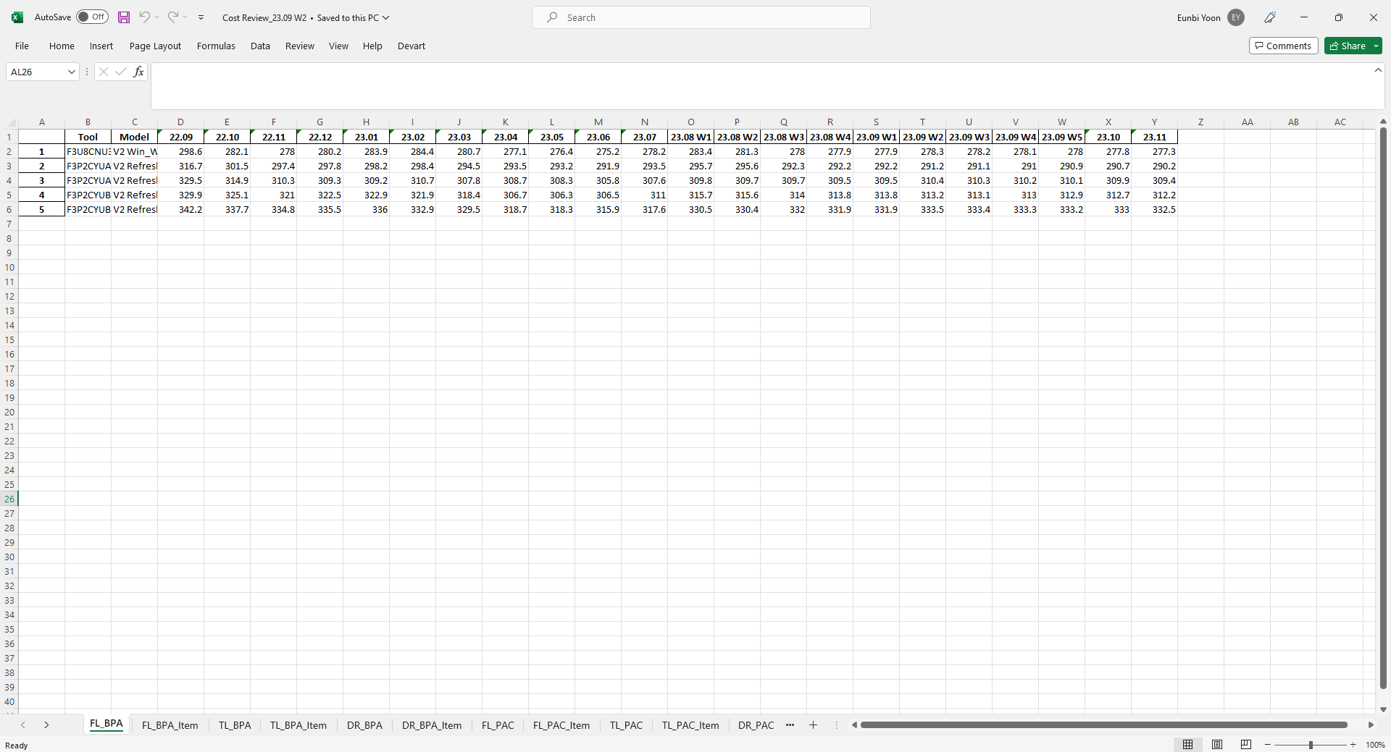
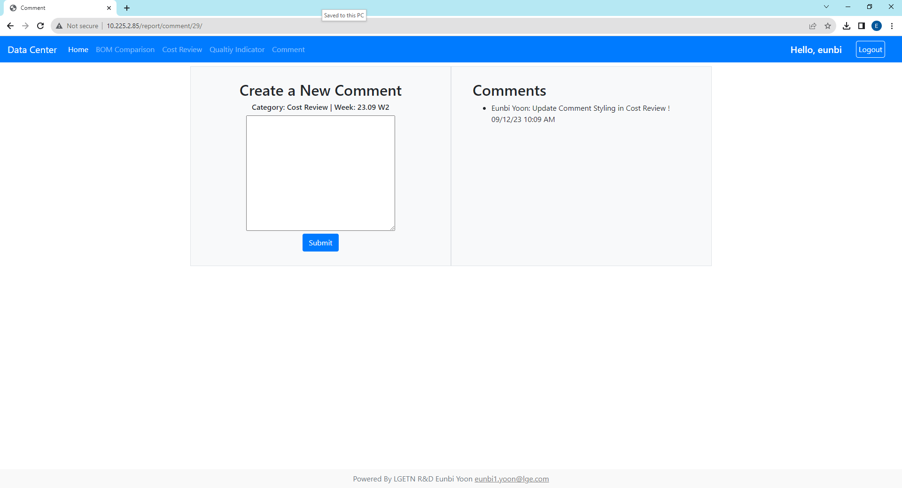
3. Cost Review - Side Bar
You can move to another page, export to excel or make comments. Each report’s comment page is linked with Quick Menu Comment.
When you make a comment in each report, don’t have to type category and week info since it recognized report page location.
Report
Side Bar
Back
Go Back To Dashboard
Go Back To Home
Export Data to Excel
Comment
Graph Trend Table Data :
It does not include “item” tag on sheet name such as “FL_BPA” sheet. “FL_BPA” sheet means Front Loader Model BPA Entity Trend. “FL_PAC” sheet means Front Loader Model PAC Entity Trend.
Make comments
of this report
View this report’s comments
Item Table Data :
It has the end “Item” Tag such as “FL_BPA_Item”. “FL_BPA_Item” sheet means Front Loader Model BPA Entity Item Table

Slide 11

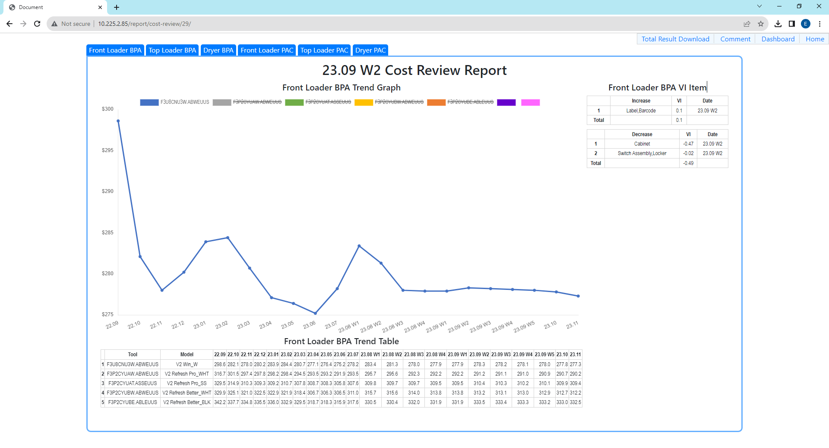
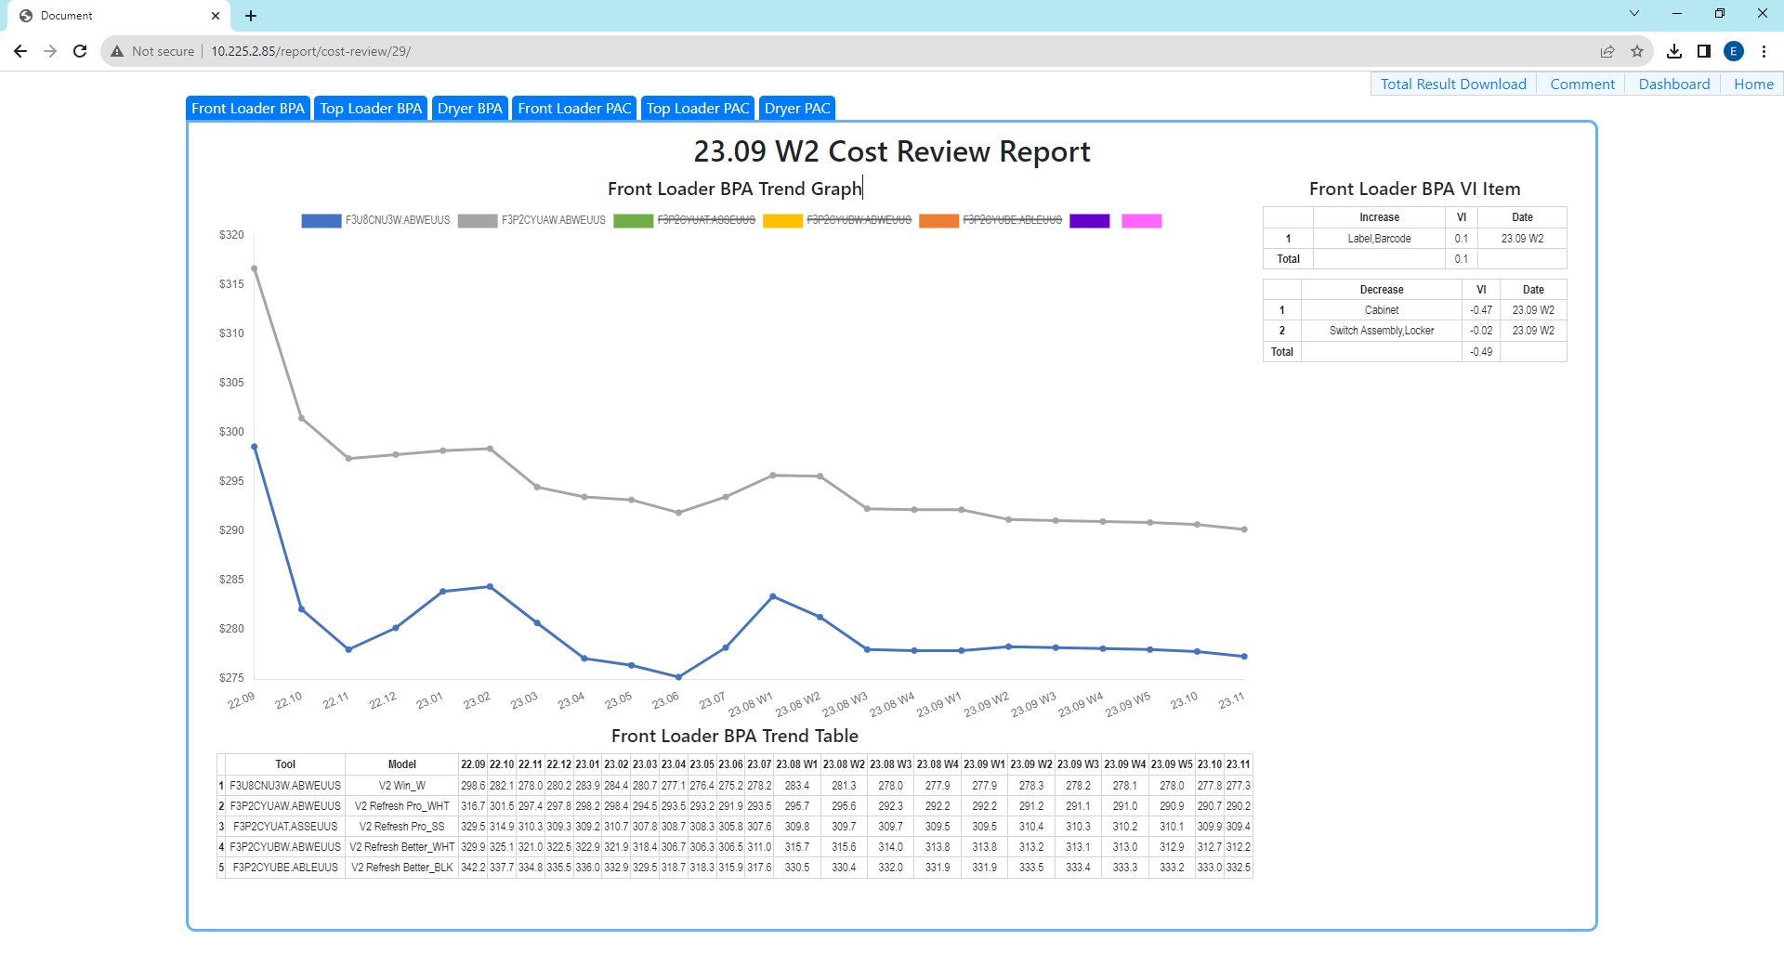
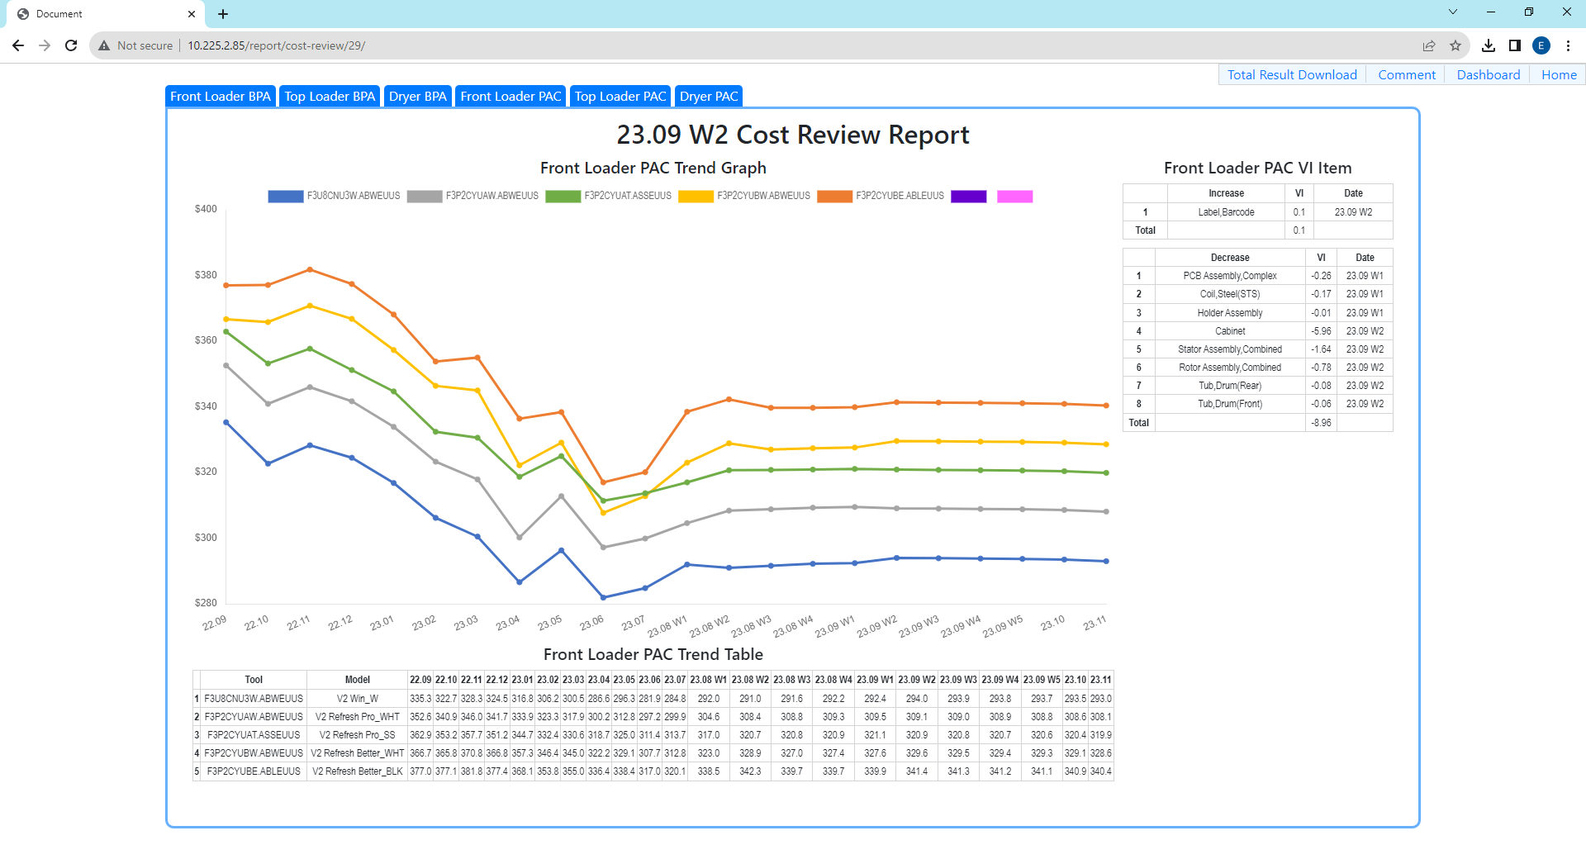
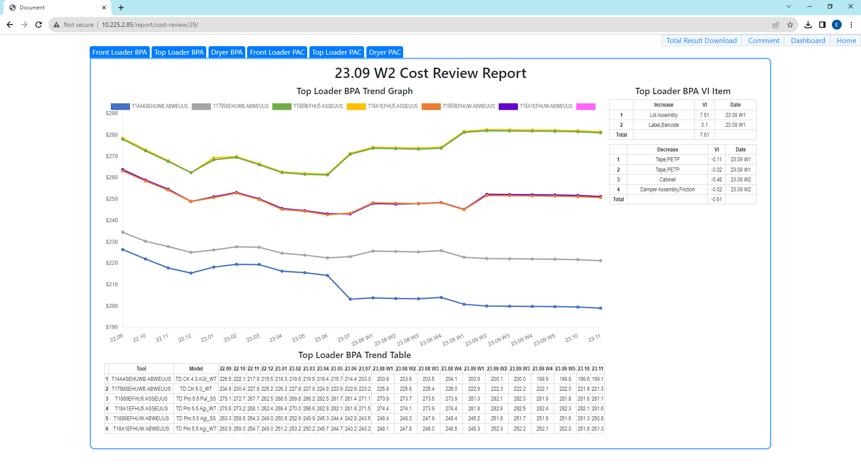
3. Cost Review - Data Sorting
In Model Bar, you can click model name “Front Loader BPA”, “Top Loader PAC” and it shows all of Front Loader Model BPA Entity, Top Loader Model PAC Entity
Click graph factor makes “not display” status. And if you click again, changes to “display” status. With this, compare graphs or detail graph view possible.
Model Bar
Graph
F3U8CNU3W.ABWEUUS
Model BPA Entity Graph
All graph shows as “Default”. If you click graph factor, you can delete graph on the board. Axis automatically change depends on what graph is displayed.
This is good when you tried to compare some of graph or review only one trend.
Graph Factor
Model
Compare BPA Entity Between F3U8CNU3W.ABWEUUS
Model & F3P2CYUAW.ABWEUUS
Front Loader Model PAC Entity
Front Loader Model BPA Entity is setting as “Default” Model. Depends on you choose model in model bar, it will sort each model data and show
Top Loader Model BPA Entity

Slide 12
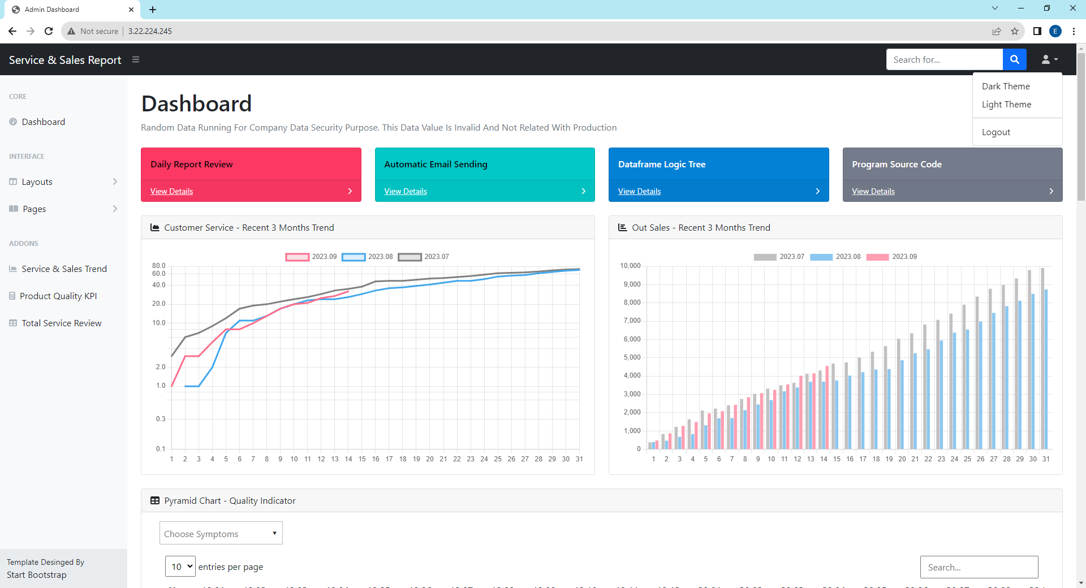
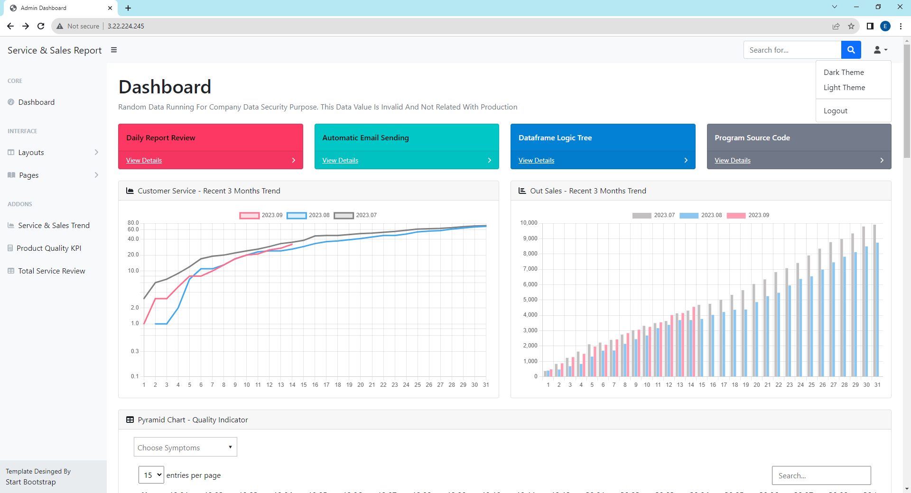
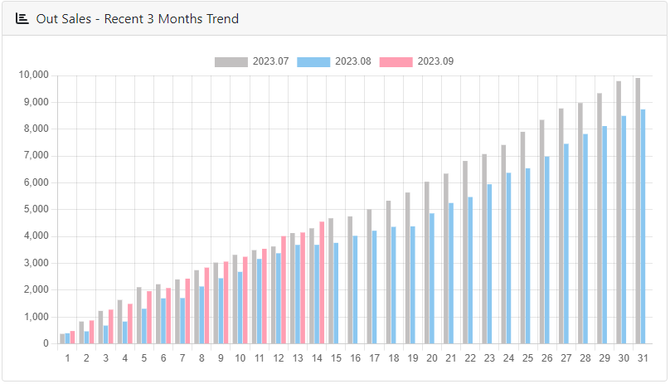
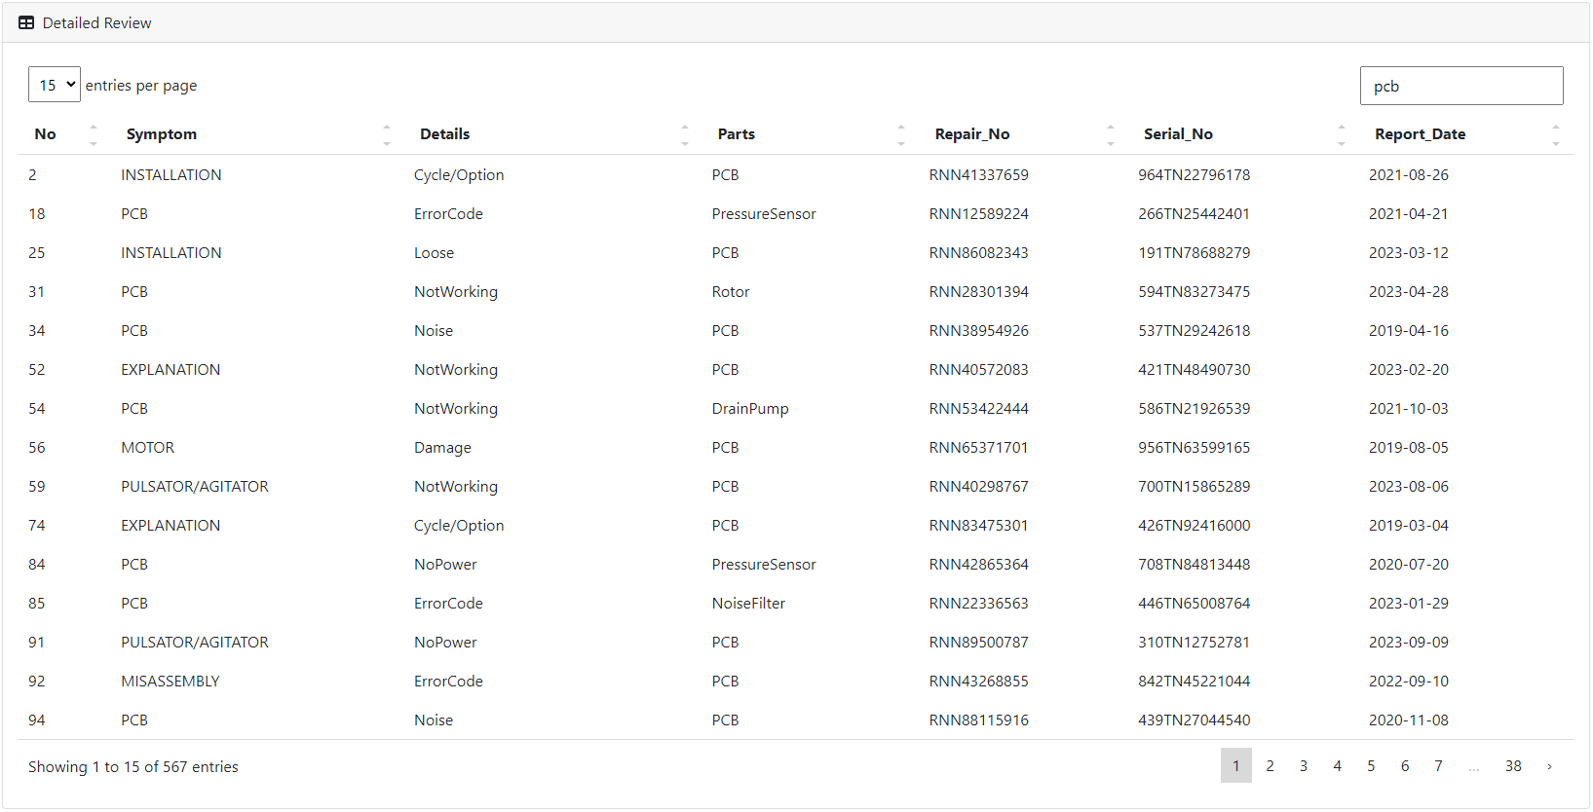
4. Quality Indicator - Features
This is just sample report so far. But all features are setting up already and UI/UX can change depends on data save & read method and user’s testing results.
The data in this dashboard is randomly generated whenever you refresh page so it could feel slow when you first access to webpage and data filtering.
Error Page, Sidebar Theme Page
Dark Theme
Light Theme
Dark Theme
Light Theme
Divide Main Page
Depends on tools
Decide how many table rows in a page
Type table searching
v
Graph Factor Click : Not Display
Graph Factor Click Again: Display
Service & Sales Trend
When you type in search bar, it finds searching data in all columns.
Graph Factor Sorting
Table Search & Page Setting
Depends on how many rows in page, the count of page is changed
v
Click forward page to see next day

Slide 13
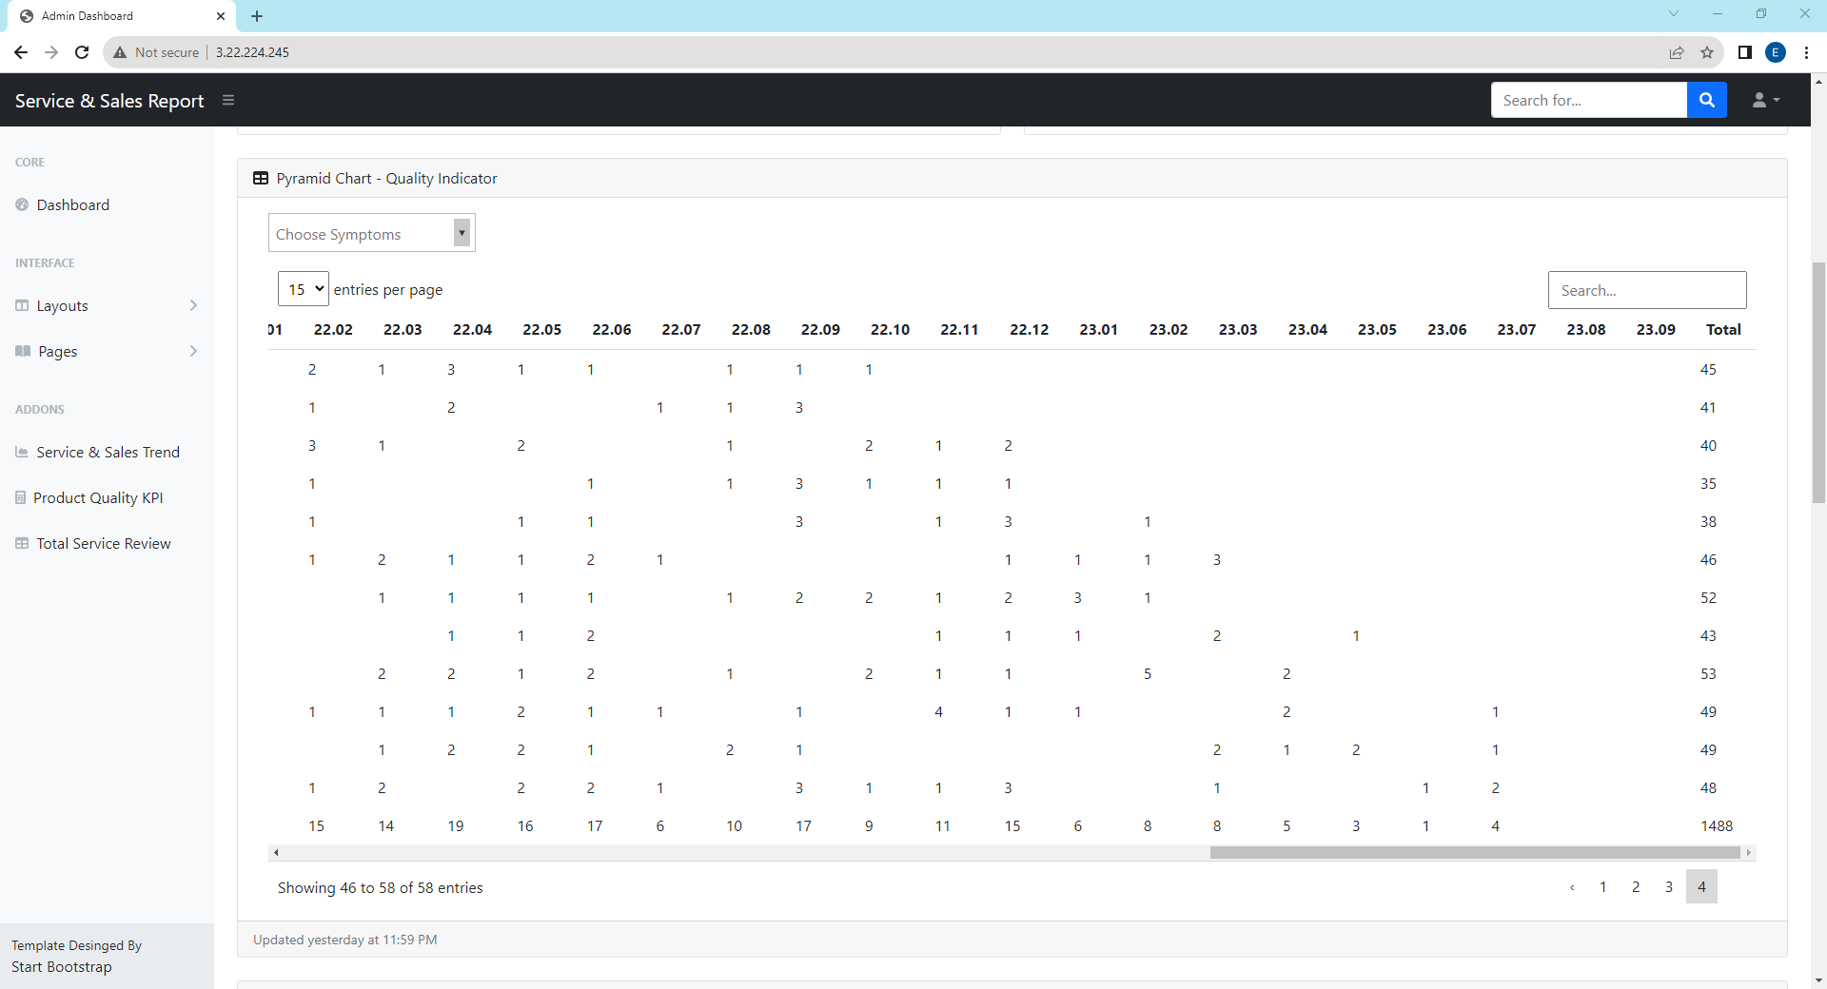
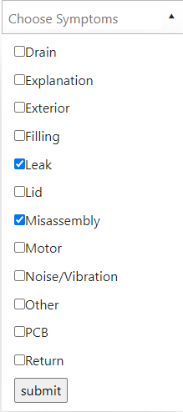
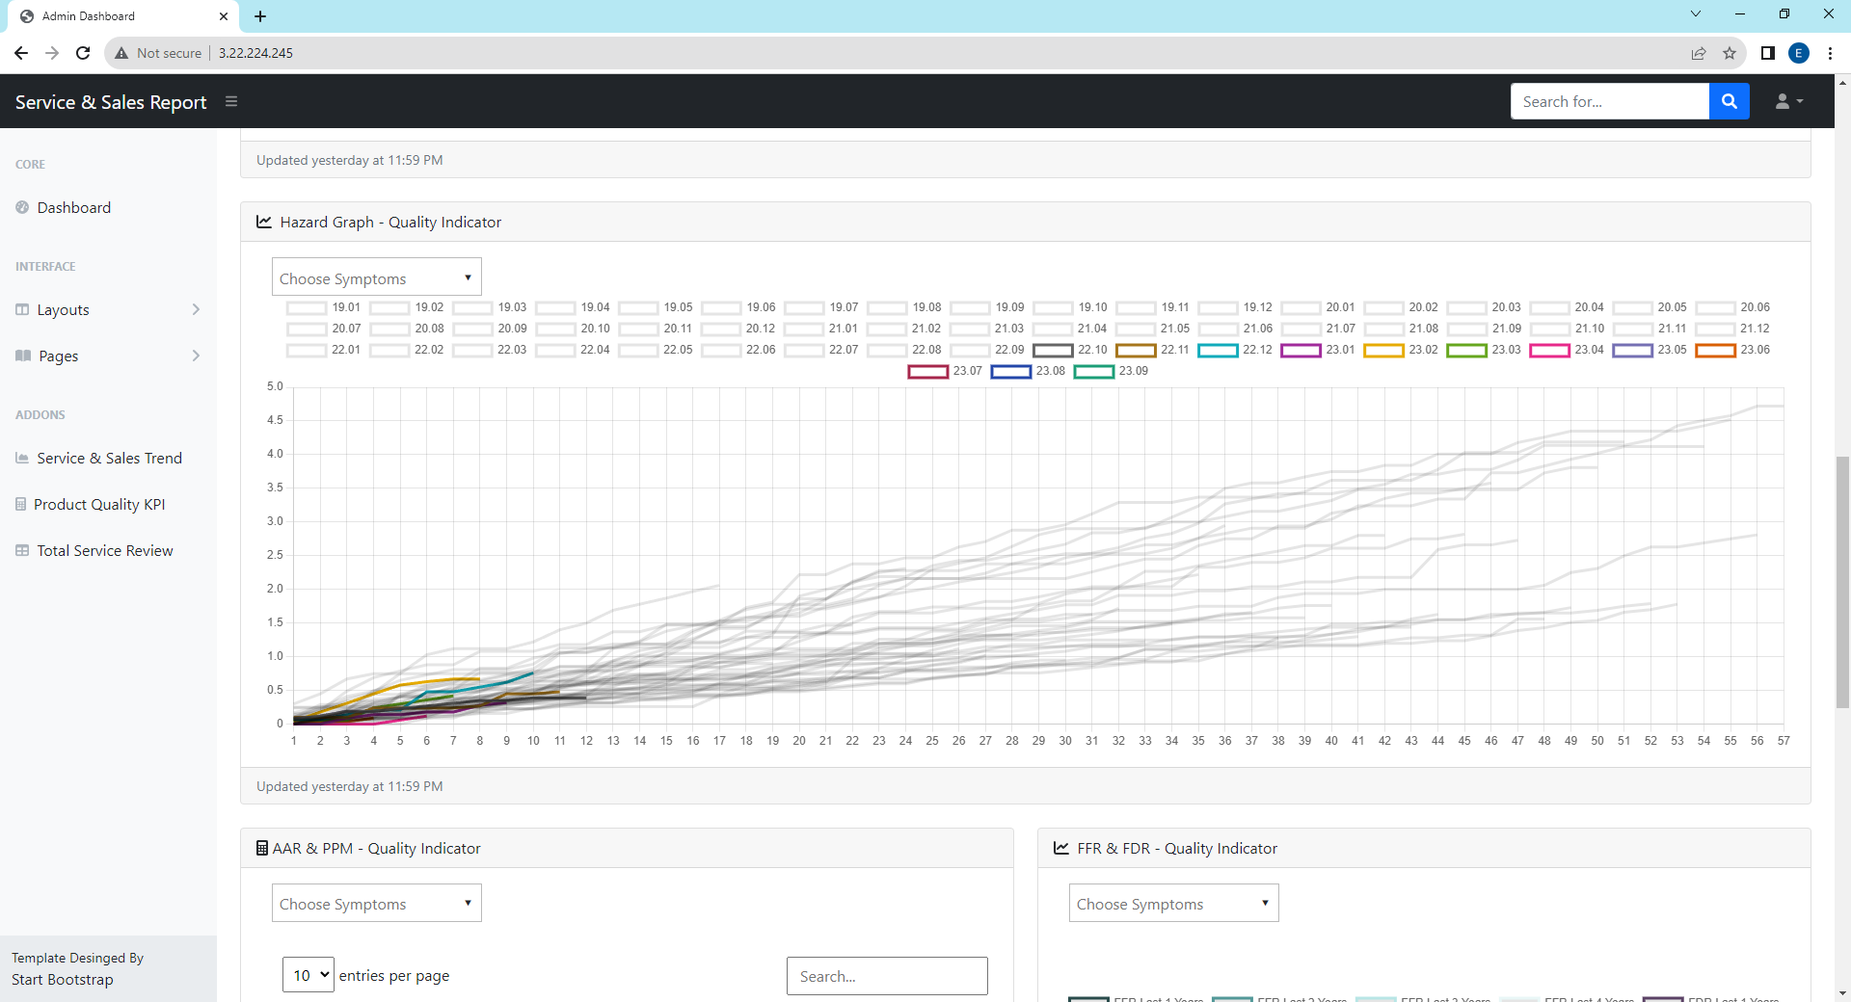
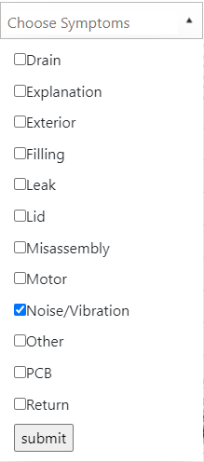
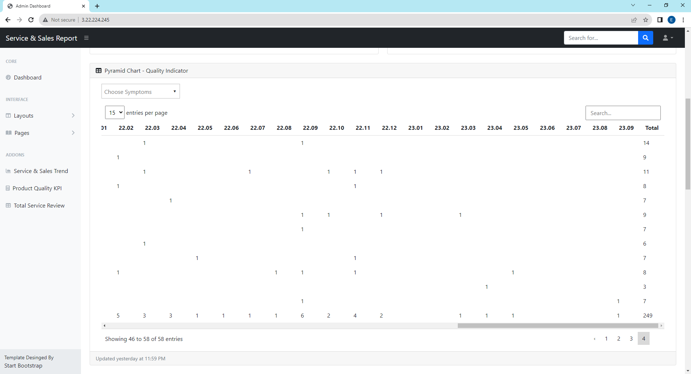
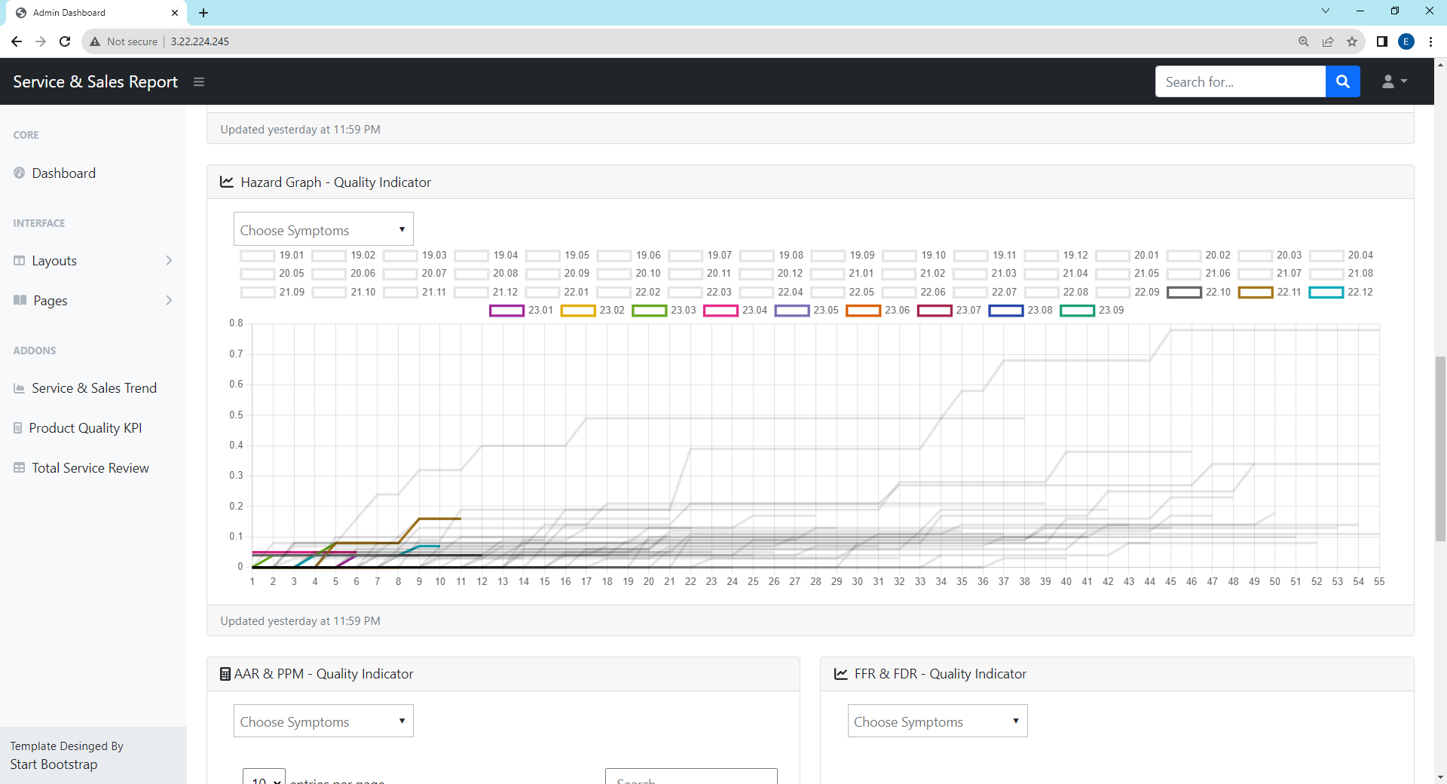
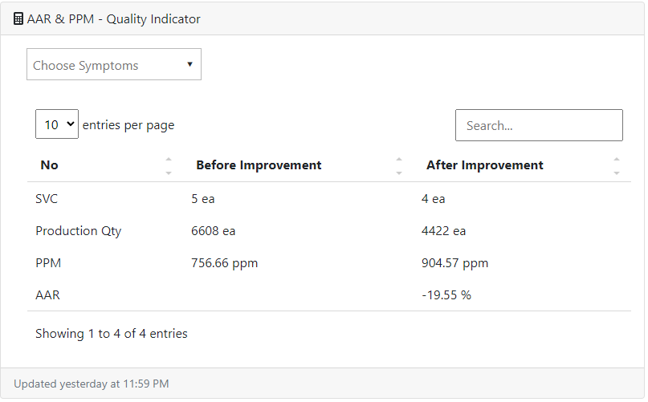
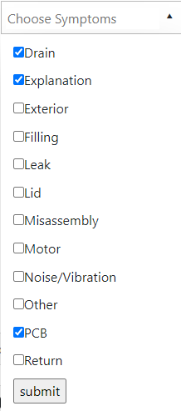
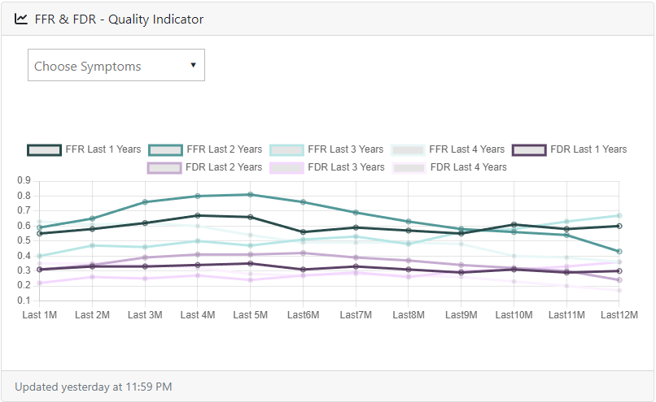
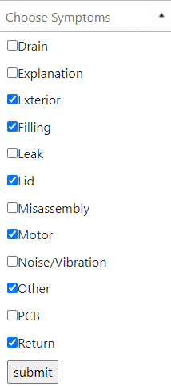
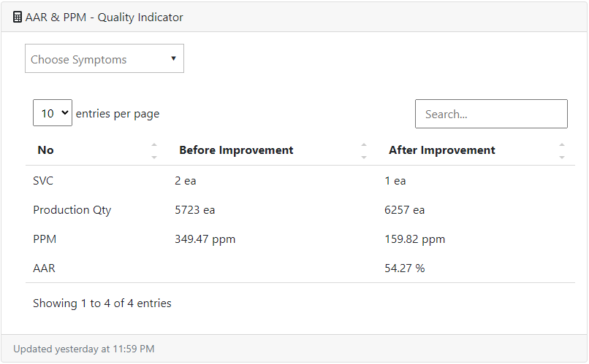

4. Quality Indicator - Data Filtering & Calculation
You can sort by symptom about Product Quality KPI (pivot table, hazard graph, AAR & PPM, FFR & FDR). For this, access to Main or Product Quality KPI Page.
After check symptom to click submit, please wait seconds for calculation. It calculated whenever you hit submit button. Press Cntrl+F5 key to refresh filter.
Pivot Table
Hazard Graph
AAR & PPM
FFR & FDR

Slide 14




5. Comment Page - View, Add
When you make comments in each report, all comments in data center are connected and you can see in Quick Menu Comment. Reverse case as well.
When you make comments in quick menu comment page, each report’s side bar comment page shows your comment also if the comment’s report location is same.
Click
Total Comment
Each Report Comment
Side Bar
Quick Menu
Add Comment in Comment Page
Add Comment in Report Page
Choose Report Category for your comment. If you just want to put general comment without related with report, then choose “dummy”
After Submit, if you go to comment page, you can see your comments has been added
Type your comment
Directly connect with comment page. And new comment is added
All fields are required to fill out.
If not, it shows error message

Slide 15



5. Comment Page - Detail, Edit, Delete
Because of space, comment page shows summary of comment body. If you want to see detail comment, click the blue letter on the top.
It describes report info(category, week), commenter and comment date. Only requester edit or delete, admin does not have authority to change comments.
Click
Comment
Detail Comment View
Quick Menu
You can only see “Edit” and “Delete” button on your post even though you have an “Admin” authority.
Edit Comment View
Delete Comment View
Check comment information and if you click this button, it is finally deleted.

