Slide 1

24.10.24
U-Boot_project
Eunchan Kim

Slide 2
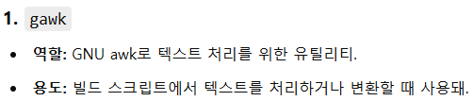
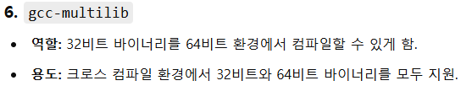
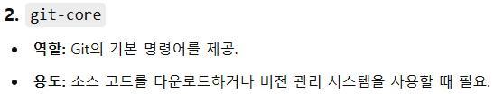
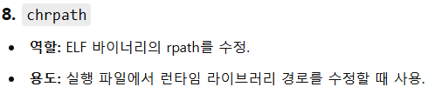
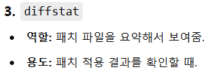
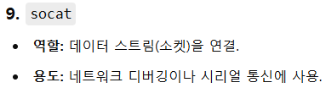
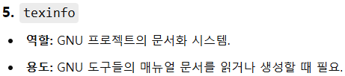
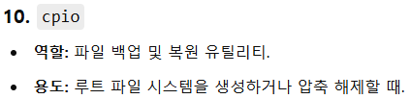
Arm crossbuild set-up
$ sudo apt-get install gawk git-core diffstat unzip texinfo gcc-multilib build-essential chrpath socat cpio python-setuptools python3-pip python3-pexpect xz-utils debianutils iputils-ping python3-git python3-jinja2 libegl1-mesa libsdl1.2-dev xterm rsync curl zstd lz4 bison flex libssl-dev libgnutls28-dev

Slide 3
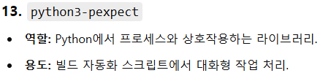
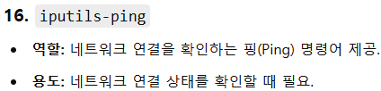
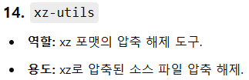
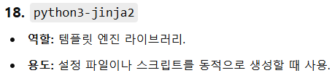
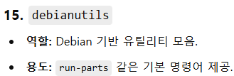
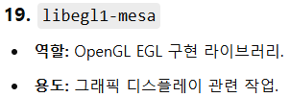
Arm crossbuild set-up
$ sudo apt-get install gawk git-core diffstat unzip texinfo gcc-multilib build-essential chrpath socat cpio python-setuptools python3-pip python3-pexpect xz-utils debianutils iputils-ping python3-git python3-jinja2 libegl1-mesa libsdl1.2-dev xterm rsync curl zstd lz4 bison flex libssl-dev libgnutls28-dev

Slide 4
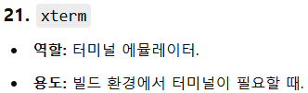
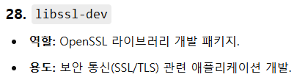
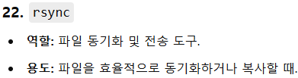

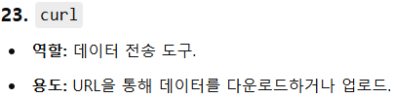
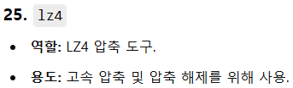
Arm crossbuild set-up
$ sudo apt-get install gawk git-core diffstat unzip texinfo gcc-multilib build-essential chrpath socat cpio python-setuptools python3-pip python3-pexpect xz-utils debianutils iputils-ping python3-git python3-jinja2 libegl1-mesa libsdl1.2-dev xterm rsync curl zstd lz4 bison flex libssl-dev libgnutls28-dev

Slide 5
Arm crossbuild set-up
sudo apt install crossbuild-essential-armhf
=> Arm 32bit 툴체인

Slide 6
/boot/firmware/cmdline.txt /boot/firmware/

Slide 7
U-boot 소스코드 다운

Slide 8
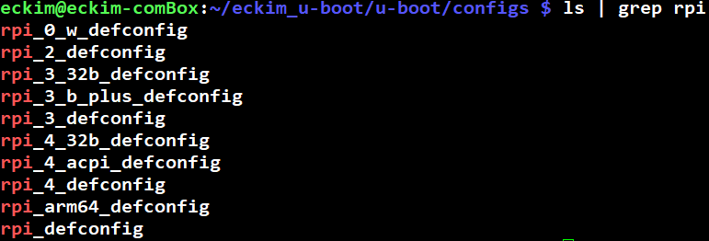
U-boot build
Rpi4 32bit build를 위한 config 파일
cpu architecture를 정의한 .config 파일 생성
make ARCH=arm CROSS_COMPILE=arm-linux-gnueabihf- rpi_4_32b_defconfig
make ARCH=arm CROSS_COMPILE=arm-linux-gnueabihf- all
Bootloader build

Slide 9
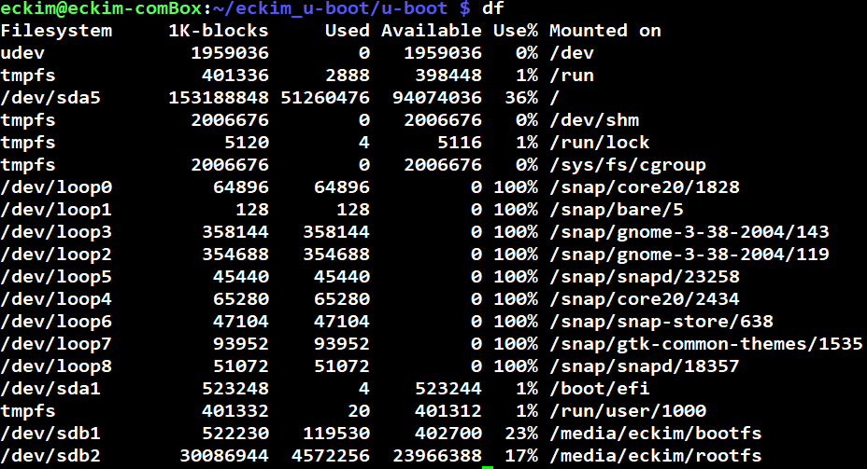
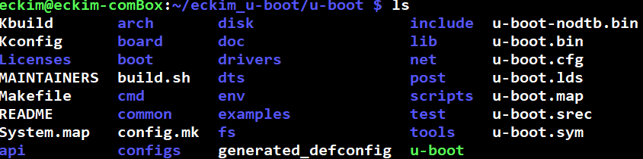
/boot/config.txt

Slide 10
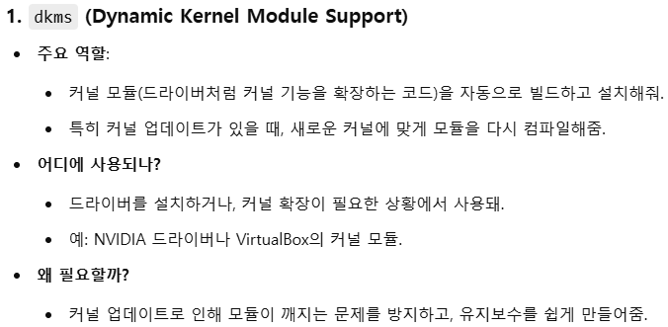
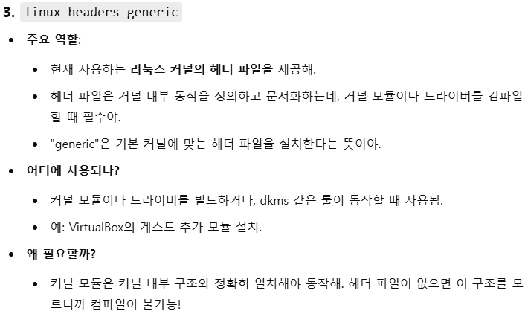
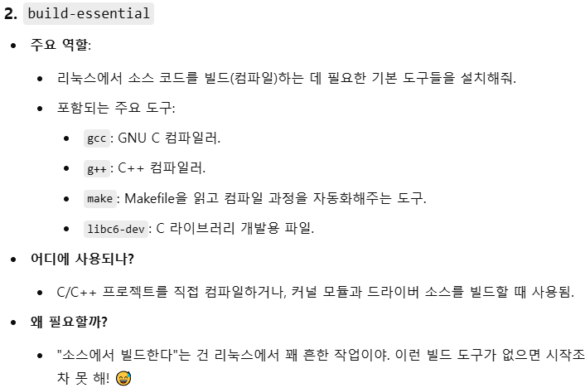
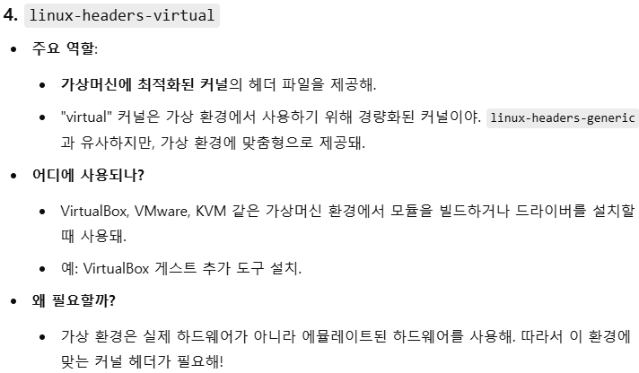
Compile을 위해 필요한 도구

