Slide 1



Identifying patients who are likely to be readmitted within 30 days of discharge
Eunice Park
February 6, 2020

Slide 2
objective
Identify patients who are likely to be readmitted within 30 days, during their hospital stay
Provide patient care to prevent readmission
Identify factors contributing to the increase in likelihood of hospital readmission

Slide 3
Why is this important?
Avoidable Readmissions: 2 million readmissions each year (CMS) – Nearly one in five fee-for-service Medicare patients returns to the hospital within 30 days of being discharged
Quality of Care: High readmission rate can be an indicator of poor quality care
High Cost: - Readmissions cost Medicare approximately $26 billion/year - $17 billion of which is potentially avoidable - CMS imposes financial penalties to hospitals with higher readmission rates

Slide 4
aim
Identify variables (features) influencing possible readmission
Build a machine learning model
Provide appropriate care to prevent avoidable readmissions

Slide 5
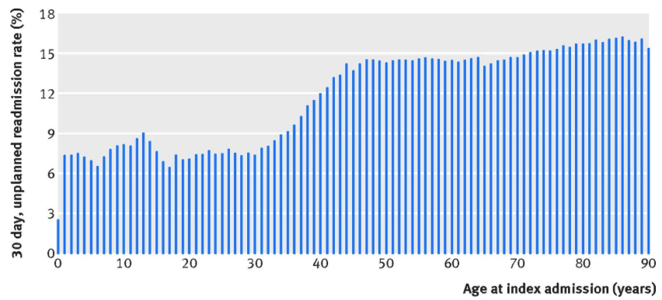
Unplanned Readmission rates by age (2018)
Reference: bmj.com
Notes:
Bmj.com

Slide 6
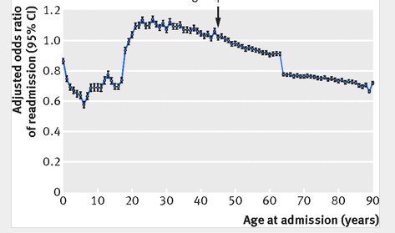
Age trends in adjusted odds of hospital readmission
Adjusted Odds of Readmission: Rates vary by patients’ demographic and clinical characteristics (Insurance type, Discharge disposition, patient leaving against medical advice, number of chronic conditions, etc. )
Reference: bmj.com
Notes:
Bmj.com

Slide 7
Data
Data Source: EPIC (Electronic Medical Record System) data in Microsoft SQL RDBMS
Patients: Adults (Age >= 18 years old)
5 years (2015-2019) of admission/discharge data for patients of a disease type that has a high rate of readmission
Discharge date of at least 30 days ago
109,227 admissions; 57928 patients

Slide 8
Data
Demographics
age, gender, race, marital status, smoking status, state of residency
Utilization
Number of admissions past year, ED visits within last 6 months, Canceled Visits, past readmissions, hospital length of stay, expected minus actual length of stay, etc.
Historical Scores
Risk score, Assessment score, Medication score, Order score, Line Drain Airway, LACE, etc. Activities of daily living score
Conditions
Diagnosis class, Hospital problem count
Procedures
Transplants (Lung, Heart), VAD (Ventricular Assist Device)
30-Day Readmissions

Slide 9
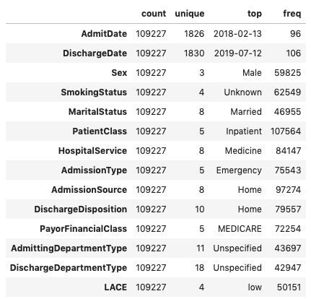
Categorical (14)

Slide 10
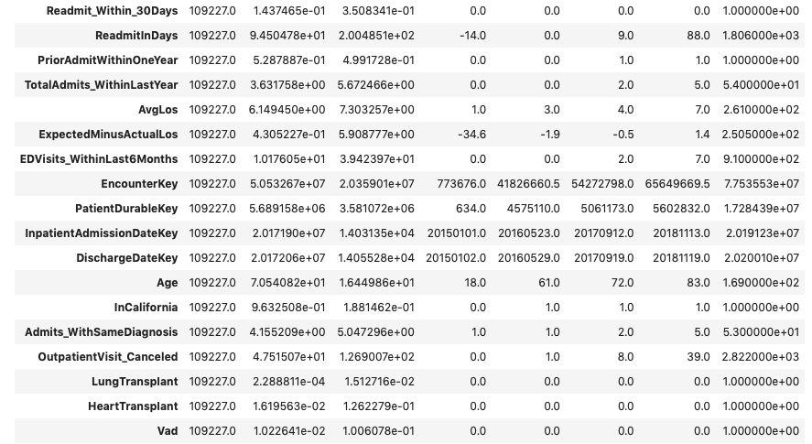
Numerical (56)

Slide 11
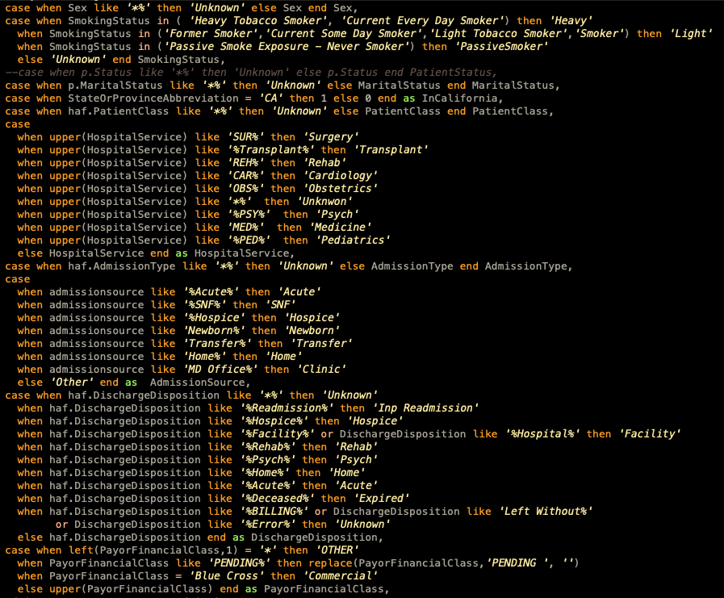
Data Transformation
Data extraction and transformation through SQL
Categorical values are grouped and cleaned
Treat Null values

Slide 12

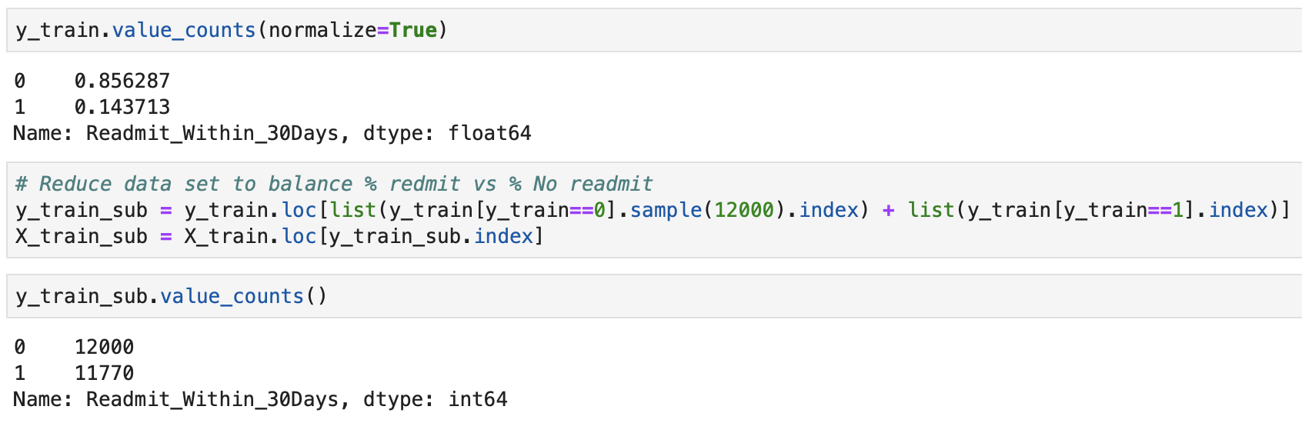
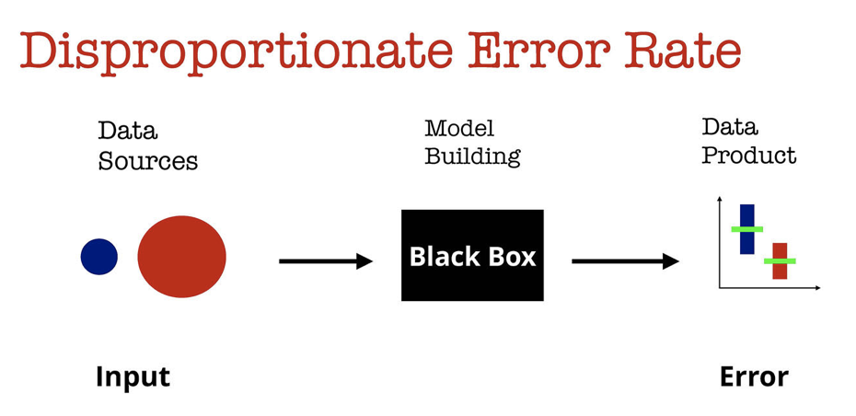
Data Transformation – Balance target variable value ratio Predictive response variable is skewed. >>> Perform Under-sampling of majority class to balance the % of readmission rate

Slide 13
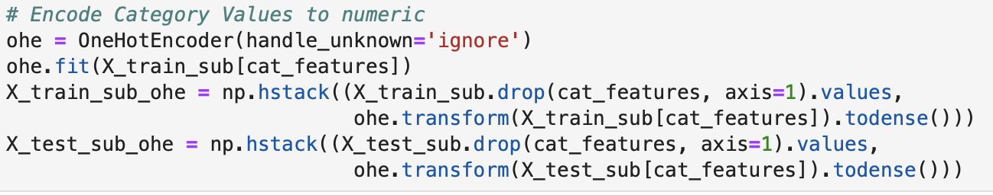
Data Transformation Encode Category Values

Slide 14
Data extraction and transformation Process Flow
SQL Transformation
(Clean and group categorical values, Treat Null values)
SQL Extraction
(2015-2019, diagnosis, discharges at least 30 days ago)
Pandas
Reduce the train dataset to balance the target variable value ratio
Train, Test Split
Scikit-learn preprocessing
Encode Categorical Values using OneHotEncoder

Slide 15
Modeling Process Flow
For each algorithm:
Train
Predict
F1 Score
ROC AUC score
Choose Classification Algorithms
Random Forest
XGBoost
Feature Selection
Cross_val_score to measure how many features produce the best accuracy
Retrain models using important features
Predict
F1 Score
ROC AUC score
ROC Curve
All algorithm scores

Slide 16
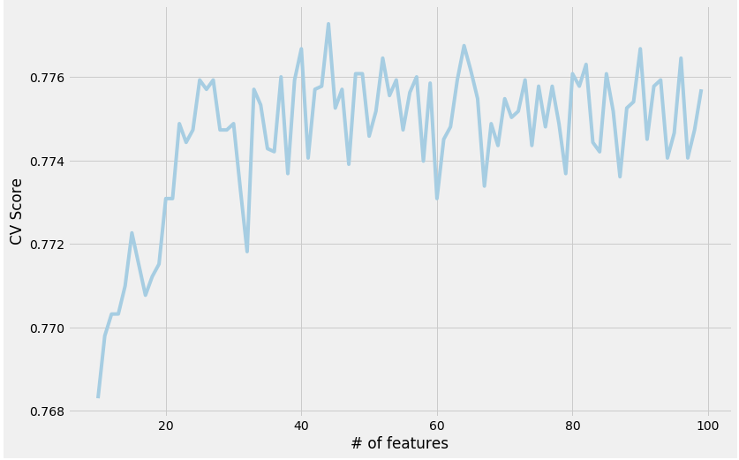
Feature selection
Determine the number of top features to use using cross validation scores

Slide 17
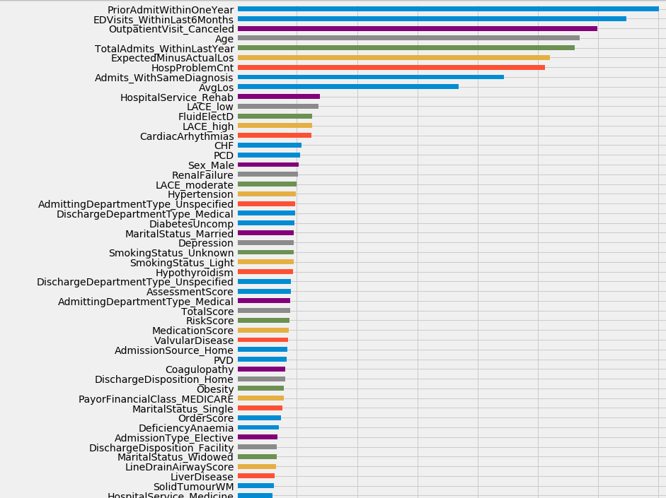
Feature importance

Slide 18
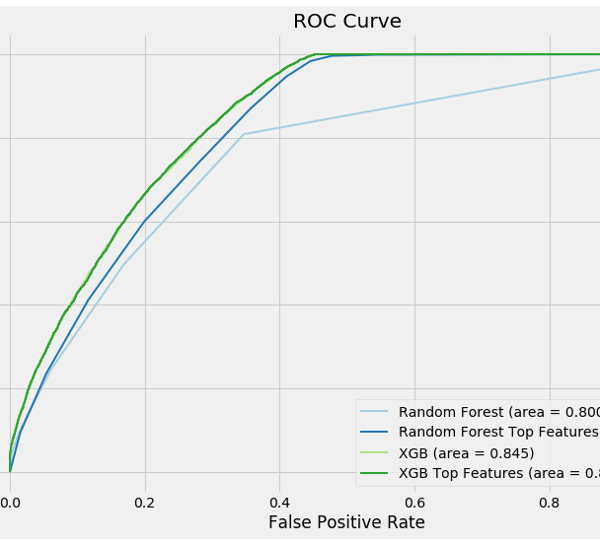
ROC Curve
Random Forest with 133 features (AUC=0.800)
Random Forest with top 45 features (AUC=0.821)
eXtreme Gradient Boosting with 133 features (AUC=0.845)
eXtreme Gradient Boosting with top 45 features (AUC=0.846)

Slide 19
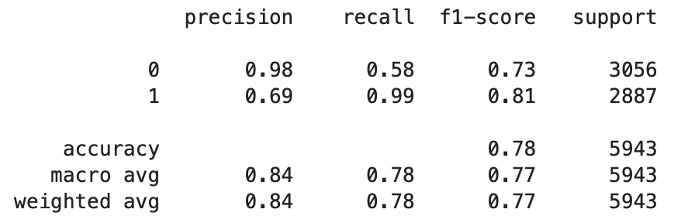
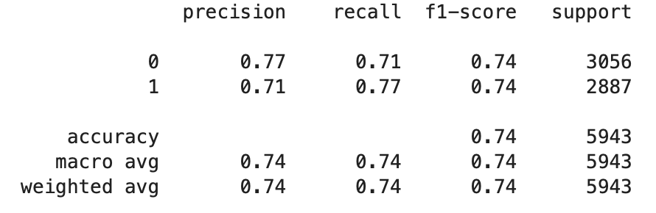
Modeling Evaluation – AUC vs. Recall scores
eXtreme Gradient Boosting
Random Forest
Goal: Optimize the AUC
Optimizing on the recall score allows us to flag more patients with risk of readmission – safer to identify than under-identify patients that actually get re-admitted

Slide 20
Next Step - Feature Engineering
Encode Categorical Values:
Rank the categorical values by density % within the dataset
Use the ranking to encode the categorical values
Explore feature selection using LGB (Light Gradient Boosting)

Slide 21
Next Step – Feature engineering
Demographics
age, gender, race, marital status, smoking status, state of residency
Utilization
Number of admissions past year, ED visits within last 6 months, past readmissions, hospital length of stay, expected minus actual length of stay, etc.
Historical Scores
Risk score, Assessment score, Medication score, Order score, Line Drain Airway, LACE, etc. Activities of daily living score
Conditions
Diagnosis class, Transplants, Hospital problem count, VAD (Ventricular Assist Device) procedure
Procedures
Transplants (Lung, Heart), VAD (Ventricular Assist Device)
Social
Environmental Interaction, etc.
Medications
Lab Tests
Physical Exams - Number of Vitals past 6 & 12 months, etc.
- Vitals, BMI (Body Mass Index)

Slide 22
Next Step
Explore using other algorithms such as AutoLGB
2. Build a model to predict number of days before readmission

Slide 23
Thank you

