Slide 1
Probe Data Analysis for Road Slope
EECS 495 Geospatial Vision and Visualization
Tzu-Chien Fu
Xiaoyu Wan

Slide 2
Introduction

Slide 3

GPS
Global positioning system (GPS) receivers are widely deployed in navigation and tracking devices installed in taxis, buses, utility vehicles, and smart phones.
These GPS receivers can provide probe data that illuminates automotive traffic conditions for applications including traffic analysis, travel time estimation, map building, and congestion and accident detection.
Wang, Yin, et al. "Challenges and opportunities in exploiting large-scale GPS probe data.
" HP Laboratories, Technical Report HPL-2011-109 21 (2011).

Slide 4

Probe Data
Probes are devices which are either carried by travelers or vehicles, and are able to relay their location and any available additional data in real-time at very frequent refresh rates.
These devices include smartphones and in-vehicle telematics. The growth in smartphones has sparked a phenomenal growth in the volume of probe data points.

Slide 5

Map Matching
Given a set of GPS probe data, try to find the matching streets in a given road network.
Also we can identify some feature of the matched road, such as road slope.

Slide 6

Our Goal
Input: probe data and map
Tasks:
Map match probe points to road links
Derive road slope for each road link
Evaluate the derived slope with the surveyed slope in the link data

Slide 7
Input
Probe Data
sampleID, dateTime, sourceCode, latitude, longitude, altitude, speed, heading
Link Data
The link data is information of road segments (links). It consist of data for the links that probe points can be map-matched to. (E.g., linkPVID, refNodeID, nrefNodeID, length, functionalClass, etc.)

Slide 8
Our method

Slide 9

Map-Matching
To match the data:
Use latitude and longitude information given in Probe Data and Link Data for matching.
We compare them with every other to find the one-pair with minimum distance between them.
The corresponding pairs are our map-matched probe points to road links.

Slide 10


Road Slope
To calculate the slope of the road:
Slope is calculated by finding the ratio of the "vertical change" to the "horizontal change" between (any) two distinct points on a line.
Use the map-matched points from the map-matching to calculate the slope of two neighbor points.
$$Slope=\frac{Δy}{Δx}$$

Slide 11
Evaluation
To evaluate derived road slope with surveyed road slope :
Calculate average of slope for each link data.
This slope is then compared with the slope we derived from map-matched points.

Slide 12
Result

Slide 13
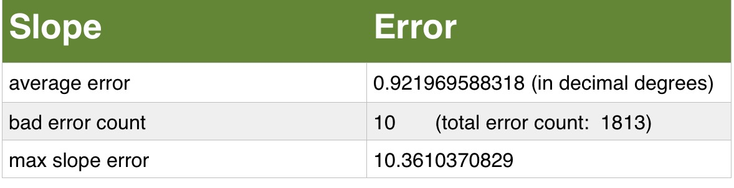
Evaluate the derived road slope with the surveyed road slope

Slide 14
Part of matched points
SampleID | DateTime | Source Code | Latitude | Longitude | Altitude | Speed | Heading
3496 | 6/12/2009 6:12:49 AM | 13 | 51.496868217364 | 9.38602223061025 | 200 | 23 | 339
3496 | 6/12/2009 6:12:54 AM | 13 | 51.4966822229326 | 9.38615726307034 | 200 | 10 | 129
3496 | 6/12/2009 6:12:59 AM | 13 | 51.4967048540711 | 9.38642229884863 | 201 | 21 | 60
3496 | 6/12/2009 6:13:04 AM | 13 | 51.4967492781579 | 9.38683996908367 | 201 | 0 | 360
3496 | 6/12/2009 6:13:09 AM | 13 | 51.4968639425933 | 9.38729401677847, | 199 | 0 | 360
3496 | 6/12/2009 6:13:15 AM | 13 | 51.4969302434474 | 9.38771596178412 | 198 | 5 | 89
3496 | 6/12/2009 6:13:20 AM | 13 | 51.4969574846327 | 9.38779382966459 | 198 | 1 | 288

Slide 15
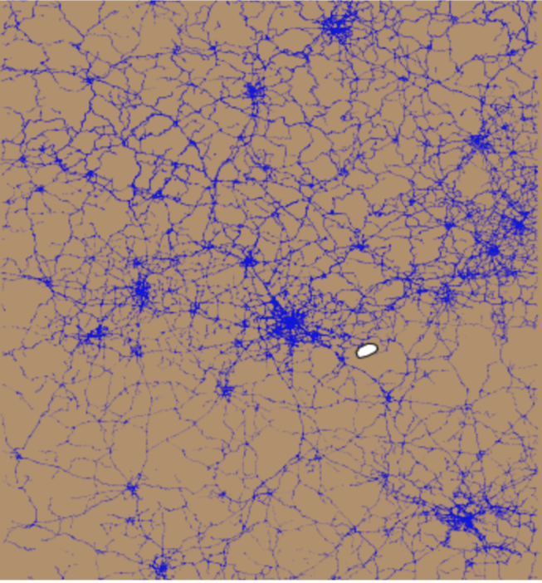
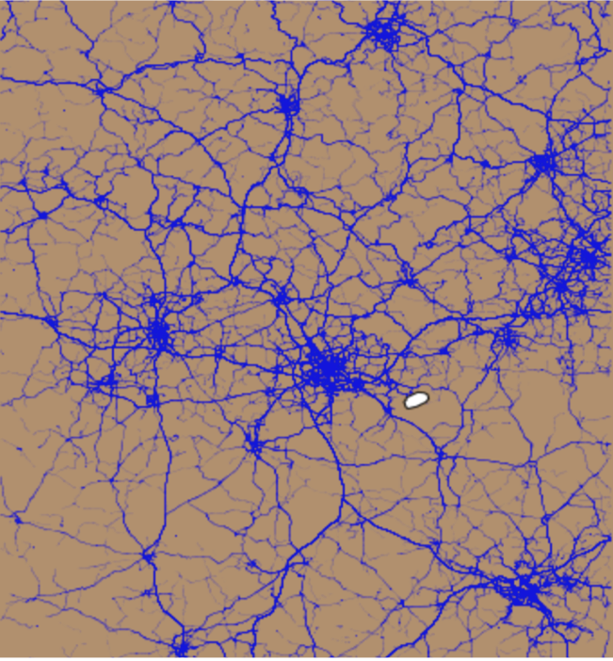
Visualization
Probe Data
Map-matched Data

Slide 16
Discussion
The running time of the program is long
In the process of program, there is no operation to remove some points which has huge distance from road.

Slide 17
Future Work
Based on the algorithm we implanted, the running time is slow. We can try to segment the link data to reduce the running time. Perhaps there is better algorithm to optimal the searching time
We can remove some points by computing the distance between probe points and each link data to improve the rate of right. For example, if the distance between probe points and the link data is less than 20 meters, we keep this link data, if not, we delete it.

Slide 18
Reference
Wang, Yin, et al. "Challenges and opportunities in exploiting large-scale GPS probe data." HP Laboratories, Technical Report HPL-2011-109 21 (2011).
Quddus, Mohammed A., Washington Y. Ochieng, and Robert B. Noland. "Current map-matching algorithms for transport applications: State-of-the art and future research directions." Transportation research part c: Emerging technologies 15.5 (2007): 312-328.APA
Zheng, Kai, et al. "Reducing uncertainty of low-sampling-rate trajectories." Data Engineering (ICDE), 2012 IEEE 28th International Conference on. IEEE, 2012.

