Slide 1



A-MENU-LEBAN SNACKS AND BEVERAGE

Slide 2
A-Menu-leban Snack Edition aims to provide energy and protein rich snacks incorporated with Aminoleban Oral. These recipes are easy to prepare, palatable and easy to incorporate in a patients diet. It gives the patients innovative and creative ways to consume Aminoleban Oral’s recommended intake of three times a day. This helps the patients to reach their daily required energy and protein requirements in order to improve their over all liver health.
Jairra Dela Cruz, RND OPPI Nutritionist

Slide 3
Our liver, the second largest organ in the body, is an active vital organ that performs many essential functions. It metabolizes, detoxifies, and regenerates. Liver diseases may have absolute effects on both nutrition and general health status. Aminoleban Oral, a nutritional supplement, is the optimum choice in nutrition for liver impaired patients. In this booklet are easy to prepare snacks that may be useful in the patient's consumption of Aminoleban Oral.
Lara Habijan, RND OPPI Nutritionist

Slide 4
Eating three big meals a day may be a hard thing to do for a patient who is experiencing nausea, loss of appetite, and has altered taste. To prevent malnutrition and muscle loss, having 5 to 6 small meals a day may help the patient meet his nutritional needs without having a hard time. This booklet contains some simple and cost-efficient recipe of snacks with Aminoleban Oral incorporated to other food items, which may help in improving the nutritional status and overall health of the patients.
Angela Ramos, RND OPPI Nutritionist

Slide 5
Good nutrition is important particularly for those patients with medical concerns like liver impairment. Whereas, some of them don’t get adequate nutrients in their diet as well as their protein requirement. However, achieving those recommendations doesn’t have to be complicated because you have Aminoleban Oral, which can be incorporated into different healthy recipes to achieve your macronutrients and micronutrient needs. This booklet will show you that a simple recipe can be nutritious at the same time will help you achieve your recommended dietary intake.
Klarisse Rubio, RND OPPI Nutritionist

Slide 6
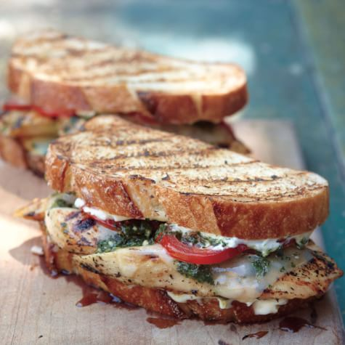

Chicken Pesto-Leban Sandwich
Nutrition Facts
Serving size: 1 sandwich: 90g chicken3tbsp. of pesto sauce
Total Calories | 476 kcal
Carbohydrates | 42 g
Protein | 30 g
Fat | 26 g
Sugar | 4 g
Sodium | 325 mg
Makes 2 servings
Ingredients:
4 slices Wheat bread
180 g Chicken Breast, sliced into ½ strips (cooked)
2 tsp. Vegetable oil
2 pcs. Tomatoes (sliced) 50 g Lettuce
Salt and Pepper
for pesto: 2 cups of fresh Basil 6pcs. Clove of garlic 3 tbsp. Walnuts/peanuts
5 tbsp. Olive Oil
Salt and Pepper
3 tbsp.Water
2 tbsp. parmesan cheese/any cheese
1 sachet Aminoleban Oral (50g)
Best paired with Orange Lettuce-Leban Cooler
^{Procedure:}
For pesto, use blender or food processor to mix the basil, olive oil, garlic, nuts, cheese, 3 tbsp. water and gradually mix the Aminoleban Oral.
For the bread, toast and set aside.
Heat the oil in a pan over high heat. Put the chicken seasoned with salt and pepper. Cook until chicken is browned.
Once it reached room temperature, add the pesto sauce and tomato. Mix the sauce and chicken.
For the sandwich, place lettuce leaf on one side of the bread and spread the chicken pesto sauce and tomatoes. Cover with another slice of bread.
Notes:
The taste is much more tasty/palatable compare to the pasta the pesto sauce complements the “tangy” flavor of amino, tho may slight sourness padin, pero hindi siya ganon ka overpowering.
Problem: marami ang servings niya, it makes 1 cup: then per sandwich around 2 ½ tbsp lang.
2ND Trial: makes 2 servings with 3 tables spoon per sandwich

Slide 7
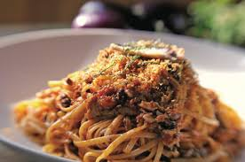

Pasta de Amino-Sardines
Nutrition Facts
Serving size: 200g
Total Calories | 435 kcal
Carbohydrates | 47.5 g
Protein | 13.25 g
Fat | 6.25 g
Sugar | 2.45 g
Sodium | 184 mg
Makes 2 servings
^{Ingredients:}
^{1 sachet Aminoleban Oral (50g)}
^{400 g cooked Linguine pasta}
^{1 tsp. vegetable oil}
^{2 tbsp. onion (minced)}
^{2 tsp. chili flakes (optional)}
^{2 tbsp. garlic (minced)}
^{1 can sardines in tomato sauce}
^{2 tbsp. Tomato Paste}
1 tbsp. grated parmesan cheese/any cheese
^{Salt and Pepper}
Best paired with Amino Carrot-Cucumber Juice
^{Procedure:}
Cook the linguine pasta according to the package instructions.
While the pasta is cooking, heat olive oil in a skillet over medium heat. Add the onion, and cook for a few minutes until soft, then add the garlic, and cook until fragrant.
Stir in the chopped sardines with the sauce. When the sardines heat through, turn off the heat and let the sauce cool for 5 mins.
Add the 1 sachet Aminoleban Oral powder in the sauce and mix thoroughly to blend well.
When the pasta is done, drain, and add it to the sardine sauce. Toss and let stand for a few minutes to absorb the flavors of the sauce. Top with chili flakes and grated cheese.
Notes:
Its not that bad, it taste like pancit canton but times two in terms of sourness..
Problem: It makes 4 servings: 2 cups of sauce: in every 200g of pasta you need ½ cup sauce
2ND Trial: Makes 2 servings. No pasta water added

Slide 8
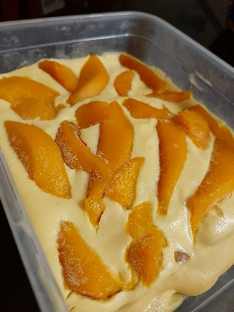
Mango-leban Graham Cake
Nutrition Facts
Serving size: Makes 2 servings
Total Calories | 810 kcal
Carbohydrates | 115.3 g
Protein | 20.4 g
Fat | 29.6 g
Sugar | 375 mg
Sodium | 44.7 g
Makes 2 servings
Ingredients:
1 sachet Aminoleban Oral
70g All Purpose Cream
50g Condensed Milk
4pcs Graham crackers
Best paired with Amintea
Procedure:
In a bowl, combine condensed milk, all purpose cream and Aminoleban Oral. Set aside.
In a rectangular container, layer graham crackers and cream mixture.
Top with ripe mangoes.
Chill for 3 hours or until firm
Serve and enjoy!

Slide 9
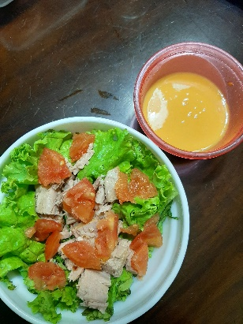

Green Salad with Amino-dressing
Nutrition Facts
Serving size: Makes 1 serving
Total Calories | 518 kcal
Carbohydrates | 42.9 g
Protein | 29.3 g
Fat | 25.9 g
Sugar | 238.6 mg
Sodium | 2.9 g
Makes 1 serving
Ingredients:
1 sachet Aminoleban Oral
2 tablespoons water
30 g Mayonnaise
56 g Canned Tuna in Brine
45 g Lettuce
25 g Tomato
Best paired with Amino Carrot-Cucumber Juice
Procedure:
In a bowl, dissolve one sachet Aminoleban Oral to 2 tablespoons water.
Add the Mayonnaise to the Aminoleban Oral mixture and set aside.
In a separate bowl, arrange the lettuce, tomato and tuna.
Finally, add the dressing to the salad.
Serve and enjoy!

Slide 10
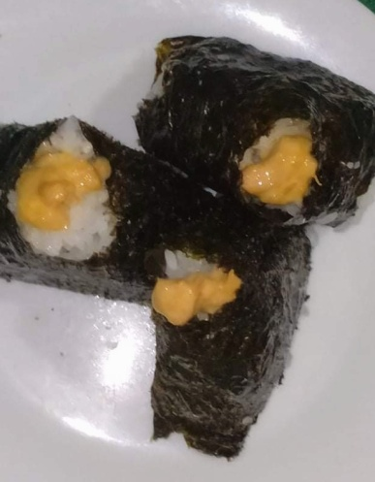

Aminogiri
Nutrition Facts
Serving size: 100g per piece
Total Calories | 682kcal
Carbohydrates | 101g
Protein | 35.5g
Fat | 15.5g
Sugar | 3.34g
Sodium | 358.23mg
Ingredients:
1 cup short-grain sushi rice
1 1/4 cups water
2/3 cup tuna in brine, canned (60g), drained
2 tablespoons mayonnaise
1 pinch ground black pepper
1 pinch salt (optional)
1 ½ sheets nori, cut into 3-inch strips, or desired width
1 sachet Aminoleban Oral (50g)
Makes 3 servings
Best paired with Amino-PiñaLeMorade
Procedure:
Place rice in a bowl with fresh water. Stir until water becomes cloudy; drain and rinse. Repeat with fresh water until water no longer clouds, 2 or 3 times more.
Bring 1 1/4 cups water, rice, and salt to a boil in a saucepan; reduce heat to low. Cover and simmer, lifting lid no more than once, until water is absorbed, about 15 minutes. Remove from heat and set aside to finish cooking, about 10 minutes more. Remove cover and cool rice until no longer hot to the touch, about 15 minutes.
Mix tuna, mayonnaise, and pepper together in a bowl until no large chunks remain. Add Aminoleban Oral powder and mix well. Arrange nori strips on a serving platter.
Lay a 10-inch sheet of plastic wrap on a work surface. Divide cooked rice into six (6) rice balls. Place 1 rice ball at the center, form a well in the middle, and fill well with 2-3 teaspoons tuna mixture. Top with the other rice ball and slightly flatten. Gather edges of plastic wrap together over rice mixture, twist together to tighten, and shape rice mixture into a pyramid shape. Remove plastic wrap and gently place onto nori strip, with nori edges protruding (for use as handles when eating). Repeat with remaining rice and tuna mixture.

Slide 11
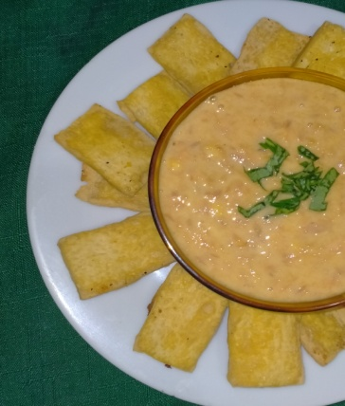
Tofu Chips & Tuna Dip
Nutrition Facts
Serving size: 250g
Total Calories | 504kcal
Carbohydrates | 38g
Protein | 49.5g
Fat | 17.5g
Sugar | 5.9g
Sodium | 199.95mg
Ingredients:
1 cup tofu
2/3 cup tuna in brine, canned (60 g), drained
4 tbsp yogurt
2 tsp grated ginger
1 sachet Aminoleban Oral (50g)
Pepper to taste
Makes 1 serving
Best paired with Orange Lettuce-Leban Cooler
Procedure:
Tofu chips:
Slice tofu into thin pieces (1/8-inch-thick).
Put in the toaster for 20 minutes or until golden brown and crisp.
Tuna dip:
Mash all the ingredients in a bowl with a fork. For a smoother texture, you may use a blender or food processor. Cover and chill until ready to serve.

Slide 12
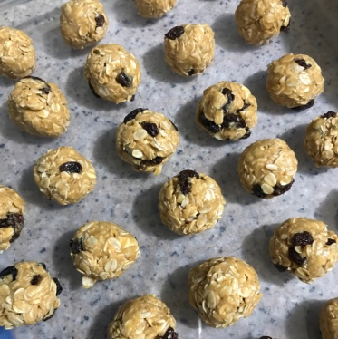
Oat-Mino Energy Balls
Nutrition Facts
Serving size: 3pcs
Total Calories | 266.7 kcal
Carbohydrates | 31.4 g
Protein | 8.46 g
Fat | 10.78 g
Sugar | 13.34 g
Sodium | 18.46 mg
Makes 30 pieces
Ingredients:
2 ¼ cups of Rolled Oats
3⁄4 cup peanut butter
1/3 cup honey
1⁄3 cup raisins
1 sachet Aminoleban Oral
Best paired with Pasta de-Amino Sardines
Procedure:
In medium heat, toast rolled oats in a pan for 10 mins or until light golden brown. Set aside and let it cool completely.
In a large bowl, mix together rolled oats and raisins.
Mix in peanut butter and honey to the dry ingredients. Add Aminoleban Oral then mix well. Form into 1 inch balls or 1tbsp.
Refrigerate for 5-6 hours then serve.
Note: You can also make oatmino bars which makes 10 pieces/servings

Slide 13
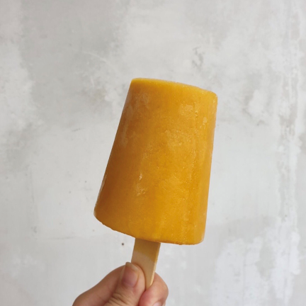
Amino-Ice Pop
Nutrition Facts
Serving size: 1 piece (8oz)
Total Calories | 165 kcal
Carbohydrates | 31 g
Protein | 7 g
Fat | 1.75 g
Sugar | 11.45 g
Sodium | 24.72 mg
Makes 2 servings
Ingredients:
½ banana (frozen)
1 ripe mango (frozen)
½ cucumber (shredded)
1 sachet Aminoleban Oral
180ml Water
Best paired with Tuna Egg Sandwich
Procedure:
Mix Aminoleban in 180mL water then set aside.
Prepare the frozen fruits by chopping in smaller pieces for easy blending. Put the banana and mango inside the blender then add Aminoleban Oral. Blend well. Add cucumber then blend again for 5 seconds.
Place in an 8oz cup then put a popsicle stick in the middle. Freeze them overnight then serve.
Note: You can use a popsicle mold or ice candy bags

Slide 14
AMINOLEBAN BEVERAGES

Slide 15
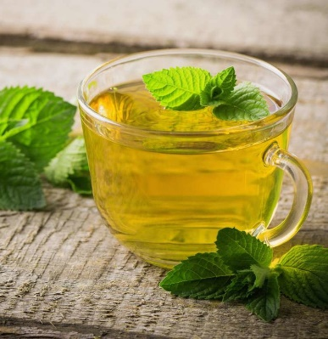
A-Mintea
Nutrition Facts
Serving size: 250 mL
Total Calories | 370 kcal
Carbohydrates | 72 g
Protein | 13.5 g
Fat | 3.5 g
Sugar | 45 g
Sodium | 49 mg
Makes 1 serving
Ingredients:
1 sachet Aminoleban Oral (50g)
2 Green Tea Bag
5 mL Lemon Concentrate
2 tbsp. Honey/ Sugar Syrup
30 mL Ginger Tea
Mint leaves (as desired)
Procedure:
Steep green tea for 2-3 mins.
Add 1 tablespoons honey or sugar syrup. Add 5 mL lemon concentrate. Set Aside.
Prepare 1 sachet Aminoleban Oral in 180 mL lukewarm water.
Mix diluted Aminoleban Oral and tea mixture.
Add 30 mL ginger tea and 1 tablespoons honey or sugar syrup.
Add chopped mint leaves as desired.
Stir and add ice. Enjoy your A-mintea.

Slide 16
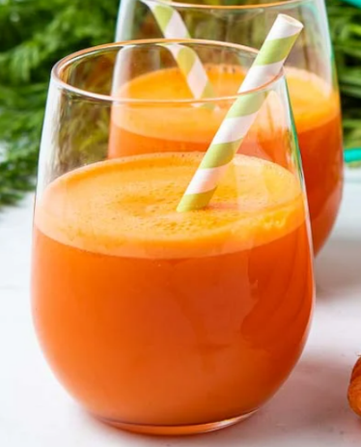
Amino Carrot-Cucumber Juice
Nutrition Facts
Serving size: 450 mL
Total Calories | 281.6 kcal
Carbohydrates | 10.5 g
Protein | 13.5 g
Fat | 0.4 g
Sugar | 0 g
Sodium | 69 mg
Makes 1 serving
Ingredients:
1 sachet Aminoleban Oral (50g)
1 piece Fresh Carrot, 100 grams
1 piece Fresh Cucumber, 250 grams
270 mL Purified water
3 sachet Stevia
Procedure:
Wash and peel carrots and cucumber. Remove the seeds.
Add 90 mL purified water, then puree using blender.
Dilute 1 sachet Aminoleban Oral in 180 mL purified water.
Mix Aminoleban Oral in 210 mL pureed carrot-cucumber.
Add 3 sachets Stevia. Serve chilled.

Slide 17
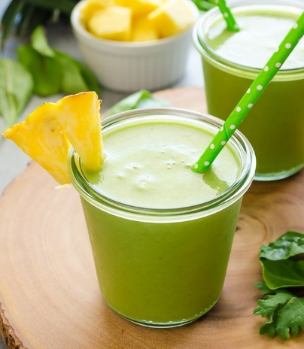
Amino-PiñaMoradé
Nutrition Facts
Serving size: 390 mL
Total Calories | 297 kcal
Carbohydrates | 57 g
Protein | 14 g
Fat | 4 g
Sugar | 17.5 g
Sodium | 80.35 mg
Makes 1 serving
Ingredients:
1 sachet Aminoleban Oral (50g)
5 g malunggay leaves
150 g Pineapple
180 mL Water
½ tsp. Honey
Ice cubes
Procedure:
Reconstitute 1 sachet Aminoleban Oral in 180 mL lukewarm water.
Combine malunggay leaves and pineapple in blender. Pour into the glass.
Add honey to taste. Serve with Ice.

Slide 18
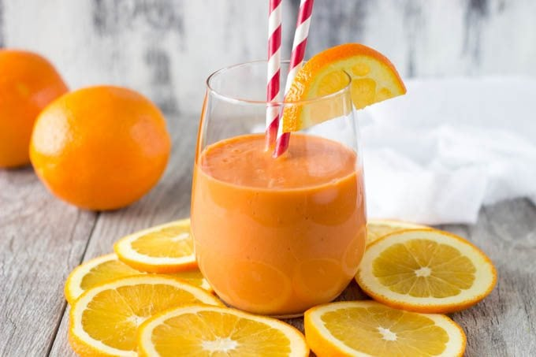
Orange Lettuce-Leban Cooler
Nutrition Facts
Serving size: 250 mL
Total Calories | 274 kcal
Carbohydrates | 45.25 g
Protein | 15 g
Fat | 4 g
Sugar | 5 g
Sodium | 49 mg
Makes 1 serving
Ingredients:
1 sachet Aminoleban Oral (50g)
55 g Lettuce
85 g Cucumber with Skin
30 g Carrots with Skin (boiled)
1 ¼ tsp. Orange powder
¼ cup water
Procedure:
Place lettuce, cucumber, carrot, orange powder and water into the blender then blend until smooth.
Add the Aminoleban Oral and blend for 30 to 45 seconds.
Put ice cubes and serve chilled.

Slide 19
REFERENCES
Allrecipes. 2020. Pasta De Sardine. [online] Available at: <https://www.allrecipes.com/recipe/70726/pasta-de-sardine> [Accessed 1 July 2020].
Dietandfitnesstoday.com. 2020. Diet And Fitness Today - Complete Online Guide To Diet And Fitness. [online] Available at: <http://www.dietandfitnesstoday.com/> [Accessed 1 July 2020].
Food and Nutrition Research Institute (Philippines). Food Exchange List for Meal Planning
(3rd Revision). Philippines: FNRI; 1994.
Gardenia.com.ph. 2020. Gardenia. [online] Available at: <https://www.gardenia.com.ph/recipes/inner/gardenia-chicken-pesto-sandwich> [Accessed 1 July 2020].
Usda.gov. 2020. USDA. [online] Available at: <https://www.usda.gov/> [Accessed 1 July 2020].

