Slide 1
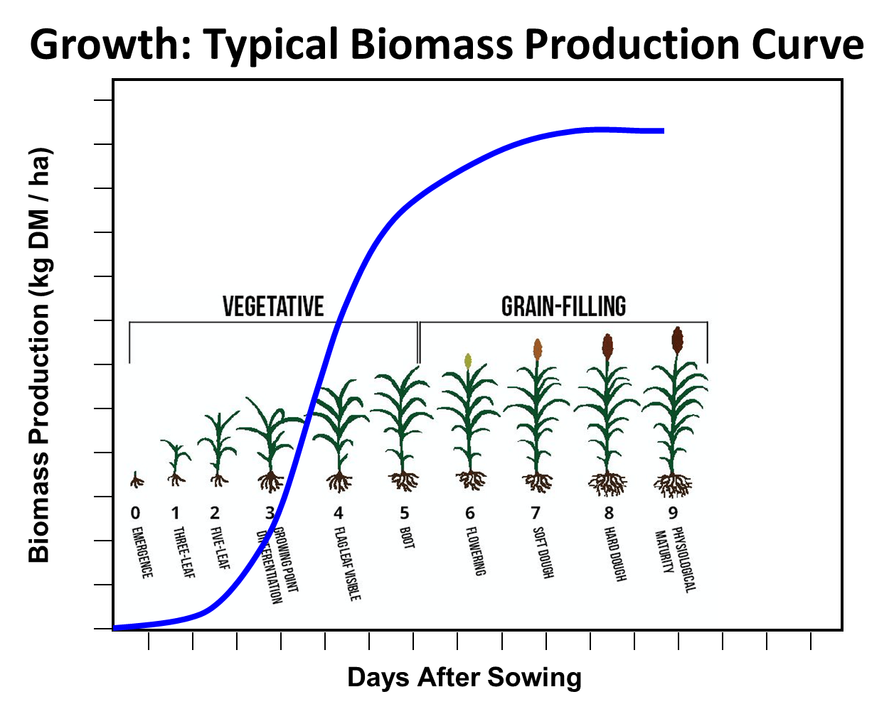
Process-based Crop Simulation Models
INPUTS
▪ crop genotype info
▪ Soil physical/chemical properties
CROP MODEL
Based on mathematical equations
OUTPUTS
Yield
Biomass
Soil moisture
Soil temperature
Phenology
LAI, ET
and many more.
Field Observations
Yield
Biomass
Soil moisture
Soil temperature
Phenology
LAI
Soil N
Soil C
ET
:
Model validation
▪ phenology (emergence- flowering- maturity)
▪ Light interception
▪ Assimilation (Photosynthesis)
▪ Respiration
▪ Assimilate partitioning
▪ Leaf area dynamics (growth and decay)
▪ Evapotranspiration
▪ Soil water balance and drought response
▪ Nitrogen/Carbon balance
▪ Daily/hourly weather: Tmin,Tmax, Srad, Rain, Wind speed, Vapor Pressure
▪ Management:
Planting, harvesting
fertilizer, irrigation,
tillage, mulch/residue
crop rotation etc.
Notes:
Crop simulation models are mathematical abstractions of the soil-plant-atmosphere continuum. The models mimic known bio-physicochemical processes and feed-back mechanisms with a focus on crop growth, development and yield formation. In general, system models quantify the interacting cycles of carbon, nutrients, and water in the soil-plant-atmosphere continuum, making it possible to forecast the behavior of the system in response to changes in component variables and environmental factors.

Slide 2
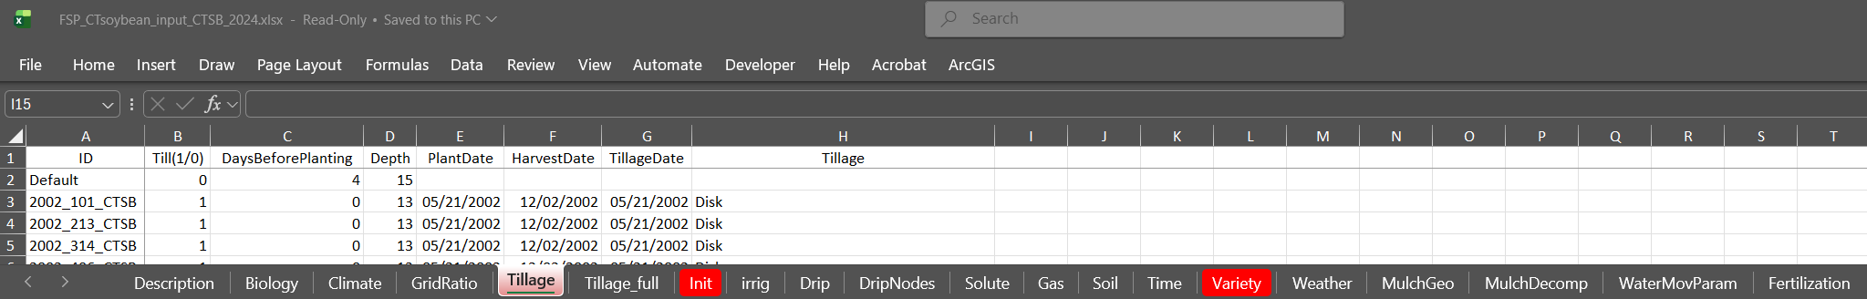
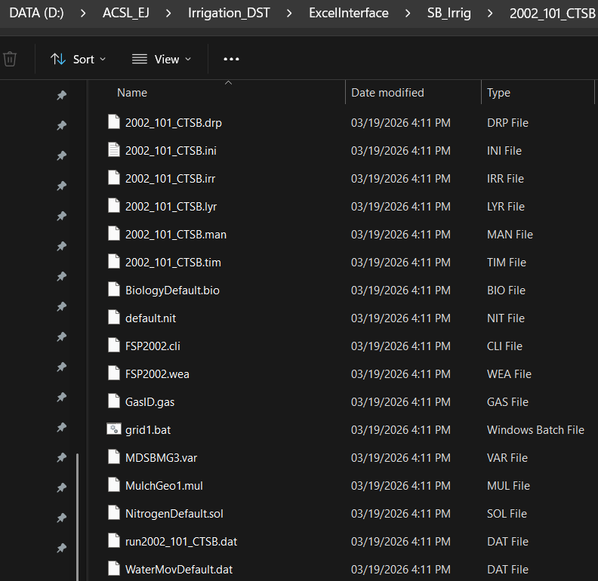
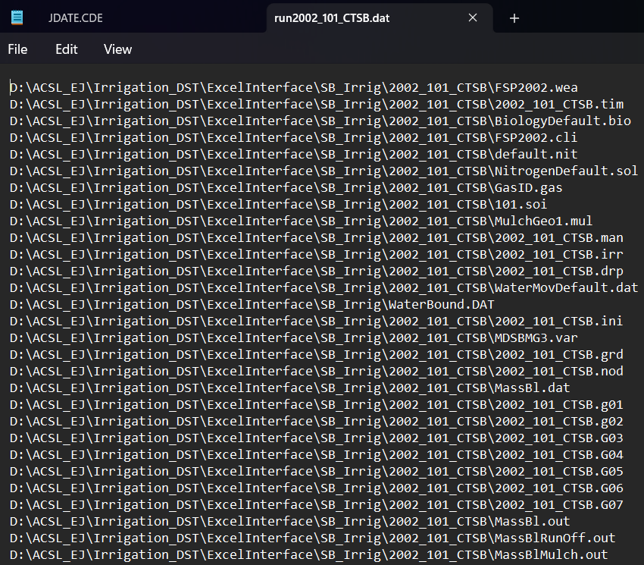

Slide 3
Python script

