Slide 1







Slide 2
Comparative
Analysis
Heuristic
Evaluation
Usability
Testing
Interviews
Survey
User/Stakeholder Interviews
Journey Mapping
Personas/Scenario
Data collection
Quantitative Data Analysis
Direct, Indirect, Partial, Parallel, Analogous
Remote Moderated Usability Testing

Slide 3
E.
E.

Slide 4
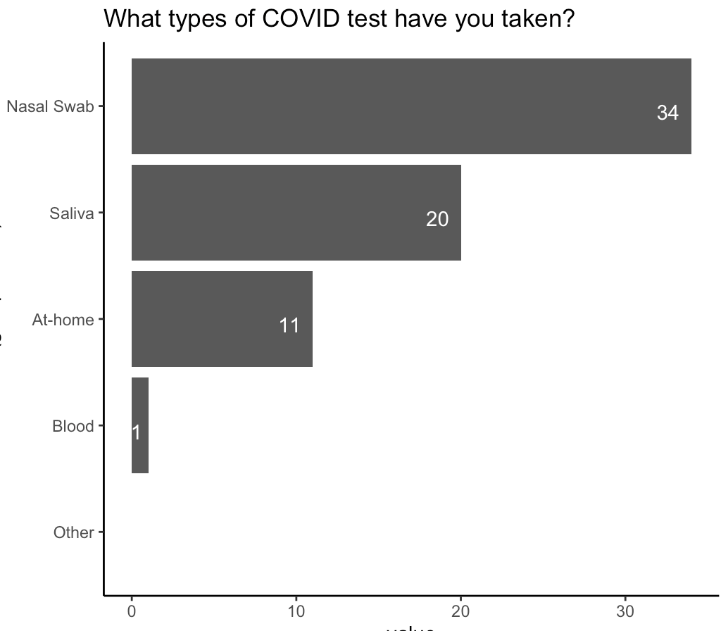
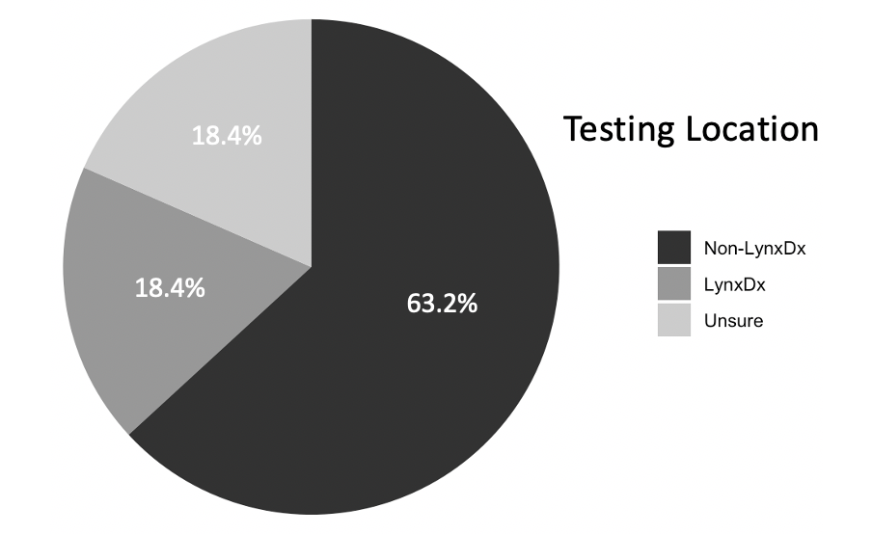
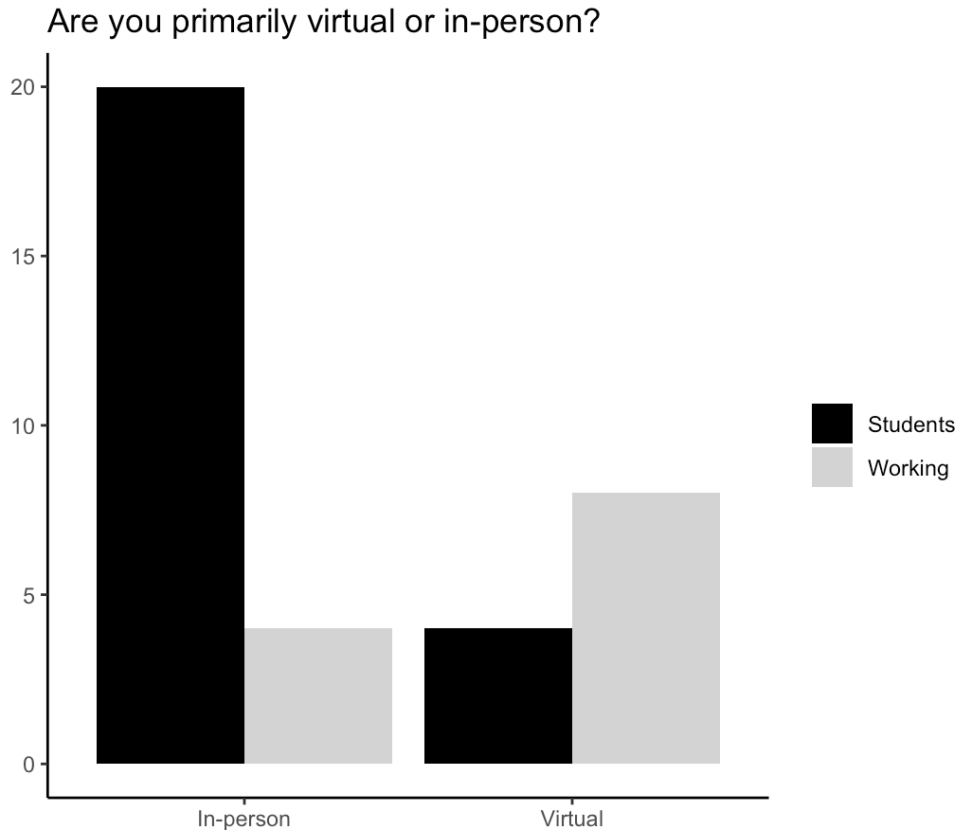
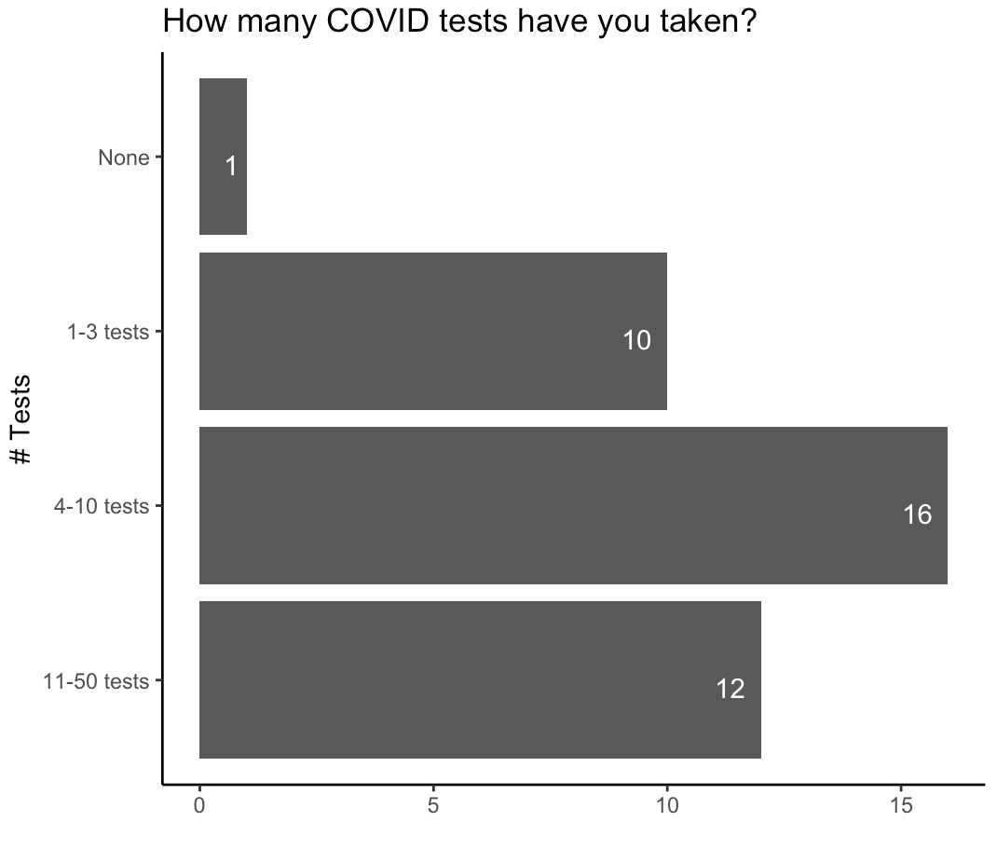

Slide 5


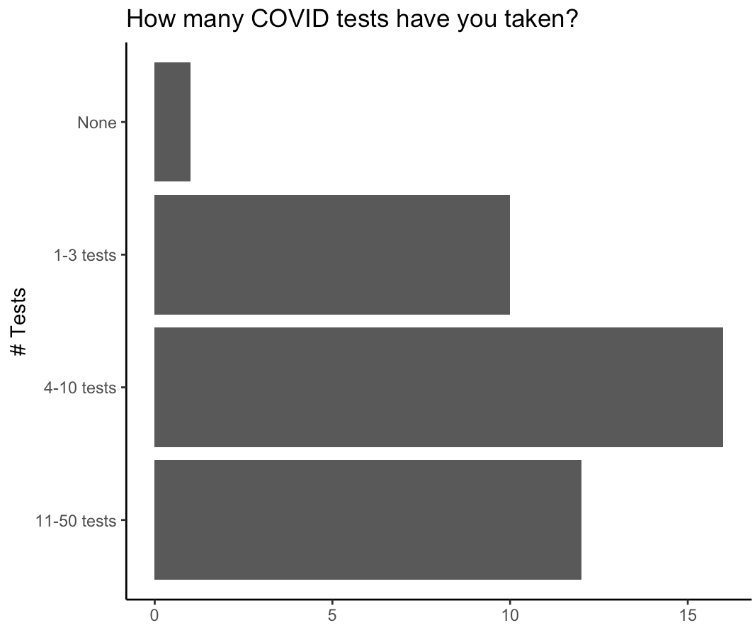


Slide 7
0
1
2
3
4

