Slide 1
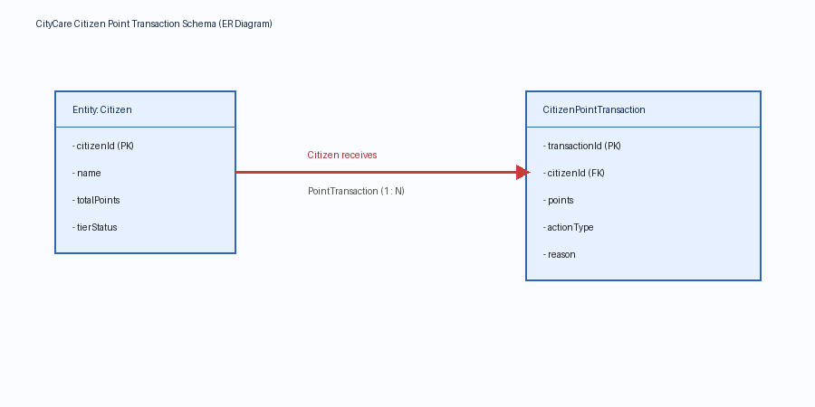
CityCare Citizen Point Transaction Architecture

Slide 2
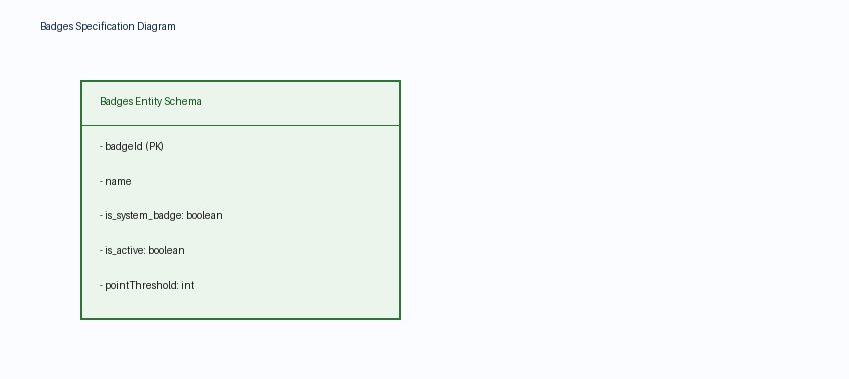
Badges Gamification Schema

Slide 3
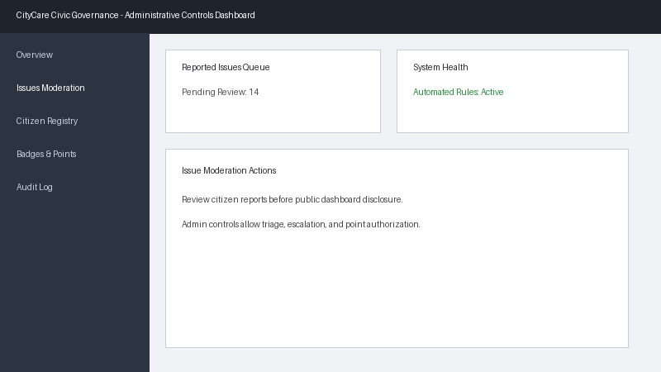
CityCare Platform Administrative Controls

